Slide 1
Deep Learning III
CS771: Introduction to Machine Learning
Purushottam Kar

Slide 2
Announcements
Quiz: November 01 (Friday), 6PM, L20 – same as before
Assigned seating – don’t be late (will waste time finding your seat)
Syllabus is till whatever we covered till October 30 (today)
Bring your institute ID card with you – will lose time if you forget
Bring a pencil, pen, eraser, sharpener with you – we wont provide!
Answers to be written on question paper itself. If you write with pen and make a mistake, no extra paper. Final answer must be in pen
Auditors cannot appear for quiz – please come to L20 at ~ 6:40PM
Doubt clearing session: Oct 31 (Thu), 6PM KD101

Slide 3
Announcements
Cross platform issue with Cython usage in Assignment 2
Since Python is a scripting language, often C/C++ code needed for speed
Cython allows C/C++ code to be called from Python code
Unfortunately requires “shared” library (.so) files to be generated which are not very cross platform compatible
Policy on shared library usage in Assignment 2
Groups are allowed to use Cython which requires .so files to be generated
All such files must be supplied with the submission at submission deadline
If such files are required but not submitted then zero marks for coding question
If your .so files are incompatible with our system, you will be called for a demo where you would be asked to generate the .so files on our system
Larger of the .so files would be counted to calculate model size

Slide 4
Recap of Previous Lecture
NN are universal models – all powerful given a “big” enough network
Using NN with multiple outputs to handle multiclass/label problems
Loss functions for DL and commonly associated o/p-layer activations
Training a depth 1 NN (a perceptron) via gradient descent
Choice of descent direction – notions of epoch, batch
Techniques to efficiently detect convergence
Techniques to decide on appropriate step length
Techniques to prevent overfitting (NNs are powerful enough to memorize)

Slide 5
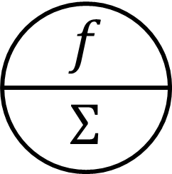

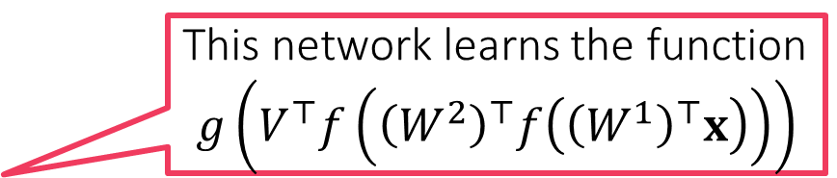



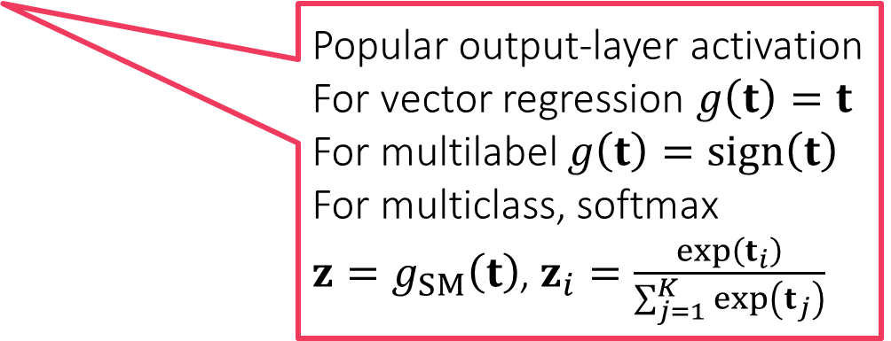
Multi-output Deep Networks
This network learns the function $$g\left(V^{⊤}f\left({\left(W^{2}\right)}^{⊤}f\left({\left(W^{1}\right)}^{⊤}x\right)\right)\right)$$
$$g\left(t\right)=z$$
Popular output-layer activation
For vector regression $g\left(t\right)=t$
For multilabel $g\left(t\right)=sign\left(t\right)$
For multiclass, softmax $z=g_{SM}\left(t\right)$, $z_{i}=\frac{\exp\left(t_{i}\right)}{\sum_{j=1}^{K}{\exp\left(t_{j}\right)}}$
$$V$$
$$W^{2}$$
$$W^{1}$$

Slide 6
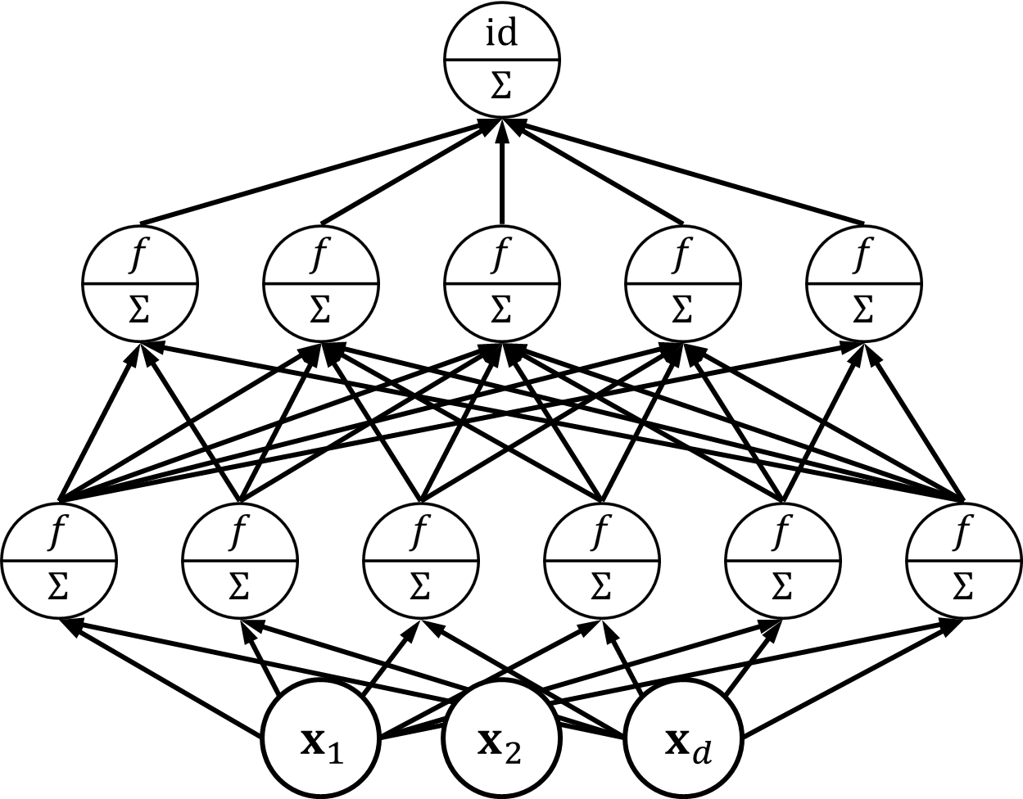






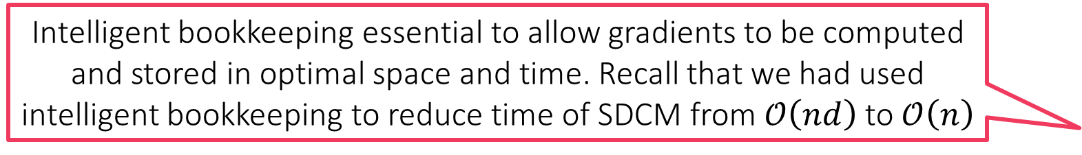
Training Multilayer NN
For sake of simplicity, use a single output NN with identity o/p layer activation to study backprop. Similar procedures apply even if multiple outputs with softmax o/p layer activation etc etc
$d$ i/p, $L−1$ hidden layers
$k_{l}$ nodes in $l$-th layer
$k_{1}=d$ nodes in i/p layer
$W^{l}∈ℝ^{k_{l−1}×k_{l}}$ weights from layer $l−1$ to $l$
$v∈ℝ^{k_{L}}$ weights from layer $L$ to output node
$h^{l}∈ℝ^{k_{l}}$ o/p by layer $l$
$\hat{y}$ output of the network
$h^{l}=f\left({\left(W^{l}\right)}^{⊤}h^{l−1} \right)$
$f\left(u\right)=\left[f\left(u_{1}\right),…,f\left(u_{k}\right)\right]$
$\hat{y}=\left\langle v,h^{L}\right\rangle$
$$v$$
We will learn the backpropagation (backprop/BP) algorithm to train deep networks. BP is essentially chain rule + intelligent bookkeeping. Despite several proposed innovations, BP is still the defacto training method for DL
Intelligent bookkeeping essential to allow gradients to be computed and stored in optimal space and time. Recall that we had used intelligent bookkeeping to reduce time of SDCM from $𝒪\left(nd\right)$ to $𝒪\left(n\right)$
$$W^{2}$$
$$W^{1}$$

Slide 7
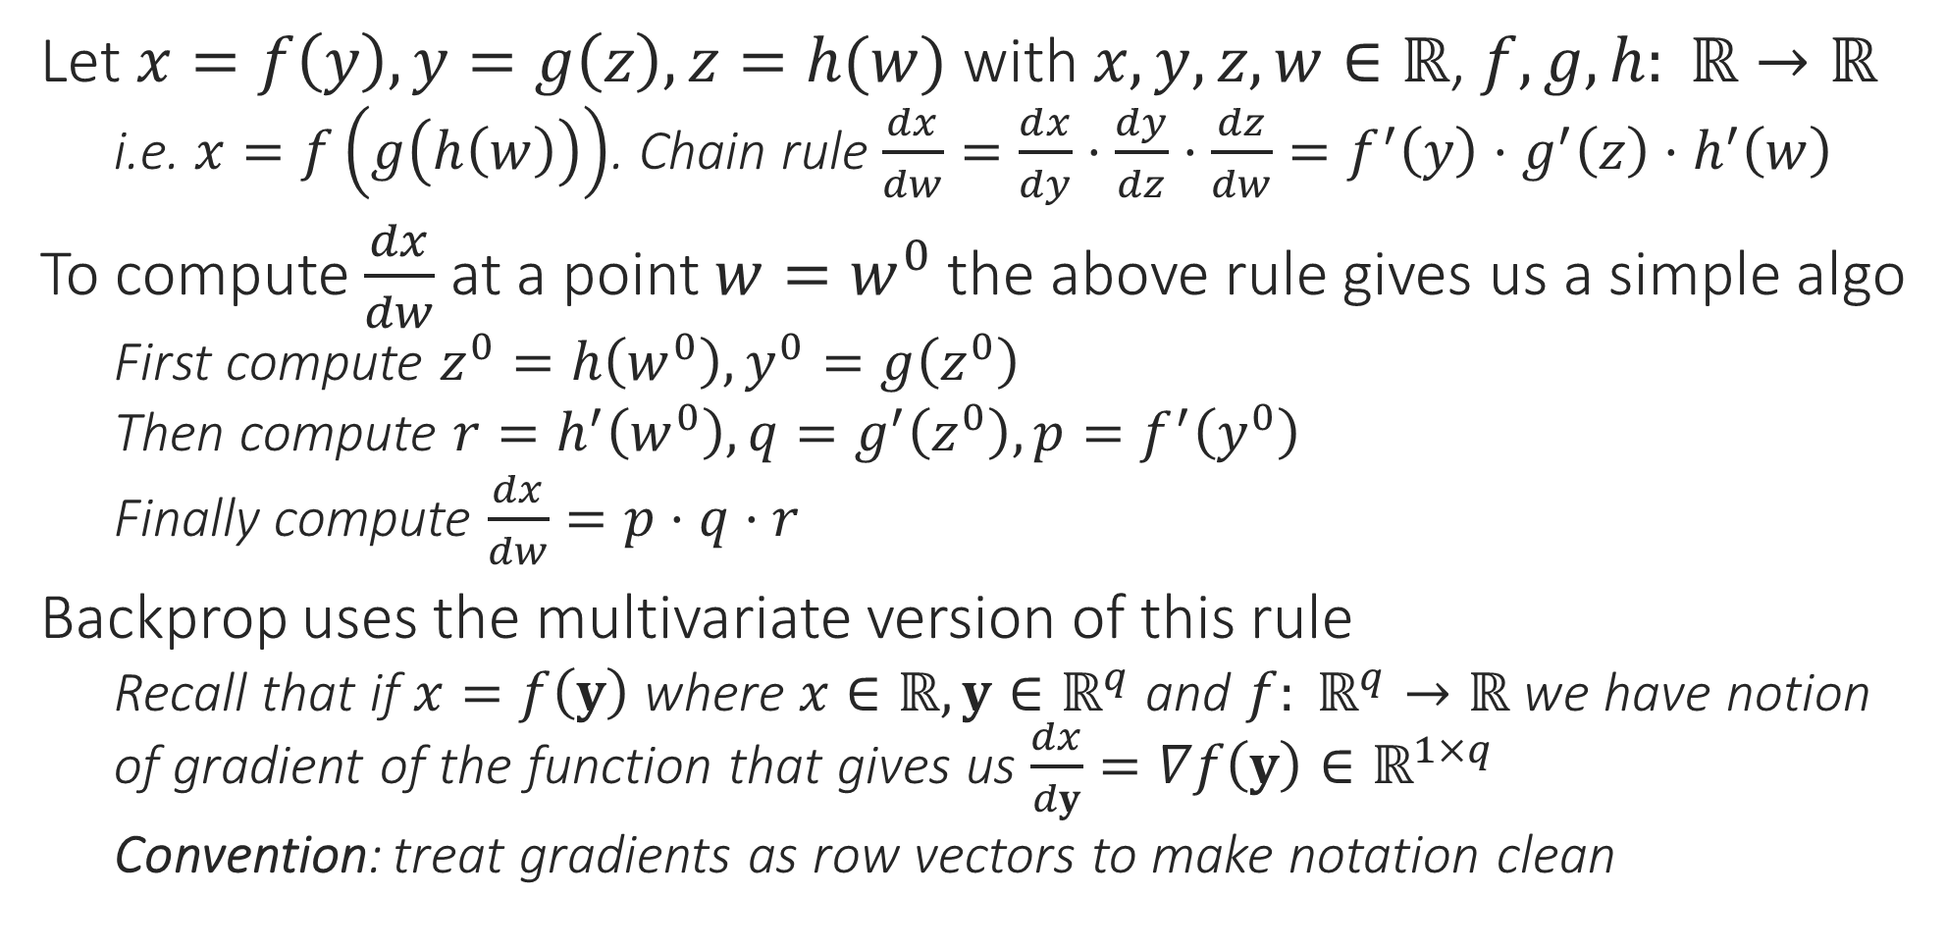
Chain Rule Revisited
Let $x=f\left(y\right), y=g\left(z\right),z=h(w)$ with $x,y,z,w∈ℝ$, $f,g,h: ℝ→ℝ$
i.e. $x=f\left(g\left(h\left(w\right)\right)\right)$. Chain rule $\frac{dx}{dw}=\frac{dx}{dy}⋅\frac{dy}{dz}⋅\frac{dz}{dw}=f^{′}\left(y\right)⋅g^{′}\left(z\right)⋅h^{′}\left(w\right)$
To compute $\frac{dx}{dw}$ at a point $w=w^{0}$ the above rule gives us a simple algo
First compute $z^{0}=h\left(w^{0}\right),y^{0}=g\left(z^{0}\right)$
Then compute $r=h^{′}\left(w^{0}\right),q=g^{′}\left(z^{0}\right),p=f^{′}\left(y^{0}\right)$
Finally compute $\frac{dx}{dw}=p⋅q⋅r$
Backprop uses the multivariate version of this rule
Recall that if $x=f\left(y\right)$ where $x∈ℝ,y∈ℝ^{q}$ and $f: ℝ^{q}→ℝ$ we have notion of gradient of the function that gives us $\frac{dx}{dy}=∇f\left(y\right)∈ℝ^{1×q}$
Convention: treat gradients as row vectors to make notation clean

Slide 8
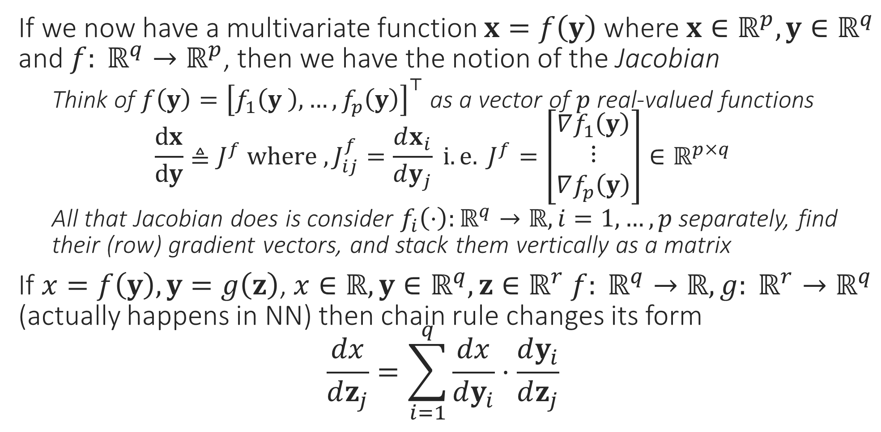
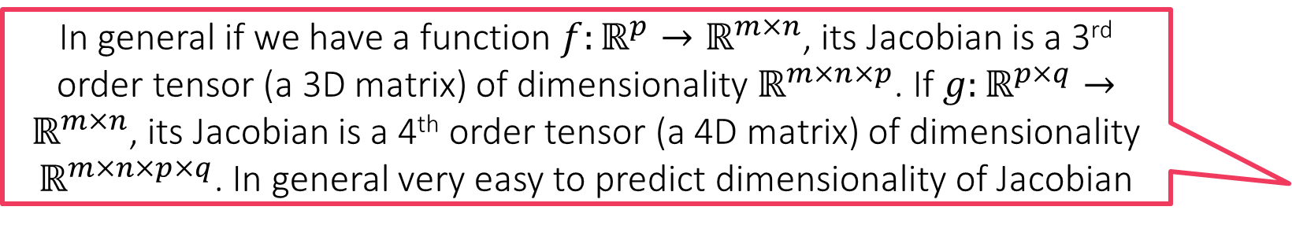
Multivariate Chain Rule
In general if we have a function $f:ℝ^{p}→ℝ^{m×n}$, its Jacobian is a 3rd order tensor (a 3D matrix) of dimensionality $ℝ^{m×n×p}$. If $g:ℝ^{p×q}→ℝ^{m×n}$, its Jacobian is a 4th order tensor (a 4D matrix) of dimensionality $ℝ^{m×n×p×q}$. In general very easy to predict dimensionality of Jacobian
If we now have a multivariate function $x=f\left(y\right)$ where $x∈ℝ^{p},y∈ℝ^{q}$ and $f: ℝ^{q}→ℝ^{p}$, then we have the notion of the Jacobian
Think of $f\left(y\right)={\left[f_{1}\left(y \right),…,f_{p}\left(y\right)\right]}^{⊤}$ as a vector of $p$ real-valued functions $\frac{dx}{dy}≜J^{f} where ,J_{ij}^{f}=\frac{dx_{i}}{dy_{j}} i.e. J^{f}=\left[\begin{matrix}∇f_{1}\left(y\right) \\ ⋮ \\ ∇f_{p}\left(y\right)\end{matrix}\right]∈ℝ^{p×q}$
All that Jacobian does is consider $f_{i}\left(⋅\right):ℝ^{q}→ℝ,i=1,…,p$ separately, find their (row) gradient vectors, and stack them vertically as a matrix
If $x=f\left(y\right), y=g\left(z\right)$, $x∈ℝ,y∈ℝ^{q},z∈ℝ^{r}$ $f: ℝ^{q}→ℝ,g: ℝ^{r}→ℝ^{q}$ (actually happens in NN) then chain rule changes its form
$$\frac{dx}{dz_{j}}=\sum_{i=1}^{q}{\frac{dx}{dy_{i}}⋅\frac{dy_{i}}{dz_{j}}}$$
Yes, it is quite simply a tensor whose dimensionality is the output dimensionality of the function “times” the input dimensionality of the function

Slide 9
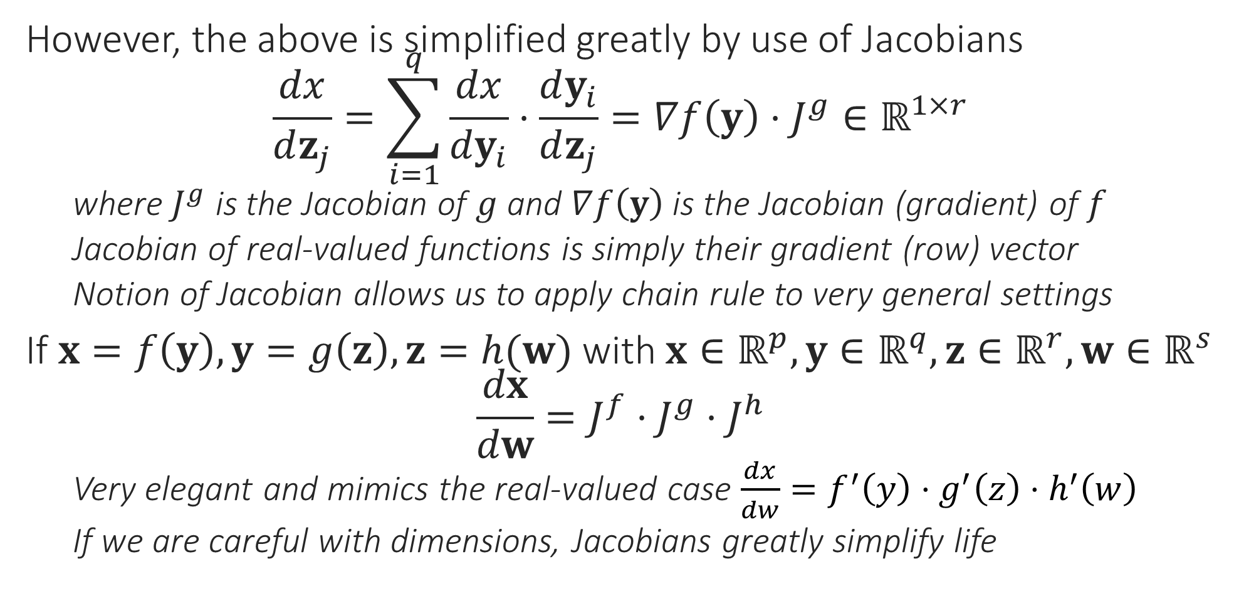
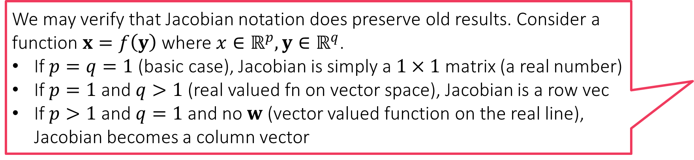
Multivariate Chain Rule
We may verify that Jacobian notation does preserve old results. Consider a function $x=f\left(y\right)$ where $x∈ℝ^{p},y∈ℝ^{q}$.
If $p=q=1$ (basic case), Jacobian is simply a $1×1$ matrix (a real number)
If $p=1$ and $q>1$ (real valued fn on vector space), Jacobian is a row vec
If $p>1$ and $q=1$ and no $w$ (vector valued function on the real line), Jacobian becomes a column vector
However, the above is simplified greatly by use of Jacobians $\frac{dx}{dz_{j}}=\sum_{i=1}^{q}{\frac{dx}{dy_{i}}⋅\frac{dy_{i}}{dz_{j}}}=∇f\left(y\right)⋅J^{g}∈ℝ^{1×r}$
where $J^{g}$ is the Jacobian of $g$ and $∇f\left(y\right)$ is the Jacobian (gradient) of $f$
Jacobian of real-valued functions is simply their gradient (row) vector
Notion of Jacobian allows us to apply chain rule to very general settings
If $x=f\left(y\right), y=g\left(z\right),z=h(w)$ with $x∈ℝ^{p},y∈ℝ^{q},z∈ℝ^{r},w∈ℝ^{s}$ $\frac{dx}{dw}=J^{f}⋅J^{g}⋅J^{h}$
Very elegant and mimics the real-valued case $\frac{dx}{dw}=f^{′}\left(y\right)⋅g^{′}\left(z\right)⋅h^{′}\left(w\right)$
If we are careful with dimensions, Jacobians greatly simplify life

Slide 10
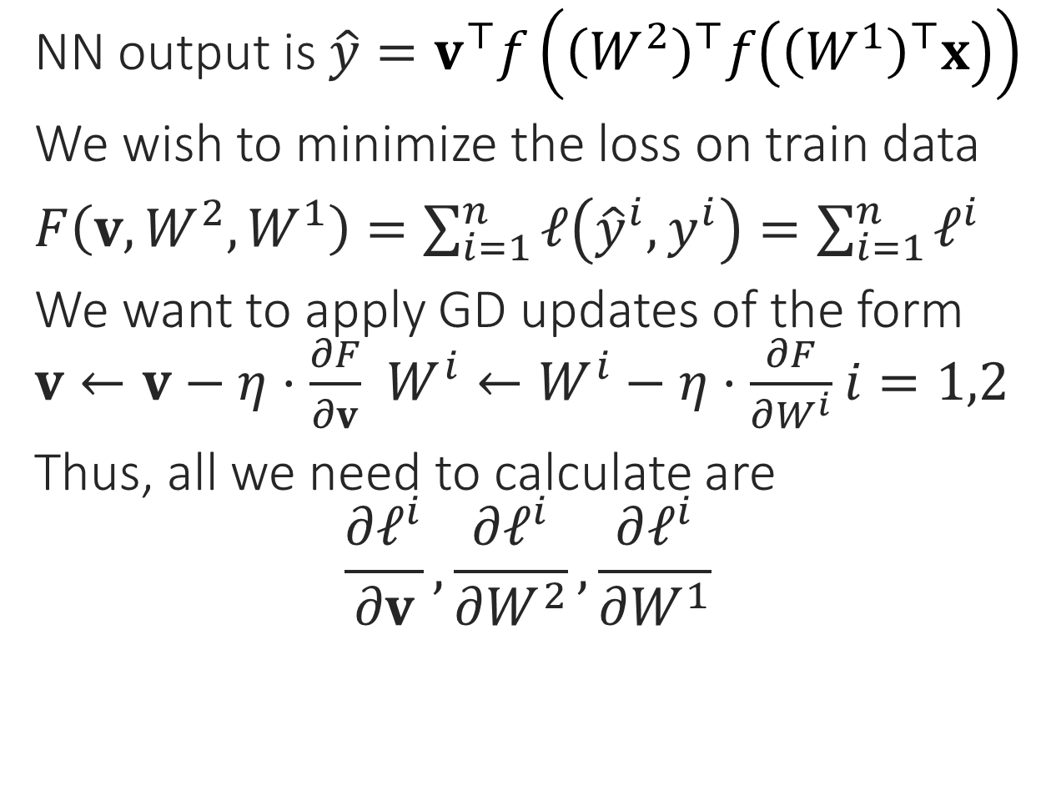



Back to Backpropagation
NN output is $\hat{y}=v^{⊤}f\left({\left(W^{2}\right)}^{⊤}f\left({\left(W^{1}\right)}^{⊤}x\right)\right)$
We wish to minimize the loss on train data
$F\left(v,W^{2},W^{1}\right)=\sum_{i=1}^{n}{ℓ\left({\hat{y}}^{i},y^{i}\right)}=\sum_{i=1}^{n}{ℓ^{i}}$
We want to apply GD updates of the form $v←v−η⋅\frac{∂F}{∂v}$ $W^{i}←W^{i}−η⋅\frac{∂F}{∂W^{i}}$ $i=1,2$
Thus, all we need to calculate are $\frac{∂ℓ^{i}}{∂v},\frac{∂ℓ^{i}}{∂W^{2}},\frac{∂ℓ^{i}}{∂W^{1}}$
$$v$$
$$W^{2}$$
$$W^{1}$$

Slide 11
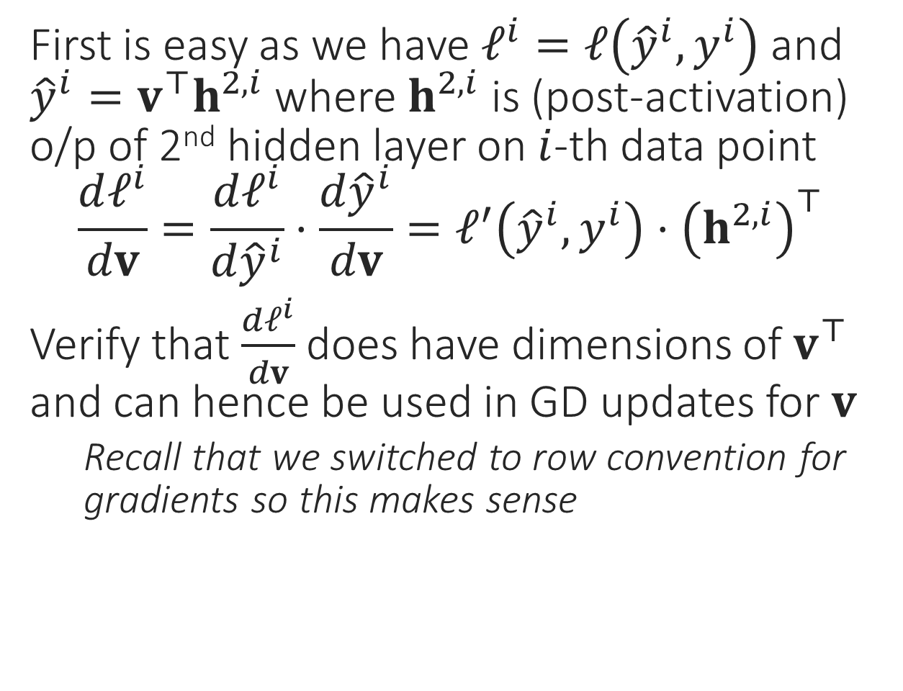
Back to Backpropagation
First is easy as we have $ℓ^{i}=ℓ\left({\hat{y}}^{i},y^{i}\right)$ and ${\hat{y}}^{i}=v^{⊤}h^{2,i}$ where $h^{2,i}$ is (post-activation) o/p of 2nd hidden layer on $i$-th data point $\frac{dℓ^{i}}{dv}=\frac{dℓ^{i}}{d{\hat{y}}^{i}}⋅\frac{d{\hat{y}}^{i}}{dv}=ℓ^{′}\left({\hat{y}}^{i},y^{i}\right)⋅{\left(h^{2,i}\right)}^{⊤}$
Verify that $\frac{dℓ^{i}}{dv}$ does have dimensions of $v^{⊤}$ and can hence be used in GD updates for $v$
Recall that we switched to row convention for gradients so this makes sense
$$v$$
$$W^{2}$$
$$W^{1}$$

Slide 12
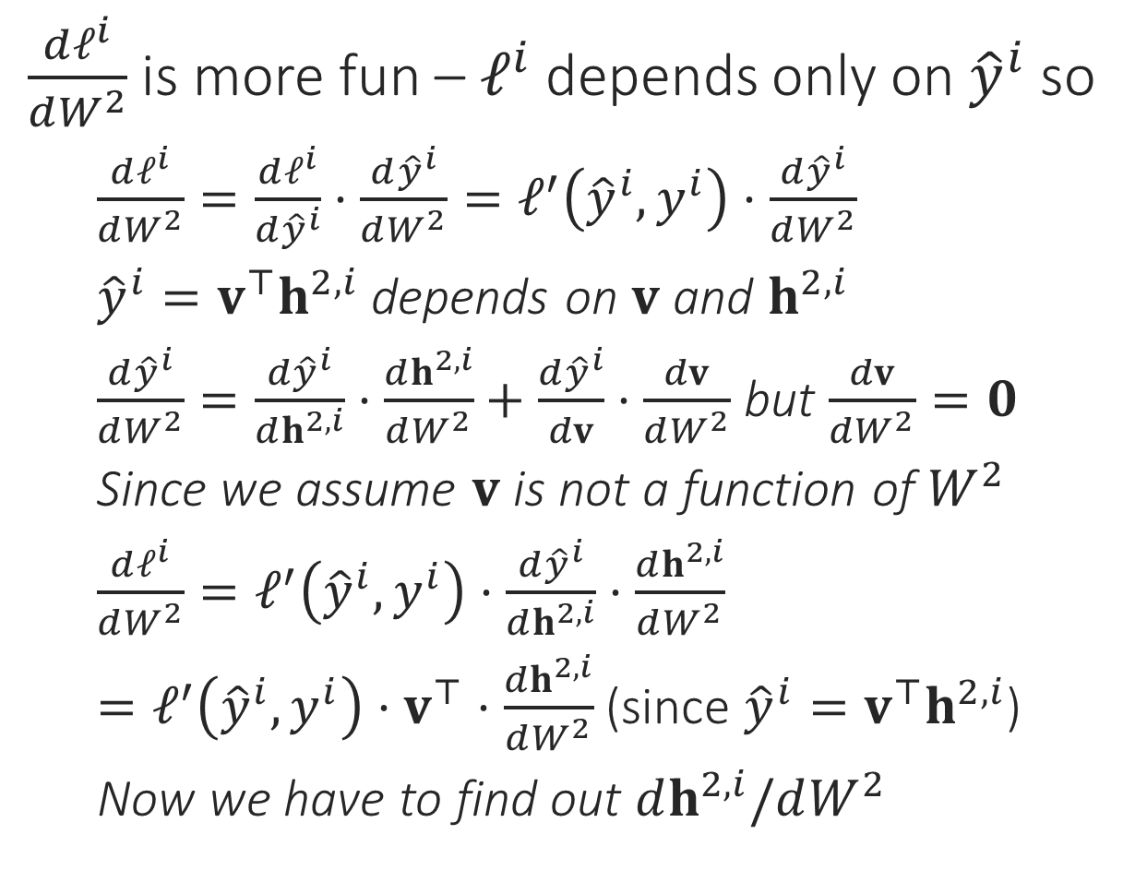
Back to Backpropagation
$\frac{dℓ^{i}}{dW^{2}}$ is more fun – $ℓ^{i}$ depends only on ${\hat{y}}^{i}$ so
$\frac{dℓ^{i}}{dW^{2}}=\frac{dℓ^{i}}{d{\hat{y}}^{i}}⋅\frac{d{\hat{y}}^{i}}{dW^{2}}=ℓ^{′}\left({\hat{y}}^{i},y^{i}\right)⋅\frac{d{\hat{y}}^{i}}{dW^{2}}$
${\hat{y}}^{i}=v^{⊤}h^{2,i}$ depends on $v$ and $h^{2,i}$
$\frac{d{\hat{y}}^{i}}{dW^{2}}=\frac{d{\hat{y}}^{i}}{dh^{2,i}}⋅\frac{dh^{2,i}}{dW^{2}}+\frac{d{\hat{y}}^{i}}{dv}⋅\frac{dv}{dW^{2}}$ but $\frac{dv}{dW^{2}}=0$
Since we assume $v$ is not a function of $W^{2}$
$\frac{dℓ^{i}}{dW^{2}}=ℓ^{′}\left({\hat{y}}^{i},y^{i}\right)⋅\frac{d{\hat{y}}^{i}}{dh^{2,i}}⋅\frac{dh^{2,i}}{dW^{2}}$
$=ℓ^{′}\left({\hat{y}}^{i},y^{i}\right)⋅v^{⊤}⋅\frac{dh^{2,i}}{dW^{2}}$ (since ${\hat{y}}^{i}=v^{⊤}h^{2,i}$)
Now we have to find out $dh^{2,i}/dW^{2}$
$$v$$
$$W^{2}$$
$$W^{1}$$

Slide 13
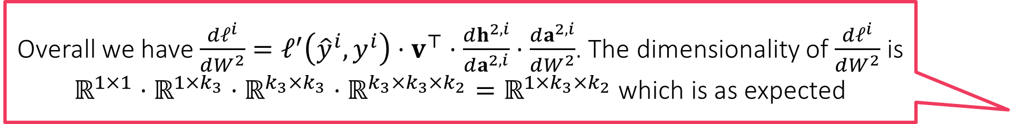
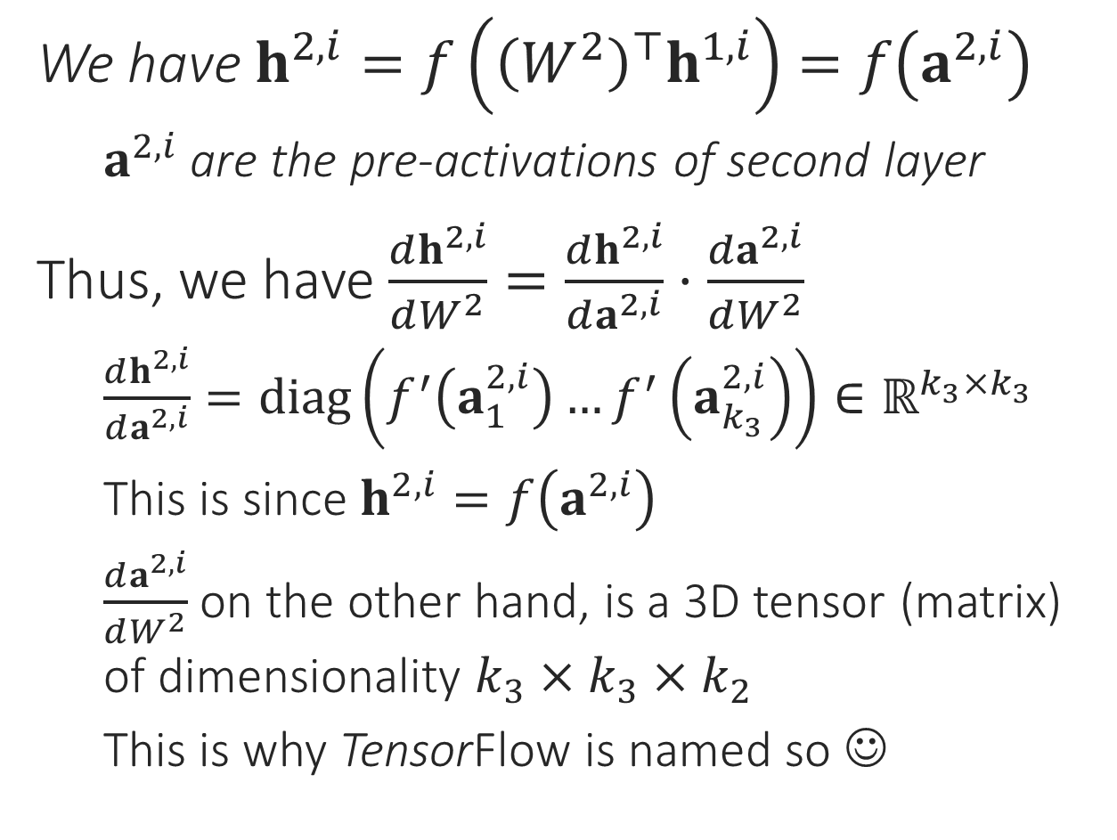
Back to Backpropagation
Overall we have $\frac{dℓ^{i}}{dW^{2}}=ℓ^{′}\left({\hat{y}}^{i},y^{i}\right)⋅v^{⊤}⋅\frac{dh^{2,i}}{da^{2,i}}⋅\frac{da^{2,i}}{dW^{2}}$. The dimensionality of $\frac{dℓ^{i}}{dW^{2}}$ is $ℝ^{1×1}⋅ℝ^{1×k_{3}}⋅ℝ^{k_{3}×k_{3}}⋅ℝ^{k_{3}×k_{3}×k_{2}}=ℝ^{1×k_{3}×k_{2}}$ which is as expected
We have $h^{2,i}=f\left({\left(W^{2}\right)}^{⊤}h^{1,i}\right)=f\left(a^{2,i}\right)$
$a^{2,i}$ are the pre-activations of second layer
Thus, we have $\frac{dh^{2,i}}{dW^{2}}=\frac{dh^{2,i}}{da^{2,i}}⋅\frac{da^{2,i}}{dW^{2}}$
$\frac{dh^{2,i}}{da^{2,i}}=diag\left(f^{′}\left(a_{1}^{2,i}\right)…f^{′}\left(a_{k_{3}}^{2,i}\right)\right)∈ℝ^{k_{3}×k_{3}}$
This is since $h^{2,i}=f\left(a^{2,i}\right)$
$\frac{da^{2,i}}{dW^{2}}$ on the other hand, is a 3D tensor (matrix) of dimensionality $k_{3}×k_{3}×k_{2}$
This is why TensorFlow is named so ☺
$$v$$
$$W^{2}$$
$$W^{1}$$

Slide 14
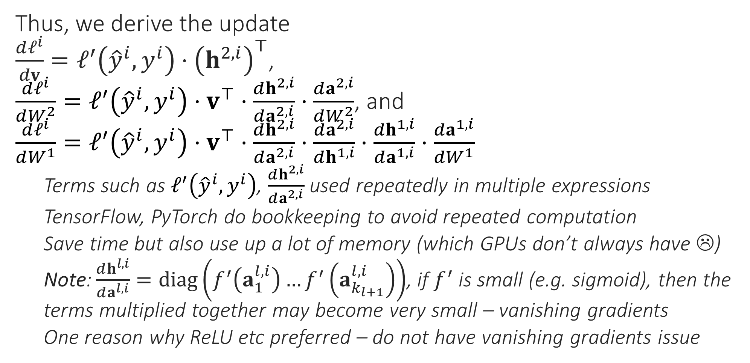
Bookkeeping in Backprop
Thus, we derive the update $\frac{dℓ^{i}}{dv}=ℓ^{′}\left({\hat{y}}^{i},y^{i}\right)⋅{\left(h^{2,i}\right)}^{⊤}$, $\frac{dℓ^{i}}{dW^{2}}=ℓ^{′}\left({\hat{y}}^{i},y^{i}\right)⋅v^{⊤}⋅\frac{dh^{2,i}}{da^{2,i}}⋅\frac{da^{2,i}}{dW^{2}}$, and $\frac{dℓ^{i}}{dW^{1}}=ℓ^{′}\left({\hat{y}}^{i},y^{i}\right)⋅v^{⊤}⋅\frac{dh^{2,i}}{da^{2,i}}⋅\frac{da^{2,i}}{dh^{1,i}}⋅\frac{dh^{1,i}}{da^{1,i}}⋅\frac{da^{1,i}}{dW^{1}}$
Terms such as $ℓ^{′}\left({\hat{y}}^{i},y^{i}\right)$, $\frac{dh^{2,i}}{da^{2,i}}$ used repeatedly in multiple expressions
TensorFlow, PyTorch do bookkeeping to avoid repeated computation
Save time but also use up a lot of memory (which GPUs don’t always have ☹)
Note: $\frac{dh^{l,i}}{da^{l,i}}=diag\left(f^{′}\left(a_{1}^{l,i}\right)…f^{′}\left(a_{k_{l+1}}^{l,i}\right)\right)$, if $f^{′}$ is small (e.g. sigmoid), then the terms multiplied together may become very small – vanishing gradients
One reason why ReLU etc preferred – do not have vanishing gradients issue

Slide 15
Generative Neural Networks
So far we have looked at networks that solve prediction problems like (binary,multiclass/label)classification, regression etc
Neural networks can also be used to learn generative models
Can be used for dim. redn. as well as to generate new data points
(Variational) Autoencoders (Kingma & Welling 2013, Rezende et al. 2014) and Generative adversarial networks (Goodfellow et al 2014) are two popular generative models that use neural networks
Will describe them with feedforward networks but can be formed out of CNNs or RNNs as well

Slide 16

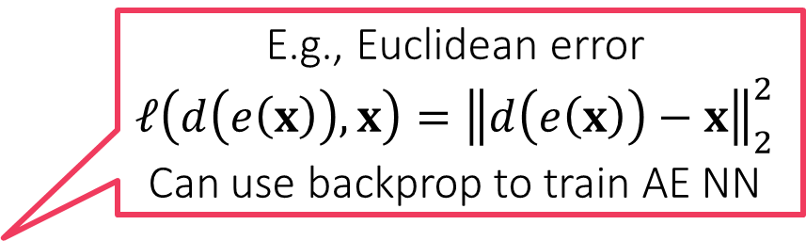


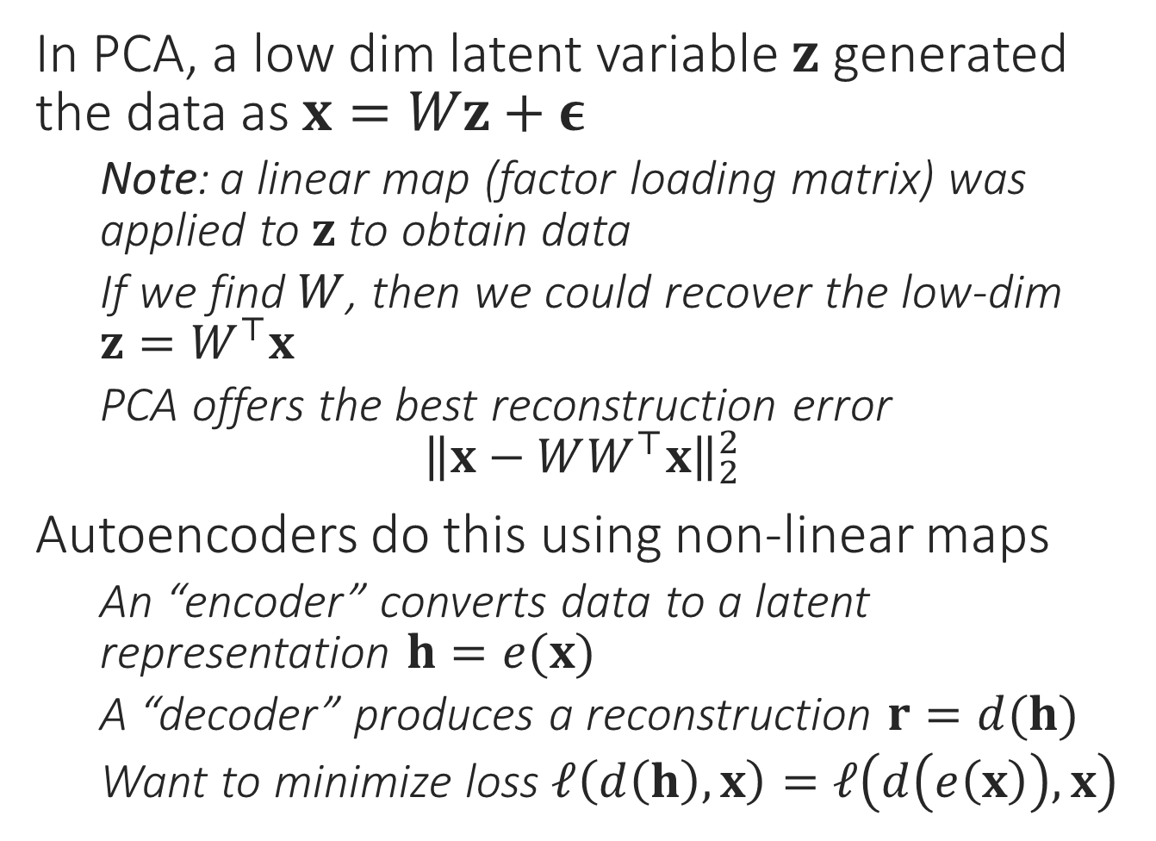






Autoencoders
In PCA, a low dim latent variable $z$ generated the data as $x=Wz+ε$
Note: a linear map (factor loading matrix) was applied to $z$ to obtain data
If we find $W$, then we could recover the low-dim $z=W^{⊤}x$
PCA offers the best reconstruction error ${\left\|x−WW^{⊤}x\right\|}_{2}^{2}$
Autoencoders do this using non-linear maps
An “encoder” converts data to a latent representation $h=e(x)$
A “decoder” produces a reconstruction $r=d(h)$
Want to minimize loss $ℓ\left(d\left(h\right),x\right)=ℓ\left(d\left(e\left(x\right)\right),x\right)$
$$id$$
$$id$$
$$id$$
$$id$$
$$W^{2}$$
$$\text{id}$$
$$\text{id}$$
$$\text{id}$$
$$W^{1}$$
E.g., Euclidean error
$$ℓ\left(d\left(e\left(x\right)\right),x\right)={\left\|d\left(e\left(x\right)\right)−x\right\|}_{2}^{2}$$
Can use backprop to train AE NN

Slide 17


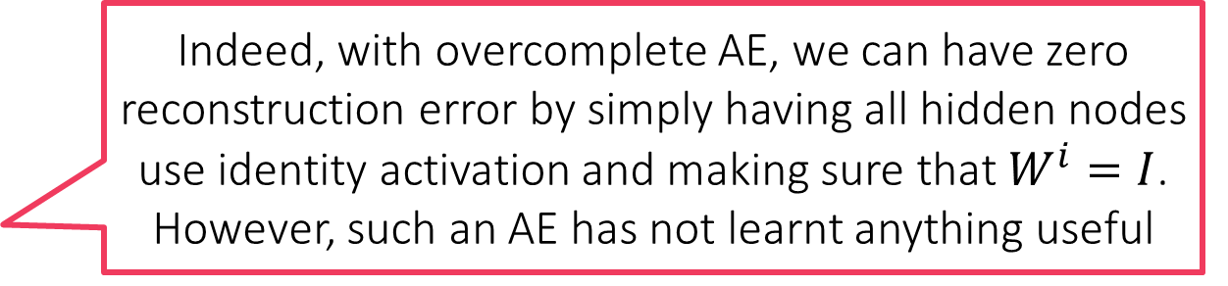



Autoencoders
$$id$$
$$id$$
$$id$$
$$id$$
Decoder
PCA can be thought of as a linear autoencoder
Just like PCA, autoencoders are trained to lower reconstruction error using backpropagation
The “hourglass” architecture very popular in AE
Gradually decreases dimensionality of data
However, a monotonic decrease not necessary
E.g. 784 →1000→500→250→30→250→500→1000→784 on MNIST data (Hinton and Salakhutdinov)
In fact some autoencoders do not decrease dim at all
Called overcomplete autoencoders. Recall that as in kernel PCA, goal may be to find better features not less features
Autoencoders can overfit badly too – just memorize data and offer no useful dim red on test data
Various techniques to regularize AE
$${\tilde{W}}^{1}$$
“Bottleneck”. For overcomplete AE, bottleneck may have more neurons than input layer. For undercomplete neurons, less neurons than input layer in bottleneck layer so dim redn
$${\tilde{W}}^{2}$$
Encoder
$$W^{2}$$
Indeed, with overcomplete AE, we can have zero reconstruction error by simply having all hidden nodes use identity activation and making sure that $W^{i}=I$. However, such an AE has not learnt anything useful
$$W^{1}$$

Slide 18
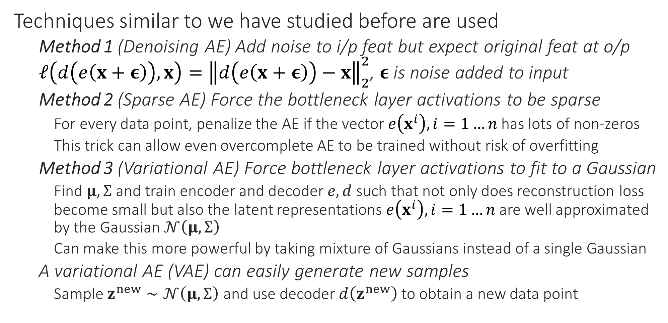
Regularized Autoencoders
Techniques similar to we have studied before are used
Method 1 (Denoising AE) Add noise to i/p feat but expect original feat at o/p $ℓ\left(d\left(e\left(x+ε\right)\right),x\right)={\left\|d\left(e\left(x+ε\right)\right)−x\right\|}_{2}^{2}$, $ε$ is noise added to input
Method 2 (Sparse AE) Force the bottleneck layer activations to be sparse
For every data point, penalize the AE if the vector $e\left(x^{i}\right),i=1…n$ has lots of non-zeros
This trick can allow even overcomplete AE to be trained without risk of overfitting
Method 3 (Variational AE) Force bottleneck layer activations to fit to a Gaussian
Find $μ,Σ$ and train encoder and decoder $e,d$ such that not only does reconstruction loss become small but also the latent representations $e\left(x^{i}\right),i=1…n$ are well approximated by the Gaussian $𝒩\left(μ,Σ\right)$
Can make this more powerful by taking mixture of Gaussians instead of a single Gaussian
A variational AE (VAE) can easily generate new samples
Sample $z^{new}∼𝒩\left(μ,Σ\right)$ and use decoder $d\left(z^{new}\right)$ to obtain a new data point

Slide 19
Generative Adversarial Networks
Do not aim to offer good reconstruction error – sole aim is to produce new data points that are realistic and distributed as training data points
E.g. given tons of cat images, generate new ones (as if there weren’t enough of them around already) but make sure the new ones do look like cats
Uses two networks to perform this – a generator which attempts to generate new samples, and a discriminator which attempts to distinguish the samples from actual training data
If the discriminator is unable to tell the generator’s samples from actual data then this means the generator has learnt to generate realistic data (or else that the discriminator is weak and needs to be strengthened)
Interesting interpretation of GAN tells us that the discriminator supplies the generator with the gradients it needs to train itself
Thus, instead of calculating backprop gradients from data, another NN (the discriminator) “learns” the gradients for the generator ☺

Slide 20
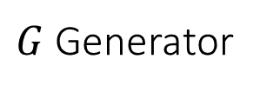
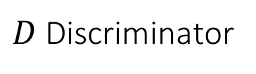
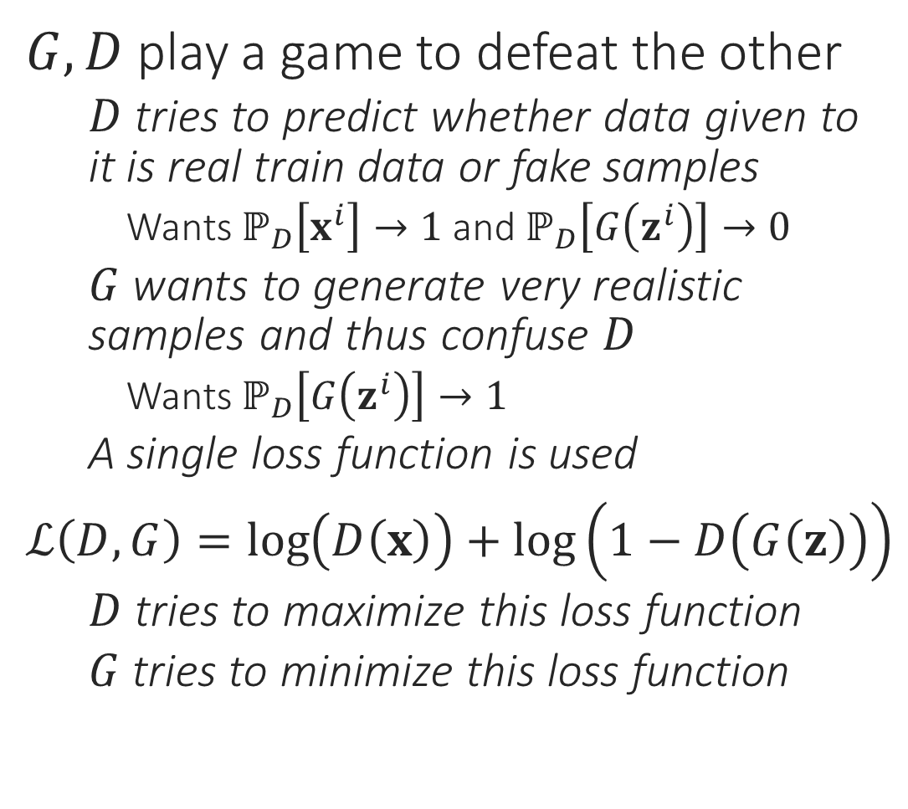
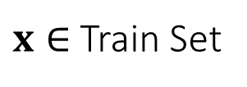


GANs – a toy depiction
$$ℙ\left[\text{image} \text{is} \text{genuine}\right]$$
$G,D$ play a game to defeat the other
$D$ tries to predict whether data given to it is real train data or fake samples
Wants $ℙ_{D}\left[x^{i}\right]→1$ and $ℙ_{D}\left[G\left(z^{i}\right)\right]→0$
$G$ wants to generate very realistic samples and thus confuse $D$
Wants $ℙ_{D}\left[G\left(z^{i}\right)\right]→1$
A single loss function is used
$ℒ\left(D,G\right)=\log\left(D\left(x\right)\right)+\log\left(1−D\left(G\left(z\right)\right)\right)$
$D$ tries to maximize this loss function
$G$ tries to minimize this loss function
$D$ Discriminator
$x∈$ Train Set
$G$ Generator
$$z∈𝒩\left(0,I_{k}\right)$$

