Slide 1
Deep Learning IV
CS771: Introduction to Machine Learning
Purushottam Kar

Slide 2
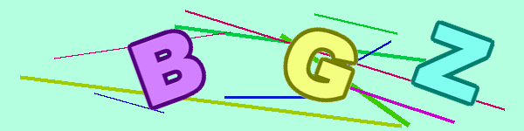



Announcements
Assignment 3 released
Deadline November 23, 2019, 9:59PM IST
Very close to grade submission deadline – do not rely on “extensions”
Use non-linear methods (kernels, NN) judiciously for this assignment
Do not forget to also explore LwP, linear methods
In ML, good and insightful feature engineering can beat the best of algos ☺
Fully exploit the simplicities and structure in given data
Maybe fruitful to use ML methods for the last step
BGZ

Slide 3
Recap of Last Lecture
Chain rule for multivariate functions (notion of Jacobian)
Backprogation rule for training DN using GD
Generative models via NN – autoencoders, GANs

Slide 4
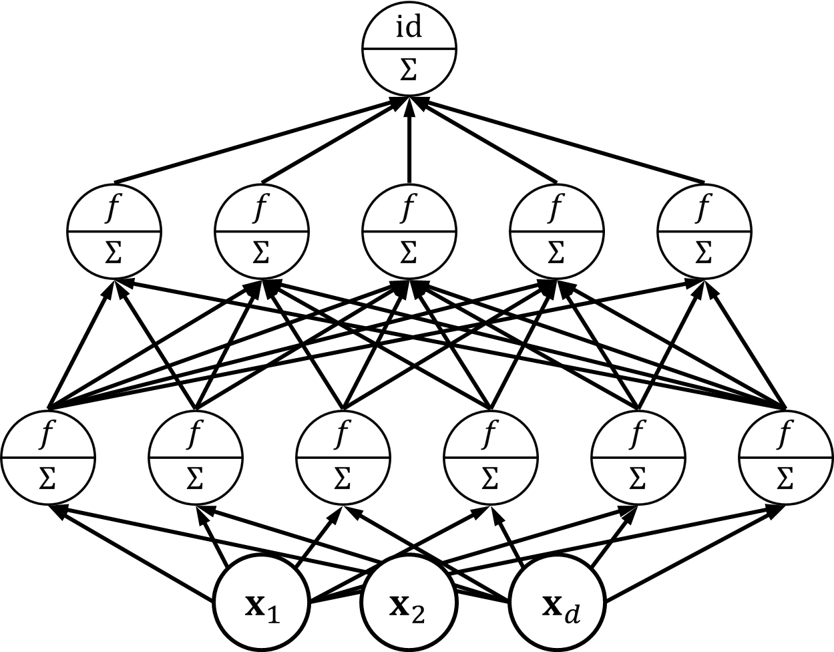
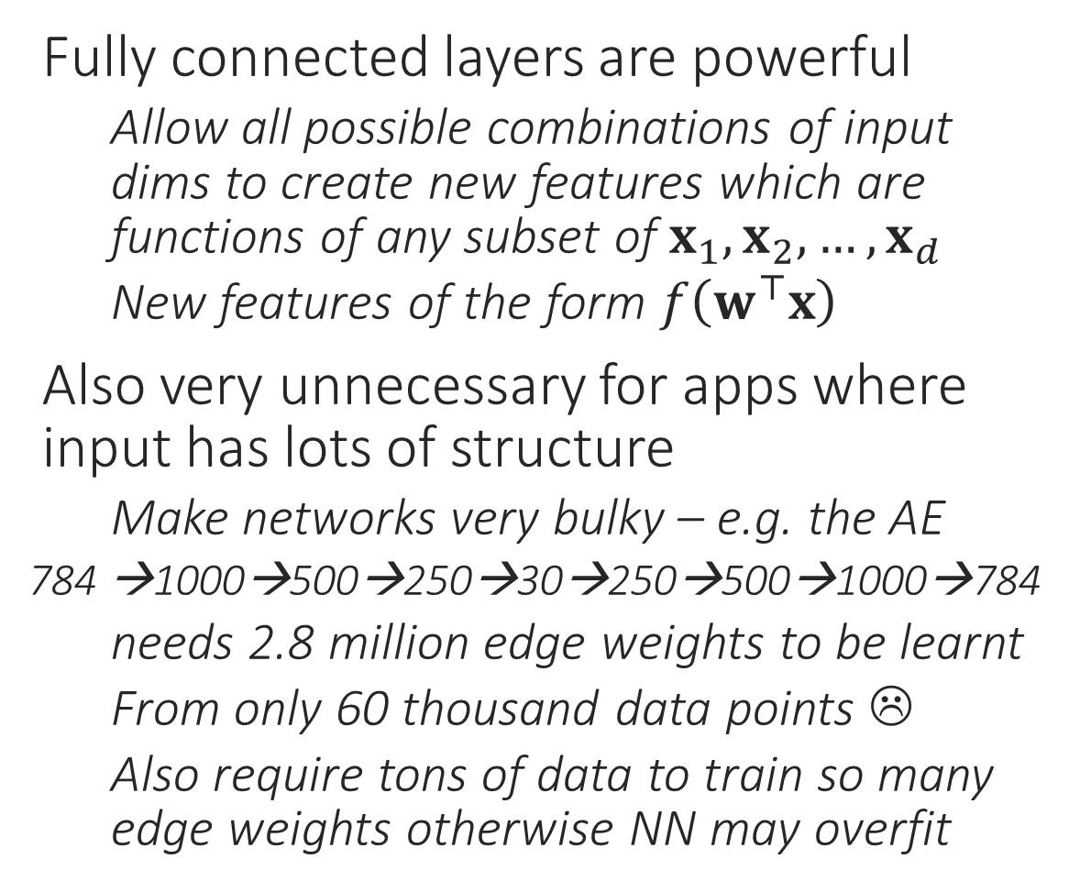
Feedforward Networks can be massive
Fully connected layers are powerful
Allow all possible combinations of input dims to create new features which are functions of any subset of $x_{1},x_{2},…,x_{d}$
New features of the form $f\left(w^{⊤}x\right)$
Also very unnecessary for apps where input has lots of structure
Make networks very bulky – e.g. the AE
784 →1000→500→250→30→250→500→1000→784
needs 2.8 million edge weights to be learnt
From only 60 thousand data points ☹
Also require tons of data to train so many edge weights otherwise NN may overfit

Slide 5
Structured Data needs Local Features
EYE
EYE
MOUTH
Highly unlikely that top left and bottom right pixels would need to be considered together right at the first hidden layer to detect edges
Only neighboring pixels need to talk to each other to detect edges. Also edge detection happens via “filters” – same filter needs to be applied everywhere
Then, need to aggregate info to detect structures
Then, need to detect even higher level features
Distant pixels are jointly considered, but at a much later stage (deeper layer)

Slide 6
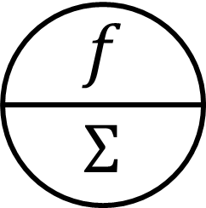
Convolution Operation
Convolutions are at the heart of signal processing and CNNs
Convolutions create layers which are sparsely connected
Only 18 edges, fully connected layer would have had 48 edges

Slide 7
Convolution Operation
Convolutions are at the heart of signal processing and CNNs
Convolutions create layers which are sparsely connected
On top of that they force equality constraints among weights in that layer
All green edges forced to have the same weight, all red edges forced to have the same weight, all blue edges …
So effectively only 3 edge weights to be learnt for this layer!
A fully connected layer would have had 48 edges

Slide 8


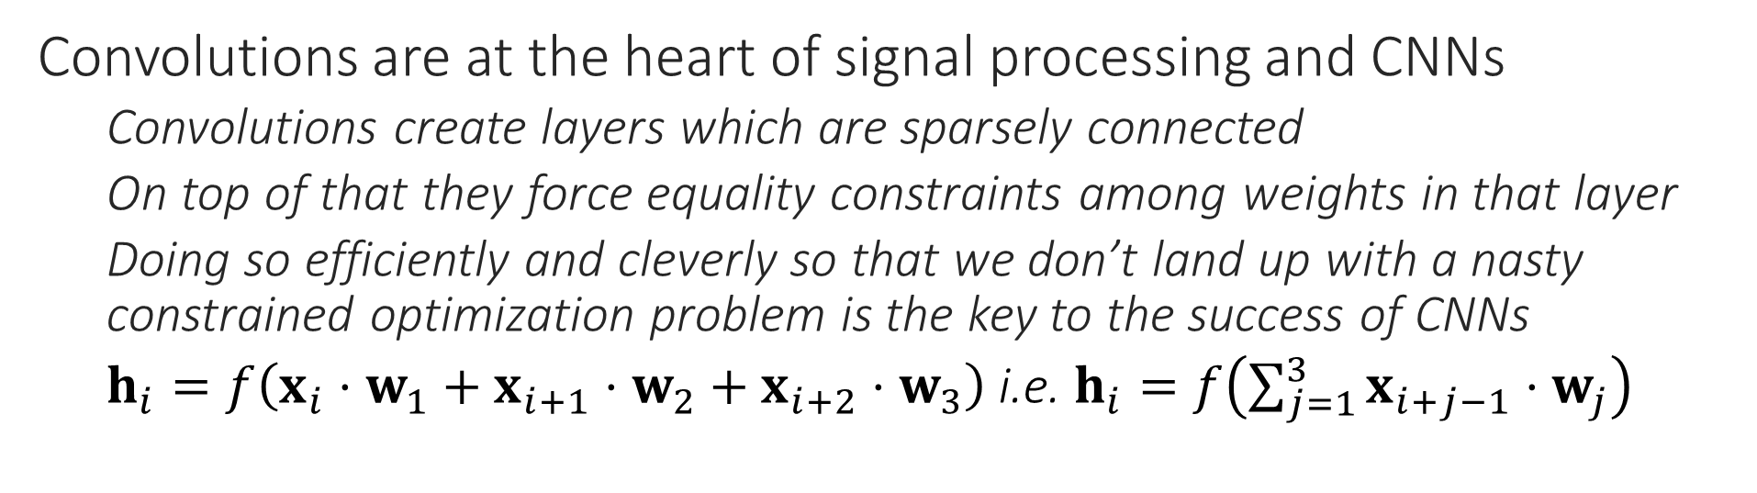
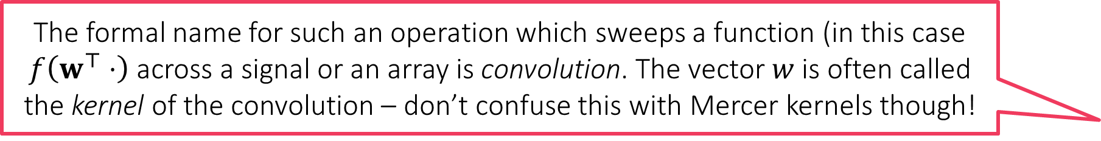
Convolution Operation
The formal name for such an operation which sweeps a function (in this case $f\left(w^{⊤}⋅\right)$ across a signal or an array is convolution. The vector $w$ is often called the kernel of the convolution – don’t confuse this with Mercer kernels though!
Convolutions have been around in image processing for decades. Earlier, people used to painstakingly design the kernels by hand (e.g. Canny filters) but CNNs allow us to learn the kernel of the convolution itself.
Convolutions are at the heart of signal processing and CNNs
Convolutions create layers which are sparsely connected
On top of that they force equality constraints among weights in that layer
Doing so efficiently and cleverly so that we don’t land up with a nasty constrained optimization problem is the key to the success of CNNs
$h_{i}=f\left(x_{i}⋅w_{1}+x_{i+1}⋅w_{2}+x_{i+2}⋅w_{3}\right)$ i.e. $h_{i}=f\left(\sum_{j=1}^{3}{x_{i+j−1}⋅w_{j}}\right)$
True, the idea is to allow difficult problems to be solved with a customized filter that works best for that problem. However, handcrafted filters may still offer good results for simple problems (and offer faster training since learning filters is not an easy task – the backprop becomes complicated)

Slide 9
2D Convolutions
Convolutions make sense for 2D, 3D, nD data as well
A fully conn. layer would’ve needed 576 weights. A conv. needs only 9 weights
Such local operations are exactly what we need for detecting local patterns
Edges, boundaries, textures
Can apply convolutions to 3D layers as well
E.g. Video data is 3D

Slide 10
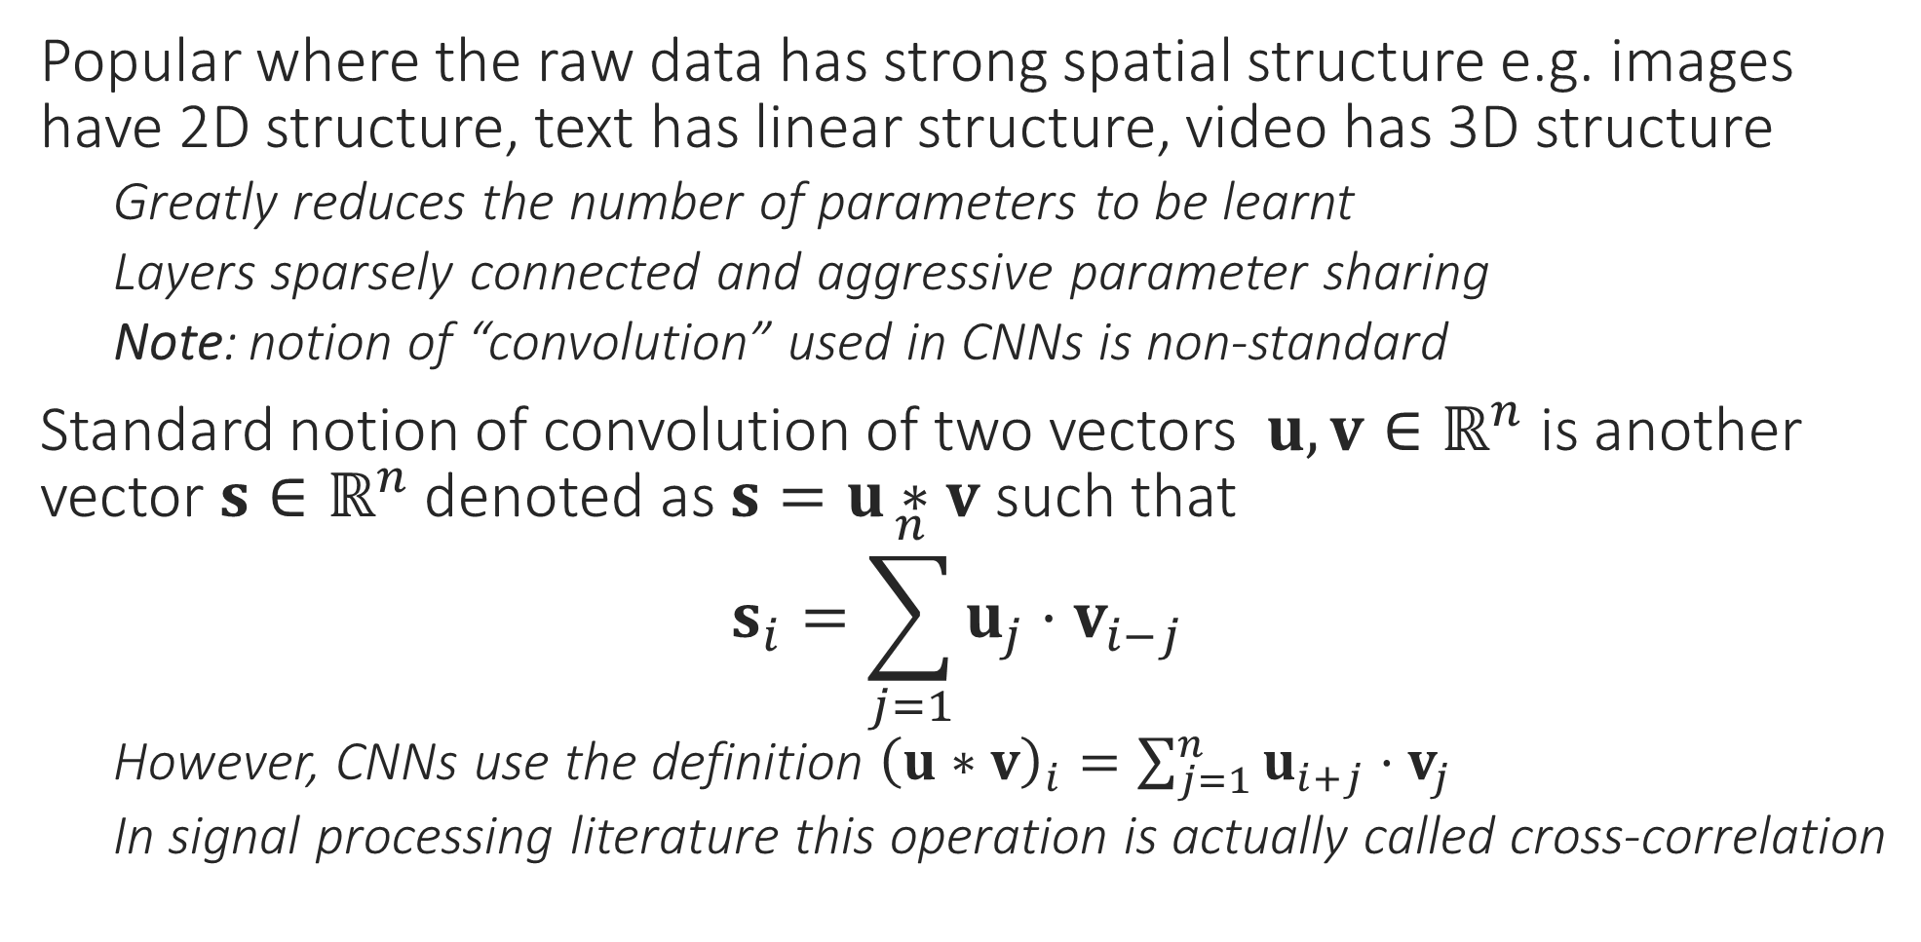
Convolutional Neural Network
Popular where the raw data has strong spatial structure e.g. images have 2D structure, text has linear structure, video has 3D structure
Greatly reduces the number of parameters to be learnt
Layers sparsely connected and aggressive parameter sharing
Note: notion of “convolution” used in CNNs is non-standard
Standard notion of convolution of two vectors $u,v∈ℝ^{n}$ is another vector $s∈ℝ^{n}$ denoted as $s=u∗v$ such that $s_{i}=\sum_{j=1}^{n}{u_{j}{⋅v}_{i−j}}$
However, CNNs use the definition ${\left(u∗v\right)}_{i}=\sum_{j=1}^{n}{u_{i+j}{⋅v}_{j}}$
In signal processing literature this operation is actually called cross-correlation

Slide 11


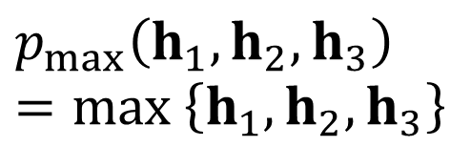

Pooling Operations
Reduce sensitivity of the network to small shifts/errors in image
Max-pooling and average pooling most common
“Stride” length – number of nodes after which a new “pool” is started. Stride = 3 here
$$p$$
$$p$$
$$p_{max}\left(h_{1},h_{2},h_{3}\right)=\max\left\{h_{1},h_{2},h_{3}\right\}$$
$$p_{avg}\left(h_{1},h_{2},h_{3}\right)=\frac{1}{3}\left(h_{1}+h_{2}+h_{3}\right)$$

Slide 12
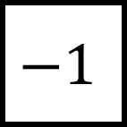
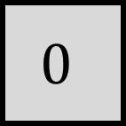
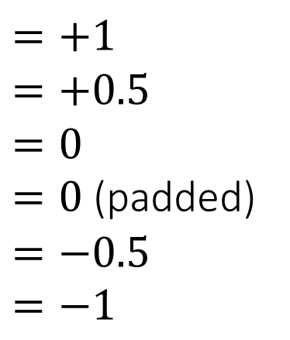
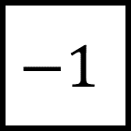
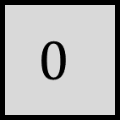
Simple Operations using Conv and Pool
Max Pooling (stride 1x2)
We may verify that 2x2 stride leads to too much info loss
Raw Image
Kernels
Convolved Image
$$0$$
$$−1$$
Detects horizontal edges!
$$=+1$$
$$=+0.5$$
$$=0$$
$=0$ (padded)
$$=−0.5 \\ =−1$$
$$0$$
$$−1$$
Detects vertical edges!
Max Pooling (stride 2x1)
Images are often padded with zero pixels so that convolved image is of same size

Slide 13
Using CNNs in Computer Vision
3 kernels used to create 3 channels
Kernels learnt using backprop
Maxpooling often done across channels too
Think of each channel (kernel) acting as a feature e.g. one kernel may tell if there is a vertical edge or not, another might tell if there is a diagonal edge or not. Maxpooling across channels is like asking if at least one of the features is active or is it the case that all features are inactive (no edges)
True. However, note that even CNNs usually have a top layer that is dense i.e. weights that connect the last hidden layer to output layer are usually dense since it is assumed that by then all features that had to be learnt, have been learnt and so now all we need is a linear function over those.

