Slide 1
Deep Learning V
CS771: Introduction to Machine Learning
Purushottam Kar

Slide 2
Announcements
We have received a quiz 4 copy with no identification marks on it
Once grades are released, the concerned student may claim the copy
Attendance records, handwriting checks will be used to verify
A token penalty of 1 mark would be awarded to the student for this quiz
The above scheme worked only because only one unmarked copy
Two or more unmarked copies put this process in jeopardy
Students are advised to write their name, roll number and department very legibly on each sheet of the answer sheet in the space provided

Slide 3
Recap of Last Lecture
Neural networks can be adapted to exploit structure in data
Faster/more accurate than simple feedforward networks
May learn more informative features with less training data
Key idea: ask initial hidden layers to learn low-level features that only combine a few raw features “locally” e.g. pixels that are near to each other
Higher level hidden layers could use these to learn more abstract features
Convolutional Neural Networks
Use the idea of convolutions to implement a local feature extractor
Notion of convolutions can be extended to 1D, 2D, 3D, … nD data
Pooling operations popular in reducing total number of features
CNNs very popular for image/video processing (even text processing)

Slide 4
Pooling and Strides – an example
1 | 2 | 3 | 4 | 5
9 | 8 | 7 | 6 | 0
0 | 2 | 4 | 6 | 8
2 | 3 | 4 | 5 | 1
6 | 7 | 8 | 9 | 0
0
0
0
0
0
0
2 x 2 max pool
2 x 1 stride
9 | 8 | 7 | 6 | 5
3 | 4 | 6 | 8 | 8
7 | 8 | 9 | 9 | 0
0 | 0 | 0 | 0 | 0
Padding

Slide 5
Pooling and Strides – an example
1 | 2 | 3 | 4 | 5
9 | 8 | 7 | 6 | 0
0 | 2 | 4 | 6 | 8
2 | 3 | 4 | 5 | 1
6 | 7 | 8 | 9 | 0
0
0
0
0
0
0
2 x 2 max pool
2 x 1 stride
9 | 8 | 7 | 6 | 5
3 | 4 | 6 | 8 | 8
7 | 8 | 9 | 9 | 0
9 | 7 | 5
9 | 7 | 8
3 | 6 | 8
7 | 9 | 1
7 | 9 | 1
2 x 2 max pool
1 x 2 stride
0 | 0 | 0 | 0 | 0
Padding

Slide 6
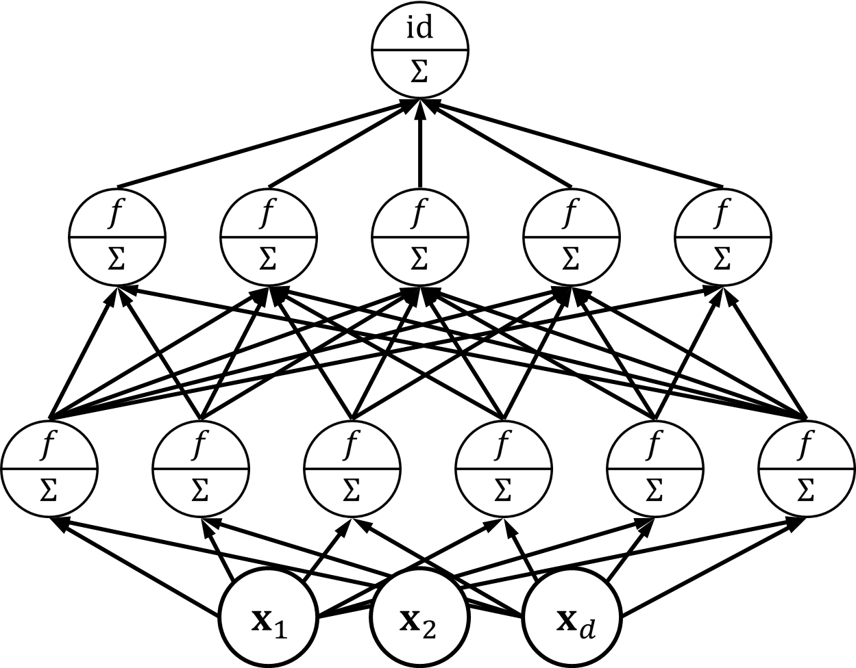
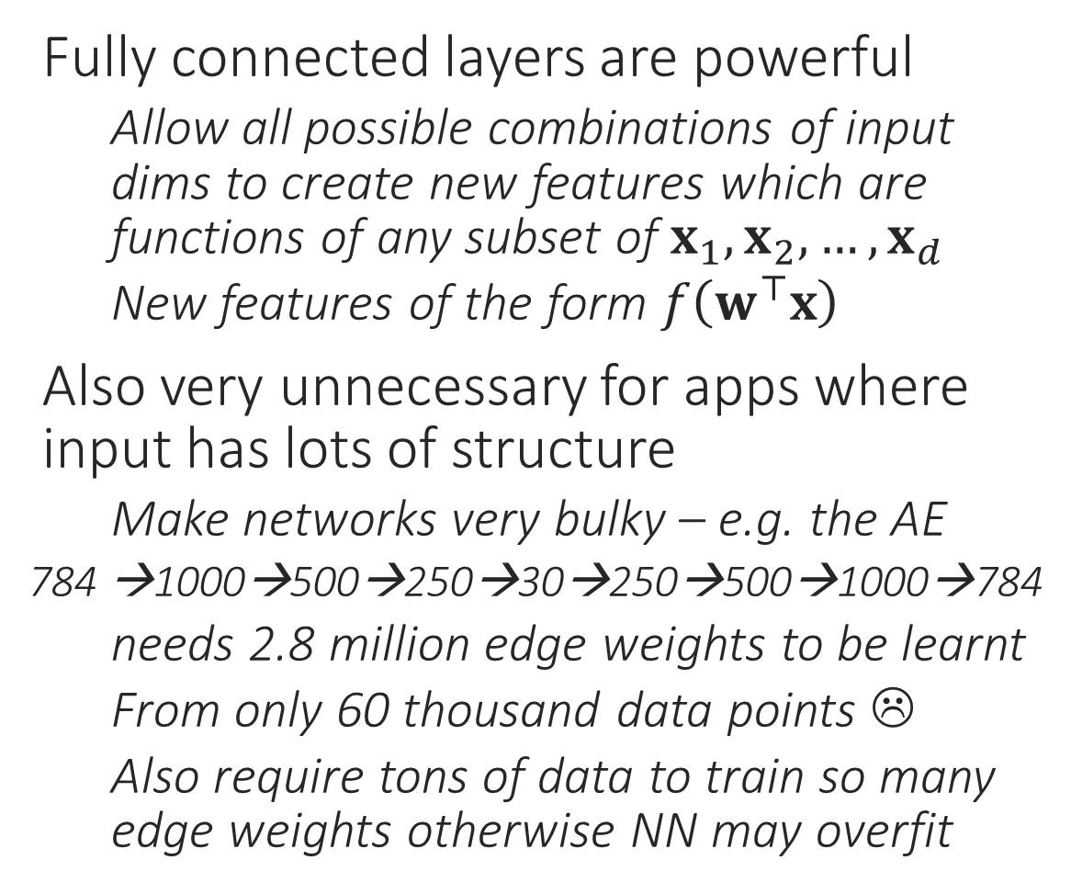
Feedforward Networks can be massive
Fully connected layers are powerful
Allow all possible combinations of input dims to create new features which are functions of any subset of $x_{1},x_{2},…,x_{d}$
New features of the form $f\left(w^{⊤}x\right)$
Also very unnecessary for apps where input has lots of structure
Make networks very bulky – e.g. the AE
784 →1000→500→250→30→250→500→1000→784
needs 2.8 million edge weights to be learnt
From only 60 thousand data points ☹
Also require tons of data to train so many edge weights otherwise NN may overfit

Slide 7
Structured Data needs Local Features
The quick brown fox jumps over the lazy dog
Clues from neighbouring words help identify part of speech, adjective, noun etc
Specific sequences of POS can be combined to form phrases (NP, VP)
This is repeated hierarchically
Note that “fox” and “dog” interact only at the “sentence” level
More importantly in a context free grammar, same rules apply to, e.g., detect a noun phrase no matter where in sentence we are looking!
DET ADJ ADJ NN VV PP DET ADJ NN
NP VV PP NP
NP VP
S
CNNs may be (and are) applied to such data as well since even here, we are looking for local features. However, special NN are designed for sequence data e.g. text, DNA

Slide 8
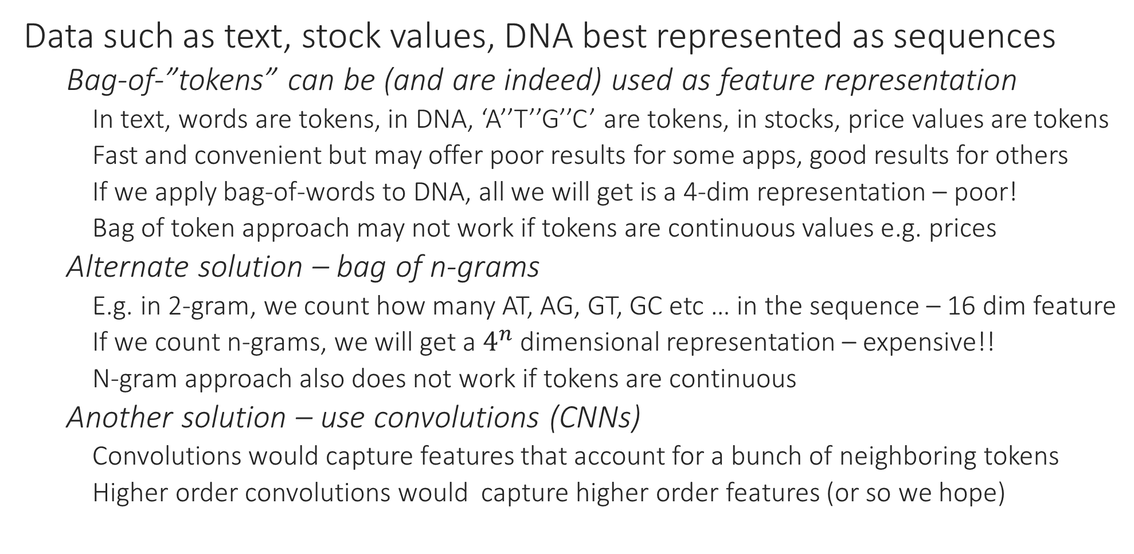
Learning with Sequence Data
Data such as text, stock values, DNA best represented as sequences
Bag-of-”tokens” can be (and are indeed) used as feature representation
In text, words are tokens, in DNA, ‘A’’T’’G’’C’ are tokens, in stocks, price values are tokens
Fast and convenient but may offer poor results for some apps, good results for others
If we apply bag-of-words to DNA, all we will get is a 4-dim representation – poor!
Bag of token approach may not work if tokens are continuous values e.g. prices
Alternate solution – bag of n-grams
E.g. in 2-gram, we count how many AT, AG, GT, GC etc … in the sequence – 16 dim feature
If we count n-grams, we will get a $4^{n}$ dimensional representation – expensive!!
N-gram approach also does not work if tokens are continuous
Another solution – use convolutions (CNNs)
Convolutions would capture features that account for a bunch of neighboring tokens
Higher order convolutions would capture higher order features (or so we hope)

Slide 9
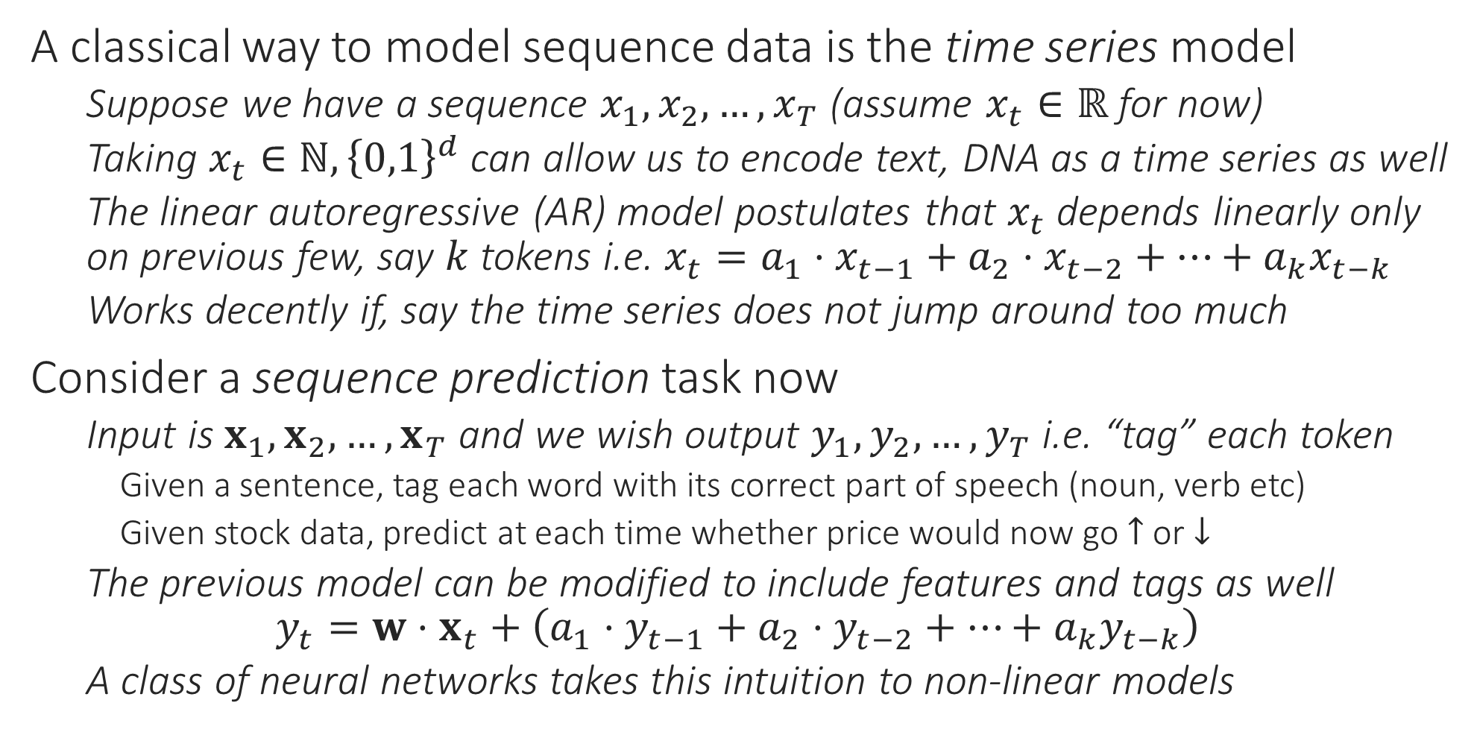
Learning with Sequence Data
A classical way to model sequence data is the time series model
Suppose we have a sequence $x_{1},x_{2},…,x_{T}$ (assume $x_{t}∈ℝ$ for now)
Taking $x_{t}∈ℕ,{\left\{0,1\right\}}^{d}$ can allow us to encode text, DNA as a time series as well
The linear autoregressive (AR) model postulates that $x_{t}$ depends linearly only on previous few, say $k$ tokens i.e. $x_{t}=a_{1}⋅x_{t−1}+a_{2}⋅x_{t−2}+…+a_{k}x_{t−k}$
Works decently if, say the time series does not jump around too much
Consider a sequence prediction task now
Input is $x_{1},x_{2},…,x_{T}$ and we wish output $y_{1},y_{2},…,y_{T}$ i.e. “tag” each token
Given a sentence, tag each word with its correct part of speech (noun, verb etc)
Given stock data, predict at each time whether price would now go $↑$ or $↓$
The previous model can be modified to include features and tags as well $y_{t}=w⋅x_{t}+\left(a_{1}⋅y_{t−1}+a_{2}⋅y_{t−2}+…+a_{k}y_{t−k}\right)$
A class of neural networks takes this intuition to non-linear models

Slide 10
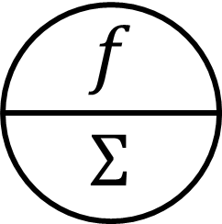




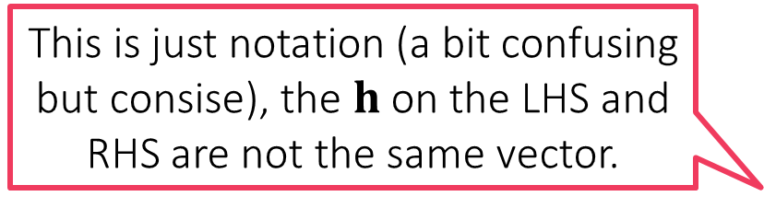


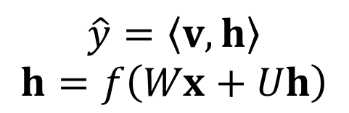

Recurrent Neural Networks
For sake of notational clarity, we now represent all hidden layers, all nodes in those hidden layers, using a single hidden layer node
Recurrent neural networks in some sense, create a virtual copy of this network for every point in the time series and allow these copies to share information
$$f$$
$$y$$
$$\hat{y}=\left\langle v,h\right\rangle \\ h=f\left(Wx+Uh\right)$$
$$\hat{y}=\left\langle v,h\right\rangle \\ h=f\left(Wx\right)$$
$$h$$
This is just notation (a bit confusing but consise), the $h$ on the LHS and RHS are not the same vector.
$$x$$
$$x$$

Slide 11










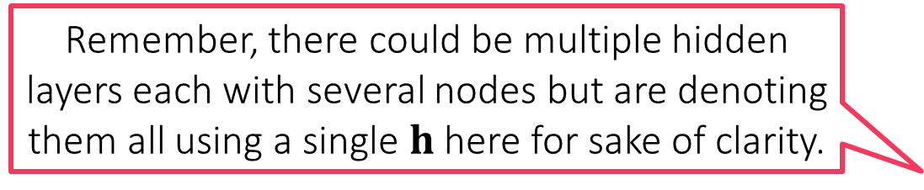







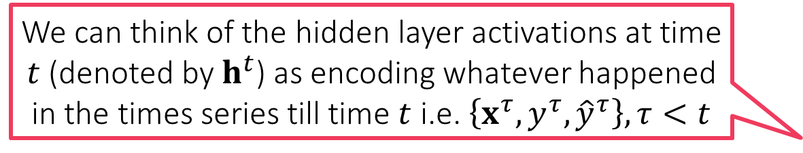












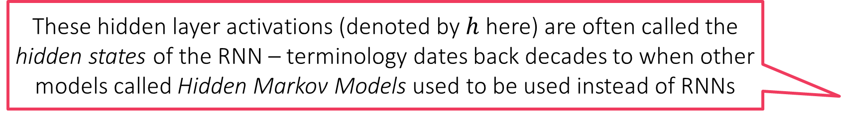

Recurrent Neural Networks
$$y^{1}$$
$$y^{2}$$
$$y^{3}$$
$$y^{4}$$
${\hat{y}}^{t}=\left\langle v,h^{t}\right\rangle$
$h^{t}=f\left(Wx^{t}+Uh^{t−1}\right)$
${\hat{y}}^{t}$ can do POS tagging etc
${\hat{y}}^{t}$ can even be a vector ${\hat{y}}^{t}$
Can have several hidden layers some recurrent i.e. receive input from their counterparts in previous time steps, others can be non recurrent as well
RNNs allow lot of freedom but get harder to train
These hidden layer activations (denoted by $h$ here) are often called the hidden states of the RNN – terminology dates back decades to when other models called Hidden Markov Models used to be used instead of RNNs
$$v$$
$$v$$
$$v$$
$$v$$
$$U$$
$$U$$
$$U$$
$$U$$
$$…$$
$$U$$
$$h^{0}$$
$$h^{1}$$
$$h^{2}$$
$$h^{3}$$
$$h^{4}$$
Remember, there could be multiple hidden layers each with several nodes but are denoting them all using a single $h$ here for sake of clarity.
$$W$$
$$W$$
$$W$$
$$W$$
$$…$$
$$x_{1}$$
$$x_{2}$$
We can think of the hidden layer activations at time $t$ (denoted by $h^{t}$) as encoding whatever happened in the times series till time $t$ i.e. $\left\{x^{τ},y^{τ},{\hat{y}}^{τ}\right\},τ<t$
$$x_{3}$$
$$x_{4}$$
The quick brown fox …

Slide 12


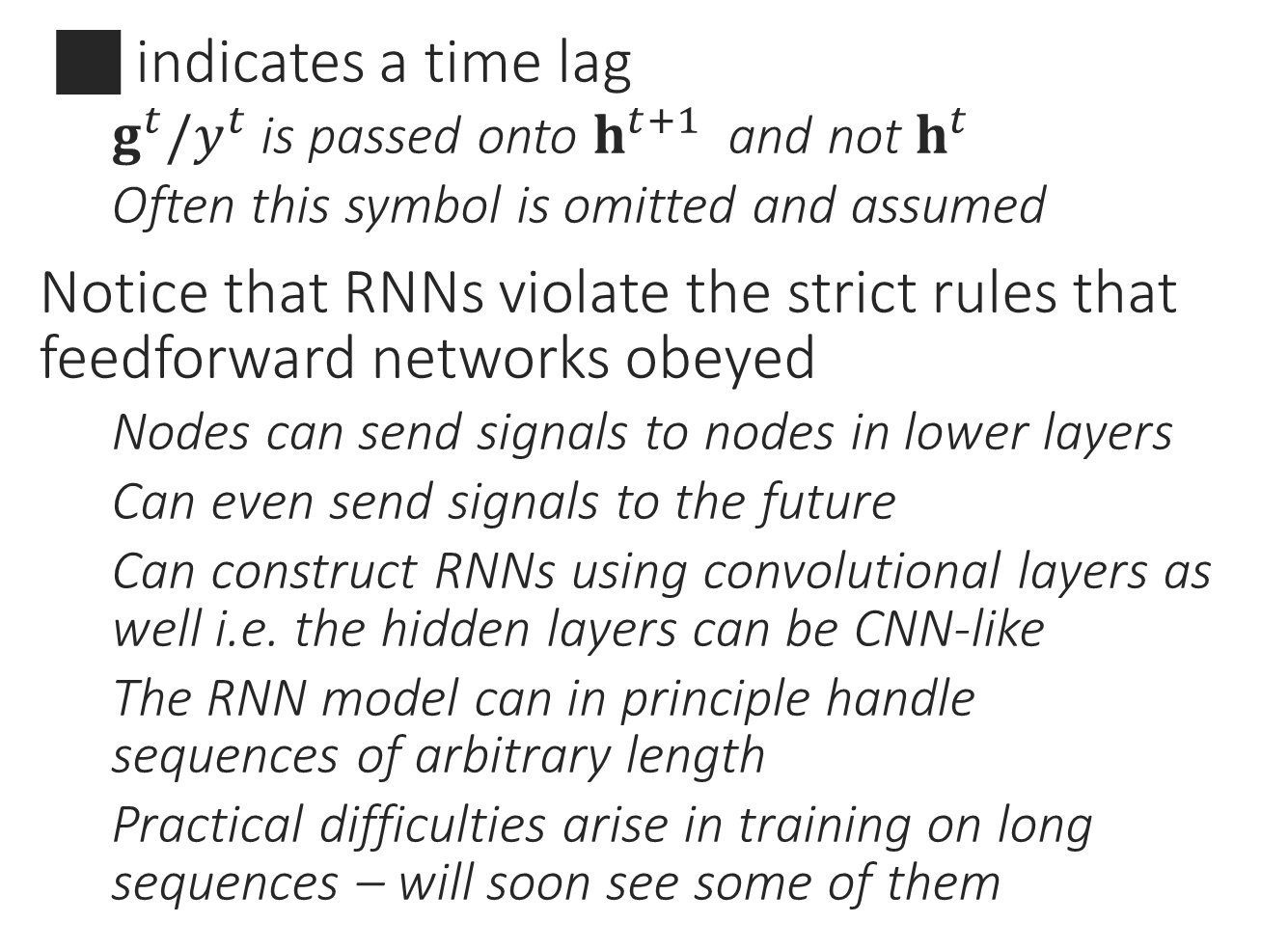










RNN Variants
$$y$$
$$y$$
$$y$$
 indicates a time lag
$g^{t}/y^{t}$ is passed onto $h^{t+1}$ and not $h^{t}$
Often this symbol is omitted and assumed
Notice that RNNs violate the strict rules that feedforward networks obeyed
Nodes can send signals to nodes in lower layers
Can even send signals to the future
Can construct RNNs using convolutional layers as well i.e. the hidden layers can be CNN-like
The RNN model can in principle handle sequences of arbitrary length
Practical difficulties arise in training on long sequences – will soon see some of them
$$g$$
$$g$$
$$g$$
$$h$$
$$h$$
$$h$$
$$x$$
$$x$$
$$x$$

Slide 13



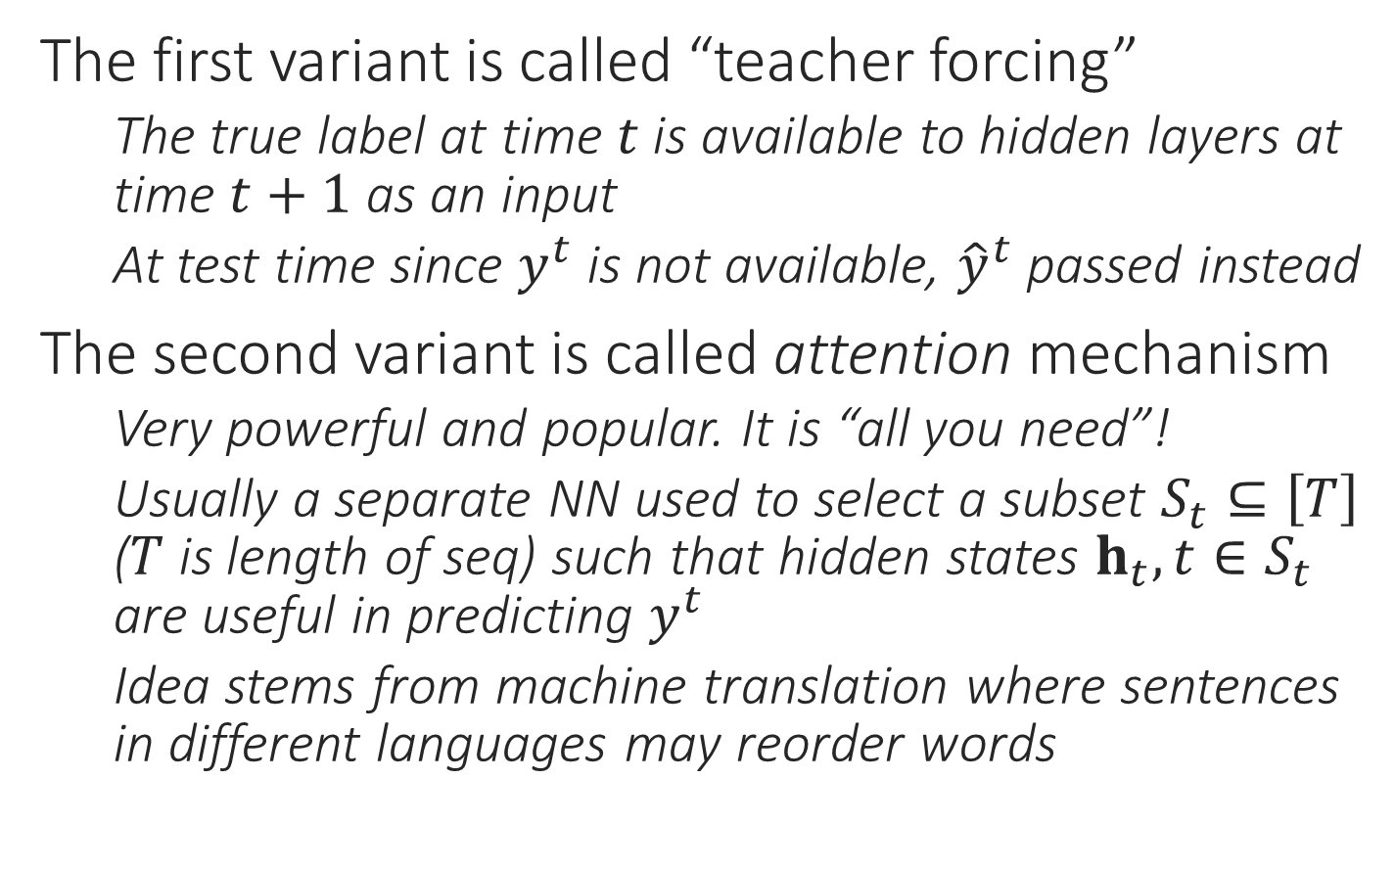





RNN Variants
$$y$$
$$y$$
The first variant is called “teacher forcing”
The true label at time $t$ is available to hidden layers at time $t+1$ as an input
At test time since $y^{t}$ is not available, ${\hat{y}}^{t}$ passed instead
The second variant is called attention mechanism
Very powerful and popular. It is “all you need”!
Usually a separate NN used to select a subset $S_{t}⊆\left[T\right]$ ($T$ is length of seq) such that hidden states $h_{t},t∈S_{t}$ are useful in predicting $y^{t}$
Idea stems from machine translation where sentences in different languages may reorder words
$$g$$
$$g$$
$$h$$
$$h$$
$$x$$
$$x$$

Slide 14
Applications of RNNs
Aligned Seq2Seq
Sequence to Single
Single to Sequence
Non-aligned Seq2Seq
POS tagging, predicting next word, language model learning, labelling frames of a video
Sentiment analysis, video/document classification
Image captioning
Machine translation, query rewriting, error correction in input seq

Slide 15
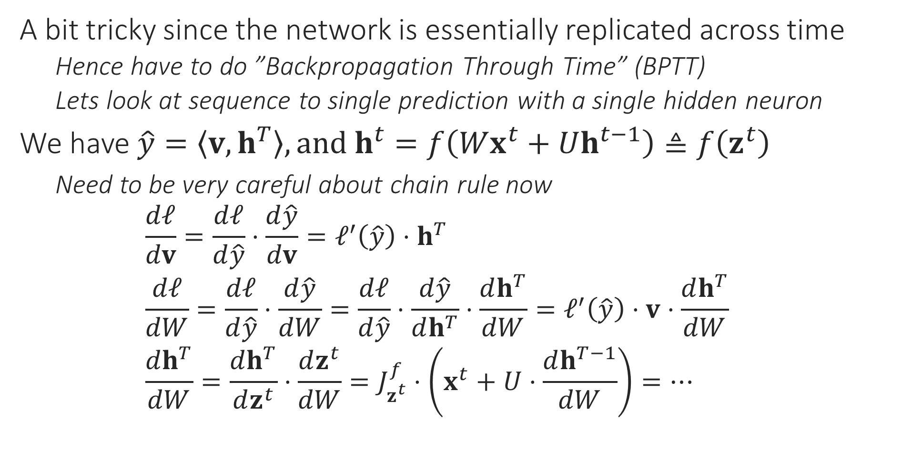
Backprop with RNNs
A bit tricky since the network is essentially replicated across time
Hence have to do ”Backpropagation Through Time” (BPTT)
Lets look at sequence to single prediction with a single hidden neuron
We have $\hat{y}=\left\langle v,h^{T}\right\rangle , and h^{t}=f\left(Wx^{t}+Uh^{t−1}\right)≜f\left(z^{t}\right)$
Need to be very careful about chain rule now $\frac{dℓ}{dv}=\frac{dℓ}{d\hat{y}}⋅\frac{d\hat{y}}{dv}=ℓ^{′}\left(\hat{y}\right)⋅h^{T}$ $\frac{dℓ}{dW}=\frac{dℓ}{d\hat{y}}⋅\frac{d\hat{y}}{dW}=\frac{dℓ}{d\hat{y}}⋅\frac{d\hat{y}}{dh^{T}}⋅\frac{dh^{T}}{dW}=ℓ^{′}\left(\hat{y}\right)⋅v⋅\frac{dh^{T}}{dW}$ $\frac{dh^{T}}{dW}=\frac{dh^{T}}{dz^{t}}⋅\frac{dz^{t}}{dW}=J_{z^{t}}^{f}⋅\left(x^{t}+U⋅\frac{dh^{T−1}}{dW}\right)=…$

Slide 16
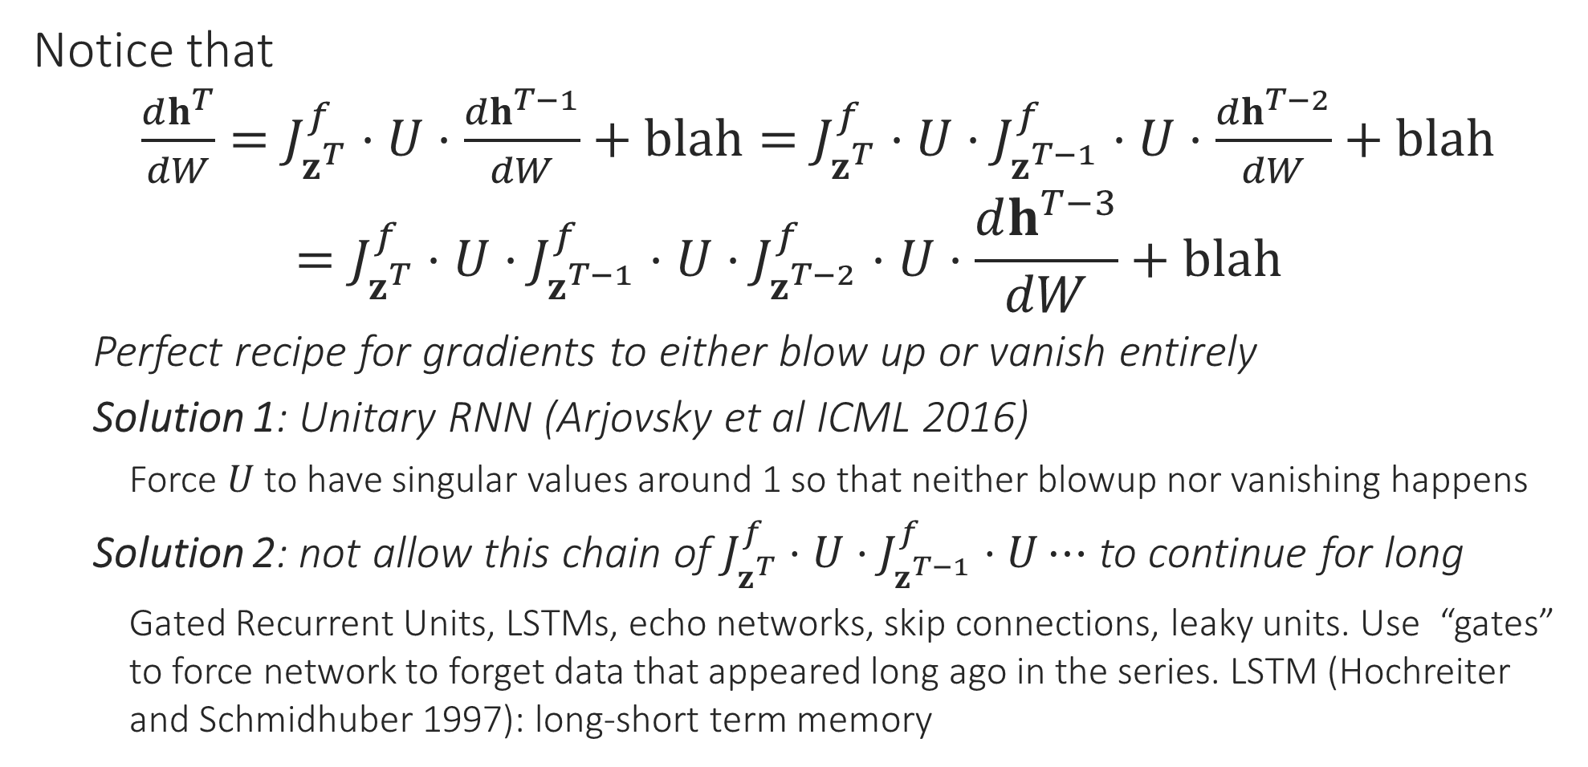
Backprop with RNNs
Notice that $\frac{dh^{T}}{dW}=J_{z^{T}}^{f}⋅U⋅\frac{dh^{T−1}}{dW}+blah=J_{z^{T}}^{f}⋅U⋅J_{z^{T−1}}^{f}⋅U⋅\frac{dh^{T−2}}{dW}+blah$ $=J_{z^{T}}^{f}⋅U⋅J_{z^{T−1}}^{f}⋅U⋅J_{z^{T−2}}^{f}⋅U⋅\frac{dh^{T−3}}{dW}+blah$
Perfect recipe for gradients to either blow up or vanish entirely
Solution 1: Unitary RNN (Arjovsky et al ICML 2016)
Force $U$ to have singular values around 1 so that neither blowup nor vanishing happens
Solution 2: not allow this chain of $J_{z^{T}}^{f}⋅U⋅J_{z^{T−1}}^{f}⋅U⋯$ to continue for long
Gated Recurrent Units, LSTMs, echo networks, skip connections, leaky units. Use “gates” to force network to forget data that appeared long ago in the series. LSTM (Hochreiter and Schmidhuber 1997): long-short term memory

