Slide 1
Meta Learning II
CS771: Introduction to Machine Learning
Purushottam Kar

Slide 2
Announcements
Students who have been granted proration for any quiz/exam should have received an email (at their CC email addresses) today.
If you missed a quiz/exam for reasons that make you eligible for proration, but have not received an email from the instructor, please contact the instructor immediately to clear the discrepancy.
https://web.cse.iitk.ac.in/users/purushot/courses/ml/2019-20-a/policies.php (see Absentee, Make-up, and Proration Policy)

Slide 3
Recap of Last Lecture
Distinction between model and model parameters
Notion of models having hyperparameters and model classes
Model selection techniques: held out/k-fold validation
Bias-variance tradeoffs and generalization error
Overfitting and underfitting
Tweaking model complexity, feats, train set size, ML algo as possible solutions
Ensemble ML Algorithms
Voting Ensemble: flexible but cannot ensure success as “experts” may sync
Need to ensure experts are diverse so that they can correct each other’s errors
Bagging and boosting take direct steps to ensure this

Slide 4
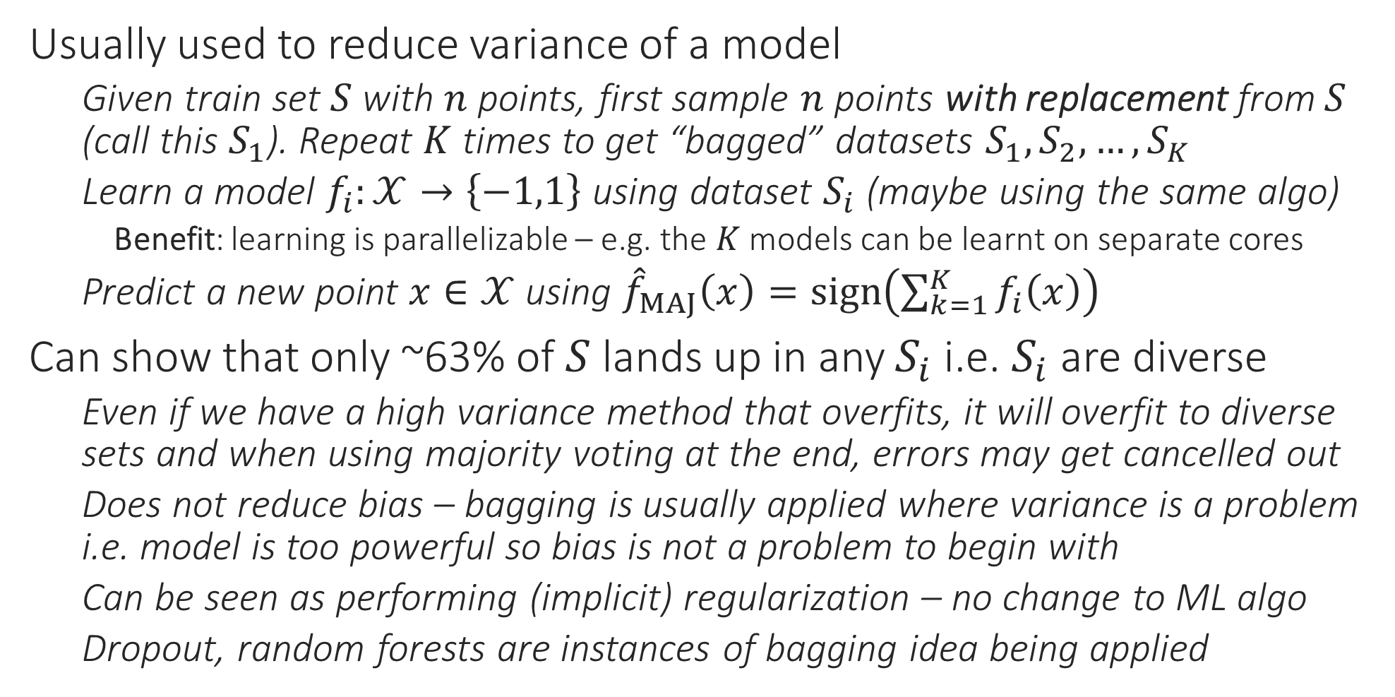
Bagging – Bootstrap AGGregatING
Usually used to reduce variance of a model
Given train set $S$ with $n$ points, first sample $n$ points with replacement from $S$ (call this $S_{1}$). Repeat $K$ times to get “bagged” datasets $S_{1},S_{2},…,S_{K}$
Learn a model $f_{i}:𝒳→\left\{−1,1\right\}$ using dataset $S_{i}$ (maybe using the same algo)
Benefit: learning is parallelizable – e.g. the $K$ models can be learnt on separate cores
Predict a new point $x∈𝒳$ using ${\hat{f}}_{MAJ}\left(x\right)=sign\left(\sum_{k=1}^{K}{f_{i}\left(x\right)}\right)$
Can show that only ~63% of $S$ lands up in any $S_{i}$ i.e. $S_{i}$ are diverse
Even if we have a high variance method that overfits, it will overfit to diverse sets and when using majority voting at the end, errors may get cancelled out
Does not reduce bias – bagging is usually applied where variance is a problem i.e. model is too powerful so bias is not a problem to begin with
Can be seen as performing (implicit) regularization – no change to ML algo
Dropout, random forests are instances of bagging idea being applied

Slide 5
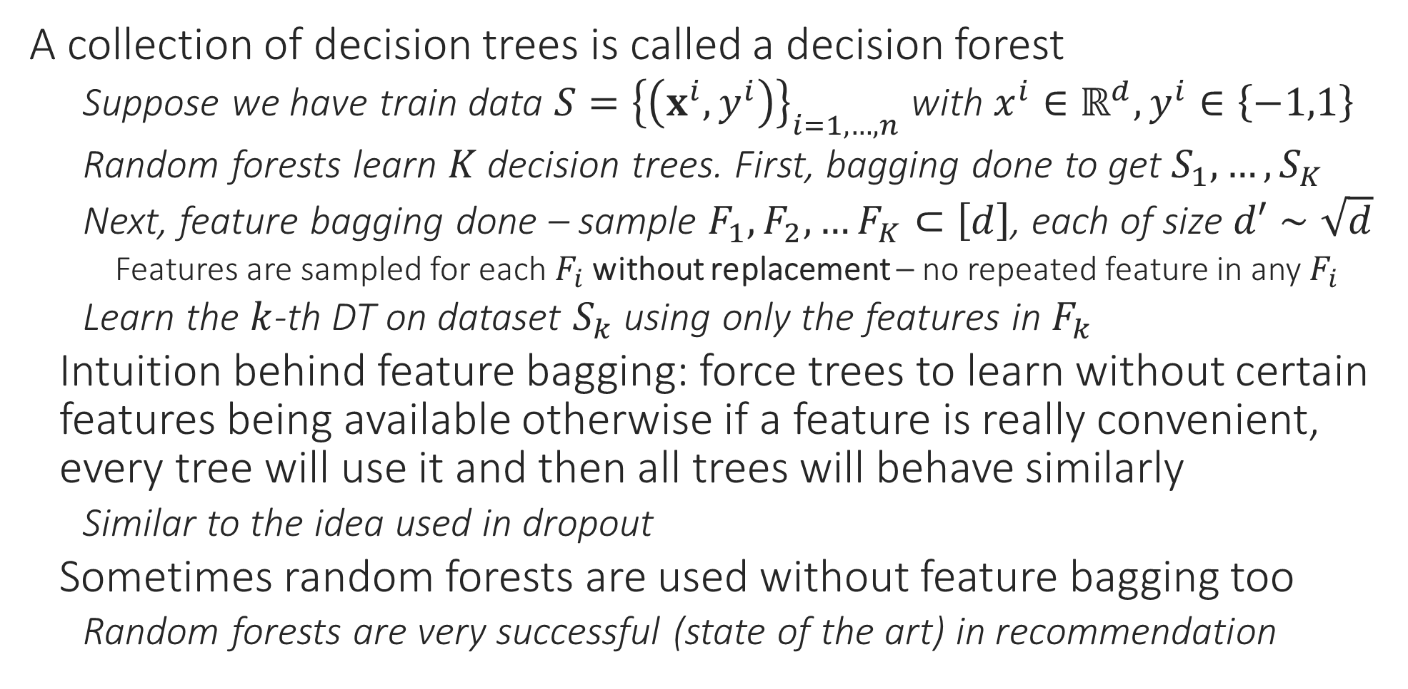
Random Forests
A collection of decision trees is called a decision forest
Suppose we have train data $S={\left\{\left(x^{i},y^{i}\right)\right\}}_{i=1,…,n}$ with $x^{i}∈ℝ^{d},y^{i}∈\left\{−1,1\right\}$
Random forests learn $K$ decision trees. First, bagging done to get $S_{1},…,S_{K}$
Next, feature bagging done – sample $F_{1},F_{2},…F_{K}⊂\left[d\right]$, each of size $d′∼\sqrt{d}$
Features are sampled for each $F_{i}$ without replacement – no repeated feature in any $F_{i}$
Learn the $k$-th DT on dataset $S_{k}$ using only the features in $F_{k}$
Intuition behind feature bagging: force trees to learn without certain features being available otherwise if a feature is really convenient, every tree will use it and then all trees will behave similarly
Similar to the idea used in dropout
Sometimes random forests are used without feature bagging too
Random forests are very successful (state of the art) in recommendation

Slide 6
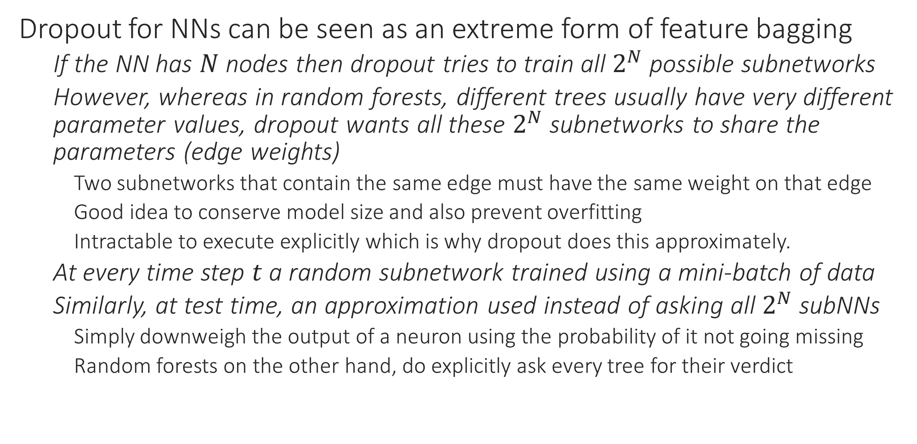
Dropout
Dropout for NNs can be seen as an extreme form of feature bagging
If the NN has $N$ nodes then dropout tries to train all $2^{N}$ possible subnetworks
However, whereas in random forests, different trees usually have very different parameter values, dropout wants all these $2^{N}$ subnetworks to share the parameters (edge weights)
Two subnetworks that contain the same edge must have the same weight on that edge
Good idea to conserve model size and also prevent overfitting
Intractable to execute explicitly which is why dropout does this approximately.
At every time step $t$ a random subnetwork trained using a mini-batch of data
Similarly, at test time, an approximation used instead of asking all $2^{N}$ subNNs
Simply downweigh the output of a neuron using the probability of it not going missing
Random forests on the other hand, do explicitly ask every tree for their verdict

Slide 7


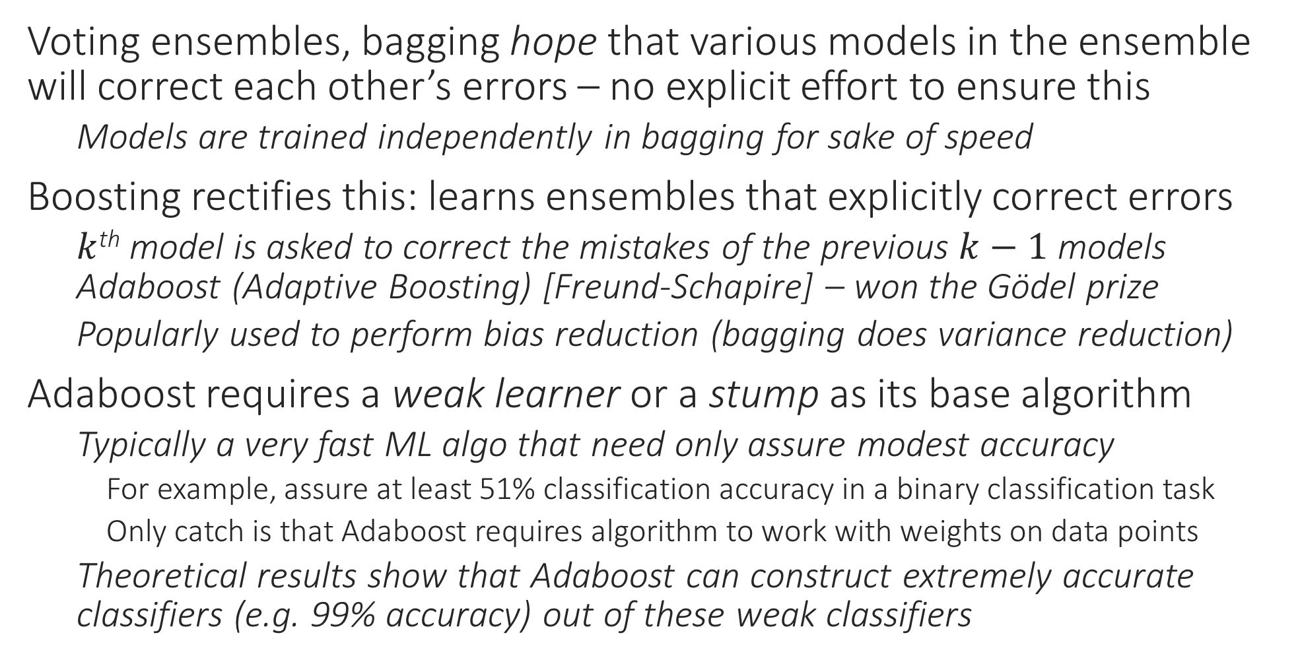
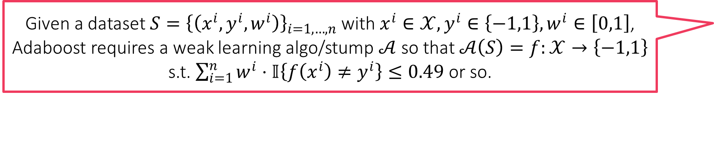
Boosting
Given a dataset $S={\left\{\left(x^{i},y^{i},w^{i}\right)\right\}}_{i=1,…,n}$ with $x^{i}∈𝒳,y^{i}∈\left\{−1,1\right\},w^{i}∈\left[0,1\right]$, Adaboost requires a weak learning algo/stump $𝒜$ so that $𝒜\left(S\right)=f:𝒳→\left\{−1,1\right\}$ s.t. $\sum_{i=1}^{n}{w^{i}⋅𝕀\left\{f\left(x^{i}\right)≠y^{i}\right\}}≤0.49$ or so.
Voting ensembles, bagging hope that various models in the ensemble will correct each other’s errors – no explicit effort to ensure this
Models are trained independently in bagging for sake of speed
Boosting rectifies this: learns ensembles that explicitly correct errors
$k$^{th} model is asked to correct the mistakes of the previous $k−1$ models Adaboost (Adaptive Boosting) [Freund-Schapire] – won the Gödel prize
Popularly used to perform bias reduction (bagging does variance reduction)
Adaboost requires a weak learner or a stump as its base algorithm
Typically a very fast ML algo that need only assure modest accuracy
For example, assure at least 51% classification accuracy in a binary classification task
Only catch is that Adaboost requires algorithm to work with weights on data points
Theoretical results show that Adaboost can construct extremely accurate classifiers (e.g. 99% accuracy) out of these weak classifiers
Sometimes may need to iterate through the above experiences (experience high bias, reduce it only to increase variance, then decrease variance etc) before reaching a sweet spot
Adaboost not used with strong learners e.g. 18 layer DCNN since
Powerful models usually have tiny bias (can memorize data) – the problem with powerful models is variance and not bias
Training usually NP-hard, time consuming for such models

Slide 8
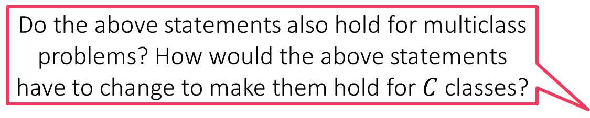

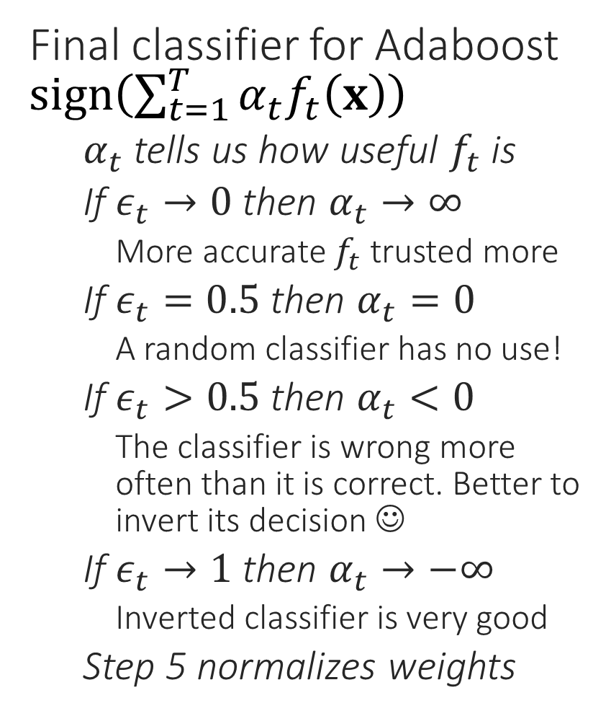


AdaBoost
$$α$$
For binary classification, we can trivially get more than 50% accuracy by just predict the more common of the two labels. A classifier that gets 1% accuracy is actually very good since its inverted form will get 99% accuracy
ADABOOST
Data $S={\left\{\left(x^{i},y^{i}\right)\right\}}_{i=1,…,n}$, stump learner
Assign initial weights $w^{i}=\frac{1}{n}$ for $i∈\left[n\right]$
For $t=1,2,…$
Use $\left(S,\left\{w^{i}\right\}\right)$ to learn $f_{t}:𝒳→\{−1,1\}$
Let $ε_{t}←\sum_{i=1}^{n}{w^{i}⋅}𝕀\left\{f_{t}\left(x^{i}\right)≠y^{i}\right\}$
Let $α_{t}←\frac{1}{2}⋅\log\left(\frac{1−ε_{t}}{ε_{t}}\right)$
For each data point $i=1,2,…,n$
Let $u^{i}←w^{i}⋅\exp\left(−α_{t}y^{i}f_{t}\left(x^{i}\right)\right)$
Let $w^{i}←{u^{i}}/{\sum_{j}{u^{j}}}$
Repeat until convergence
Final classifier for Adaboost $sign\left(\sum_{t=1}^{T}{α_{t}f_{t}\left(x\right)}\right)$
$α_{t}$ tells us how useful $f_{t}$ is
If $ε_{t}→0$ then $α_{t}→∞$
More accurate $f_{t}$ trusted more
If $ε_{t}=0.5$ then $α_{t}=0$
A random classifier has no use!
If $ε_{t}>0.5$ then $α_{t}<0$
The classifier is wrong more often than it is correct. Better to invert its decision ☺
If $ε_{t}→1$ then $α_{t}→−∞$
Inverted classifier is very good
Step 5 normalizes weights
0
1
$$ε$$
Do the above statements also hold for multiclass problems? How would the above statements have to change to make them hold for $C$ classes?

Slide 9
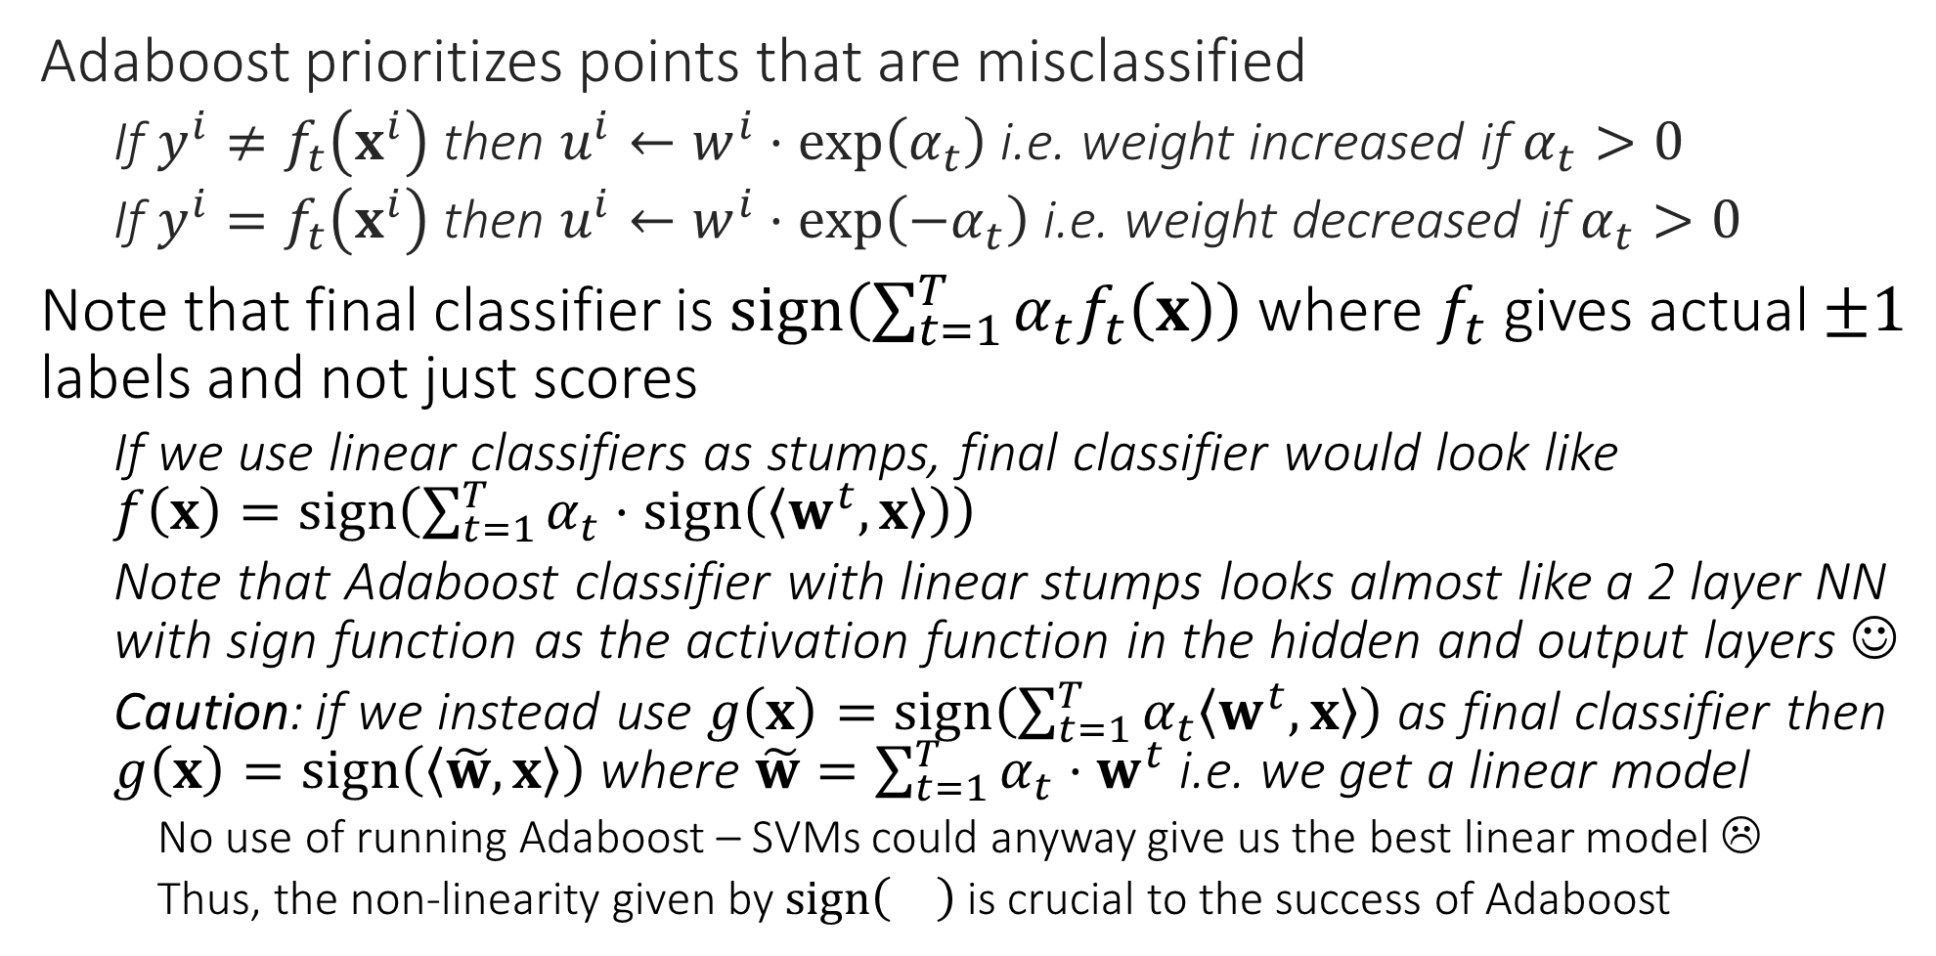
Adaboost
Adaboost prioritizes points that are misclassified
If $y^{i}≠f_{t}\left(x^{i}\right)$ then $u^{i}←w^{i}⋅\exp\left(α_{t}\right)$ i.e. weight increased if $α_{t}>0$
If $y^{i}=f_{t}\left(x^{i}\right)$ then $u^{i}←w^{i}⋅\exp\left(−α_{t}\right)$ i.e. weight decreased if $α_{t}>0$
Note that final classifier is $sign\left(\sum_{t=1}^{T}{α_{t}f_{t}\left(x\right)}\right)$ where $f_{t}$ gives actual $±1$ labels and not just scores
If we use linear classifiers as stumps, final classifier would look like $f\left(x\right)=sign\left(\sum_{t=1}^{T}{α_{t}⋅sign\left(\left\langle w^{t},x\right\rangle \right)}\right)$
Note that Adaboost classifier with linear stumps looks almost like a 2 layer NN with sign function as the activation function in the hidden and output layers ☺
Caution: if we instead use $g\left(x\right)=sign\left(\sum_{t=1}^{T}{α_{t}\left\langle w^{t},x\right\rangle }\right)$ as final classifier then $g\left(x\right)=sign\left(\left\langle \tilde{w},x\right\rangle \right)$ where $\tilde{w}=\sum_{t=1}^{T}{α_{t}⋅w^{t}}$ i.e. we get a linear model
No use of running Adaboost – SVMs could anyway give us the best linear model ☹
Thus, the non-linearity given by $sign\left(\right)$ is crucial to the success of Adaboost

Slide 10
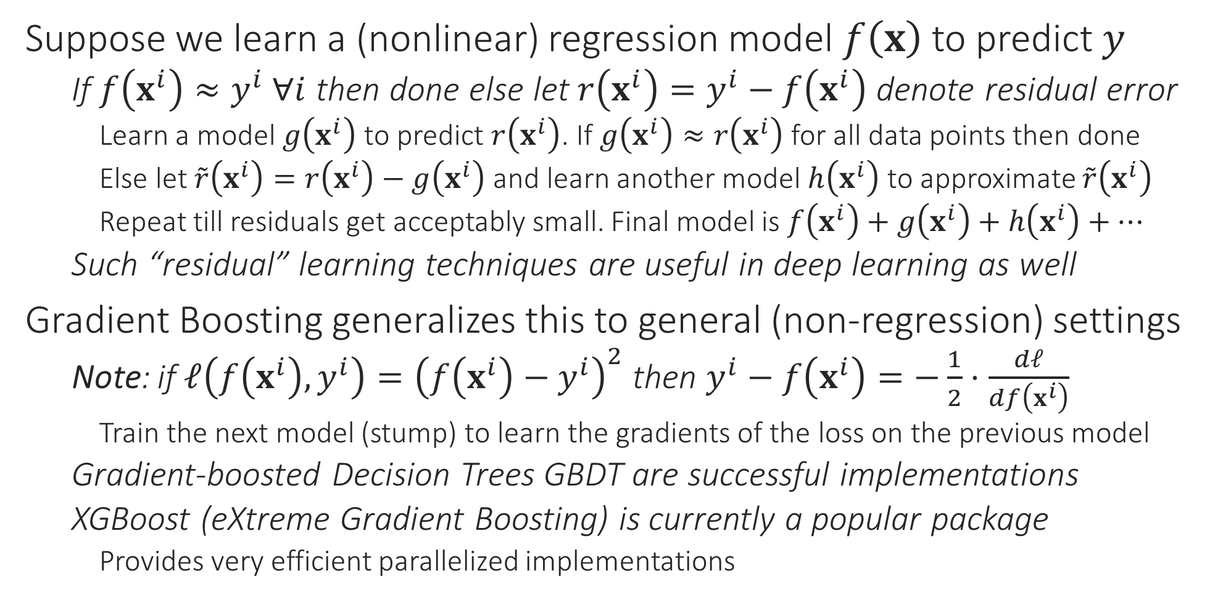
Gradient Boosting
Suppose we learn a (nonlinear) regression model $f\left(x\right)$ to predict $y$
If $f\left(x^{i}\right)≈y^{i}$ $∀i$ then done else let $r\left(x^{i}\right)=y^{i}−f\left(x^{i}\right)$ denote residual error
Learn a model $g\left(x^{i}\right)$ to predict $r\left(x^{i}\right)$. If $g\left(x^{i}\right)≈r\left(x^{i}\right)$ for all data points then done
Else let $\tilde{r}\left(x^{i}\right)=r\left(x^{i}\right)−g\left(x^{i}\right)$ and learn another model $h\left(x^{i}\right)$ to approximate $\tilde{r}\left(x^{i}\right)$
Repeat till residuals get acceptably small. Final model is $f\left(x^{i}\right)+g\left(x^{i}\right)+h\left(x^{i}\right)+…$
Such “residual” learning techniques are useful in deep learning as well
Gradient Boosting generalizes this to general (non-regression) settings
Note: if $ℓ\left(f\left(x^{i}\right),y^{i}\right)={\left(f\left(x^{i}\right)−y^{i}\right)}^{2}$ then $y^{i}−f\left(x^{i}\right)=−\frac{1}{2}⋅\frac{dℓ}{df\left(x^{i}\right)}$
Train the next model (stump) to learn the gradients of the loss on the previous model
Gradient-boosted Decision Trees GBDT are successful implementations
XGBoost (eXtreme Gradient Boosting) is currently a popular package
Provides very efficient parallelized implementations

Slide 11


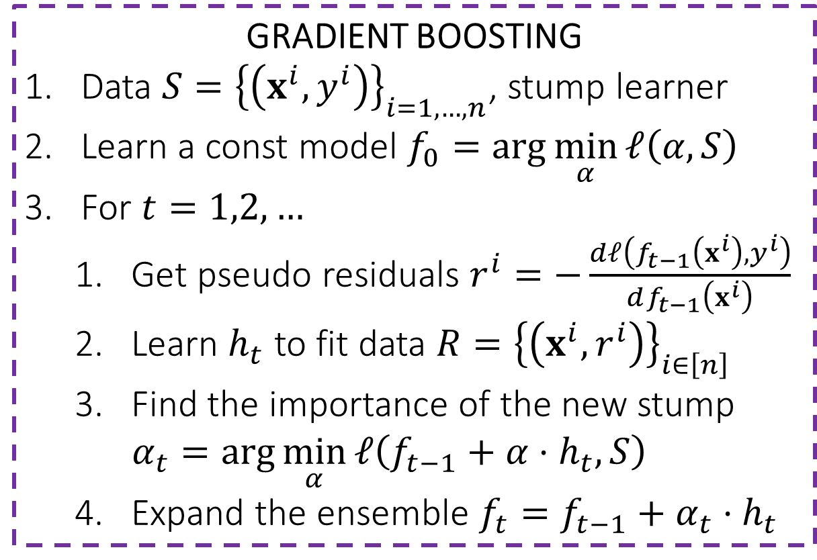
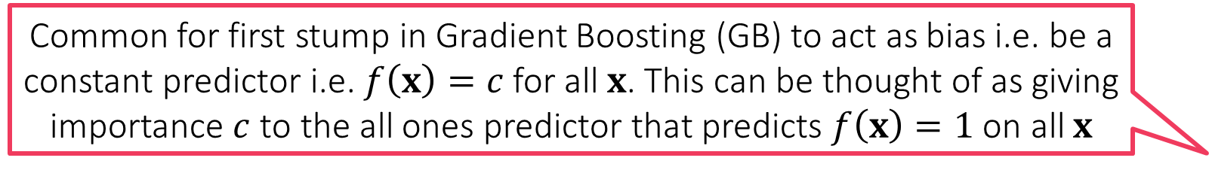
Gradient Boosting
Common for first stump in Gradient Boosting (GB) to act as bias i.e. be a constant predictor i.e. $f\left(x\right)=c$ for all $x$. This can be thought of as giving importance $c$ to the all ones predictor that predicts $f\left(x\right)=1$ on all $x$
GB secretly tries to do GD ☺
If possible, it would’ve done $f_{t}=f_{t−1}−η_{t}⋅{\left.\frac{dℓ}{df}\right]}_{f_{t−1}}$
Since taking gradients w.r.t functions is intractable, GB settles for an approximation
Approx. ${−\left.dℓ/df\right]}_{f_{t−1}}$using $h_{t}$
Search for best step length $η_{t}$
Step 3 does this implicitly
The final ensemble is actually the result of approximate GD in the function space!
GRADIENT BOOSTING
Data $S={\left\{\left(x^{i},y^{i}\right)\right\}}_{i=1,…,n}$, stump learner
Learn a const model $f_{0}=\arg{\min_{α}{ℓ\left(α,S\right)}}$
For $t=1,2,…$
Get pseudo residuals $r^{i}=−\frac{dℓ\left(f_{t−1}\left(x^{i}\right),y^{i}\right)}{df_{t−1}\left(x^{i}\right)}$
Learn $h_{t}$ to fit data $R={\left\{\left(x^{i},r^{i}\right)\right\}}_{i∈\left[n\right]}$
Find the importance of the new stump $α_{t}=\arg{\min_{α}{ℓ\left(f_{t−1}+α⋅h_{t},S\right)}}$
Expand the ensemble $f_{t}=f_{t−1}+α_{t}⋅h_{t}$
Gradient of the loss function would be large on data points which are experiencing large loss so GB would pay more attention to them while learning the next stump – similar intuition as Adaboost had

