Slide 1
Meta Learning III
CS771: Introduction to Machine Learning
Purushottam Kar

Slide 2
Precap
Learning with Imbalanced Data
Examples of imbalanced data in ML problems
Techniques to handle imbalanced data

Slide 3
Imbalance is common – Binary Classfn
Valid credit transactions
Don’t have disease
Molecule inactive
Mail not spam
Fraudulent transactions
Molecule medicinal
Spam
Mail
Have disease
In anomaly detection, medical diagnosis, drug discovery, spam filtering and many other domains, data is heavily biased
Lots of data may be available in total but very less (0.01% or lesser) may belong to the “rare” class e.g. 100000 red vs 10 green
Trivial for a classifier to get 99.99% accuracy (simply predict everything red)
May be disastrous, e.g. if green class denotes a rare disease or fraudulent transaction
Many ML algorithms that are designed to greedily chase classification accuracy may completely ignore green training data points since it is easy to do well on red data points
The whole purpose of learning is lost if the above happens ☹

Slide 4
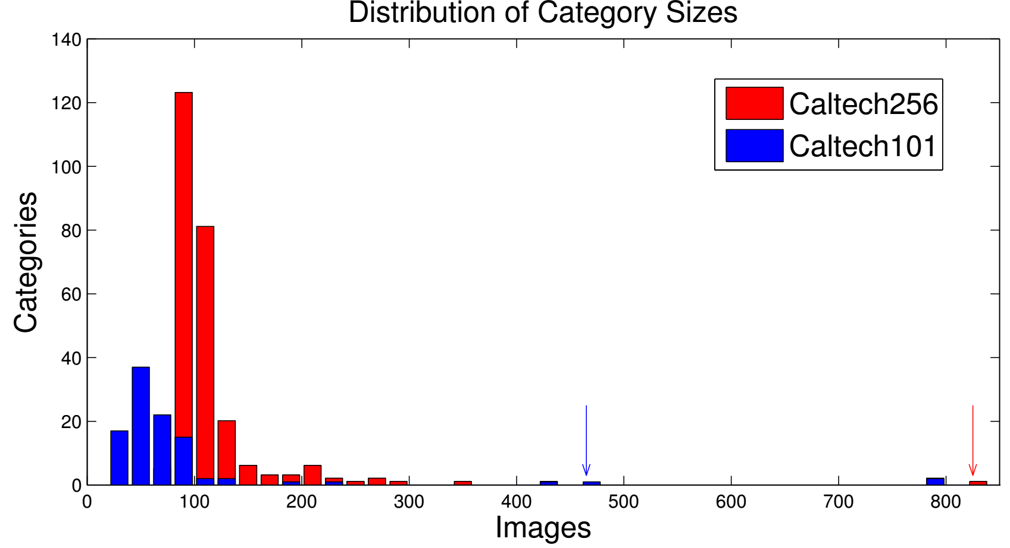
Imbalance is common – Multi Classfn
Caltech-256 is an object detection dataset with 256 classes
Simple averaging argument shows that 50% of classes must each have less than 0.8% of the data
Lots of data for few classes but most classes impoverished
In fact, rarest class has only 80 images, most popular 800 images
Makes learning challenging
Easier to do well on popular classes with lots of data points e.g. cats
Difficult to handle rare classes

Slide 5
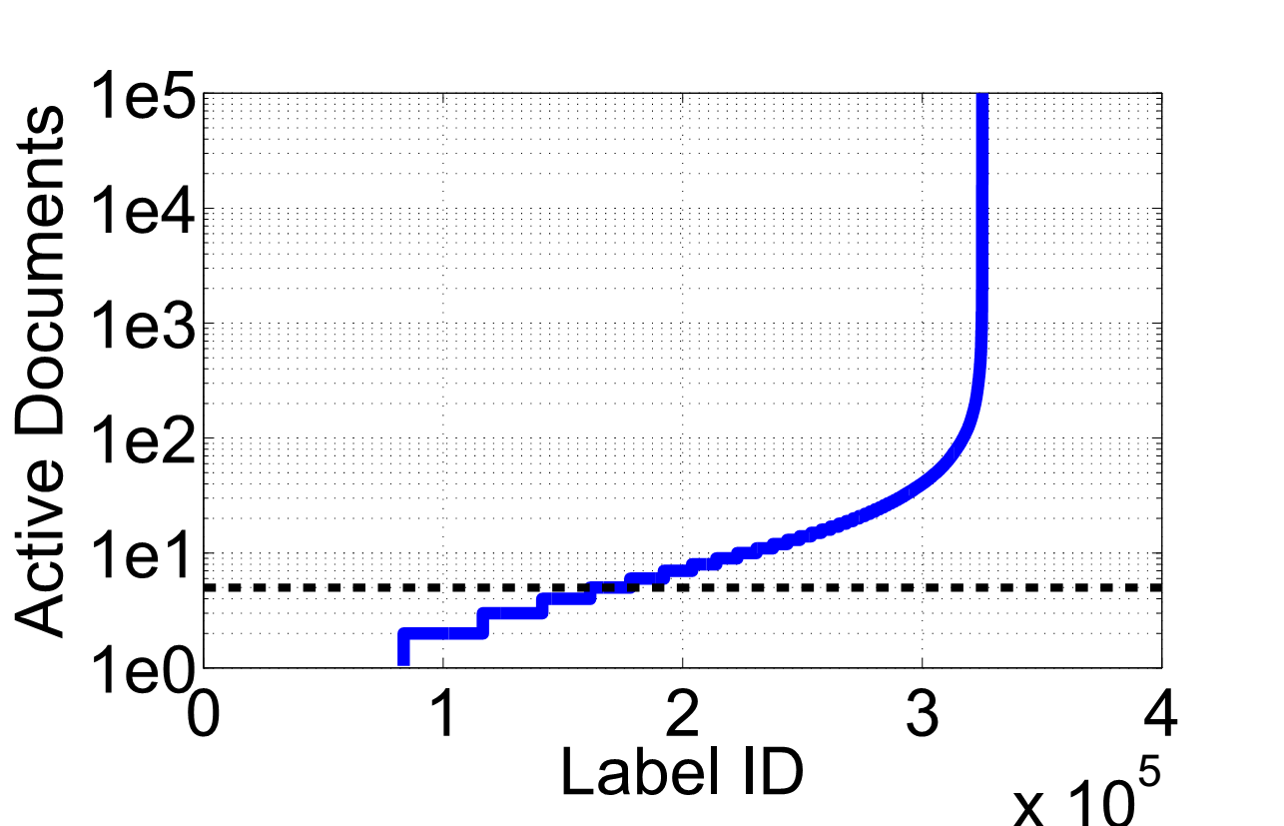
Imbalance is common – Multilabel Classfn
Ironically, whereas we often proudly refer to these as “big-data” problems, they can often be seen as collections of a huge number of “tiny-data” problems (one tiny data problem per rare label) and a few “reasonable-data” problems
0
0
0
0
0
0
0
0
0
1
0
0
0
1
0
1
0
0
0
0
1
0
0
0
0
0
0
0
0
0
0
0
0
0
0
1
0
0
0
0
0
0
1
0
0
0
0
0
0
0
0
0
0
0
0
0
1
0
0
0
0
0
0
1
0
0
0
0
0
0
0
0
0
0
0
0
0
0
0
1
0
0
0
0
0
0
0
1
0
0
0
0
0
0
0
0
Wikipedia LSHTC is a multilabel dataset with 300000 labels
As many as 150000 labels occur only in less than 5 documents
Most popular label (“living persons”) occurs in 100000 documents
Similar situation in recommendation – most people like iPhone but most items liked by a very select group of individuals
Lots of train data to find out who likes iPhone, not enough for most other items

Slide 6
Solutions to Label Imbalance
Get more data for the rare classes so that they don’t remain rare ☺
Generate artificial data for rare classes to make them more prominent
Change training algorithms that artificially make rare classes prominent
Includes using loss functions that are aware of class imbalance
Use different learning strategies for rare classes and popular classes
A combination of all of the above may be required in practice
Extreme classification algos (assignment 2) do indeed practice some of these

Slide 7
Dataset Modification Techniques
A bit pointless to handle label rarity problem by making all labels rare. Would be like a hypothetical administration that aims at equidistribution of wealth but ends up with equidistribution of poverty instead
Undersample the popular class so that it does not dominate
Actually throwing out data not a very good idea since it throws away data
In practice we may give smaller weights to popular class points
Oversample the rare class by repeating each rare point (say 100 times)
Not done explicitly since that would needlessly increase train set size+time
Implicitly done by giving higher weights to rare class points
A technique SMOTE (Synthetic Minority Oversampling TEchnique) however actually samples new data points around rare class points

Slide 8
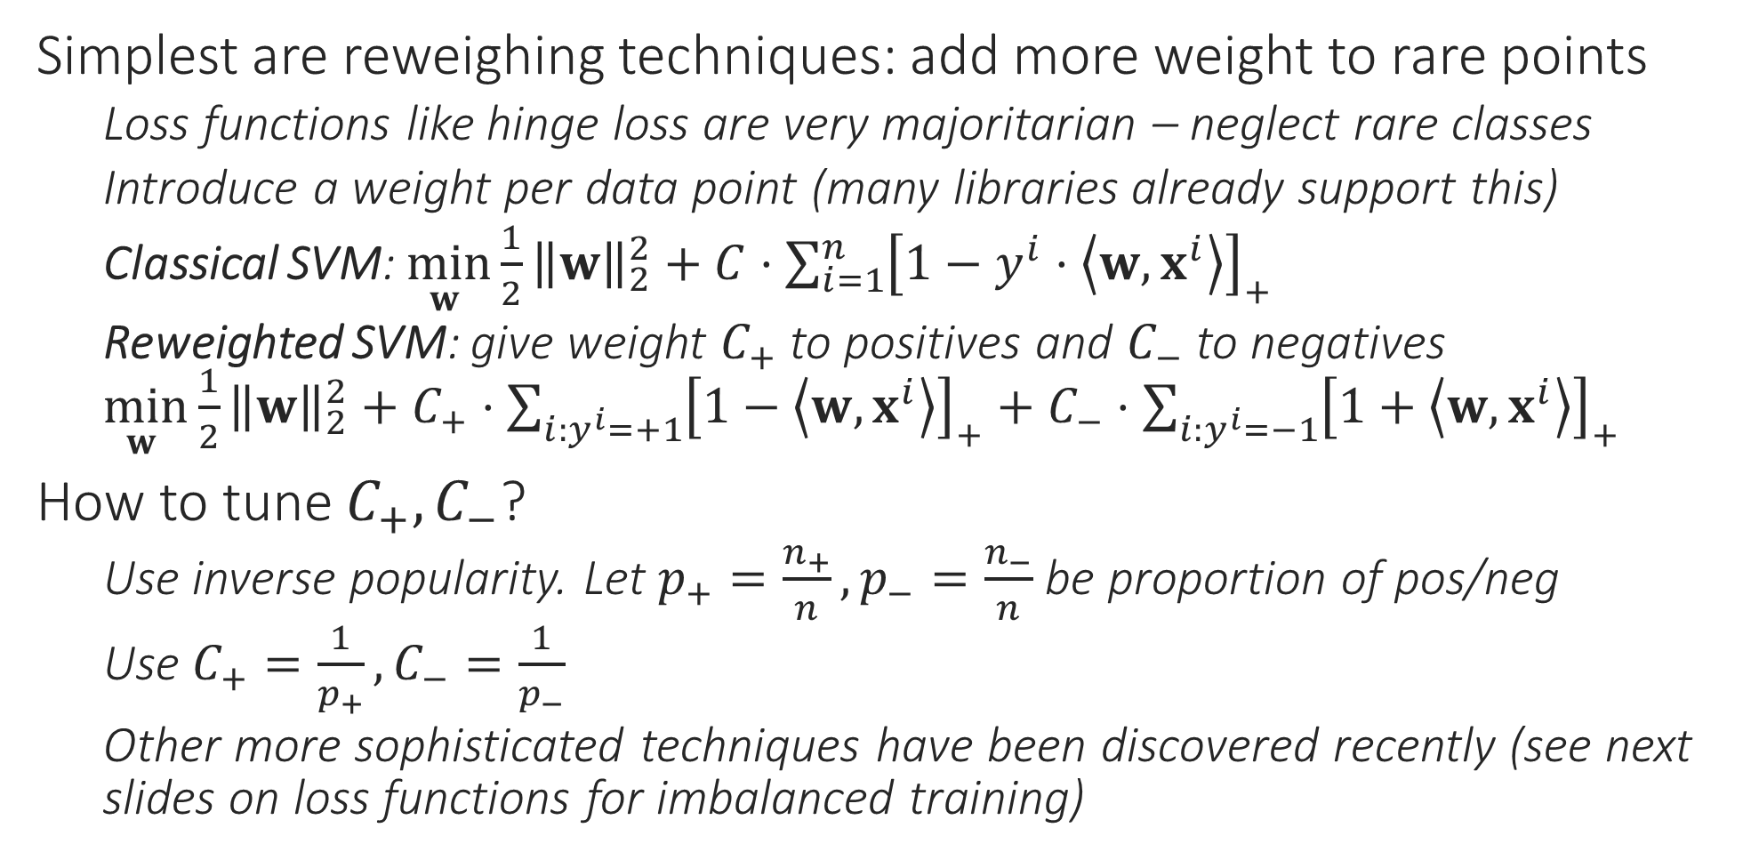
Imbalance-aware Training Techniques
Simplest are reweighing techniques: add more weight to rare points
Loss functions like hinge loss are very majoritarian – neglect rare classes
Introduce a weight per data point (many libraries already support this)
Classical SVM: $\min_{w }{\frac{1}{2}{\left\|w\right\|}_{2}^{2}}+C⋅\sum_{i=1}^{n}{{\left[1−y^{i}⋅\left\langle w,x^{i}\right\rangle \right]}_{+}}$
Reweighted SVM: give weight $C_{+}$ to positives and $C_{−}$ to negatives $\min_{w }{\frac{1}{2}{\left\|w\right\|}_{2}^{2}}+C_{+}⋅\sum_{i:y^{i}=+1}{{\left[1−\left\langle w,x^{i}\right\rangle \right]}_{+}}+C_{−}⋅\sum_{i:y^{i}=−1}{{\left[1+\left\langle w,x^{i}\right\rangle \right]}_{+}}$
How to tune $C_{+},C_{−}$?
Use inverse popularity. Let $p_{+}=\frac{n_{+}}{n},p_{−}=\frac{n_{−}}{n}$ be proportion of pos/neg
Use $C_{+}=\frac{1}{p_{+}},C_{−}=\frac{1}{p_{−}}$
Other more sophisticated techniques have been discovered recently (see next slides on loss functions for imbalanced training)

Slide 9
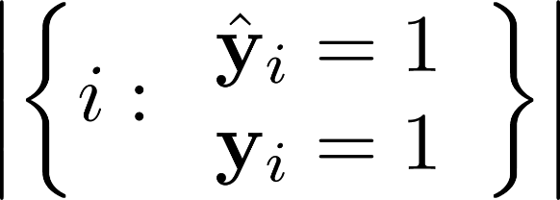
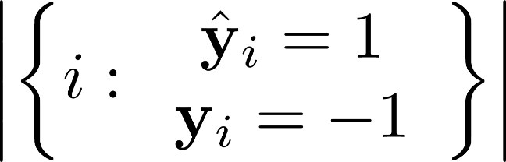
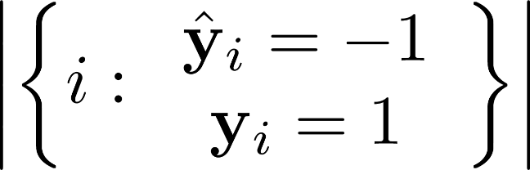
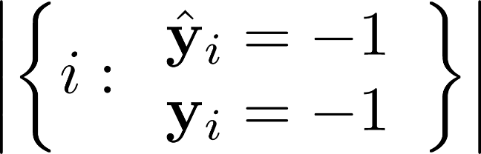


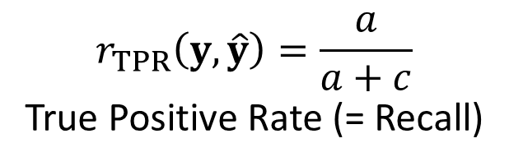
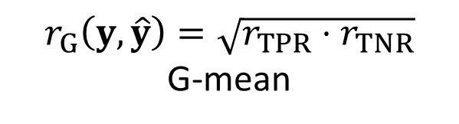
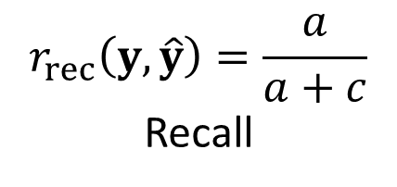
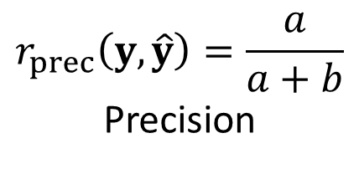
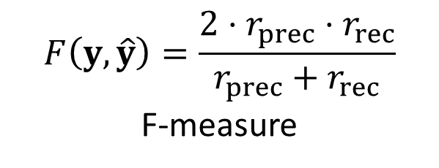
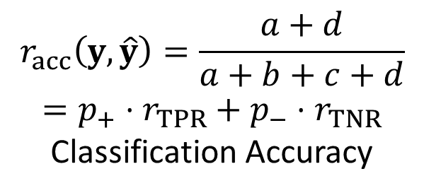
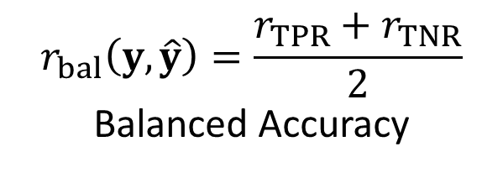
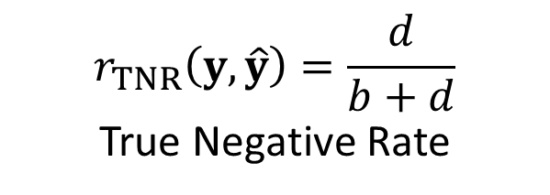
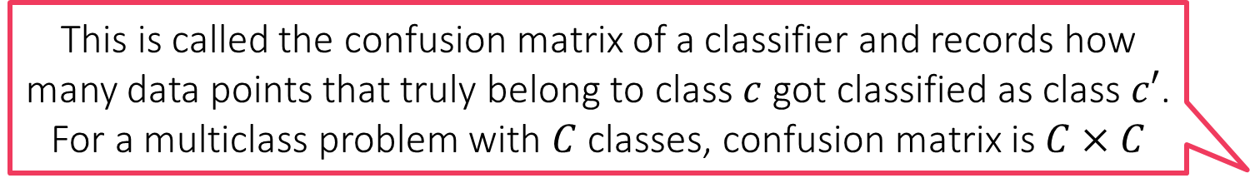
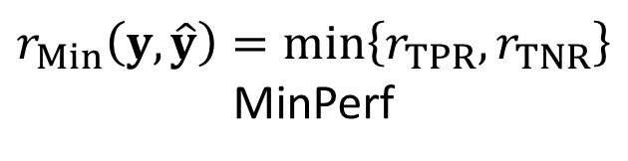
Imbalance-aware Training Techniques
This is called the confusion matrix of a classifier and records how many data points that truly belong to class $c$ got classified as class $c′$. For a multiclass problem with $C$ classes, confusion matrix is $C×C$
Use loss fns that themselves penalize models that neglect rare classes
a
b
$$r_{acc}\left(y,\hat{y}\right)=\frac{a+d}{a+b+c+d}$$
$$=p_{+}⋅r_{TPR}+p_{−}⋅r_{TNR}$$
Classification Accuracy
c
d
$$r_{bal}\left(y,\hat{y}\right)=\frac{r_{TPR}+r_{TNR}}{2}$$
Balanced Accuracy
$$r_{TPR}\left(y,\hat{y}\right)=\frac{a}{a+c}$$
True Positive Rate (= Recall)
$$r_{TNR}\left(y,\hat{y}\right)=\frac{d}{b+d}$$
True Negative Rate
$$r_{prec}\left(y,\hat{y}\right)=\frac{a}{a+b}$$
Precision
$$F\left(y,\hat{y}\right)=\frac{2⋅r_{prec}⋅r_{rec}}{r_{prec}+r_{rec}}$$
F-measure
$$r_{G}\left(y,\hat{y}\right)=\sqrt{r_{TPR}⋅r_{TNR}}$$
G-mean
$$r_{rec}\left(y,\hat{y}\right)=\frac{a}{a+c}$$
Recall
$$r_{Min}\left(y,\hat{y}\right)=\min\left\{r_{TPR},r_{TNR}\right\}$$
MinPerf
9

Slide 10
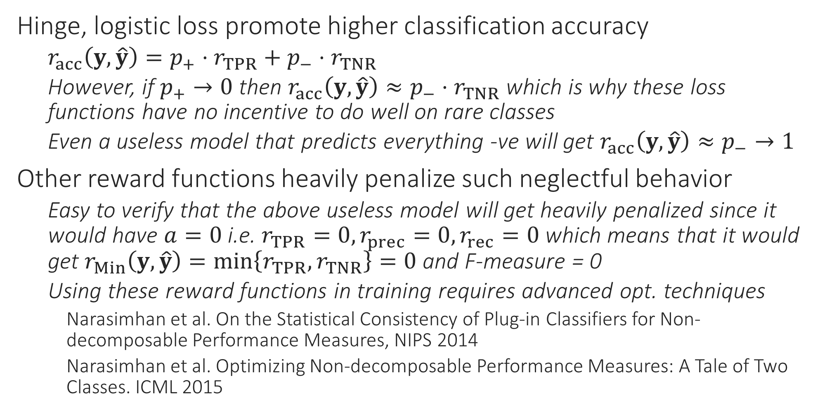
Imbalance-aware Training Techniques
Hinge, logistic loss promote higher classification accuracy
$r_{acc}\left(y,\hat{y}\right)=p_{+}⋅r_{TPR}+p_{−}⋅r_{TNR}$
However, if $p_{+}→0$ then $r_{acc}\left(y,\hat{y}\right)≈p_{−}⋅r_{TNR}$ which is why these loss functions have no incentive to do well on rare classes
Even a useless model that predicts everything -ve will get $r_{acc}\left(y,\hat{y}\right)≈p_{−}→1$
Other reward functions heavily penalize such neglectful behavior
Easy to verify that the above useless model will get heavily penalized since it would have $a=0$ i.e. $r_{TPR}=0,r_{prec}=0,r_{rec}=0$ which means that it would get $r_{Min}\left(y,\hat{y}\right)=\min\left\{r_{TPR},r_{TNR}\right\}=0$ and F-measure = 0
Using these reward functions in training requires advanced opt. techniques
Narasimhan et al. On the Statistical Consistency of Plug-in Classifiers for Non-decomposable Performance Measures, NIPS 2014
Narasimhan et al. Optimizing Non-decomposable Performance Measures: A Tale of Two Classes. ICML 2015

Slide 11
Imbalance-aware Training Techniques
1
Another technique is to treat classification problems as ranking problems instead
For binary problems, this is done by asking the model to assign scores to data points and try to give high scores to +ve points and low scores to -ve points
Next, data points are ranked according to their scores
Note: here we do not threshold scores at 0 to arrive labels
This ranking is used to assign loss/reward to the model
Model is rewarded if lots of positives are in top positions
Model is penalized if negatives pollute the ranking
Such loss fns are key in multiclass/label learning too
For multiclass/label, instead of ranking data points, we ask model to rank classes from most likely to least likely for each data point e.g. rank items for each user
7
3
5
8
2
4
6

Slide 12
Imbalance-aware Training Techniques
Advanced techniques exist to even optimize these on training data.
Zhao et al, Online AUC Maximization, ICML 2011
K. et al, Surrogate Functions for Maximizing Precision at the Top, ICML 2015
1
Bipartite Ranking Loss (AUC loss)
Counts # times a -ve point was ranked above a +ve point divided by product of # +ves and # -ves
In this cartoon this mistake was committed 3 times and #+ves = 3, #-ves = 5 so AUC loss is 3/(3*5) = 0.2
Precision@k
Counts # +ves present in top k positions divided by k
Recall@k
Counts # +ves present in top k positives divided by #+ves
MAP (Mean average Precision)
Finds the average reciprocal rank at which +ves were predicted. In this cartoon this is (1/1+1/3+1/5) = 1.533
7
3
5
8
2
4
6

Slide 13
Hybrid Learning Strategies
It is folklore in ML that discriminative models do better when lots of data is available but generative models do better with less data
Ng and Jordan, On Discriminative vs. Generative classifiers, NIPS 2001
For popular classes with lots of data, safe to use discriminative techniques like kernels, trees, deep nets along with one-vs-all etc
For rare classes with less data, may try generative techniques like naive Bayes, GMM or even LwP
Hybrid strategies are often used in recommendation systems
Rocchio classifiers, reranking algorithms etc
Use a standard discriminative algorithm e.g. trees etc to rank all labels but then use LwP-style techniques to boost the ranks of rare labels so that they do not get lost
Jain et al. Extreme Multi-label Loss Functions for Recommendation, KDD 2016

