Slide 1
Reinforcement Learning
CS771: Introduction to Machine Learning
Purushottam Kar

Slide 2
Announcements
Doubt clearing session: November 17 (Sunday), 6:00PM KD101
Practice end-sem paper now available on website
End-sem Exam: November 18 (Monday), 4-7PM, L19, L20
Syllabus is till whatever we cover today i.e. Nov 15 (Fri)
Bring your institute ID card with you – will lose time if you forget
Bring a pencil, pen, eraser, sharpener with you – we wont provide!
Answers to be written on question paper itself. If you write with pen and make a mistake, no extra paper. Final answer must be in pen
Auditors cannot appear for the mid-sem exam
Seating for end-sem exam: assigned seating (announced on Piazza)
Everyone has been assigned a lecture hall, and a seat number in that hall
All must go to their assigned hall – no extra space if you go to wrong hall

Slide 3
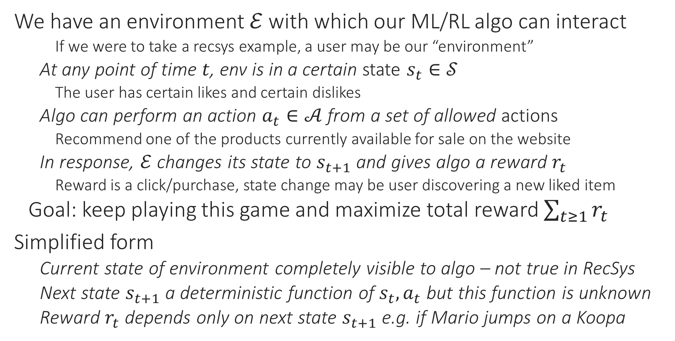
Reinforcement Learning
We have an environment $ℰ$ with which our ML/RL algo can interact
If we were to take a recsys example, a user may be our “environment”
At any point of time $t$, env is in a certain state $s_{t}∈𝒮$
The user has certain likes and certain dislikes
Algo can perform an action $a_{t}∈𝒜$ from a set of allowed actions
Recommend one of the products currently available for sale on the website
In response, $ℰ$ changes its state to $s_{t+1}$ and gives algo a reward $r_{t}$
Reward is a click/purchase, state change may be user discovering a new liked item
Goal: keep playing this game and maximize total reward $\sum_{t≥1}{r_{t}}$
Simplified form
Current state of environment completely visible to algo – not true in RecSys
Next state $s_{t+1}$ a deterministic function of $s_{t},a_{t}$ but this function is unknown
Reward $r_{t}$ depends only on next state $s_{t+1}$ e.g. if Mario jumps on a Koopa

Slide 4
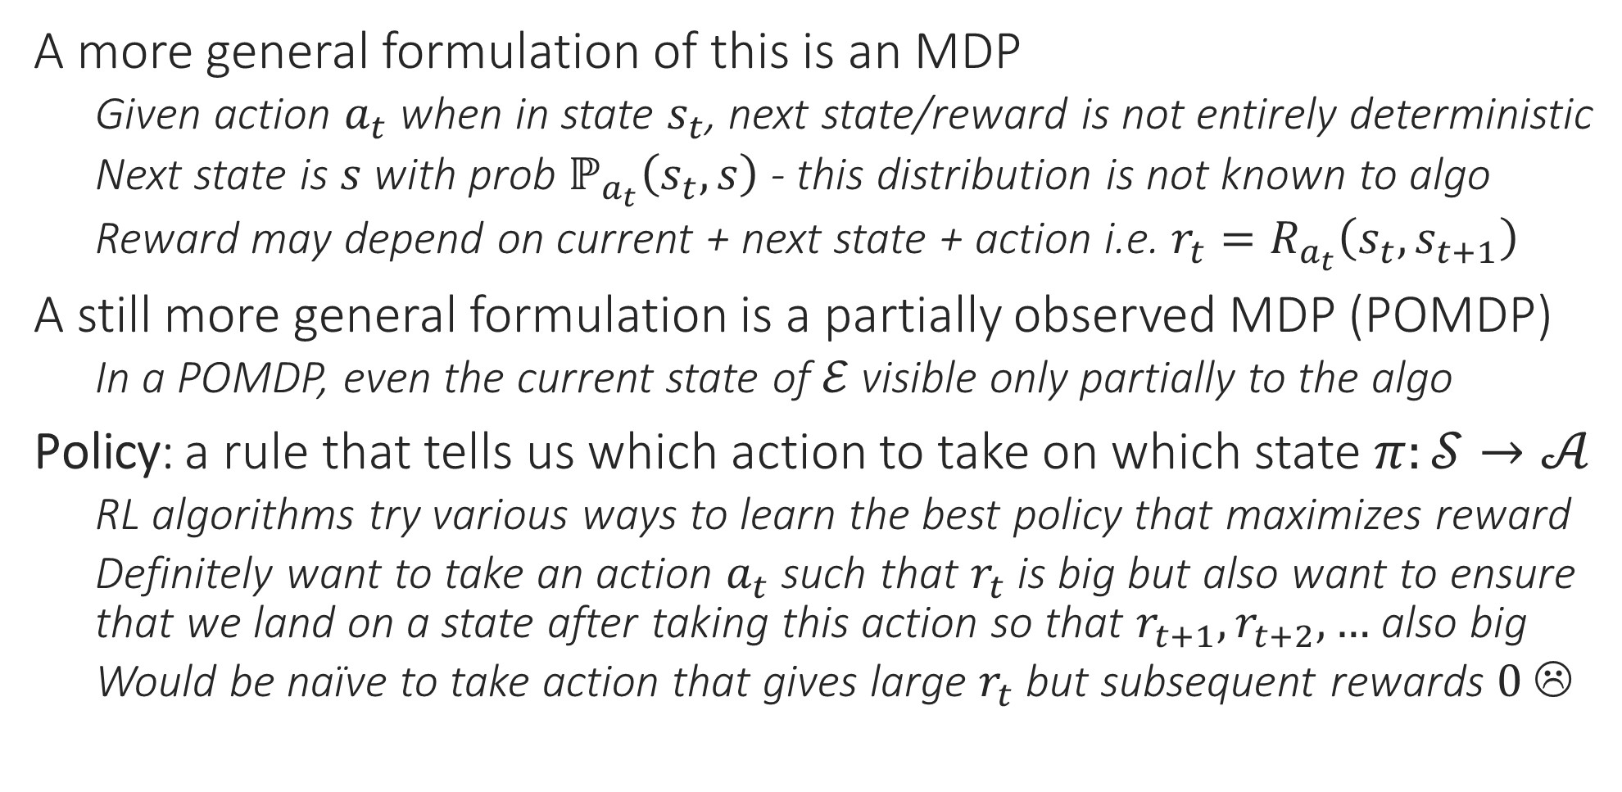
Markovian Decision Process (MDP)
A more general formulation of this is an MDP
Given action $a_{t}$ when in state $s_{t}$, next state/reward is not entirely deterministic
Next state is $s$ with prob $ℙ_{a_{t}}\left(s_{t}, s\right)$ - this distribution is not known to algo
Reward may depend on current + next state + action i.e. $r_{t}=R_{a_{t}}\left(s_{t},s_{t+1}\right)$
A still more general formulation is a partially observed MDP (POMDP)
In a POMDP, even the current state of $ℰ$ visible only partially to the algo
Policy: a rule that tells us which action to take on which state $π:𝒮→𝒜$
RL algorithms try various ways to learn the best policy that maximizes reward
Definitely want to take an action $a_{t}$ such that $r_{t}$ is big but also want to ensure that we land on a state after taking this action so that $r_{t+1},r_{t+2},…$ also big
Would be naïve to take action that gives large $r_{t}$ but subsequent rewards $0$ ☹

Slide 5


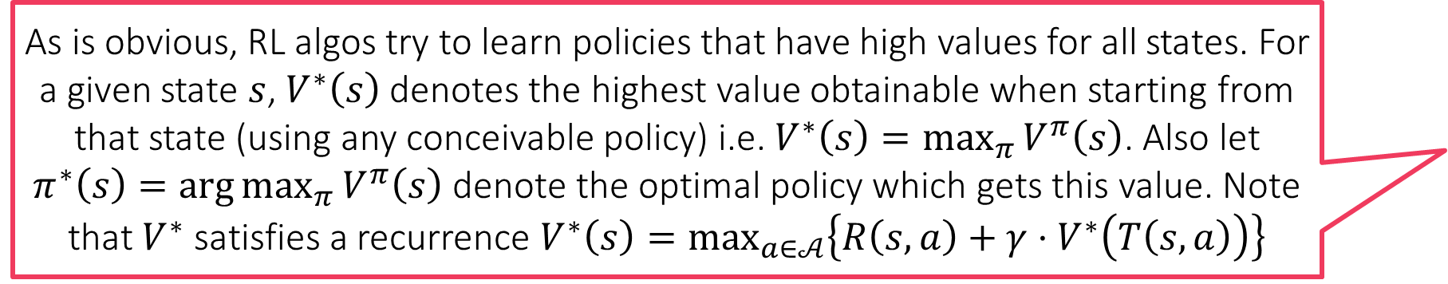
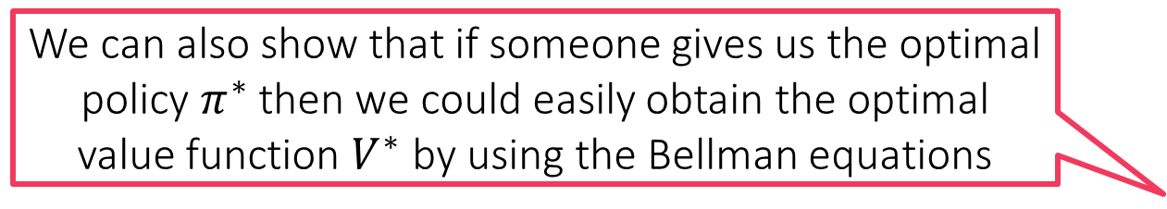

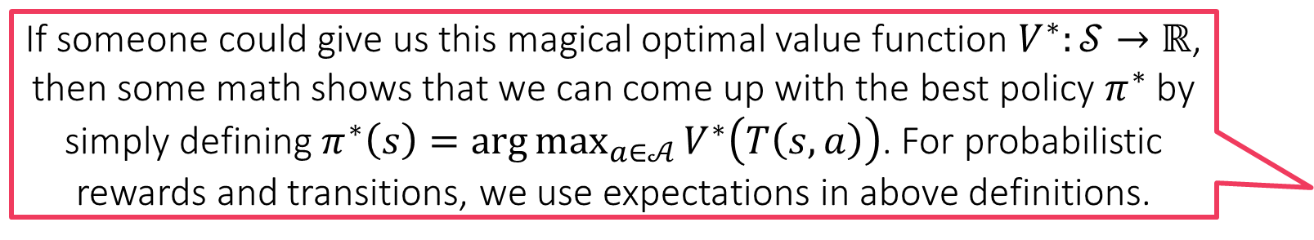
Value Function
As is obvious, RL algos try to learn policies that have high values for all states. For a given state $s$, $V^{∗}\left(s\right)$ denotes the highest value obtainable when starting from that state (using any conceivable policy) i.e. $V^{∗}\left(s\right)=\max_{π}{V^{π}\left(s\right)}$. Also let $π^{∗}\left(s\right)=\arg{\max_{π}{V^{π}\left(s\right)}}$ denote the optimal policy which gets this value. Note that $V^{∗}$ satisfies a recurrence $V^{∗}\left(s\right)=\max_{a∈𝒜}\left\{R\left(s,a\right)+γ⋅V^{∗}\left(T\left(s,a\right)\right)\right\}$
Given a policy $π:𝒮→𝒜$, we assign a value to this policy
Tells us how much reward we get if we always play actions dictated by policy $π$
Assume for simplicity that state transitions and rewards are deterministic
Notation: action $a$ in state $s$ takes us to state $T\left(s,a\right)$ and gives reward $R\left(s,a\right)$
Notation: let $s_{0}≔s$ be first state, $s_{1}=T\left(s_{0},π\left(s_{0}\right)\right)$ be state after playing according to $π$ for one step, $s_{2}=T\left(s_{1},π\left(s_{0}\right)\right)$ be state after playing using $π$ for two steps and so on …
Possible defn of value $R\left(s_{0},π\left(s_{0}\right)\right)+R\left(s_{1},π\left(s_{1}\right)\right)+R\left(s_{2},π\left(s_{2}\right)\right)+…$
Usually we care less about future rewards so discount them – let $γ∈\left(0,1\right)$
$V^{π}\left(s_{0}\right)≜R\left(s_{0},π\left(s_{0}\right)\right)+γ⋅R\left(s_{1},π\left(s_{1}\right)\right)+γ^{2}⋅R\left(s_{2},π\left(s_{2}\right)\right)+…$
Note that we have $V^{π}\left(s_{0}\right)=R\left(s_{0},π\left(s_{0}\right)\right)+γ⋅V^{π}\left(s_{1}\right)$
Called the Bellman Equation. For settings where state transitions and rewards are probabilistic, we replace the above using expectations
If someone could give us this magical optimal value function $V^{∗}:𝒮→ℝ$, then some math shows that we can come up with the best policy $π^{∗}$ by simply defining $π^{∗}\left(s\right)=\arg{\max_{a∈𝒜}{V^{∗}\left(T\left(s,a\right)\right)}}$. For probabilistic rewards and transitions, we use expectations in above definitions.
We can also show that if someone gives us the optimal policy $π^{∗}$ then we could easily obtain the optimal value function $V^{∗}$ by using the Bellman equations

Slide 6
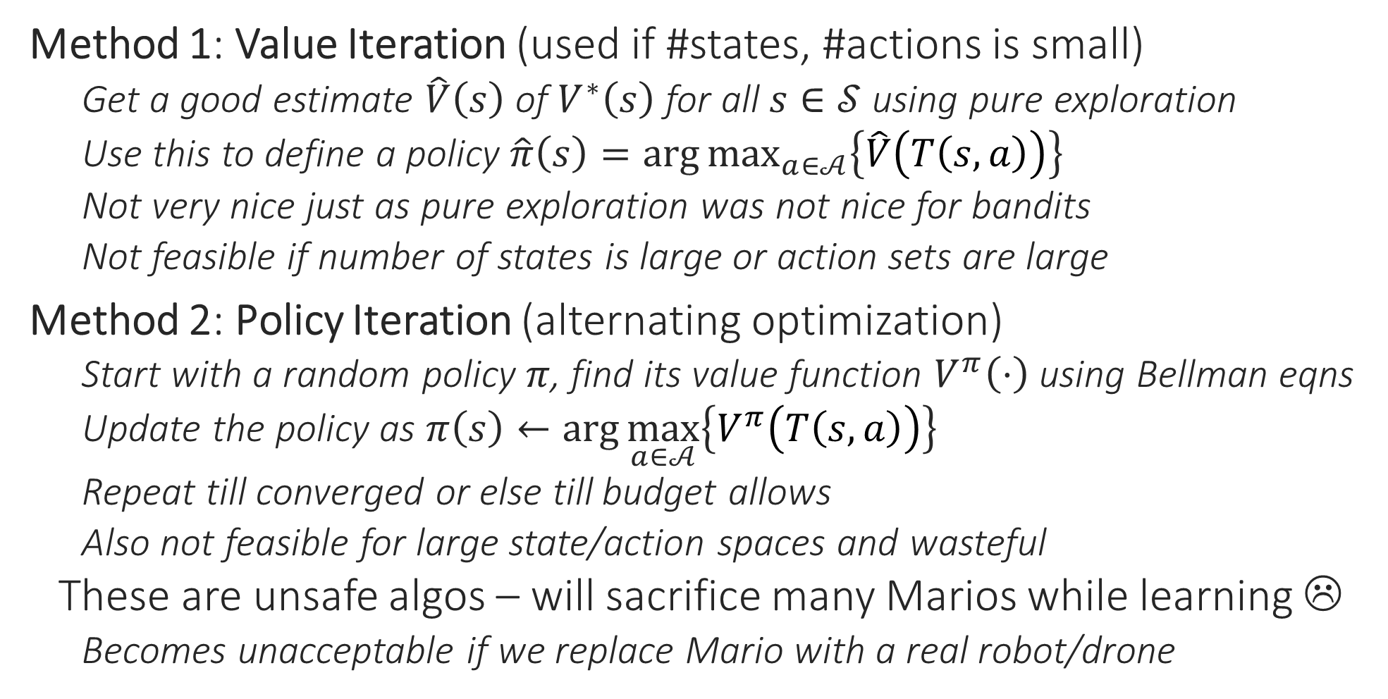
Value and Policy Iteration Algos
Method 1: Value Iteration (used if #states, #actions is small)
Get a good estimate $\hat{V}\left(s\right)$ of $V^{∗}\left(s\right)$ for all $s∈𝒮$ using pure exploration
Use this to define a policy $\hat{π}\left(s\right)=\arg{\max_{a∈𝒜}\left\{\hat{V}\left(T\left(s,a\right)\right)\right\}}$
Not very nice just as pure exploration was not nice for bandits
Not feasible if number of states is large or action sets are large
Method 2: Policy Iteration (alternating optimization)
Start with a random policy $π$, find its value function $V^{π}\left(⋅\right)$ using Bellman eqns
Update the policy as $π\left(s\right)←\arg{\max_{a∈𝒜}\left\{V^{π}\left(T\left(s,a\right)\right)\right\}}$
Repeat till converged or else till budget allows
Also not feasible for large state/action spaces and wasteful
These are unsafe algos – will sacrifice many Marios while learning ☹
Becomes unacceptable if we replace Mario with a real robot/drone

Slide 7
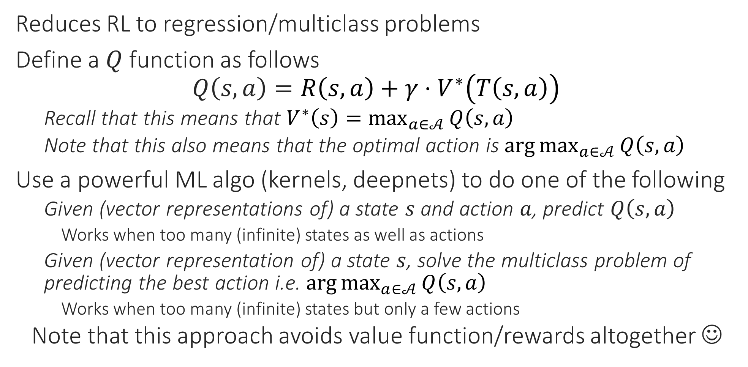
Q Learning
Deep Q learning is a leading technique in reinforcement learning for several application domains – very convenient
Reduces RL to regression/multiclass problems
Define a $Q$ function as follows $Q\left(s,a\right)=R\left(s,a\right)+γ⋅V^{∗}\left(T\left(s,a\right)\right)$
Recall that this means that $V^{∗}\left(s\right)=\max_{a∈𝒜}{Q\left(s,a\right)}$
Note that this also means that the optimal action is $\arg{\max_{a∈𝒜}{Q\left(s,a\right)}}$
Use a powerful ML algo (kernels, deepnets) to do one of the following
Given (vector representations of) a state $s$ and action $a$, predict $Q\left(s,a\right)$
Works when too many (infinite) states as well as actions
Given (vector representation of) a state $s$, solve the multiclass problem of predicting the best action i.e. $\arg{\max_{a∈𝒜}{Q\left(s,a\right)}}$
Works when too many (infinite) states but only a few actions
Note that this approach avoids value function/rewards altogether ☺

Slide 8
Episodic RL
In certain settings, instantaneous rewards i.e. rewards being given on every single action taken by algo is infeasible
E.g. game of chess, reward is win/loss/tie only available at end of game
E.g. Robot navigation, some instantaneous reward e.g. following a predefined trajectory, not falling into a ditch, but eventual reward only on reaching goal
In such settings, usually there is a terminal or goal state
Entire or large bunch of reward given when reaching that state
Period from start state to one such terminal state is called an episode
We usually do not discount rewards in episodic tasks

Slide 9
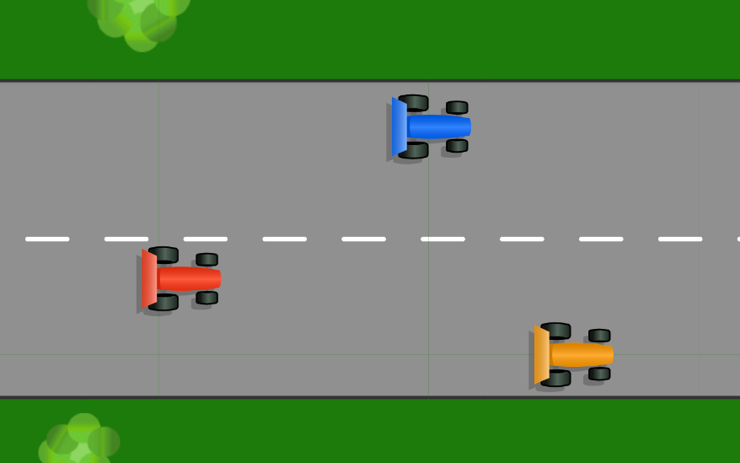
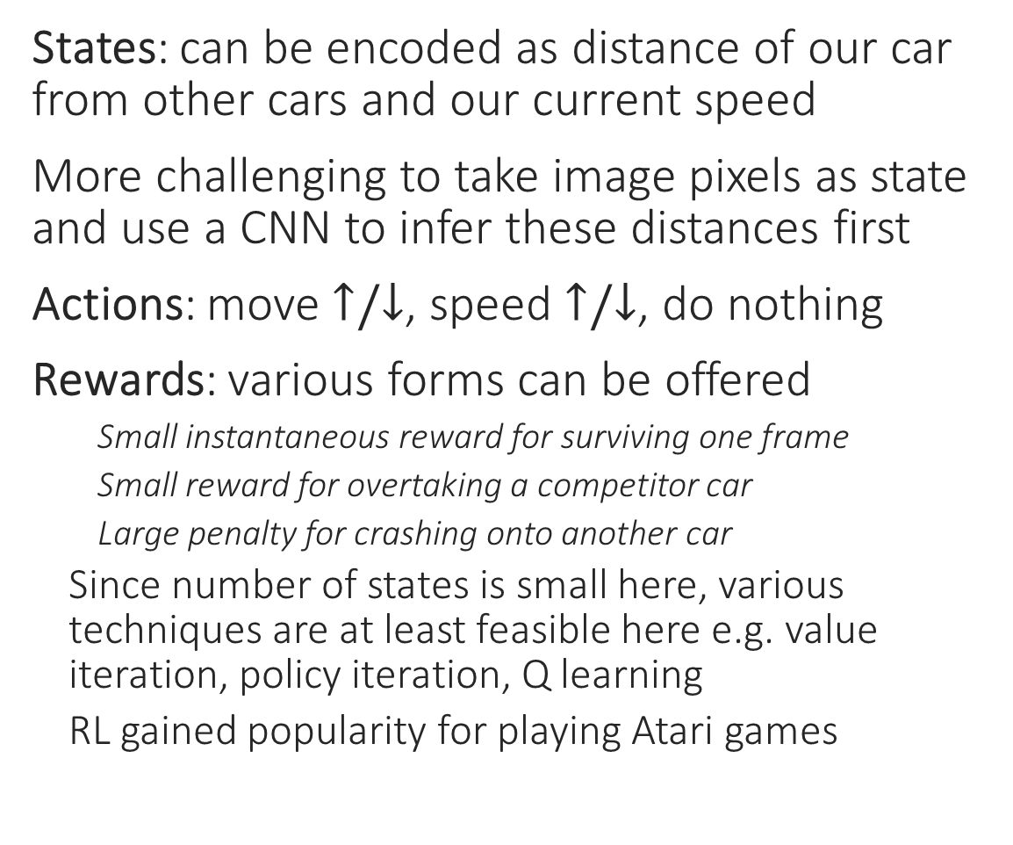
RL for Playing Video Games
States: can be encoded as distance of our car from other cars and our current speed
More challenging to take image pixels as state and use a CNN to infer these distances first
Actions: move $↑/↓$, speed $↑/↓$, do nothing
Rewards: various forms can be offered
Small instantaneous reward for surviving one frame
Small reward for overtaking a competitor car
Large penalty for crashing onto another car
Since number of states is small here, various techniques are at least feasible here e.g. value iteration, policy iteration, Q learning
RL gained popularity for playing Atari games

Slide 10
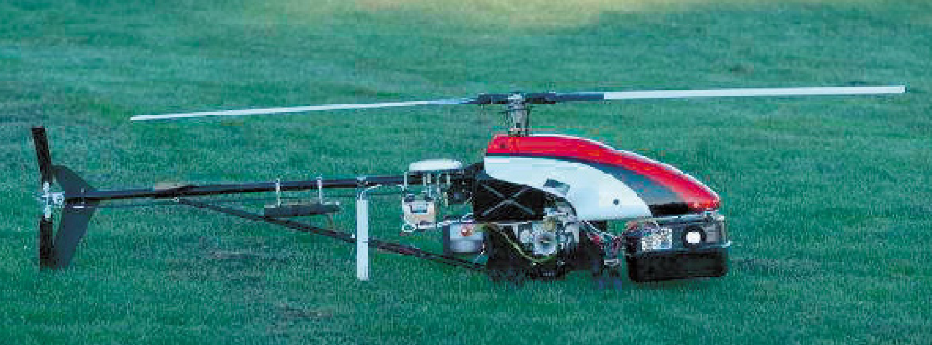
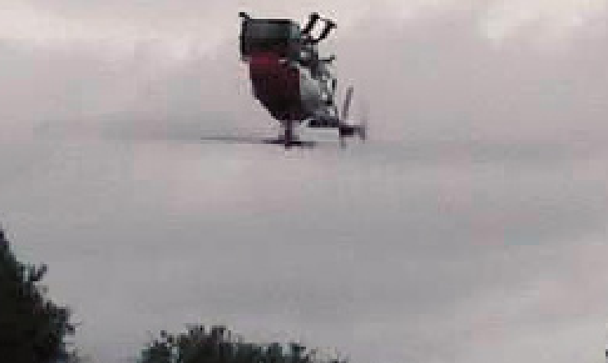
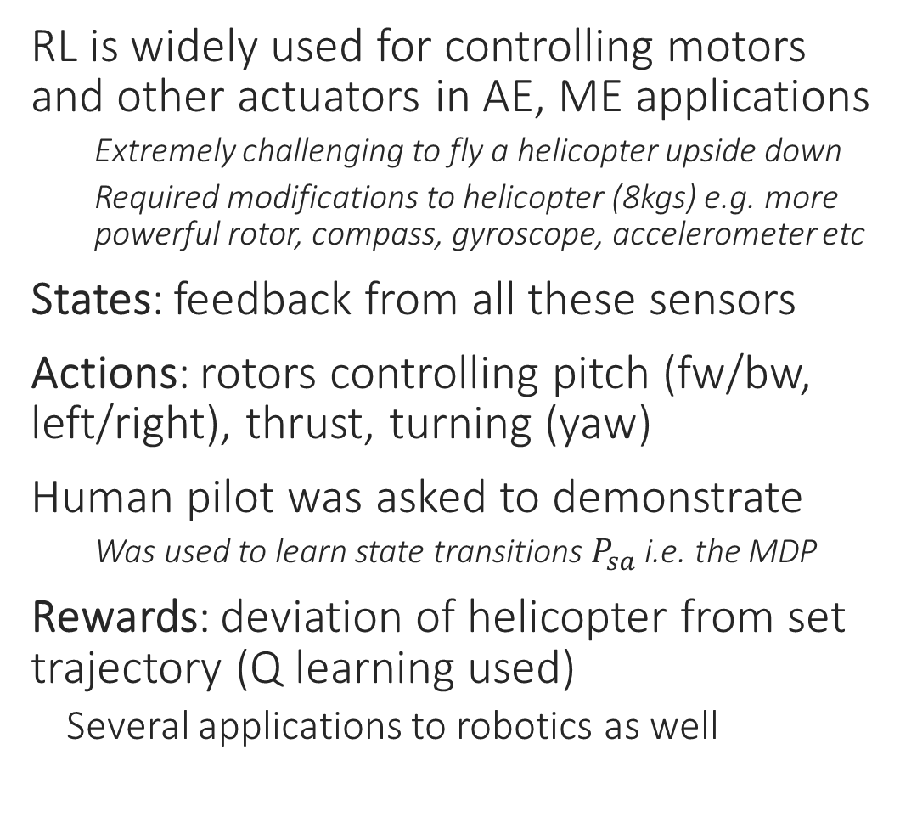
RL for Adaptive Control
RL is widely used for controlling motors and other actuators in AE, ME applications
Extremely challenging to fly a helicopter upside down
Required modifications to helicopter (8kgs) e.g. more powerful rotor, compass, gyroscope, accelerometer etc
States: feedback from all these sensors
Actions: rotors controlling pitch (fw/bw, left/right), thrust, turning (yaw)
Human pilot was asked to demonstrate
Was used to learn state transitions $P_{sa}$ i.e. the MDP
Rewards: deviation of helicopter from set trajectory (Q learning used)
Several applications to robotics as well

Slide 11
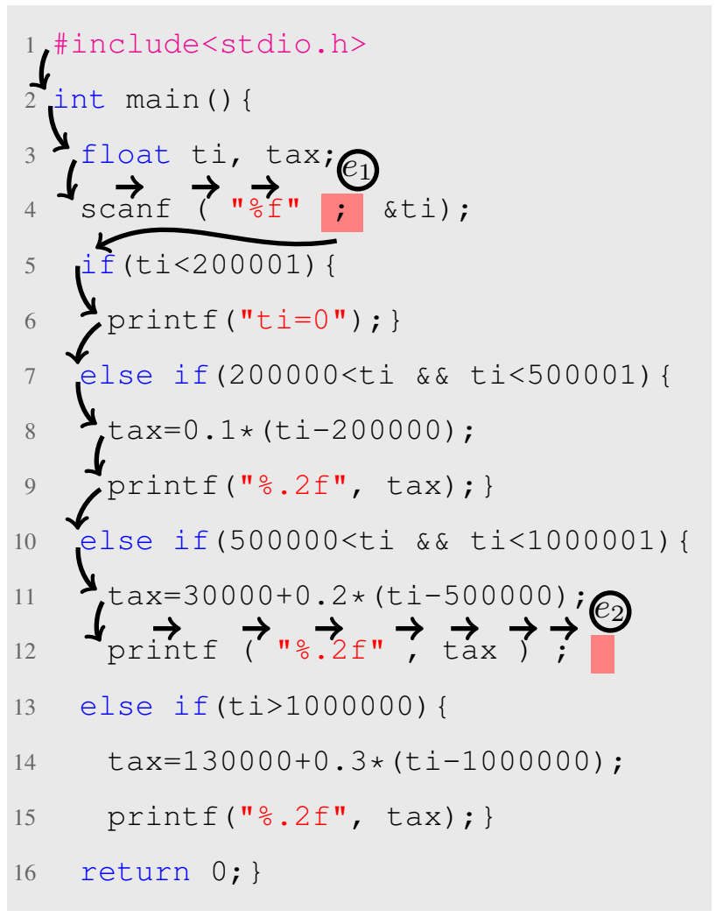
RL for Program Repair
States: encoding of program as string of tokens and posn of cursor within that string
Actions: two types of actions
Navigation: move the cursor around (these actions do not change the program at all)
Edit: insert/delete/replace token at cursor posn
Rewards: episodic learning
Full reward given when all errors removed
Partial reward for removing one error
NN used to get low-dim representation of states
Linear models used to predict the best action by treating it as a multi-class problem

Slide 12






RL for Planning and Routing
Numerous other applications in economics, finance, governance. Basically in any situation where “environment” changes dynamically, possibly in response to our actions, RL is a valuable candidate algo
One of the earliest applications of RL
Boyan and Littman, NIPS 93 – proposed Q learning
Recent works: delivery vehicle and network routing
Optimize route of delivery vehicle so that food/items can be delivered to maximum users in single round trip
States: encoding of user locations, (remaining) demand for each user, (current) traffic conditions
Our actions change the state by fulfilling (some) user demands but can be assumed to not change traffic conditions
Actions: given state, find next user to serve
Rewards: instantaneous rewards
Positive reward for amount of demand fulfilled
Penalty for amount of time taken to do so (traffic etc)
Depot

Slide 13
Other Learning Paradigms
Learning with incomplete/deficient/semi/active supervision
Learning with drift (test data slightly different from train data)
Learning multiple-tasks (generalization of multi-label learning)
Learning with multiple views (several feature rep of same data pt)
Learning with adversarial train/test data (robust ML)
Learning under resource constraints (tiny/edge ML for IOT devices)
Learning with online/streaming data
Have seen glimpses of some of these in the course but only just ☺

Slide 14












Acknowledgements
Course Team:
CSE Office staff members: Mr Prashant Kumar Sahu, Mr Rajesh Kumar, Mr Ranjan Kumar, Mr Anubhav Kumar Arya, Mr Amit Kumar Bharti
Piazza, Gradescope teams: invaluable for large courses such as ours

