Slide 1
Decision Trees
CS771: Introduction to Machine Learning
Purushottam Kar

Slide 2
Announcements
Please form groups of 5 by Wednesday – will give you an online form to specify your group details – please do not mail group details to me
Please activate your Piazza account if not done so
Heads-up: Quiz 1 is coming up next week August 14 – do not miss

Slide 3
Recap of Last Lecture
Notion of decision boundary – points where the classifiers are confused about what to predict - all classifiers have a decision boundary whether LwP, NN, trees, deep nets
Hyperplane classifiers – model vector, bias and their role
Metric learning and how it can help LwP and NN improve
NN variants – kNN, rNN (not to be confused with RNN)
Hyperparameter tuning via held out validation/cross validation

Slide 4






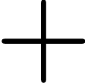


Regression with Weighted
rNN
This neighbour being closer gets more weight
Can I use this trick with kNN? Can I use it while doing classification?
Once you have found the neighbours, you can average their scores to predict a score for the test data point
E.g. when data point is a student and we wish to predict their marks
Yes, and yes. Need to be a bit careful while doing weighted classification since adding labels makes no sense
Or else, you may give the score of closer neighbours more weight and those of far neighbours less weight
In regression, each point needs to be given a real-valued score instead of a label like spam/non-spam

Slide 5

Classification with Weighted rNN
This neighbour being closer gets more weight
This method elegantly works even if there are more than 2 classes!
Green gets 1/3 + 1/3 = 2/3 votes whereas Red gets 1/3 votes – Green wins!!
Green gets 1/5 + 1/5 = 2/5 votes whereas Red gets 3/5 votes – Red wins!!

Slide 6
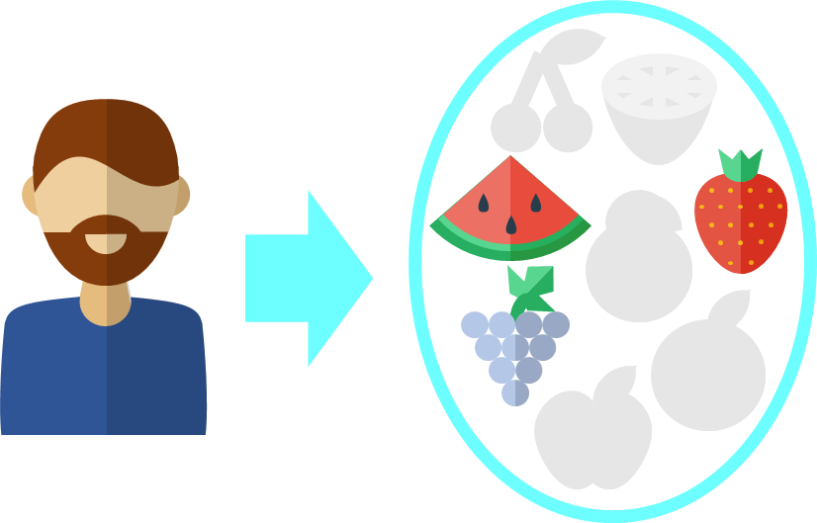
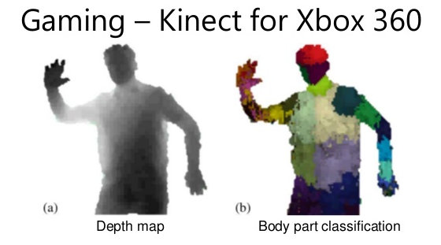
Decision Trees
Recommendation Systems
Give a faster way to perform NN search
Can handle non-numeric features too!
Very popular in ML – classification, recsys
Extremely fast at making predictions
Easy to interpret by humans too
Model size can be very large ☹
Can give good train perf. but bad test perf. (known as overfitting)

Slide 7


Decision Trees for Classification
Finding the nearest neighbours can be slow
So repeatedly partition feature space $ℝ^{d}$
For test data point, much faster to find out which partition is it in which it lies
Can consider the other (train) points in that partition as approximate neighbours
However, if your partitions are fine enough, this will happen very rarely and not hurt performance too much!
What about points like this? The nearest neighbours are lying in another partition ☹
Yes, decision trees may not always give you the exact neighbors for points lying at boundary of a partition

Slide 8

Building Decision Trees
Root
Yes
X < 5.5
No
Internal Node
Y > 10.5
Y > 9
1 2 3 4 5 6 7 8 9 10 11 12
Internal Node
X < 11.5
X < 8.5
Internal Node
Y > 2.5
Y > 5.5
1 2 3 4 5 6 7 8 9 10 11 12 13 14
Nice! Instead of calculating distances from 32 data points, I located my partition by evaluating just 4 inequalities!!
Leaf
X < 12
Leaf
Leaf
Leaf

Slide 9


Decision Trees – all shapes and sizes
May prune the tree to make it more shallow as well. Also possible to have DT with more than 2 children per internal node
The previous DT was very imbalanced and considered bad in general
This DT is balanced – all leaf nodes are at same depth from the root
Imbalanced DTs may
offer very poor
Prediction accuracy
as well as take as long as
kNN to make a prediction.
Imagine a DT which is just a
chain of nodes. With $n$ data points, there would be $𝒪\left(n\right)$ chain: some predictions will take $𝒪\left(n\right)$ time ☹. With a balanced DT, every prediction takes at most $𝒪(\log{n})$ time ☺☺

Slide 10
Regression with Decision Trees
To perform real valued regression, may simply use average score at a leaf node to predict scores for test data points

Slide 11


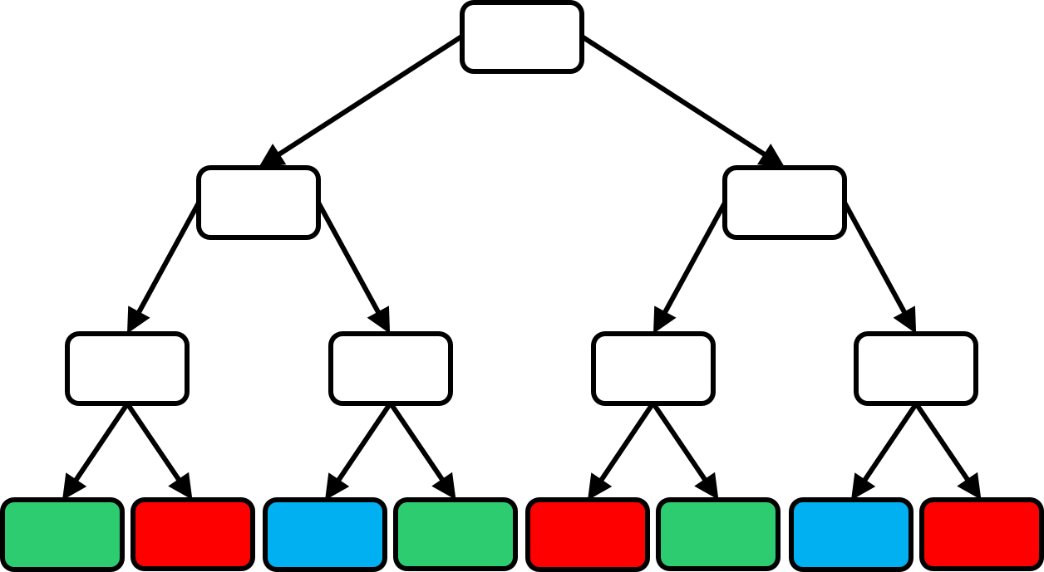
How to learn a DT?
How many children should a node have?
How to send data points to children?
When to stop splitting and make the node a leaf?
What to do at a leaf?
How many trees to train?

Slide 12
What to do at a leaf?
Can take any (complicated) action at a leaf
Why not call another machine learning algorithm?
For speed, keep leaf action simple
Simplest action – constant prediction
Such a DT will encode a piecewise constant prediction function

Slide 13
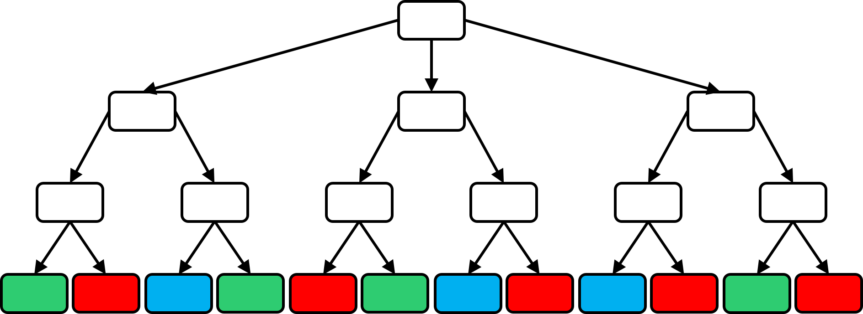
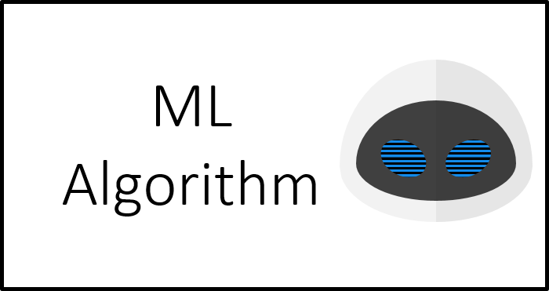


How to split a node into children nodes?
In principle there is no restriction (e.g. can even use a deep net to split a node). However, practical limitations are there.
Notice, splitting a node is a classification problem in itself! Binary if two children, multiclass if more than 2 children
Can we use any classification technique to split a node or are there some restrictions?
Oh! So we are using a simple ML technique such as binary classification to learn a DT!

Slide 14

Splitting a Node – some lessons
Various notions of purity exist – entropy and Gini index for classification problems, variance for regression problems
Recall, one of the goals of DT is to speed up kNN prediction time
Thus, node splitting algorithm must be super fast otherwise no benefit of using DT – may just as well do NN directly
Often people carefully choose just a single feature and split a node based on that e.g. (age $<$ 25 go left, age $≥$ 25 go right)
Such “simple classifiers” are often called decision stumps
Making sure that the split is balanced (e.g. roughly half the data points go left and right) is also important to ensure that the tree is balanced. However, ensuring balance is often tricky
Pure nodes are very convenient. We can make them leaves right away and not have to worry about splitting them ☺
A child node is completely pure if it contains training data of only one class.
How do I decide whether to use age or gender? Even if using age, how do I decide whether to threshold at 25 or 65?
Usually, people go over all available features and all possible thresholds (can be slow if not done cleverly) and choose a feature and a threshold for that feature so that the child nodes that are created are as pure as possible

Slide 15
Purifying Decision Stumps
Purest horizontal split
Purest vertical split
Horizontal Split
Vertical Split
Left Right
Left Right
Search purest horizontal split by going over all possible thresholds and checking
Two possible splitting directions. Let us choose the one that gives us purer children
Vertical split is more pure – lets go with it!

Slide 16
Node splitting via LwP/linear classifiers

Slide 17
Node splitting via LwP/linear classifiers

Slide 18

One Final Recap

Slide 19
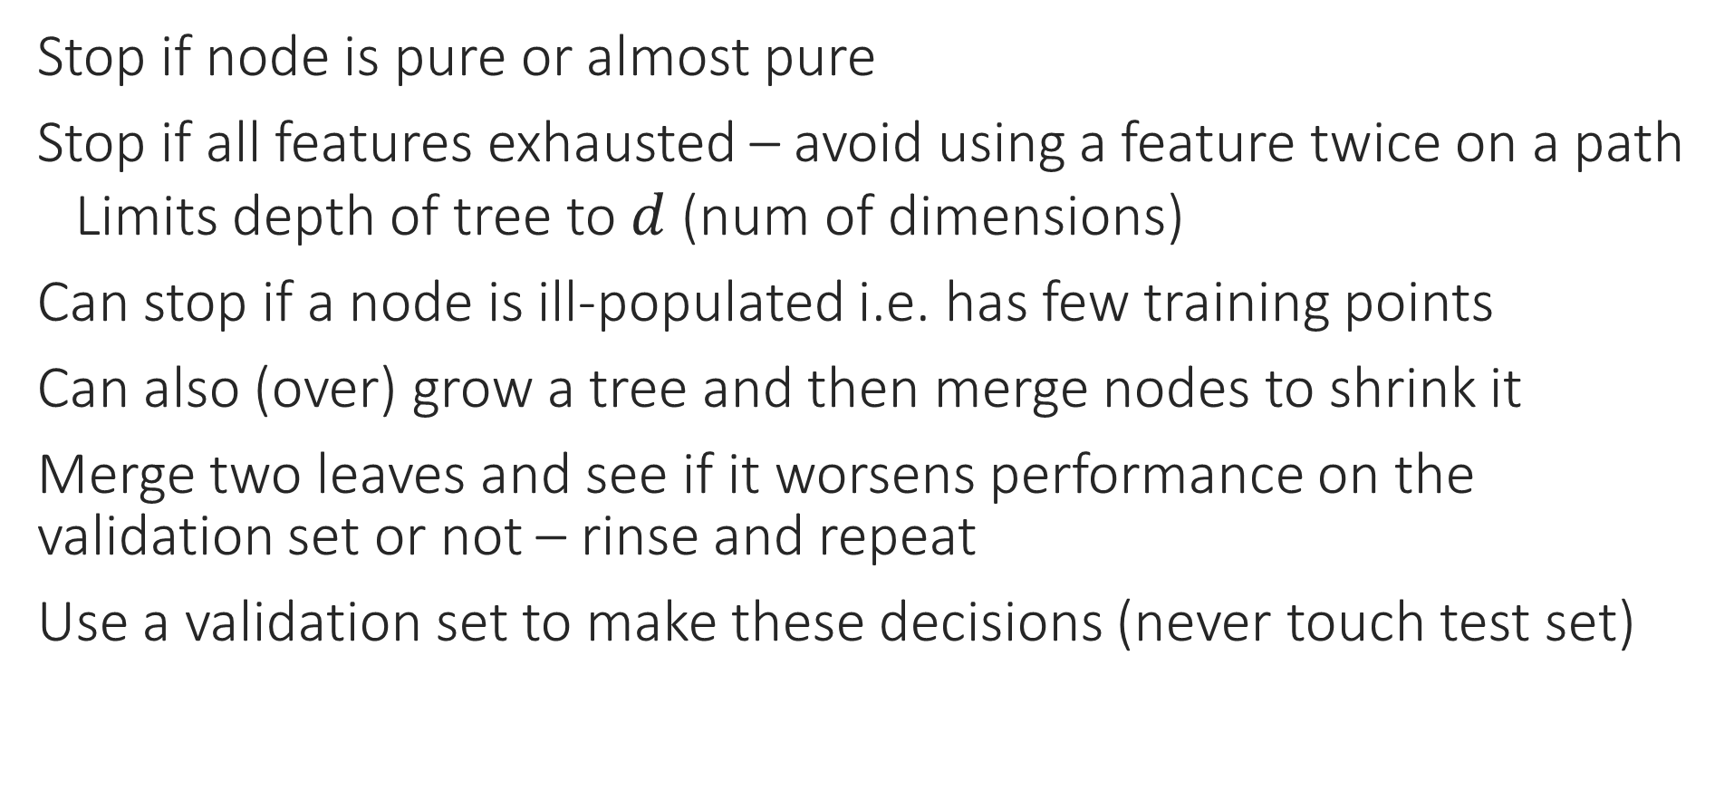
Pruning Strategies
Stop if node is pure or almost pure
Stop if all features exhausted – avoid using a feature twice on a path
Limits depth of tree to $d$ (num of dimensions)
Can stop if a node is ill-populated i.e. has few training points
Can also (over) grow a tree and then merge nodes to shrink it
Merge two leaves and see if it worsens performance on the validation set or not – rinse and repeat
Use a validation set to make these decisions (never touch test set)

Slide 20
Decision Trees - Lessons
Very fast at making predictions (if tree is reasonably balanced)
Can handle discrete data (even non numeric data) as well – e.g. can have a stump as: blood group AB or O go left, else go right
LwP, NN have difficulty with such non-numeric and discrete data since difficult to define distance and averages with them (however, there are workarounds to do NN/LwP with discrete data as well)
Tons of DT algorithms – both classical (ID3, C4.5) as well as very recent (GBDT, LPSR, Parabel) – DTs are versatile and very useful
Reason: DT learning is an NP hard problem – no single algo ☹
If you think you have a better way of splitting nodes or handling leaf nodes, it might be the next big thing in DT learning ☺

