Slide 1
Linear Classifiers
CS771: Introduction to Machine Learning
Purushottam Kar

Slide 2
Announcements
Please declare your assignment groups using the form below https://forms.gle/Zqe3yZyGv7rvzjm56
5 registered students per group (no auditors)
Deadline for filling this form August 09 (Friday), 11:59PM IST
Assignment 1 will be released soon thereafter and we will simply assign remaining students to arbitrary groups after above deadline
Groups that are not of proper size (5) may be reorganized by us
Please fill the form only once per project group
Auditor groups should not fill this form
Project groups will be listed on the website

Slide 3
Recap of Last Lecture
Looked at a weighted variant of the NN algorithm
Studied decision trees which have several benefits
Can be thought of as a speed up way to perform NN classification
Offer extremely fast prediction times
Can handle non-numeric, discrete, categorical features with ease
Some challenges with decision trees
Can be bulky i.e. model size can be large
Deciding how to split a node can be time consuming
Learning the best decision tree is an intractable (NP hard) problem

Slide 4


Decision Boundaries
Indeed, since we would have to not only predict for that data point, but also for other data points around it!
Some interesting discussion on Piazza
Earlier definition of decision boundary (points where classifier gets confused is simple but not general enough)
More robust definition of decision boundary: locations where classifier decision abruptly changes from one class to another class
All classifiers have such a decision boundary
Easy to detect whether a test point is at decision boundary for linear classifiers – difficult to do so for most other classifiers, e.g. deep nets
It might still get confused if there are 4 points equally close 2 of them red and 2 green ☺
For example, kNN will never get confused if k = 3 (or some odd number) and 2 classes

Slide 5



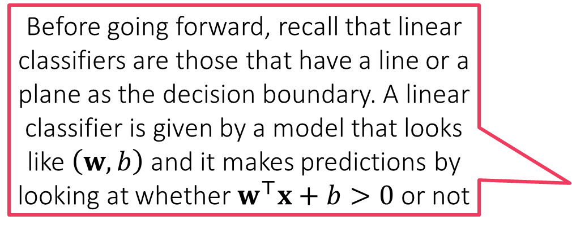
Linear Classifiers
Before going forward, recall that linear classifiers are those that have a line or a plane as the decision boundary. A linear classifier is given by a model that looks like $\left(w,b\right)$ and it makes predictions by looking at whether $w^{⊤}x+b>0$ or not
Keep appearing again and again in various methods
LwP with 2 classes, Euclidean metric always gives a linear classifier
Even if Mahalanobis metric used, still LwP gives a linear classifier
Decision stumps with a single feature also give a linear classifier
Extremely popular in ML
Very small model size – just one vector (and one bias value)
Very fast $𝒪\left(d\right)$ prediction time
Used to build DTs, deep nets etc
Learning classifiers directly will allow us to control many useful properties about them!
That is exactly what we will do today!
Instead of indirectly getting a linear classifier via LwP + Mahalanobis etc etc, can’t we learn one directly?

Slide 6


The “best” Linear Classifier
It seems infinitely many classifiers perfectly classify the data. Which one should I choose?
All these brittle dotted classifiers misclassify the two new test points
However, the bold classifier, whose decision boundary is far from all train points is not affected
Indeed! Such models would be very brittle and might misclassify test data (i.e. predict the wrong class), even those test data which look very similar to train data
It is better to not select a model whose decision boundary passes very close to a training data point

Slide 7
Large Margin Classifiers
I cannot search all classifiers to find the one with the largest margin! It would take an infinite amount of time!
Geometric Margin
That is where math comes to our rescue!
Indeed, my name is Ms M for a reason (M for ML as well as M for Math)
A good linear classifier would can be one where all data points are correctly classified, as well as far from the hyperplane

Slide 8
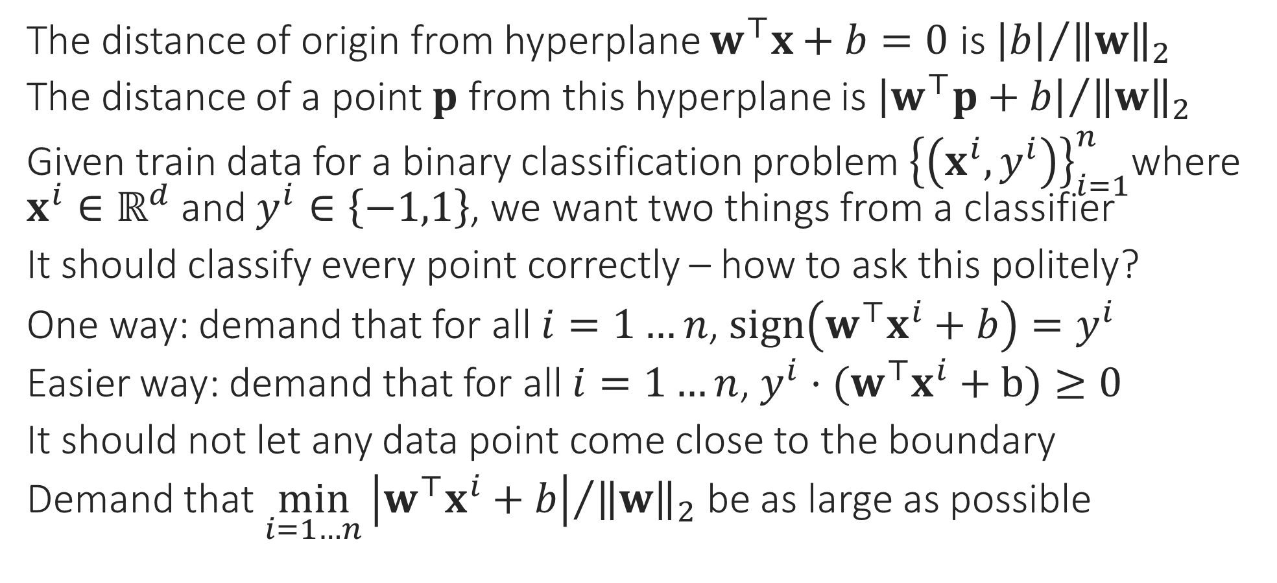
Large Margin Classifiers
The distance of origin from hyperplane $w^{⊤}x+b=0$ is ${\left|b\right|}/{{\left\|w\right\|}_{2}}$
The distance of a point $p$ from this hyperplane is ${\left|w^{⊤}p+b\right|}/{{\left\|w\right\|}_{2}}$
Given train data for a binary classification problem ${\left\{\left(x^{i},y^{i}\right)\right\}}_{i=1}^{n}$where $x^{i}∈ℝ^{d}$ and $y^{i}∈\left\{−1,1\right\}$, we want two things from a classifier
It should classify every point correctly – how to ask this politely?
One way: demand that for all $i=1…n$, $sign\left(w^{⊤}x^{i}+b\right)=y^{i}$
Easier way: demand that for all $i=1…n$, $y^{i}⋅(w^{⊤}x^{i}+b)≥0$
It should not let any data point come close to the boundary
Demand that $\min_{i=1…n}{{\left|w^{⊤}x^{i}+b\right|}/{{\left\|w\right\|}_{2}}}$ be as large as possible
Geometric Margin

Slide 9


Support Vector Machines
“
Just a fancy way of saying
Please find me a linear classifier that perfectly classifies the train data while keeping data points as far away from the hyperplane as possible
The mathematical way of writing this request is the following
$\max_{w,b}\left\{\min_{i=1…n}{{\left|w^{⊤}x^{i}+b\right|}/{{\left\|w\right\|}_{2}}}\right\}$
such that $y^{i}⋅(w^{⊤}x^{i}+b)≥0$ for all $i=1…n$
Let us simplify this optimization problem
“
Constraints
Objective
This is known as an optimization problem with an objective and lots of constraints
This looks so complicated, how will I ever find a solution to this optimization problem?

Slide 10
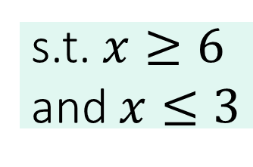
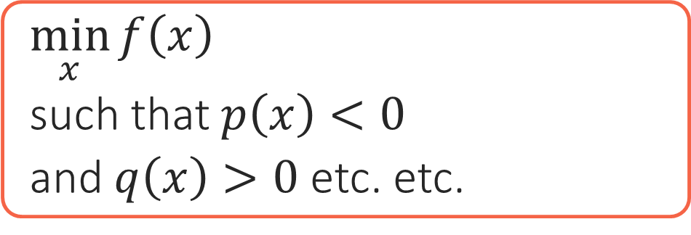
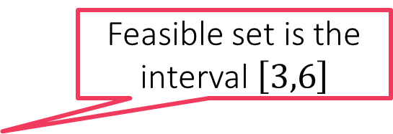
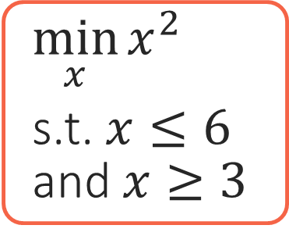
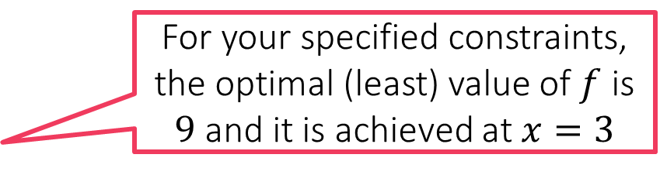

Constrained Optimization 101
Constraints are usually specified using math equations. The set of points that satisfy all the constraints is called the feasible set of the optimization problem
How WE MUST SPEAK TO MS M
How we speak to a human
Objective
Constraints
$\min_{x}{f\left(x\right)}$
such that $p\left(x\right)<0$
and $q\left(x\right)>0$ etc. etc.
I want to find an unknown $x$ that gives me the best value according to this function $f$
Oh! btw, not any $x$ would do! $x$ must satisfy these conditions
All I am saying is, of the values of $x$ that satisfy my conditions, find me the one that gives the best value according to $f$
You optimization problem has no solution since no point satisfies all your constraints ☹
For your specified constraints, the optimal (least) value of $f$ is $9$ and it is achieved at $x=3$
Feasible set is empty!
$\min_{x}{x^{2}}$
s.t. $x≤6$ and $x≥3$
Feasible set is the interval $\left[3,6\right]$
s.t. $x≥6$ and $x≤3$
3 6

Slide 11
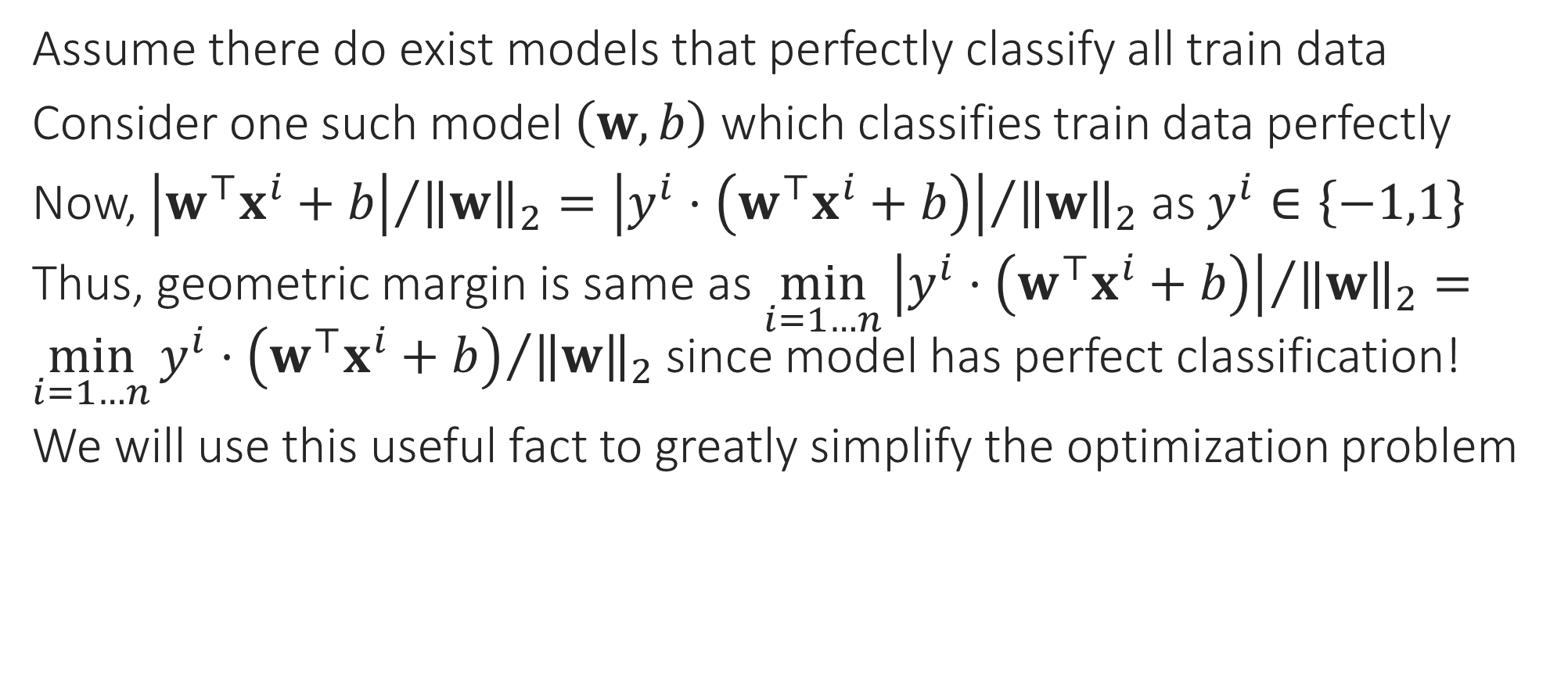
Back to SVMs
Assume there do exist models that perfectly classify all train data
Consider one such model $\left(w,b\right)$ which classifies train data perfectly
Now, ${\left|w^{⊤}x^{i}+b\right|}/{{\left\|w\right\|}_{2}}={\left|y^{i}⋅\left(w^{⊤}x^{i}+b\right)\right|}/{{\left\|w\right\|}_{2}}$ as $y^{i}∈\left\{−1,1\right\}$
Thus, geometric margin is same as $\min_{i=1…n}{{\left|y^{i}⋅\left(w^{⊤}x^{i}+b\right)\right|}/{{\left\|w\right\|}_{2}}}=$ $\min_{i=1…n}{{y^{i}⋅\left(w^{⊤}x^{i}+b\right)}/{{\left\|w\right\|}_{2}}}$ since model has perfect classification!
We will use this useful fact to greatly simplify the optimization problem
What if train data is non-linearly separable i.e no linear classifier can perfectly classify it? For example
We will remove this assumption later

Slide 12
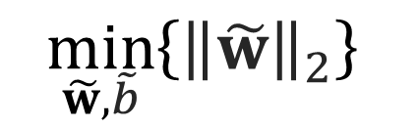
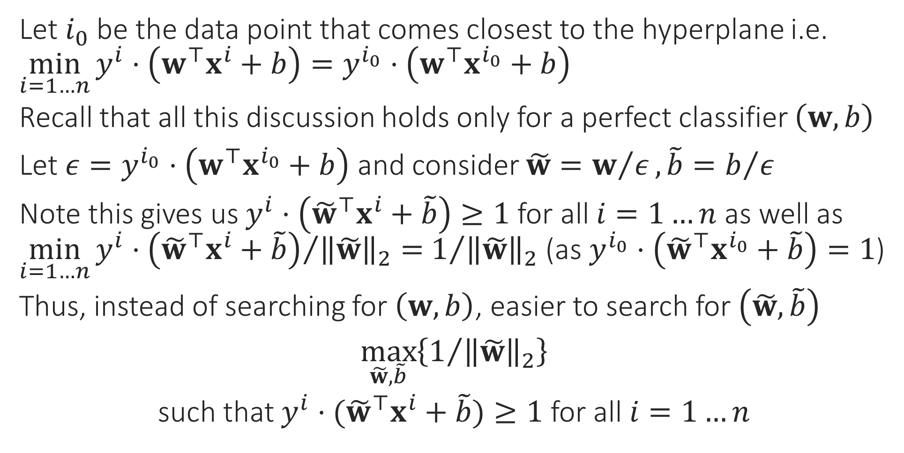
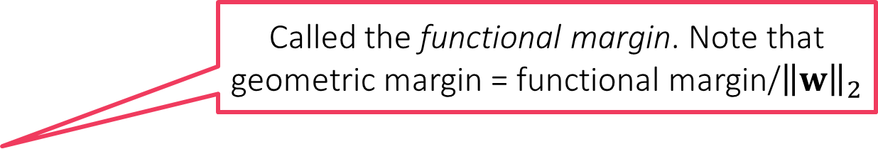
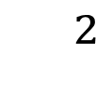
Support Vector Machines
Called the functional margin. Note that geometric margin = functional margin/${\left\|w\right\|}_{2}$
Let $i_{0}$ be the data point that comes closest to the hyperplane i.e. $\min_{i=1…n}{y^{i}⋅\left(w^{⊤}x^{i}+b\right)}=y^{i_{0}}⋅\left(w^{⊤}x^{i_{0}}+b\right)$
Recall that all this discussion holds only for a perfect classifier $\left(w,b\right)$
Let $ε=y^{i_{0}}⋅\left(w^{⊤}x^{i_{0}}+b\right)$ and consider $\tilde{w}=w/ε, \tilde{b}=b/ε$
Note this gives us $y^{i}⋅\left({\tilde{w}}^{⊤}x^{i}+\tilde{b}\right)≥1$ for all $i=1…n$ as well as $\min_{i=1…n}{{y^{i}⋅\left({\tilde{w}}^{⊤}x^{i}+\tilde{b}\right)}/{{\left\|\tilde{w}\right\|}_{2}}}=$ $1/{{\left\|\tilde{w}\right\|}_{2}}$ (as $y^{i_{0}}⋅\left({\tilde{w}}^{⊤}x^{i_{0}}+\tilde{b}\right)=1$)
Thus, instead of searching for $\left(w,b\right)$, easier to search for $\left(\tilde{w},\tilde{b}\right)$
$\max_{\tilde{w},\tilde{b}}\left\{1/{{\left\|\tilde{w}\right\|}_{2}}\right\}$
such that $y^{i}⋅({\tilde{w}}^{⊤}x^{i}+\tilde{b})≥1$ for all $i=1…n$
$${}^{2}$$
$$\min_{\tilde{w},\tilde{b}}\left\{{\left\|\tilde{w}\right\|}_{2}\right\}$$

Slide 13

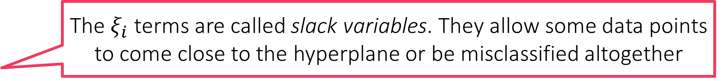
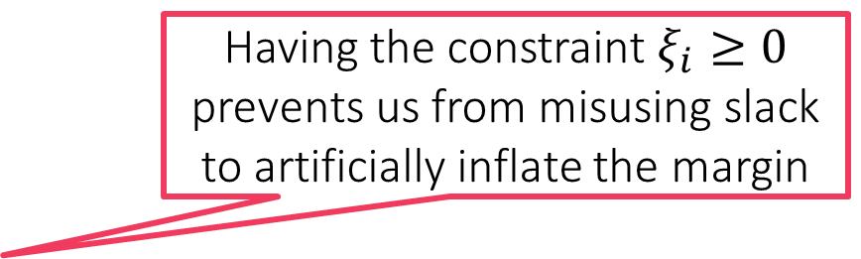

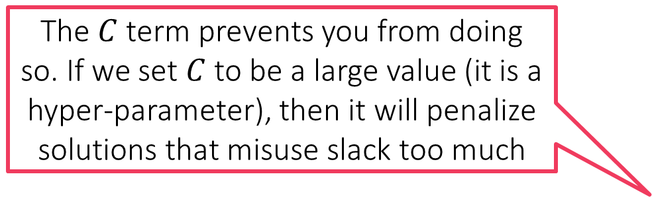
The C-SVM Technique
What prevents me from misusing the slack variables to learn a model that misclassifies every data point?
For linearly separable cases where we suspect a perfect classifier exists
$\min_{\tilde{w},\tilde{b}}{{\frac{1}{2}\left\|\tilde{w}\right\|}_{2}^{2}}$
s.t. $y^{i}⋅({\tilde{w}}^{⊤}x^{i}+\tilde{b})≥1$ for all $i∈\left[n\right]$
If a linear classifier cannot perfectly classify data, then find model using
$\min_{\tilde{w},\tilde{b},\left\{ξ_{i}\right\}}{{\frac{1}{2}\left\|\tilde{w}\right\|}_{2}^{2}+C\sum_{i=1}^{n}{ξ_{i}}}$
s.t. $y^{i}⋅\left({\tilde{w}}^{⊤}x^{i}+\tilde{b}\right)≥1−ξ_{i}$ for all $i∈\left[n\right]$
as well as $ξ_{i}≥0$ for all $i∈\left[n\right]$
The $C$ term prevents you from doing so. If we set $C$ to be a large value (it is a hyper-parameter), then it will penalize solutions that misuse slack too much
Having the constraint $ξ_{i}≥0$ prevents us from misusing slack to artificially inflate the margin
Recall English phrase “cut me some slack”
The $ξ_{i}$ terms are called slack variables. They allow some data points to come close to the hyperplane or be misclassified altogether

Slide 14
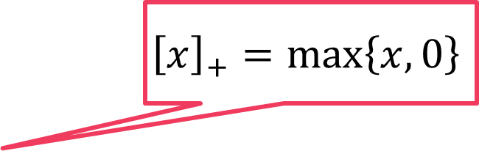
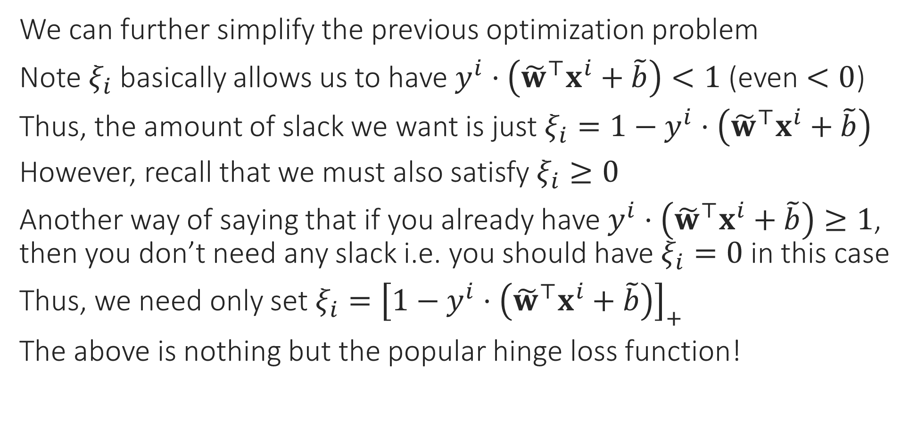
From C-SVM to Loss Functions
We can further simplify the previous optimization problem
Note $ξ_{i}$ basically allows us to have $y^{i}⋅\left({\tilde{w}}^{⊤}x^{i}+\tilde{b}\right)<1$ (even $<0$)
Thus, the amount of slack we want is just $ξ_{i}=1−y^{i}⋅\left({\tilde{w}}^{⊤}x^{i}+\tilde{b}\right)$
However, recall that we must also satisfy $ξ_{i}≥0$
Another way of saying that if you already have $y^{i}⋅\left({\tilde{w}}^{⊤}x^{i}+\tilde{b}\right)≥1$, then you don’t need any slack i.e. you should have $ξ_{i}=0$ in this case
Thus, we need only set $ξ_{i}={\left[1−y^{i}⋅\left({\tilde{w}}^{⊤}x^{i}+\tilde{b}\right)\right]}_{+}$
The above is nothing but the popular hinge loss function!
$${\left[x\right]}_{+}=\max\left\{x,0\right\}$$

Slide 15
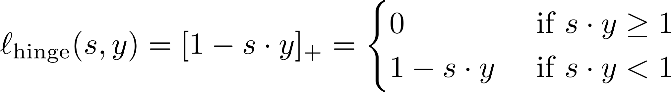

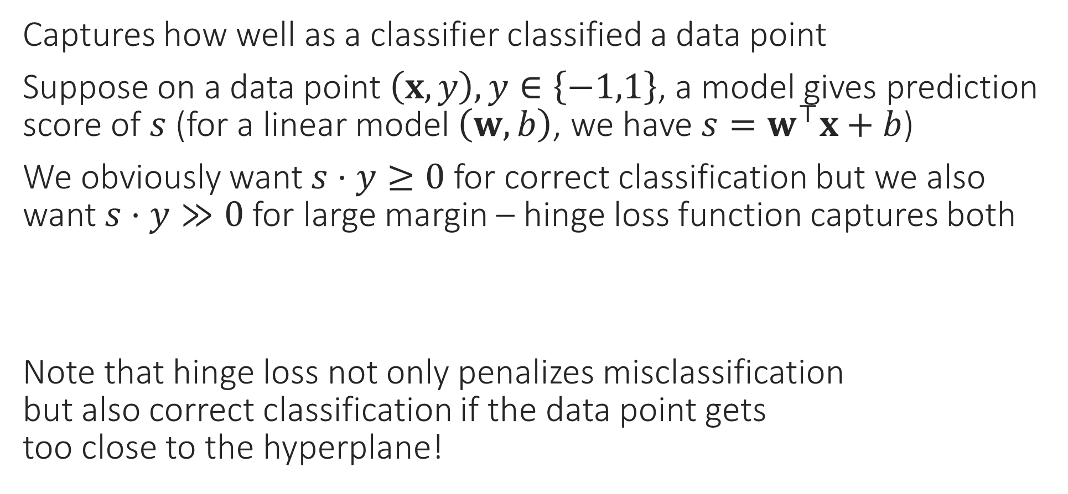
Hinge Loss
Captures how well as a classifier classified a data point
Suppose on a data point $\left(x,y\right), y∈\left\{−1,1\right\}$, a model gives prediction score of $s$ (for a linear model $\left(w,b\right)$, we have $s=w^{⊤}x+b$)
We obviously want $s⋅y≥0$ for correct classification but we also want $s⋅y≫0$ for large margin – hinge loss function captures both
Note that hinge loss not only penalizes misclassification but also correct classification if the data point gets too close to the hyperplane!

Slide 16
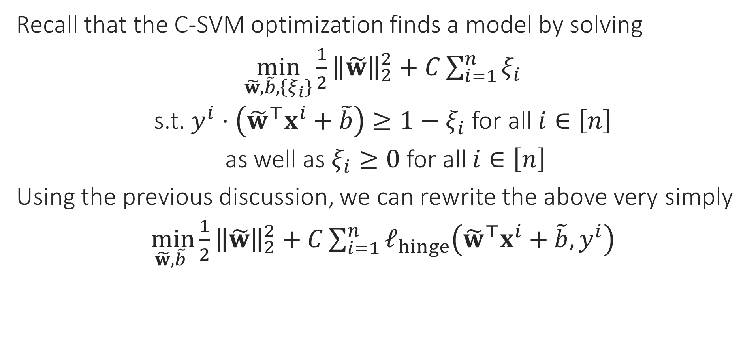
Final Form of C-SVM
Recall that the C-SVM optimization finds a model by solving
$\min_{\tilde{w},\tilde{b},\left\{ξ_{i}\right\}}{{\frac{1}{2}\left\|\tilde{w}\right\|}_{2}^{2}+C\sum_{i=1}^{n}{ξ_{i}}}$
s.t. $y^{i}⋅\left({\tilde{w}}^{⊤}x^{i}+\tilde{b}\right)≥1−ξ_{i}$ for all $i∈\left[n\right]$
as well as $ξ_{i}≥0$ for all $i∈\left[n\right]$
Using the previous discussion, we can rewrite the above very simply
$\min_{\tilde{w},\tilde{b} }{{\frac{1}{2}\left\|\tilde{w}\right\|}_{2}^{2}+C\sum_{i=1}^{n}{ℓ_{hinge}\left({\tilde{w}}^{⊤}x^{i}+\tilde{b},y^{i}\right)}}$
Agreed this is simpler than before but I still don’t know how to use this to find the model
This is where calculus and some more math comes in ☺

Slide 17

Emoticons from Flaticon, designed by Twitter
https://www.flaticon.com/packs/smileys-and-people-9 Licensed under CC BY 3.0

