Slide 1
Optimus II
CS771: Introduction to Machine Learning
Purushottam Kar

Slide 2
Announcements
Quiz/exam copies shall be graded on Gradescope
Will create accounts for you – no action needed from your side
It may take a week or so for grading (many graders are on leave)
Will release Assignment 1 this week as well

Slide 3
Recap of Last Lecture
Notions of (local/global) extrema, derivatives (first, second)
Multivariate analogues of these (gradient, Hessian)
Stationary points and the (multivariate) second derivative test
Gradient as offering the directions of steepest ascent/descent
Convex sets and convex functions
Several examples and exercises in course notes (see GitHub repo)

Slide 4
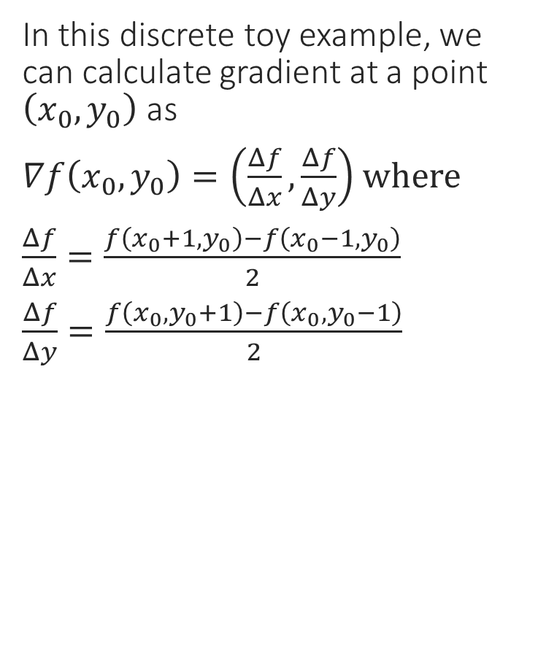
A Toy Example – Function Values
In this discrete toy example, we can calculate gradient at a point $\left(x_{0},y_{0}\right)$ as
$∇f\left(x_{0},y_{0}\right)=\left(\frac{Δf}{Δx},\frac{Δf}{Δy}\right)$ where
$\frac{Δf}{Δx}=\frac{f\left(x_{0}+1,y_{0}\right)−f\left(x_{0}−1,y_{0}\right)}{2}$
$\frac{Δf}{Δy}=\frac{f\left(x_{0},y_{0}+1\right)−f\left(x_{0},y_{0}−1\right)}{2}$
3 | 3 | 3 | 3 | 3 | 3 | 3 | 3 | 3
2 | 2 | 2 | 3 | 4 | 3 | 3 | 2 | 1
1 | 1 | 1 | 3 | 3 | 3 | 1 | 1 | 1
1 | 0 | 1 | 1 | 2 | 1 | 1 | 0 | 1
1 | 1 | 1 | 3 | 3 | 3 | 1 | 1 | 1
1 | 2 | 3 | 3 | 4 | 3 | 2 | 2 | 2
3 | 3 | 3 | 3 | 3 | 3 | 3 | 3 | 3
0 1 2 3 4 5 6
0 1 2 3 4 5 6 7 8

Slide 5
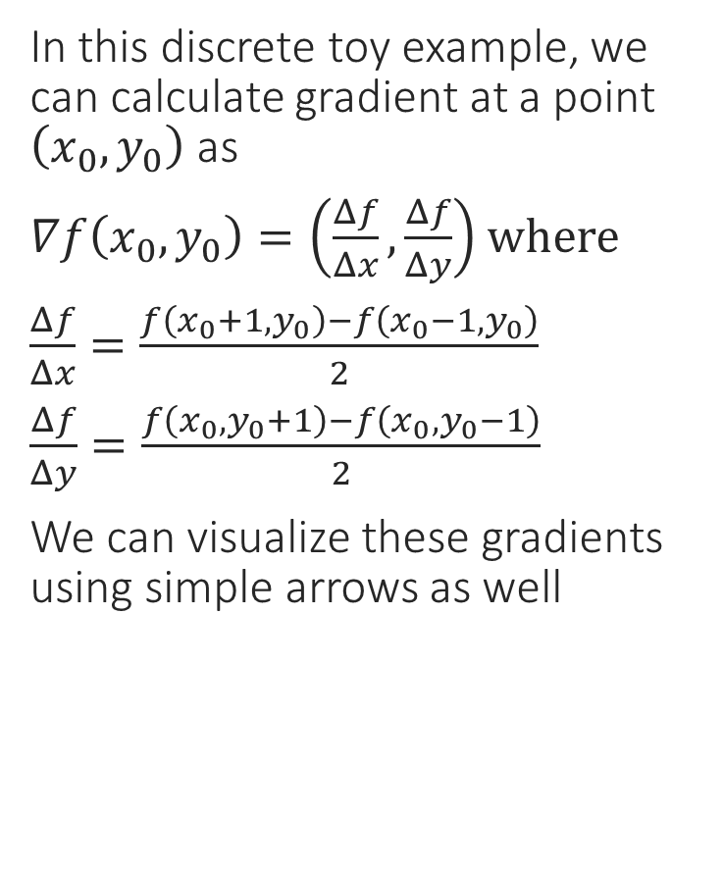
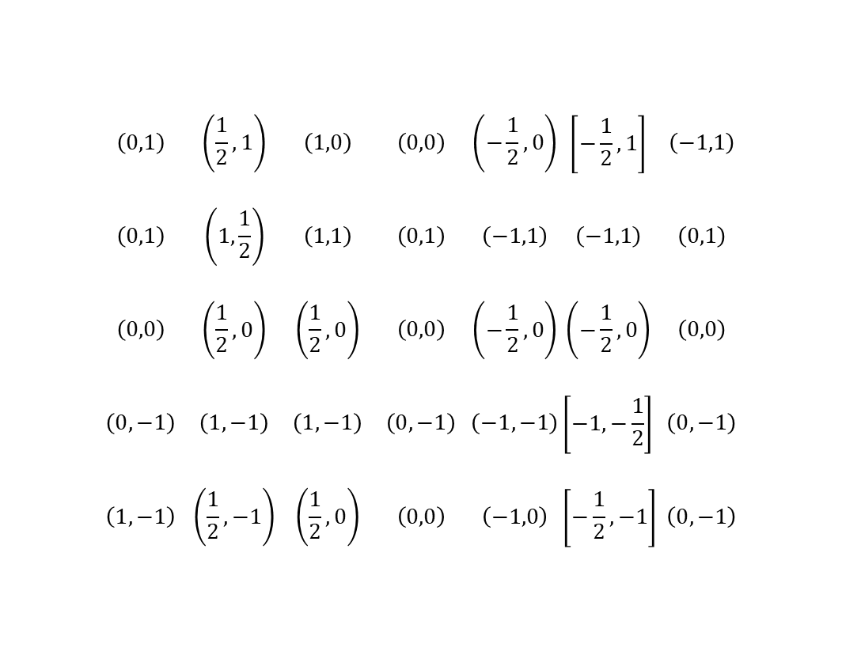
A Toy Example – Gradients
In this discrete toy example, we can calculate gradient at a point $\left(x_{0},y_{0}\right)$ as
$∇f\left(x_{0},y_{0}\right)=\left(\frac{Δf}{Δx},\frac{Δf}{Δy}\right)$ where
$\frac{Δf}{Δx}=\frac{f\left(x_{0}+1,y_{0}\right)−f\left(x_{0}−1,y_{0}\right)}{2}$
$\frac{Δf}{Δy}=\frac{f\left(x_{0},y_{0}+1\right)−f\left(x_{0},y_{0}−1\right)}{2}$
We can visualize these gradients using simple arrows as well
 | $$\left(0,1\right)$$ | $$\left(\frac{1}{2},1\right)$$ | $$\left(1,0\right)$$ | $$\left(0,0\right)$$ | $$\left(−\frac{1}{2},0\right)$$ | $$\left[−\frac{1}{2},1\right]$$ | $$\left(−1,1\right)$$
 | $$\left(0,1\right)$$ | $$\left(1,\frac{1}{2}\right)$$ | $$\left(1,1\right)$$ | $$\left(0,1\right)$$ | $$\left(−1,1\right)$$ | $$\left(−1,1\right)$$ | $$\left(0,1\right)$$
 | $$\left(0,0\right)$$ | $$\left(\frac{1}{2},0\right)$$ | $$\left(\frac{1}{2},0\right)$$ | $$\left(0,0\right)$$ | $$\left(−\frac{1}{2},0\right)$$ | $$\left(−\frac{1}{2},0\right)$$ | $$\left(0,0\right)$$
 | $$\left(0,−1\right)$$ | $$\left(1,−1\right)$$ | $$\left(1,−1\right)$$ | $$\left(0,−1\right)$$ | $$\left(−1,−1\right)$$ | $$\left[−1,−\frac{1}{2}\right]$$ | $$\left(0,−1\right)$$
 | $$\left(1,−1\right)$$ | $$\left(\frac{1}{2},−1\right)$$ | $$\left(\frac{1}{2},0\right)$$ | $$\left(0,0\right)$$ | $$\left(−1,0\right)$$ | $$\left[−\frac{1}{2},−1\right]$$ | $$\left(0,−1\right)$$
Saddle
Local min
0 1 2 3 4 5 6
Local max
0 1 2 3 4 5 6 7 8

Slide 6
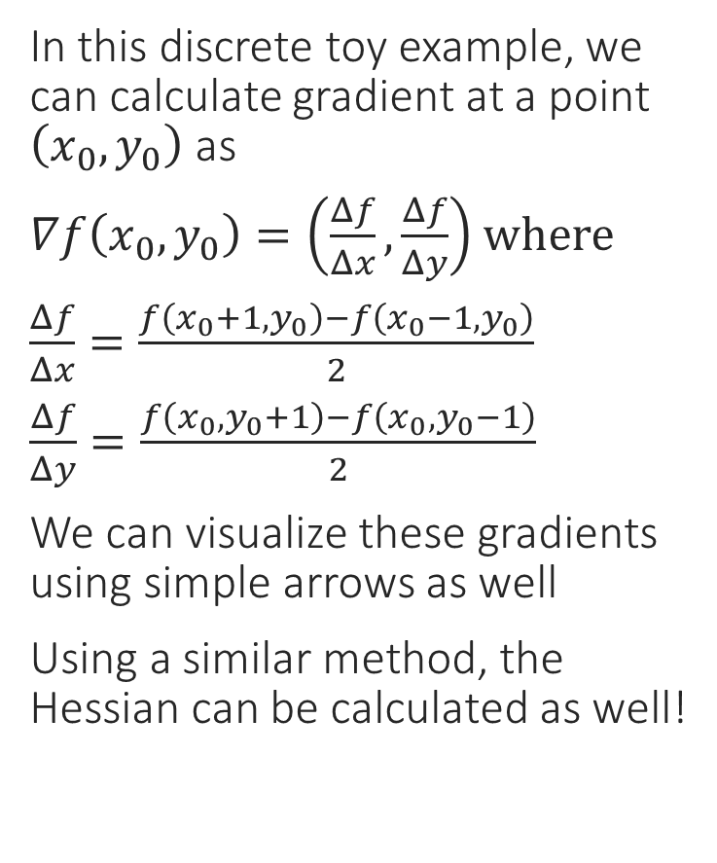
A Toy Example – Gradients
Gradients converge toward local max
In this discrete toy example, we can calculate gradient at a point $\left(x_{0},y_{0}\right)$ as
$∇f\left(x_{0},y_{0}\right)=\left(\frac{Δf}{Δx},\frac{Δf}{Δy}\right)$ where
$\frac{Δf}{Δx}=\frac{f\left(x_{0}+1,y_{0}\right)−f\left(x_{0}−1,y_{0}\right)}{2}$
$\frac{Δf}{Δy}=\frac{f\left(x_{0},y_{0}+1\right)−f\left(x_{0},y_{0}−1\right)}{2}$
We can visualize these gradients using simple arrows as well
Using a similar method, the Hessian can be calculated as well!
Gradients diverge away from local min
0 1 2 3 4 5 6
At saddle points, both can happen along different axes
0 1 2 3 4 5 6 7 8

Slide 7
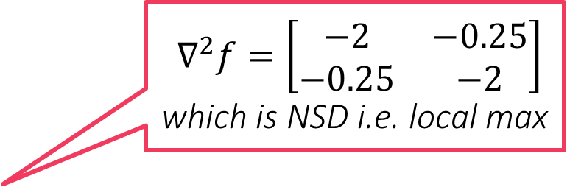
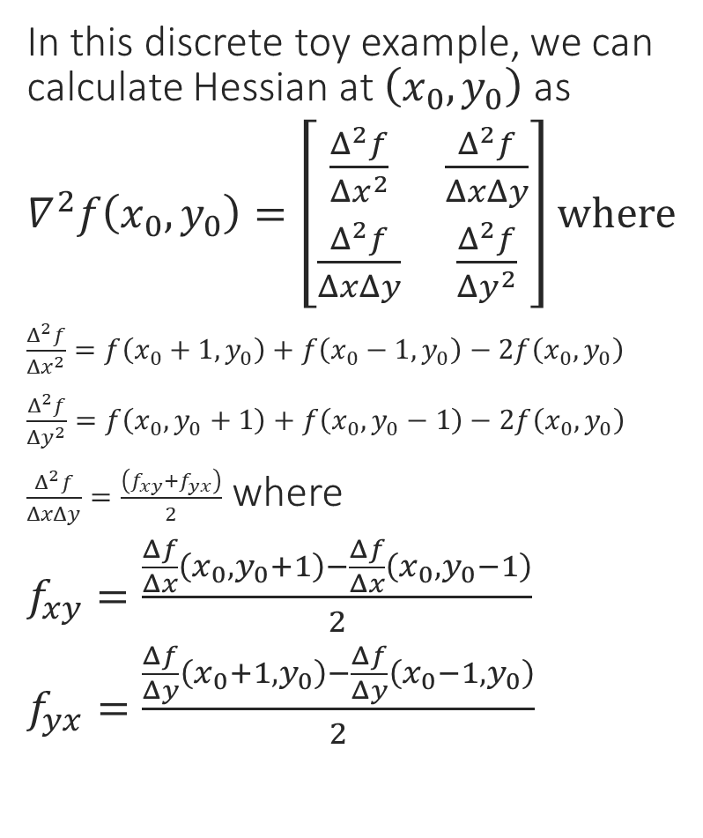
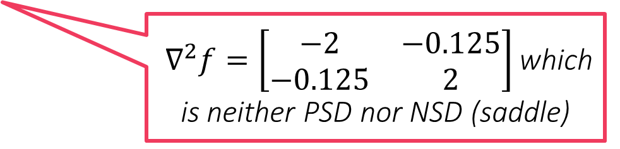

A Toy Example – Hessians
$∇^{2}f=\left[\begin{matrix}−2 & −0.25 \\ −0.25 & −2\end{matrix}\right]$ which is NSD i.e. local max
In this discrete toy example, we can calculate Hessian at $\left(x_{0},y_{0}\right)$ as
$∇^{2}f\left(x_{0},y_{0}\right)=\left[\begin{matrix}\frac{Δ^{2}f}{Δx^{2}} & \frac{Δ^{2}f}{ΔxΔy} \\ \frac{Δ^{2}f}{ΔxΔy} & \frac{Δ^{2}f}{Δy^{2}}\end{matrix}\right]$ where
$\frac{Δ^{2}f}{Δx^{2}}=f\left(x_{0}+1,y_{0}\right)+f\left(x_{0}−1,y_{0}\right)−2f\left(x_{0},y_{0}\right)$
$\frac{Δ^{2}f}{Δy^{2}}=f\left(x_{0},y_{0}+1\right)+f\left(x_{0},y_{0}−1\right)−2f\left(x_{0},y_{0}\right)$
$\frac{Δ^{2}f}{ΔxΔy}=\frac{\left(f_{xy}+f_{yx}\right)}{2}$ where
$f_{xy}=\frac{\frac{Δf}{Δx}\left(x_{0},y_{0}+1\right)−\frac{Δf}{Δx}\left(x_{0},y_{0}−1\right)}{2}$
$f_{yx}=\frac{\frac{Δf}{Δy}\left(x_{0}+1,y_{0}\right)−\frac{Δf}{Δy}\left(x_{0}−1,y_{0}\right)}{2}$
$∇^{2}f=\left[\begin{matrix}2 & 0.125 \\ 0.125 & 2\end{matrix}\right]$ which is PSD i.e. local min
0 1 2 3 4 5 6
$∇^{2}f=\left[\begin{matrix}−2 & −0.125 \\ −0.125 & 2\end{matrix}\right]$ which is neither PSD nor NSD (saddle)
0 1 2 3 4 5 6 7 8

Slide 8

Non-differentiable Functions
The hinge loss function is not differentiable everywhere ☹
Can we define some form of gradient for non-diff functions as well?
Yes, if a function is convex, then no matter if it is non-differentiable, a notion of gradient called subgradient can always be defined for it
Recall that for differentiable functions, the gradient defines a tangent hyperplane at every point and the function must lie above this plane
Subgradients exploit and generalize this property ☺
Point of non-differentiability

Slide 9



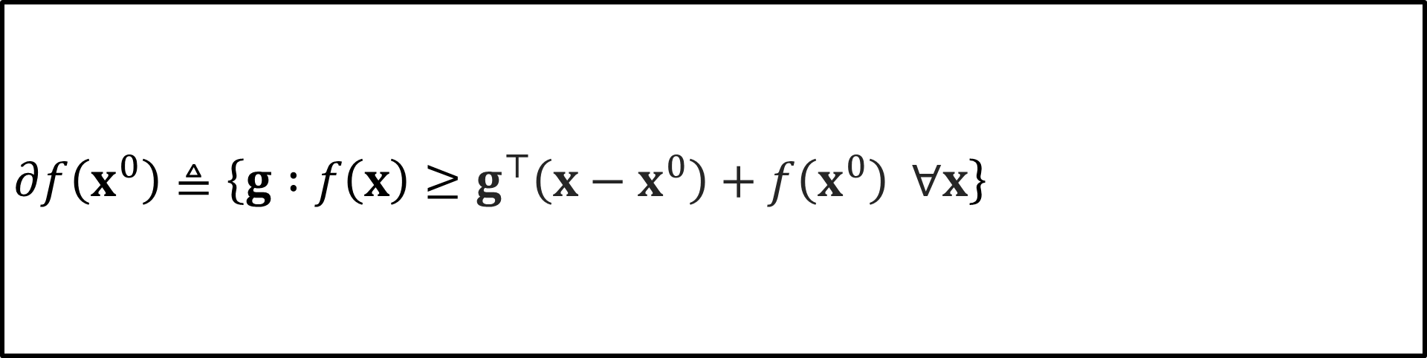
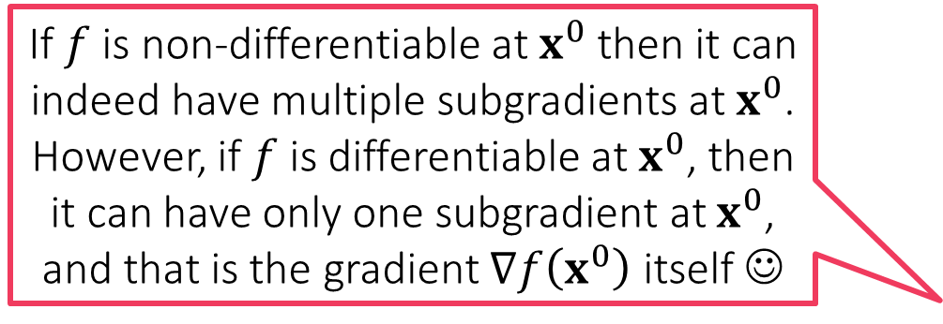
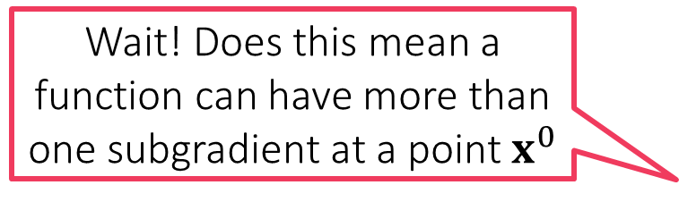
Subgradients and the subdifferential
How can I find out the subgradients of a function?
Wait! Does this mean a function can have more than one subgradient at a point $x^{0}$
Tangents of a convex differentiable function $f:ℝ^{d}→ℝ$ are uniquely linked to its gradients
The tangent at $x^{0}$ is the hyperplane $∇f{\left(x^{0}\right)}^{⊤}\left(x−x^{0}\right)+f\left(x^{0}\right)$
Convex functions lie above all tangents $f\left(x\right)≥∇f{\left(x^{0}\right)}^{⊤}\left(x−x^{0}\right)+f\left(x^{0}\right)$
Trick: turn the definition around and say that gradient at $x^{0}$ is a vector $g$ so that the hyperplane $g^{⊤}\left(x−x^{0}\right)+f\left(x^{0}\right)=0$ is tangent to $f$ at $x^{0}$
Subgradients: given a (possibly non-differentiable but convex) function $f:ℝ^{d}→ℝ$ and a point $x^{0}$, any vector $g$ that satisfies $f\left(x\right)≥g^{⊤}\left(x−x^{0}\right)+f\left(x^{0}\right)$ is called a subgradient of $f$ at $x^{0}$
Subdifferential: the set of all subgradients of $f$ at a point $x^{0}$ is known as the subdifferential of $f$ at $x^{0}$ and denoted by $∂f\left(x^{0}\right)$
If $f$ is non-differentiable at $x^{0}$ then it can indeed have multiple subgradients at $x^{0}$. However, if $f$ is differentiable at $x^{0}$, then it can have only one subgradient at $x^{0}$, and that is the gradient $∇f\left(x^{0}\right)$ itself ☺
$$∂f\left(x^{0}\right)≜\left\{g :f\left(x\right)≥g^{⊤}\left(x−x^{0}\right)+f\left(x^{0}\right) ∀x\right\}$$

Slide 10


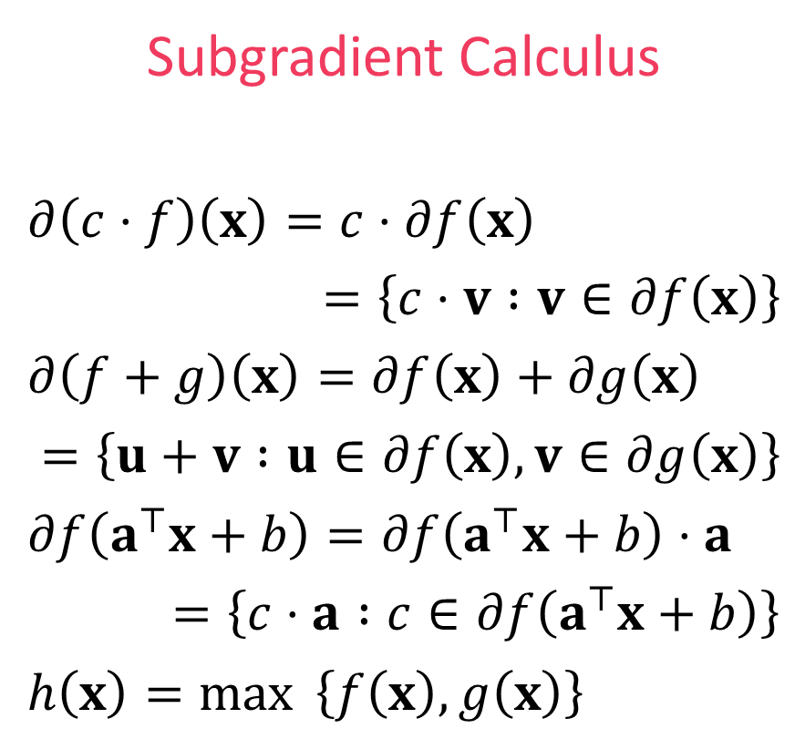

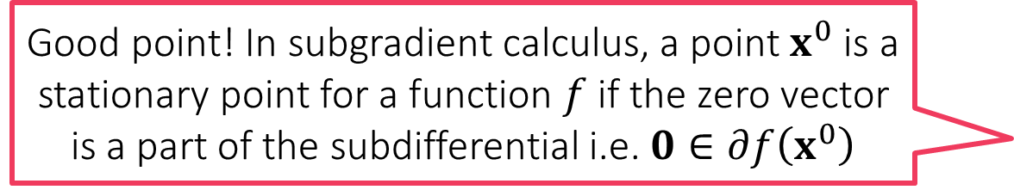

Subgradient Calculus
What about stationary points?
Good point! In subgradient calculus, a point $x^{0}$ is a stationary point for a function $f$ if the zero vector is a part of the subdifferential i.e. $0∈∂f\left(x^{0}\right)$
Gradient Calculus
$∇\left(c⋅f\right)\left(x\right)=c⋅∇f\left(x\right)$
$∇\left(f+g\right)\left(x\right)=∇f\left(x\right)+∇g\left(x\right)$
$∇f\left(a^{⊤}x+b\right)=f^{′}\left(a^{⊤}x+b\right)⋅a$
No counterpart in general
Subgradient Calculus
$∂\left(c⋅f\right)\left(x\right)=c⋅∂f\left(x\right)$
$=\left\{c⋅v :v∈∂f\left(x\right)\right\}$
$∂\left(f+g\right)\left(x\right)=∂f\left(x\right)+∂g\left(x\right)$
$=\left\{u+v :u∈∂f\left(x\right),v∈∂g\left(x\right)\right\}$
$∂f\left(a^{⊤}x+b\right)=∂f\left(a^{⊤}x+b\right)⋅a$
$=\left\{c⋅a :c∈∂f\left(a^{⊤}x+b\right)\right\}$
$h\left(x\right)=\max{ \left\{f\left(x\right),g\left(x\right)\right\}}$
Scaling Rule
Sum Rule
Chain Rule
Max Rule
$$x∈ℝ^{d},a∈ℝ^{d},b,c∈ℝ$$
Local minima/maxima must be stationary in this sense even for non-differentiable functions
If $f\left(x^{0}\right)>g\left(x^{0}\right),∂h\left(x^{0}\right)=∂f\left(x^{0}\right)$. If $g\left(x^{0}\right)>f\left(x^{0}\right),∂h\left(x^{0}\right)=∂g\left(x^{0}\right)$
If $f\left(x^{0}\right)=g\left(x^{0}\right), ∂h\left(x^{0}\right)=\{λu+\left(1−λ\right)v :u∈∂f\left(x^{0}\right),v∈∂g\left(x^{0}\right),λ∈\left[0,1\right]\}$

Slide 11
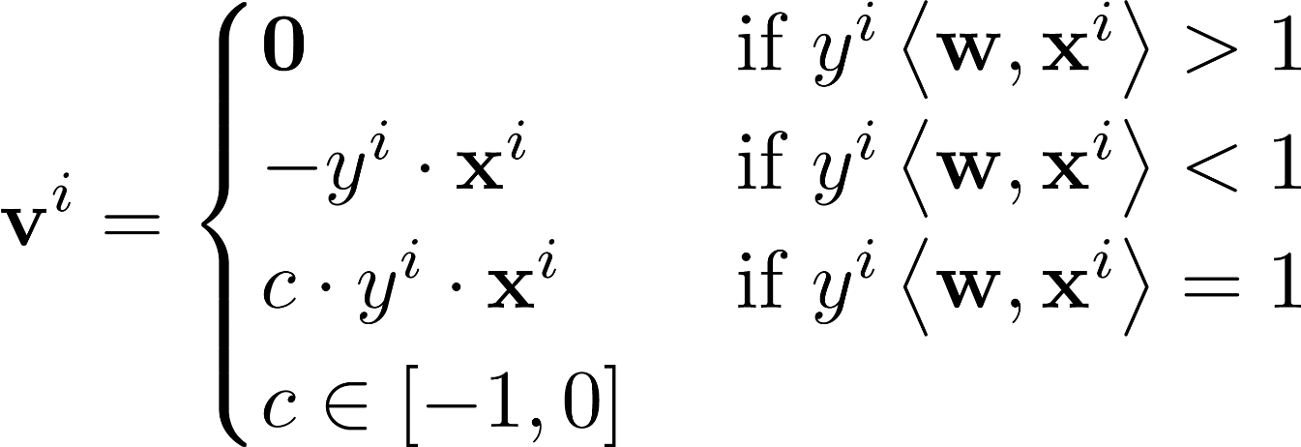

Example: subgradient for hinge loss
$ℓ_{hinge}\left(x\right)=\max\left\{1−x,0\right\}=\max{ \left\{f\left(x\right),g\left(x\right)\right\}}$
$ℓ_{hinge}$ is differentiable at all points except $x=1$
Thus, $∂ℓ_{hinge}\left(x\right)=ℓ_{hinge}^{′}\left(x\right)$ if $x≠1$
At $x=1$ use subdifferential calculus
$f\left(x\right)=1−x$ (differentiable) i.e. $∂f\left(x\right)=f^{′}\left(x\right)=−1$
$g\left(x\right)=0$ (differentiable) i.e. $∂g\left(x\right)=g^{′}\left(x\right)=0$
Thus, $∂ℓ_{hinge}\left(1\right)=\left\{λ⋅\left(−1\right)+\left(1−λ\right)⋅0 :λ∈\left[0,1\right]\right\}=\left[−1,0\right]$
Applying subgradient chain rule gives us

Slide 12
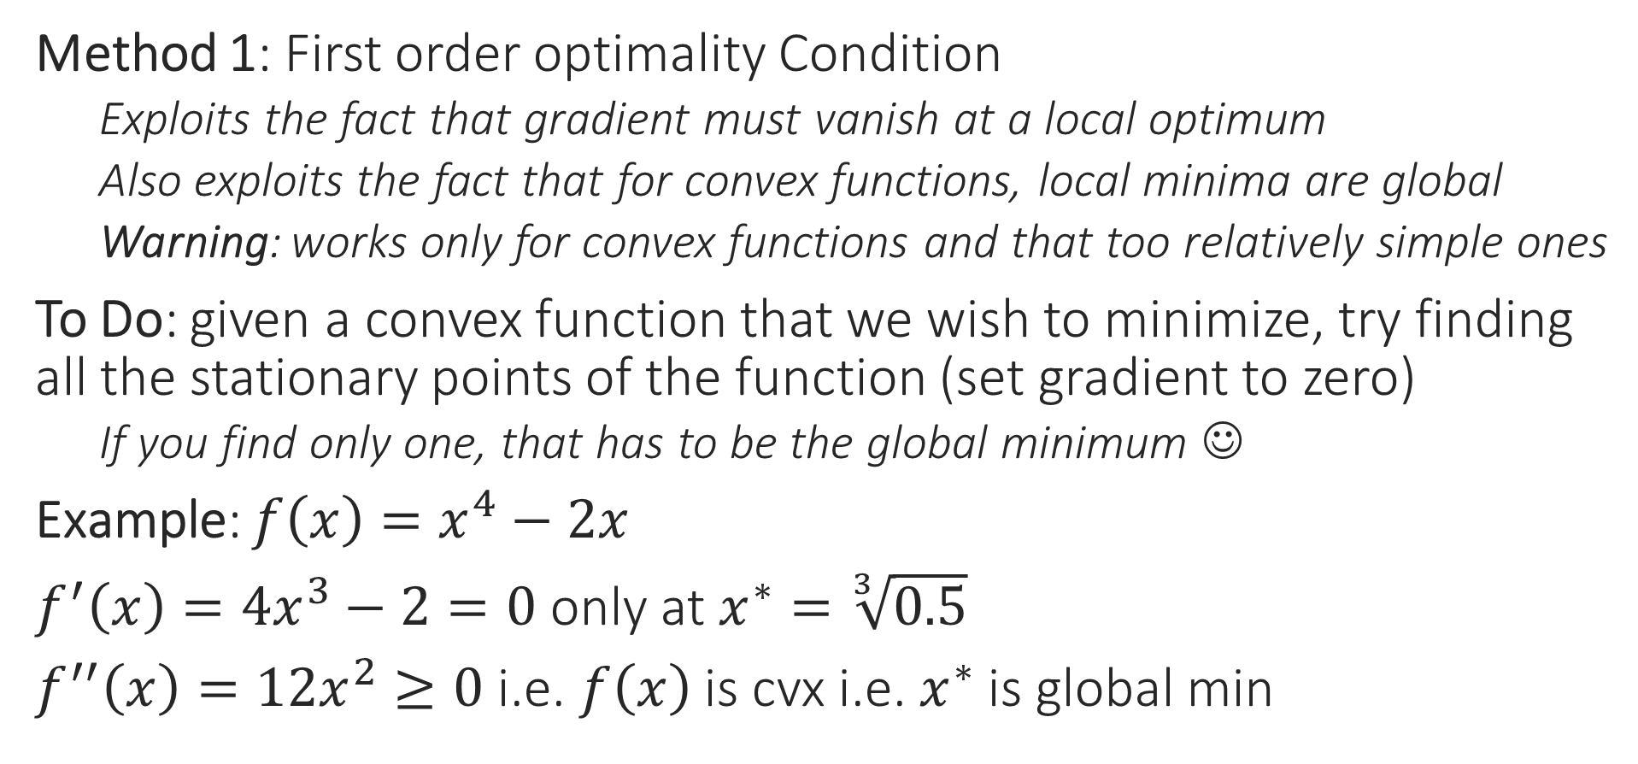
From calculUS to OPTIMization
Method 1: First order optimality Condition
Exploits the fact that gradient must vanish at a local optimum
Also exploits the fact that for convex functions, local minima are global
Warning: works only for convex functions and that too relatively simple ones
To Do: given a convex function that we wish to minimize, try finding all the stationary points of the function (set gradient to zero)
If you find only one, that has to be the global minimum ☺
Example: $f\left(x\right)=x^{4}−2x$
$f^{′}\left(x\right)=4x^{3}−2=0$ only at $x^{∗}=\sqrt[3]{0.5}$
$f^{′′}\left(x\right)=12x^{2}≥0$ i.e. $f\left(x\right)$ is cvx i.e. $x^{∗}$ is global min

Slide 13


From calculUS to OPTIMization
Method 2: Perform (sub)gradient descent
Recall that direction opposite to gradient offers steepest descent
(SUB)GRADIENT DESCENT
Given: obj. func. $f:ℝ^{d}→ℝ$ to minimize
Initialize $w^{0}∈ℝ^{d}$
For $t=0, 1, …$
Obtain a (sub)gradient $g^{t}∈∂f\left(w^{t}\right)$
Choose a step length $η_{t}$
Update $w^{t+1}←w^{t}−η_{t}⋅g^{t}$
Repeat until convergence
How to initialize $w^{0}$?
How to choose $η_{t}$
Often called step length or learning rate
How to decide if we have converged?
What does convergence even mean?

Slide 14
Gradient Descent (GD)
Move opposite to the gradients
Choose step length carefully
Initialize carefully
Global minimum
With convex functions, all local minima are global minima
Still need to be careful with step lengths otherwise may overshoot global minima

Slide 15
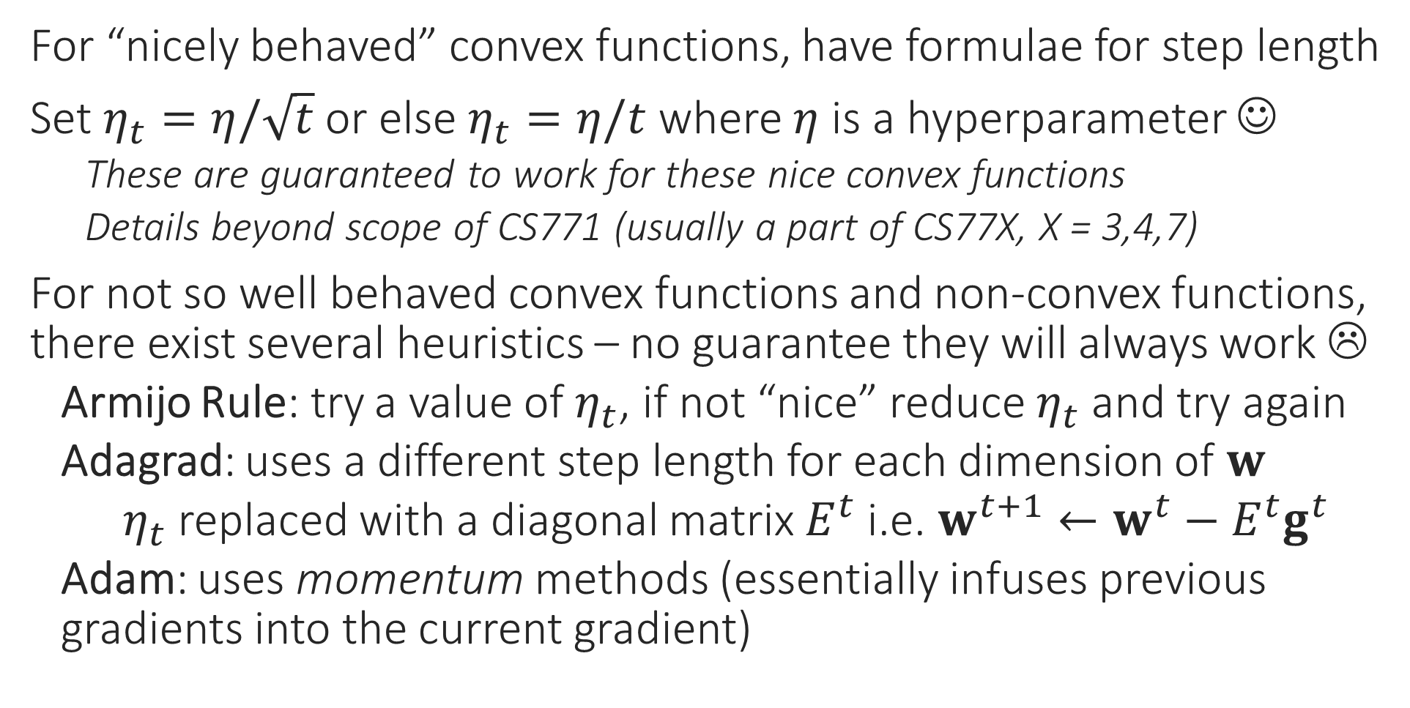
How to choose Step Length?
For “nicely behaved” convex functions, have formulae for step length
Set $η_{t}=η/\sqrt{t}$ or else $η_{t}=η/t$ where $η$ is a hyperparameter ☺
These are guaranteed to work for these nice convex functions
Details beyond scope of CS771 (usually a part of CS77X, X = 3,4,7)
For not so well behaved convex functions and non-convex functions, there exist several heuristics – no guarantee they will always work ☹
Armijo Rule: try a value of $η_{t}$, if not “nice” reduce $η_{t}$ and try again
Adagrad: uses a different step length for each dimension of $w$
$η_{t}$ replaced with a diagonal matrix $E^{t}$ i.e. $w^{t+1}←w^{t}−E^{t}g^{t}$
Adam: uses momentum methods (essentially infuses previous gradients into the current gradient)

Slide 16
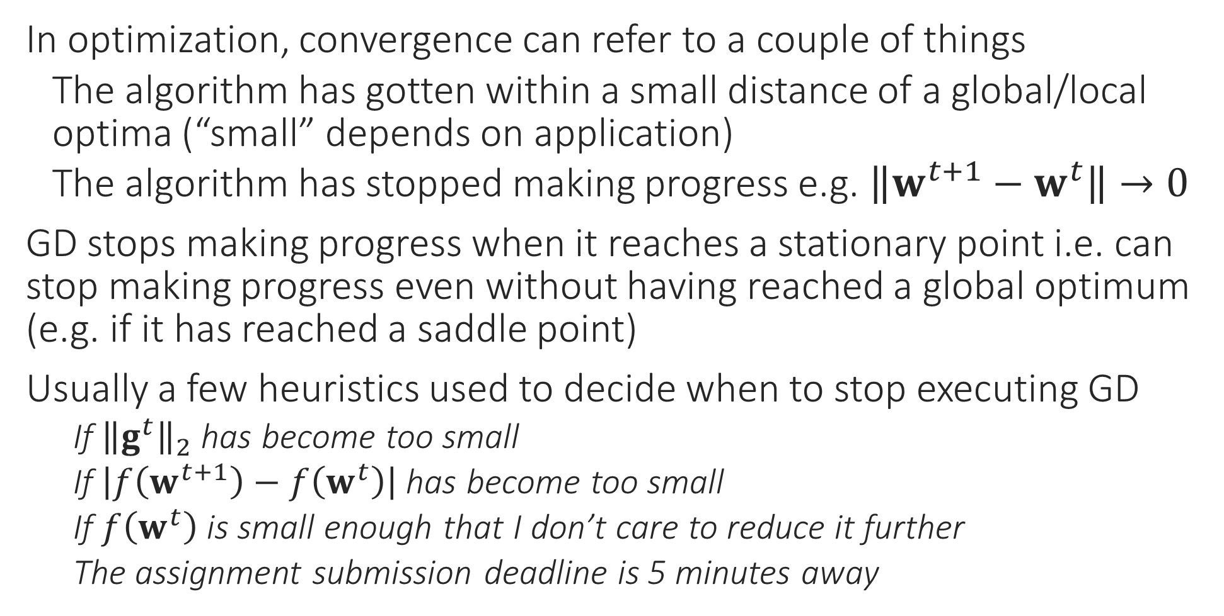
How to decide Convergence?
In optimization, convergence can refer to a couple of things
The algorithm has gotten within a small distance of a global/local optima (“small” depends on application)
The algorithm has stopped making progress e.g. $\left\|w^{t+1}−w^{t}\right\|→0$
GD stops making progress when it reaches a stationary point i.e. can stop making progress even without having reached a global optimum (e.g. if it has reached a saddle point)
Usually a few heuristics used to decide when to stop executing GD
If ${\left\|g^{t}\right\|}_{2}$ has become too small
If $\left|f\left(w^{t+1}\right)−f\left(w^{t}\right)\right|$ has become too small
If $f\left(w^{t}\right)$ is small enough that I don’t care to reduce it further
The assignment submission deadline is 5 minutes away

Slide 17
How to Initialize?
Initializing close to the global optimum is obviously preferable ☺
For convex functions, bad initialization may mean slow convergence, but if step lengths are nice then GD should converge eventually
For non-convex functions (e.g. while training deepnets), bad initialization may mean getting stuck at a very bad saddle point
Random restarts used to overcome this problem
For some nice non-convex problems, we do know very good ways to provably initialize close to the global optimum (e.g. collaborative filtering in recommendation systems) – details beyond scope of CS771

