Slide 1
Optimus III
CS771: Introduction to Machine Learning
Purushottam Kar

Slide 2
Recap of Last Lecture
Notion of subgradient that elegantly extends the notion of derivative to non-differentiable functions that are nevertheless convex
Subgradient calculus: scaling, sum, chain, max rules
Using the first order optimality condition to solve simple optimization problems
Using (sub)gradient descent to solve general optimization problems
Notions of initialization, step length, convergence

Slide 3

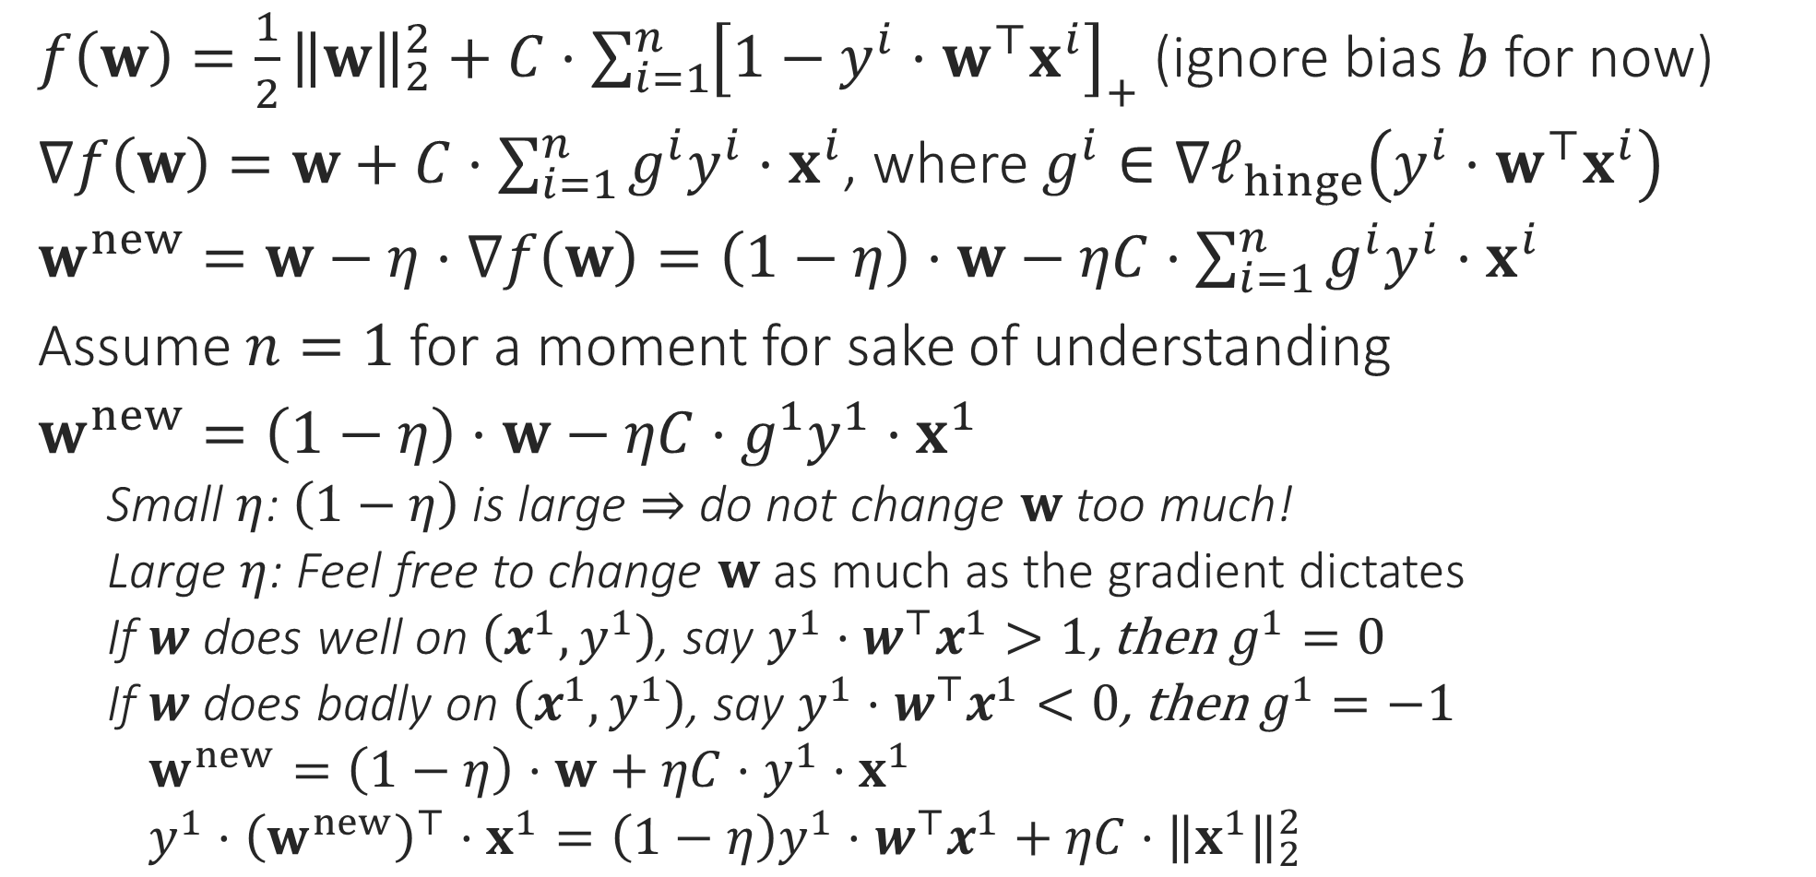

Behind the scenes in GD
So gradient descent, although a mathematical tool from calculus, actually tries very actively to make the model perform better on all data points
$f\left(w\right)=\frac{1}{2}{\left\|w\right\|}_{2}^{2}+C⋅{\sum_{i=1}^{n}{\left[1−y^{i}⋅w^{⊤}x^{i}\right]}}_{+}$ (ignore bias $b$ for now)
$∇f\left(w\right)=w+C⋅\sum_{i=1}^{n}{g^{i}y^{i}⋅x^{i}}$, where $g^{i}∈∇ℓ_{hinge}\left(y^{i}⋅w^{⊤}x^{i}\right)$
$w^{new}=w−η⋅∇f\left(w\right)=\left(1−η\right)⋅w−ηC⋅\sum_{i=1}^{n}{g^{i}y^{i}⋅x^{i}}$
Assume $n=1$ for a moment for sake of understanding
$w^{new}=\left(1−η\right)⋅w−ηC⋅g^{1}y^{1}⋅x^{1}$
Small $η$: $\left(1−η\right)$ is large $⇒$ do not change $w$ too much!
Large $η$: Feel free to change $w$ as much as the gradient dictates
If $w$ does well on $\left(x^{1},y^{1}\right)$, say $y^{1}⋅w^{⊤}x^{1}>1$, then $g^{1}=0$
If $w$ does badly on $\left(x^{1},y^{1}\right)$, say $y^{1}⋅w^{⊤}x^{1}<0$, then $g^{1}=−1$
$w^{new}=\left(1−η\right)⋅w+ηC⋅y^{1}⋅x^{1}$
$y^{1}⋅{\left(w^{new}\right)}^{⊤}⋅x^{1}={\left(1−η\right)y}^{1}⋅w^{⊤}x^{1}+ηC⋅{\left\|x^{1}\right\|}_{2}^{2}$
No change to $w$ due to the data point $\left(x^{1},y^{1}\right)$
$w^{new}$ may get much better margin on $\left(x^{1},y^{1}\right)$ than $w$

Slide 4

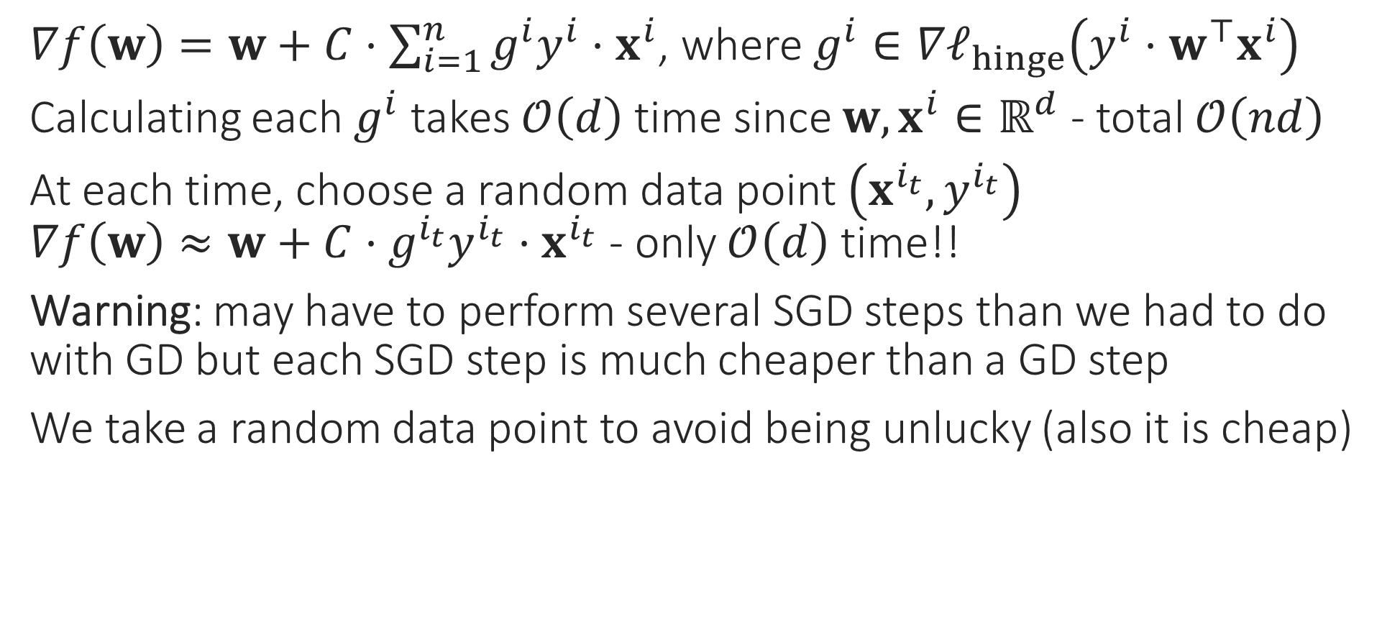
Stochastic Gradient Method
$∇f\left(w\right)=w+C⋅\sum_{i=1}^{n}{g^{i}y^{i}⋅x^{i}}$, where $g^{i}∈∇ℓ_{hinge}\left(y^{i}⋅w^{⊤}x^{i}\right)$
Calculating each $g^{i}$ takes $𝒪\left(d\right)$ time since $w,x^{i}∈ℝ^{d}$ - total $𝒪\left(nd\right)$
At each time, choose a random data point $\left(x^{i_{t}},y^{i_{t}}\right)$ $∇f\left(w\right)≈w+C⋅g^{i_{t}}y^{i_{t}}⋅x^{i_{t}}$ - only $𝒪\left(d\right)$ time!!
Warning: may have to perform several SGD steps than we had to do with GD but each SGD step is much cheaper than a GD step
We take a random data point to avoid being unlucky (also it is cheap)
Do we really need to spend so much time on just one update?
Initially, all we need is a general direction in which to move
Especially in the beginning, when we are far away from the optimum!
No, SGD gives a cheaper way to perform gradient descent

Slide 5
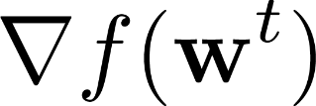
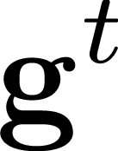
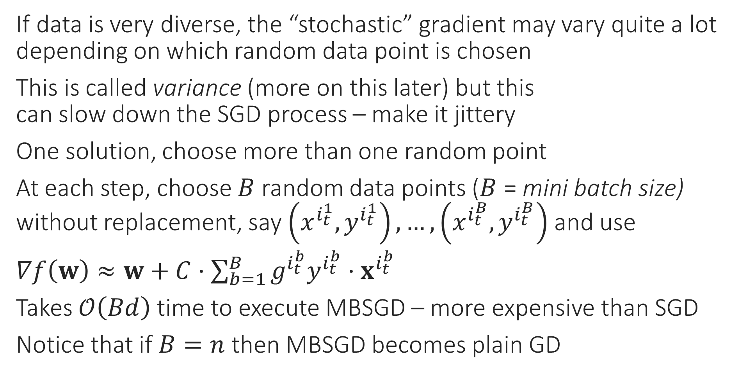
Mini-batch SGD
If data is very diverse, the “stochastic” gradient may vary quite a lot depending on which random data point is chosen
This is called variance (more on this later) but this can slow down the SGD process – make it jittery
One solution, choose more than one random point
At each step, choose $B$ random data points ($B$ = mini batch size) without replacement, say $\left(x^{i_{t}^{1}},y^{i_{t}^{1}}\right),…,\left(x^{i_{t}^{B}},y^{i_{t}^{B}}\right)$ and use
$∇f\left(w\right)≈w+C⋅\sum_{b=1}^{B}{g^{i_{t}^{b}}y^{i_{t}^{b}}⋅x^{i_{t}^{b}}}$
Takes $𝒪\left(Bd\right)$ time to execute MBSGD – more expensive than SGD
Notice that if $B=n$ then MBSGD becomes plain GD

Slide 6
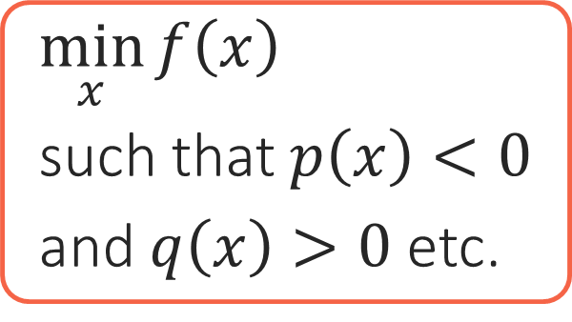
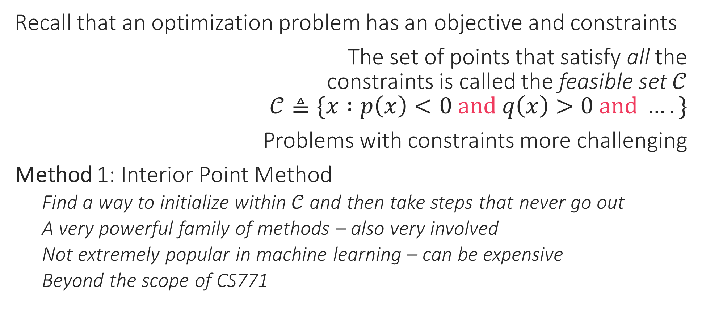
Constrained Optimization
Recall that an optimization problem has an objective and constraints
The set of points that satisfy all the constraints is called the feasible set $𝒞$ $𝒞≜\{x :p\left(x\right)<0 and q\left(x\right)>0 and ….\}$
Problems with constraints more challenging
Method 1: Interior Point Method
Find a way to initialize within $𝒞$ and then take steps that never go out
A very powerful family of methods – also very involved
Not extremely popular in machine learning – can be expensive
Beyond the scope of CS771
Objective
Constraints
$\min_{x}{f\left(x\right)}$
such that $p\left(x\right)<0$
and $q\left(x\right)>0$ etc.

Slide 7




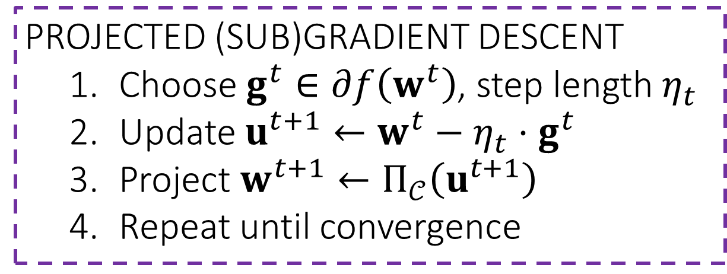
Constrained Optimization
Method 2: Projected Gradient Descent
Perform (stochastic) gradient descent as usual. However, if this causes us to step outside the feasible set $𝒞$, go back to the feasible set
Process of “going back” into $𝒞$: projection step $\hat{x}=Π_{𝒞}\left(x\right)=\arg{\min_{z∈𝒞}{{\left\|x−z\right\|}_{2}^{2}}}$
Warning: works only if $𝒞$ is such that projection step is easy
PROJECTED (SUB)GRADIENT DESCENT
Choose $g^{t}∈∂f\left(w^{t}\right)$, step length $η_{t}$
Update $u^{t+1}←w^{t}−η_{t}⋅g^{t}$
Project $w^{t+1}←Π_{𝒞}\left(u^{t+1}\right)$
Repeat until convergence
Projection

Slide 8
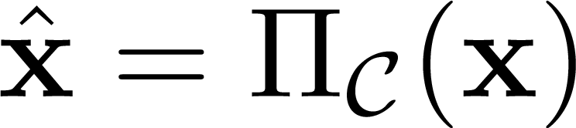
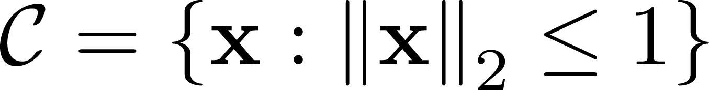

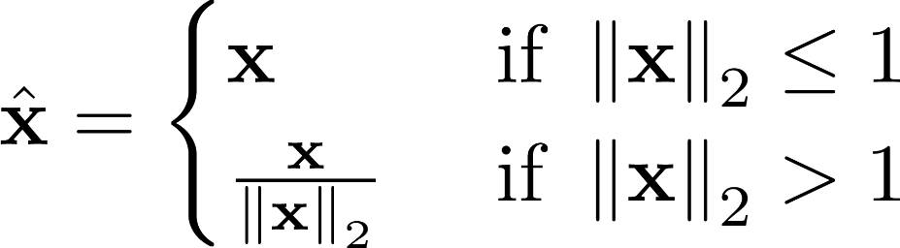
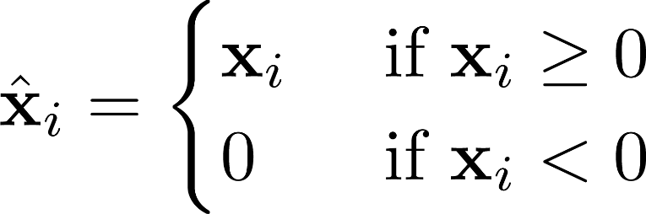
A few useful Projections

Slide 9





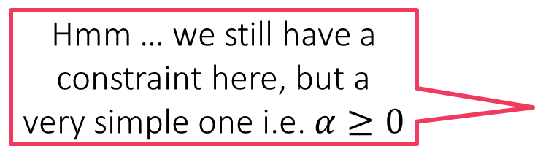

Constrained Optimization
Method 3: Creating a Dual Problem
Suppose we wish to solve $\min_{x∈ℝ^{d}}{f\left(x\right)}+r\left(x\right)$ s.t. $g\left(x\right)≤0$
Trick: sneak this constraint into the objective
Construct a barrier function $r\left(x\right)$ so that $r\left(x\right)=0$ if $g\left(x\right)≤0$ and $r\left(x\right)=∞$ otherwise, and simply solve
Easy to see that both problems have the same solution
One very elegant way to construct such a barrier is the following $r\left(x\right)=\max_{α≥0}{α⋅g\left(x\right)}$
Thus, we want to solve $\min_{x∈ℝ^{d}}\left\{f\left(x\right)+\max_{α≥0}{α⋅g\left(x\right)}\right\}$
Let us see how to handle multiple constraints and equality constraints
Hmm … we still have a constraint here, but a very simple one i.e. $α≥0$
Same as $\min_{x∈ℝ^{d}}\left\{\max_{α≥0} \left\{f\left(x\right)+α⋅g\left(x\right)\right\}\right\}$

Slide 10

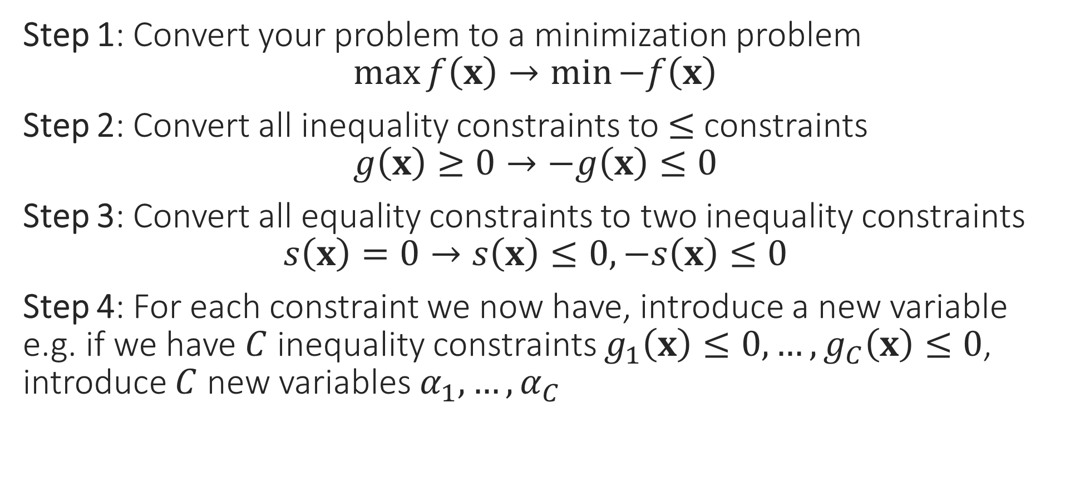

A few Cleanup Steps
Step 1: Convert your problem to a minimization problem $\max{f\left(x\right)}→\min{−f\left(x\right)}$
Step 2: Convert all inequality constraints to $≤$ constraints $g\left(x\right)≥0→−g\left(x\right)≤0$
Step 3: Convert all equality constraints to two inequality constraints $s\left(x\right)=0→s\left(x\right)≤0,−s\left(x\right)≤0$
Step 4: For each constraint we now have, introduce a new variable e.g. if we have $C$ inequality constraints $g_{1}\left(x\right)≤0,…,g_{C}\left(x\right)≤0$, introduce $C$ new variables $α_{1},…,α_{C}$
These new variables are called dual variables or sometimes even called Lagrange multipliers
The variables of the original optimization problem, e.g. $x$in this case, are called the primal variables by comparison

Slide 11

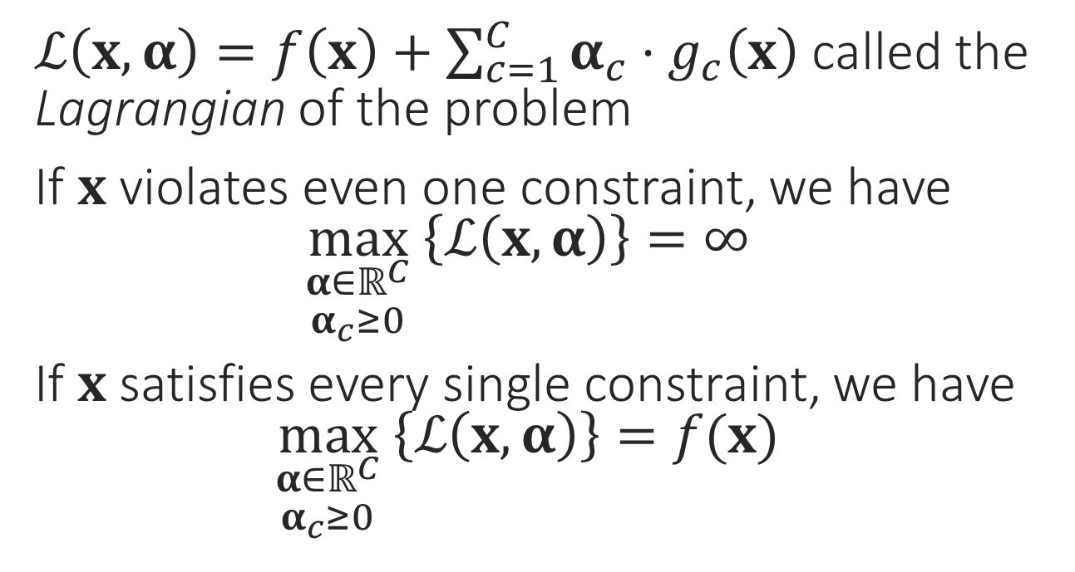
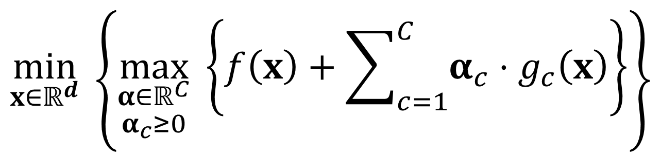
The Lagrangian
$\min_{x}{f\left(x\right)}$
s.t. $g_{1}\left(x\right)≤0$
$g_{2}\left(x\right)≤0$ $$⋮$$ $g_{C}\left(x\right)≤0$
$ℒ\left(x,α\right)=f\left(x\right)+\sum_{c=1}^{C}{α_{c}⋅g_{c}\left(x\right)}$ called the Lagrangian of the problem
If $x$ violates even one constraint, we have $\max_{\begin{aligned}α∈ℝ^{C} \\ α_{c}≥0\end{aligned}} \left\{ℒ\left(x,α\right)\right\}=∞$
If $x$ satisfies every single constraint, we have $\max_{\begin{aligned}α∈ℝ^{C} \\ α_{c}≥0\end{aligned}} \left\{ℒ\left(x,α\right)\right\}=f(x)$
This is just a nice way of rewriting the above problem
$$\min_{x∈ℝ^{d}}\left\{\max_{\begin{aligned}α∈ℝ^{C} \\ α_{c}≥0\end{aligned}} \left\{f\left(x\right)+\sum_{c=1}^{C}{α_{c}⋅g_{c}\left(x\right)}\right\}\right\}$$

Slide 12
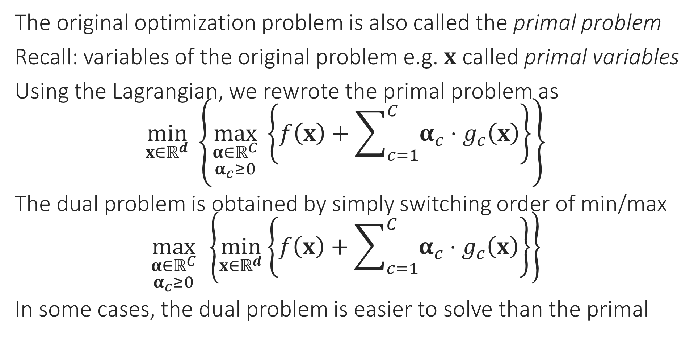
The Dual Problem
The original optimization problem is also called the primal problem
Recall: variables of the original problem e.g. $x$ called primal variables
Using the Lagrangian, we rewrote the primal problem as $\min_{x∈ℝ^{d}}\left\{\max_{\begin{aligned}α∈ℝ^{C} \\ α_{c}≥0\end{aligned}} \left\{f\left(x\right)+\sum_{c=1}^{C}{α_{c}⋅g_{c}\left(x\right)}\right\}\right\}$
The dual problem is obtained by simply switching order of min/max $\max_{\begin{aligned}α∈ℝ^{C} \\ α_{c}≥0\end{aligned}}\left\{\min_{x∈ℝ^{d}}\left\{f\left(x\right)+\sum_{c=1}^{C}{α_{c}⋅g_{c}\left(x\right)}\right\}\right\}$
In some cases, the dual problem is easier to solve than the primal

Slide 13
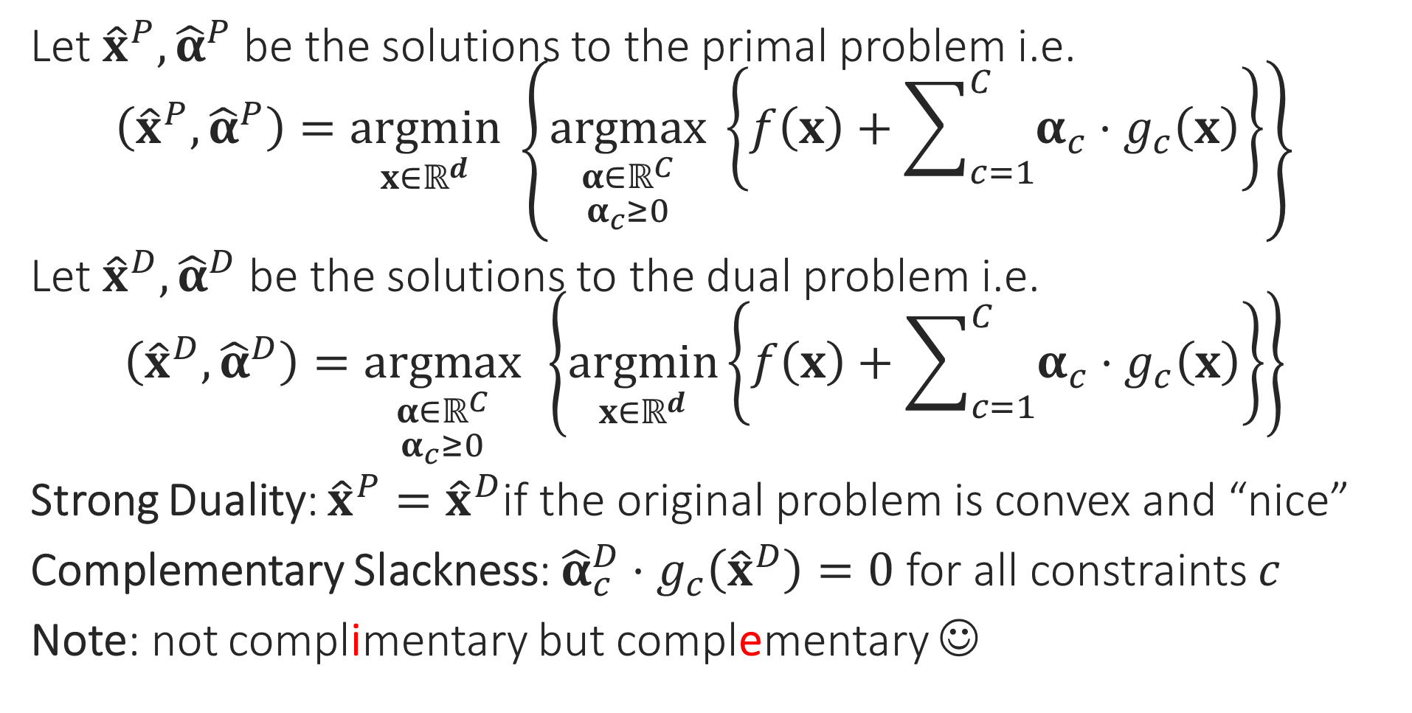
Duality
Let ${\hat{x}}^{P},{\hat{α}}^{P}$ be the solutions to the primal problem i.e. $\left({\hat{x}}^{P},{\hat{α}}^{P}\right)=\underset{x∈ℝ^{d}}{argmin}\left\{\underset{\begin{aligned}α∈ℝ^{C} \\ α_{c}≥0\end{aligned}}{argmax} \left\{f\left(x\right)+\sum_{c=1}^{C}{α_{c}⋅g_{c}\left(x\right)}\right\}\right\}$
Let ${\hat{x}}^{D},{\hat{α}}^{D}$ be the solutions to the dual problem i.e. $\left({\hat{x}}^{D},{\hat{α}}^{D}\right)=\underset{\begin{aligned}α∈ℝ^{C} \\ α_{c}≥0\end{aligned}}{argmax}\left\{\underset{x∈ℝ^{d}}{argmin}\left\{f\left(x\right)+\sum_{c=1}^{C}{α_{c}⋅g_{c}\left(x\right)}\right\}\right\}$
Strong Duality: ${\hat{x}}^{P}={\hat{x}}^{D}$if the original problem is convex and “nice”
Complementary Slackness: ${\hat{α}}_{c}^{D}⋅g_{c}\left({\hat{x}}^{D}\right)=0$ for all constraints $c$
Note: not complimentary but complementary ☺

Slide 14
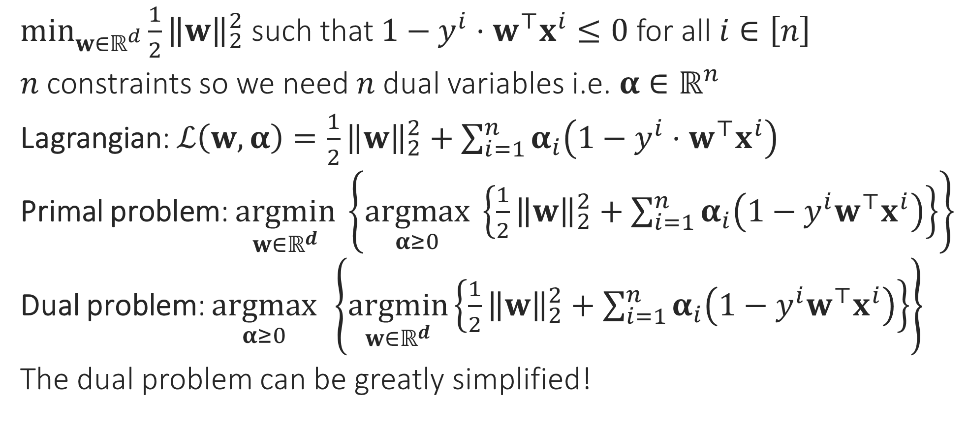
Hard SVM without a bias
$\min_{w∈ℝ^{d}}{\frac{1}{2}{\left\|w\right\|}_{2}^{2}}$ such that $1−y^{i}⋅w^{⊤}x^{i}≤0$ for all $i∈\left[n\right]$
$n$ constraints so we need $n$ dual variables i.e. $α∈ℝ^{n}$
Lagrangian: $ℒ\left(w,α\right)=\frac{1}{2}{\left\|w\right\|}_{2}^{2}+\sum_{i=1}^{n}{α_{i}\left(1−y^{i}⋅w^{⊤}x^{i}\right)}$
Primal problem: $\underset{w∈ℝ^{d}}{argmin}\left\{\underset{α≥0}{argmax} \left\{\frac{1}{2}{\left\|w\right\|}_{2}^{2}+\sum_{i=1}^{n}{α_{i}\left(1−y^{i}w^{⊤}x^{i}\right)}\right\}\right\}$
Dual problem: $\underset{α≥0}{argmax}\left\{\underset{w∈ℝ^{d}}{argmin}\left\{\frac{1}{2}{\left\|w\right\|}_{2}^{2}+\sum_{i=1}^{n}{α_{i}\left(1−y^{i}w^{⊤}x^{i}\right)}\right\}\right\}$
The dual problem can be greatly simplified!

Slide 15
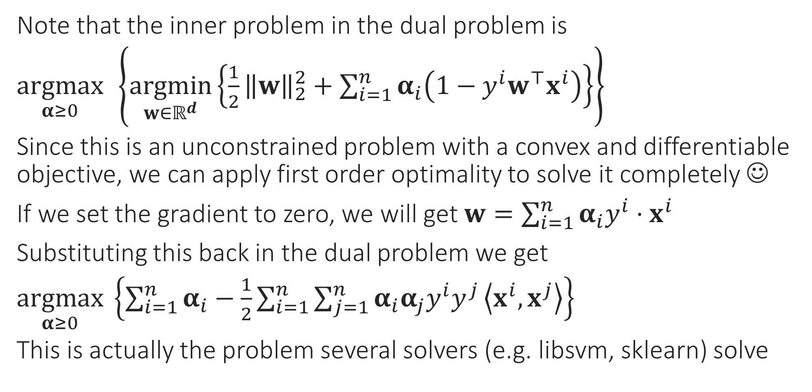
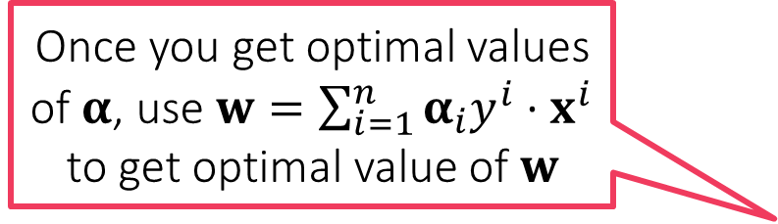
Simplifying the Dual Problem
Once you get optimal values of $α$, use $w=\sum_{i=1}^{n}{α_{i}y^{i}⋅x^{i}}$ to get optimal value of $w$
Note that the inner problem in the dual problem is
$\underset{α≥0}{argmax}\left\{\underset{w∈ℝ^{d}}{argmin}\left\{\frac{1}{2}{\left\|w\right\|}_{2}^{2}+\sum_{i=1}^{n}{α_{i}\left(1−y^{i}w^{⊤}x^{i}\right)}\right\}\right\}$
Since this is an unconstrained problem with a convex and differentiable objective, we can apply first order optimality to solve it completely ☺
If we set the gradient to zero, we will get $w=\sum_{i=1}^{n}{α_{i}y^{i}⋅x^{i}}$
Substituting this back in the dual problem we get
$\underset{α≥0}{argmax} \left\{\sum_{i=1}^{n}{α_{i}}−\frac{1}{2}\sum_{i=1}^{n}{\sum_{j=1}^{n}{α_{i}α_{j}y^{i}y^{j}}\left\langle x^{i},x^{j}\right\rangle }\right\}$
This is actually the problem several solvers (e.g. libsvm, sklearn) solve

Slide 16

Support Vectors
Support Vectors!!
Recall: we have $α_{i}$ for every data point
After solving the dual problem, the data points for which $α_{i}≠0$: Support Vectors
Usually we have $≪n$ support vectors
Recall: complementary slackness tells us that $α_{i}\left(1−y^{i}w^{⊤}x^{i}\right)=0$ i.e. only those data points can become SVs for which $y^{i}w^{⊤}x^{i}=1$ i.e. at margin
The reason these are called support vectors has to do with a mechanical interpretation of these objects – need to look at CSVM to understand that

Slide 17
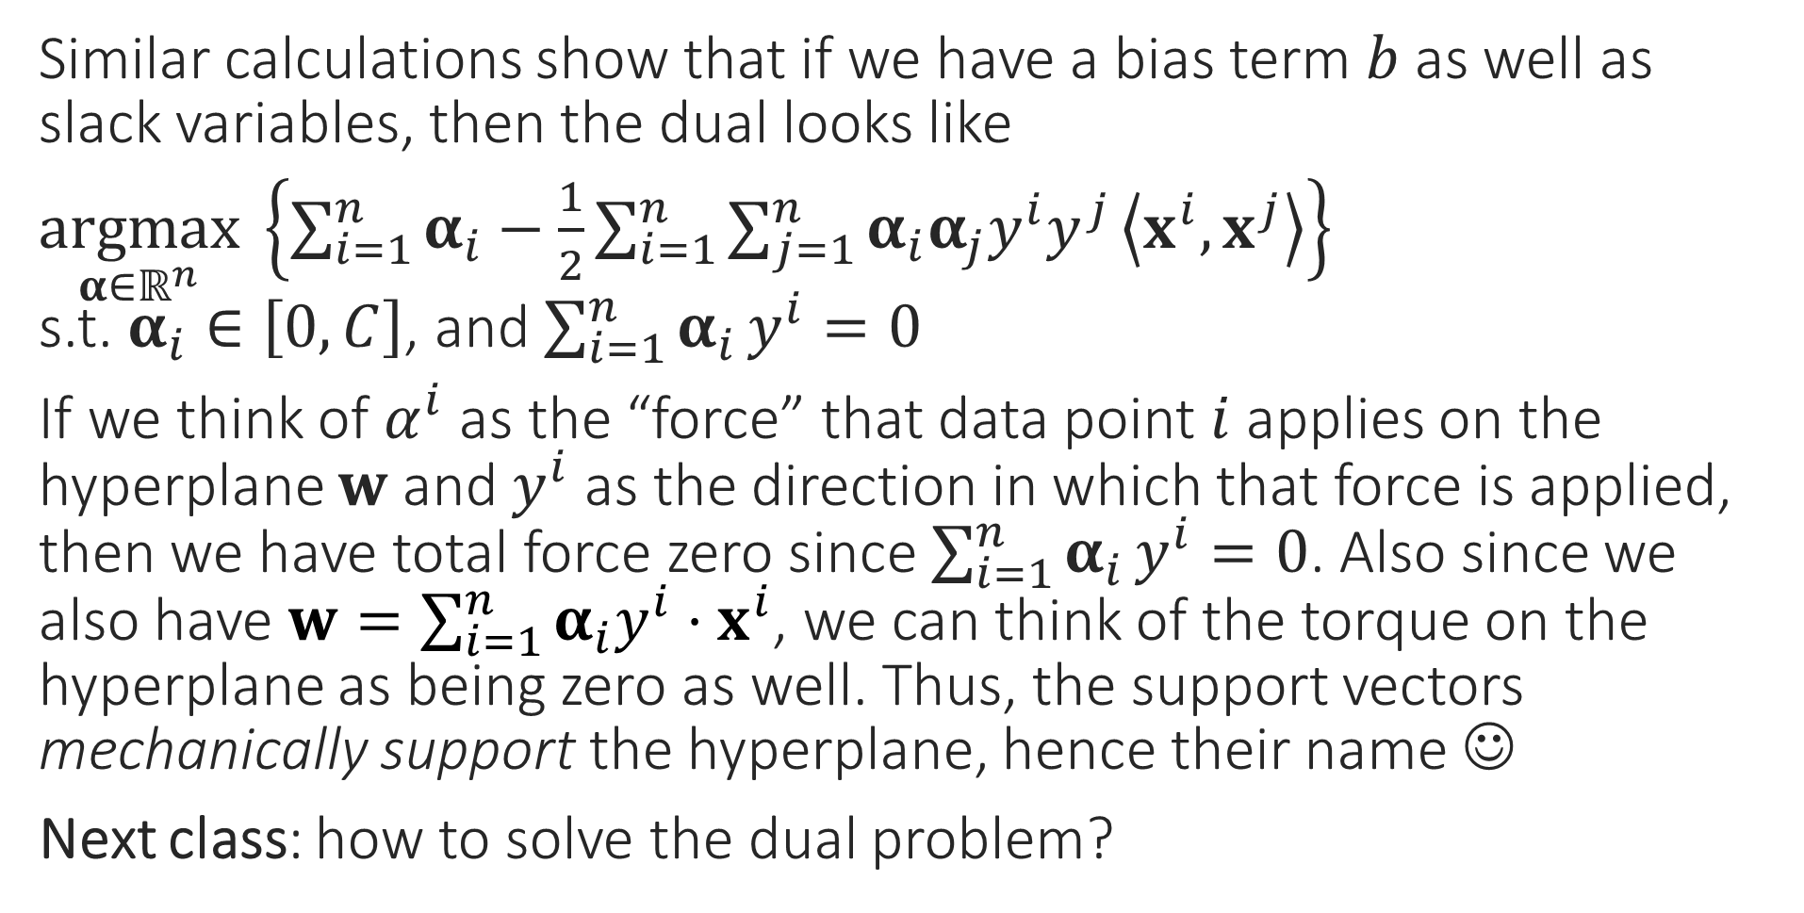
Dual for CSVM
Similar calculations show that if we have a bias term $b$ as well as slack variables, then the dual looks like
$\underset{α∈ℝ^{n}}{argmax} \left\{\sum_{i=1}^{n}{α_{i}}−\frac{1}{2}\sum_{i=1}^{n}{\sum_{j=1}^{n}{α_{i}α_{j}y^{i}y^{j}}\left\langle x^{i},x^{j}\right\rangle }\right\}$ s.t. $α_{i}∈\left[0,C\right]$, and $\sum_{i=1}^{n}{α_{i}}y^{i}=0$
If we think of $α^{i}$ as the “force” that data point $i$ applies on the hyperplane $w$ and $y^{i}$ as the direction in which that force is applied, then we have total force zero since $\sum_{i=1}^{n}{α_{i}}y^{i}=0$. Also since we also have $w=\sum_{i=1}^{n}{α_{i}y^{i}⋅x^{i}}$, we can think of the torque on the hyperplane as being zero as well. Thus, the support vectors mechanically support the hyperplane, hence their name ☺
Next class: how to solve the dual problem?

