Slide 1
Linear Models II
CS771: Introduction to Machine Learning
Purushottam Kar

Slide 2
Recap of Last Lecture
Looked at SGD as a speedier way to implement GD
Mini-batch SGD as a more stable version of SGD
Dealing with constraints in optimization problems
Projected Gradient Descent: simple but only if projection is easy
Lagrangian Dual Problems: notions of dual variables/Lagrange multipliers, Lagrangian, primal/dual problems
Strong duality, complementary slackness
Looked at the dual problem for the CSVM (with/without bias/slack)

Slide 3
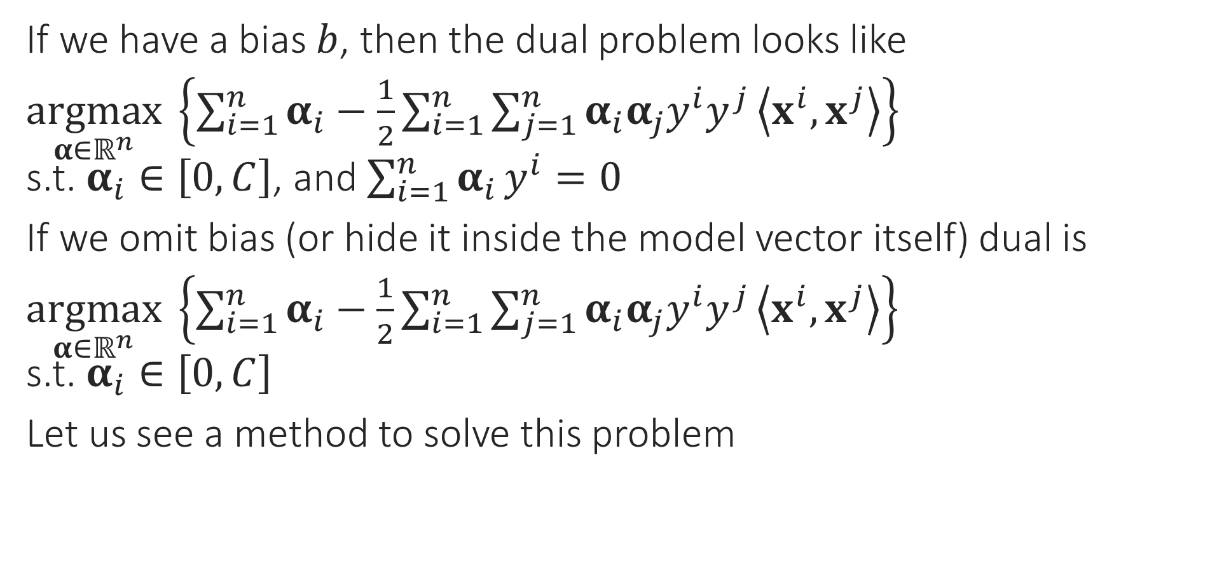
CSVM Dual Problem
If we have a bias $b$, then the dual problem looks like
$\underset{α∈ℝ^{n}}{argmax} \left\{\sum_{i=1}^{n}{α_{i}}−\frac{1}{2}\sum_{i=1}^{n}{\sum_{j=1}^{n}{α_{i}α_{j}y^{i}y^{j}}\left\langle x^{i},x^{j}\right\rangle }\right\}$ s.t. $α_{i}∈\left[0,C\right]$, and $\sum_{i=1}^{n}{α_{i}}y^{i}=0$
If we omit bias (or hide it inside the model vector itself) dual is
$\underset{α∈ℝ^{n}}{argmax} \left\{\sum_{i=1}^{n}{α_{i}}−\frac{1}{2}\sum_{i=1}^{n}{\sum_{j=1}^{n}{α_{i}α_{j}y^{i}y^{j}}\left\langle x^{i},x^{j}\right\rangle }\right\}$ s.t. $α_{i}∈\left[0,C\right]$
Let us see a method to solve this problem

Slide 4

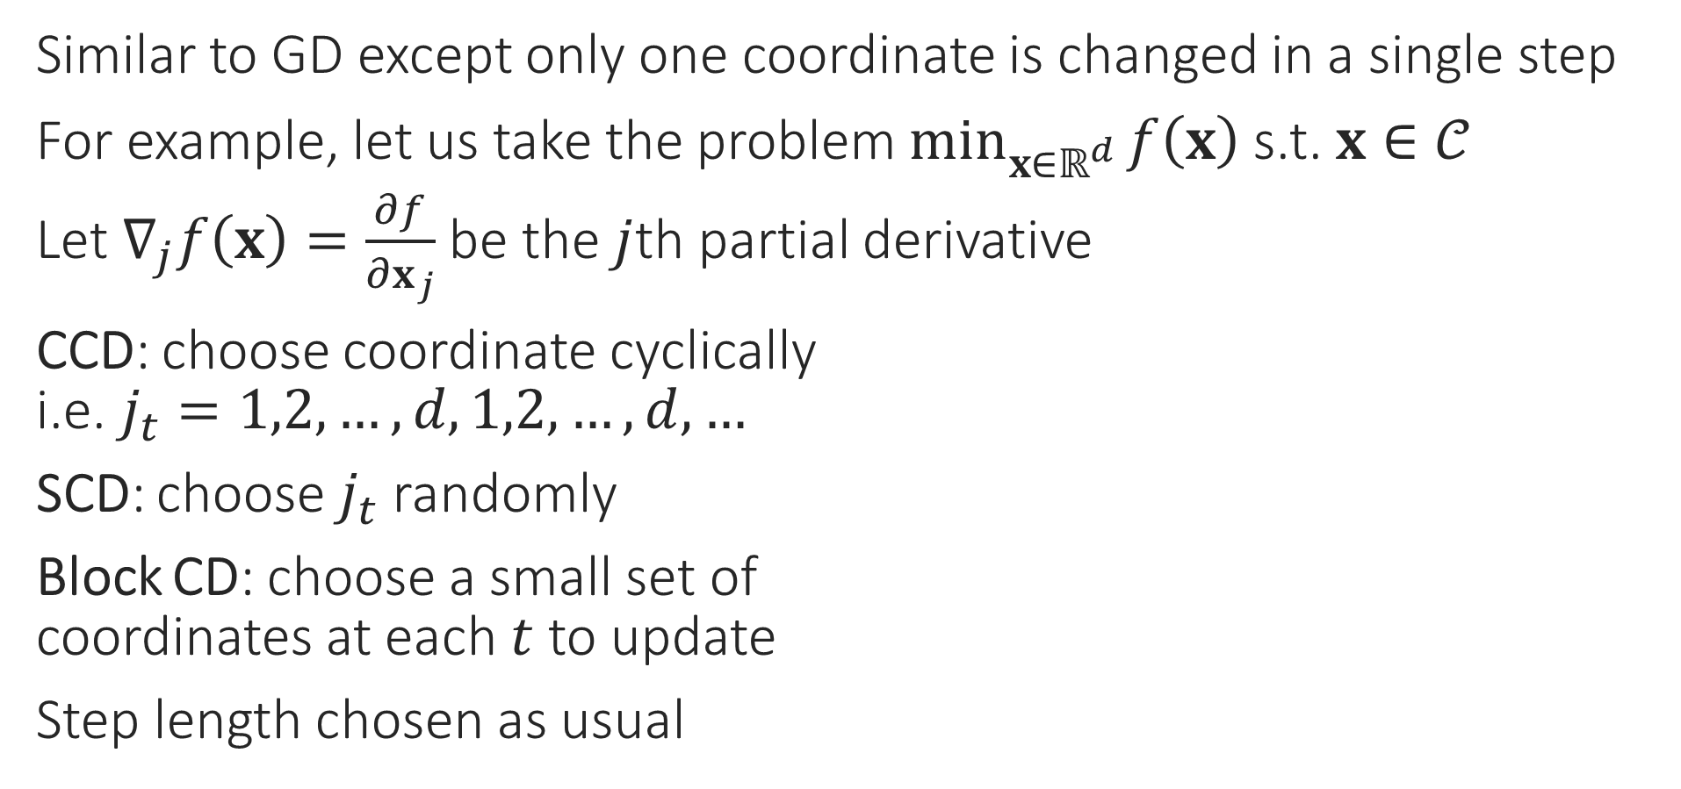
Coordinate Descent
Similar to GD except only one coordinate is changed in a single step
For example, let us take the problem $\min_{x∈ℝ^{d}}{f\left(x\right)}$ s.t. $x∈𝒞$
Let $∇_{j}f\left(x\right)=\frac{∂f}{∂x_{j}}$ be the $j$th partial derivative
CCD: choose coordinate cyclically i.e. $j_{t}=1,2,…,d,1,2,…,d,…$
SCD: choose $j_{t}$ randomly
Block CD: choose a small set of coordinates at each $t$ to update
Step length chosen as usual
(PROJECTED) COORDINATE DESCENT
1. For $t=0,1,…$
Select a coordinate $j_{t}∈\left[d\right]$
Let $u_{j_{t}}^{t+1}←x_{j_{t}}^{t}−η_{t}⋅∇_{j_{t}}f\left(x^{t}\right)$
Let $u_{j}^{t+1}←x_{j}^{t}$ for $j≠j_{t}$
Project $x^{t+1}←Π_{𝒞}\left(u^{t+1}\right)$
Repeat until convergence

Slide 5
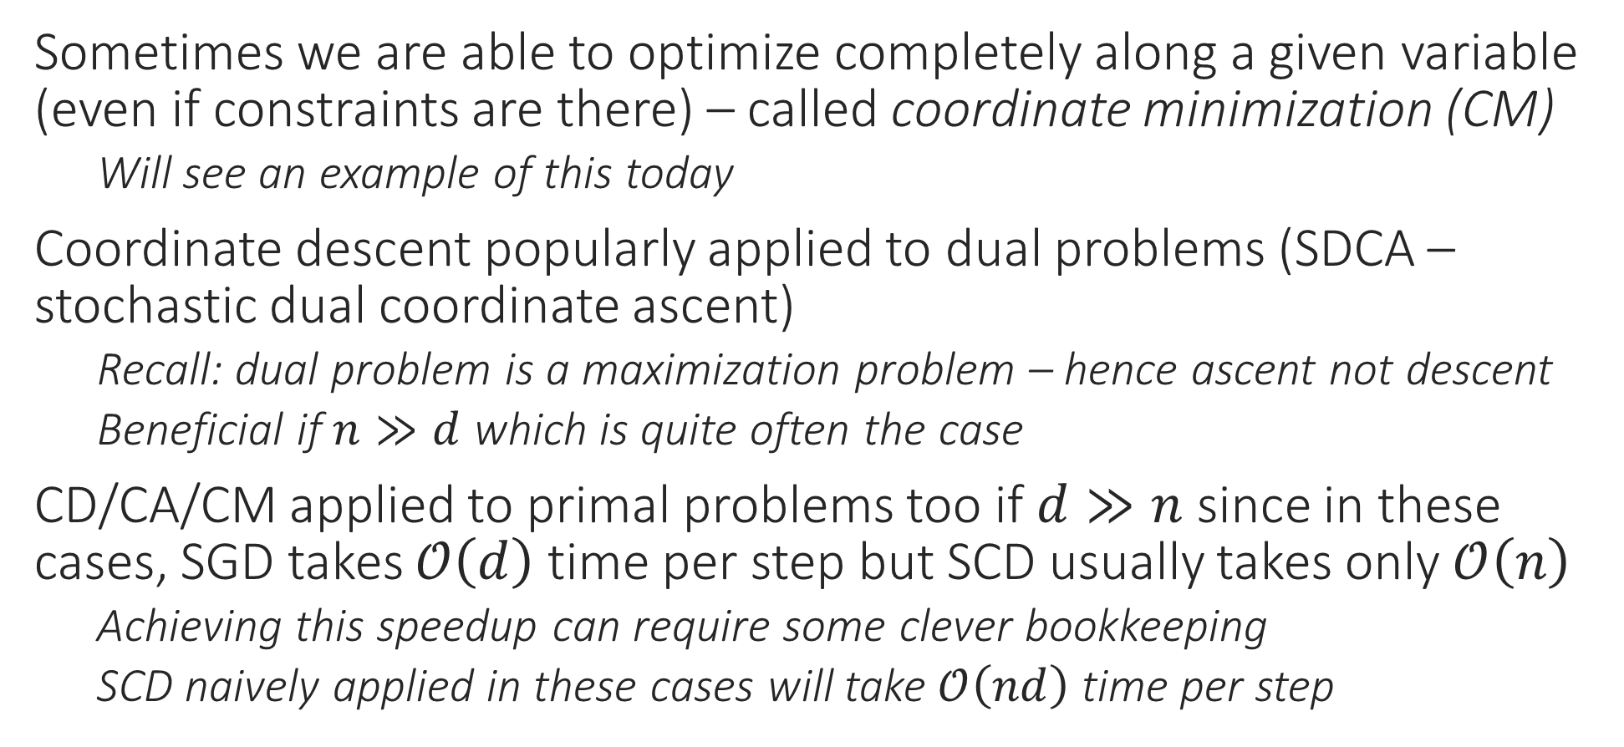
Coordinate Descent
Sometimes we are able to optimize completely along a given variable (even if constraints are there) – called coordinate minimization (CM)
Will see an example of this today
Coordinate descent popularly applied to dual problems (SDCA – stochastic dual coordinate ascent)
Recall: dual problem is a maximization problem – hence ascent not descent
Beneficial if $n≫d$ which is quite often the case
CD/CA/CM applied to primal problems too if $d≫n$ since in these cases, SGD takes $𝒪\left(d\right)$ time per step but SCD usually takes only $𝒪\left(n\right)$
Achieving this speedup can require some clever bookkeeping
SCD naively applied in these cases will take $𝒪\left(nd\right)$ time per step

Slide 6

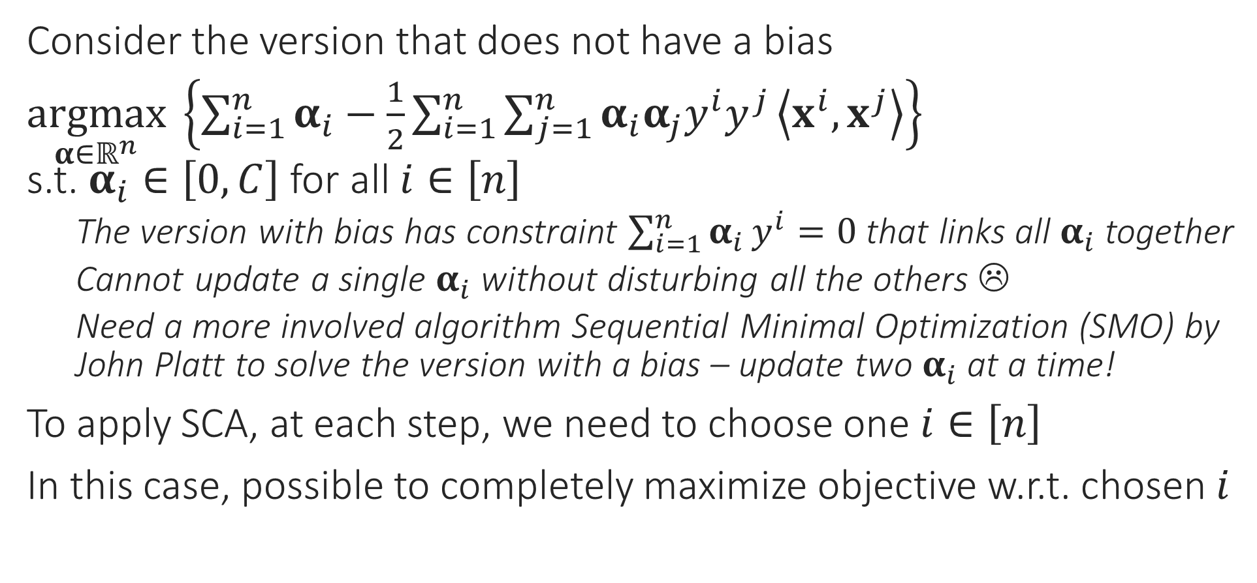
SDCA for the CSVM Problem
Does this mean I need to choose one data point at each time step?
Consider the version that does not have a bias
$\underset{α∈ℝ^{n}}{argmax} \left\{\sum_{i=1}^{n}{α_{i}}−\frac{1}{2}\sum_{i=1}^{n}{\sum_{j=1}^{n}{α_{i}α_{j}y^{i}y^{j}}\left\langle x^{i},x^{j}\right\rangle }\right\}$ s.t. $α_{i}∈\left[0,C\right]$ for all $i∈\left[n\right]$
The version with bias has constraint $\sum_{i=1}^{n}{α_{i}}y^{i}=0$ that links all $α_{i}$ together
Cannot update a single $α_{i}$ without disturbing all the others ☹
Need a more involved algorithm Sequential Minimal Optimization (SMO) by John Platt to solve the version with a bias – update two $α_{i}$ at a time!
To apply SCA, at each step, we need to choose one $i∈\left[n\right]$
In this case, possible to completely maximize objective w.r.t. chosen $i$
Yes, coordinate ascent in the dual looks a lot like stochastic gradient descent in the primal! Both work with a single data point at a time

Slide 7

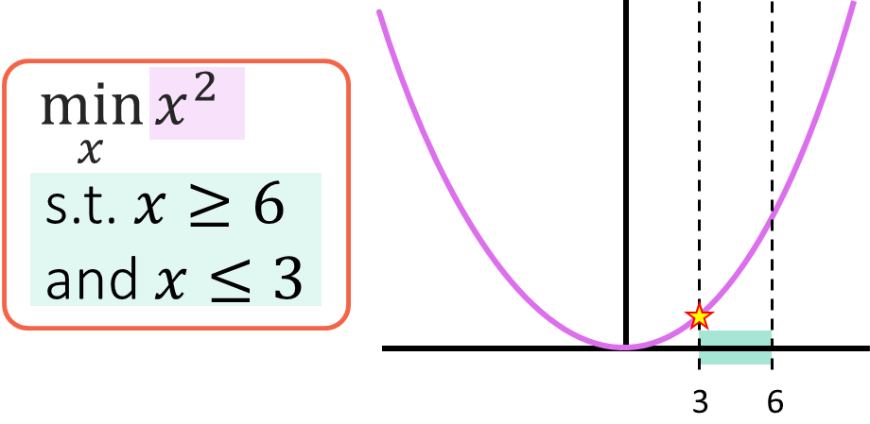

SDCA for the CSVM Problem
Warning: in general, finding an unconstrained solution and doing a projection step does not give a true solution
$\underset{α∈ℝ^{n}}{argmax} \left\{\sum_{i=1}^{n}{α_{i}}−\frac{1}{2}\sum_{i=1}^{n}{\sum_{j=1}^{n}{α_{i}α_{j}y^{i}y^{j}}\left\langle x^{i},x^{j}\right\rangle }\right\}$ s.t. $α_{i}∈\left[0,C\right]$ for all $i∈\left[n\right]$
Concentrating on just the terms that involve $α_{i}$ we get
$\underset{α_{i}∈ℝ}{argmax} \left\{α_{i}−\frac{1}{2}α_{i}^{2}{\left\|x^{i}\right\|}_{2}^{2}−α_{i}y^{i}⋅\sum_{j≠i}{α_{j}y^{j}}\left\langle x^{i},x^{j}\right\rangle \right\}$ s.t. $α_{i}∈\left[0,C\right]$
Renaming $x=α_{i}, q={\left\|x^{i}\right\|}_{2}^{2},p=y^{i}⋅\sum_{j≠i}{α_{j}y^{j}}\left\langle x^{i},x^{j}\right\rangle$, we get
$\arg{\min_{x}{\frac{1}{2}qx^{2}−x(1−p)}}$ s.t. $x∈\left[0,C\right]$
Solution is very simple: find unrestricted minimum i.e. $\tilde{x}=\left(1−p\right)/q$
If $\tilde{x}∈\left[0,C\right]$, solution is $\tilde{x}$ elif $\tilde{x}<0$, solution is $0$, else solution is $C$
Indeed! In this special case, our objective had a nice property called unimodality which is why this trick works – it won’t work in general

Slide 8
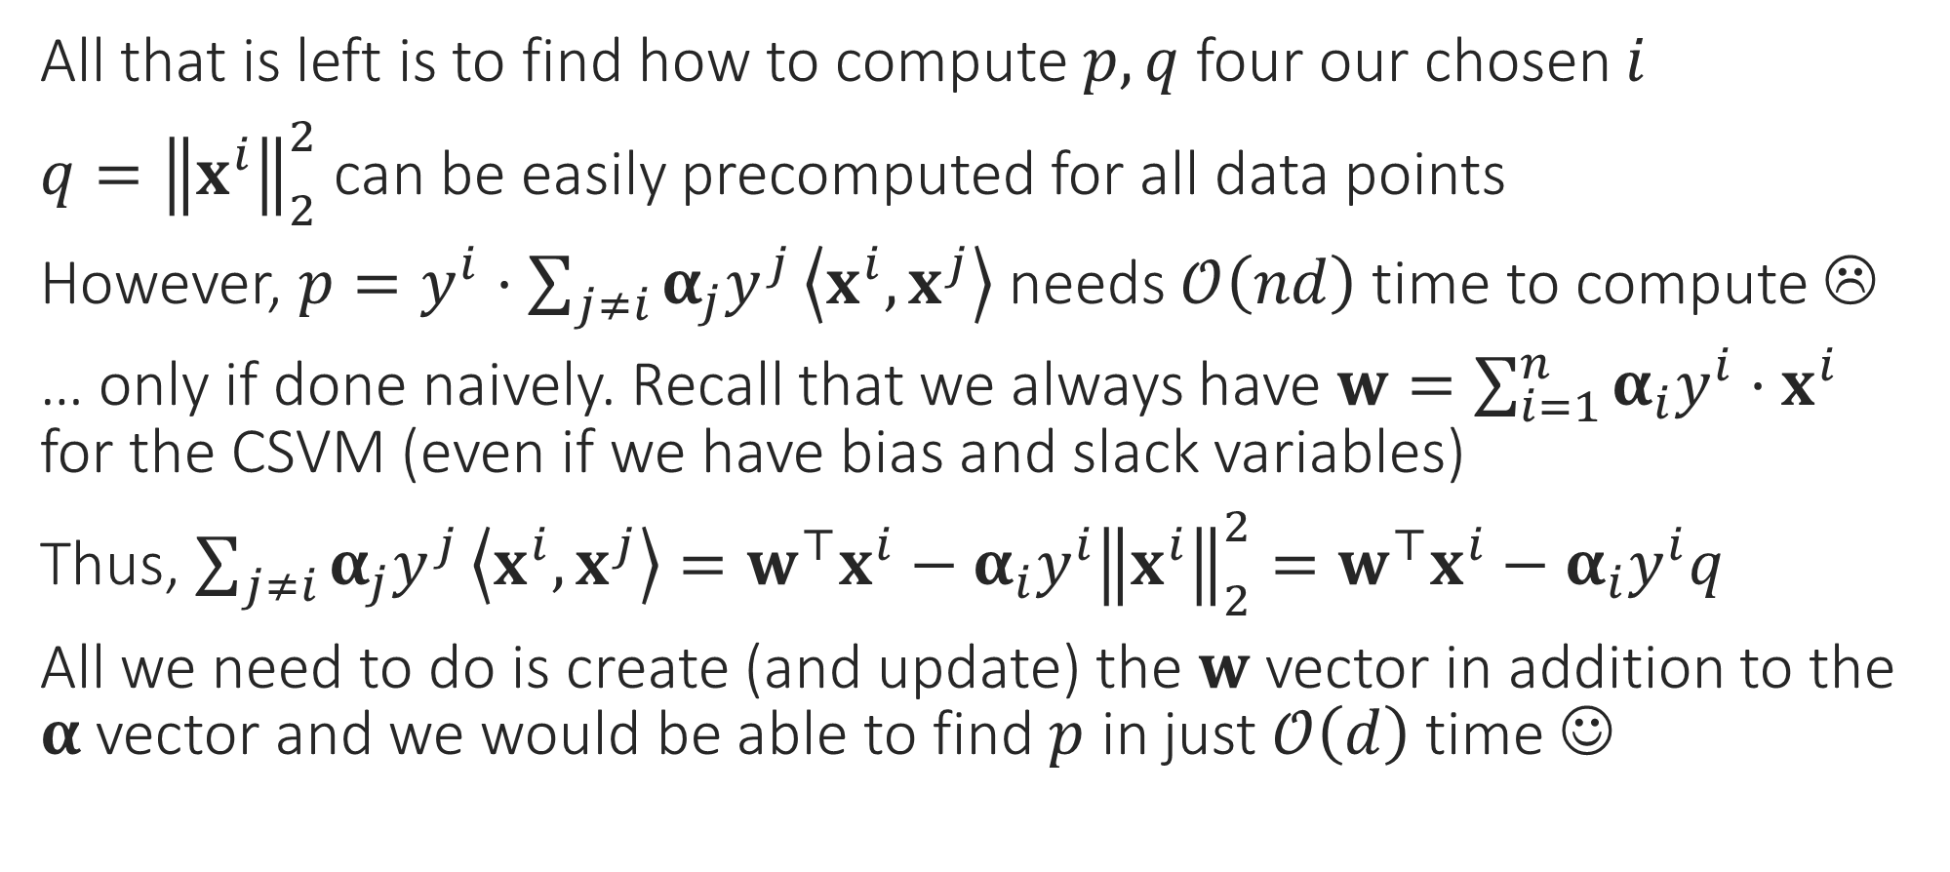
Speeding up SDCA computations
All that is left is to find how to compute $p,q$ four our chosen $i$
$q={\left\|x^{i}\right\|}_{2}^{2}$ can be easily precomputed for all data points
However, $p=y^{i}⋅\sum_{j≠i}{α_{j}y^{j}}\left\langle x^{i},x^{j}\right\rangle$ needs $𝒪\left(nd\right)$ time to compute ☹
… only if done naively. Recall that we always have $w=\sum_{i=1}^{n}{α_{i}y^{i}⋅x^{i}}$ for the CSVM (even if we have bias and slack variables)
Thus, $\sum_{j≠i}{α_{j}y^{j}}\left\langle x^{i},x^{j}\right\rangle =w^{⊤}x^{i}−α_{i}y^{i}{\left\|x^{i}\right\|}_{2}^{2}=w^{⊤}x^{i}−α_{i}y^{i}q$
All we need to do is create (and update) the $w$ vector in addition to the $α$ vector and we would be able to find $p$ in just $𝒪\left(d\right)$ time ☺

Slide 9

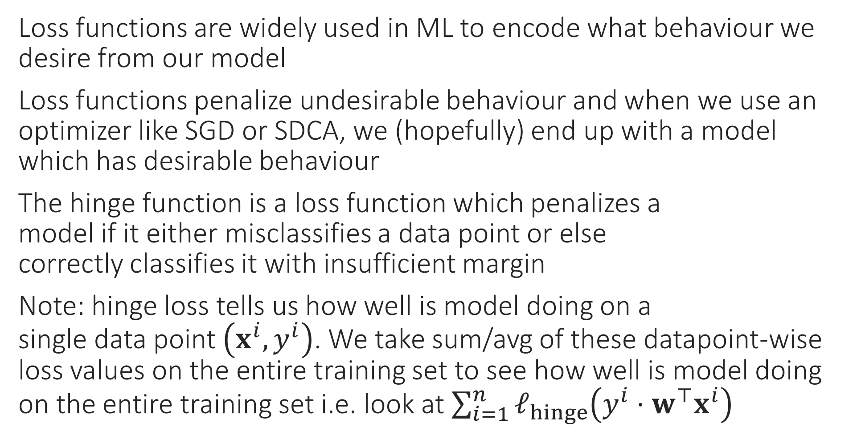

Loss Functions
Loss functions are widely used in ML to encode what behaviour we desire from our model
Loss functions penalize undesirable behaviour and when we use an optimizer like SGD or SDCA, we (hopefully) end up with a model which has desirable behaviour
The hinge function is a loss function which penalizes a model if it either misclassifies a data point or else correctly classifies it with insufficient margin
Note: hinge loss tells us how well is model doing on a single data point $\left(x^{i},y^{i}\right)$. We take sum/avg of these datapoint-wise loss values on the entire training set to see how well is model doing on the entire training set i.e. look at $\sum_{i=1}^{n}{ℓ_{hinge}\left(y^{i}⋅w^{⊤}x^{i}\right)}$
$$ℓ_{hinge}\left(y^{i}⋅w^{⊤}x^{i}\right)={\left[1−y^{i}⋅w^{⊤}x^{i}\right]}_{+}$$

Slide 10
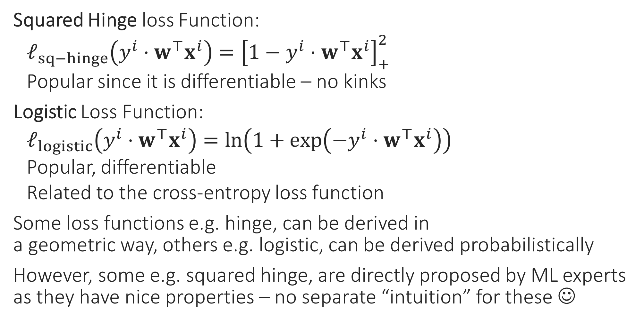
Other Classification Loss Functions
Squared Hinge loss Function:
$ℓ_{sq−hinge}\left(y^{i}⋅w^{⊤}x^{i}\right)={\left[1−y^{i}⋅w^{⊤}x^{i}\right]}_{+}^{2}$
Popular since it is differentiable – no kinks
Logistic Loss Function:
$ℓ_{logistic}\left(y^{i}⋅w^{⊤}x^{i}\right)=\ln\left(1+\exp\left(−y^{i}⋅w^{⊤}x^{i}\right)\right)$
Popular, differentiable
Related to the cross-entropy loss function
Some loss functions e.g. hinge, can be derived in a geometric way, others e.g. logistic, can be derived probabilistically
However, some e.g. squared hinge, are directly proposed by ML experts as they have nice properties – no separate “intuition” for these ☺

Slide 11
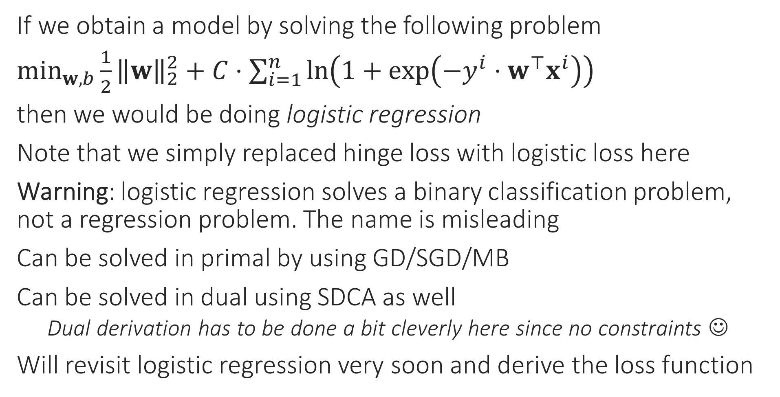
Logistic Regression
If we obtain a model by solving the following problem
$\min_{w,b}{\frac{1}{2}{\left\|w\right\|}_{2}^{2}}+C⋅\sum_{i=1}^{n}{\ln\left(1+\exp\left(−y^{i}⋅w^{⊤}x^{i}\right)\right)}$
then we would be doing logistic regression
Note that we simply replaced hinge loss with logistic loss here
Warning: logistic regression solves a binary classification problem, not a regression problem. The name is misleading
Can be solved in primal by using GD/SGD/MB
Can be solved in dual using SDCA as well
Dual derivation has to be done a bit cleverly here since no constraints ☺
Will revisit logistic regression very soon and derive the loss function

Slide 12
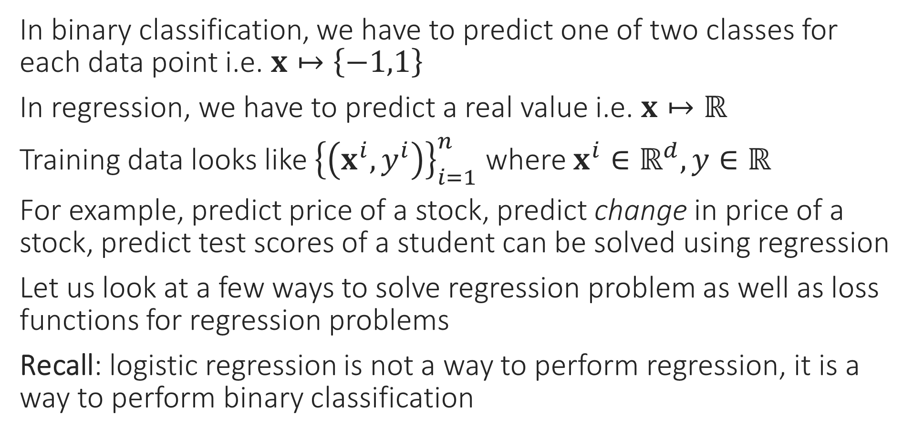
Regression Problems
In binary classification, we have to predict one of two classes for each data point i.e. $x↦\left\{−1,1\right\}$
In regression, we have to predict a real value i.e. $x↦ℝ$
Training data looks like ${\left\{\left(x^{i},y^{i}\right)\right\}}_{i=1}^{n}$ where $x^{i}∈ℝ^{d},y∈ℝ$
For example, predict price of a stock, predict change in price of a stock, predict test scores of a student can be solved using regression
Let us look at a few ways to solve regression problem as well as loss functions for regression problems
Recall: logistic regression is not a way to perform regression, it is a way to perform binary classification

Slide 13
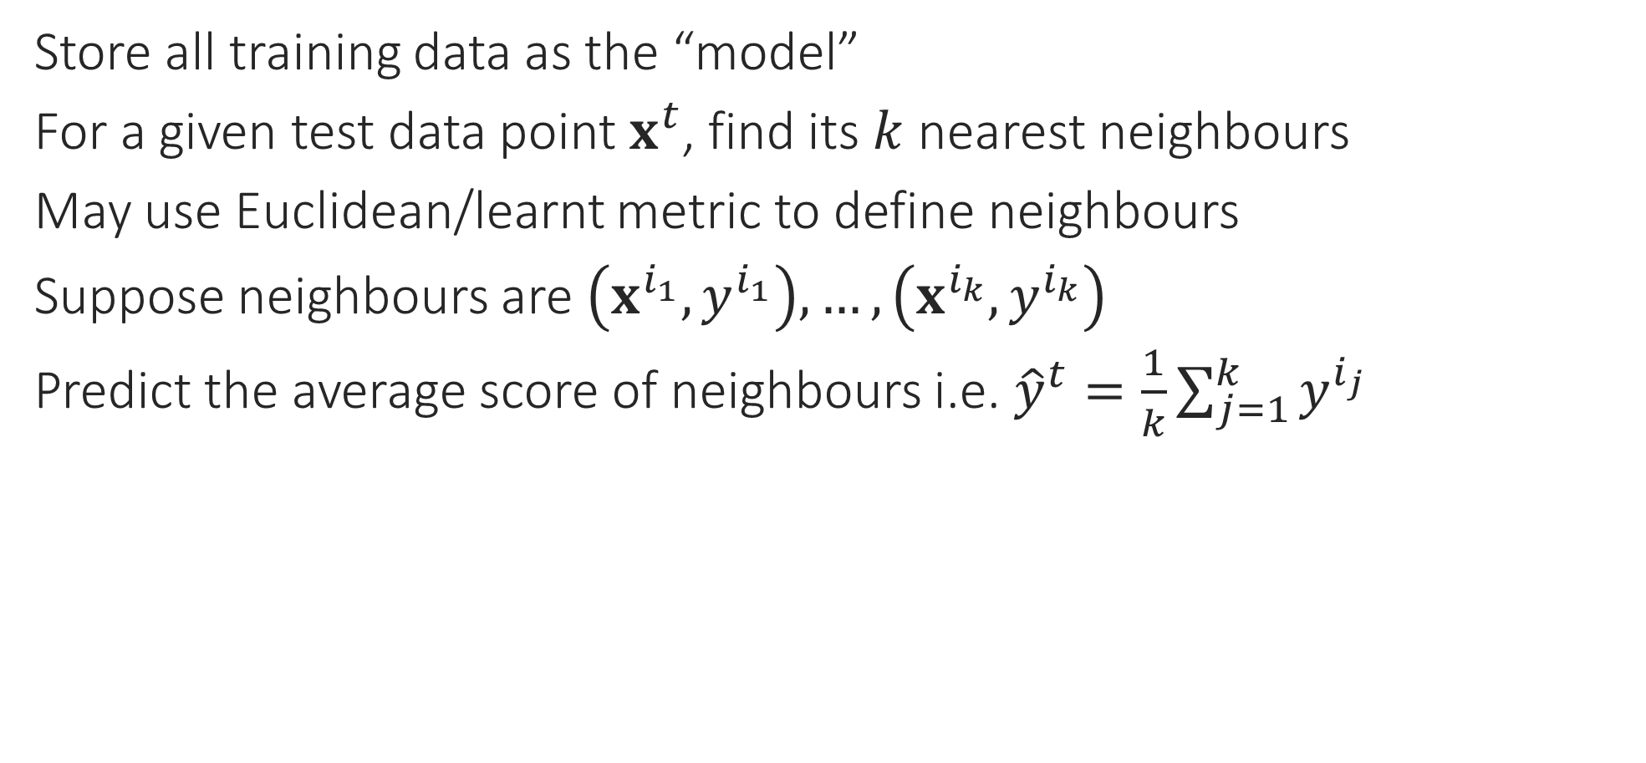
Solving Regression Problems via kNN
Store all training data as the “model”
For a given test data point $x^{t}$, find its $k$ nearest neighbours
May use Euclidean/learnt metric to define neighbours
Suppose neighbours are $\left(x^{i_{1}},y^{i_{1}}\right),…,\left(x^{i_{k}},y^{i_{k}}\right)$
Predict the average score of neighbours i.e. ${\hat{y}}^{t}=\frac{1}{k}\sum_{j=1}^{k}{y^{i_{j}}}$

Slide 14
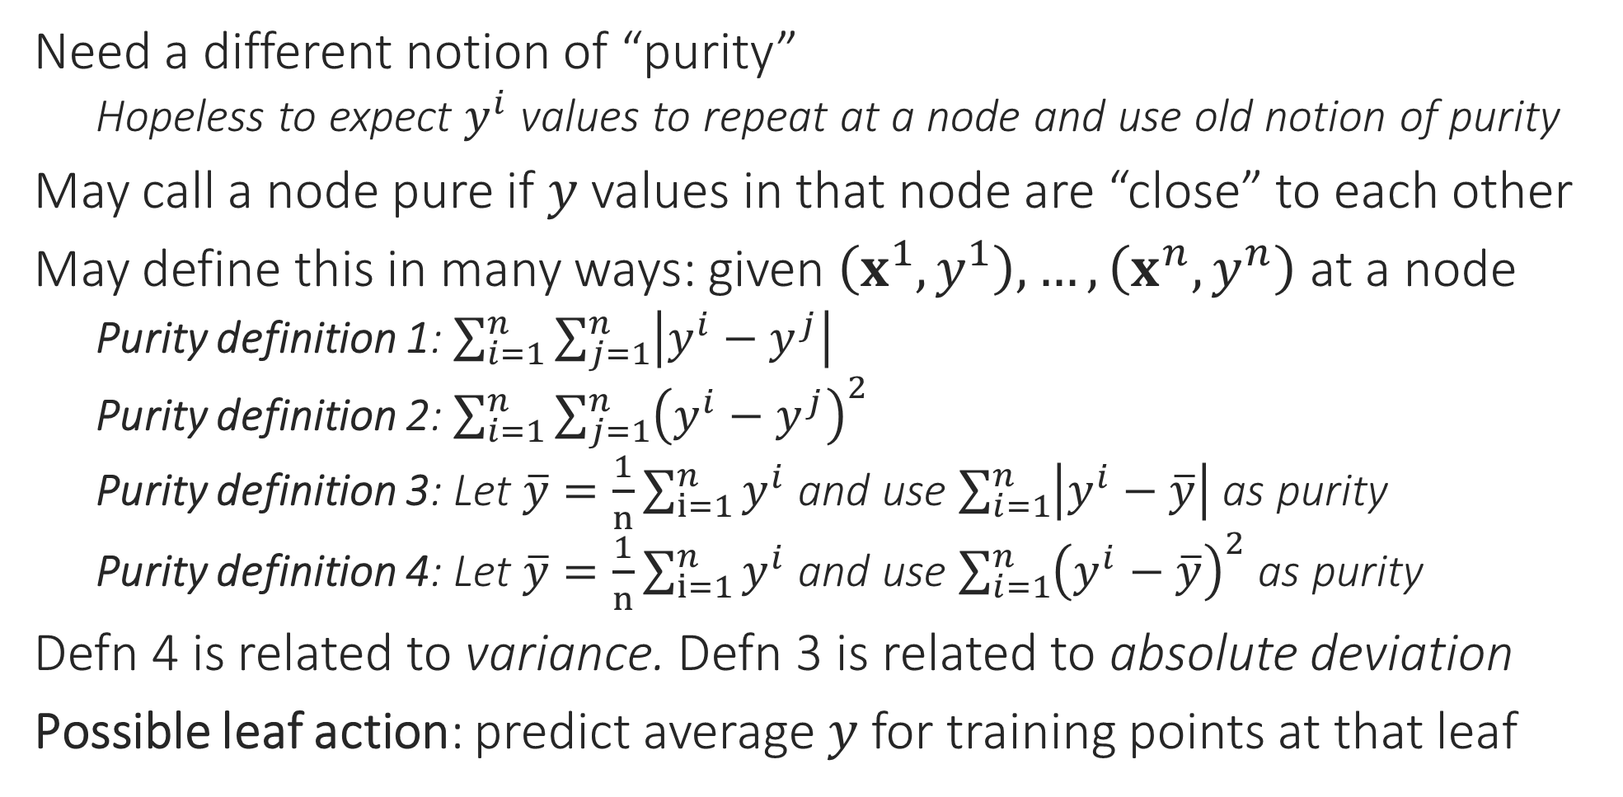
Solving Regression Problems via DT
Need a different notion of “purity”
Hopeless to expect $y^{i}$ values to repeat at a node and use old notion of purity
May call a node pure if $y$ values in that node are “close” to each other
May define this in many ways: given $\left(x^{1},y^{1}\right),…,\left(x^{n},y^{n}\right)$ at a node
Purity definition 1: $\sum_{i=1}^{n}{\sum_{j=1}^{n}{\left|y^{i}−y^{j}\right|}}$
Purity definition 2: $\sum_{i=1}^{n}{{\sum_{j=1}^{n}{\left(y^{i}−y^{j}\right)}}^{2}}$
Purity definition 3: Let $\overline{y}=\frac{1}{n}\sum_{i=1}^{n}{y^{i}}$ and use $\sum_{i=1}^{n}{\left|y^{i}−\overline{y}\right|}$ as purity
Purity definition 4: Let $\overline{y}=\frac{1}{n}\sum_{i=1}^{n}{y^{i}}$ and use ${\sum_{i=1}^{n}{\left(y^{i}−\overline{y}\right)}}^{2}$ as purity
Defn 4 is related to variance. Defn 3 is related to absolute deviation
Possible leaf action: predict average $y$ for training points at that leaf

Slide 15

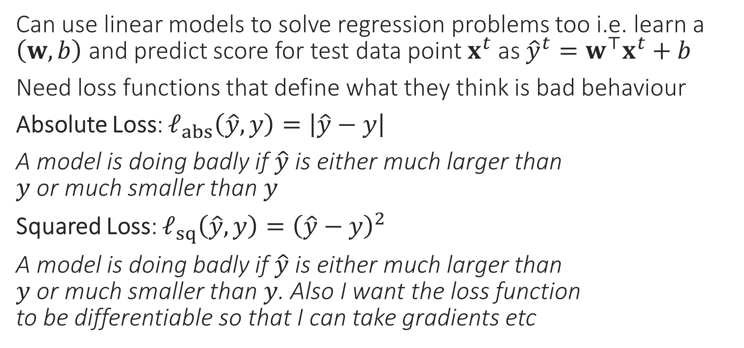
Loss Functions for Regression Problems
Can use linear models to solve regression problems too i.e. learn a $\left(w,b\right)$ and predict score for test data point $x^{t}$ as ${\hat{y}}^{t}=w^{⊤}x^{t}+b$
Need loss functions that define what they think is bad behaviour
Absolute Loss: $ℓ_{abs}\left(\hat{y},y\right)=\left|\hat{y}−y\right|$
A model is doing badly if $\hat{y}$ is either much larger than $y$ or much smaller than $y$
Squared Loss: $ℓ_{sq}\left(\hat{y},y\right)={\left(\hat{y}−y\right)}^{2}$
A model is doing badly if $\hat{y}$ is either much larger than $y$ or much smaller than $y$. Also I want the loss function to be differentiable so that I can take gradients etc

Slide 16
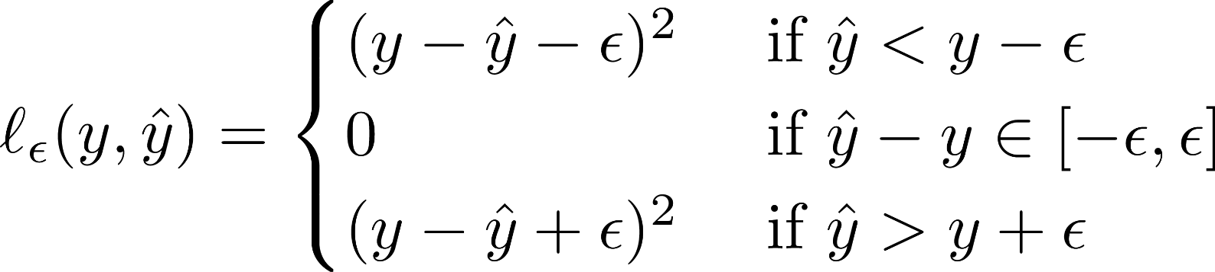

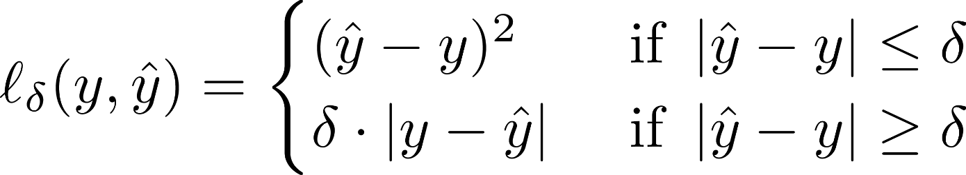

Loss Functions for Regression Problems
Loss functions have to be chosen according to needs of the problem and experience. Eg. Huber loss popular if some data points are corrupted. However, some loss functions are very popular in ML for various reasons e.g. hinge/cross entropy for binary classification, squared for regression
Vapnik’s $ε$-insensitive Loss:
If a model is doing slightly badly, don’t penalize it at all, else penalize it as squared loss. Ensure a differentiable function
Huber Loss:
If a model is doing slightly badly, penalize it as squared loss, if doing very badly, penalize it as absolute loss. Ensure a differentiable function

Slide 17

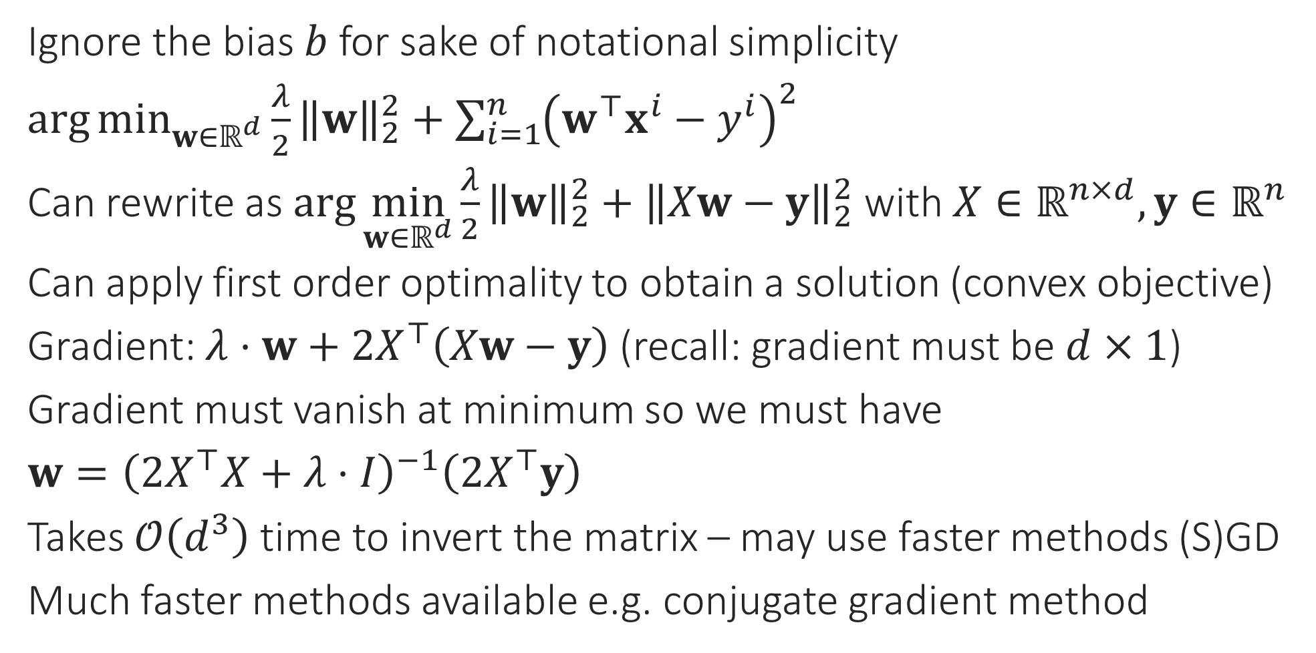
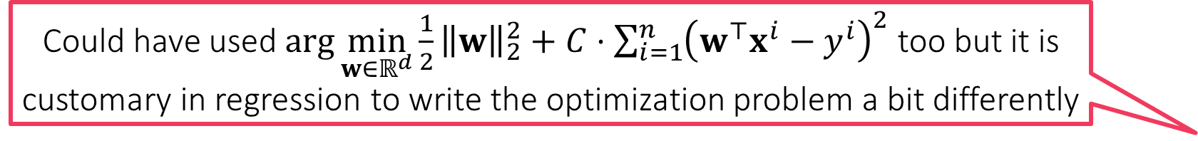
Least Squares Regression
Could have used $\arg{\min_{w∈ℝ^{d}}{\frac{1}{2}{\left\|w\right\|}_{2}^{2}}+C⋅\sum_{i=1}^{n}{{\left(w^{⊤}x^{i}−y^{i}\right)}^{2}}}$ too but it is customary in regression to write the optimization problem a bit differently
Ignore the bias $b$ for sake of notational simplicity
$\arg{\min_{w∈ℝ^{d}}{\frac{λ}{2}{\left\|w\right\|}_{2}^{2}}+\sum_{i=1}^{n}{{\left(w^{⊤}x^{i}−y^{i}\right)}^{2}}}$
Can rewrite as $\arg{\min_{w∈ℝ^{d}}{\frac{λ}{2}{\left\|w\right\|}_{2}^{2}}+{\left\|Xw−y\right\|}_{2}^{2}}$ with $X∈ℝ^{n×d},y∈ℝ^{n}$
Can apply first order optimality to obtain a solution (convex objective)
Gradient: $λ⋅w+2X^{⊤}\left(Xw−y\right)$ (recall: gradient must be $d×1$)
Gradient must vanish at minimum so we must have
$w={\left(2X^{⊤}X+λ⋅I\right)}^{−1}\left(2X^{⊤}y\right)$
Takes $𝒪\left(d^{3}\right)$ time to invert the matrix – may use faster methods (S)GD
Much faster methods available e.g. conjugate gradient method
Even here, we may use dual methods like SDCA (liblinear etc do indeed use them) but need to carefully derive the dual since no constraints
If we want to use fancier loss functions like Vapnik’s loss function, then cannot apply first order optimality, need to use SGD, SDCA etc methods

Slide 18
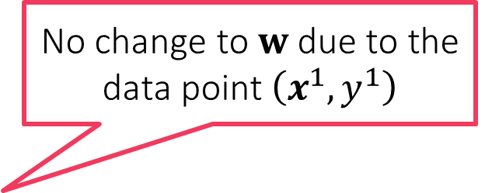
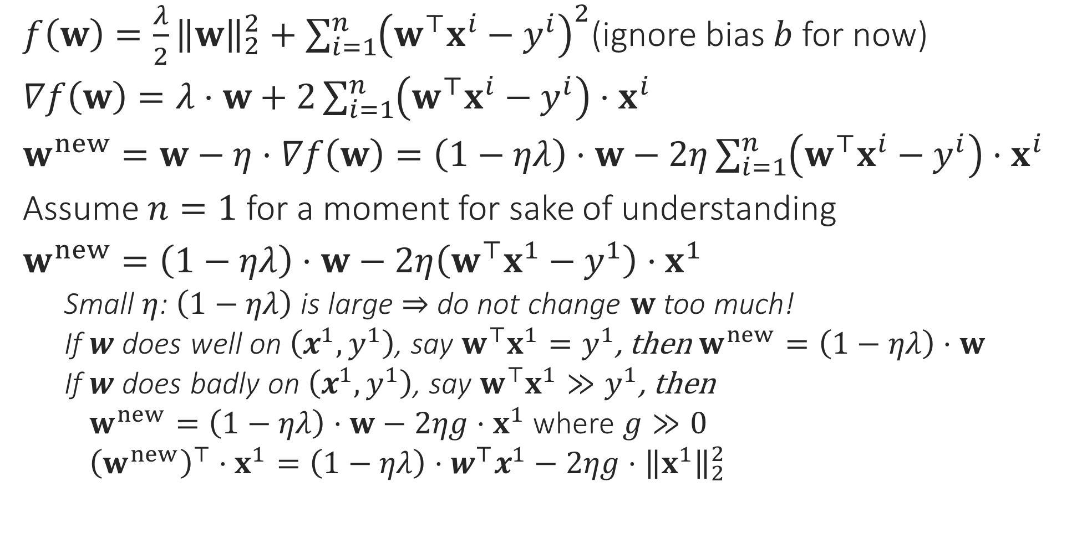
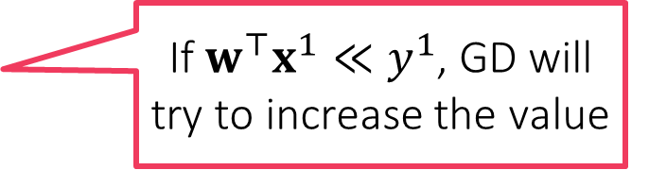
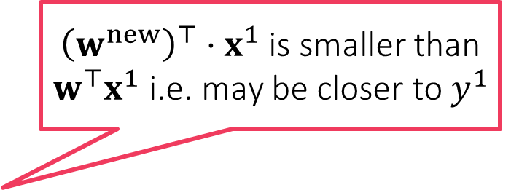
Behind the scenes in GD for Least Squares
GD and other optimization techniques merely try to obtain models that obey the rules of good behaviour as encoded in the loss function
$f\left(w\right)=\frac{λ}{2}{\left\|w\right\|}_{2}^{2}+\sum_{i=1}^{n}{{\left(w^{⊤}x^{i}−y^{i}\right)}^{2}}$(ignore bias $b$ for now)
$∇f\left(w\right)=λ⋅w+2\sum_{i=1}^{n}{\left(w^{⊤}x^{i}−y^{i}\right)⋅x^{i}}$
$w^{new}=w−η⋅∇f\left(w\right)=\left(1−ηλ\right)⋅w−2η\sum_{i=1}^{n}{\left(w^{⊤}x^{i}−y^{i}\right)⋅x^{i}}$
Assume $n=1$ for a moment for sake of understanding
$w^{new}=\left(1−ηλ\right)⋅w−2η\left(w^{⊤}x^{1}−y^{1}\right)⋅x^{1}$
Small $η$: $\left(1−ηλ\right)$ is large $⇒$ do not change $w$ too much!
If $w$ does well on $\left(x^{1},y^{1}\right)$, say $w^{⊤}x^{1}=y^{1}$, then $w^{new}=\left(1−ηλ\right)⋅w$
If $w$ does badly on $\left(x^{1},y^{1}\right)$, say $w^{⊤}x^{1}≫y^{1}$, then
$w^{new}=\left(1−ηλ\right)⋅w−2ηg⋅x^{1}$ where $g≫0$
${\left(w^{new}\right)}^{⊤}⋅x^{1}=\left(1−ηλ\right)⋅w^{⊤}x^{1}−2ηg⋅{\left\|x^{1}\right\|}_{2}^{2}$
No change to $w$ due to the data point $\left(x^{1},y^{1}\right)$
${\left(w^{new}\right)}^{⊤}⋅x^{1}$ is smaller than $w^{⊤}x^{1}$ i.e. may be closer to $y^{1}$
If $w^{⊤}x^{1}≪y^{1}$, GD will try to increase the value

