Slide 1
Team BBV
Members:
Bhavita Potturi
Chepa Bhargavi Sai
Kilari Vasudha Yadav

Slide 2
IOT based atmospheric pollution monitoring system using Hadoop map reduce paradigm

Slide 3
Description
The main objective of this project is to design an Internet of things (IOT) based atmosphere monitoring system using hadoop eco system. The key feature of this project is to measure the level of air contaminants, temperature and humidity in the atmosphere.

Slide 4
Approach to the problem
We measure the pollution levels in the atmosphere using the sensors, store the sensor data into the cloud server (Adafruit).Later, we redirect the data into hadoop distributed file systems (HDFS) and process the sensor data to find out the areas with highest pollution level and temperature.

Slide 5
Internet Of Things
IoT platform is a multi-layer technology which offers a platform for sensors and devices to communicate consistently within a smart environment and enables the sharing of information across various platforms in a convenient manner.
. In recent years Internet of Things (IoT) has begun to play a crucial role in our daily lives with the ability to modify the environment around us.

Slide 6
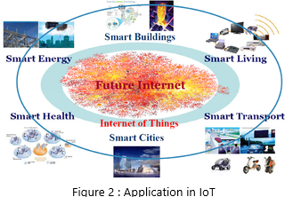
Applications Of Internet Of Things

Slide 7
ESP8266 Wifi Module
a Wi-Fi enabled system on chip module ESP8266 is used which is capable of either hosting an application or offloading all Wi-Fi networking functions from another application processor.
ADAFRUIT:
In order to display the data in the real time online we use Adafruit IO for visualizing multiple feeds of data. We can Connect our project to other internet-enabled devices using adafruit.

Slide 8
Hadoop
Hadoop is a platform that provides both distributed storage and computational capabilities. It is an open source software project that enables the distributed processing of large data sets across clusters of commodity servers. Hadoop is more of a data warehousing system-so it needs a system like Map-Reduce to actually process the data. Hadoop can handle all types of data from disparate systems: structured, unstructured, log files, pictures, audio files, communication records, email.

Slide 9
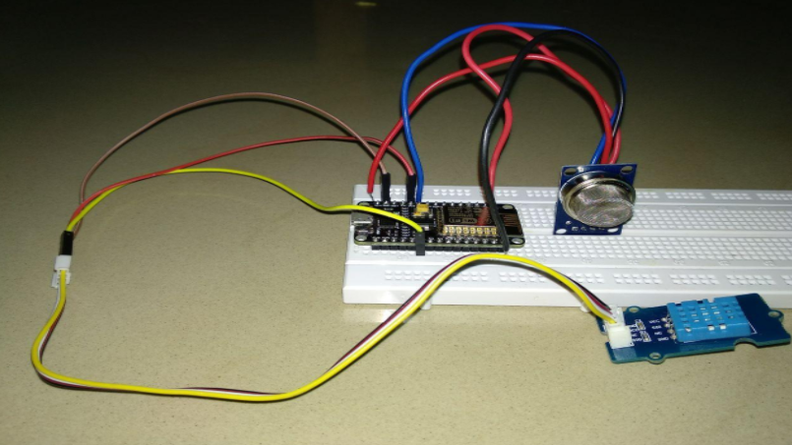
Implementation

Slide 10
solution
The sensors used in this experiment read the temperature, humidity and pollution values which can also be displayed in our smart phones where in we need not be continuously montioring the values as they will be automatically updated.
These values once redirected to the Adafruit IO cloud store the data which can then be used to process using map reduce techiniques in the Hadoop environment.Thus the areas holding records of high temperatures and pollution values are displayed.

Slide 11
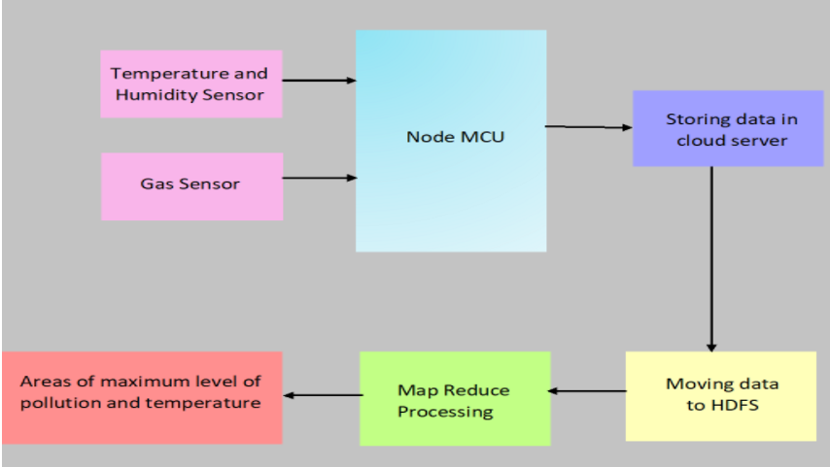
Block Diagram

Slide 12
THANK YOU

