Slide 1

DISCOVER YOUR NEXT EVENT DESTINATION
Name: M. Sai Bhavitha Reddy
Roll No: 2520030551
Branch: CSE
Section: 2nd
Cluster: 1st cluster
Under the Guidance
of
Supervisor Name: Jayram Boga
Assistant Professor
Department of CSE

Slide 2
Outline
Abstract
Existing System
Proposed System
System Architecture
Project Modules
Objectives
CO Attainments – FWD
CO Attainments – DSA
Screenshots
Conclusion
Geo-Tag

Slide 3
Abstract
Discover your next event destination is a responsive web-based event discovery platform designed to help users explore and filter local events efficiently. The application allows users to search events by city, category, price range, and sorting preferences. It incorporates modern web technologies including HTML semantic elements, CSS features such as Grid, Flexbox, animations, media queries, and JavaScript ES6 concepts like arrow functions, promises, async/await, and DOM manipulation. The system also includes interactive components such as modal popups, theme toggling (dark/light mode), toast notifications, and local storage integration for saving user preferences and bookmarked events. This is a simple web app which is user friendly.

Slide 4
Existing System
Event information scattered across different platforms
Difficult to find events quickly
Limited filtering and search options
No centralized event discovery platform
Users cannot easily save favourite events
Users must manually search multiple platforms.

Slide 5
Proposed System
Centralized event discovery platform
Search events by city
Filter events by categories
Sort events by date, price or name
Save favourite events
User friendly responsive interface
Direct ticket booking feature.

Slide 6

Project details
Category:- Web Application
Purpose:- This code is designed to develop an interactive and user-friendly event discovery web application. It allows users to search, filter, and sort events based on city, category, and price. The application demonstrates modern web development concepts using HTML, CSS, and JavaScript. The project aims to provide a responsive and engaging platform for discovering local events efficiently.
Users:- Travelers, General users.

Slide 7
System Architecture
User Interface Layer
Built using HTML, CSS, and JavaScript
Provides event search form, category filters, and event cards
Application Logic Layer
JavaScript handles event filtering, sorting, and searching
Data Layer
Event information stored as JavaScript objects in arrays
DSA Layer
Java program implements searching and sorting algorithms
Uses linked lists, stacks, queues, heaps, and hash tables for data management
Output Layer
Displays filtered events and detailed information dynamically
Provides interactive feedback through UI updates and notifications

Slide 8
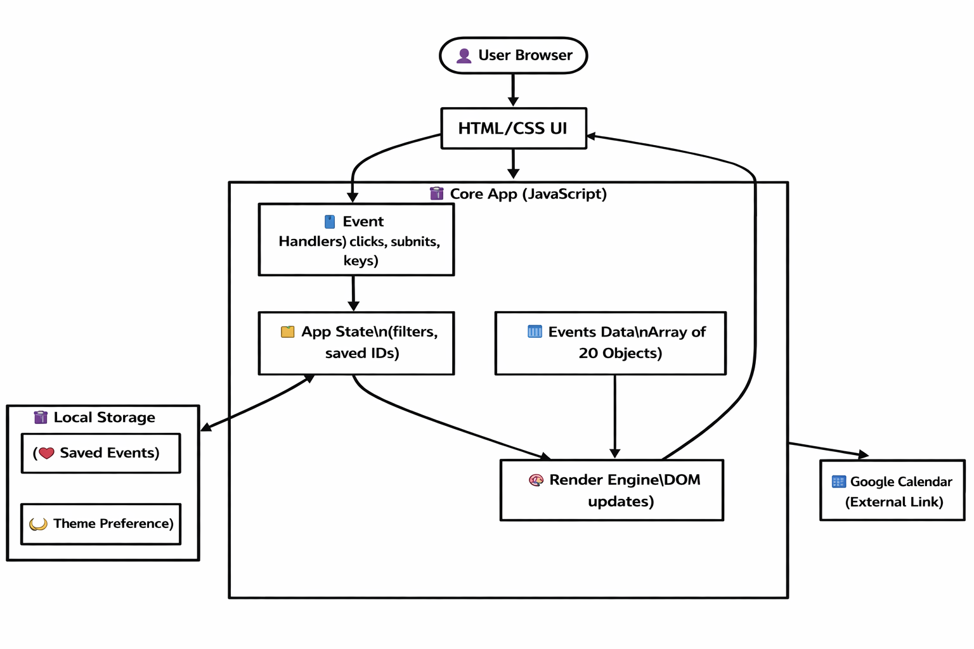
System Architecture Diagram

Slide 9
Project Modules
Event Search Module
Allows users to search events using city and price filters
Category Filter Module
Filters events by categories such as music, gaming, sports, education, and arts
Event Display Module
Displays event name, location, date, and price
Event Details Module
Includes organizer, capacity, description, and date
Event Management Module
Implements searching, sorting, linked lists, stacks, queues, and hash tables

Slide 10
Objectives
Develop an interactive event discovery website
Provide easy access to event information
Implement search and filtering features
Improve user experience with responsive UI
Demonstrate frontend development concepts

Slide 11
CO’s Attainments – FWD
CO1 – HTML Structure
Used HTML5 semantic elements to design the webpage structure
CO2 – CSS Styling
Applied CSS Grid, Flexbox, and responsive design
Used animations, transitions, and media queries
CO3 – JavaScript Programming
Implemented variables, arrays, objects, and functions
Stored event data using JavaScript objects
CO4 – DOM Manipulation
Used DOM methods and event listeners
Dynamically updated event cards and modal windows
CO5 – Advanced Web Features
Implemented local Storage for saved events

Slide 12
CO’s Attainments – DSA
CO1 – Algorithm Analysis
Implemented searching and sorting algorithms
Used Linear Search, Binary Search, Bubble Sort, Selection Sort, Insertion Sort, Merge Sort, and Quick Sort
Analyzed algorithm efficiency using Big-O notation
CO2 – Abstract Data Types
Implemented Singly Linked List, Doubly Linked List, and Circular Linked List
CO3 – Linear Data Structures
Implemented Stack and Queue structures
Used Circular Queue and Deque for event processing
CO4 – Hash-Based Structures
Implemented Hash Tables using Chaining and Open Addressing

Slide 13
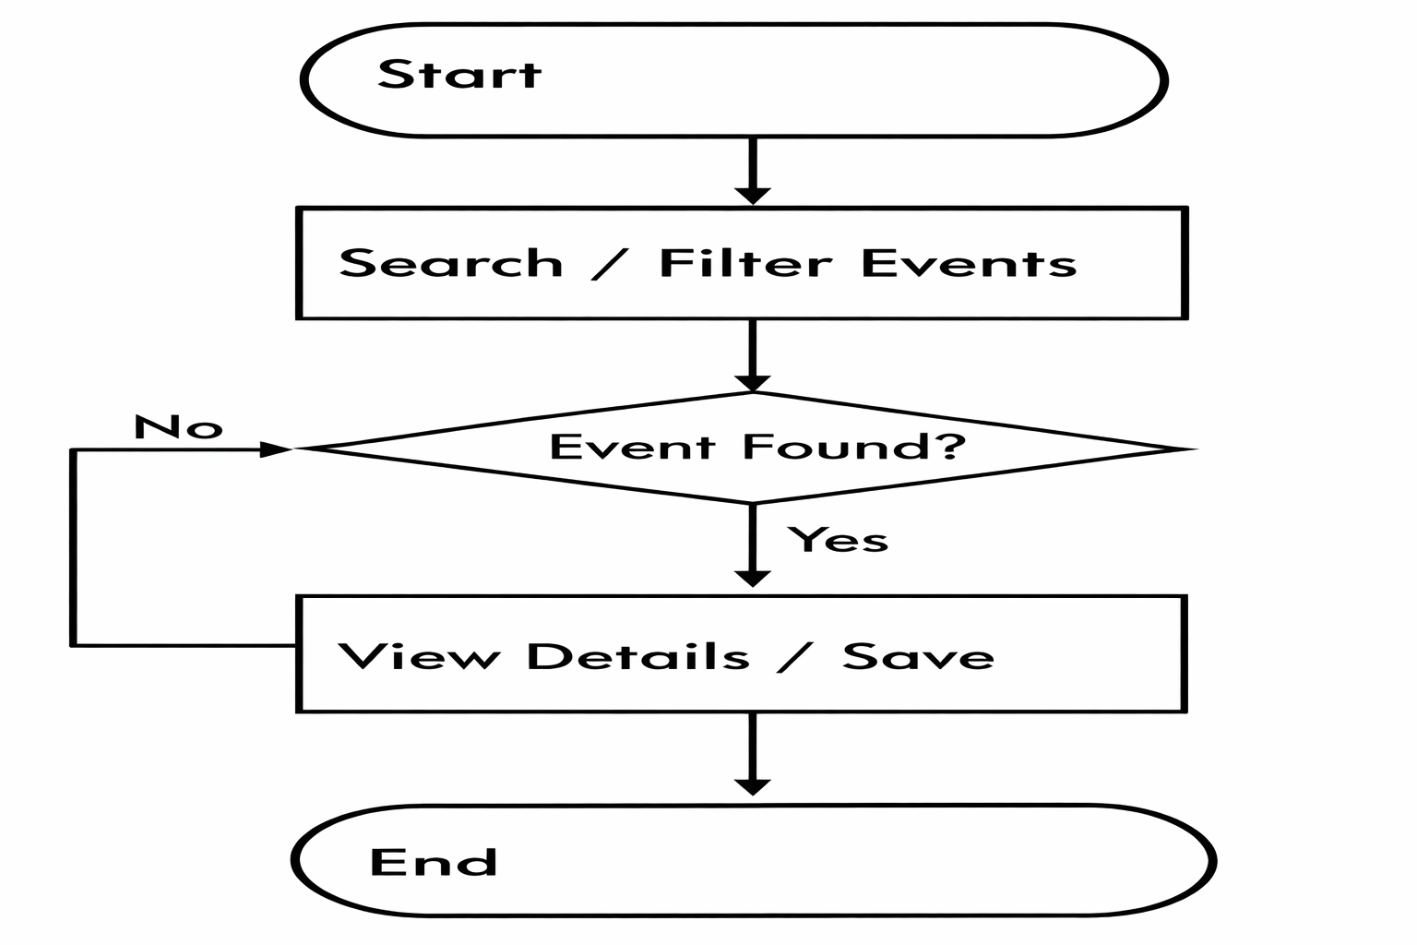
System Flowchart

Slide 14
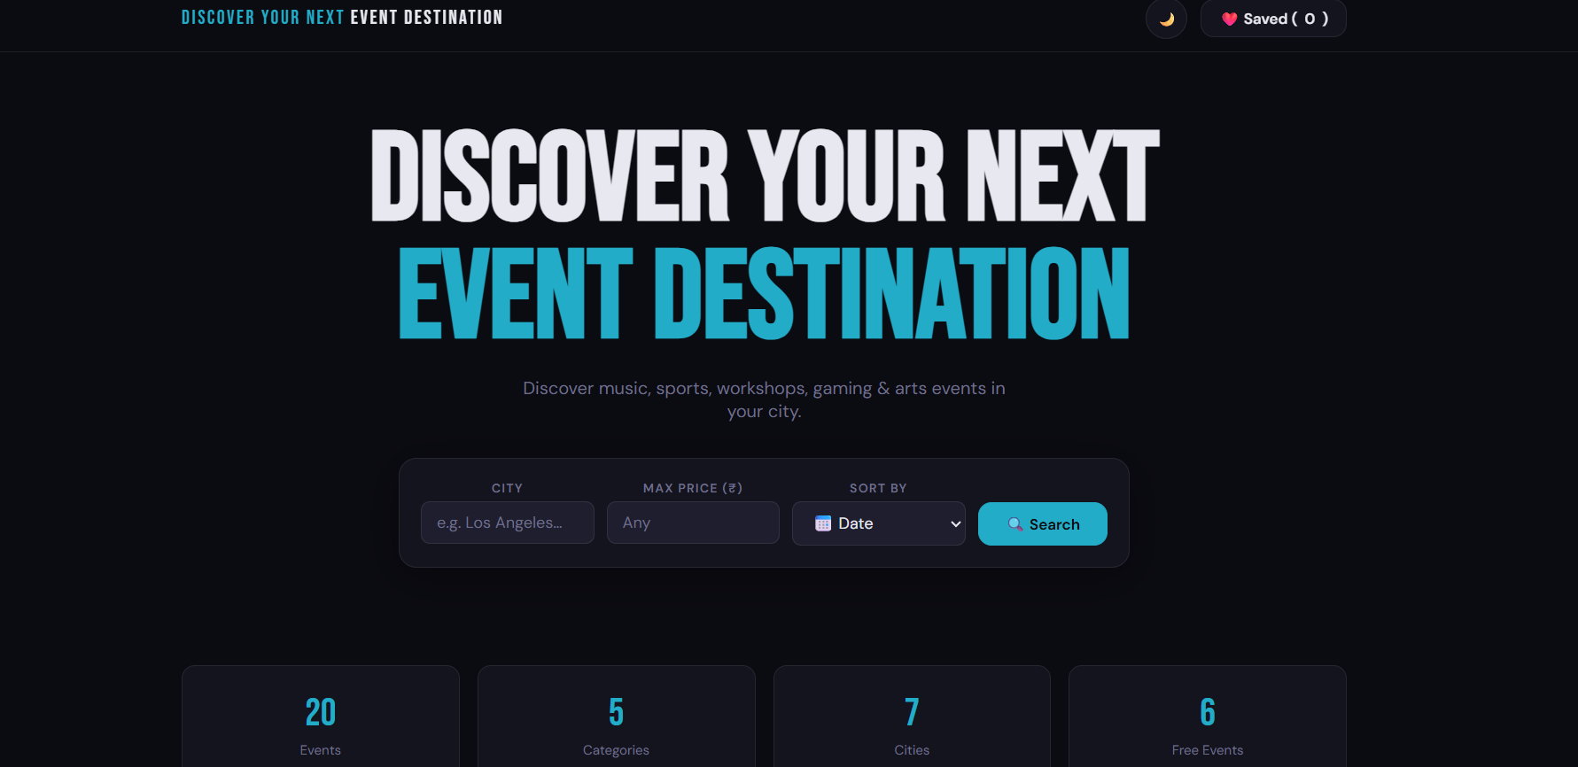
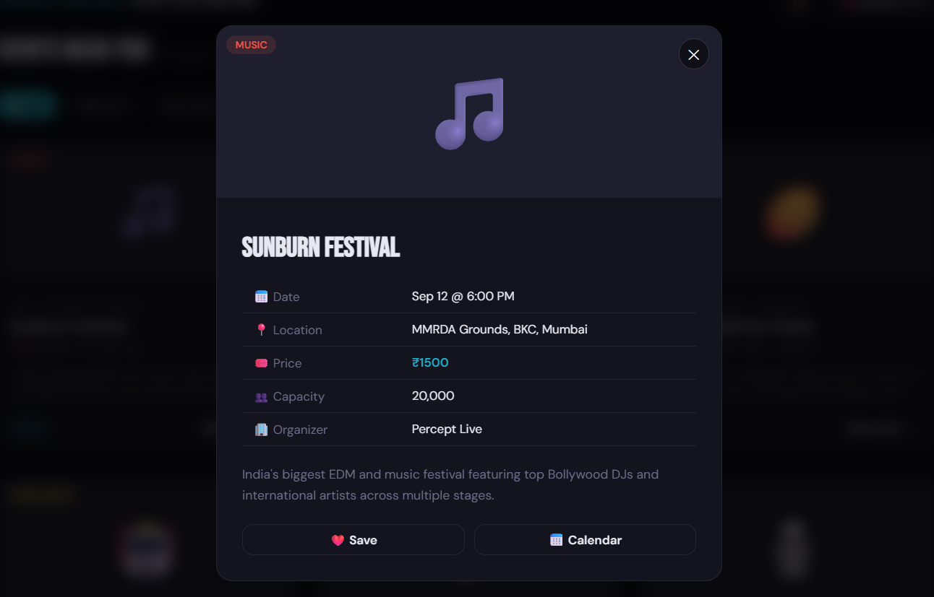
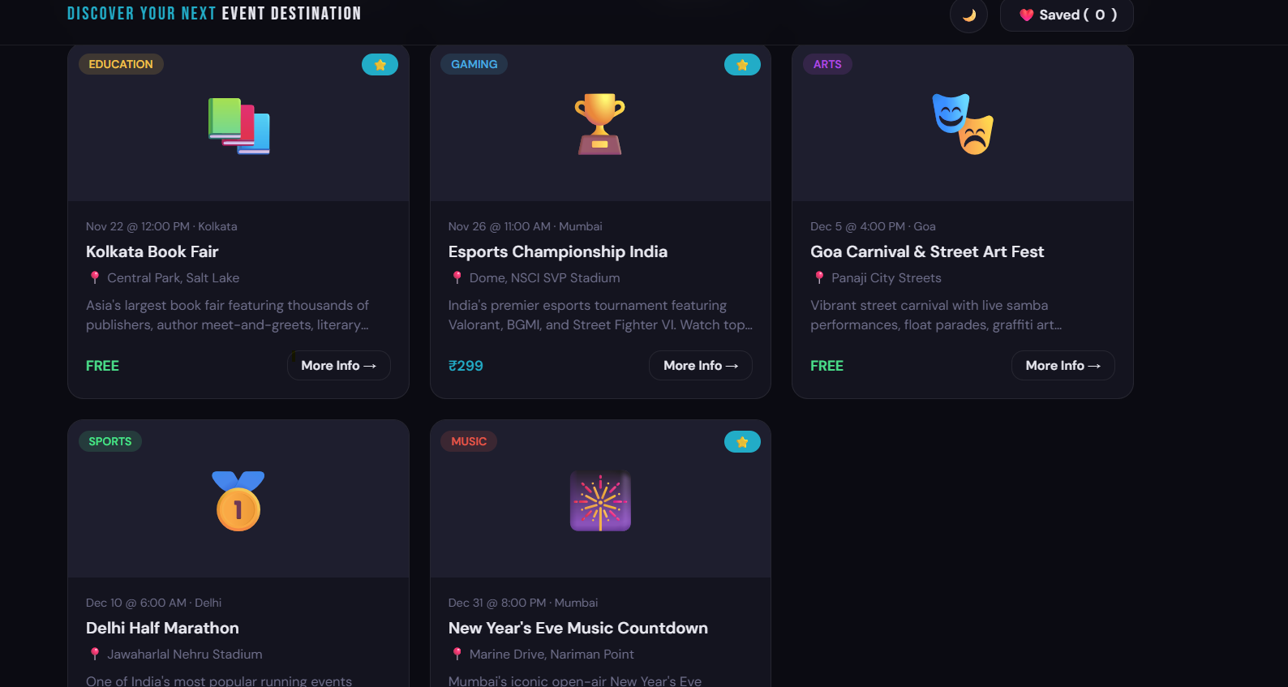
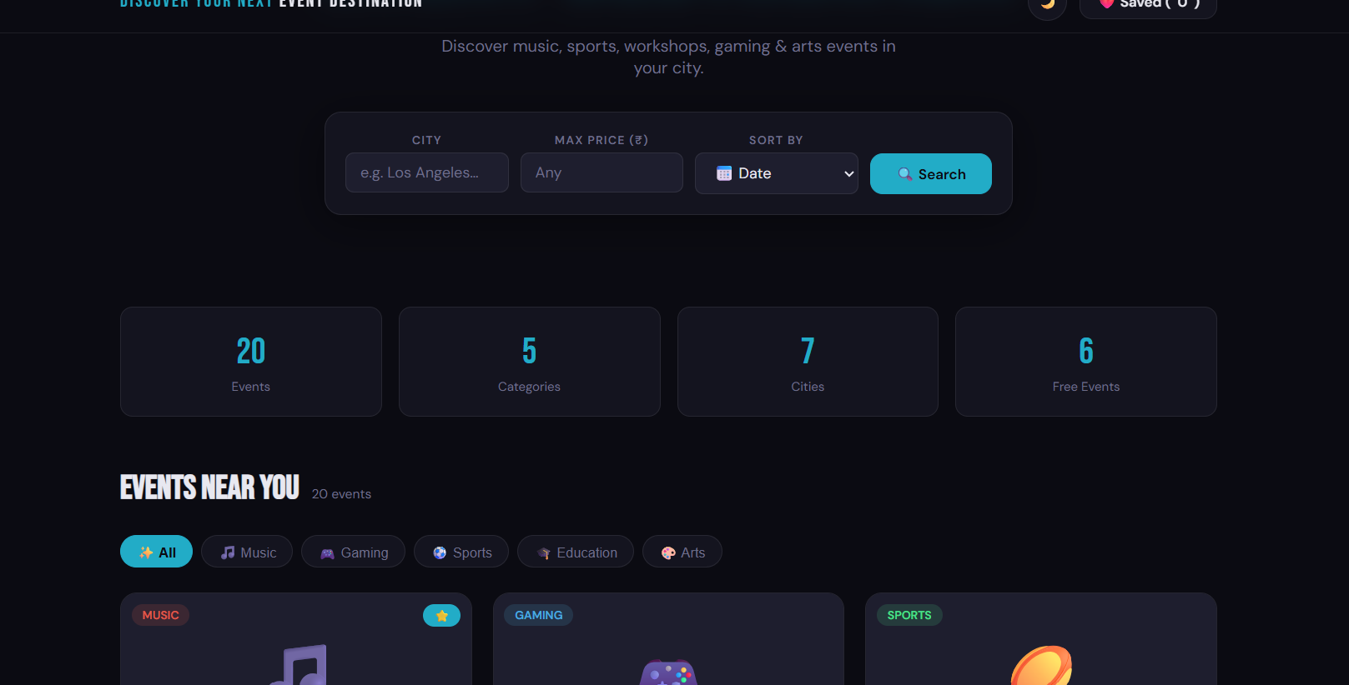
Screenshots – FWD

Slide 15
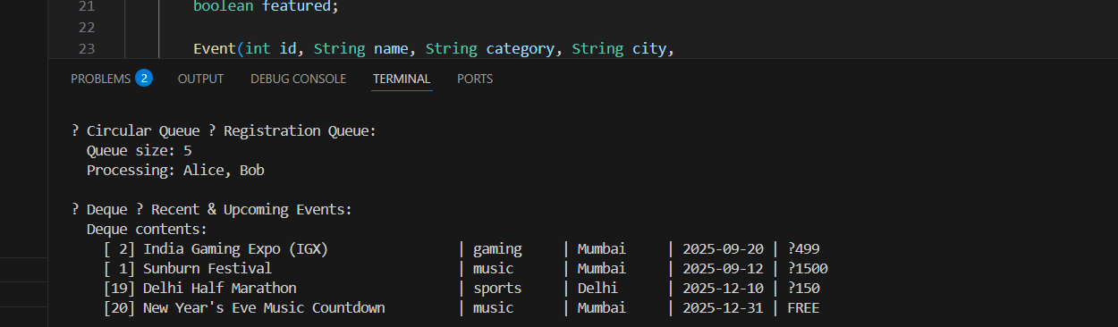
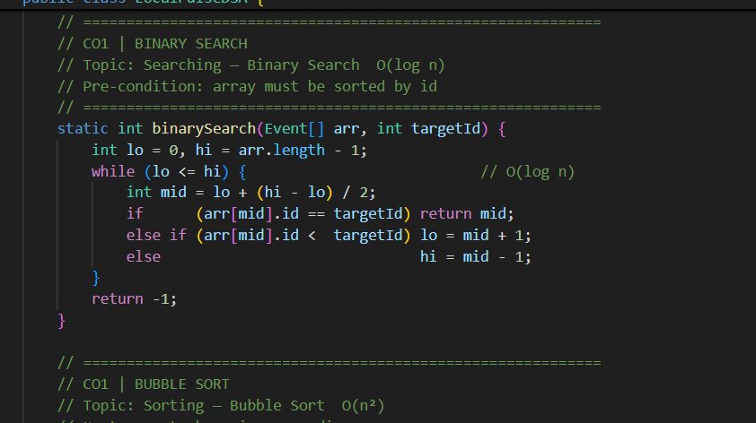
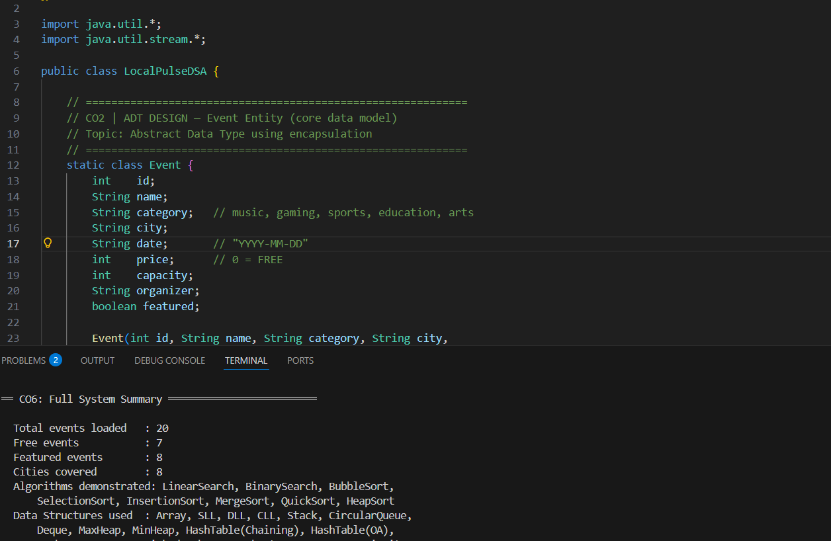
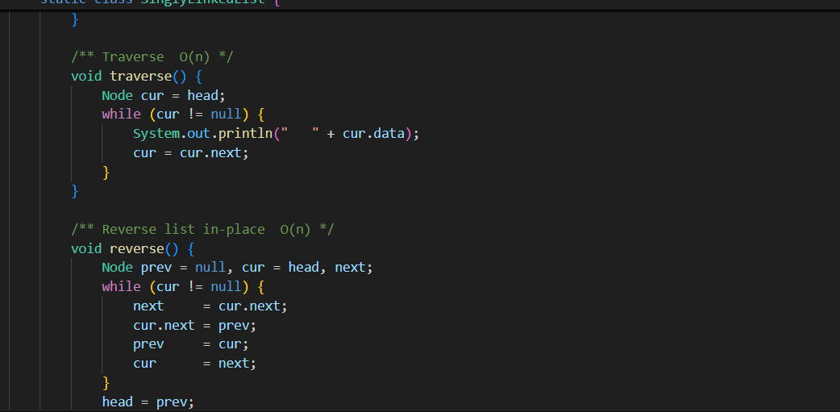
Screenshots – DSA

Slide 16
Conclusion
The project “Discover Your Next Event Destination” provides a platform to explore local events easily.
Built using HTML, CSS, and JavaScript to create a responsive and interactive user interface.
Users can search, filter, and view event details dynamically.
Data Structures and Algorithms in Java were implemented for efficient event management.
The project demonstrates practical knowledge of Front-End Web Development and DSA concepts.

Slide 17
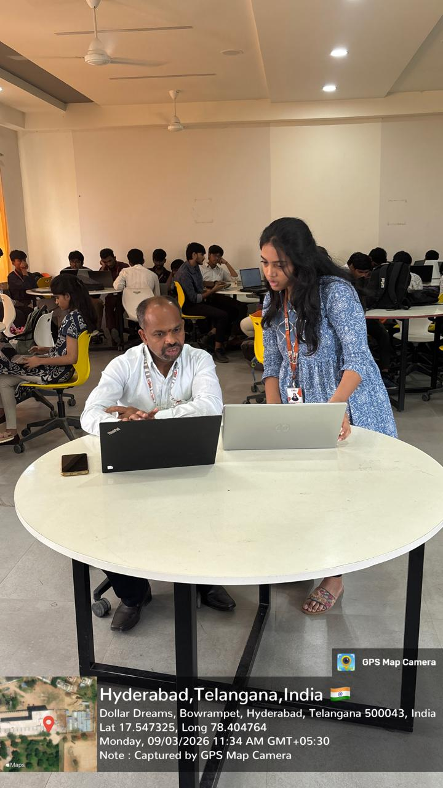
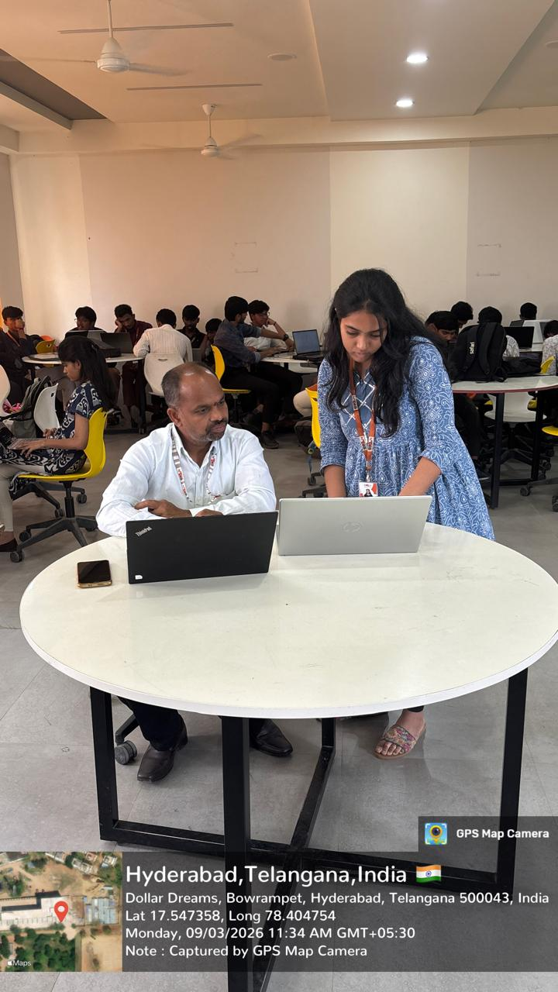
Geo-Tag pictures

Slide 18
THANK YOU

