Slide 1
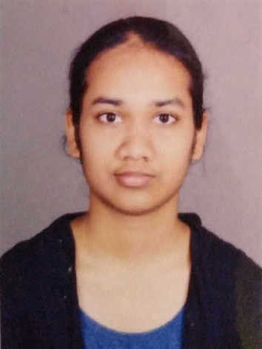
Student Details
Name: Bhavna Aggarwal
SkillsBuild Email ID: bhavna.aggarwal@learner.manipal.edu
College Name: Manipal Institute Of Technology
College State: Karnataka
Internship Domain and Internship Start and End Date: Artificial Intelligence, 12-06-2023 to 24-07-2023

Slide 2
PROJECT TITLE/Problem Statement
Mental Fitness Tracker

Slide 3
AGENDA
Introduction
Project Overview
End Users
Solution and Value Proposition
Customization and Uniqueness
Modelling
Results

Slide 4
PROJECT OVERVIEW
Purpose: Monitor and enhance mental well-being through data analysis and personalized recommendations
Scope and Key Features: Data collection, analysis, personalized insights, and proactive recommendations
Objective: Develop an AI-based Mental Fitness Tracker

Slide 5
WHO ARE THE END USERS of this project?
Target Audience: Individuals seeking to improve their mental fitness
Potential Users: Students, professionals, athletes, and anyone interested in mental well-being
Benefits: Enhanced self-awareness, improved mental resilience, and better overall well-being

Slide 6
YOUR SOLUTION AND ITS VALUE PROPOSITION
Solution: AI-powered Mental Fitness Tracker
Value Proposition:
- Real-time analysis
- Personalized insights and recommendations
- Improved mental well-being and overall quality of life

Slide 7
How did you customize the project and make it your own
The project takes the metrics of various mental health disorders and gives and output value to determine the state.
The user can see what is having the most impact on his/her mental health
The project shows the average mental health situation in countries, year wise, and the impact each mental health condition has on an individual.

Slide 8
MODELLING
Data Collection: User input, wearable device data, and external data sources
Data Analysis: Machine Learning algorithms to identify patterns and correlations
Predictive Models: Forecasting mental well-being based on historical data
Models used include linear regression, svm and random forest, out of which random forest regression has proved to be the most efficient with near accurate predictions.

Slide 9
Results
Improved Mental Well-being: Positive impact on user-reported happiness and resilience.
Increased Self-Awareness: Users gain insights into their mental health patterns
Personalized Recommendations: Tailored strategies for stress reduction, sleep improvement, and relaxation techniques

Slide 10
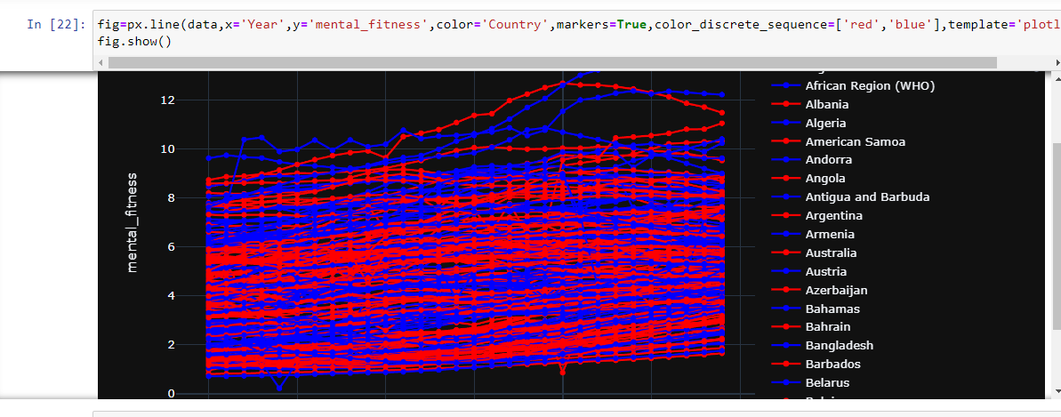
Various findings
The image shows mental health trend over many years, across different countries

Slide 11
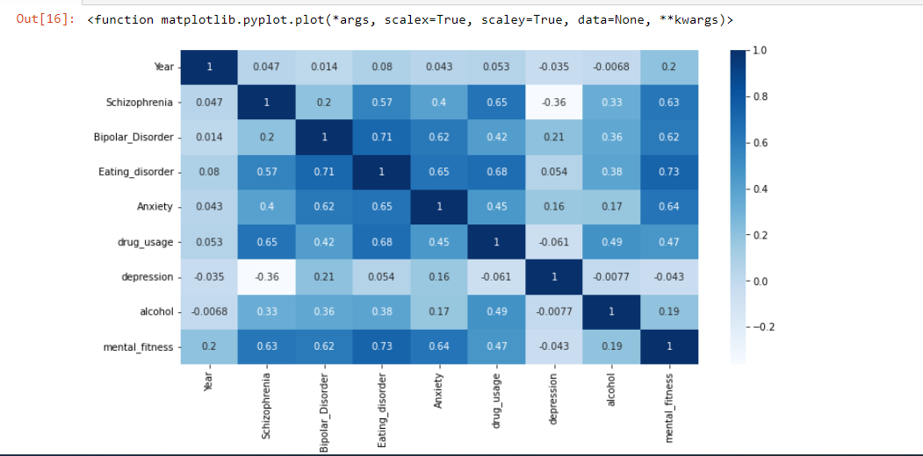
In this heatmap, we can see the correlation of every mental health disorder with the mental fitness on an average. We see that eating disorder drastically impacts mental fitness followed by anxiety and schizophrenia.

Slide 12
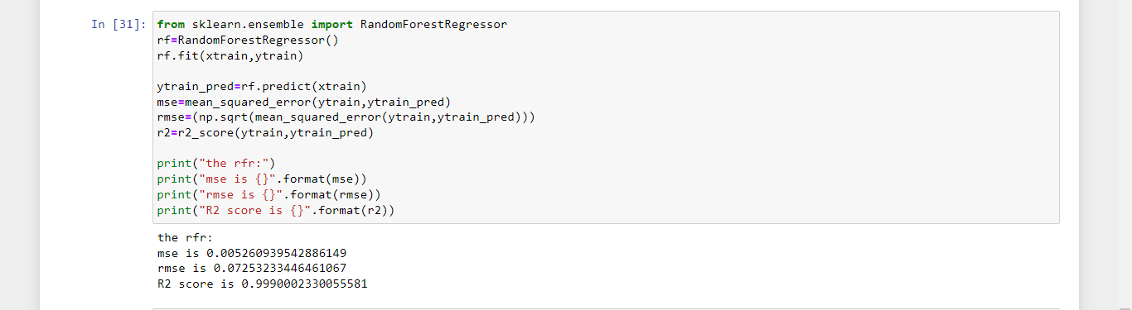
Output
Random forest regressor gives near perfect predictions.

Slide 13
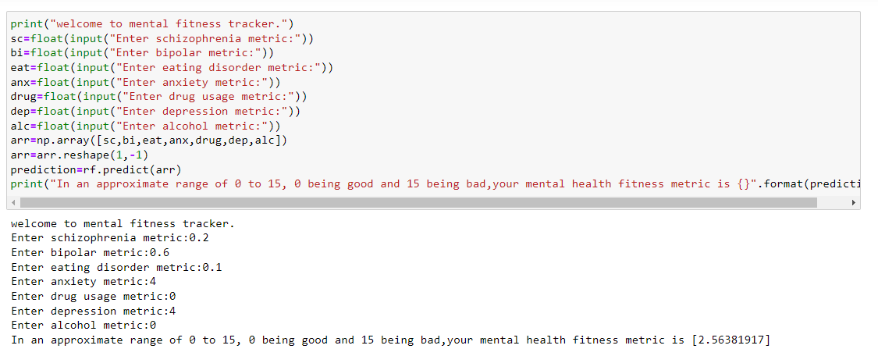
According to the given dataset, a good mental health is given by a zero, and a bad one is given approximately at 15. This metric is used is a standard method called DALYS, which gives disability adjusted life years, hence lesser adjusted or lost years due to disability means higher mental fitness.

Slide 14
links
https://skillsbuild.edunetworld.com/courses/ai/mental-fitness-tracker/
https://scikit-learn.org/stable/modules/svm.html
https://ourworldindata.org/mental-health
https://www.kaggle.com/datasets/programmerrdai/mental-health-dataset
https://data.world/datasets/mental-health
Drive link for ipynb file and datasets→ https://drive.google.com/drive/folders/1GKdqcpwBYxhBY0kbQa25iCoOEnZWgLGZ?usp=sharing

