Slide 1

Experiential Learning Project Assessment-I on
“ Python Snake Game”
under the course
Python Programming Language (N-PCCCM304P)
Presented By
-Bhavna Sarile
Under the Guidance of
Mrs. Suchita Meshkar
Session:2026-27 (ODD )
Department of CSE(AI&ML)
S. B. JAIN INSTITUTE OF TECHNOLOGY MANAGEMENT AND
RESEARCH,NAGPUR
An Autonomous Institute, Affiliated to RTMNU, Nagpur
)

Slide 2



Problem Statement :
Develop a Python-based Snake Game in which the player controls a snake that moves continuously on the screen to collect food. Each time the snake eats food, its length increases and the player's score is updated. The game ends if the snake collides with the screen boundaries or with its own body. The application should provide smooth gameplay, score tracking, and options to restart or exit after the game is over.
S. B. Jain Institute of Technology Management and research

Slide 3

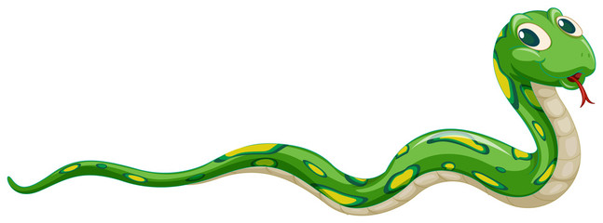

Objectives :-
To develop a functional Snake game using Python and Pygame.
To improve programming skills involving Python classes, lists, functions, loops, conditions, and event handling.
To develop practical Based learning by implementing real life situations
Understand logic used to build a game.
S. B. Jain Institute of Technology Management and research

Slide 4
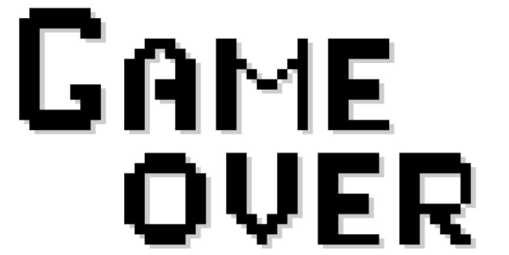

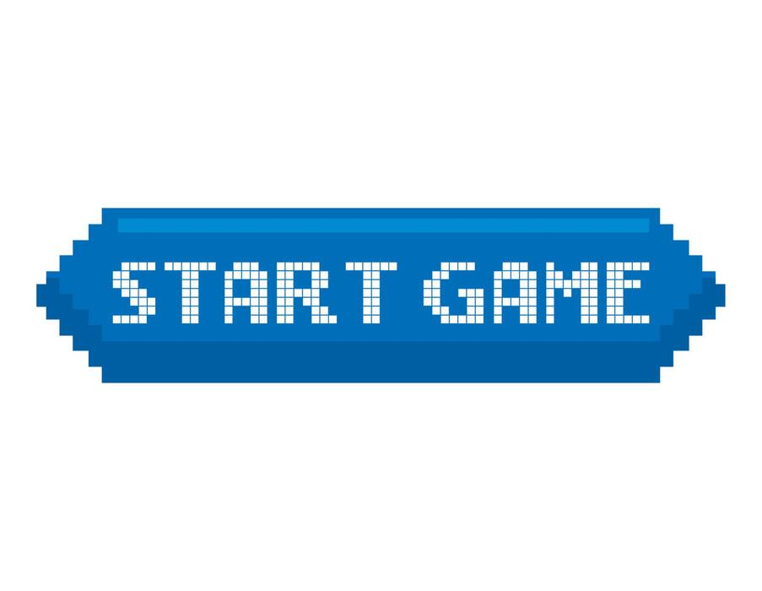
Algorithm:-
🐍
Start the game and choose speed.
Create the snake and food.
Take keyboard input for movement.
Move the snake in the selected direction.
Check wall/body collision.
If food is eaten, increase score and snake length.
Generate new food.
Continue until collision occurs.
Display Game Over and allow restart or quit.
S. B. Jain Institute of Technology Management and research

Slide 5

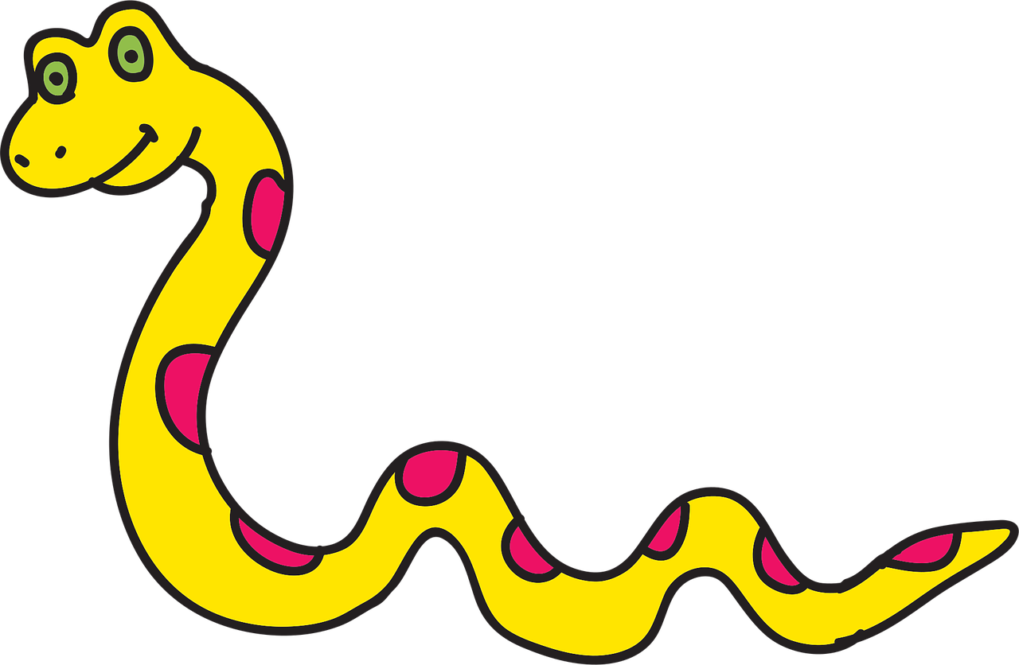

Flow Chart:
START
↓
Choose Speed
↓
Create Snake & Food
↓
Take Keyboard Input
↓
Move Snake
↓
Hit Wall or Body?
↙ ↘
YES NO
↓ ↓
GAME OVER Eat Food?
↙ ↘
YES NO
↓ ↓
Score +1 & Remove
Grow Snake Tail
↘ ↙
↓
Draw Game
↓
Continue Game

Slide 6
Logic:-
KEYBOARD INPUT
↓
CALCULATE NEW HEAD
↓
CHECK COLLISION
↓ ↓
HIT SAFE
↓ ↓
GAME OVER ADD HEAD
↓
FOOD EATEN?
↓ ↓
YES NO
↓ ↓
GROW SNAKE REMOVE TAIL
↓ ↓
└────┬────┘
↓
DRAW SCREEN
↓
REPEAT
Start → Create snake and food.
Input → Player chooses the snake's direction.
Move → Snake's head moves one grid cell.
Collision Check → Check wall or snake body.
Food Check → If snake eats food, score increases and snake grows.
New Food → Food appears at a random empty position.
Repeat → Continue moving until a collision occurs.
Game Over → Display final score and allow restart.

Slide 7
Thank You
S. B. Jain Institute of Technology Management and research

