Slide 1

Experiential Learning Project Assessment-I on
“ Python Snake Game”
under the course
Python Programming Language (N-PCCCM304P)
Presented By
-Bhavna Sarile
Under the Guidance of
Mrs. Suchita Meshkar
Session:2026-27 (ODD )
Department of CSE(AI&ML)
S. B. JAIN INSTITUTE OF TECHNOLOGY MANAGEMENT AND
RESEARCH,NAGPUR
An Autonomous Institute, Affiliated to RTMNU, Nagpur
)

Slide 2



01 · PROJECT INTRODUCTION
A classic game built as a Python application
Snake moves through a bounded play area and grows after collecting food.
Purpose: apply programming fundamentals through an interactive gaming application.
Gaming ApplicationPython + PygameVS Code
The project turns core concepts into user interaction
Need
A simple, responsive gaming application with immediate feedback.
Game loop
Repeat input, state updates, rendering, and timing.
Events
Convert keyboard input into a new direction.
Movement
Advance the snake through the bounded play area.
Rules
Use collision and score logic to shape the experience.
S. B. Jain Institute of Technology Management and research

Slide 3
Phase 3 focuses on a complete playable experience
Build the game
Develop the Snake Game using Python
Track progress
Add food generation , and score tracking.
User Interface
Improve the game screen and score display.
Control movement
Implement keyboard- -> based movement.
Food Generation
Add random food generation for the snake.
.
Game Loop
Continuously update movement and game events.
.
Enforce rules
Implement collision detection.
Score Tracking
Update the score whenever food is collected.
.
Game Over Screen
Display a message when the game ends.
Enforce rules
Implement collision detection.
Snake Growth
Increase the snake's length after eating food.
Collision Detection
Detect wall and self-collision to end the game.
S. B. Jain Institute of Technology Management and research

Slide 4
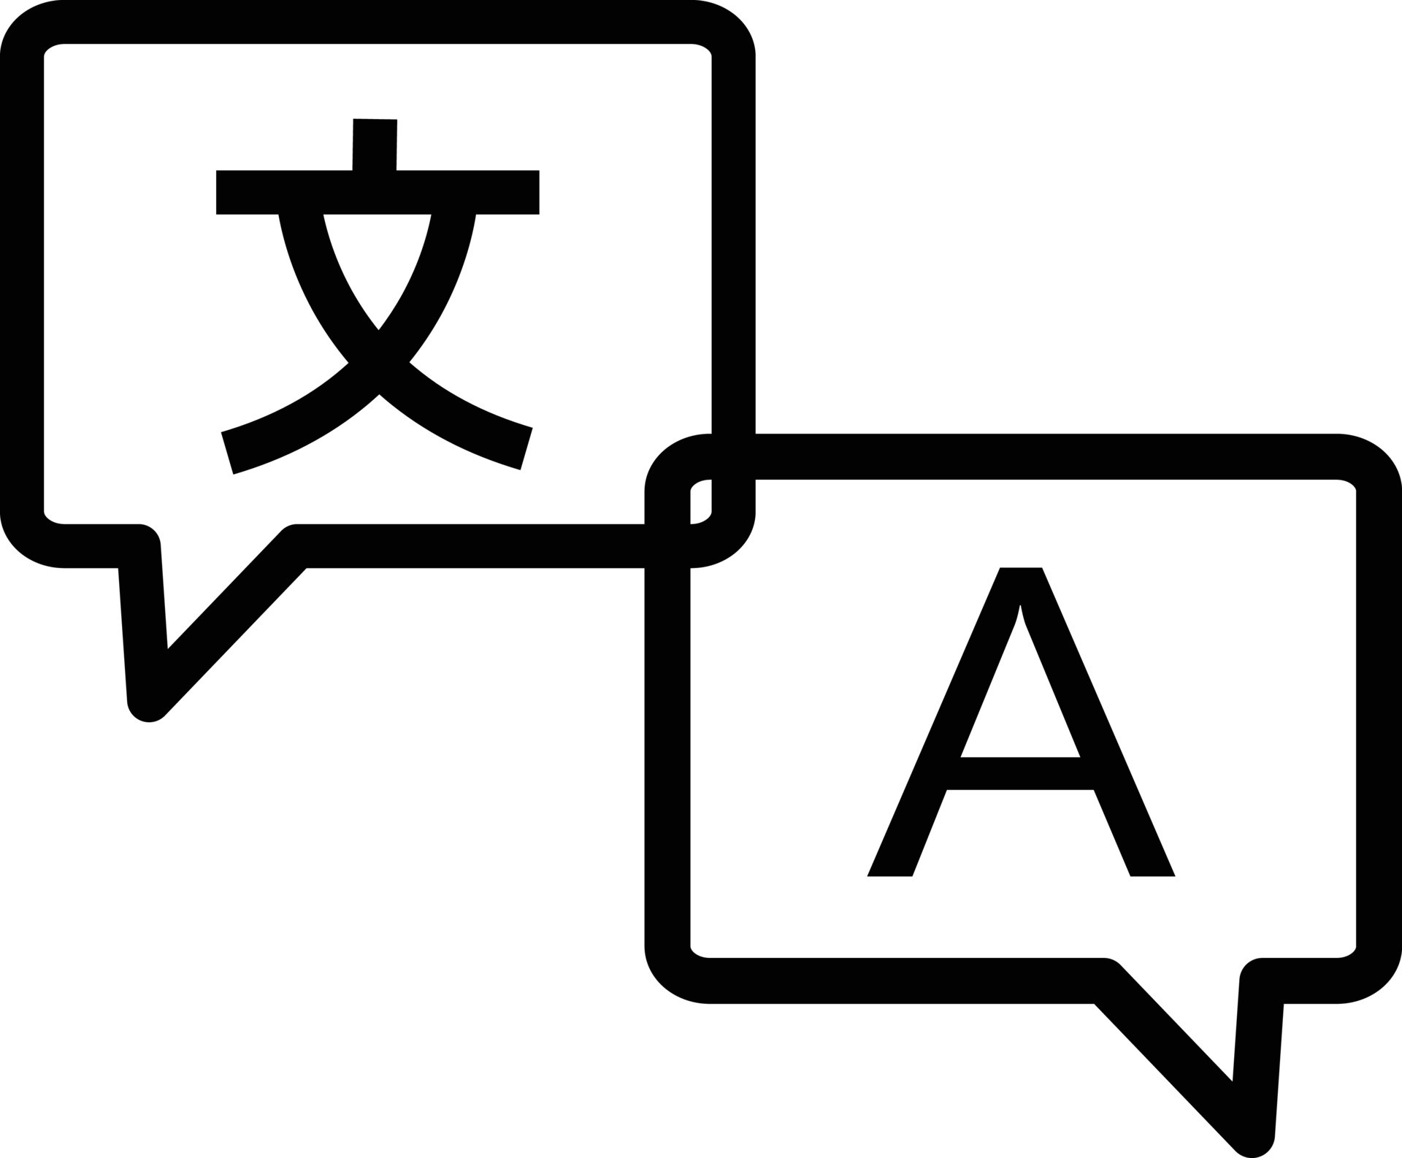


Python and Pygame power the game loop
Tools cover application logic, rendering, and debugging.
Python
Application logic and game rules.
Pygame
Window, rendering, keyboard input, timing, and sound-ready structure.
VS Code
Development and debugging environment.
Browser version, if used
HTML, CSS, and JavaScript.
S. B. Jain Institute of Technology Management and research `

Slide 5
Phase 3 moves the project from progress to polish
Phase 2 progress is a starting point. Phase 3 concentrates on gameplay refinement, interface improvements, and validation.
100% COMPLETED
Phase 3 focuses on completing the Snake Game by improving gameplay, refining the user interface, implementing smooth controls, enhancing scoring functionality and performing final testing to ensure a complete and reliable gaming experience.
S. B. Jain Institute of Technology Management and research

Slide 6
Conclusion :
Python Snake Game a practical engineering build Python and Pygame turn a complete interactive game concept into a focused engineering project.
The build develops understanding of event loops, state updates, rendering, and collision logic.
Next step: replace placeholders with verified screenshots, test results, and presenter details.
Successfully developed a Snake Game using Python and Pygame.
Implemented keyboard controls, snake movement, and food generation.
Added score tracking and collision detection for better gameplay.
Improved the game interface and tested its functionality for a smooth gaming experience.

Slide 7
Thank You !!!!
S. B. Jain Institute of Technology Management and research

