Slide 1
Accessing Linux Machines
CLI (Command Line Interface): to input instructions to a computer. In Linux, the program which provides CLI is called a SHELL The shell is attached to a Terminal to input instructions from keyboard.
BASH (Bourne Again Shell) Shell: Default in most modern Linux systems. You interact with a shell from shell prompt ($ for standard user and # for root or superuser)
commands: program name (use --help or man pages)
options: flags to change the behavior of commands
arguments: command targets
example: usermod -L john

Slide 2
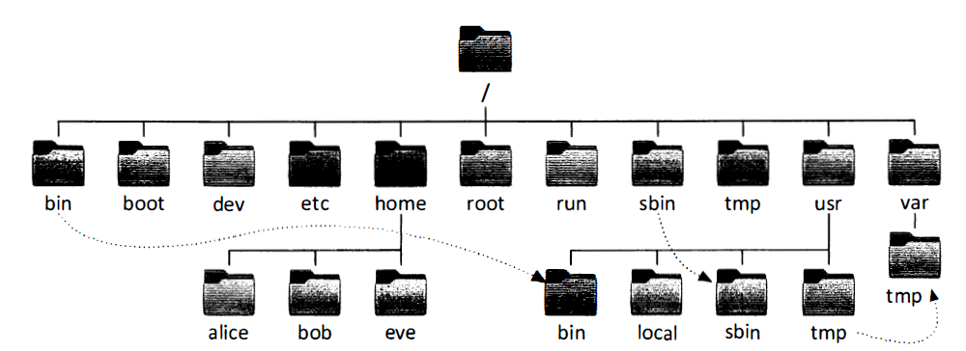
File System Hierarchy

Slide 3
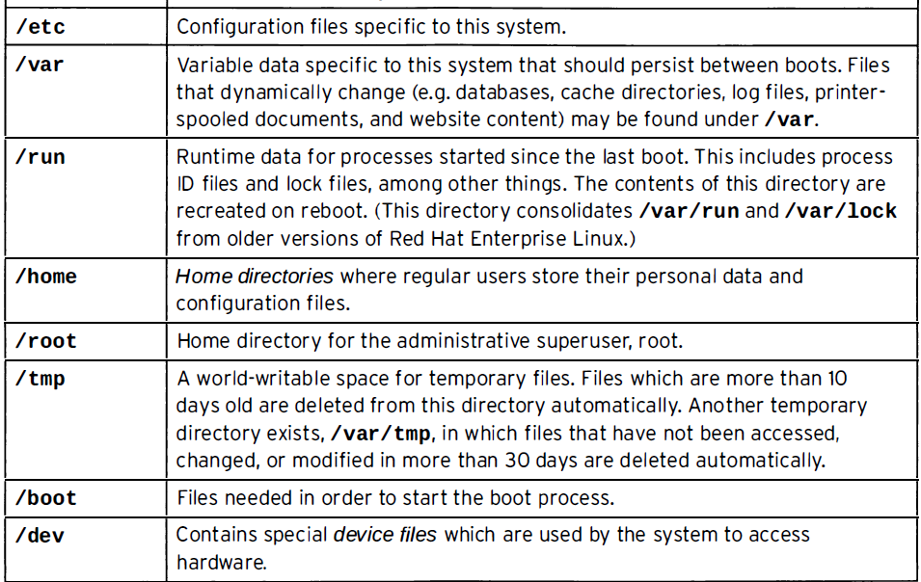
Important Directories

Slide 4
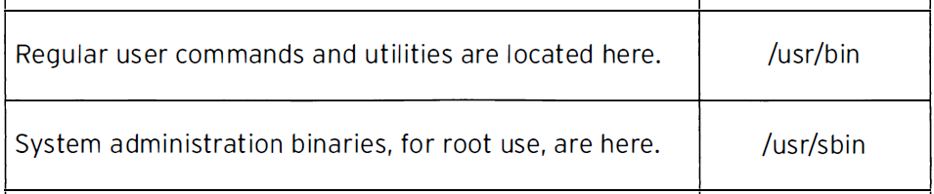
Important Directories Part 2

Slide 5
Absolute and Relative Paths
An Absolute Path begins at the root (/) directory and specifies each subdirectory it traversed through to reach the destination.
Example: /var/log/messages
Similarly, a Relative Path specifies only the path necessary to reach the file from the working directory.
Example: A user in the /var directory could refer to the message log file relatively as log/messages

Slide 6
(.) and (..)
The two special characters at the top of the listing refer to the current directory (.) and the parent directory (..)
These special characters exist in every directory on the system.

Slide 7
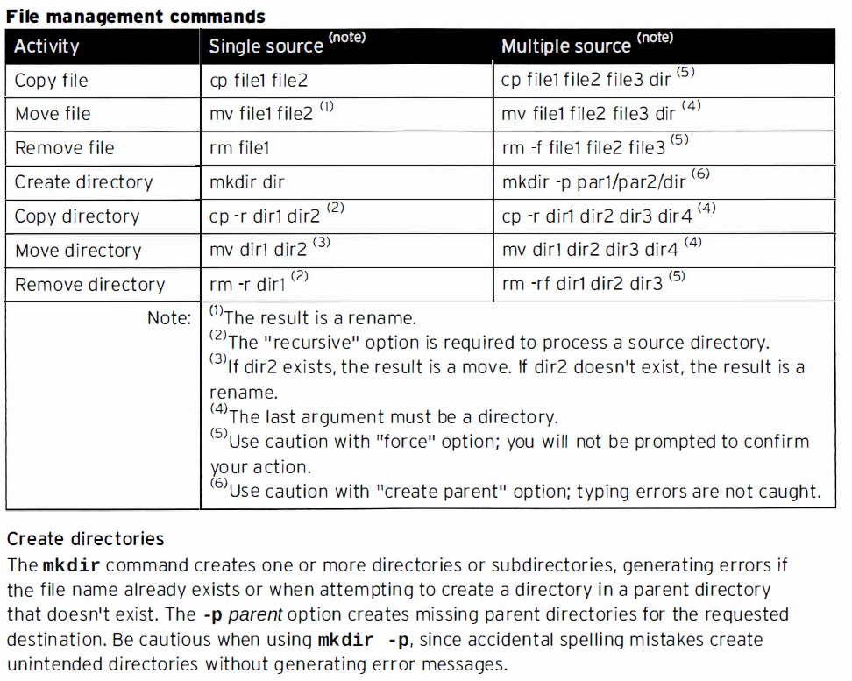
File Management Commands

Slide 8
Local Users and Groups
Every process (running program) runs as a particular user. Each file is owned by a user.
id = show info about current logged-in user
Id username = show info about other user
ls -l = To view the user associated with a file or directory (3rd column)
ps au = All processes with user info
Note: OS tracks user info with UID number
/etc/passwd = stores information about local users ( follows 7 colon-separated fields)

Slide 9
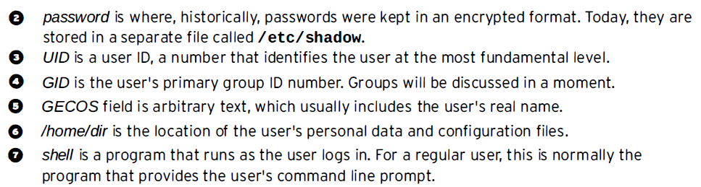
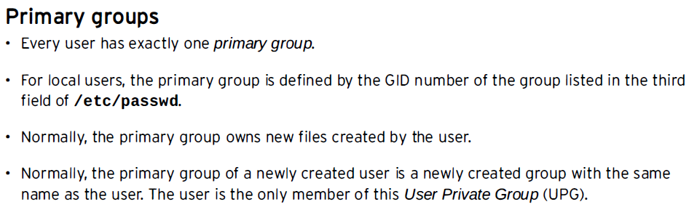
Local Users and Groups Part 2

Slide 10
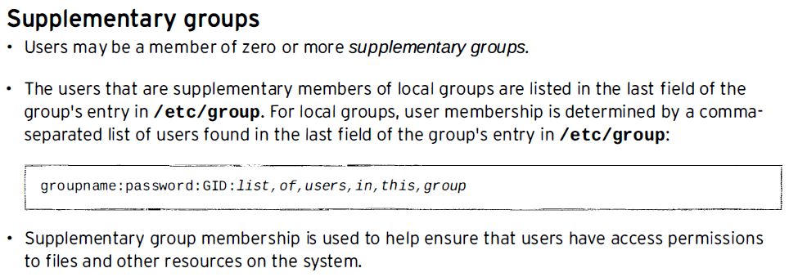
Local Users and Groups Part 3
root user in linux is like playing a game in GOD mode. It should be used wisely or else it can damage the system. It is recommended to work as a non-root user wherever possible and only elevate privileges when its really required.

Slide 11
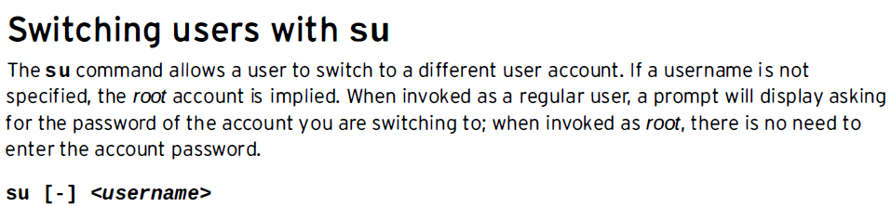
Local Users and Groups Part 4

Slide 12
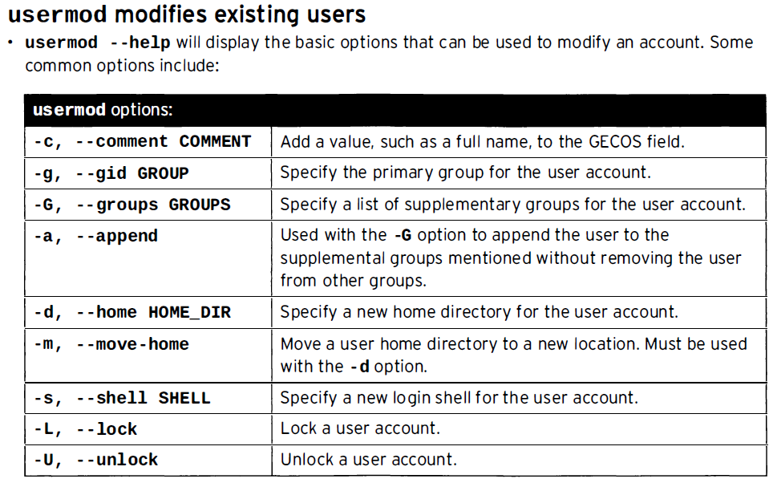
Local Users and Groups Part 5
useradd username creates the user and makes an entry in /etc/passwd file
usermod modifies an existing user

Slide 13
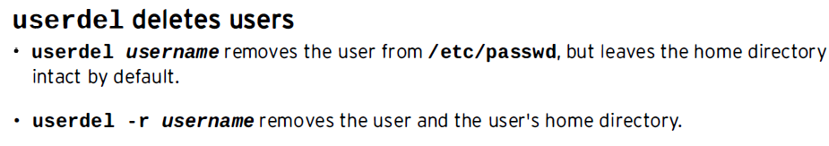
Local Users and Groups Part 6
passwd username sets user’s password and encrypted password is saved in /etc/shadow file

