Slide 1
GRADESENSE
Explainable AI for safer, faster paper grade transitions
Honeywell Hackathon Final Submission
Industrial AI | Software Prototype
Bhavuk Mahajan | GradeSense
PREDICT
EXPLAIN
RECOMMEND
Human-in-the-loop • Constraint-aware • Real-time
Notes:
[Sources]
Internal source: GradeSense README.md
No external claims or assets.

Slide 2
PREDICT BEFORE QUALITY DRIFTS
THE PROBLEM
THE GRADE SENSE LOOP
Grade transitions are multivariable, time-dependent, and costly when deviation is detected late.
Sense
Predict
Act
Live process state
Quality, risk, time
Safe ranked guidance
Operators must connect changing sensor values, future basis-weight behavior, safety constraints, and past outcomes under time pressure.
Learn
Explain
Simulate
Decision + outcome
Drivers + confidence
Forecast under action
One governed system connects detection, explanation, intervention, and measurable learning.
Notes:
[Sources]
Internal source: README.md and docs/SYSTEM_ARCHITECTURE.md
No external claims or assets.

Slide 3
WHY GRADESENSE IS DIFFERENT
WHY THIS APPROACH
SYSTEM ARCHITECTURE
APPROACH COMPARISON
Forecast the whole trajectory, then simulate only constraint-valid actions with the same active model.
METHOD
WARNING
ACTION QUALITY
TRUST
React UI
FastAPI
Domain services
SQL + artifacts
Operations + governance
REST + WebSocket
Reactive thresholds
Late
None
Low
Inference + intervention
History + immutable models
The result is earlier warning without recursive error accumulation - plus recommendations an operator can verify before acting.
Recursive forecast
Early
Error compounds
Medium
AI WORKFLOW
Black-box optimizer
Early
Needs external guardrails
Low
1
Validate
2
Forecast
3
Explain
4
Constrain
5
Recommend
DESIGN ADVANTAGES
Typed process state
Direct horizon
GradeSense
Early + 12-step
Pre-checked + simulated
High
• Windows never cross transitions
• Empirical confidence bands
• Safety gate before inference
• Human approval + outcome audit
Drivers + confidence
Safety gate
Ranked benefit
Python • FastAPI • SQLAlchemy • scikit-learn • React • TypeScript • PostgreSQL • Docker
Notes:
[Sources]
Internal source: docs/MODEL_OVERVIEW.md and backend/app/services/forecasting.
The comparison is qualitative; no external benchmark is claimed.

Slide 4
EXPLAINABILITY, SAFETY, AND OUTCOMES
EXPLAINABLE AI
RECOMMENDATION ENGINE
BUSINESS IMPACT
Why did risk change?
Generate
Gate
Simulate
EARLIER
1-4 variable actions
Reject unsafe sets
Compare to baseline
Moisture
risk detection
Steam pressure
Only positive, constraint-valid improvements are ranked for the operator.
SAFER
Machine speed
set-point guidance
Feature direction • model version • confidence • drift
TRACEABLE
Advisory by design: the operator remains in control.
decision-to-outcome loop
Notes:
[Sources]
Internal source: backend/app/services/explainability.py, recommendation.py, intervention.py
Business-impact wording is directional; no unvalidated ROI figures are claimed.

Slide 5
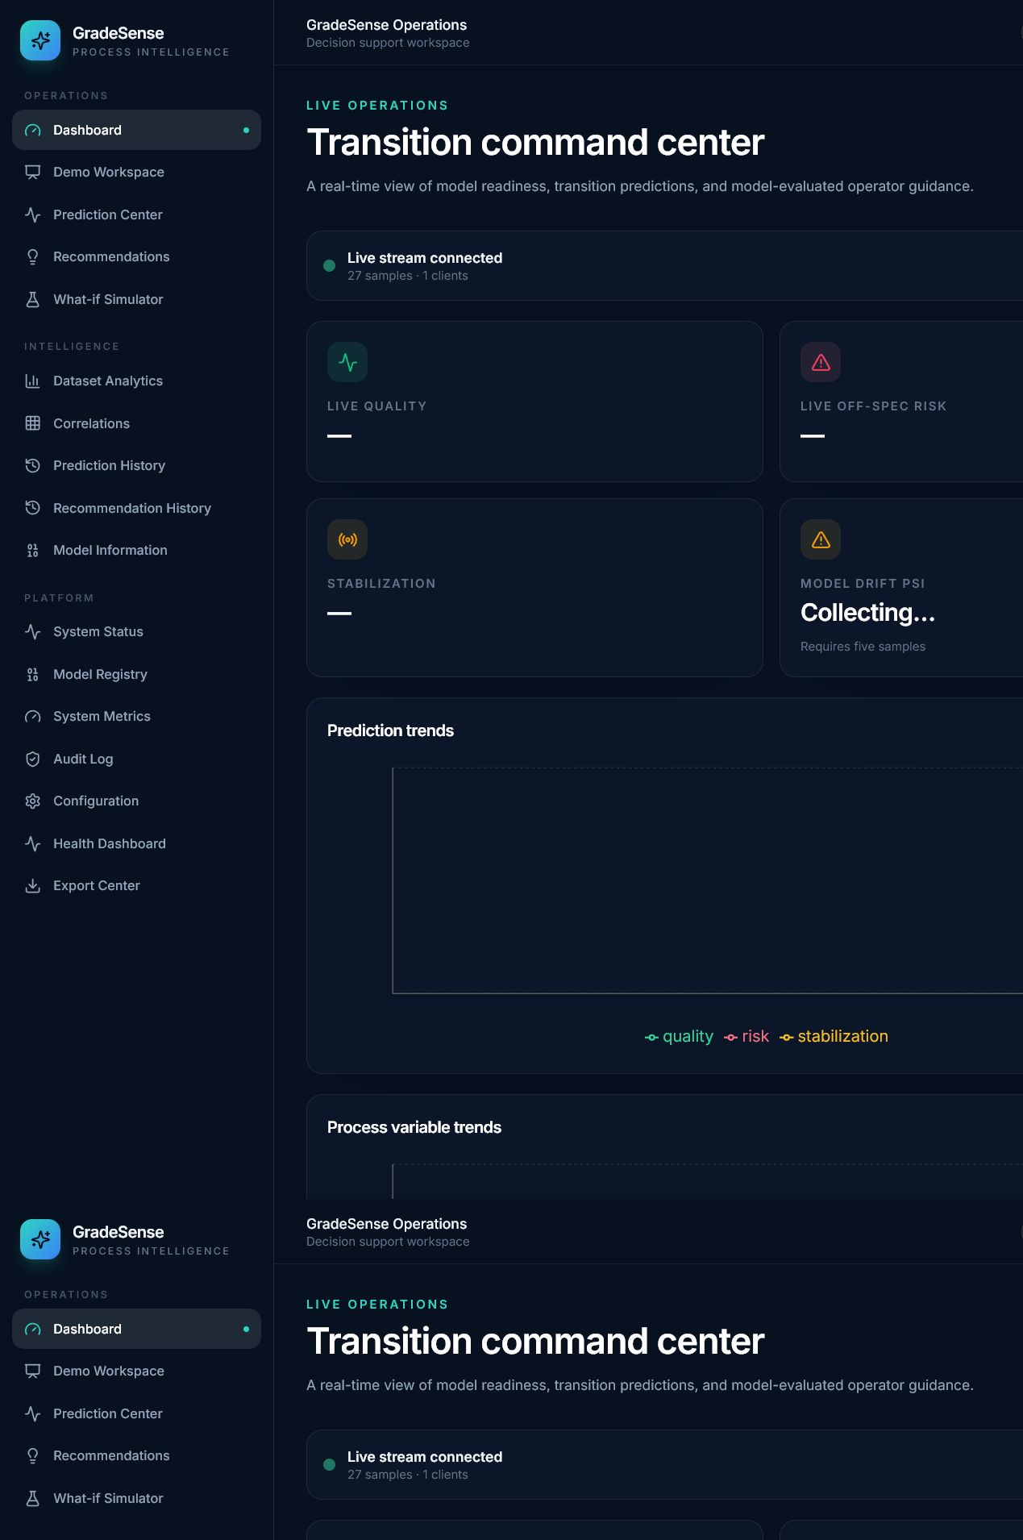
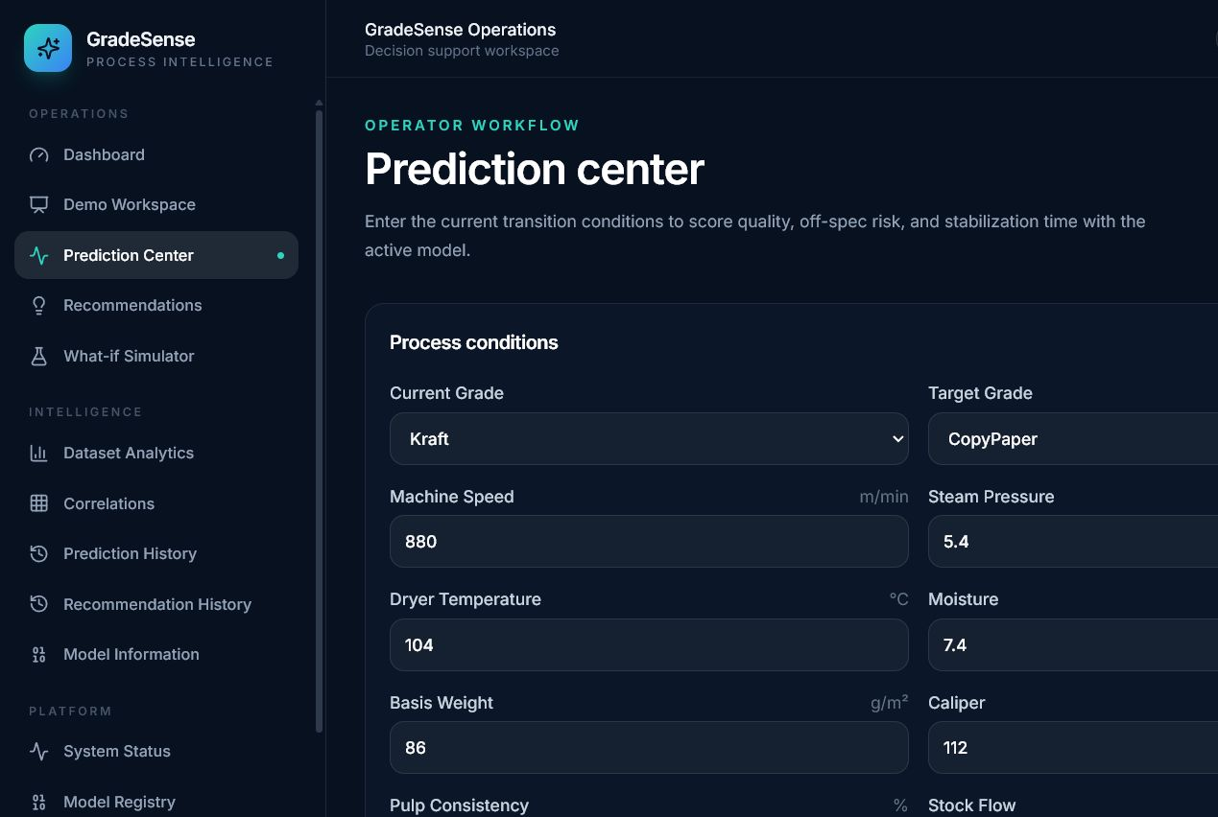
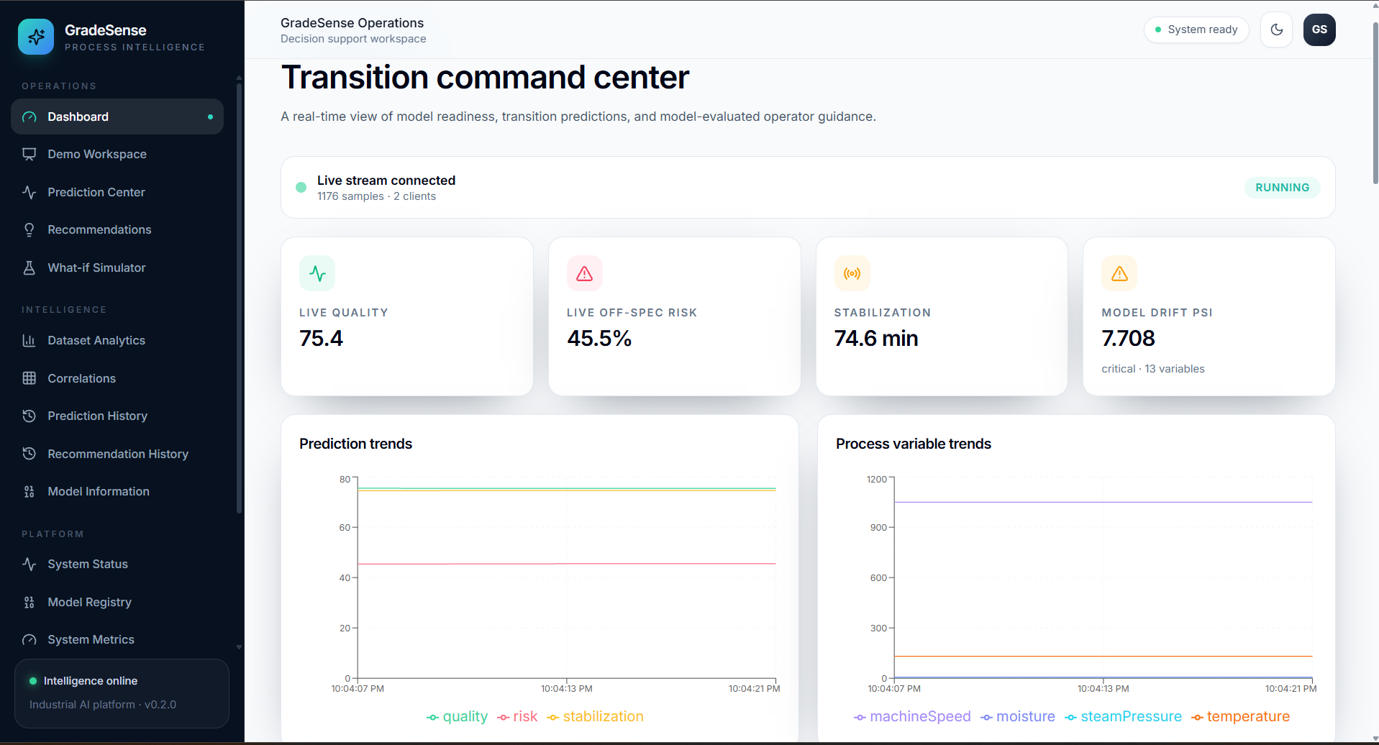
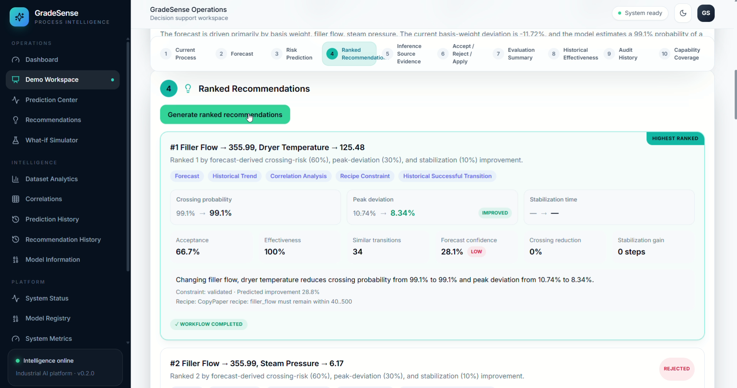
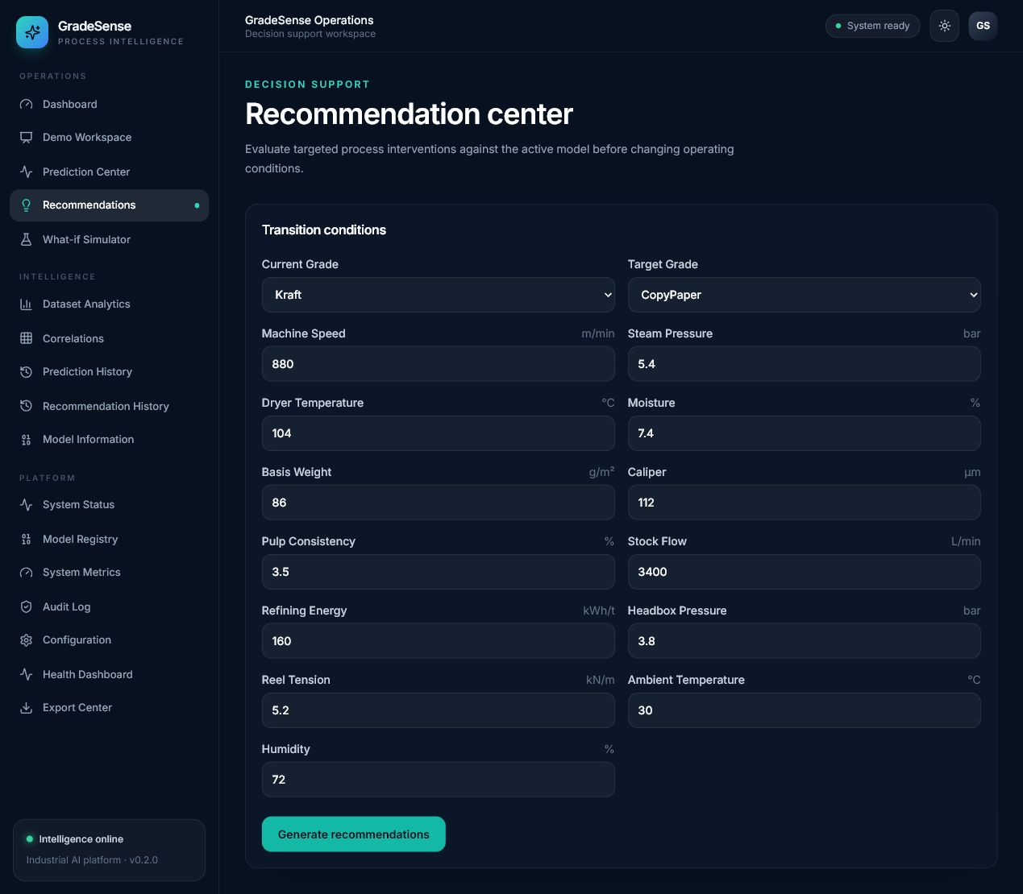
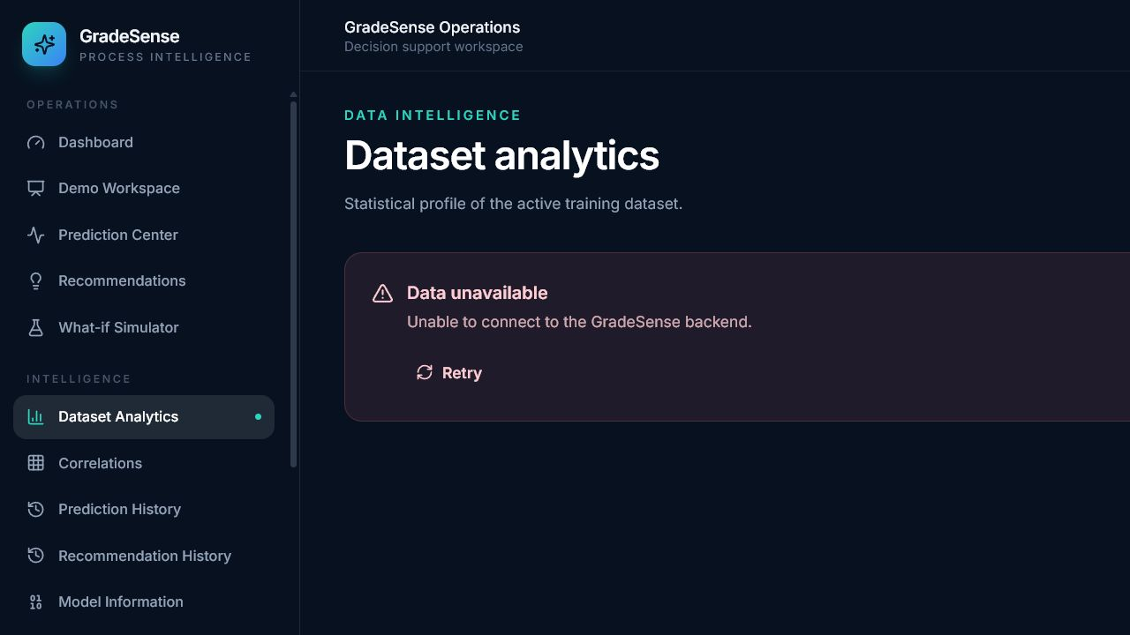
VALIDATED ANALYTICS + WORKING PRODUCT
0.920
1.388
0.962
20,000
2,544
Crossing ROC-AUC
Trajectory MAE
Stabilization R²
Snapshot records
Held-out windows
Validation is grouped by complete transitions: 192 train / 48 held out. Windows never cross transition boundaries.
LIVE OPERATIONS
EXPLAINABLE PREDICTION
REAL-TIME RISK + DRIFT
RANKED, EXPLAINED ACTIONS
CONSTRAINT-AWARE ACTION
ANALYTICS + GOVERNANCE
Notes:
[Sources]
Internal source: models/grade_transition_model.joblib and models/basis_weight_forecast.joblib.
Metrics: crossing ROC-AUC 0.920313; mean trajectory MAE 1.388263; stabilization R2 0.9622; 20,000 snapshot records; 2,544 validation windows; 192/48 transition split.
Screenshots: Submission/screenshots/Home.png and Recommendation.png.

Slide 6
TRY IT, REVIEW IT, BUILD ON IT
DEPLOYMENT ARCHITECTURE
GradeSense turns model output into safe, explainable, measurable operator action.
Mill browser
TLS gateway
React + FastAPI
PostgreSQL
Operator experience
Identity + routing
Nginx, REST, WebSocket
Durable history + audit
LIVE PRODUCT
https://gradesense-4weh.onrender.com/
SOURCE CODE
https://github.com/bhavukm007/GradeSense
REFERENCE DELIVERY
PILOT NEXT
API DOCUMENTATION
https://gradesense-api.onrender.com/docs
Docker Compose • Render blueprint • Alembic migrations • health checks • read-only model mounts
Connect PLC/SCADA data
Calibrate on plant history
Enable SSO and governed roles
Measure off-spec and stabilization outcomes
DEMO VIDEO
https://drive.google.com/file/d/1rCr3CzuCit0O029VzyxIhHoR1lv9E93E/view?usp=sharing
Pilot next: historian integration, mill-specific calibration, identity controls, and measured avoided off-spec production.
GradeSense turns model output into safe, explainable, measurable operator action.
Notes:
[Sources]
LIVE PRODUCT: https://gradesense-4weh.onrender.com/
SOURCE CODE: https://github.com/bhavukm007/GradeSense
API DOCUMENTATION: https://gradesense-api.onrender.com/docs
DEMO VIDEO: https://drive.google.com/file/d/1rCr3CzuCit0O029VzyxIhHoR1lv9E93E/view?usp=sharing

