Slide 1
GRADESENSE
INDUSTRIAL AI / SMART MANUFACTURING
HONEYWELL HACKATHON · 01
AI-POWERED INTELLIGENT PROCESS OPTIMIZATION
GRADE
SENSE
PREDICT
↓
EXPLAIN
Predict quality. Explain risk. Recommend action.
↓
An AI-assisted manufacturing intelligence platform that predicts product quality in real time and recommends safe process adjustments before defects occur.
RECOMMEND
HUMAN-IN-THE-LOOP · REAL-TIME · TRACEABLE
BHAVUK MAHAJAN
Candidate ID 20484629 · Category: Software
Honeywell Hackathon · Industrial AI / Smart Manufacturing
Notes:
[Sources]
Internal source: README.md.
The official Honeywell problem-statement ID and exact title were not present in the supplied files; the slide flags this rather than inventing them.

Slide 2
GRADESENSE
PROBLEM + IDEA
HONEYWELL HACKATHON · 02
Quality decisions arrive too late
CURRENT WORKFLOW
GRADESENSE WORKFLOW
1
Watch hundreds of changing sensor values
SENSE
Continuous process stream
2
Detect drift after quality moves off target
PREDICT
Quality, risk, stabilization
3
Rely on experience to choose an adjustment
EXPLAIN
Drivers, confidence, drift
4
Inspect output and absorb waste or rework
RECOMMEND
Safe set-point changes
WHY IT MATTERS
BEFORE DEFECTS
ACTION, NOT ALERTS
EXPLAINED DECISIONS
CONTINUOUS LEARNING
OPERATOR CONTROL
Notes:
[Sources]
Internal source: README.md and docs/DEMO_GUIDE.md.
Benefits are capability statements, not quantified plant ROI claims.

Slide 3
GRADESENSE
TECHNICAL APPROACH
HONEYWELL HACKATHON · 03
One governed path from sensor to action
01
02
03
04
05
06
SENSORS
PIPELINE
PREDICT
EXPLAIN
RECOMMEND
DASHBOARD
Live process data
Validate + engineer
Snapshot + forecast
Drivers + confidence
Constrain + simulate
Decide + learn
TECHNOLOGY STACK
FRONTEND
BACKEND
ML
REAL TIME
DEPLOY
React · TypeScript · Vite
FastAPI · Python · SQLAlchemy
Scikit-learn · Pandas · NumPy
REST APIs · WebSockets
Docker · Render · PostgreSQL
LIVE MONITORING
PREDICTIVE ANALYTICS
EXPLAINABLE AI
RANKED ACTIONS
AUDIT + HISTORY
Notes:
[Sources]
Internal source: docs/SYSTEM_ARCHITECTURE.md, docs/MODEL_OVERVIEW.md, backend/app, and frontend/src.

Slide 4
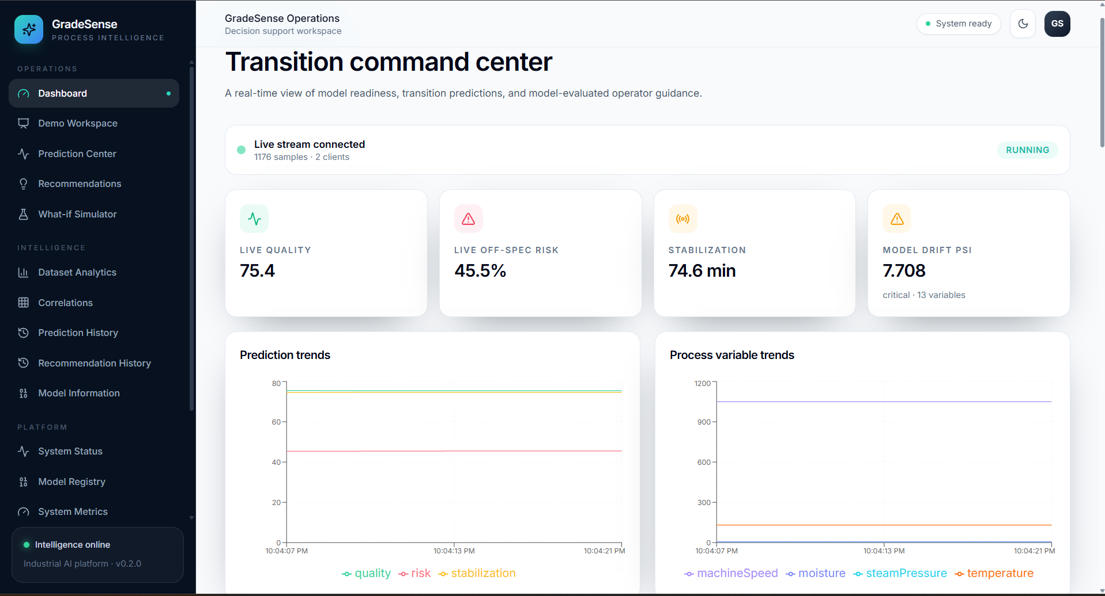
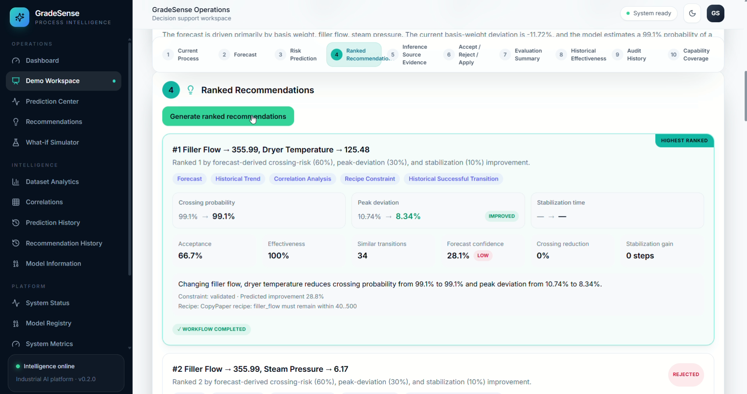
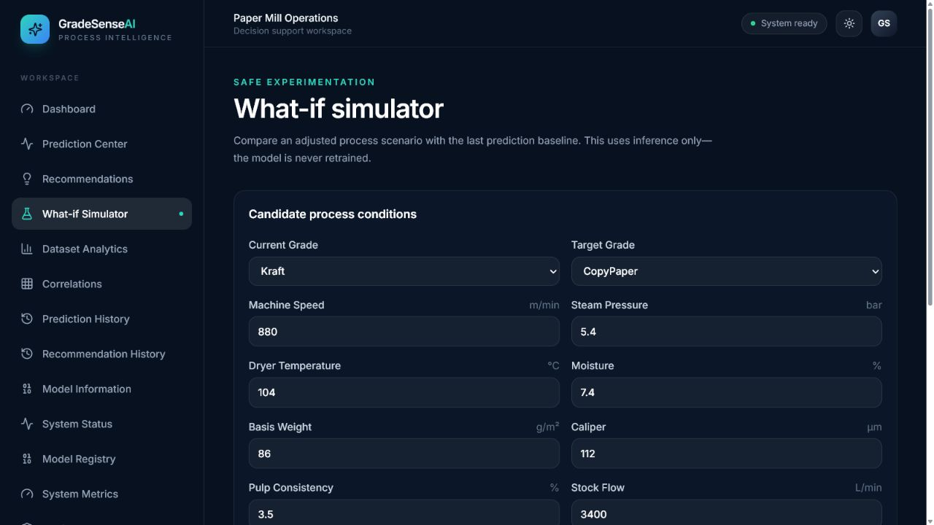
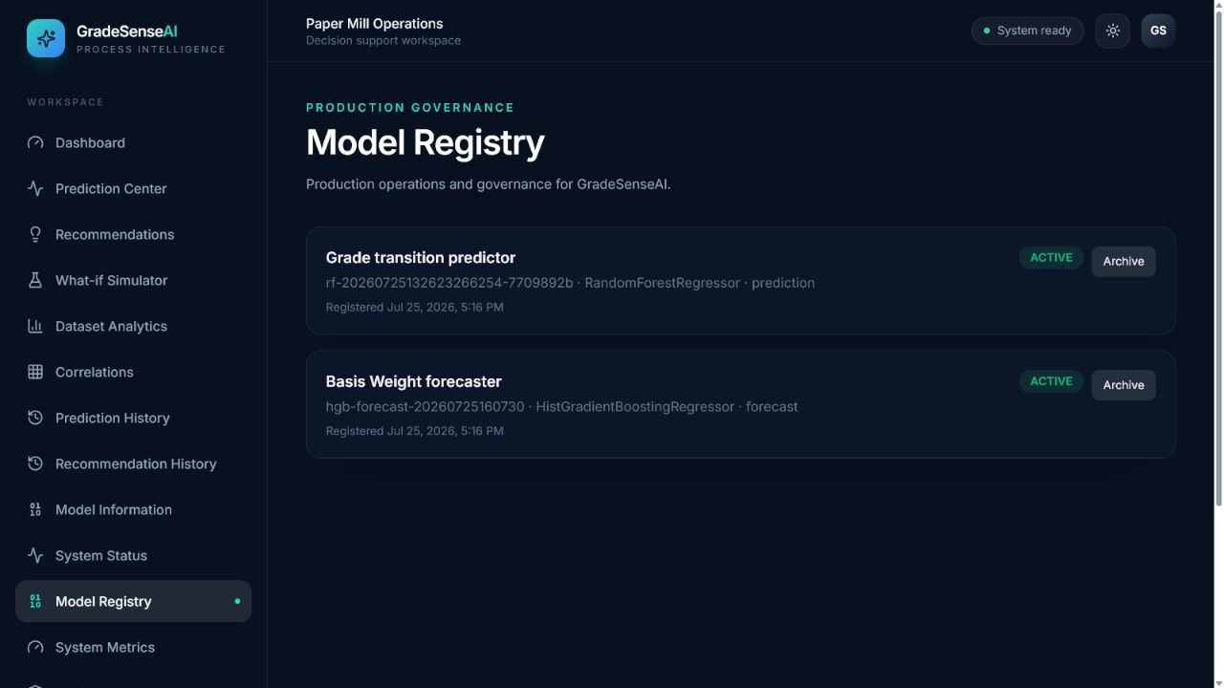
GRADESENSE
SOLUTION DEMONSTRATION
HONEYWELL HACKATHON · 04
The closed loop is already working
LIVE SIGNALS + EARLY RISK
EXPLAINED, RANKED ACTIONS
WHAT-IF BEFORE APPLYING
VERSIONED + AUDITABLE
Notes:
[Sources]
Internal assets: user-supplied GradeSense screenshots and docs/screenshots/simulator.png, docs/screenshots/model-registry.png.
No external assets.

Slide 5
GRADESENSE
FEASIBILITY + IMPACT
HONEYWELL HACKATHON · 05
Built to deploy - designed to earn trust
0.920
1.388
0.962
2,544
Crossing ROC-AUC
Trajectory MAE
Stabilization R²
Held-out windows
TECHNICALLY FEASIBLE
BUSINESS VALUE
WHY GRADESENSE?
•
Cloud deployed
•
Earlier intervention
PREDICT
↓
EXPLAIN
↓
RECOMMEND
↓
OPTIMIZE
•
API-driven modules
•
Faster operator decisions
•
Real-time WebSockets
•
Lower rejection opportunity
•
Dockerized services
•
Improved process stability
•
Versioned model registry
•
Higher trust through XAI
One unified industrial decision-support platform.
Notes:
[Sources]
Internal source: models/grade_transition_model.joblib and models/basis_weight_forecast.joblib.
Validated metrics: crossing ROC-AUC 0.920313; mean trajectory MAE 1.388263; stabilization R2 0.9622; 2,544 validation windows.
Business benefits are directional opportunities; no plant ROI has been claimed.

Slide 6
GRADESENSE
REFERENCES
HONEYWELL HACKATHON · 06
Explore the working submission
GITHUB REPOSITORY
https://github.com/bhavukm007/GradeSense
TECHNOLOGY REFERENCES
React
LIVE DEPLOYMENT
https://gradesense-4weh.onrender.com/
FastAPI
Scikit-learn
Docker
DEMO VIDEO
https://drive.google.com/file/d/1rCr3CzuCit0O029VzyxIhHoR1lv9E93E/view?usp=sharing
Render
Pandas + NumPy
GRADESENSE
AI-powered intelligent process optimization platform
Honeywell Hackathon Submission · Bhavuk Mahajan · Candidate ID 20484629
Notes:
[Sources]
GITHUB REPOSITORY: https://github.com/bhavukm007/GradeSense
LIVE DEPLOYMENT: https://gradesense-4weh.onrender.com/
DEMO VIDEO: https://drive.google.com/file/d/1rCr3CzuCit0O029VzyxIhHoR1lv9E93E/view?usp=sharing
Technology references are the official project names used in the repository.

