Slide 1
GRADESENSE
Explainable AI for Paper Grade Transitions
Problem: predict off-spec basis-weight risk before limits are exceeded
Team: GradeSense | Bhavuk Mahajan
Honeywell Hackathon Final Submission
Notes:
[Sources]
Internal GradeSense repository content.

Slide 2
PROBLEM
Paper grade transitions are difficult to stabilize because quality depends on interacting variables over time.
Off-spec behavior is often detected after material has already been produced.
Sensor trends, confidence, alerts, and historical outcomes are fragmented.
Black-box predictions do not explain why risk changed or which action is safe.
GradeSense must predict early, explain clearly, recommend safely, and keep operators in control.
Notes:
[Sources]
Honeywell challenge statement supplied by the participant; internal GradeSense repository content.

Slide 3
TECHNICAL APPROACH
React + TypeScript dashboard -> FastAPI REST and WebSocket layer -> domain services
Snapshot ML + direct-horizon forecasting -> explainability -> safe recommendation ranking
SQLAlchemy + PostgreSQL/SQLite persist predictions, alerts, decisions, outcomes, audit, and models
Dockerized frontend/backend deployment on Render with health checks and environment configuration
Notes:
[Sources]
Internal GradeSense architecture and deployment documentation.

Slide 4
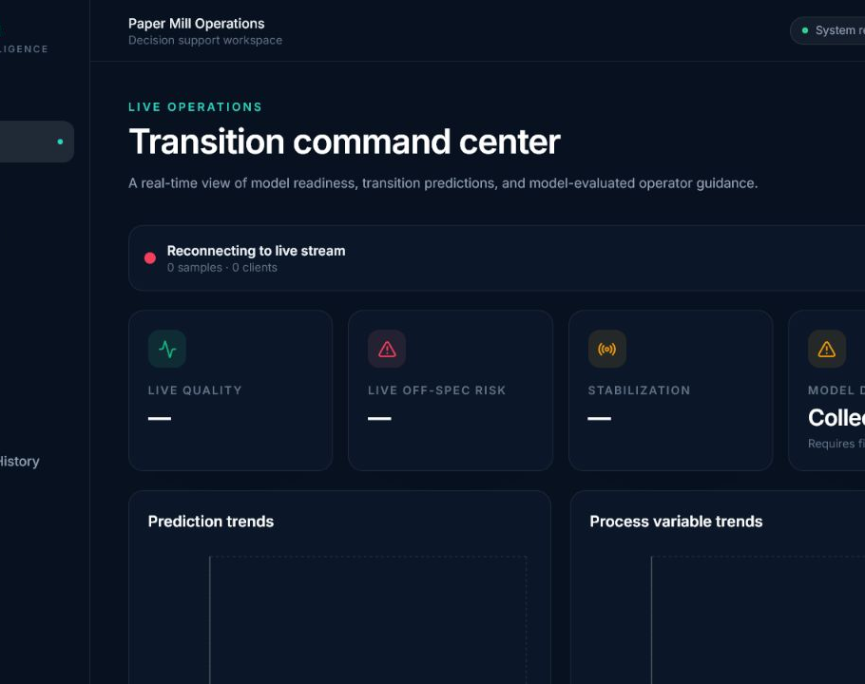
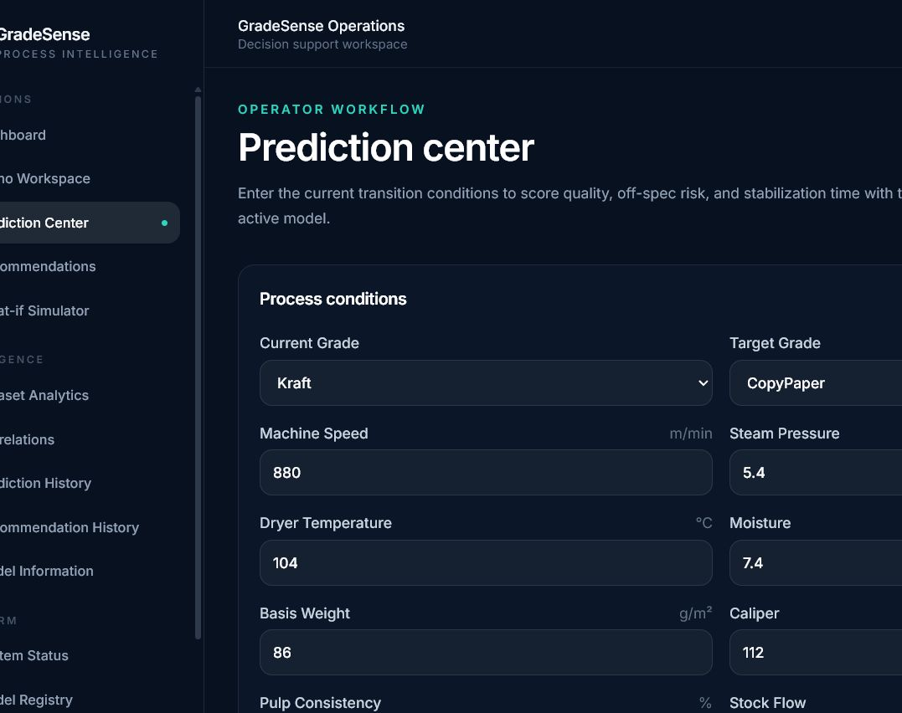
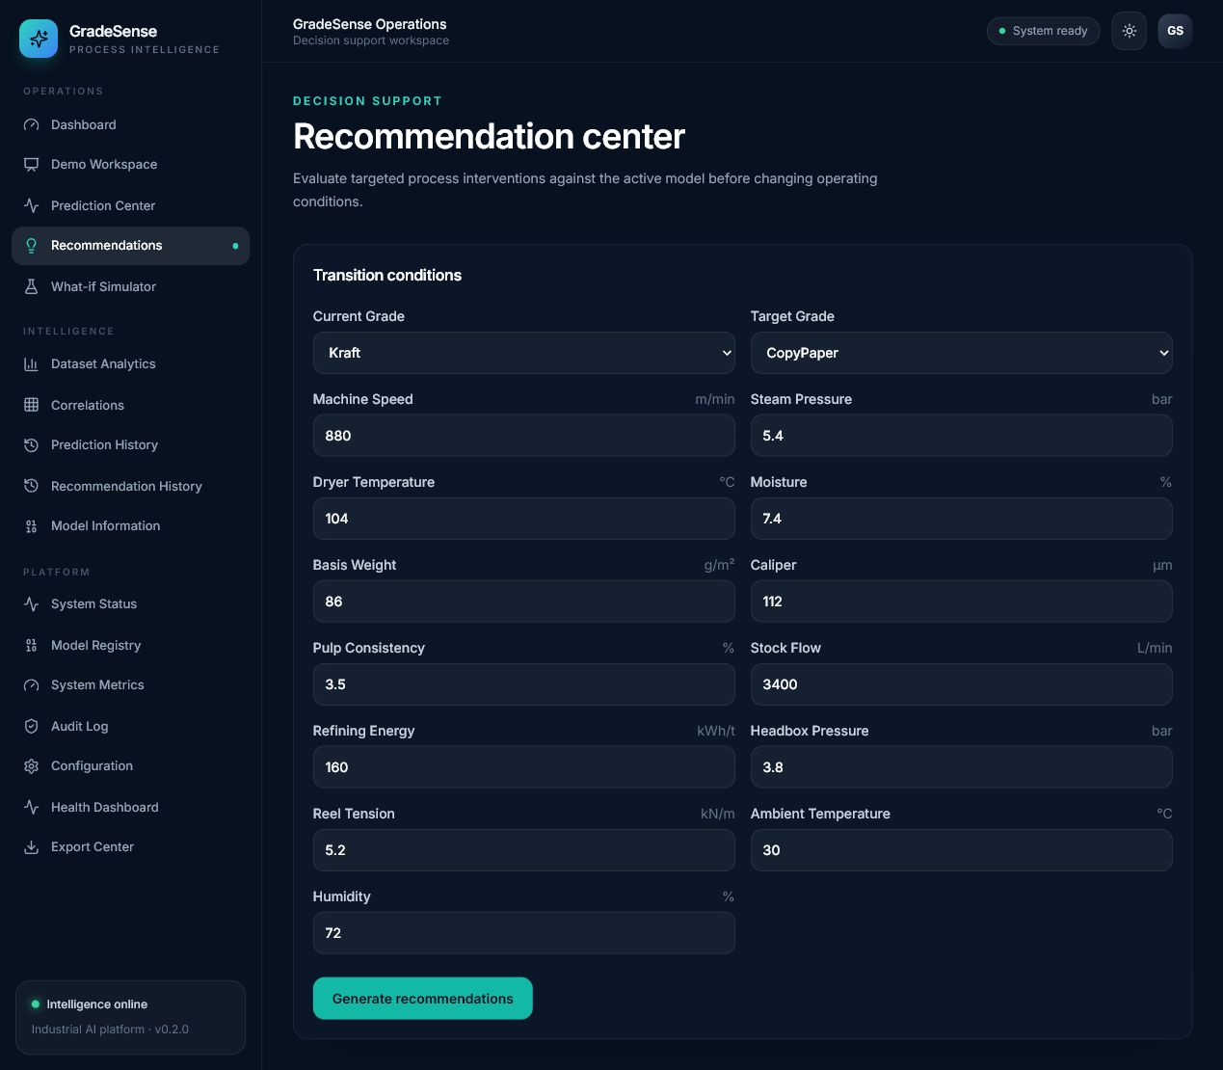
SOLUTION DEMONSTRATION
Notes:
[Sources]
Internal production captures stored in Submission/deployed_screenshots.

Slide 5
INNOVATION + RESULTS
Early basis-weight risk visibility supports intervention before avoidable off-spec production.
Direct-horizon forecasting reduces recursive error accumulation during grade transitions.
Explainable, constraint-checked recommendations keep operators in the decision loop.
Predictions, decisions, and outcomes form an auditable learning loop, deployed live on Render.
Notes:
[Sources]
Internal GradeSense model and service documentation. Impact language is directional.

Slide 6
REFERENCES
GitHub Repository
https://github.com/bhavukm007/GradeSense
Live Deployment
https://gradesense-4weh.onrender.com/
Demo Video
https://drive.google.com/file/d/1rCr3CzuCit0O029VzyxIhHoR1lv9E93E/view?usp=sharing
Notes:
[Sources]
GitHub Repository: https://github.com/bhavukm007/GradeSense
Live Deployment: https://gradesense-4weh.onrender.com/
Demo Video: https://drive.google.com/file/d/1rCr3CzuCit0O029VzyxIhHoR1lv9E93E/view?usp=sharing

