Slide 1
GRADESENSE
Explainable AI for safer, faster paper grade transitions
Honeywell Hackathon Final Submission
Industrial AI | Software Prototype
GradeSense Team
PREDICT
EXPLAIN
RECOMMEND
Human-in-the-loop • Constraint-aware • Real-time
Notes:
[Sources]
Internal source: GradeSense README.md
No external claims or assets.

Slide 2
PREDICT BEFORE QUALITY DRIFTS
THE PROBLEM
THE GRADE SENSE LOOP
Grade transitions are multivariable, time-dependent, and costly when deviation is detected late.
Sense
Predict
Act
Live process state
Quality, risk, time
Safe ranked guidance
Operators must connect changing sensor values, future basis-weight behavior, safety constraints, and past outcomes under time pressure.
Learn
Explain
Simulate
Decision + outcome
Drivers + confidence
Forecast under action
One governed system connects detection, explanation, intervention, and measurable learning.
Notes:
[Sources]
Internal source: README.md and docs/SYSTEM_ARCHITECTURE.md
No external claims or assets.

Slide 3
PRODUCTION-READY AI ARCHITECTURE
SYSTEM ARCHITECTURE
React UI
FastAPI
Domain services
SQL + artifacts
Operations + governance
REST + WebSocket
Inference + intervention
History + immutable models
AI WORKFLOW
1
Validate
2
Forecast
3
Explain
4
Constrain
5
Recommend
Typed process state
Direct horizon
Drivers + confidence
Safety gate
Ranked benefit
Python • FastAPI • SQLAlchemy • scikit-learn • React • TypeScript • PostgreSQL • Docker
Notes:
[Sources]
Internal source: docs/SYSTEM_ARCHITECTURE.md, backend/app, frontend/src
No external claims or assets.

Slide 4
EXPLAINABILITY, SAFETY, AND OUTCOMES
EXPLAINABLE AI
RECOMMENDATION ENGINE
BUSINESS IMPACT
Why did risk change?
Generate
Gate
Simulate
EARLIER
1-4 variable actions
Reject unsafe sets
Compare to baseline
Moisture
risk detection
Steam pressure
Only positive, constraint-valid improvements are ranked for the operator.
SAFER
Machine speed
set-point guidance
Feature direction • model version • confidence • drift
TRACEABLE
Advisory by design: the operator remains in control.
decision-to-outcome loop
Notes:
[Sources]
Internal source: backend/app/services/explainability.py, recommendation.py, intervention.py
Business-impact wording is directional; no unvalidated ROI figures are claimed.

Slide 5
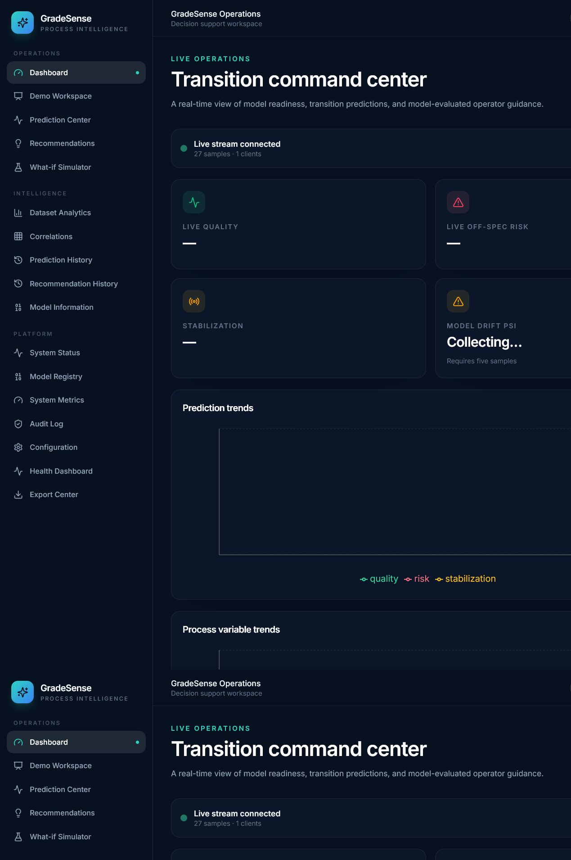
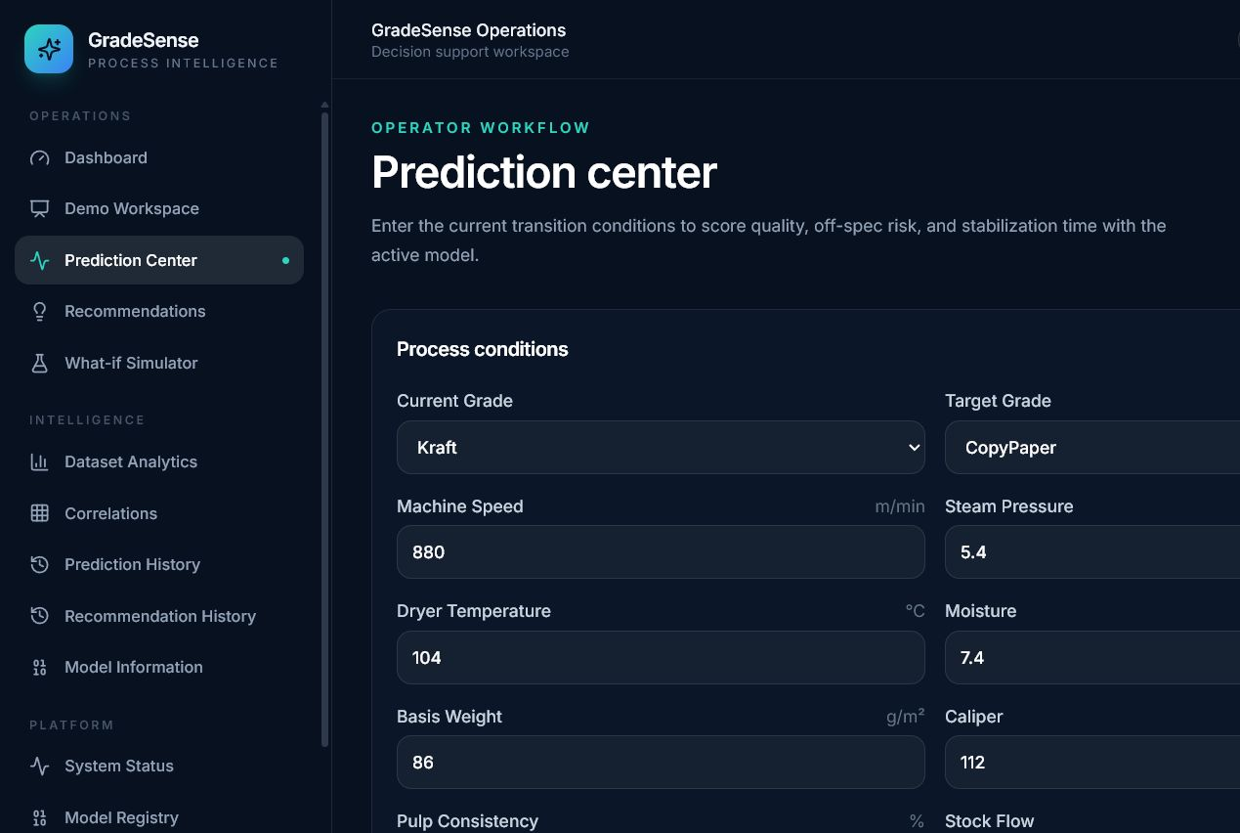
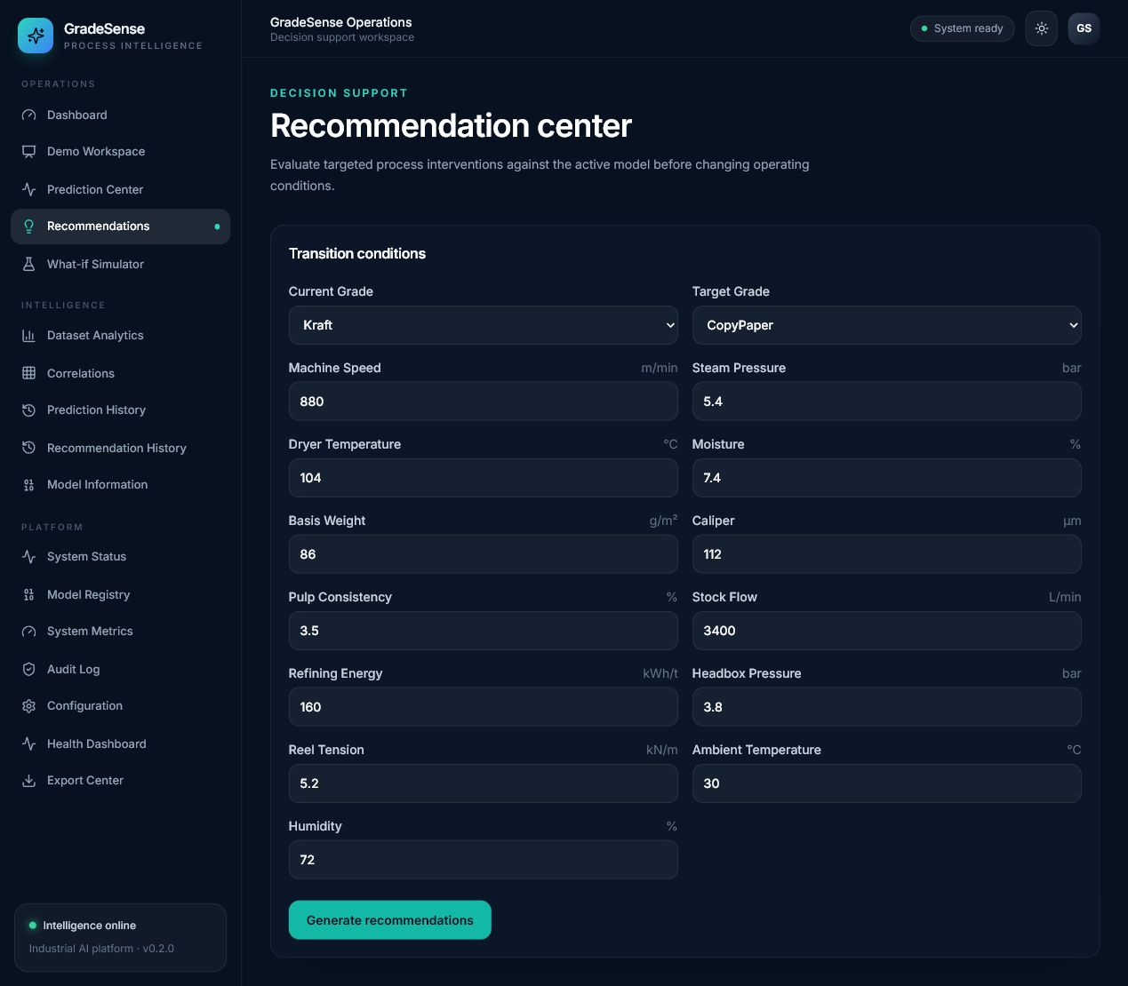
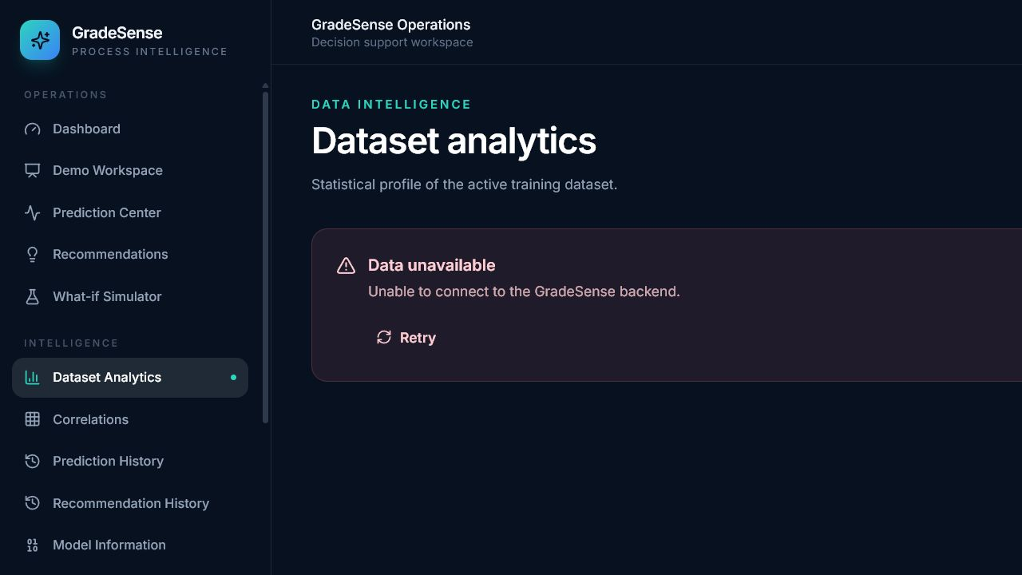
WORKING DASHBOARD: THE CLOSED LOOP
LIVE OPERATIONS
EXPLAINABLE PREDICTION
CONSTRAINT-AWARE ACTION
ANALYTICS + GOVERNANCE
Notes:
[Sources]
Internal source: live local GradeSense application captured 2026-07-26
Screenshots: Submission/screenshots/Home.png, Prediction.png, Recommendation.png, Analytics.png

Slide 6
DEPLOYABLE TODAY; PILOT-READY NEXT
DEPLOYMENT ARCHITECTURE
Mill browser
TLS gateway
React + FastAPI
PostgreSQL
Operator experience
Identity + routing
Nginx, REST, WebSocket
Durable history + audit
REFERENCE DELIVERY
PILOT NEXT
Docker Compose • Render blueprint • Alembic migrations • health checks • read-only model mounts
Connect PLC/SCADA data
Calibrate on plant history
Enable SSO and governed roles
Measure off-spec and stabilization outcomes
GradeSense turns model output into safe, explainable, measurable operator action.
Notes:
[Sources]
Internal source: docker-compose.yml, render.yaml, docs/DEPLOYMENT.md
No external claims or assets.

