Slide 1

Hosteldekho.com
Group No. 17
Presented by:-
Bhavy Gupta (194200037)
Vaseem Khan (194200146)
Raunak Agarwal (194200106)
Yash Raj (194200157)
Yug Garg (194200162)
Vinayak Jaiswal (194200147)
Under the supervision of:-
Mr. Gaurav Sharma
(Asst. Professor)
Department of CEA
GLA University, Mathura

Slide 2
Content
Introduction
Problem Statement
Objective
Purpose
Project Scope
Tools and Technology
Hardware And Software Requirement
ER-Diagram
DFD Level-0
DFD Level-1
Conclusion
References

Slide 3
Introduction
Basically Hosteldekho.com is rooms finding website where student can easily find rooms outside the campus.
Easy for student to find rooms in their budget and according to their comfort.
By checking the price and selecting the required facilities they can easily find rooms from our website.
They can easily compare many hostels also.
The problem consists of basically two parts as follows:-
Money
Facilities

Slide 4
Problem Statement
The Hostel problem can be of various types, the one implemented over here relates to the COLLEGE STUDENTS WHO STAY AS A PAYING GUEST OUTSIDE COLLEGE. The objective of such a website is to help them regarding-
Genuine Price
True Facilities
How far from the College
Environment of the Hostel as well as the society

Slide 5
Objective
The objectives of the system are-
Decrease the human efforts in finding best room.
Increase operational efficiency and accuracy.
Fast Finding of suitable Room as per demand.
Saves time by showing comparison between many rooms.
Budget friendly Rooms.

Slide 6
Purpose
Maximum utilization of resources.
No false information reach to the student.
Finding Rooms can be done at any time and any place.
Student do not have to waste time by looking for many different rooms separately.

Slide 7
Project Scope
Simple
Fast
Intelligent
Time Saving System
In-expensive

Slide 8
Tools And Technology
HTML and CSS:- HTML stands for Hyper Text Mark up Language. It is used in creating web pages. CSS stands for Cascading Style Sheets. It is used in designing webpages and help in creativity.
PHP and MySQL:- PHP is a widely-used, open source scripting language. PHP scripts are executed on the server. MySQL is an open-source relational database management system. It will help in maintaining the customers record.
Brackets and VSCode:- Brackets is a source code editor with a primary focus on web development. Created by Adobe Systems, it is free and open-source software licensed under the MIT License, and is currently maintained on GitHub by Adobe. Visual Studio Code is a free source-code editor made by Microsoft for Windows, Linux and macOS. Features include support for debugging, syntax highlighting, intelligent code completion, snippets, code refactoring, and embedded Git.

Slide 9
Hardware And Software Requirement for Developer
Operating System – Windows or Linux
RAM – 4 GB (Min.)
Processor – Intel i3 8th gen, Ryzen 3
Browser – Edge, Google Chrome, Opera Mini, Safari, Mozilla Firefox(Any one).
IDE – Brackets & Vscode
Server – XAMPP

Slide 10
Hardware And Software Requirement for User
Operating System – Any
RAM – 1 GB (Min.)
Processor – Any
Internet – Required
Browser – Internet Explorer , Google Chrome , Mozilla Firefox , etc.

Slide 11
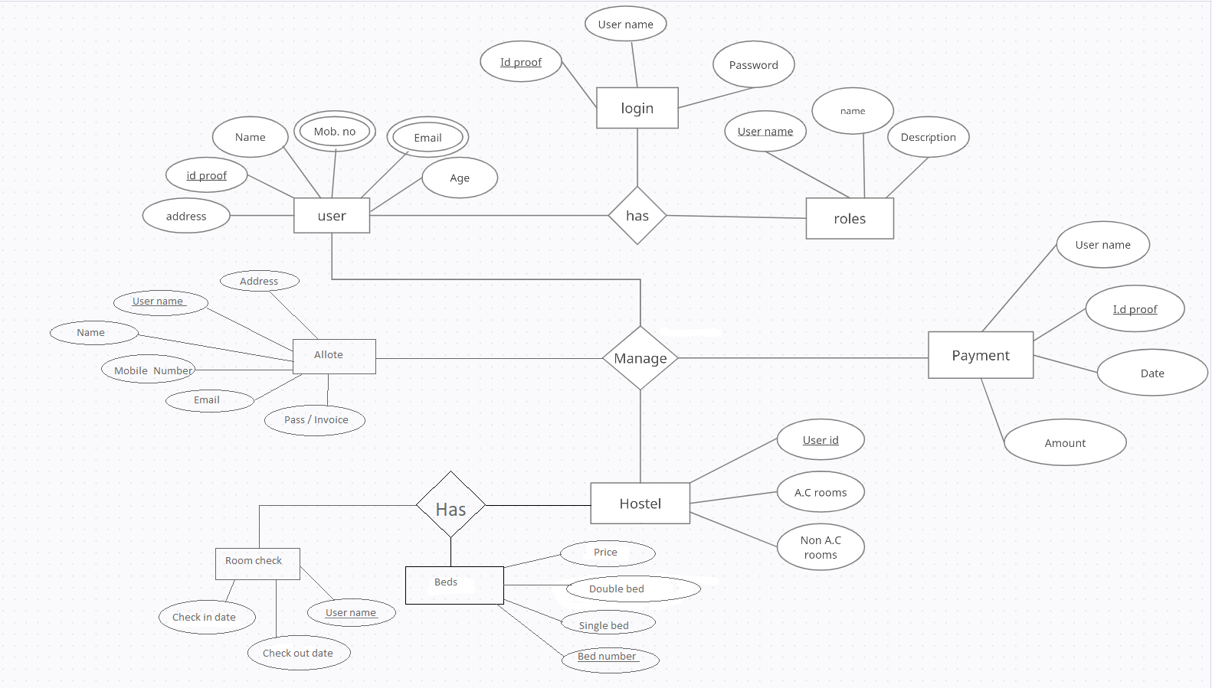
ER DIAGRAM

Slide 12
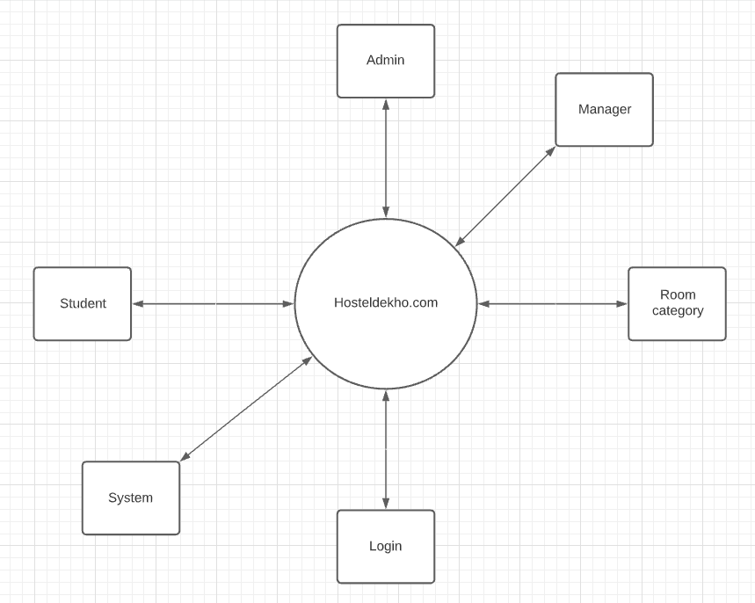
DFD Level 0

Slide 13
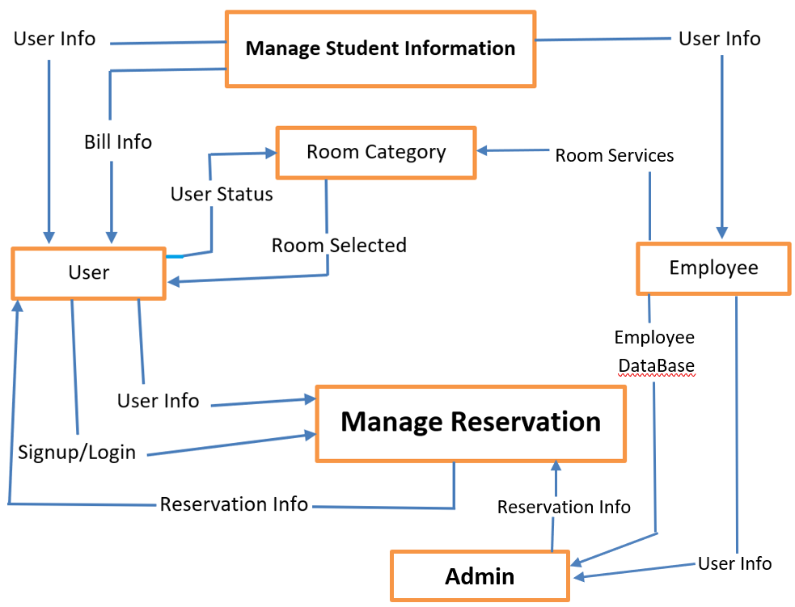
DFD Level 1

Slide 14
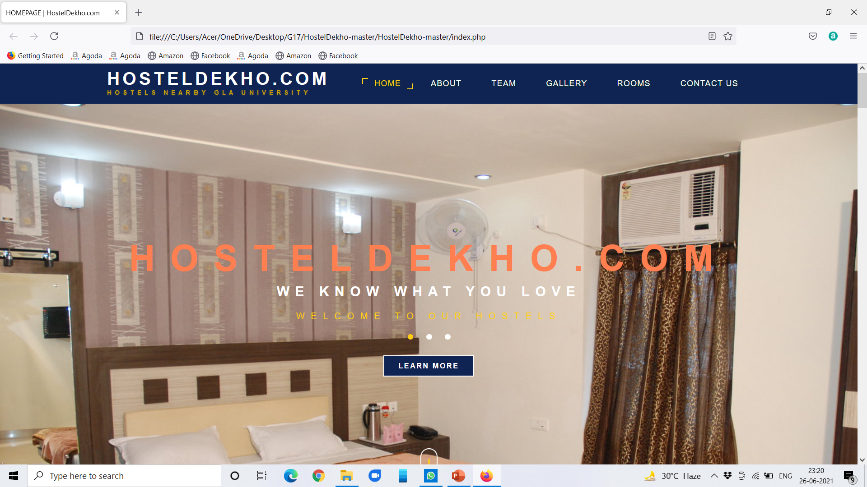

Slide 15
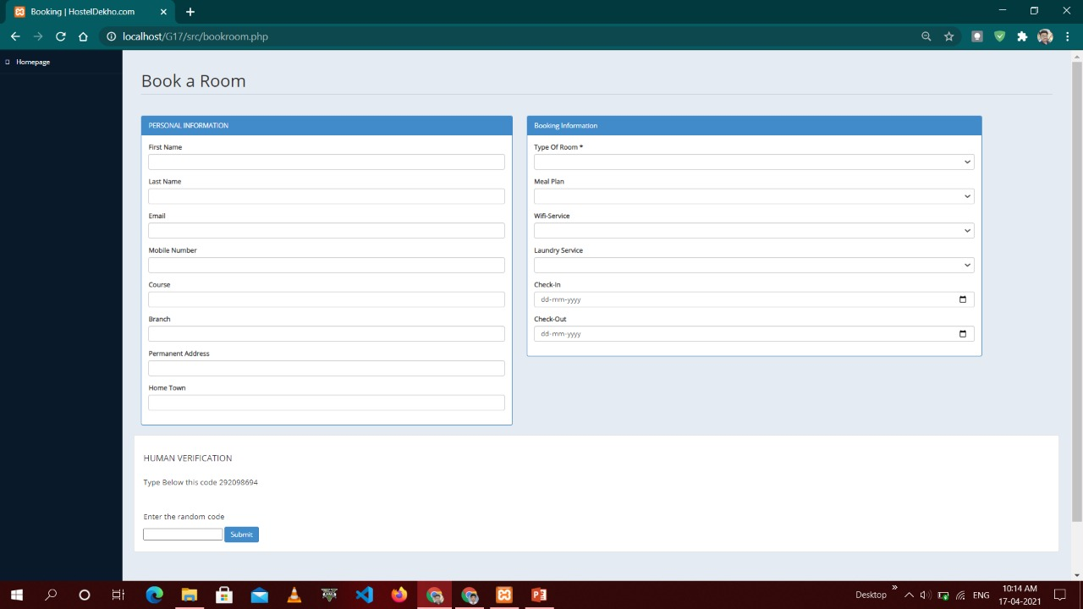
Room Booking

Slide 16
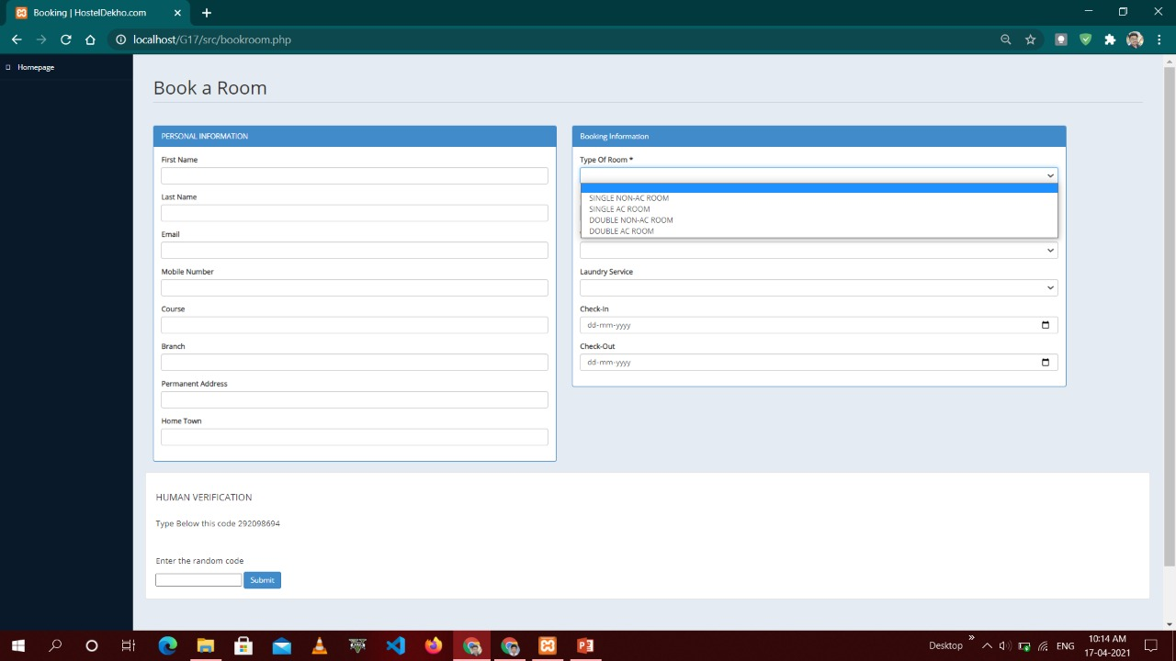
Room Booking

Slide 17

Room Booking

Slide 18
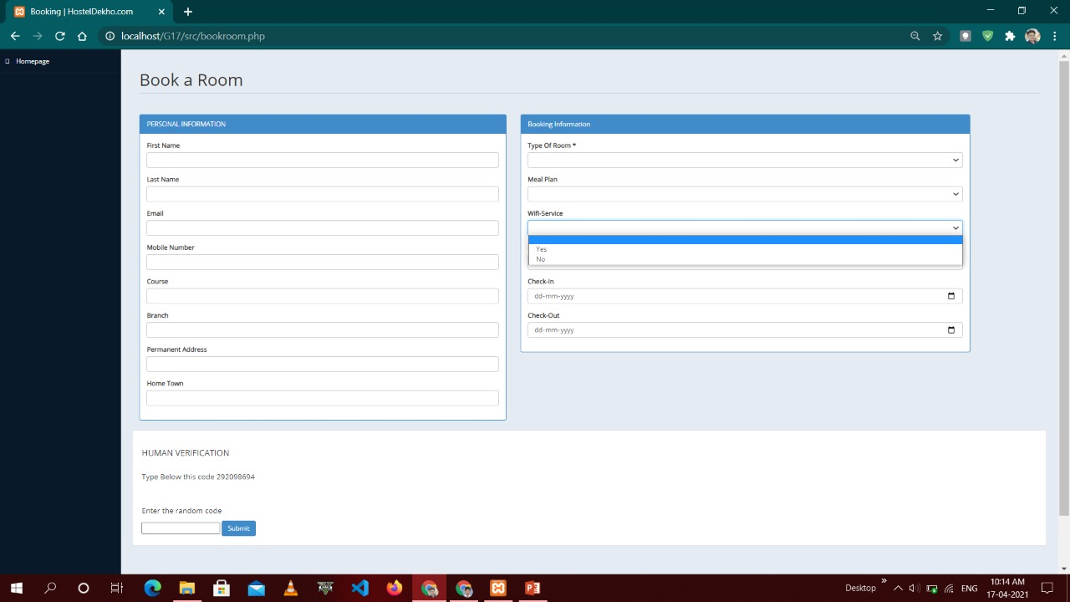
Room Booking

Slide 19
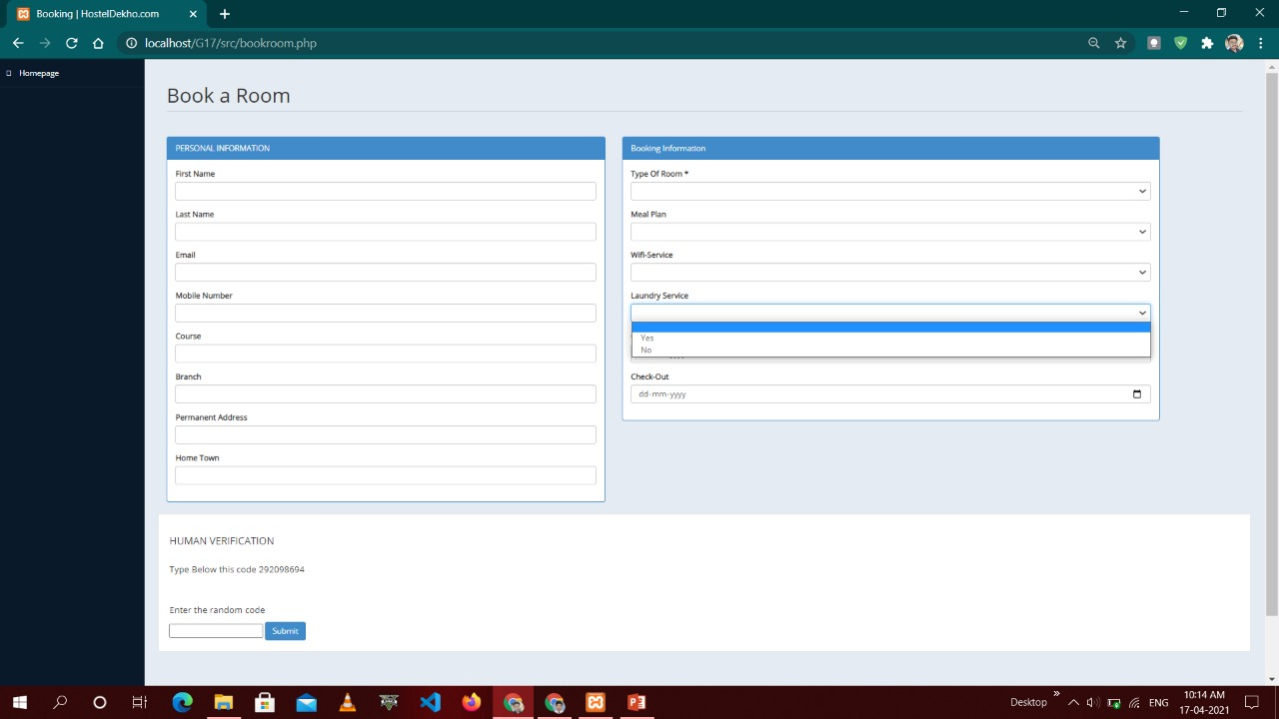
Room Booking

Slide 20
Conclusion
Reduces human efforts.
Steps ahead in technology.
Reduces time.
Can find rooms anytime, Near GLA University.

Slide 21
References
www.guru99.com
www.w3school.com
www.tutorialspoint.com
www.javatpoint.com
www.wikipedia.com

Slide 22
THANK YOU!!!

