Slide 1

DATA ANALYSIS PROJECT
Google Maps
Business Analysis — Jharkhand
Find. Analyze. Recommend.
Identifying local businesses without a website and uncovering real digital-growth opportunities across Jharkhand.
1,650
24
22
Businesses Analyzed
Categories
Cities
Week 3 · Data Analysis Task

Slide 2




Project Overview
What this analysis sets out to do
Collect Data
Clean & Structure
Analyze
Find Opportunities
Business data pulled from Google Maps — name, category, rating, location, website, and contact info.
Standardized the Website field and engineered flags for website presence, opportunity level, and rating tier.
Category-wise and city-wise digital presence, cross-checked against rating and service amenities.
Isolated high-rated businesses with no website — real, ready-to-convert growth prospects.
Google Maps Business Analysis — Jharkhand
2

Slide 3
Dataset & Methodology
Tech Stack
Dataset
Data Collection
Source: Google Maps Points of Interest (POI)
Coverage: 22 cities across Jharkhand
Records: 1,650 businesses, 24 categories
Fields: Name, Category, City, Locality, Address,
Lat/Long, Website, Phone, Rating, Hours,
Parking, Delivery, Status
Google Maps POI export (.xlsx)
Data Handling & Cleaning
Python (Pandas, NumPy)
Analysis & Visualization
Python (Matplotlib, Seaborn) in Jupyter Notebook
Quality Checks
Dashboard & Reporting
Zero missing values across all 14 fields
Zero duplicate business names
Whitespace in URLs standardized (e.g. " https://sbi.co.in")
Excel (formulas, pivot-style tables, native charts)
Presentation
PowerPoint — Insights & Opportunities
Google Maps Business Analysis — Jharkhand
3

Slide 4
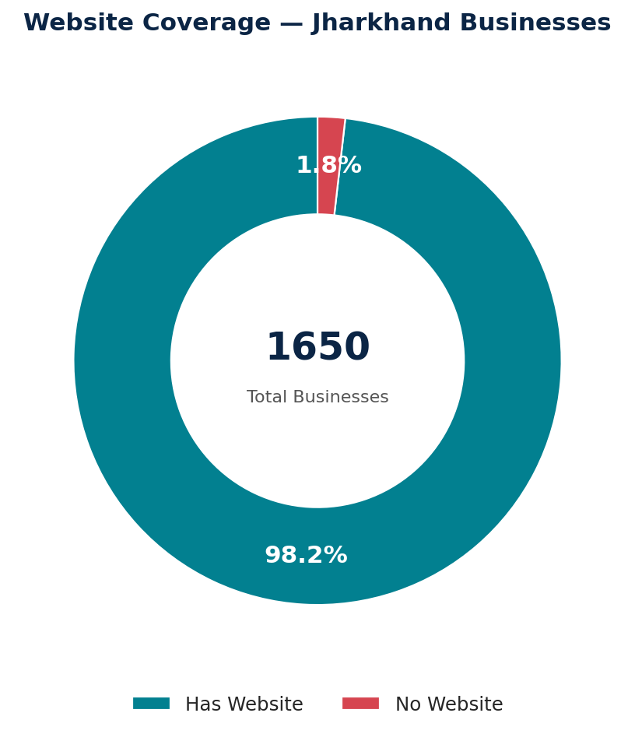
Website Coverage — The Headline Numbers
1,650
Total Businesses Analyzed
1,620 (98.2%)
Businesses With a Website
30 (1.8%)
Businesses Without a Website
16
High-Opportunity Businesses (4.0★+, no site)
Google Maps Business Analysis — Jharkhand
4

Slide 5
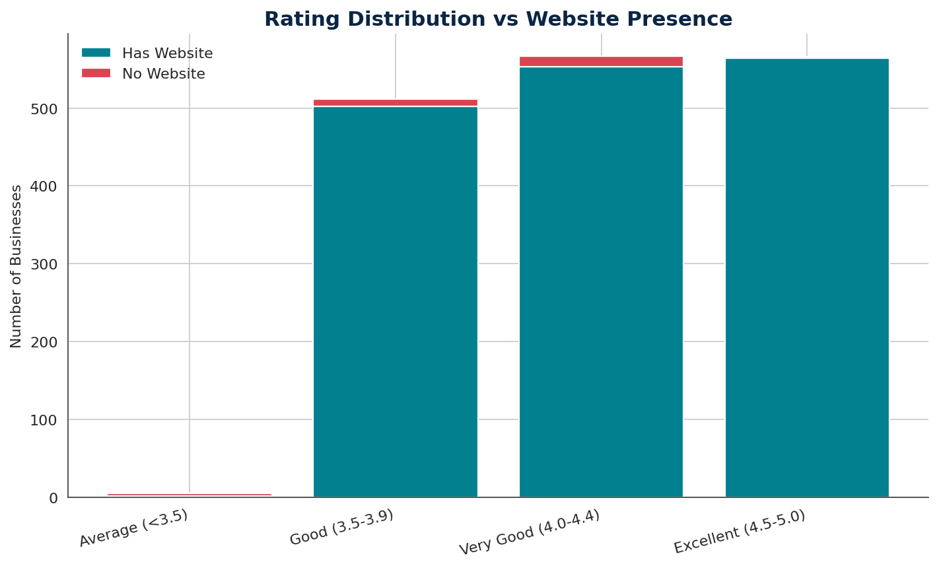
Does Having a Website Relate to Rating?
4.23
3.90
Avg rating — Has Website
Avg rating — No Website
Insight
Businesses without a website average a third of a point lower in rating. While not necessarily causal, it reinforces that these 30 businesses are an underexposed segment — solid on quality, invisible online.
Google Maps Business Analysis — Jharkhand
5

Slide 6
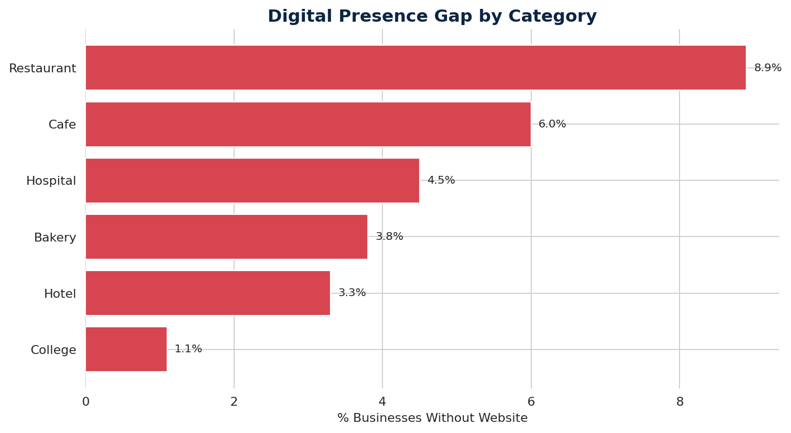
Category-wise Digital Presence Gap
Which categories most need to get online
Top Gaps
Restaurant
8.9%
Cafe
6.0%
Hospital
4.5%
Bakery
3.8%
Hotel
3.3%
0% Gap Categories
Schools · Banks · Supermarkets · Grocery Stores already have full website coverage.
Google Maps Business Analysis — Jharkhand
6

Slide 7
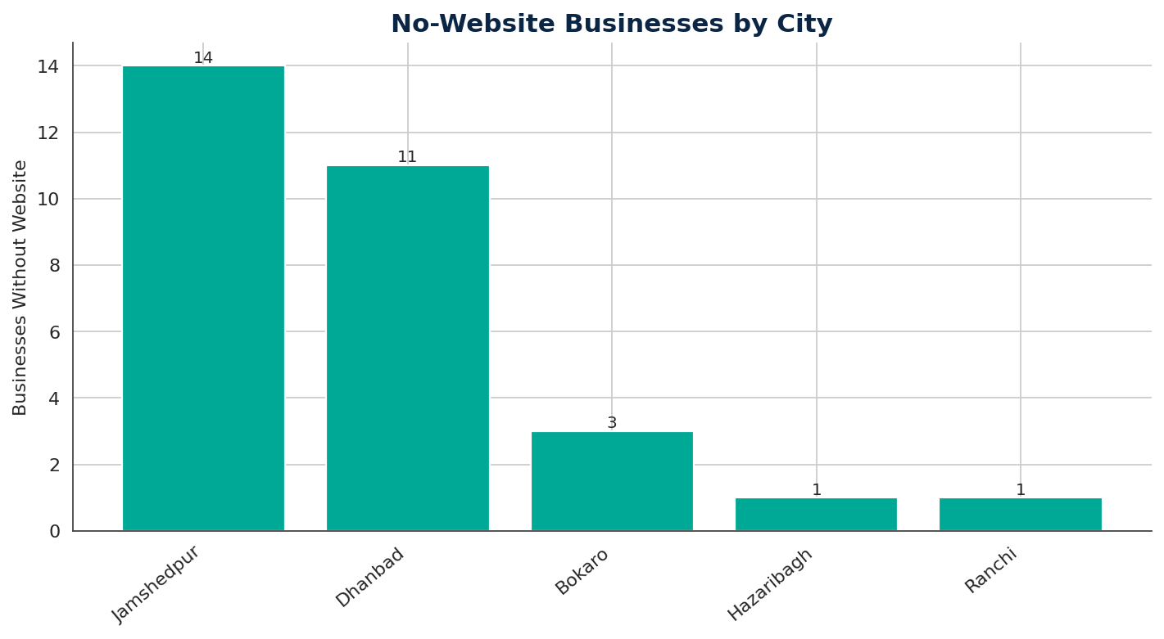
City-wise Opportunity Concentration
Where the no-website businesses are located
83%
of all no-website businesses are in just 2 cities — Jamshedpur (14) and Dhanbad (11).
Priority Cities
Jamshedpur
14 businesses · 12.3%
Dhanbad
11 businesses · 11.0%
Bokaro
3 businesses · 3.6%
Google Maps Business Analysis — Jharkhand
7

Slide 8
Opportunity Zones — Locality Hotspots
Combining city + locality pinpoints exactly where to focus
City
Locality
Total Biz.
No Website
High Opp.
Jamshedpur
Jamshedpur
27
6
6
Jamshedpur
Bistupur
15
4
4
Dhanbad
Dhanbad
15
7
1
Jamshedpur
Sakchi
9
3
1
Dhanbad
Bank More
5
2
1
Ranchi
Ranchi
18
1
1
Insight
Jamshedpur town center and Bistupur alone account for 10 of the 16 high-opportunity businesses — an efficient starting radius for on-ground outreach.
Google Maps Business Analysis — Jharkhand
8

Slide 9
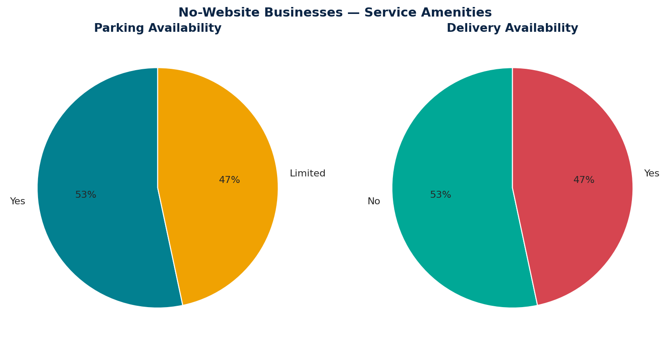


What These Businesses Already Offer
Parking & delivery among no-website businesses
53%
already offer Parking (Yes / Limited)
47%
already offer Delivery
Why it matters
These amenities are ready-made content for a first website — the pitch is: "we'll put what you already offer on the map."
Google Maps Business Analysis — Jharkhand
9

Slide 10

Top 10 Business Opportunities
Highest-rated businesses with no website today — ready for outreach
#
Business Name
Category
City
Rating
1
Bombay Brew Cafe
Cafe
Jamshedpur
4.6
2
Brubeck Bakery
Bakery
Jamshedpur
4.5
9 of 10
3
Chanoya Cafe
Cafe
Jamshedpur
4.4
are in Jamshedpur alone
4
Caramel Patisserie
Bakery
Jamshedpur
4.3
5
28 Downtown Cafe
Cafe
Jamshedpur
4.2
6 of 10
6
Cafe Regal
Restaurant
Jamshedpur
4.2
are Cafes — the single most under-represented category online
7
Bokaro Mall
Shopping Mall
Bokaro
4.2
8
Pool Cafe
Cafe
Jamshedpur
4.1
9
Equinox Restaurant
Restaurant
Jamshedpur
4.1
4.6★
10
South Indian Cafe
Cafe
Jamshedpur
4.1
top-rated opportunity: Bombay Brew Cafe
Google Maps Business Analysis — Jharkhand
10

Slide 11
Recommendations
Turning the analysis into action
1
Prioritize Restaurants & Cafes
2
Focus on Jamshedpur & Dhanbad
Highest digital-presence gaps (8.9% & 6.0%) — biggest ROI from menus, reviews & online ordering.
83% of all no-website businesses sit in these two cities — concentrate outreach effort here.
3
Convert the 16 High-Opportunity businesses first
4
Pitch existing amenities
Already rated 4.0★+ with no website — fastest, lowest-risk wins.
~50% already offer parking/delivery — surface this on a simple site or Google Business Profile.
5
Keep the solution lightweight
6
Skip fully-covered categories
A one-page mobile site + Google Business Profile beats a costly custom build for this segment.
Schools, Banks, Supermarkets & Grocery Stores are already at 0% gap — redirect resources.
Google Maps Business Analysis — Jharkhand
11

Slide 12

Real Data. Real Skills.
Analyze Today, Create Impact Tomorrow.
Deliverables: Cleaned Dataset · Excel Dashboard · Jupyter Notebook Analysis · Top 10 List · Recommendations
Google Maps Business Analysis — Jharkhand
12

