Slide 1
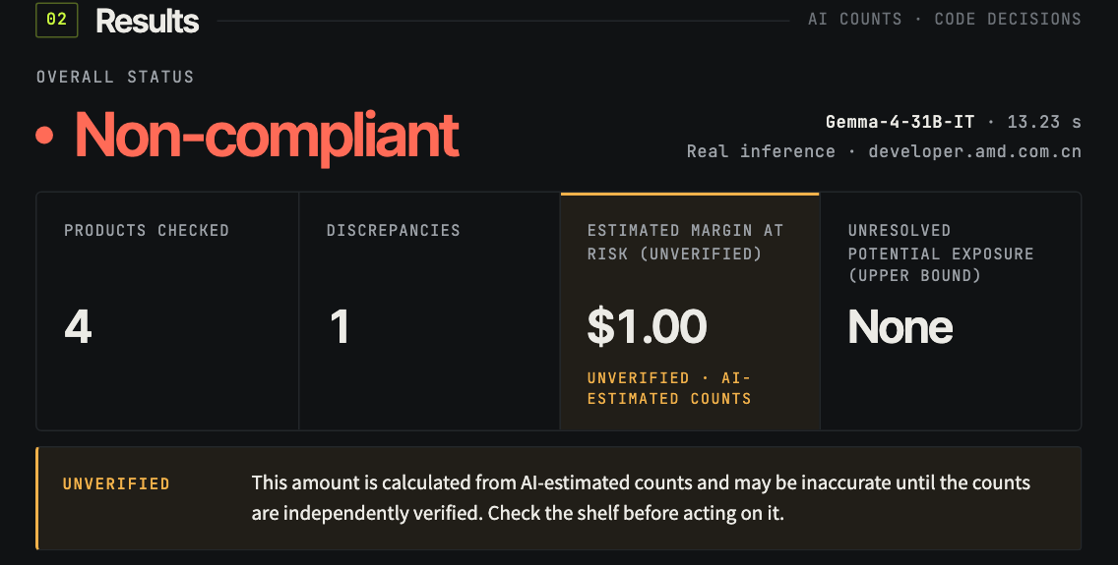
Shelf-Sense
[ AMD DEVELOPER HACKATHON: ACT III · REINVENT COMMERCE ]
AI-powered retail shelf intelligence
Photograph a shelf. Get per-product counts, a compliance verdict, an estimated margin at risk and a restocking list. The model counts; code decides.
Real result from the app: one inspection on the AMD endpoint
Gemma-4-31B-IT · AMD Developer Cloud Token Factory
Notes:
Shelf-Sense turns one ordinary shelf photograph into a preliminary compliance report. The screenshot is a real result from the app: one call to Gemma-4-31B-IT on AMD Developer Cloud's Token Factory. The money figure is labelled unverified from the first slide on; we'll explain why.

Slide 2
Shelves are still checked by eye
[01] THE PROBLEM
Missing facings quietly cost margin. Manual shelf walks are slow and inconsistent, and small stores can’t justify dedicated shelf-scanning hardware.
[01] MANUAL
[02] INFREQUENT
[03] INCONSISTENT
[04] UNPRICED
01
02
03
04
Every count is a person with a clipboard
Gaps sit unnoticed between walks
Two people, two different counts
Nobody knows what the gap costs
Checking a bay means walking it, counting facings and writing them down.
A missing facing can stay missing until the next scheduled check.
Half-hidden boxes and variants are judged differently each time.
Without a number attached, restocking competes with everything else.
Notes:
Shelf audits today are manual: a person counts facings against a planned layout. That's slow, infrequent and inconsistent, and the gap rarely has a cost attached. We're not quoting industry statistics here; these are the operational frictions Shelf-Sense targets.

Slide 3
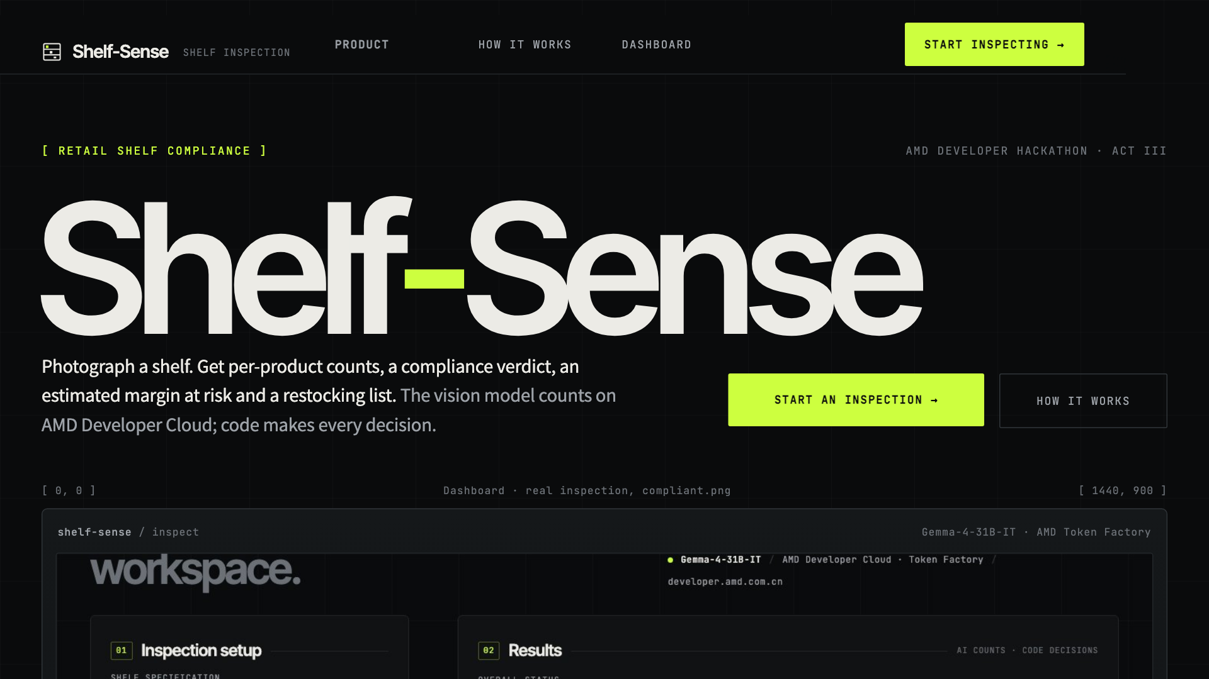
One photo in, a preliminary compliance report out
[02] THE SOLUTION
[01]
Choose a shelf specification
[02]
Add a shelf photograph
[03]
Run one inspection
WHAT COMES BACK
Per-product status and shelf-by-shelf counts
Discrepancies against the expected inventory
Estimated Margin at Risk (Unverified), computed in code
A restocking note, labelled with who wrote it
The live web app: landing page, dashboard and method pages
Notes:
The user picks a shelf specification, adds a photo and runs one inspection. A vision model counts each product shelf by shelf; plain Python turns those counts into the verdict, the estimated margin at risk and a restocking list. The result is preliminary by design.

Slide 4
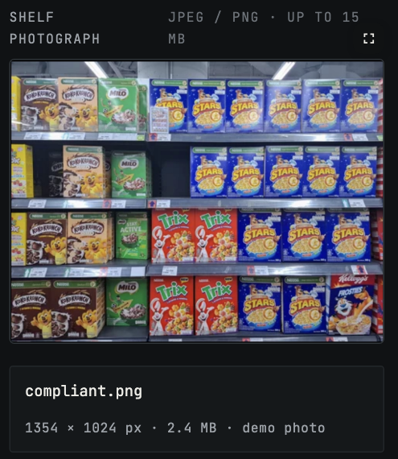
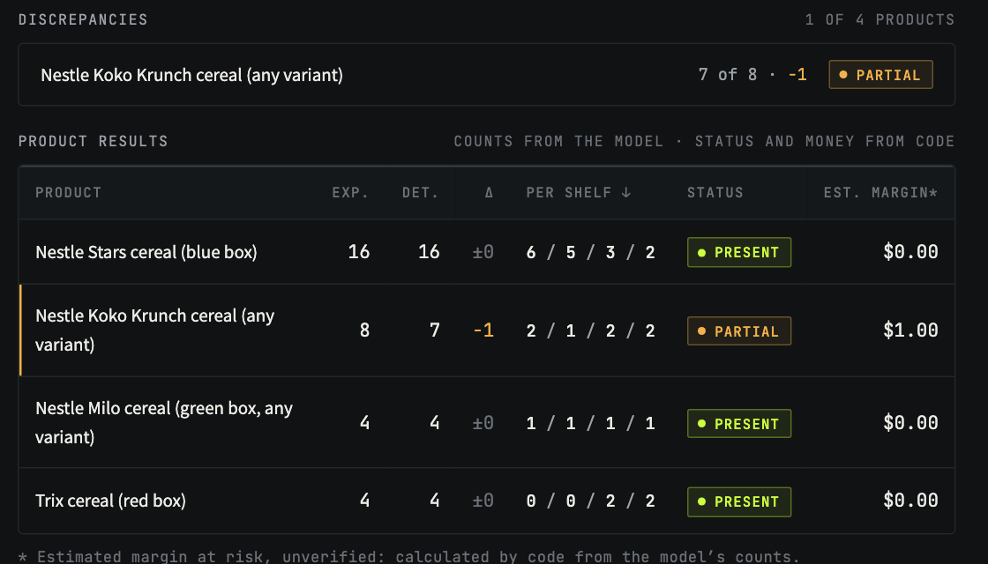
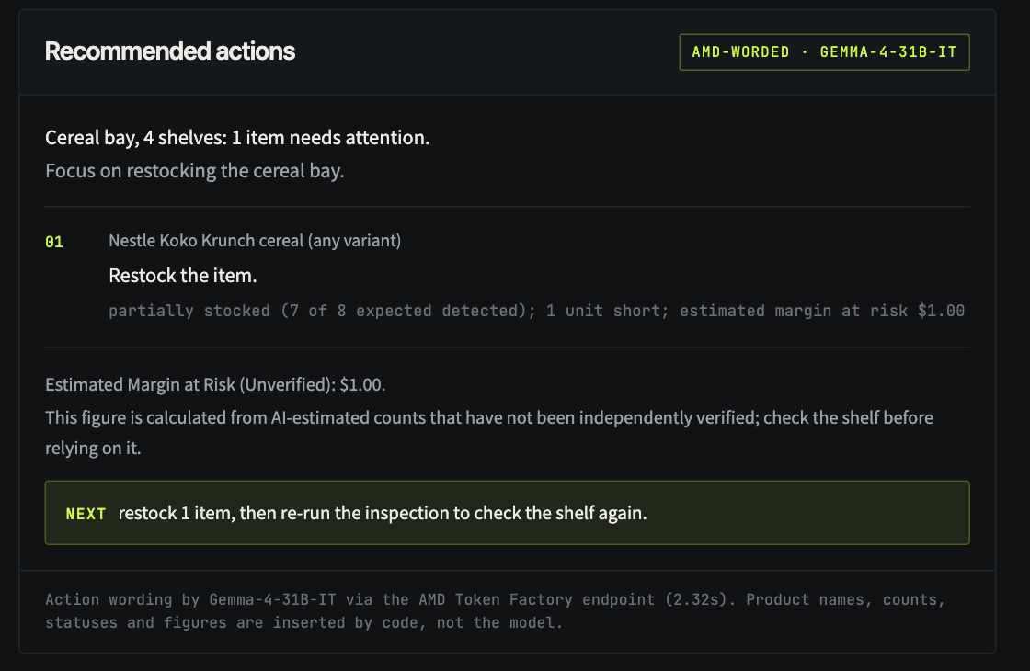
A real inspection, end to end
[03] PRODUCT DEMONSTRATION
1 Specification
2 Shelf image
3 Inference on AMD
4 Results
5 Action note
AMD-worded note; names, counts and figures inserted by code
Per-shelf counts against expected; Koko Krunch 7 of 8 flagged
compliant.png, a self-taken photo of a 4-shelf cereal bay
Notes:
These three screenshots are from one real run: 13.2 seconds of inspection on the AMD endpoint. The model reported Koko Krunch as 7 of 8 boxes, so the shelf came back non-compliant with an estimated $1.00 at risk, labelled unverified. The action note was worded by Gemma, but every number in it was inserted by code.

Slide 5
One Python process, one model call
[04] TECHNICAL ARCHITECTURE
CODE
CODE
MODEL
CODE
CODE
CODE + MODEL
Streamlit app
Inspection + prompt
AMD Token Factory
Validation
Financial calculation
Action note
Spec, photo, results UI; three pages
EXIF-rotate, resize to 1024 px; spec as text
Gemma-4-31B-IT returns per-shelf counts (JSON)
Pydantic schema, one retry, review flags
Verdict and margin estimate, Decimal maths
Template; AMD may reword; numbers from code
Model output: per-product, per-shelf counts and optional wording. Code: validation, statuses, the verdict, every dollar figure, and the checks on any AI wording.
Single Docker container on Render · no database · no other model provider · 195 offline tests
Notes:
Everything runs in one Python process. The photo and the spec go to the AMD endpoint in a single call; Gemma returns structured counts. Pydantic validates them, invented items are dropped, and unreliable or contradictory counts go to review. The verdict and the money are computed in code; the model never sets a status or a number.

Slide 6
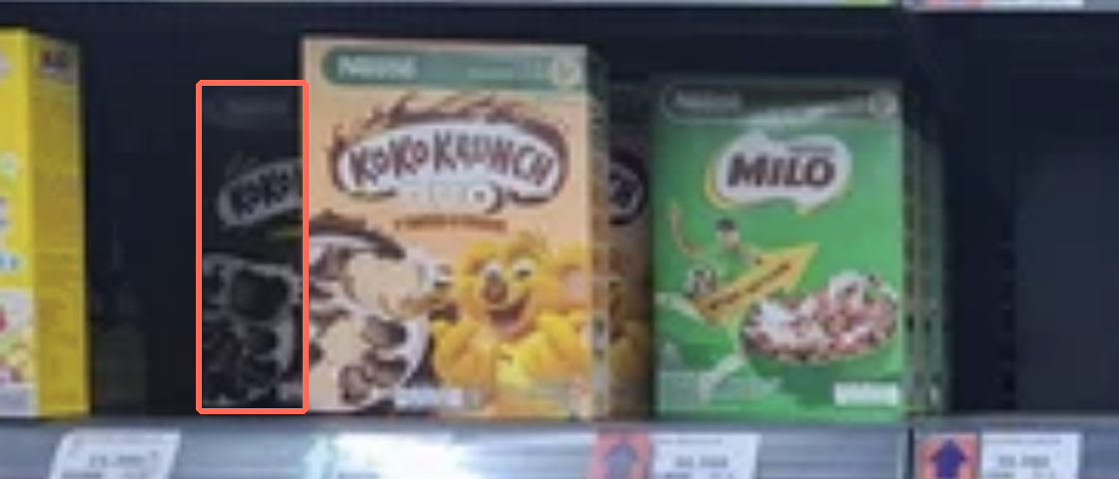
Measured on a real shelf, reported as measured
[05] EVALUATION AND LIMITATIONS
EXPERIMENT | CHANGE | EXACT | ERROR | SHELF RIGHT
Baseline | First prompt | 1 / 4 | 8 boxes | 0 of 2
1 · production | Shelf-by-shelf prompt | 3 / 4 | 1 box | 0 of 3
2 | 1536 px instead of 1024 | 3 / 4 | 1 box | 0 of 6
3 | MiniCPM-V instead of Gemma | 3 / 4 | 1 box | 0 of 2
4 | Per-shelf crops (by hand) | 2–3 / 4 | 2–3 | 3 of 3
Shelf 2 of the real photo. Hand count: 2 Koko Krunch. Model: 1, at 100% confidence. Box outlined by hand.
MEASURED
EXPERIMENTAL
DEMO ASSUMPTIONS
FUTURE
Production misses one half-hidden box in all 9 recorded runs, so the full shelf is reported short.
Per-shelf crops fixed the verdict (3 of 3) but overcounted neighbours. Not adopted.
$1.00 per-unit margins. One self-taken photo: a case study, not a benchmark.
Occlusion-aware counting, human verification, many more shelves.
Notes:
Ground truth was counted by hand: 16 Stars, 8 Koko Krunch, 4 Milo, 4 Trix. A shelf-by-shelf prompt cut the error from 8 boxes to 1. Higher resolution and a second model didn't fix the last, half-hidden box. Per-shelf cropping did, but it overcounted neighbours and used hand-placed crops, so it isn't in production. That's why every dollar figure is labelled unverified.

Slide 7
Every inspection runs on AMD
[06] AMD INTEGRATION AND VALUE
18.2 s
Gemma-4-31B-IT, vision input
median inspection on the shared endpoint (9 recorded runs, 11.7–45.8 s)
MODEL
ENDPOINT
AMD Developer Cloud Token Factory, OpenAI-compatible chat completions
1
vision call per inspection, plus 1 text call to word the actions
EVIDENCE
First raw HTTP 200 and every experiment reply kept in the repository
NOT CLAIMED
We call a hosted service: no GPU, vLLM or ROCm claims
24
experiment records kept with the model’s raw replies
Intended value: a fast, photo-based second opinion for store staff on where to look and roughly what is at stake, without shelf-scanning hardware.
Notes:
The integration is real and simple: each inspection is an HTTPS call to the Token Factory endpoint with Gemma-4-31B-IT, and the measured median is 18.2 seconds. We kept the first raw response and every experiment reply. We don't claim which serving software or GPU runs behind the hosted service. The value is intended, not measured in a store yet.

Slide 8
What comes next
[07] ROADMAP · PLANNED, NOT BUILT
[01]
Better product counting under occlusion
Shelf-Sense
[02]
Human verification of uncertain findings
AMD-hosted vision. Decisions in code. Honest about its limits.
[03]
Evaluation on diverse shelf images
[04]
Reliability testing in a real store
github.com/bhavya-jpg/shelf-sense
MIT licence · ACT III · Reinvent Commerce
Notes:
Next steps follow directly from what we measured: better counting under occlusion, a step where a person verifies uncertain findings, evaluation on many more shelves, and real operational testing. None of that is built yet. Shelf-Sense today is AMD-hosted vision with decisions in code, and it's honest about its limits.

