Slide 1
CyberPal
Developed By:
Prashansa Kulshrestha
Arpit Goyal
Bhavya Kashyap
Safwan Khan

Slide 2
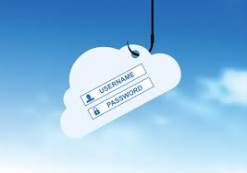
Cyber Security: Need of the Hour
Cyber crimes are increasing and are tough to stop/report.
Phishing
Hacking
Identity Theft
Spoofing
DoS Attack
Intrusion into Networks

Slide 3
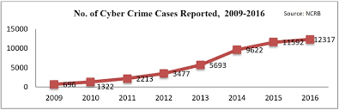
Statistics

Slide 4
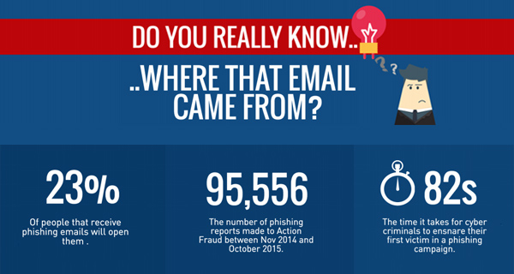

Slide 5
Product Features
At General User Level:
Continuous monitoring of received emails:
Check the content for phishing links.
Notifying user about unsafe emails.
At Server Level:
Checking for DoS Attack:
Blocking the attacker automatically

Slide 6
Architecture
Block IP Address of Attacker
URL Features extractor
Content Checker
(Extract links)
Get IP Address of client sending >=50% requests
Notify for unsafe mails
Mail monitoring program
Monitor Web Server logs
Prediction
ML Model:
Trained to identify Phishing links
Splunk

Slide 7
Future Scope
Intrusion Detection System
Service to work at network layer
Will detect intrusion of undesirable packets
Implementing the email-monitoring program as a systemd service.

