Slide 1
INTELLIGENT ATS OPTIMIZATION SYSTEM
AI Resume Analyzer & ATS Optimizer
Empowering job seekers with semantic search matching, NLP skills-gap analysis, and automated professional bullet writing.

Slide 2
AI RESUME ANALYZER
The Recruitment Gap
THE PROBLEM
• Rigid ATS Algorithms: Over 75% of resumes are discarded automatically due to simple keyword match failures.
• Keyword Stuffing vs. Context: Traditional screening tools fail to understand semantic relevance and synonyms.
• Invisible Rejection: Candidates lack actionable feedback, leaving them unaware of why their resumes fail to pass.
• Formatting Bottlenecks: Unstructured PDFs and poorly organized sections lead to parsing glitches.
THE SOLUTION
• Semantic Score (Sentence Transformers): Evaluates true contextual match, not just exact keyword repetitions.
• Skills-Gap Analysis: Auto-extracts missing skills and provides clear comparisons with the job description.
• AI Bullet Point Rewriter: Instantly generates high-impact action bullets for missing skills to integrate directly.
• Checklist and Recommendations: Scans formatting layout and ranks mock job recommendations on similarity.

Slide 3
AI RESUME ANALYZER
System Architecture & Tech Stack
01.
Parser Engine
PyMuPDF (fitz)
Extracts raw text, counts word density, validates page length constraints, and detects critical section headers (Experience, Projects, Education, Contact).
02.
NLP Core
Sentence Transformers
Uses the pre-trained 'all-MiniLM-L6-v2' model to map resume and job description to high-dimensional vectors and calculates Cosine Similarity.
03.
Backend API
Flask & CORS
Python Flask server serving REST endpoints (/analyze, /history, /jobs). Integrates SQLite database tables to store scan history and seeds mock job templates.
04.
Client Frontend
Modern Vanilla JS
Ultra-responsive CSS3 dark-theme design. Integrates dynamic Chart.js bar graphs, circular SVG gauge paths, sidebar state, and responsive overlays.

Slide 4
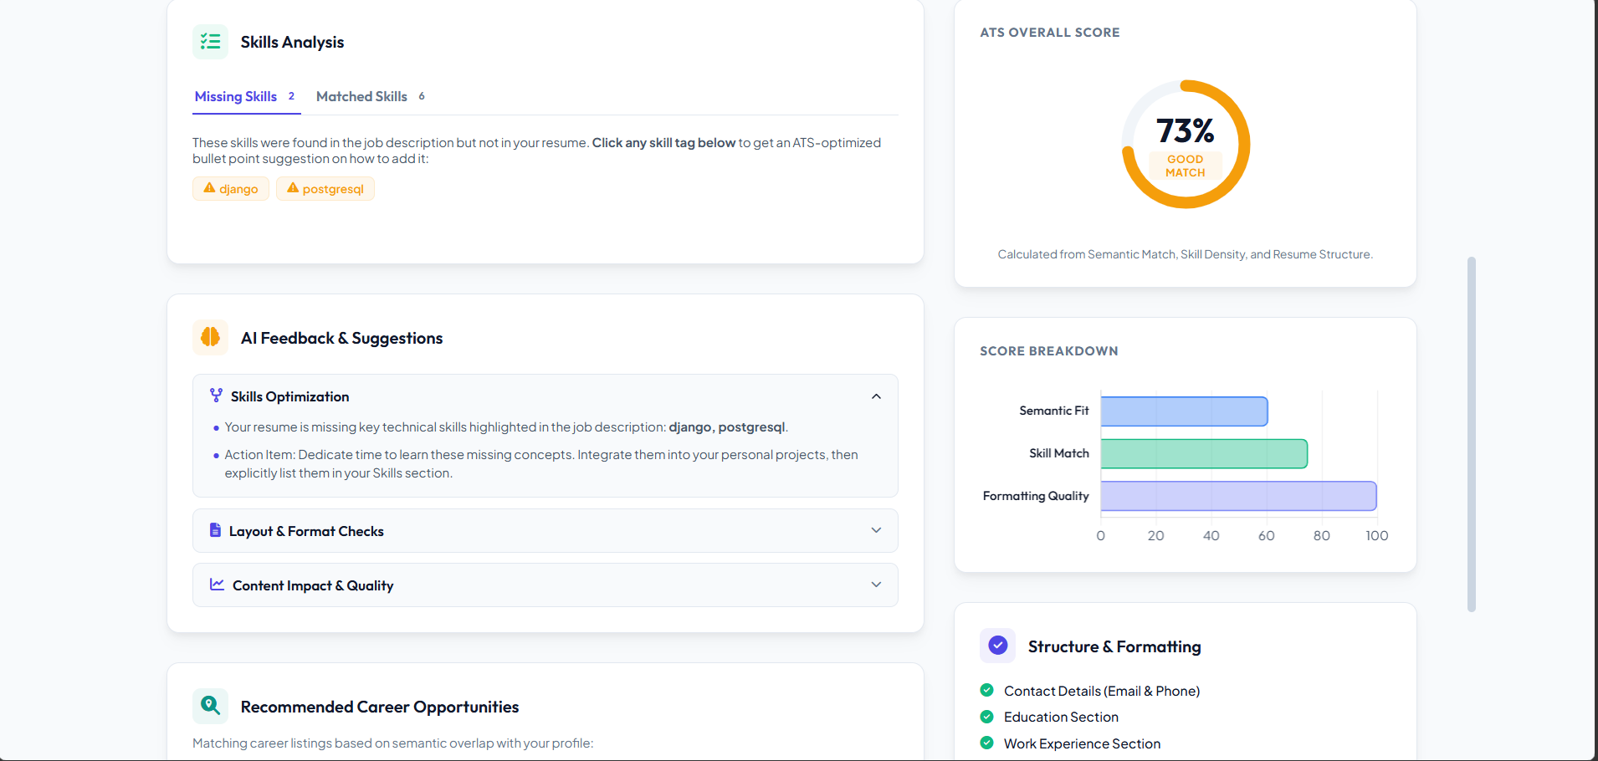
AI RESUME ANALYZER
ATS Scoring & Dynamic Dashboard
• Composite ATS Score: Weighted score calculation combining Semantic Similarity (50%), Skill Coverage (30%), and Document Formatting (20%).
• Semantic Fit: Utilizes PyTorch sentence embeddings to look beyond keyword matches, scoring conceptual alignment.
• Skills Gap Panel: Automatically segregates overlapping matched keywords from critical missing items.
• Interactive Charting: Chart.js bar graphs draw live parameter breakdowns for candidates to isolate and address weaknesses.

Slide 5
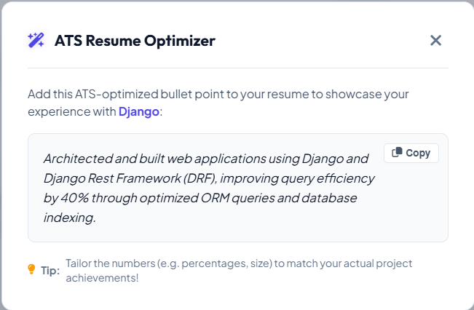
AI RESUME ANALYZER
Interactive AI Resume Rewriter
• Actionable Intervention: Simply clicking on any detected 'Missing Skill' tag opens the rewriter modal window.
• ATS-Optimized Formatting: Generates concrete bullet point descriptions showcasing real metrics and business impact.
• Pre-designed Skill Library: Contains robust templates for 50+ core skills (Python, Docker, React, AWS, Kubernetes, etc.) and falls back to dynamic templates.
• One-Click Copy: Copies formatted sentences straight to the clipboard to speed up user editing.

Slide 6
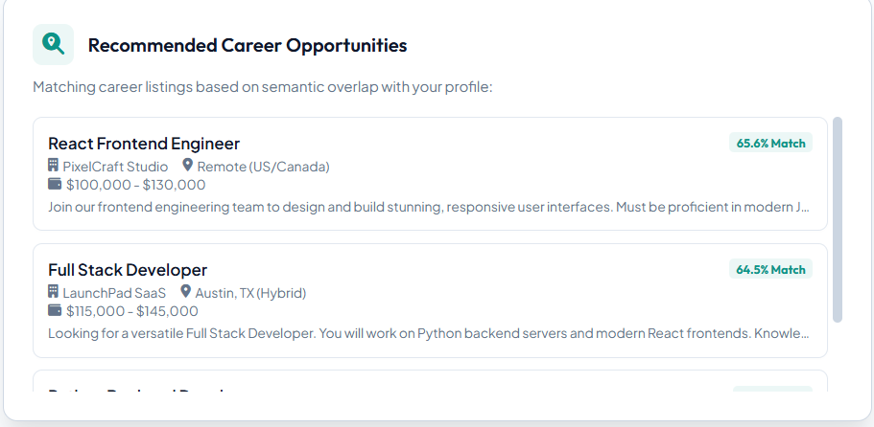
AI RESUME ANALYZER
Smart Job Recommendations & History
• Cosine Similarity Ranking: Matches candidate profile against mock positions in the SQLite database.
• Automatic Feed: Pulls description, salary, company location details and calculates a dynamic % match.
• Quick Fill: Clicking any job card inserts its description directly into the scanner input for instant cross-comparison.
• Database History: Persists all past scans to a localized database file, supporting list loads and item deletion.

Slide 7
AI RESUME ANALYZER
Future Enhancements & Roadmap
PHASE 01
Generative LLM Integration
Integrate open LLM models (such as Llama 3 or Gemini APIs) to write highly customized project and work descriptions tailored to the candidate's exact background, eliminating static templates.
PHASE 02
Real-time Job Board Sync
Connect matching routines with public API endpoints (LinkedIn, Indeed, Reed) to fetch real, active job descriptions rather than mock SQLite records, providing direct application pathways.
PHASE 03
In-app PDF Editor
Implement a web-based LaTeX or React-PDF editor inside the portal. Enables job seekers to edit and compile resume text dynamically and export a fully-optimized, parser-friendly PDF.

