Slide 1

HR Analytics Dashboard using Tableau
A student project exploring employee attrition through data visualization
BHAVYA MISHRA
R290222025

Slide 2

Project Introduction
This project uses Tableau to build an interactive HR Analytics Dashboard from a real-world employee dataset. The goal is to uncover patterns in employee attrition — helping organizations understand why employees leave and identify the departments, roles, and demographics most at risk.
📊 Dataset
🔍 Focus
HR Analytics Employee Attrition dataset
Identifying attrition drivers across departments and job roles
🎯 Outcome
Interactive, shareable Tableau dashboard with key insights

Slide 3


Technology Stack
Three tools power this end-to-end analytics project — from raw data to published insights.
Tableau
Microsoft Excel
GitHub
Primary visualization tool used to design interactive charts, filters, and the final dashboard layout.
Used for initial data cleaning, formatting, and preparing the HR dataset before importing into Tableau.
Project repository for version control and sharing the workbook with peers and evaluators.

Slide 4
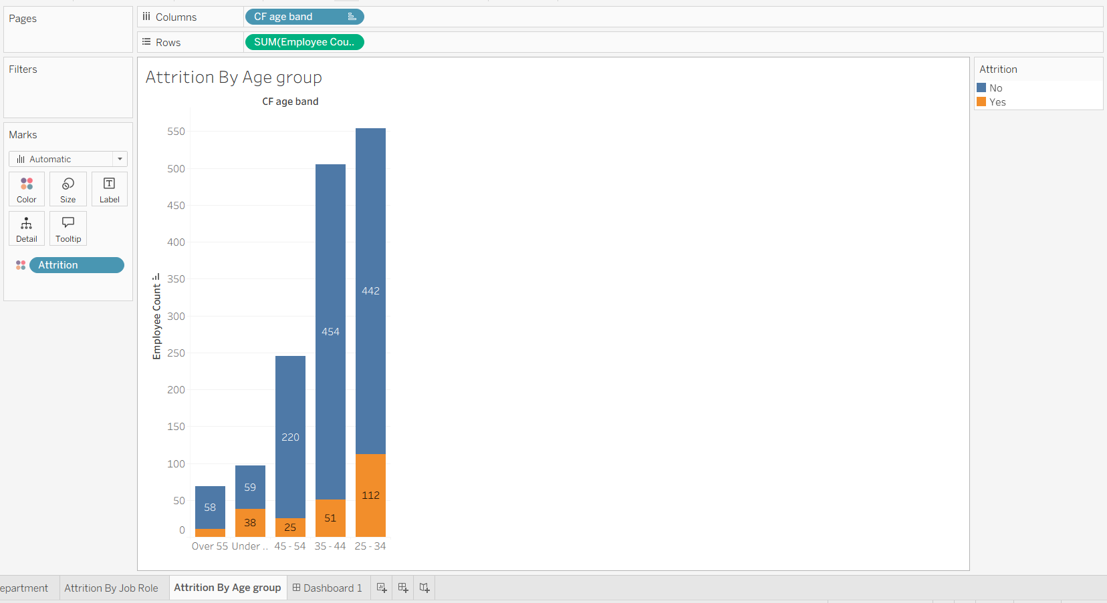
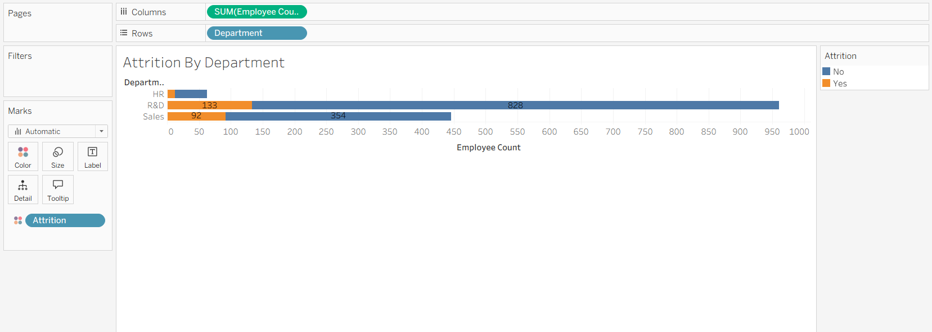
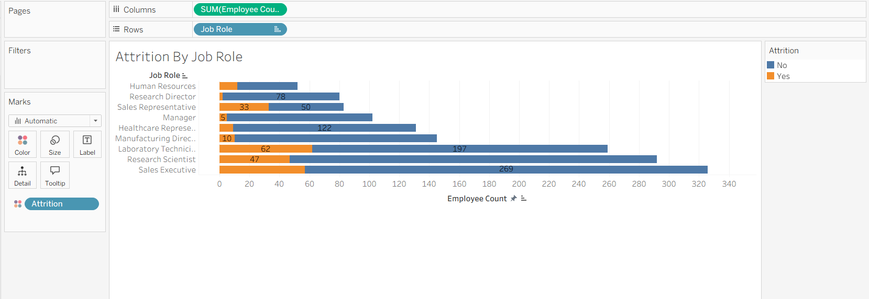

Key Findings & Analysis
What the Data Reveals
Attrition varies by department — Sales and R&D show the highest departure rates.
Certain job roles are high-risk — Sales Reps and Lab Technicians lead in turnover.
Younger employees leave more — The 18–35 age group accounts for the majority of attrition.

Slide 5
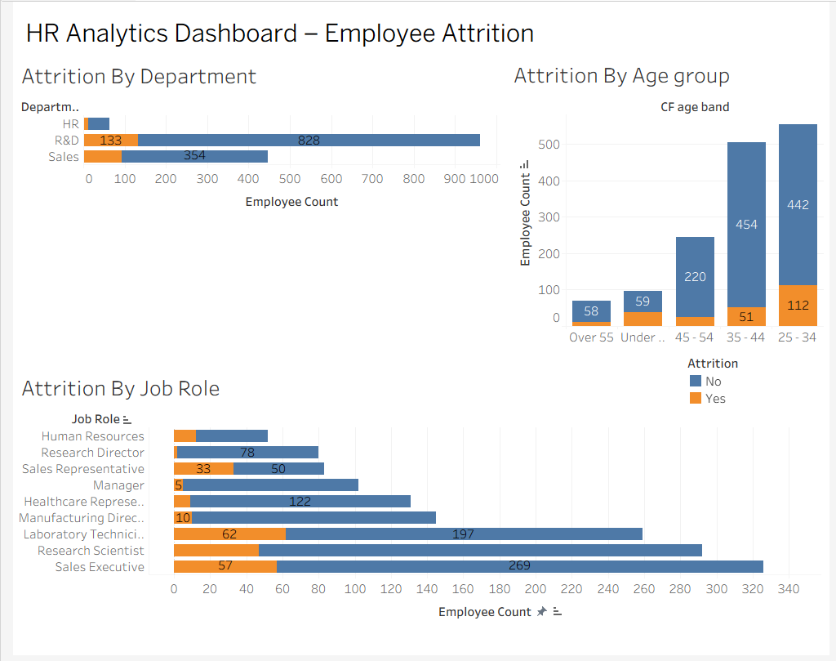


Dashboard Output
What's Inside the Dashboard
The final Tableau dashboard features:
Attrition rate by department and job role
Age group breakdown of employee exits
Interactive filters for deeper exploration
KPI summary cards for quick overview

