Slide 1

Serverless URL Shortener using AWS
Aditya patil

Slide 2
Problem Statement
Long URLs are difficult to share and remember. A system is needed to convert long URLs into short, easy-to-share links.
Challenges:
Managing URL redirection
Tracking link usage
Handling link expiration
Ensuring scalability

Slide 3
Project Objective
The objective of this project is to build a serverless URL shortening system using AWS cloud services.
Goals:
Generate short URLs
Redirect users to original URLs
Track number of clicks
Support link expiration
Provide analytics API

Slide 4
AWS Services Used
This project uses the following AWS services:
• Amazon API Gateway – manages REST APIs • AWS Lambda – runs backend logic without servers • Amazon DynamoDB – stores URL mappings
Programming Language:
Python (Boto3)

Slide 5
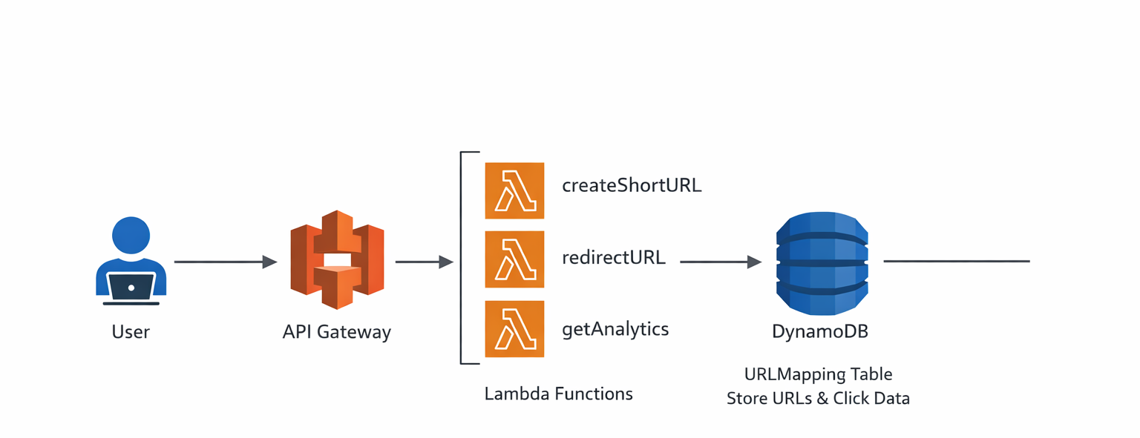
System Architecture

Slide 6
DynamoDB Database Design
Attribute | Description
ShortCode (Primary key) | Unique short link code
OriginalURL | Original long URL
ClickCount | Number of clicks
CreatedDate | Link creation time
ExpiryDate | Link expiration time

Slide 7
Lambda Functions
Three Lambda functions were implemented:
1️⃣ createShortURL
Generates a unique short code
Stores mapping in DynamoDB
2️⃣ redirectURL
Retrieves original URL
Increments click counter
Redirects user
3️⃣ getAnalytics
Returns click statistics for a URL

Slide 8
API Endpoints
The system exposes the following HTTP APIs:
POST /shorten
Creates a short URL
Example request:
{ "url": "https://google.com" }
GET /{code}
Redirects to the original URL
Example: /abc123
GET /analytics/{code}
Returns analytics data

Slide 9
Features Implemented
The system supports:
✅ URL shortening ✅ Redirection service ✅ Click tracking ✅ Link expiration ✅ Analytics API ✅ Serverless architecture

Slide 10
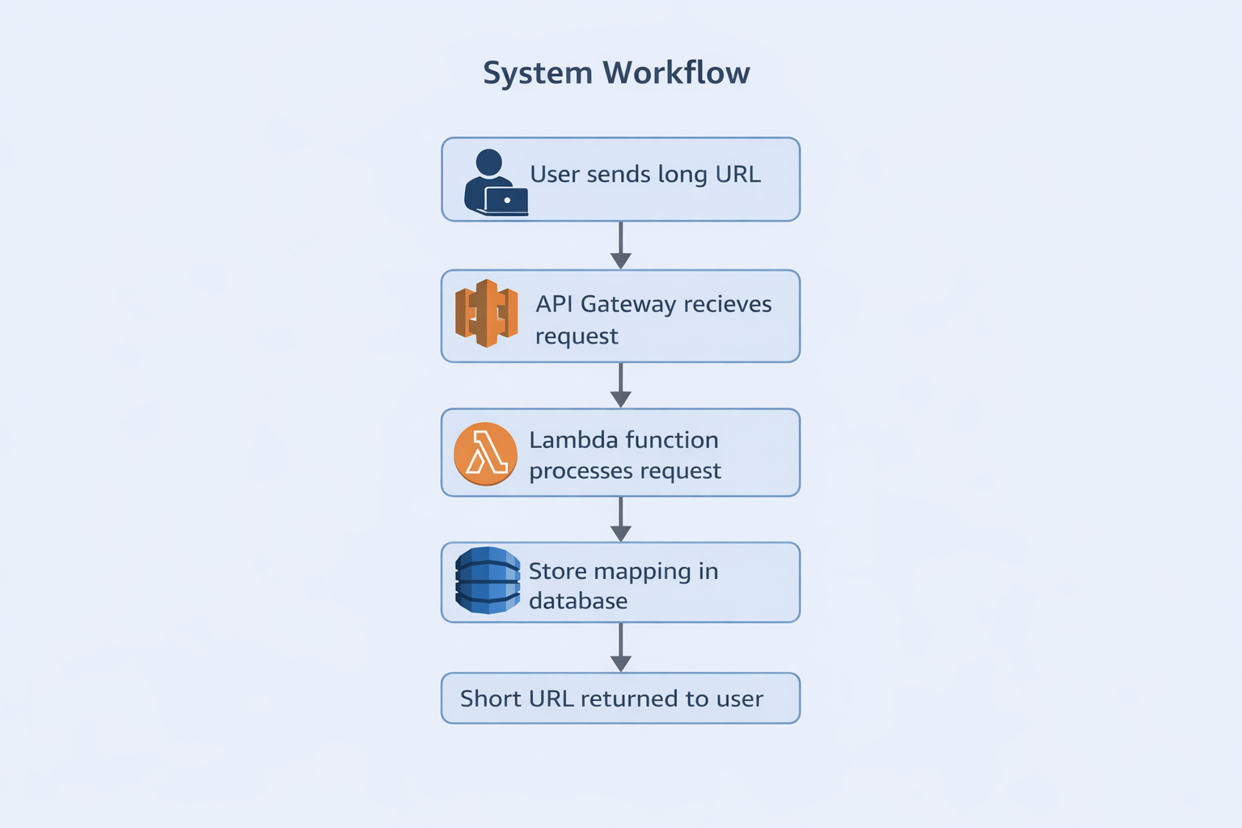
Demo Workflow

Slide 11
Advantages of Serverless Architecture
Benefits:
• No Server Management • Automatic Scaling • Cost Efficient • High Availability • Easy to deploy
Serverless reduces infrastructure complexity.

Slide 12
Future Enhancements
This system can be improved with the following features:
User Authentication
Analytics Dashboard
Custom Short URLs
Frontend Web Interface
Security Enhancements

Slide 13
Applications in IT Industry
URL shortening systems are widely used in the IT industry.
Social Media Platforms
Marketing Campaigns
Analytics & Data Tracking
Content Sharing Platforms
Mobile Applications

Slide 14
CONCLUSION
This project demonstrates a serverless cloud architecture using AWS.
Achievements:
Built scalable URL shortening service
Implemented analytics and expiration
Used fully managed cloud services
Future improvements:
User authentication
Frontend dashboard
Advanced analytics

Slide 15
THANK YOU

