Slide 1
Project Title : AI-Enhanced Career Guidance System for Personalized Career Pathways
DEPARTMENT OF CSE-AIML (CSM) – IV-II Sem
FINAL PROJECT
Batch :1
TEAM MEMBERS: IV– II :: CSM-B
1. 21BQ1A4278 - K. BHAVYA SRI SAI
2. 21BQ1A42B1- M. NAVYA MADHURI
3. 22BQ5A4209- K. PHANI KIRAN
4. 21BQ1A42A8- M. BABY KAVYA SRI
Project Guide:
K. BALAKRISHNA,
Assistant Professor,
Department of CSM,
VVIT

Slide 2
DEPARTMENT OF CSE-AIML (CSM) – IV-II Sem
FINAL PROJECT
Abstract:
Career guidance is a critical component of educational and professional development, yet many
individuals struggle to find the right career path that aligns with their skills, interests, and long-term goals.
Traditional career counseling methods often lack personalization and may not fully account for an
individual’s unique profile, including their aptitude, aspirations, abilities, and past experiences. We provide
a novel AI-Enhanced Career Guidance System designed to provide personalized career pathways for
students. Leveraging advanced machine learning algorithms, the system analyzes a wide array of data,
including academic performance, skills assessment, personality traits, and market trends. By integrating
natural language processing and predictive analytics, the system delivers tailored recommendations that
empower students to make informed decisions about their future careers. The system has broad applications
across various sectors, including educational institutions, career counseling centers, corporate HR
departments, government workforce programs, online career platforms, and personal development
tools.Key features include AI-driven aptitude assessment, analysis of aspirations and interests, ability and
experience mapping, and identification of future progression opportunities. The system highlights skill
gaps and suggests targeted learning opportunities, ensuring that recommendations remain relevant in a
rapidly evolving job market.This research contributes to the field of smart education by providing an
innovative solution that bridges the gap between education and the workforce, ultimately fostering a
generation of well-prepared professionals. Through this AI-driven approach, we aim to develop an
intuitive, user-friendly interface that makes the career guidance process accessible and engaging for users
at all levels, from students exploring initial career options to professionals considering a change or
advancement.

Slide 3
DEPARTMENT OF CSE-AIML (CSM) – IV-II Sem
FINAL PROJECT
Project Features
AI-Driven Aptitude Assessment
Personalized Career Pathway Recommendations
Skill and Experience Mapping
Interest and Aspiration Analysis
Gap Identification and Skill Development Suggestions
Natural Language Processing (NLP) Interface
Predictive Analytics for Career Progression
User-Friendly Dashboard
Feedback and Iteration Mechanism
Community and Networking Opportunities

Slide 4
DEPARTMENT OF CSE-AIML (CSM) – IV-II Sem
FINAL PROJECT
OBJECTIVES
Limitations of Existing Systems:
Limited Personalization: Most systems provide generic recommendations without deeply understanding individual traits, preferences, or aspirations.
Lack of Real-Time Insights: Systems often fail to provide up-to-date job market trends and demands.
Static User Experience:Engagement is typically limited to static questionnaires and predefined workflows, which may not be engaging for diverse users.
Improvements in the Proposed System:
Advanced Personalization: Use AI and ML models to offer highly personalized career recommendations by analyzing user profiles, interests, skills, and aspirations in depth.
Real-Time Data Integration: Incorporate real-time labor market trends, job availability, and emerging industry demands into the recommendation process.
Interactive AI Features: Provide conversational AI (chatbots) and virtual career counselors for a more interactive and engaging experience.
Accessibility: Optimize the system for mobile and web platforms, ensuring access for remote and underserved communities.

Slide 5
DEPARTMENT OF CSE-AIML (CSM) – IV-II Sem
FINAL PROJECT
Project Tools Required:
. Frameworks :Python(3.8+)
. Front end: HTML, CSS, JavaScript
. Backend: Python
. Business logic/models: ML,DL
. Hardware specifications: Mini capacities for execution of the
proposed system
Operating System: Windows 10x or Higher Versions
RAM: Minimum 4 GB
HDD (Storage): Minimum 1 TB
Graphics Card: Minimum 1 GB
Network Bandwidth: 512 kbps (required for cloud computing or AWS-based deployment)

Slide 6
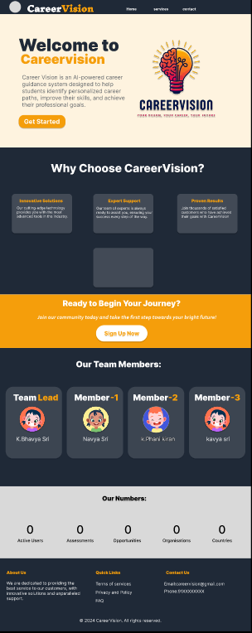

Slide 7
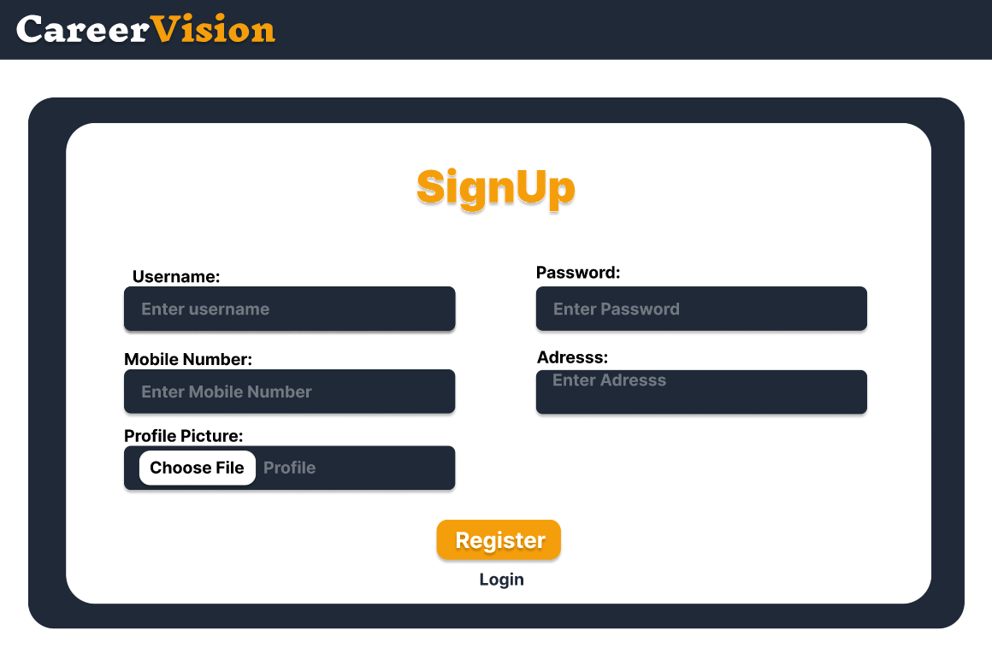

Slide 8
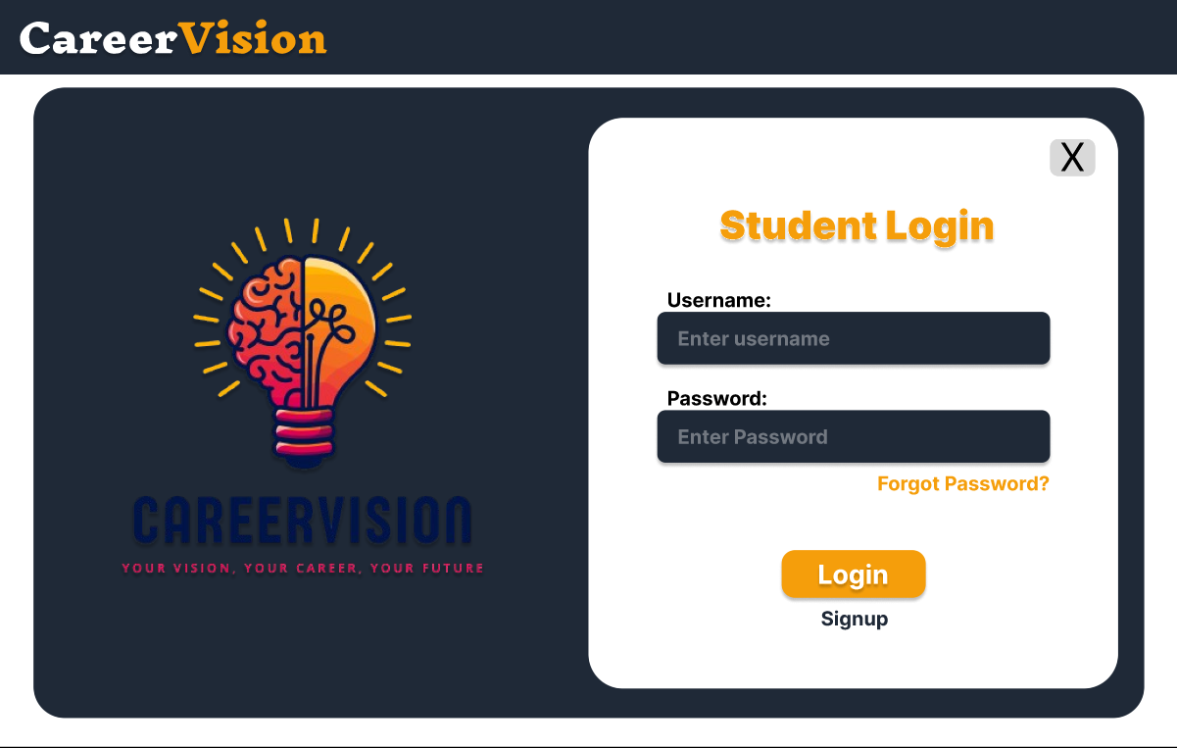

Slide 9
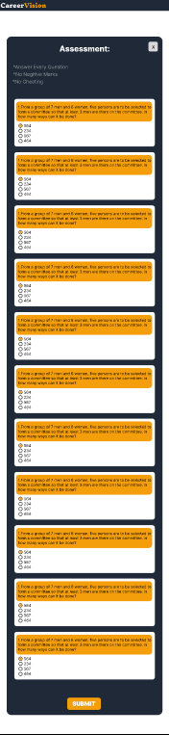

Slide 10
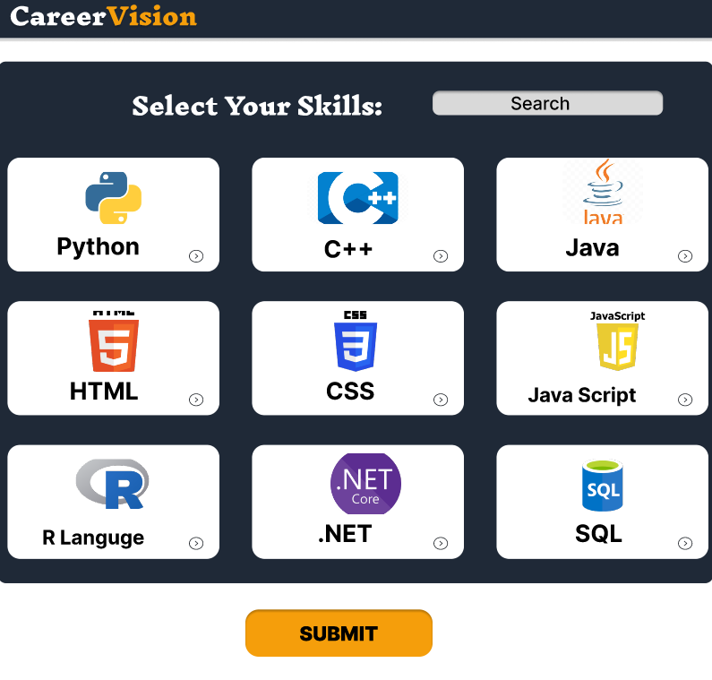

Slide 11
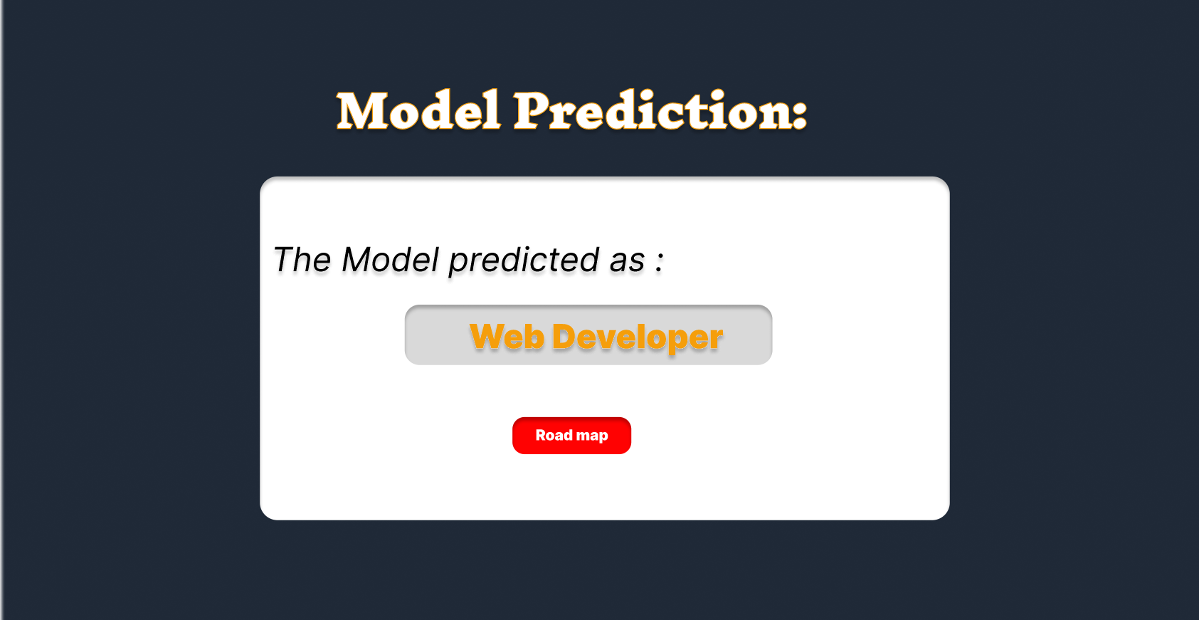

Slide 12
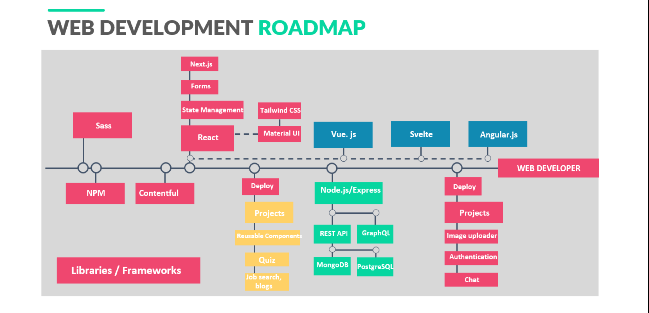

Slide 13
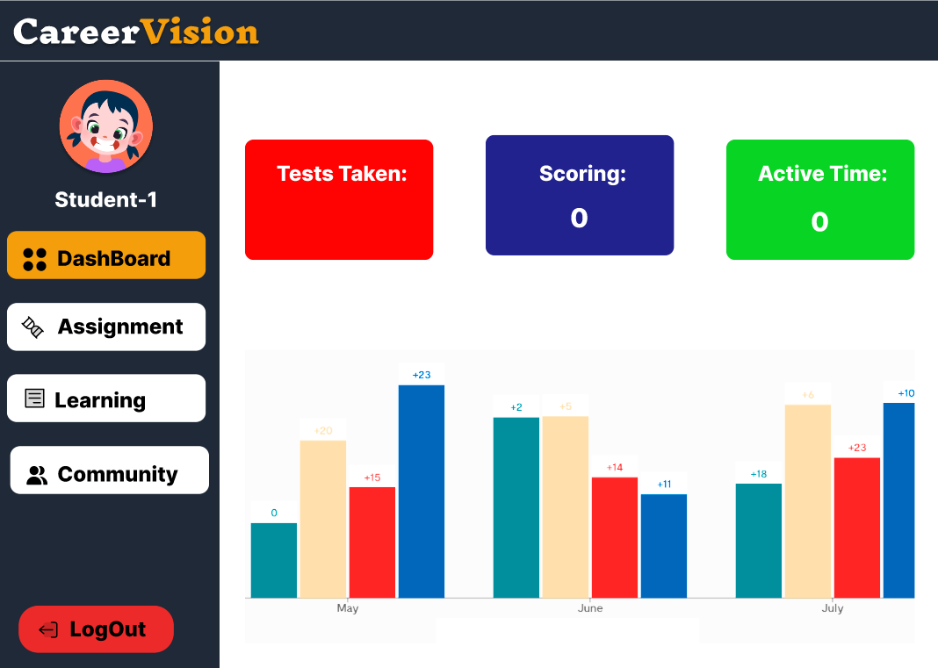

Slide 14
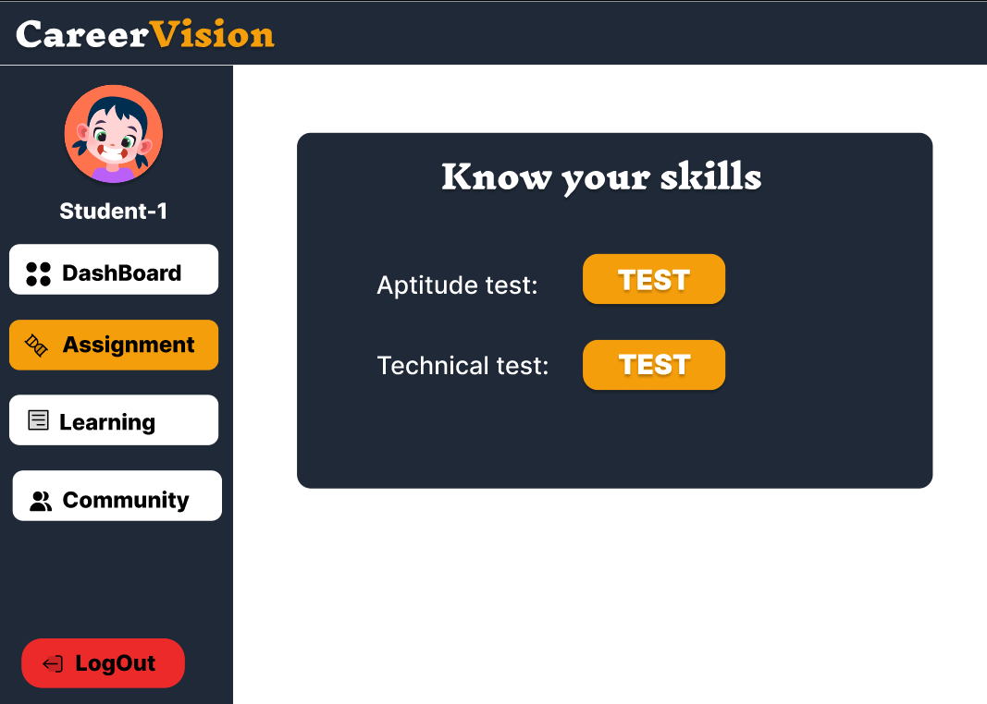

Slide 15
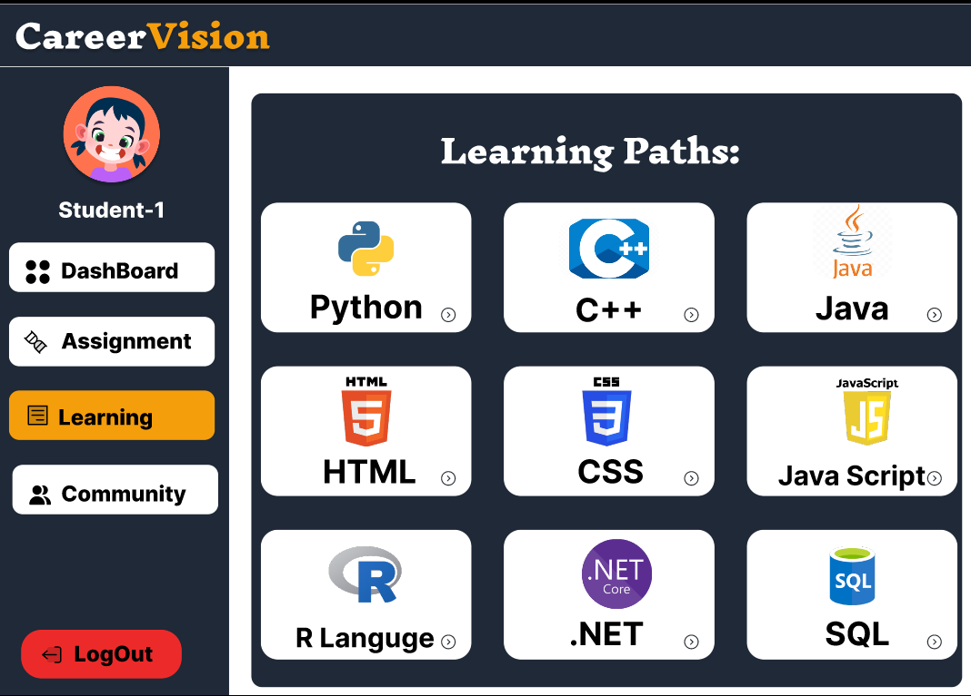

Slide 16
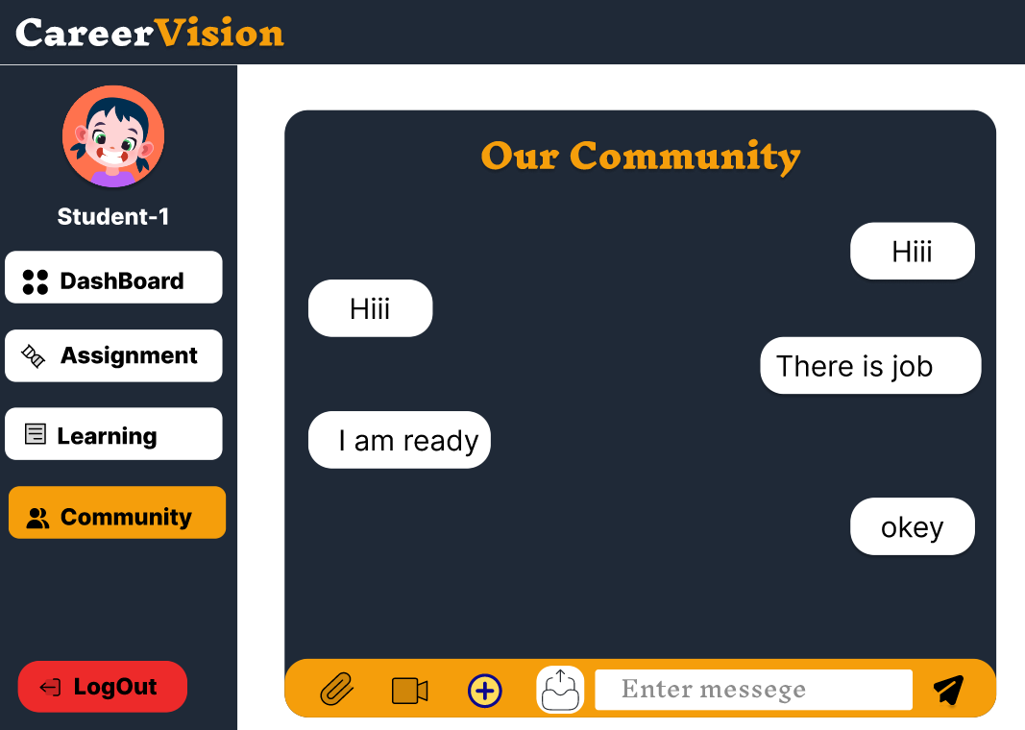

Slide 17
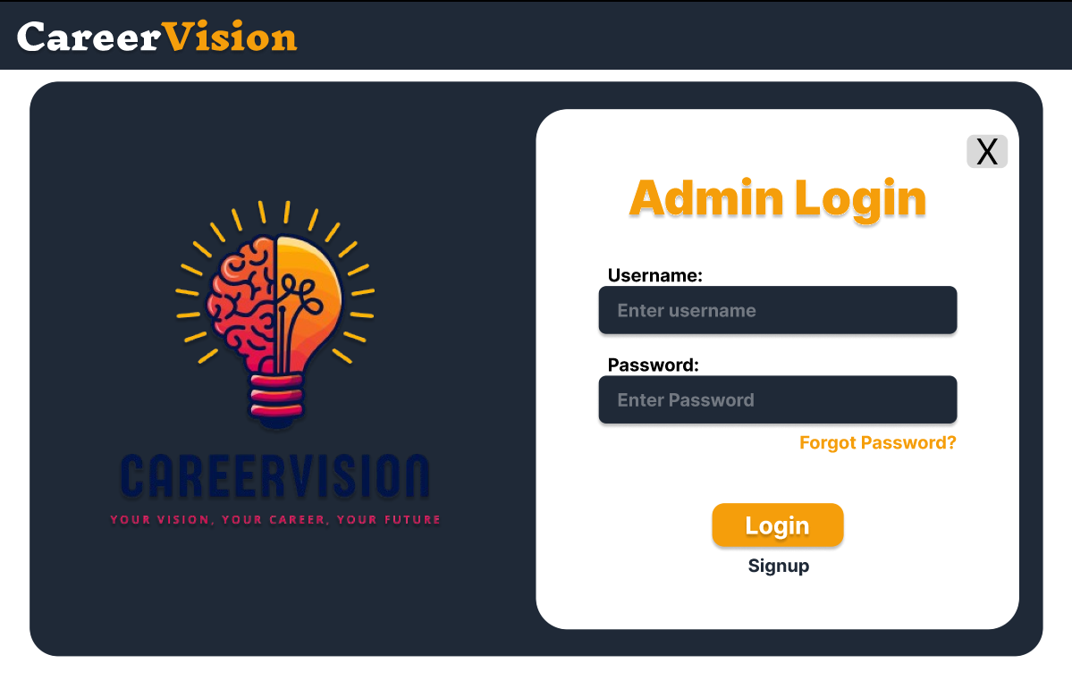

Slide 18
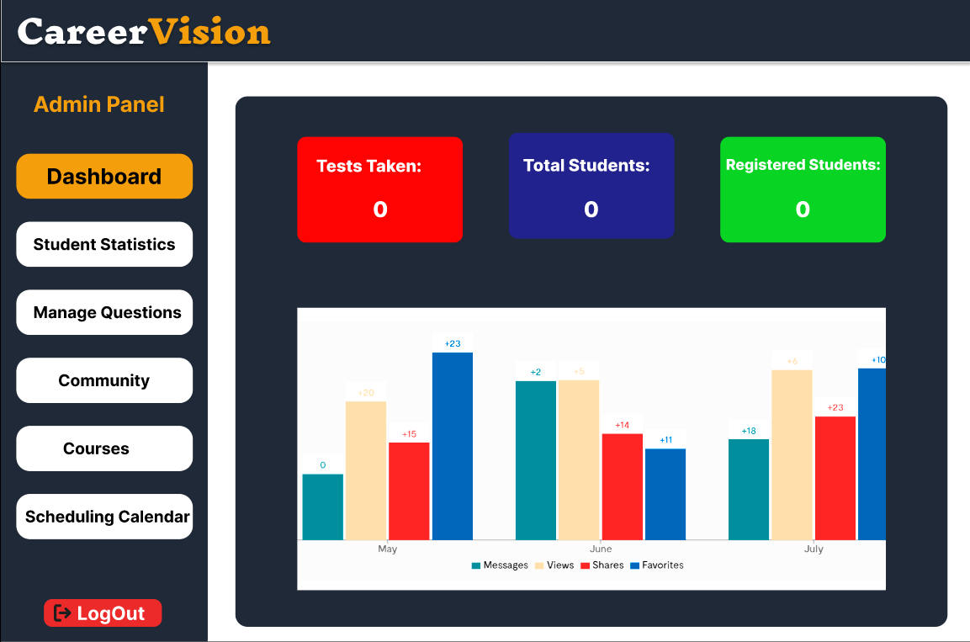

Slide 19
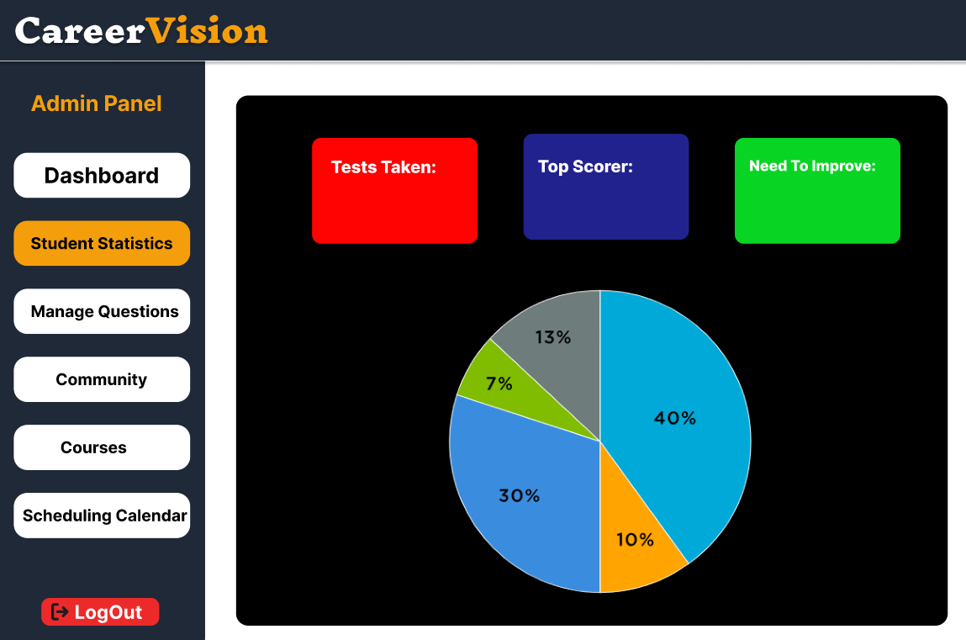

Slide 20
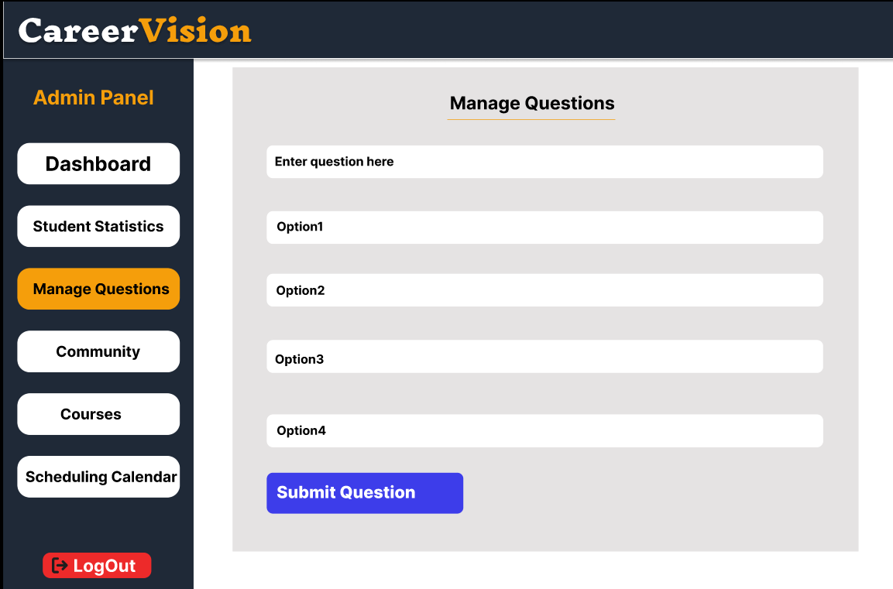

Slide 21
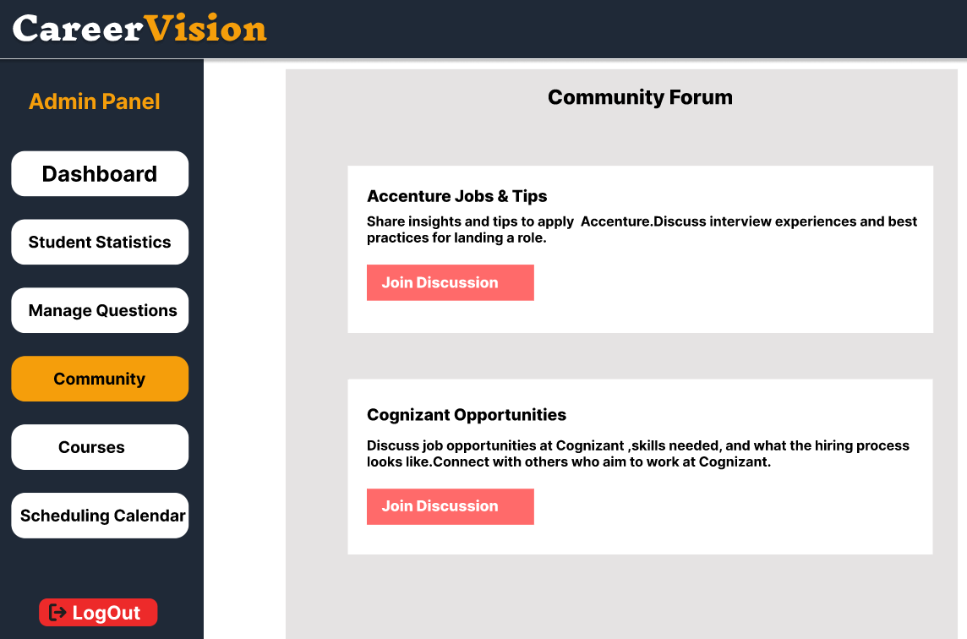

Slide 22
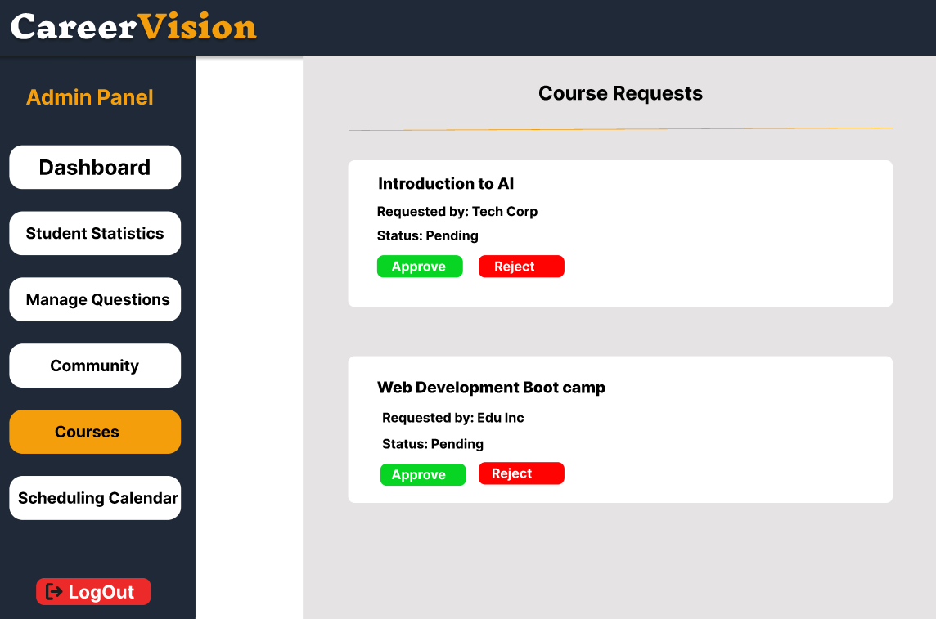

Slide 23
