Slide 1
Bluestock Mutual Fund Analytics
End-to-End Mutual Fund Analytics Using Python, SQLite & Power BI
CAPSTONE PROJECT
BHAVYA SREE

Slide 2

Problem Statement & Objectives
Analyze
Explore Indian mutual fund industry data across schemes, NAV, and AUM
Build ETL
Design and implement a robust data pipeline for ingestion and transformation
Measure
Calculate key performance metrics including CAGR, Sharpe, and Sortino ratios
Visualize
Create an interactive Power BI dashboard to generate business insights

Slide 3








Data Sources
Eight comprehensive datasets covering the full spectrum of the Indian mutual fund ecosystem.
NAV History
Scheme Performance
Daily net asset value records
Returns and benchmark comparisons
Investor Transactions
SIP Inflows
Purchase and redemption data
Systematic investment plan trends
AUM Data
Category Inflows
Assets under management over time
Fund category-wise flow analysis
Portfolio Holdings
Nifty Benchmarks
Underlying asset allocations
Market index reference data

Slide 4

Project Architecture
ETL Pipeline
Business Insights
Analytics
A structured, reproducible pipeline transforms raw Indian mutual fund data into actionable business insights — from ingestion through visualization.

Slide 5
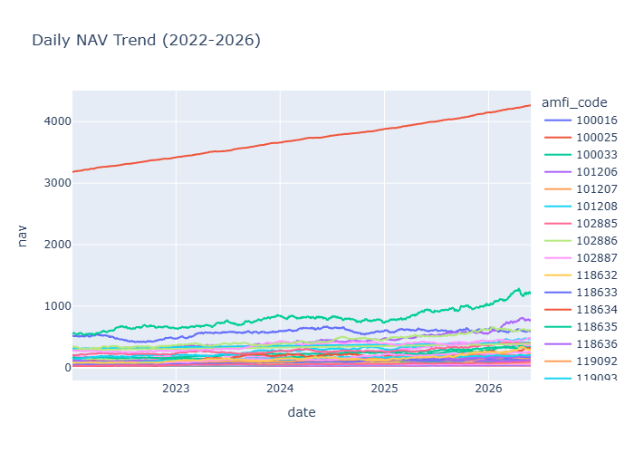
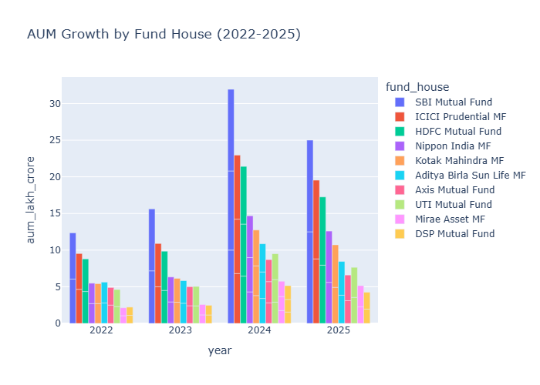
EDA Highlights — Industry Growth
AUM Growth Analysis
Examined total assets under management across fund categories to identify expansion patterns and category-level growth trajectories in the Indian mutual fund industry.
NAV Trend Analysis
Tracked net asset value movements over time to understand fund performance dynamics and market-wide valuation trends.
Key Finding
Consistent industry expansion observed across multiple fund categories, reflecting growing investor participation in the Indian mutual fund market.

Slide 6
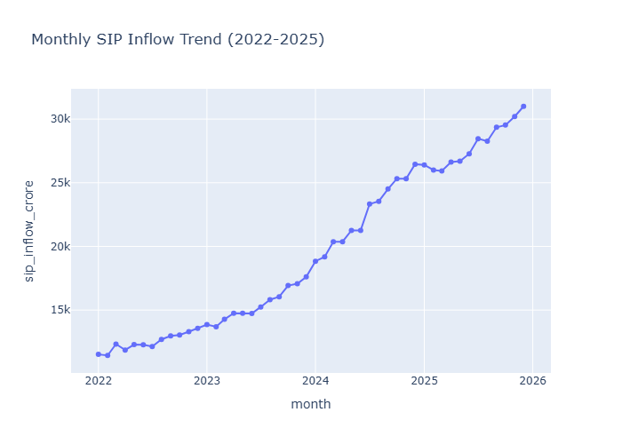
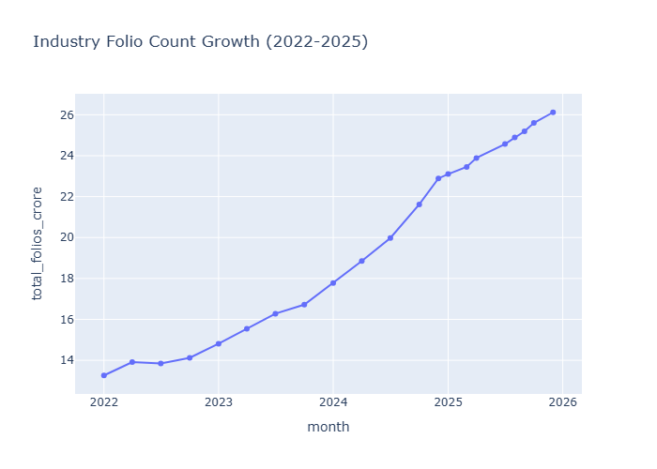
EDA Highlights — Investor Trends
SIP Trend Analysis
Analyzed systematic investment plan inflows to assess recurring investment behavior and gauge the growing adoption of disciplined investing among retail participants.
Folio Growth Analysis
Studied investor folio expansion over time to measure the depth of market penetration and track the growth of the active investor base.
Investor Participation
Combined SIP and folio insights to reveal increasing retail engagement and a broadening investor base across the Indian mutual fund landscape.

Slide 7

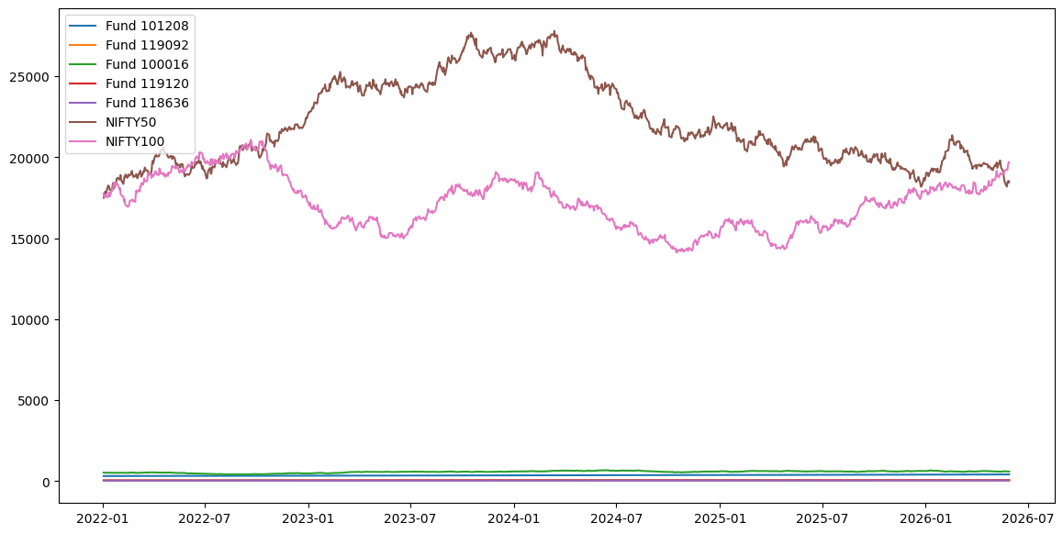
Performance Analytics
1
CAGR
Compound Annual Growth Rate — measures long-term fund returns
2
Sharpe Ratio
Risk-adjusted return relative to total volatility
3
Sortino Ratio
Downside risk-adjusted performance metric
4
Fund Ranking
Comparative ranking of schemes across categories

Slide 8
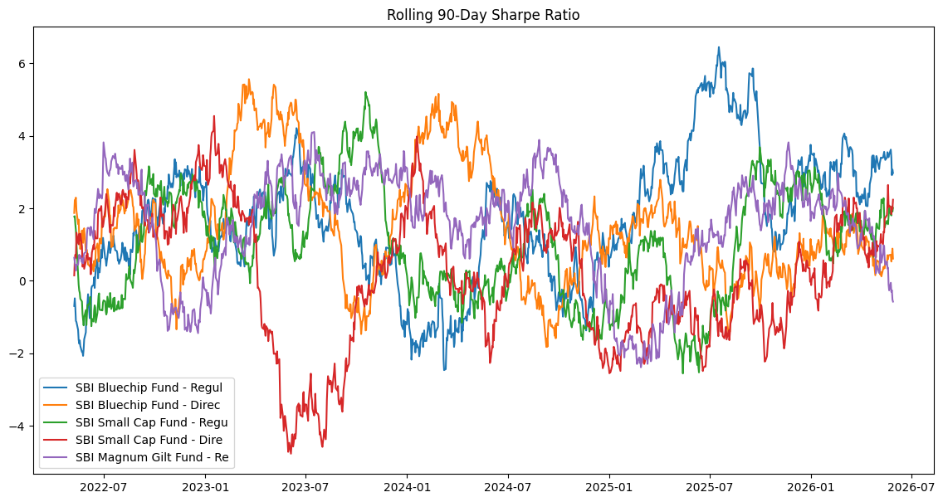
Advanced Risk Analytics
These six advanced metrics provide a comprehensive risk profile for each fund — from market sensitivity (Beta) and tail-risk exposure (VaR, CVaR) to consistency of risk-adjusted performance (Rolling Sharpe).
Alpha
Beta
Excess return vs. benchmark
Market sensitivity measure
Max Drawdown
VaR
Peak-to-trough loss
Value at Risk estimate
CVaR
Rolling Sharpe
Conditional VaR (tail risk)
Time-varying risk-adjusted returns

Slide 9
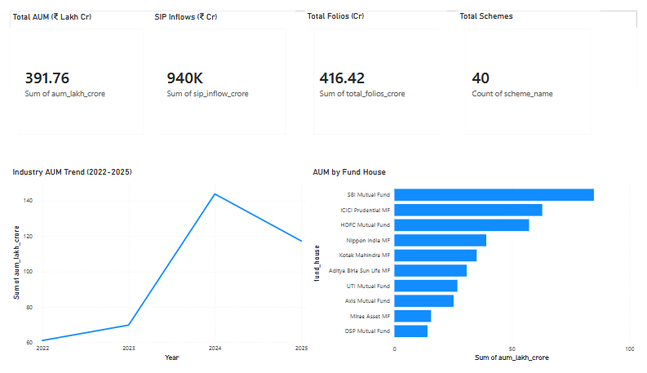
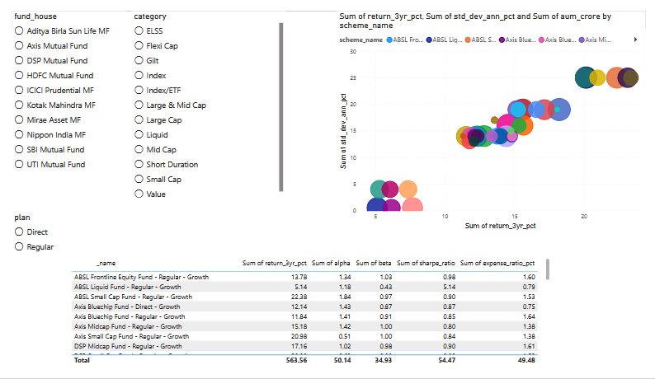
Dashboard Overview — Industry & Fund Performance
KPI Cards
At-a-glance summary metrics including total AUM, scheme count, and category-level aggregates for quick industry health assessment.
AUM Trend
Visual timeline of assets under management growth, enabling identification of expansion patterns and category-wise performance shifts.
Fund Performance Analysis
Comparative charts and tables for evaluating scheme returns, rankings, and benchmark-relative performance across fund categories.

Slide 10
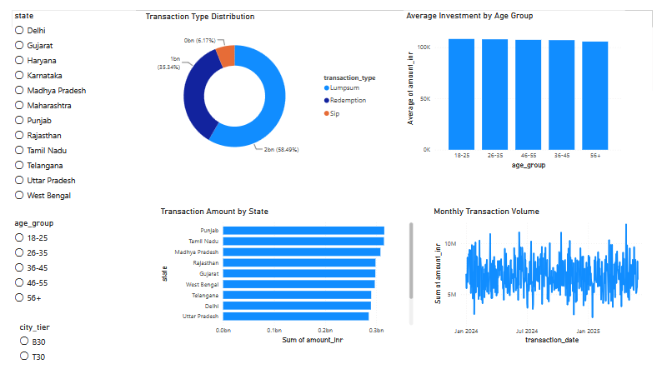
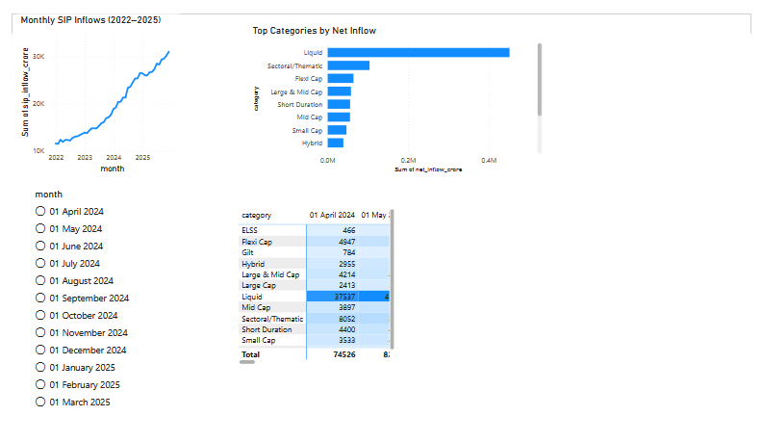
Dashboard Overview — Investor & SIP Analytics
Investor Analytics
SIP Market Trends
Folio growth trends, investor segmentation, and participation metrics across demographics and geographies.
Systematic investment plan inflow patterns, category-wise SIP adoption, and recurring investment behavior analysis.

Slide 11

Key Findings
SIP Inflows
Equity Fund Performance
Risk-Adjusted Returns
SIP inflows increased consistently across the study period.
Equity funds outperformed over the long term.
Risk-adjusted returns varied significantly across fund categories.
Investor Participation
Concentration Risk
Investor participation increased throughout the period.
Some funds showed high concentration risk.

Slide 12

Conclusion & Thank You
Project Completed
Project successfully completed, demonstrating an end-to-end analytics workflow.

