Slide 1


GUNNAM BHAVYA SRI
Final Project

Slide 2
PROJECT TITLE: KEY LOGGER AND SECURITY
Understanding and Mitigating key logging Threats

Slide 3
AGENDA:
Key loggers are a type of malicious software designed to record keystrokes made by a user on their keyboard, often without their knowledge or consent. 1. Objectives of Key loggers 2. Types of Key loggers 3. Security Risks 4. Detection and Prevention 5. Legal and Ethical Considerations 6. Best Practices for Security 7. Future Trends 8.Conclusion

Slide 4
20XX
PROBLEM STATEMENT:
Problem:
impact:
Key loggers can cause identity theft and financial loss by capturing sensitive information, undermining trust in digital systems Implementing robust security measures, as regular updates and multifactor authentication, is essential to mitigate these impacts.
Key loggers covertly capture keystrokes, leading to identity theft and financial loss by stealing sensitive information. Their stealthy nature makes detection difficult, undermining systems. Robust security measures like regular update and multifactor authentication are essential to mitiga.

Slide 5
PROJECT OVERVIEW:
Objectives: .Develop a comprehensive understanding of keyloggers, .their types, how they work, and effective security .prevent keylogging attacks. | Scope: .Identity theft and financial loss. .Difficulty in detection and removal. .Undermined trust in digital systems.

Slide 6
WHO ARE THE END USERS?
Individuals using personal computers and mobile devices .Employees in organizations handling sensitive data .IT security professionals .Financial institutions and their clients .Healthcare providers and patients accessing medical records online

Slide 7
YOUR SOLUTION AND ITS VALUE PROPOSITION:
Enhance Detection and Removal
Implement Multifactor Authentication
Regular Software Updates
Use Virtual Keyboard to type passwords

Slide 8
The WOW in My Solution
AI-Driven Detection:Utilize cutting-edge artificial intelligence to identify and neutralize key loggers in real-time, offering unparalleled protection
User Behavior Analytics:Implement sophisticated behavior analytics that learn and isolating any anomalies that may indicate key logger activity.
Seamless Integration: Develop a comprehensive security suite that seamlessly integrates with existing systems
Proactive Threat Intelligence: Leverage global threat intelligence networks to stay ahead of emerging key logger techniques,

Slide 9
MODELLING
A keylogger captures all keystrokes made on a keyboard, stores this data, and often operates in stealth mode. It can transmit data to a remote server and may start recording based on specific triggers. The data is then analyzed for patterns or sensitive information. Its use should always be legal and ethical, respecting privacy rights. Unauthorized use can lead to severe legal consequences. Always ensure you have proper authorization before using such tools. Respect for privacy and adherence to ethical standards should always be paramount when using keyloggers.

Slide 10
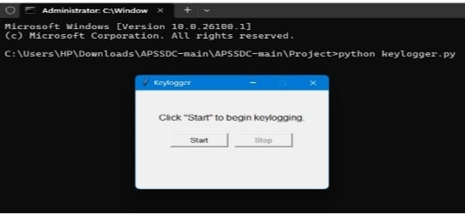
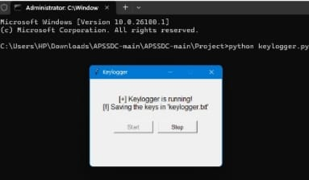
RESULTS:
01

Slide 11


RESULTS:
Gets all the information that the user has typed then and all the tabs or applications of the user has opened and will put it into a Notepad file

Slide 12
RESULTS:
Successfully implemented a key logger that captures keystrokes and records them into both text and JSON files.
Real-time key logging with start and stop functionality controlled via a simple GUI.
The key logger project demonstrated the capability to effectively them into both text and JSON files.
The GUI provided a user-friendly way to control the key logger, making it accessible and easy to use.
Emphasized the ethical use of key loggers and the importance of implementing security measures to protect against malicious .

Slide 13
Thank you

