Slide 1
GUNNAM BHAVYA SRI
Final Project
3/21/2024 Annual Review

Slide 2
PROJECT TITLE: KEY LOGGER AND SECURITY Understanding and Mitigating key logging Threats
3/21/2024 Annual Review

Slide 3


AGENDA: Key loggers are a type of malicious software designed to record keystrokes made by a user on their keyboard, often without their knowledge or consent. 1. Objectives of Key loggers 2. Types of Key loggers 3. Security Risks 4. Detection and Prevention 5. Legal and Ethical Considerations 6. Best Practices for Security 7. Future Trends 8.Conclusion
3/21/2024 Annual Review

Slide 4

PROBLEM STATEMENT: Problem: Key loggers covertly capture keystrokes, leading to identity theft and financial loss by stealing sensitive information. Their stealthy nature makes detection difficult, undermining systems. Robust security measures like regular updates and multifactor authentication are essential to mitigate these risks. Impact: Key loggers can cause identity theft and financial loss by capturing sensitive information, undermining trust in digital systems Implementing robust security measures, as regular updates and multifactor authentication, is essential to mitigate these impacts.
3/21/2024 Annual Review

Slide 5

PROJECT OVERVIEW: Objectives: .Protect sensitive information from being captured by key loggers. .Enhance detection and removal of key loggers through advanced security measures. .Maintain trust and reputation by implementing robust security practices. Scope: .Identity theft and financial loss. .Difficulty in detection and removal. .Undermined trust in digital systems.
3/21/2024 Annual Review

Slide 6

WHO ARE THE END USERS? .Individuals using personal computers and mobile devices .Employees in organizations handling sensitive data .IT security professionals .Financial institutions and their clients .Healthcare providers and patients accessing medical records online
3/21/2024 Annual Review

Slide 7

YOUR SOLUTION AND ITS VALUE PROPOSITION: .Enhance Detection and Removal .Educate Users .Implement Multifactor Authentication .Regular Software Updates .Comprehensive Monitoring Value of Propositions: Propositions are critical in providing clear, actionable plans to combat the threats posed by key loggers. They specify the actions needed to protect sensitive information and maintain system security. For instance
3/21/2024 Annual Review

Slide 8

The WOW in My Solution .AI-Driven Detection: Utilize cutting-edge artificial intelligence to identify and neutralize key loggers in real-time, offering unparalleled protection .User Behavior Analytics: Implement sophisticated behavior analytics that learn and isolating any anomalies that may indicate key logger activity. .Seamless Integration: Develop a comprehensive security suite that seamlessly integrates with existing systems .Proactive Threat Intelligence: Leverage global threat intelligence networks to stay ahead of emerging key logger techniques,
3/21/2024 Annual Review
8

Slide 9
MODELLING
Components:
.Key logger Module: Captures keystrokes from user input.
.Data Transmission Module: Sends captured data to remote servers or attackers.
.Stealth Module: Hides key logger processes and files to evade detection.
.Detection Module: Identifies and alerts on presence of key loggers.
.Encryption Module: Secures sensitive data from being intercepted.
3/21/2024 Annual Review
9

Slide 10
MODELLING
2. GUI Integration:
.Dashboard: Provides overview of system status and alerts.
..Settings Panel: Allows configuration of security settings and preferences.
.Logs Viewer: Displays captured keystrokes and suspicious activities.
.Alerts and Notifications: Alerts users to potential keylogger activities.
.Reporting: Generates reports on security incidents and threats.

Slide 11
MODELLING
3. Flow Diagram:
.User Input: Keystrokes entered by user.
.Key logger Capture: Key logger module captures keystrokes.
.Data Transmission: Captured data transmitted to remote server.
.Stealth Mode: Key logger hides its presence from detection.
.Detection Module: Monitors for suspicious activities and key logger behaviors.
.Alert Generation: Alerts generated for detected key logger activities.
.Encryption: Sensitive data encrypted before transmission.
.GUI Interaction: User interacts with GUI to view logs, configure settings, and receive alerts.

Slide 12
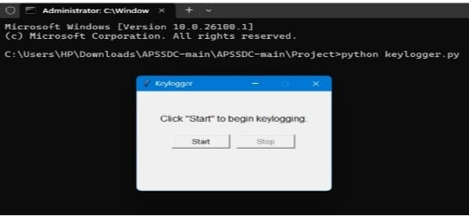
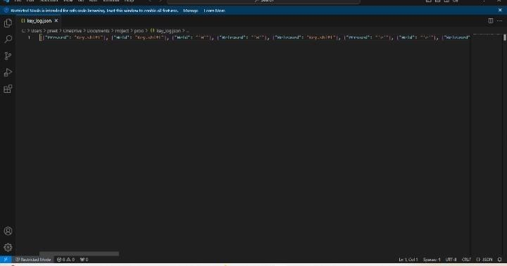
RESULTS
3/21/2024 Annual Review
12

Slide 13
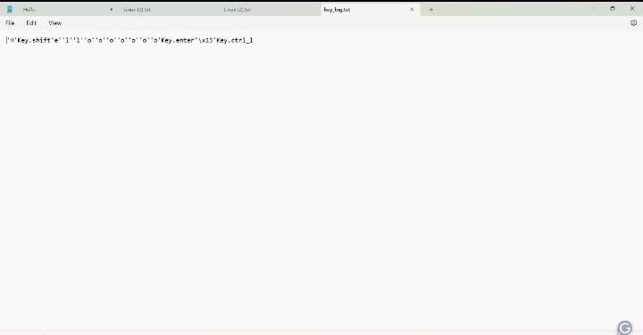
RESULTS

Slide 14
RESULTS:
Successfully implemented a key logger that captures keystrokes and records them into both text and JSON files.
Real-time key logging with start and stop functionality controlled via a simple GUI.
The key logger project demonstrated the capability to effectively them into both text and JSON files.
The GUI provided a user-friendly way to control the key logger, making it accessible and easy to use.
Emphasized the ethical use of key loggers and the importance of implementing security measures to protect against malicious .

Slide 15
PROJECT LINK: https://github.com/bhavya22p31a4214/Bhavya-sri

