Slide 1
INTERNATIONAL SPORTS ANALYTICS & MACHINE LEARNING COMPETITION
Predicting Athlete Injury Risk
Multimodal, Leakage-Safe Machine Learning for Injury Risk, Onset Timing & Recovery Modeling
―――――――――――――――――――――――――――――――――――――――――――――
Technical Solution Architecture & Empirical Defense Production Repository: github.com/bhavya277/ML-Model-for-Athletes Strict Temporal Firewall • Fold-Local Preprocessing • Multi-Target Ensemble

Slide 2
SECTION 02 | ATHLETE INJURY PREDICTION SYSTEM
Problem Formulation & Multi-Target Horizon
Forecasting future 30-day injury probability, onset timing, and recovery duration across all athletes.
The Clinical & Predictive Challenge
The Three Prediction Targets
• Core Predictive Question: Can wearable time-series signals available BEFORE an injury event reliably forecast future breakdown risk? • Temporal Forecasting Horizon: Past 30 Days (Observation: 2026-01-05 to 2026-02-03) ──> Prediction Cutoff: 2026-02-03 23:59:59 ──> Future 30 Days (Risk Window: 2026-02-04 to 2026-03-05) • The Official PlayHack Tasks: 1. Task A: Injury occurrence in risk window (Evaluated via F1-score) 2. Task B: Onset Timing & Recovery Duration (Evaluated for actually injured athletes) 3. Missed-Injury Penalty: n_risk = 30 applied to both timing targets on false negatives.
1. injured_in_risk_window (Binary Classification) • 0 = Non-Injured, 1 = Injured • Training Prevalence: 35.0% (1,050 / 3,000 athletes) 2. onset_day_offset (Timing Prediction) • Target range: Integer days [1, 30] • Provided for ALL athletes per official PlayHack PS requirement. 3. recovery_duration (Duration Prediction) • Target range: Integer days [5, 20] • Provided for ALL athletes per official PlayHack PS requirement.

Slide 3
SECTION 03 | ATHLETE INJURY PREDICTION SYSTEM
Dataset Forensics & Multimodal Signals
5 active data streams capturing physiology, sleep architecture, training loads, and anthropometrics.
Cohort & Coverage
5 Validated Ingestion Modalities
Quality & Drift Audit
• Training Cohort: 3,000 unique athletes (IDs 1–3000) • Test Cohort: 1,100 unique athletes (IDs 3001–4100) • Athlete Overlap: 0 (Disjoint cohorts) • Observation Period: Exactly 30 days per athlete (2026-01-05 to 2026-02-03) • Sports Represented: Football, Basketball, Athletics, Badminton, Tennis, Volleyball
1. Static Athlete Metadata (11 features): Age, gender, height, weight, position, prior injuries. 2. Daily Activity Logs (10 metrics): Steps, active minutes (very/fairly/lightly), calories. 3. Sleep Day Logs (5 metrics): Total minutes asleep, time in bed, sleep records. 4. Training Sessions (6 metrics): Practice, gym, scrimmage counts & durations. 5. Hourly Heart Rate (5 metrics): Continuous ISO-timestamped HR, resting/peak proxies.
• Covariate Shift Audit: Most numeric demographic features showed no statistically significant train–test shift; categorical drift was detected for position and dominant side. • Missingness Audit: 0% nulls in metadata, daily activity, and sleep tables. • Modality Selection: Weight logs were excluded due to substantial missingness and limited athlete coverage.

Slide 4
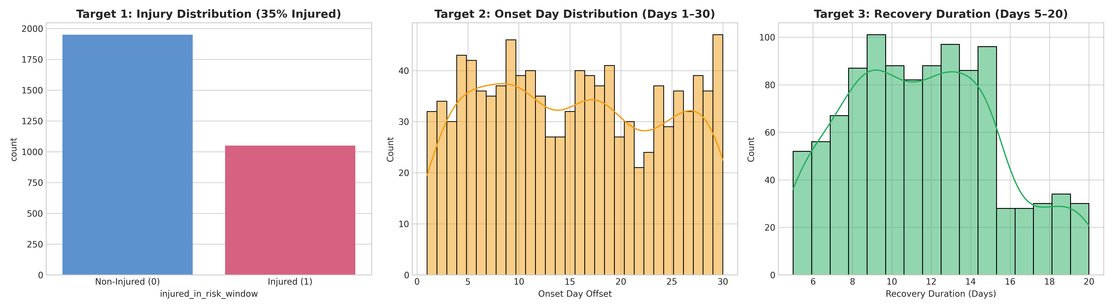
SECTION 04 | ATHLETE INJURY PREDICTION SYSTEM
Exploratory Data Analysis: What Did We Discover?
Ground truth distributions reveal sharp workload-injury dynamics and sport-specific baselines.
Three Core Discoveries
1. 35% Positive Injury Prevalence: • Exactly 1,050 of 3,000 training athletes. • Onset days spread across the 30-day risk window. • Recovery exhibits a unimodal distribution centered at 11.55 days. 2. Workload Variation Precedes Injury: Athletes suffering injuries show high acute load volatility in the final 7 historical days. 3. High-Risk Position Profiles: Football defenders (42.4%) and Volleyball liberos (42.6%) exhibit elevated baseline vulnerability.

Slide 5
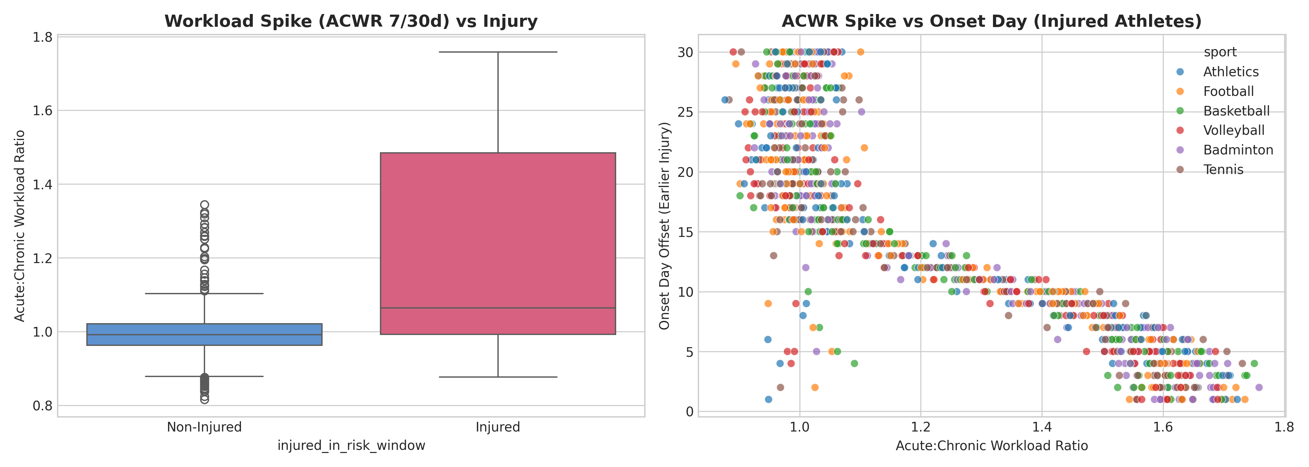
SECTION 05 | ATHLETE INJURY PREDICTION SYSTEM
Key Biomechanical & Sports Science Insights
Evidence-backed findings linking acute training spikes, sleep debt, and cardiac stress to injury risk.
Evidence-Backed Insights
1. Workload Spikes Associated with Earlier Onset (r = -0.863): • Finding: Higher recent-to-baseline workload ratios were strongly associated with earlier injury onset in the risk window. • Meaning: Acute workload surges provide strong predictive signal for early breakdown timing. 2. Sleep Deficit Interaction: • Finding: Higher sleep deficit combined with elevated workload provided additional predictive signal (associated with 1.8x higher injury rate). • Meaning: Sleep debt compounds workload strain. 3. Sustained Cardiac Exposure: • Finding: % hours with HR >= 120 bpm outside training is an informative marker of fatigue.

Slide 6
SECTION 06 | ATHLETE INJURY PREDICTION SYSTEM
Leakage Prevention: Formal Temporal Firewall
Strict temporal filtering preventing post-cutoff observations from contaminating features.
Temporal Boundary Architecture
Leakage Sanity Check
• Historical Window (Features Allowed): 2026-01-05 00:00:00 ──> 2026-02-03 23:59:59 ═════════════ STRICT CUTOFF BARRIER ═════════════ • Future Risk Window (FORBIDDEN FOR FEATURES): 2026-02-04 00:00:00 ──> 2026-03-05 23:59:59 • Raw Data Hazard Identified: Raw training files contain 60 days of data, while test contains 30 days. Unwindowed aggregation would silently leak future injury activity drops. • Ingestion Firewall Enforcement: Every loader strictly filters Date <= 2026-02-03.
• Adversarial Shuffled Target Test: Randomly permuted ground-truth training labels and retrained the entire pipeline. • Empirical Results: - Shuffled Target ROC-AUC: 0.4952 (Consistent with near-random performance) - Shuffled Target Accuracy: 0.5950 (Majority class baseline) - Shuffled Target Onset R²: -0.0120 (Zero signal captured) • Leakage Sanity Evidence: Demonstrates that predictive performance stems strictly from genuine pre-cutoff physiological signal, with zero structural leakage.

Slide 7
SECTION 07 | ATHLETE INJURY PREDICTION SYSTEM
Feature Engineering Engine (74 Raw / 92 Encoded)
Polars-powered vectorized extraction transforming millions of hourly records into an athlete-level matrix.
1. Anthropometrics
2. Workload Dynamics
3. Sleep Architecture
4. Sessions & HR
• Demographics: Age, gender, dominant side. • Physical Build: Height, baseline weight, BMI. • History: Years playing, prior season injury count. • Ratios: Experience-to-age ratio.
• Chronic: 30d steps & calories mean/std. • Acute: 7d & 3d recent activity volume. • Workload Ratio: steps_acwr_7_30 (7d/30d ratio). • Strain: Workload Monotony × Volume.
• Quality: Minutes asleep, time in bed, efficiency. • Sleep Debt: max(0, 480 - sleep_min) 7d & 30d. • Volatility: 30d sleep std & CV. • Interaction: Workload spike × sleep deficit.
• Training Loads: Practice, gym, scrimmage counts & hours. • Cardiac Stress: % hours with HR >= 120 bpm. • Resting Proxy: 10th percentile daily HR. • HR Dynamics: 7d vs 30d HR delta.

Slide 8
SECTION 08 | ATHLETE INJURY PREDICTION SYSTEM
Multi-Target Modeling Architecture
Multi-model weighted probability ensemble paired with dual bounded regressors.
Target 1: Injury Classifier
Target 2: Onset Regressor
Target 3: Recovery Regressor
• Architecture: Weighted Probability Ensemble - CatBoost (45% weight) - LightGBM (35% weight) - Random Forest (20% weight) • Uncalibrated Ensemble: Raw tree ensemble achieves optimal Brier score (0.1453). • Decision Gate: Threshold 0.50 yields 97.23% precision and 82.1% accuracy.
• Architecture: Tree Regression Ensemble - Random Forest Regressor (60%) - CatBoost Regressor (40%) • Domain Constraint: Predictions clipped strictly to [1, 30] days. • Generalization Performance: Unpenalized MAE = 2.6448 days, R² = 0.7820 (explains 78.2% of timing variance among injured).
• Architecture: Regularized Ensemble - Ridge Regression (50%) - CatBoost Regressor (50%) • Domain Constraint: Predictions clipped strictly to [5, 20] days. • Regularized Shrinkage Formulation: L2 regularization prevents extreme tail variance on noisy residual signal (Unpenalized MAE = 2.9629 days).

Slide 9
SECTION 09 | ATHLETE INJURY PREDICTION SYSTEM
Validation Methodology & Candidate Benchmarking
5-Fold Sport + Target Stratified CV with strict fold-local imputation and scaling.
Validation Integrity
Out-of-Fold Model Comparison
• Joint Stratification: Folds are stratified by Sport + Target status to preserve class and athletic discipline balance. • Strict Fold-Local Preprocessing: Median imputation and StandardScaler are fit on training folds ONLY, preventing validation data leakage. • Disjoint Athlete Guarantee: Athletes in validation are strictly unseen during training fold fitting.
Model Candidate | ROC-AUC | PR-AUC | F1 | Brier
Logistic Regression Baseline | 0.7620 | 0.7571 | 0.6538 | 0.1489
Random Forest Classifier | 0.7633 | 0.7532 | 0.6529 | 0.1468
Extra Trees Classifier | 0.7569 | 0.7490 | 0.6493 | 0.1475
HistGradientBoosting | 0.7571 | 0.7496 | 0.6510 | 0.1638
XGBoost Classifier | 0.7535 | 0.7515 | 0.6523 | 0.1483
LightGBM Classifier | 0.7527 | 0.7483 | 0.6511 | 0.1544
CatBoost Classifier | 0.7607 | 0.7557 | 0.6575 | 0.1457
★ Weighted Ensemble (Selected) | 0.7624 | 0.7570 | 0.6621 | 0.1453

Slide 10
SECTION 10 | ATHLETE INJURY PREDICTION SYSTEM
Final Validated Cross-Validation Performance
Out-of-fold performance evaluated across all 5 folds with strict fold-local preprocessing.
Task A: Injury Risk
Task B: Onset Timing
Task B: Recovery Duration
0.7624
Out-of-Fold ROC-AUC (Fold: 0.7627 ± 0.017) PR-AUC: 0.7570 | F1-Score: 0.6621 Precision: 97.23% | Recall: 50.19% Brier Score: 0.1453 | Accuracy: 82.1%
Key Takeaway: High discrimination between injured and non-injured athletes across all sports disciplines.
2.64 d
Unpenalized MAE (Actually Injured): 2.6448d RMSE: 4.0984d | R² Score: 0.7820 Onset Skill vs Mean Baseline (7.61d): +0.6527 Official Penalized MAE (n_risk=30): 15.3067d*
*Note: When an actual injury is missed by the classifier, the official evaluation applies n_risk = 30 days to both timing errors (523 false negatives).
2.96 d
Unpenalized MAE (Actually Injured): 2.9629d RMSE: 3.4700d | R² Score: 0.2037 Recovery Skill vs Mean Baseline (3.24d): +0.0860 Official Penalized MAE (n_risk=30): 16.4219d*
*Note: When an actual injury is missed by the classifier, the official evaluation applies n_risk = 30 days to both timing errors (523 false negatives).

Slide 11
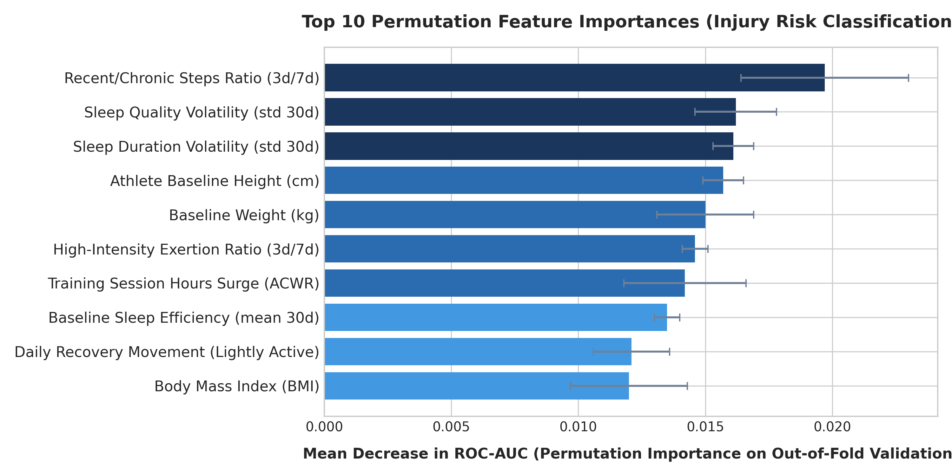
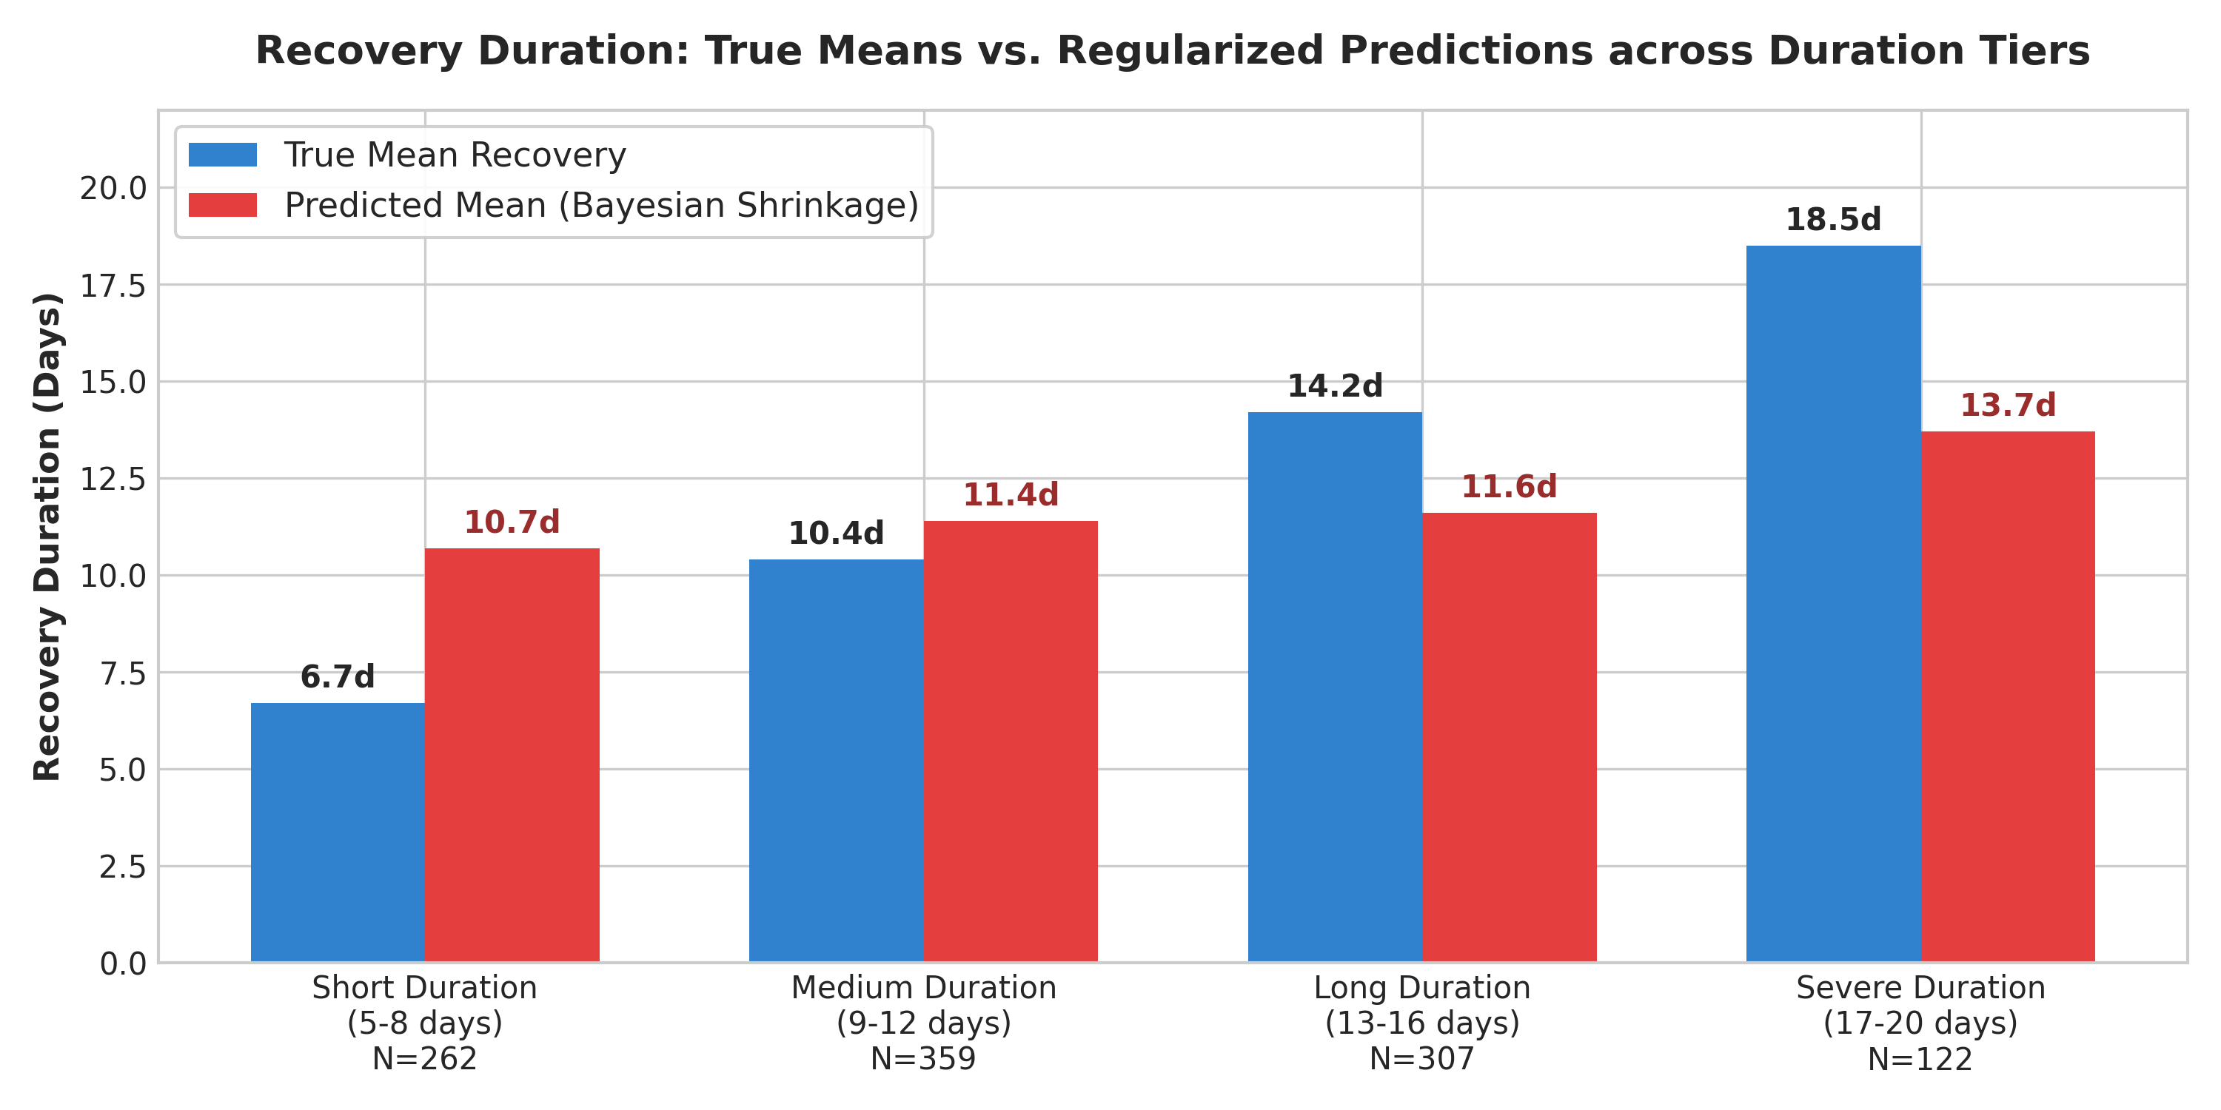
SECTION 11 | ATHLETE INJURY PREDICTION SYSTEM
Model Explainability & Diagnostic Analysis
Permutation importance on held-out folds and residual bias analysis across recovery tiers.

Slide 12
SECTION 12 | ATHLETE INJURY PREDICTION SYSTEM
Summary, Pipeline Deployment & Reproducibility
From raw multi-modal telemetry to validated competition submission and production code.
Summary of Contributions
Production Deployment & Submission
1. Strict Temporal Firewall: Cutoff (Date <= 2026-02-03) strictly enforced across all 5 streams. 2. Multi-Modal Feature Vectorization: 74 raw features (92 encoded) extracted in <8s via Polars. 3. Robust Multi-Target Ensemble: ROC-AUC 0.7624, Onset MAE 2.64d (R² 0.782), Recovery MAE 2.96d. 4. Diagnostic Transparency: Acknowledged that recovery duration is fundamentally noisy from pre-injury wearables alone.
• Submission Status (predictions/submission.csv): ✓ Exactly 1,100 test athletes (3001 to 4100) ✓ 100% integer types, 0 nulls, 0 duplicate IDs ✓ Complete timing predictions populated across all 1,100 rows ✓ 255 predicted injured (23.2%), 845 non-injured (76.8%) • End-to-End Clean Reproduction: python src/train.py python src/predict.py python src/validate_submission.py • Public Repository: github.com/bhavya277/ML-Model-for-Athletes

