Slide 1
LICENSE PLATE RECOGNITION
USING MATLAB
By
V.Bhavya
B.Chandana

Slide 2
INTRODUCTION
LPR is mainly designed to help in the recognition of number plates of vehicles.
This is designed for the purpose of security and is a security system.
Based on image processing technology.
Uses MATLAB software.
Used for access control.

Slide 3
MATLAB
Abbreviation of Matrix Laboratory.
It is a mathematical programming environment.
In MATLAB everything is represented in the form of array or matrices.
Main use of MATLAB in software development is algorithm design and development.

Slide 4
IMAGE PROCESSING
An image is used to convey useful information in a visible format.
Pixel is the basic element used to describe an image.
Image processing involves the extraction of useful information from an image.
The main applications of image processing are face detection, quality control, traffic control etc.

Slide 5
ALGORITHM FOR LPR SYSTEM
Capturing of image.
Converting the image into binary format.
Detection of number plate area.
Segmentation.
Number plate identification.
Save to file in given format.

Slide 6
APPLICATIONS
Keeping record of incoming and outgoing vehicles from the parking area .
Detecting vehicles in a black list.
Average speed control.
Red light control.
Urban toll payment.
Security increased.

Slide 7
CONCLUSION
Through this project we learn about image processing .
The basic focus of the project was in image processing using MATLAB.
MATLAB is used as a programming tool which provides many features related to image processing.
Practical implementation of this project range from small use such as keeping record of incoming and outgoing vehicles from the parking area to a vast implementation such as border security system.

Slide 8
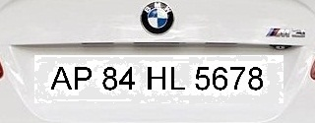

Slide 9
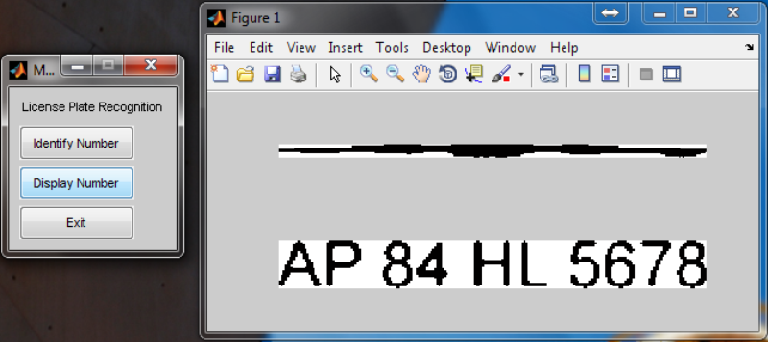

Slide 10
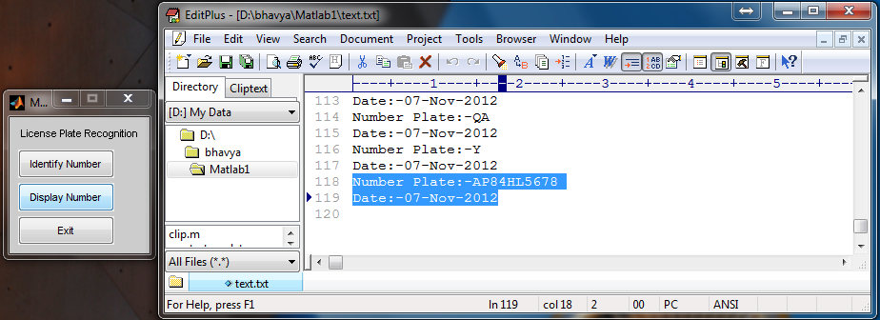

Slide 11
THANK YOU

