Slide 1



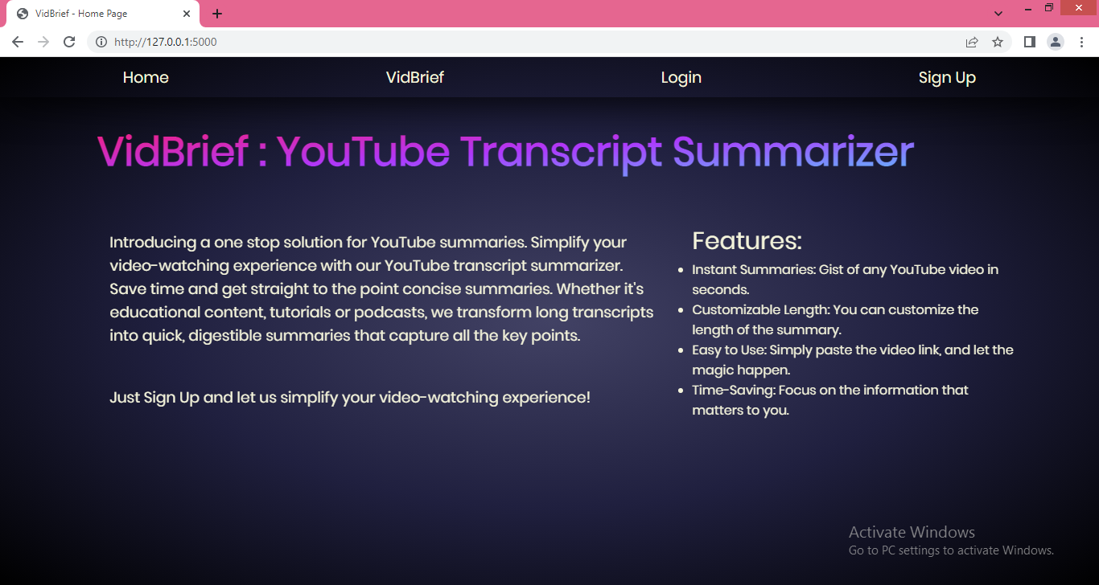
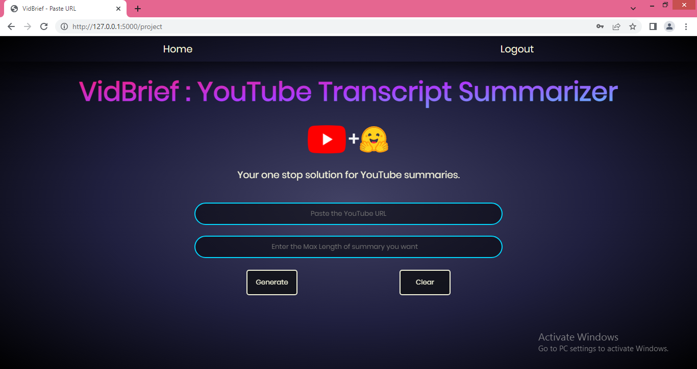
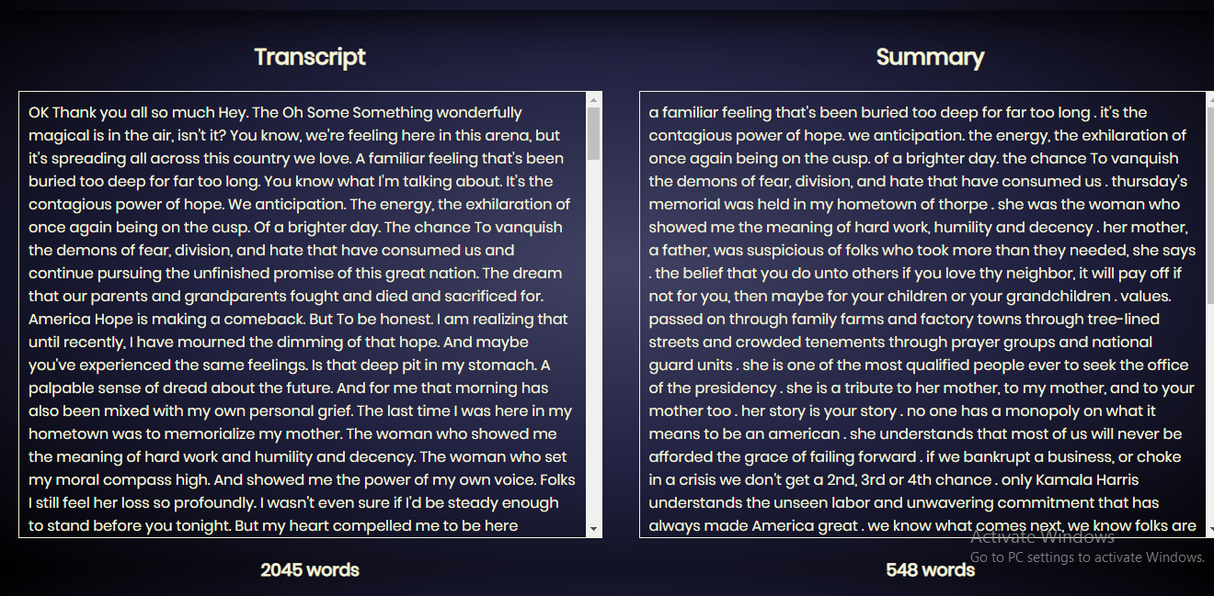
Vid Brief: A YouTube Transcript Summarizer using Hugging Face Transformers
Aditya Yadav (0827CD211005)
Akash Patel (0827CD211006)
Bhavya Jain (0827CD211018)
Neeraj Sahu (0827CD211040)
IT Department, Acropolis Institute of Technology & Research, Indore
Session: Jul. – Dec. 2024
Abstract
Methodology
Results
Vid Brief is an AI-powered tool designed to save users time by providing concise summaries of YouTube video transcripts. Using Hugging Face transformers and direct YouTube API integration, Vid- Brief quickly extracts key information from lengthy videos, making it easier for students, professionals, and content creators to grasp main ideas without watching the full content.
Technologies Used: The project uses a mix of front-end and back-end tools like HTML, CSS, Python, Flask, and Hugging Face transformers. These technologies support the development of an effective summarization tool that integrates with the YouTube API.
System Design: Utilizes YouTube API, NLP techniques, and a GUI allowing users to input URLs and choose summarization options.
User Interface (UI): A simple, intuitive interface allows users to enter a YouTube video URL and customize summarization options, such as summary length and preferred language.
Reliability: The summarizer consistently produces accurate summaries across different types of videos.
Availability: The tool is accessible online and available 24/7, providing users with instant access to video summaries whenever needed.
Security: Built-in data protection ensures users' information and privacy are secure while using the service.
Time Efficiency: Reduces video-watching time significantly by providing quick access to essential information.
Introduction
This project tackles the challenge of summarizing YouTube video transcripts, such as lectures, webinars, and speeches. Many people find it time-consuming to watch lengthy videos just to get a few key points. The YouTube Transcript Summarizer provides a solution by generating brief, accurate summaries, helping users quickly understand the main ideas of a video without watching it in full.
Project Flow
Conclusion
Youtube Video URL
Vid Brief enhances the accessibility, efficiency, and usability of video content, making it valuable for diverse user groups like students, professionals, content creators, and everyday viewers. By transforming lengthy videos into concise text summaries, it saves time and supports more effective learning and information retention.
Transcript API
Objectives
Transcript text
Enhance Accessibility: Provide easy access to video content in a text-based summary form for faster understanding.
Save Time: Allow users to gain insights from lengthy videos within seconds.
User-Friendly Interface: Develop an intuitive interface where users can easily input a video URL and receive the summary.
Summarization Pipeline
Acknowledgement
Summarized Text
We thank our Project Guide, Prof. Pawan Makhija, for his support and guidance. We are also grateful to our Project In-charge, Prof. Mayank Bhatt, Project Coordinator, Prof. Deepak Singh Chauhan, and Prof. (Dr.) Prashant Lakkadwala, HOD sir for their assistance throughout this project.
GUI

