Slide 1


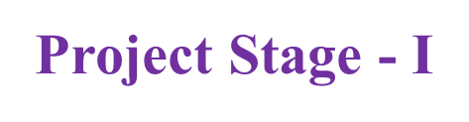
Project Title: AI- Lend Sense: Predictive and Explainable loan Decision System.
Presented By:​
Batch No: 2
1 . H. No: 227R1A05E4 Name: G. Bhavya Bhargavi
2 . H. No: 227R1A05D4 Name: B. Deepthi
3 . H. No: 227R1A05D2 Name: B. Balaji Nayak
​
.
Project Supervisor:​
Name:​ Dr. K. Srujan Raju
Designation: Professor

Slide 2
Index
Abstract
Introduction
Literature survey
Problem Definition
Proposed System
Objectives
Methodology
UML Diagrams
Analysis
Expected Outcomes

Slide 3
Abstract (Overview)
This project aims to automate loan approval decisions using AI and Machine Learning for faster, more consistent, and data-driven outcomes.
It addresses two major issues: bias in data leading to unfair results, and lack of transparency in AI decisions.
Models like Logistic Regression, Decision Tree, and Random Forest are trained on past loan data, with Explainable AI tools like LIME providing clear reasons for acceptance or rejection.
The system enhances fairness, transparency, and efficiency, helping both banks and applicants understand and trust the decision-making process.

Slide 4
Abstract (Contribution)
Developed an AI-based loan approval system that ensures fair and unbiased decisions by using high-quality, representative datasets.
Integrated Explainable AI (LIME) to clearly present reasons for loan approval or rejection, improving transparency and trust.
Provided applicants with actionable feedback on rejection reasons to help them improve future eligibility.
Enhanced decision-making speed and consistency compared to traditional manual loan assessment methods.

Slide 5
Introduction
Loan approval is a key process in banks, traditionally handled by officers who evaluate factors like income, job details, and credit score, but manual review can be slow and prone to bias.
Artificial Intelligence (AI) and Machine Learning (ML) can speed up decisions, improve accuracy, and reduce human errors by analyzing past loan data to identify approval patterns.
This project addresses two challenges — eliminating bias in decision-making and providing clear explanations for approvals or rejections to improve fairness and transparency.
Using tools like LIME, the system will offer applicants quick, understandable reasons for loan outcomes, helping them improve eligibility for future applications.

Slide 6
Literature Review
Kumar, A. & Sharma, S. (2022) – IEEE Access
Compared Logistic Regression, Random Forest, and XGBoost for predicting loan approvals.
Das, P. & Ghosh, S. (2023) – Springer, Financial Analytics Journal
Introduced a Hybrid Model (ANN + Decision Tree) for bank loan approvals.
Improved prediction precision by combining deep learning with rule-based logic.
Chaudhary, M. & Verma, R. (2023) – Elsevier Expert Systems with Applications
Used CatBoost and LightGBM on credit scoring datasets.
Reported 92% accuracy and faster training compared to traditional ML models
Bhat, K. & Reddy, A. (2024) – IEEE Transactions on Computational Intelligence
Proposed a Deep Neural Network (DNN) architecture with autoencoder preprocessing.
Achieved 94% accuracy and reduced overfitting via dropout layers.

Slide 7
Proposed System
This project is an AI-powered loan approval framework enhanced with fairness-aware preprocessing and explainable decision-making techniques.
Key Features:
Bias-Resistant Data Processing: Implements preprocessing methods to detect and reduce bias in applicant data, ensuring fair treatment across all demographic groups.
Multi-Model Prediction Pipeline: Uses Logistic Regression, Decision Tree, and Random Forest models to collaboratively predict loan approvals with higher accuracy.
Explainable AI Integration: Employs LIME to clearly present the factors influencing each approval or rejection decision.
Applicant Feedback System: Provides applicants with transparent and actionable reasons for rejection, enabling them to improve future applications.
Continuous Learning: Periodically retrains models with updated, unbiased data to maintain accuracy and fairness over time.

Slide 8
Problem Definition
Traditional loan approval processes in banks are time-consuming, involve manual evaluation, and can lead to inconsistencies or unfair decisions.
AI-based systems can speed up the process, but if trained on biased historical data, they may reproduce or amplify discrimination (e.g., against specific income groups or genders).
Many existing AI models lack transparency, making it unclear to applicants and banks why a loan was approved or rejected, which reduces trust in the system.
There is a need for a solution that ensures fairness, accuracy, and explainability while providing applicants with clear reasons for rejection or acceptance to help them improve future applications.

Slide 9
Objectives
Develop an AI-driven loan approval system capable of making faster, more consistent, and unbiased decisions.
Eliminate decision-making bias by using fair and representative data during model training.
Integrate Explainable AI tools (e.g., LIME) to provide clear and understandable reasons for loan acceptance or rejection.
Increase transparency and trust in the loan approval process for both customers and banks.
Help applicants understand the cause of rejection and guide them on improving future applications.
Ensure the system’s predictions are accurate, fair, and compliant with ethical AI practices.

Slide 10
Implementation
1.Data Collection
Collect loan-related data such as applicant income, credit score, employment type, loan amount, and repayment history.
Use this data to build and train the model.
2.Data Preprocessing
Clean the data (remove missing or incorrect values).
Convert text data (like employment type) into numerical form.
Split the data into training and testing sets.
3.Model Building
Use machine learning algorithms such as:
Decision Tree – learns decision rules.
Logistic Regression – learns a simple linear boundary.
Random Forest – combines multiple trees for better accuracy.
Train these models using training data.

Slide 11
Implementation(cont..)
4.Model Evaluation
Test each model with test data to measure performance (accuracy, precision, recall).
Choose the best-performing model for predictions.
5.Prediction Phase
When a new applicant applies for a loan, their data is entered into the system.
The trained model predicts whether the loan should be Approved or Rejected.
6.Explainability (Using LIME/SHAP)
Provide clear explanations for model decisions.
Example: “Loan approved due to high income and good credit score.”
This builds trust and transparency in the AI system.

Slide 12
Implementation(cont..)
7.Drift Detection and Monitoring
Continuously monitor data and model performance.
If prediction accuracy drops or new patterns appear, the model is retrained.
8.Admin Review
The admin reviews loan decisions, model performance, and system logs.
They can trigger model retraining when needed.
9.Final Decision Output
The system outputs the decision as Approved or Rejected, along with an explanation.
All results are stored in the database for future reference and reporting.

Slide 13
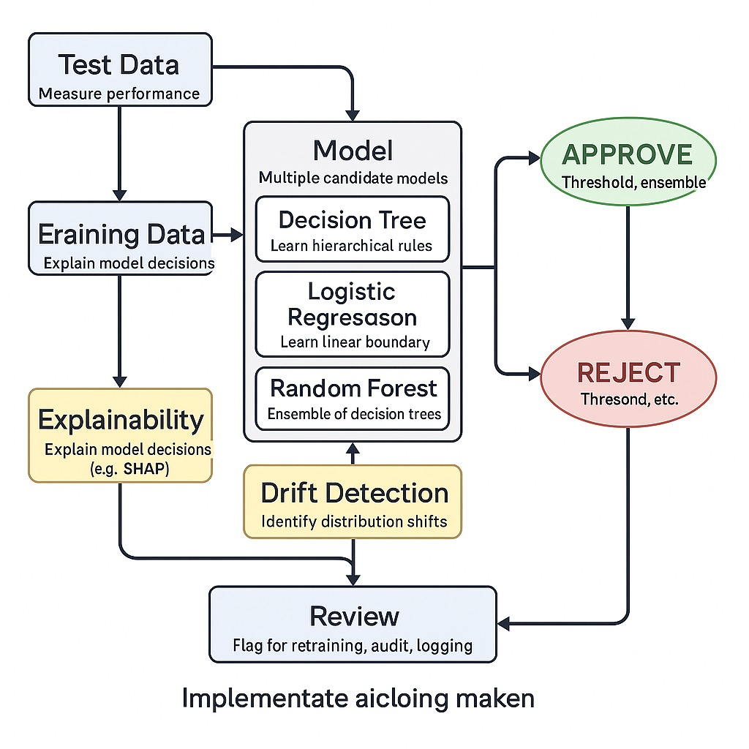
System Architecture
.
Work Flow of Loan Prediction

Slide 14
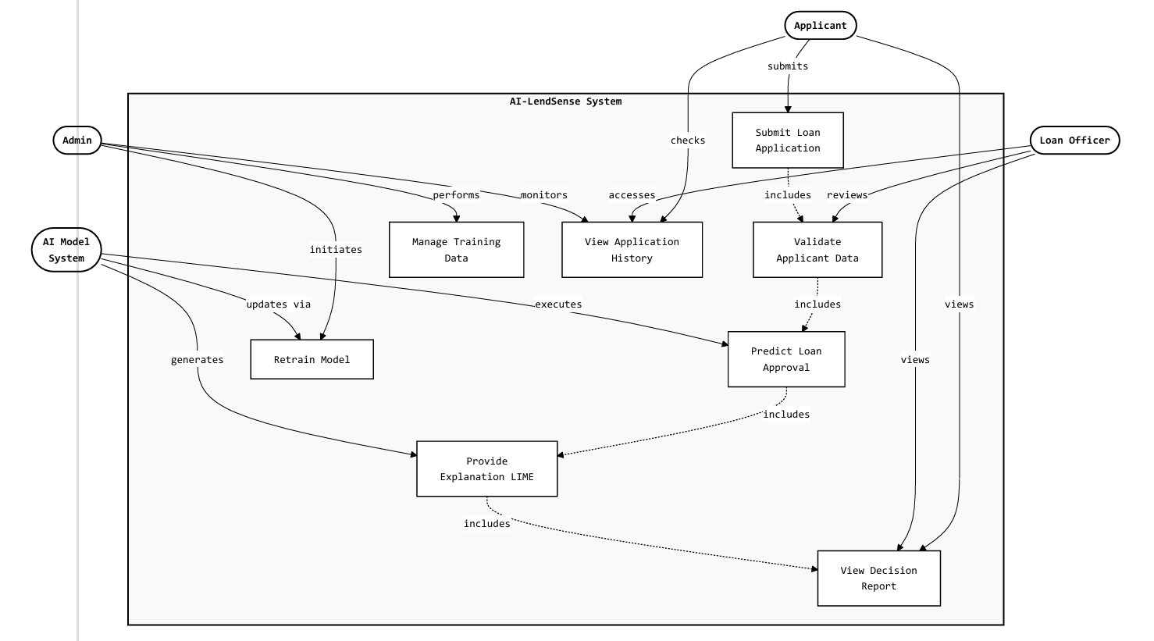
UML Diagrams
USECASE DIAGRAM

Slide 15
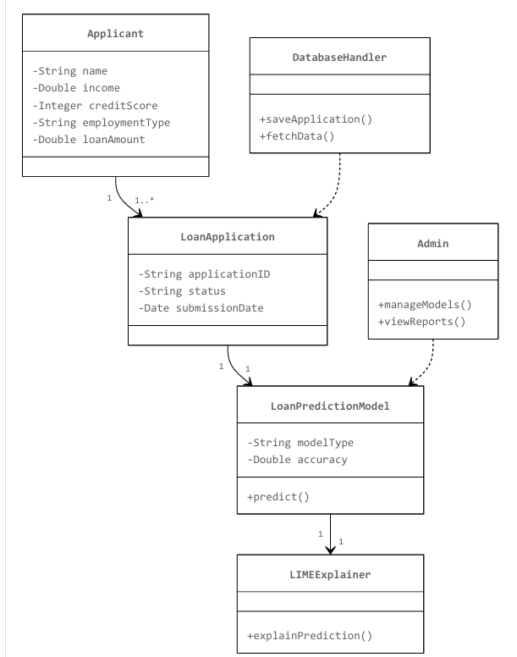
Class Diagram

Slide 16
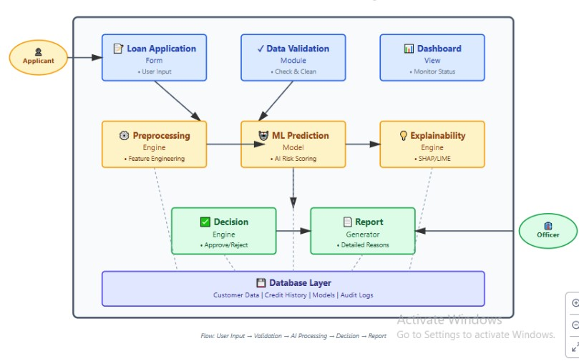
Component Diagram

Slide 17
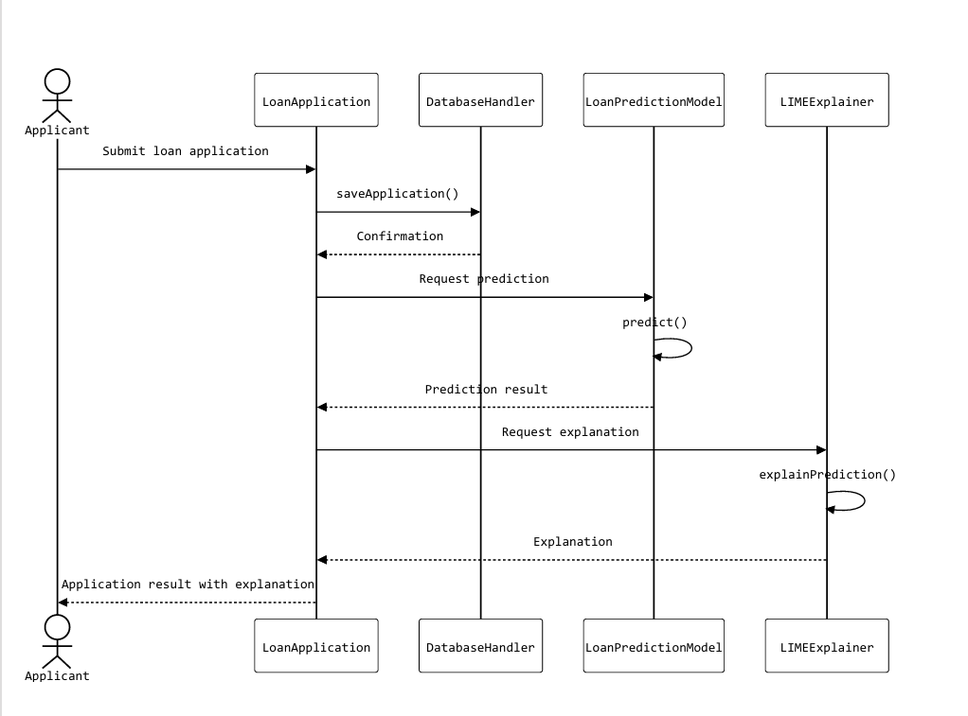
SEQUENCE DIAGRAM

Slide 18
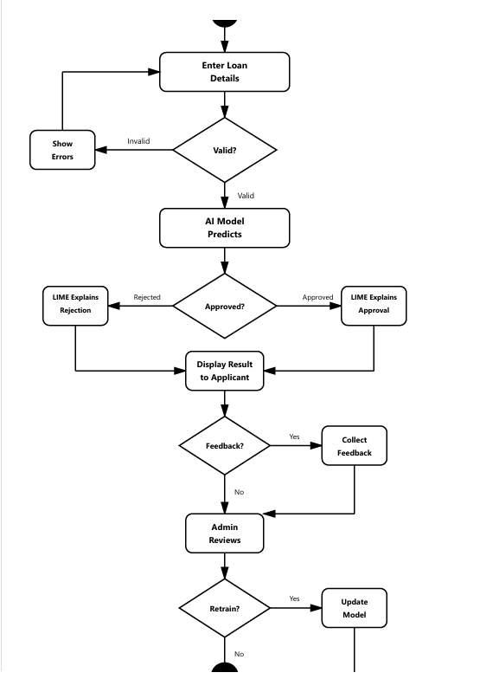
Activity Diagram

Slide 19
Analysis
Bias Impact: Biased training data (e.g., against certain income groups or genders) can lead the AI model to replicate existing discrimination, reducing fairness and trust in the system.
Explainability Gap: Many AI models act as “black boxes,” failing to clearly explain why a loan was approved or rejected, which limits user understanding and bank transparency.
Role of Explainable AI: Using tools like LIME allows the system to identify and present key factors influencing the decision, making the outcome easier to justify to applicants.
Fair Decision-Making: Combining clean, unbiased datasets with explainable outputs helps maintain both accuracy and equity in loan approvals.
Process Transparency: Providing rejection reasons empowers applicants to address shortcomings and reapply, improving customer experience and trust.

Slide 20
Expected Outcomes
Improved Loan Approval Accuracy: Achieve higher prediction accuracy in determining loan eligibility using AI models (Logistic Regression, Decision Tree, Random Forest).
Faster Decision-Making: Reduce loan processing time by automating approval predictions through machine learning algorithms.
Fair and Transparent Evaluation: Provide explainable results using LIME, ensuring applicants understand reasons for approval or rejection.
Bias Reduction in Decisions: Minimize unfair treatment by training models on balanced and representative datasets.
Enhanced Customer Experience: Deliver instant feedback on loan applications, improving satisfaction and trust.

