Slide 1
Forecast Honeybee health
COMP4610 Advanced Database Systems | Group 5
Bhavya Bhola (T00729544) | Kenji Lopez (T00712309)
Kshitij Santokhee (T00736607) | Nilam Rai (T00688491)
Jugias Girn (T00712501)
April 7, 2026

Slide 2
Agenda
Introduction & Research Objectives
Dataset Overview
Data Preprocessing
Data Modelling Setup
Methodology & Data Modelling
Experimental Results & Analysis
Challenges & Limitations
Conclusion & Future Work

Slide 3
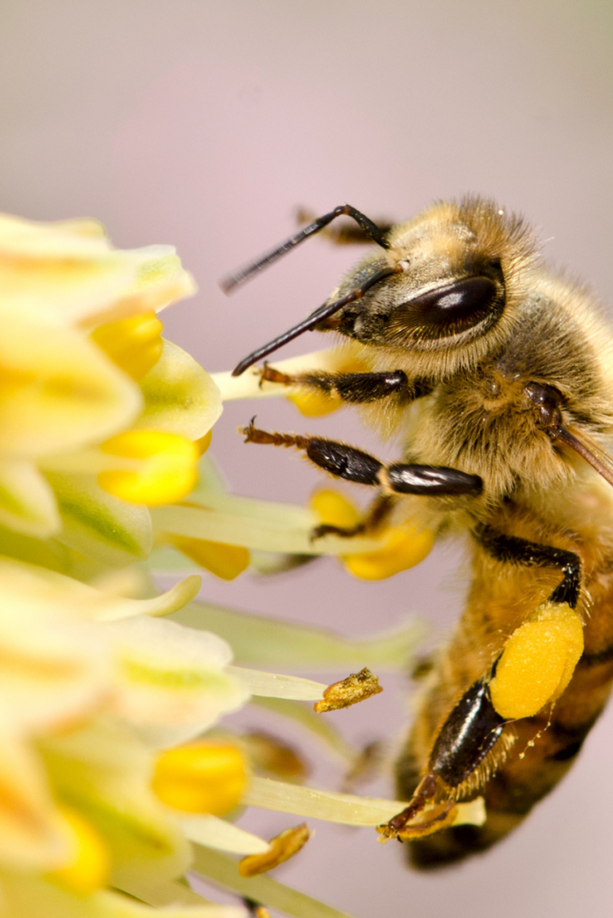
Introduction
The problem
Honeybee colony health is declining due to weather, pesticides, parasites, and disease. Early detection of unhealthy hives is critical for beekeepers managing large apiaries.
The approach & objectives
By doing data mining with the records from:
Hive inspections from 13 apiaries (NC & UT, 2016–2019)
Hourly weather data from 3 weather stations
Research Objectives:
Integrate 6 relational tables and perform end-to-end preprocessing
Train and compare 7 classification models to predict colony health
Support beekeepers in identifying at-risk hives earlier

Slide 4
Dataset overview
Table | Transactions | Description
HCC_Inspections | 2,404 records | Colony health checklist
Hive_Information | 188 records | Hive tags, linked to apiaries via ApiaryID
Apiary_Information | 13 records | Locations of apiaries in North Carolina and Utah
Hourly_Weather | 3,672 records | Temperature, humidity, wind, pressure, precipitation
Weather_Stations | 3 records | Details from weather stations in Clayton, Durham and Salt Lake City.
Weather_Observations | 1,776 records | Observation timestamps and hour values
**Class Imbalance: 63.7% Unhealthy | 36.3% Healthy — handled using SMOTE during modelling

Slide 5
Data preprocessing
1
Merged 6 tables using ApiaryID, HiveID, StationID, ObsID, and Date
Data Integration
2
Mode imputation for categorical, mean for numeric, capped outliers with IQR
Data Cleaning
3
Equal-width binning, mean smoothing, rolling average, regression smoothing
Noise Reduction
4
Feature Aggregation
Hourly weather → daily summaries (mean/min/max temp, humidity, wind, precipitation)
5
Feature Engineering
Hive Stress Index, Weather Stress Index, Colony Risk Score, Temp Range
6
Encoding & Scaling
Label Encoding for categorical, Min-Max Scaling for all numeric columns
7
Dimensionality Reduction
Correlation filter, Random Forest importance, SelectKBest, PCA (90% variance)

Slide 6
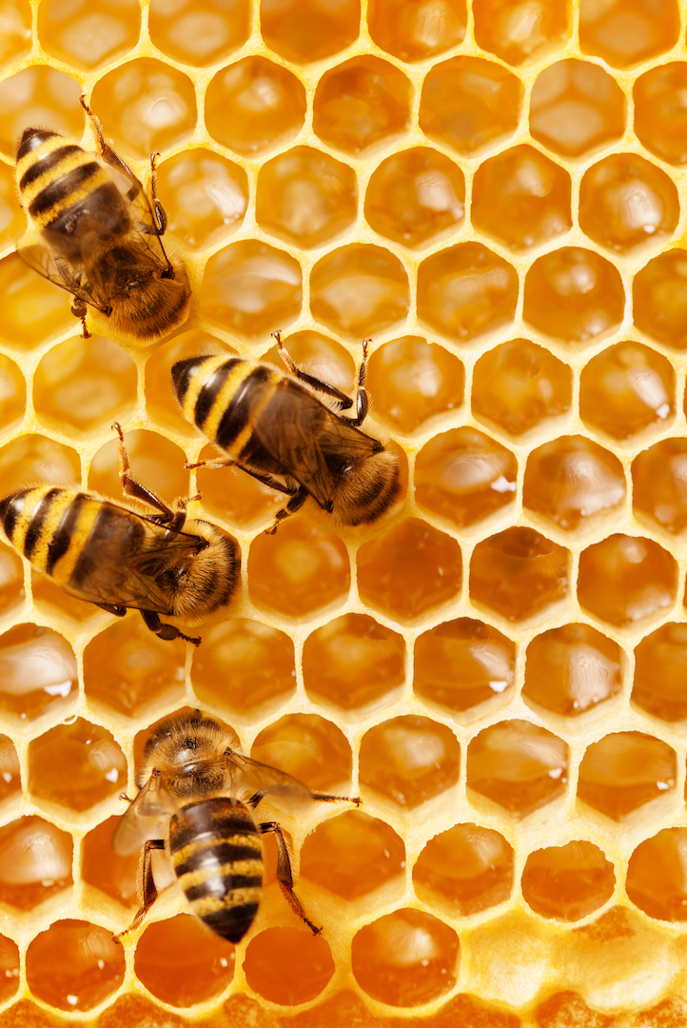
Data modelling setup
7 Models Trained
1. Logistic Regression
2. Decision Tree
3. Random Forest
4. Gradient Boosting
5. K-Nearest Neighbors
6. Naive Bayes
7. AdaBoost
Split & Balance
80/20 stratified train/test split
Train: 1,923 samples
Test: 481 samples
SMOTE on training set only:
2,450 samples, 50/50 balanced
Dataset
2,404 rows (inspection level)
26 features — no leakage
Percent_Met excluded (direct copy of the target label)
Target: Healthy = Yes (1) / No (0)
Evaluation Metrics
Accuracy | Precision | Recall | F1-Score | ROC-AUC (primary ranking metric)

Slide 7
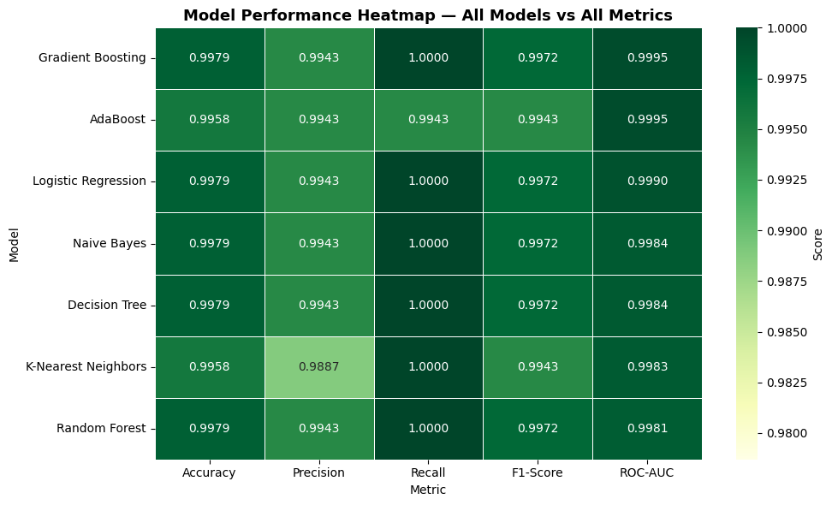
Model performance results
**All 7 models were evaluated on the same test set

Slide 8
Best model: Gradient boosting​
Highest AUC
0.9995
Best probability estimates for distinguishing healthy vs unhealthy colonies
Perfect Recall
ROC-AUC Score
Every healthy colony in the test set was correctly identified
100%
99.72%
Sequential Learning
Recall
F1-Score
Each tree corrects errors of the previous, producing refined predictions
99.79%
99.43%
Accuracy
Precision
Handles Interactions
Naturally captures complex relationships between inspection and weather features

Slide 9
Feature importance analysis

Slide 10
Model comparison – ROC AUC Overview

Slide 11
Deep Learning Results
Feedforward Neural Network (FNN) — AUC: 0.9975 | Accuracy: 99.79% | Recall: 100%
Architecture: Dense(64,ReLU) → BatchNorm → Dropout(0.3) → Dense(32,ReLU) → Dense(1,Sigmoid). 4,737 parameters. Matched classical model performance — converged by Epoch 4.
LSTM (Time-Series) — AUC: 0.9991 | Accuracy: 97.09% | Recall: 100%
Architecture: LSTM(64) → Dropout(0.2) → LSTM(32) → Dense(16,ReLU) → Dense(1,Sigmoid). 36,257 parameters. Processes last 3 consecutive inspections per hive as temporal sequences to capture colony trends over time.
Takeaway: FNN matched classical performance; LSTM’s lower accuracy is due to reduced test set size (413 vs 481 samples). Both confirm the dataset is well-suited to deep learning approaches.

Slide 12
Key finding
The dataset required integration of six relational tables before any kind of analysis could be performed.
Hive inspection attributes especially Queen condition, Brood health, and Stressors have emerged as the most important predictors of the colony health.
Weather features like Temperature and Humidity have also contributed but with a lower level of importance as compared to inspection attributes.
The feature engineered Hive Stress Index and Colony Risk Score provided us with additional predictive signals and symptoms.
All of the seven models have achieved a strong performance metric on this dataset along with the best model determined by ROC-AUC score.

Slide 13
Challenges & Limitations
Row explosion from hourly join — merging inspections with hourly weather expanded 2,404 rows to 35,656. Resolved by daily weather aggregation.
Class imbalance (63.7% unhealthy) — models biased toward majority class without correction. Addressed using SMOTE on training set only.
High dimensionality — 66 features after engineering required correlation filtering, Random Forest importance, SelectKBest, and PCA (retaining 90% variance = 16 components).
Limited dataset size — only 2,404 inspection records constrained LSTM sequence depth and deep learning capacity. Broader real-world deployment would benefit from larger longitudinal datasets.
Geographic limitation — data covers only two US states (NC and UT). Results may not generalize to different climates or beekeeping practices in other regions.

Slide 14
Conclusion & Future Work
Summary: Gradient Boosting achieved the best performance (AUC 0.9995, 99.79% accuracy, 100% recall) identifying every healthy colony in the test set without a single miss.
Key insight: Hive inspection attributes (Hive Stress Index 67.96%, Stressors 30.34%) dominate prediction. Weather features contribute less on their own but matter through engineered indices.
Future: Broader hyperparameter tuning (Bayesian optimization), longer LSTM sequence windows (5–10 inspections), and attention mechanisms to pinpoint critical inspection timesteps.
Deployment vision: Package Gradient Boosting into a beekeeper app where inspection inputs generate real-time health predictions with confidence scores for each hive.
Impact: Predictive tools can flag at-risk hives earlier, reducing preventable colony losses, lowering operational costs, and improving pollination capacity for agricultural operations of all sizes.

Slide 15
References
[1] Redd, B. (2020). Predicting Honeybee Health from Hive and Weather Data. Kaggle.
[2] Han, J., Kamber, M., & Pei, J. (2011). Data Mining: Concepts and Techniques (3rd ed.). Morgan Kaufmann.
[3] Pedregosa, F., et al. (2011). Scikit-learn: Machine Learning in Python. JMLR, 12, 2825–2830.
[4] Chawla, N. V., et al. (2002). SMOTE: Synthetic Minority Over-sampling Technique. JAIR, 16, 321–357.
[5] Friedman, J. H. (2001). Greedy function approximation: A gradient boosting machine. Annals of Statistics, 29(5), 1189–1232.
[6] Breiman, L. (2001). Random Forests. Machine Learning, 45(1), 5–32.
[7] Hochreiter, S., & Schmidhuber, J. (1997). Long Short-Term Memory. Neural Computation, 9(8), 1735–1780.
[8] Genersch, E. (2010). Honey bee pathology: current threats. Applied Microbiology and Biotechnology, 87(1), 87–97.
[9] Fayyad, U., Piatetsky-Shapiro, G., & Smyth, P. (1996). From Data Mining to Knowledge Discovery. AI Magazine, 17(3), 37–54.
[10] USDA. (2023). Honey Bee Colonies Report. National Agricultural Statistics Service.

Slide 16
THANK YOU
Any questions?

