Slide 1
Team REVOLVERS TEAM:GAT38
Bhavya Bhosale*: Lead Developer - Implemented AI models for crop recommendation and disease recognition, integrated Google Generative AI.
Anuj Jadhav: UI/UX Designer - Designed the Streamlit interface and optimized the user experience.
M Karthik: Data Scientist - Handled data processing and model training for plant disease prediction.
Darshan Babji: Backend Engineer - Developed the API integration for Google Generative AI and managed model deployment.

Slide 2
Problem Statement
Agriculture is heavily impacted by plant diseases and the lack of data-driven crop selection. Farmers often struggle to identify plant diseases early or to determine the best crop for their farm based on soil and climate conditions.

Slide 3
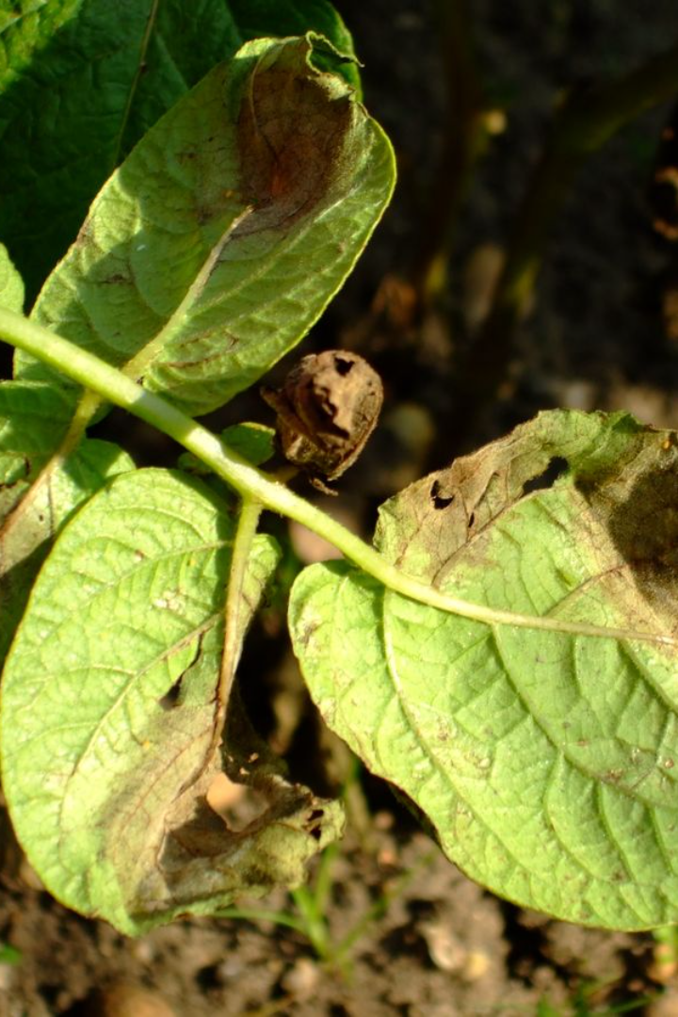
Idea Name: AgriAI
Empowering farmers with AI-driven crop recommendations and plant disease identification to improve yield and sustainability.

Slide 4
Solution
Crop Recommendation: Based on soil nutrients, pH, temperature, and rainfall, AgriAI recommends the most suitable crops for a farm.
Plant Disease Recognition: Farmers can upload images of plant leaves, and the AI identifies diseases, providing actionable information.

Slide 5
Wow factors
AI-Powered Diagnosis: Advanced AI models that analyze plant images and environmental data to provide real-time insights.-
Google Generative AI: For in-depth information about plant diseases, helping farmers with treatment recommendations.
User-Friendly Interface: Streamlined design for non-tech-savvy users, making complex AI accessible.

Slide 6
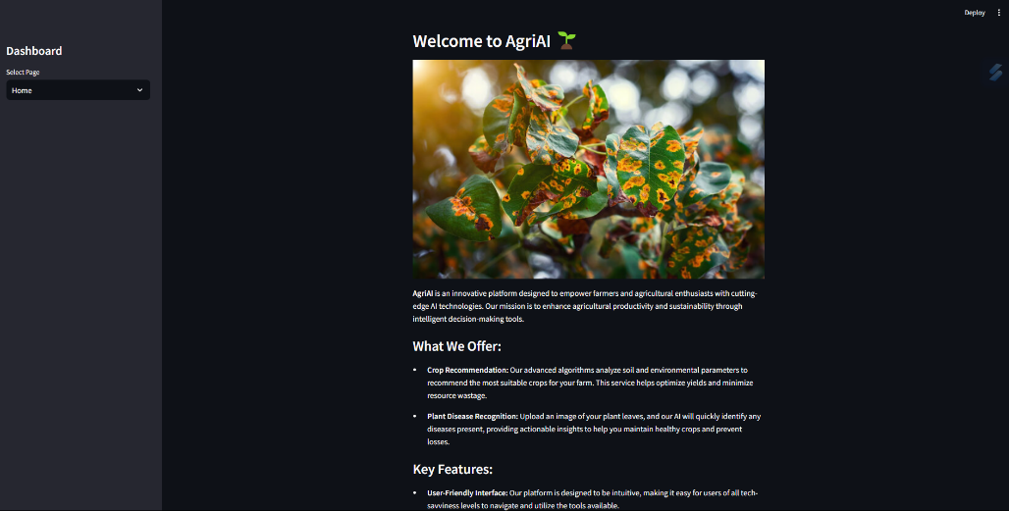
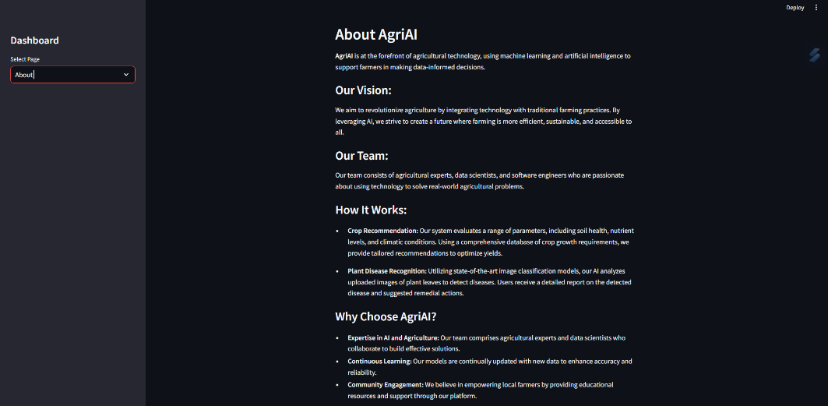
DEMO
HOME
ABOUT

Slide 7
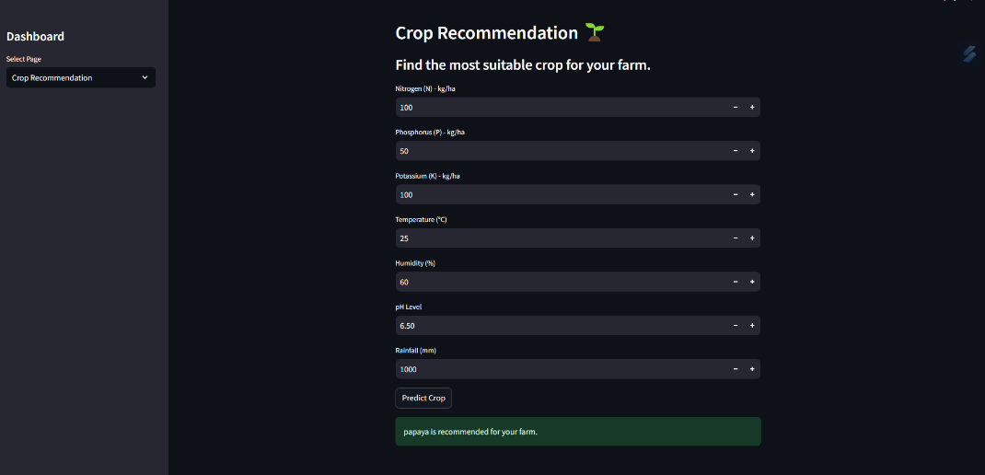
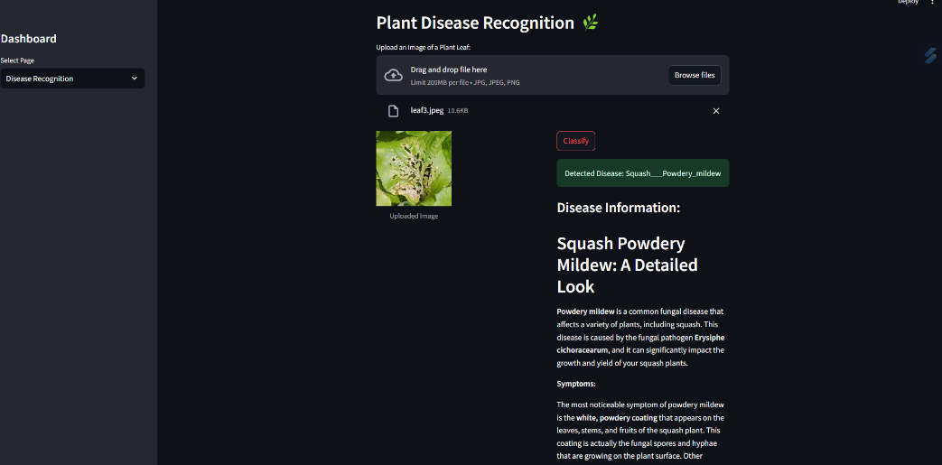
DEMO
CROP PREDICTION
DISEASE PREDICTION

Slide 8
Learnings during the Datathon
Learned how to streamline AI workflows for better performance under real-time constraints.
Mastered integrating AI with external services (like Google Generative AI) to provide enhanced value to users.
Explored designing user-centric AI interfaces using Streamlit for ease of use.

