Slide 1
The Controllers and how to use them

Slide 2
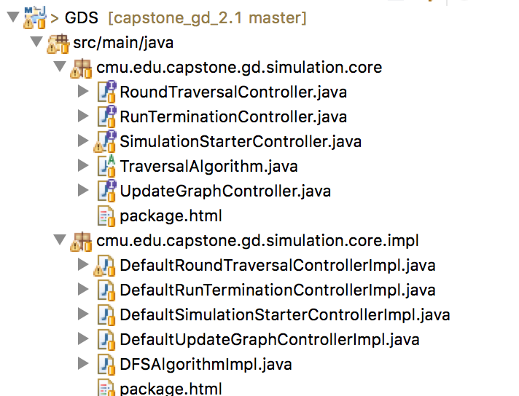
The controllers follow the interfaces defined in the “core” package.
In the “core.impl” package, we provide the default implementation
Interfaces
RoundTraversalController and SimulationStarterController, and TraversalAlgorithm are mandatory and have to be implemented. Therefore, is no such implementation is provided by the user, simulation calls the default implementation. (If the user bypasses default implementation without providing their own, error returns)
The others are optional, if no implementation is provided by the user, default holds.
Default Implementation
Here we provide the default implementation of everything in above interfaces.
User can make their own implementation using the methods we provide in utilities or write their own.
These implementations are initialized in CommandLineExcecutor(found in execution folder)

Slide 3
Command to initialize the controllers
Below is how we call the controllers using our default implementation in CommandLineExecuter:
/**
* [[[[[Mandatory]]]]] RoundTraversalController.
*/
static RoundTraversalController roundTraversalController = new DefaultRoundTraversalControllerImpl();
/**
* [[[[[Mandatory]]]]] SimulationStarterController.
*/
static SimulationStarterController simulationStarterController = new DefaultSimulationStarterControllerImpl();
/**
* Optional UpdateGraphController.
*/
static UpdateGraphController updateGraphController = new DefaultUpdateGraphControllerImpl();
/**
* Optional RunTerminationController.
*/
static RunTerminationController runTerminationController = new DefaultRunTerminationControllerImpl();
When the user write their own implementations, they will follow this convention. These controller objects will be passed to traversalAlgorithm.setControllers() method when the simulation is run.

Slide 4
Main method
Below is the main method in CommandLineExecuter, it shows how the controllers are passed after they have been initialized.
public static void main(String[] args) throws SimulationExecutionException {
configFilePath = getConfigurationFilePath(args);
inputFilePath = getInputFilePath(args);
simulationRunCount = getTotalSimulationRunCount();
traversalAlgorithm = getTraversalAlgorithm(); //The user can choose “DFSA” or “BFSA” or write their own implementation and pass that
traversalAlgorithm.setControllers(simulationStarterController, roundTraversalController,
runTerminationController, updateGraphController); //This is where the controllers get called
inputGraph = fetchInputGraph();
NormalizationUtility.normalizeAttributeValues(inputGraph, null, new String[] { "weight" });
SimulationRunner.runSimulationUsingConfigFile(inputGraph, traversalAlgorithm, simulationRunCount,
updateGraphController);
generateOutputGraphMLFile();
}

Slide 5
User Work Flow
Set their own implementation(Or decide to use thedefault) of the controller interfaces
Initialize these controllers (if there are any)
Pass these controllers to traversalAlgorithm.setControllers() method. If a controller is null, pass null. e.g.
traversalAlgorithm.setControllers(simulationStarterController, roundTraversalController, null, null);

