Slide 1

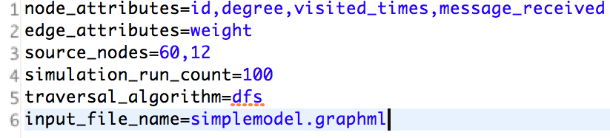
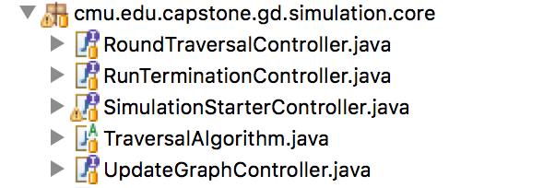
User Input
GraphML
Random
Data Generator
Configuration Properties
GraphML
Parser
e.g. Number of runs
Simulation Parameters
Initial Model
Output Model & Characterization
Simulation Input
Drivers of Simulation
The way messages traverse between nodes
GraphML
Parser
e.g. Initial Message, Starting Nodes
Simulation Controllers
Output in
GraphML

