Slide 1

Meeting Scribe & Prep Coach
Turning chaos into productivity with intelligent meeting workflows.
AI-powered productivity assistant for smarter meetings and automated task management
MSRIT · Hawkers · Batthula Bhavyasree Chillara Bhavya · Jalimanchi Sree Kruthi · Manasa Rajendran ·

Slide 2

The Real Problem We're Solving
Meetings generate rich discussion — yet decisions and action items vanish. Teams lose hours to manual note-taking, task assignment, and follow-up tracking.
Missed Deadlines
Poor Accountability
Commitments fall through the cracks without structured tracking.
Unclear ownership leads to duplicated effort and stalled progress.
Productivity Loss
Manual summaries drain time that should go to execution.
Most tools record conversations but fail to convert them into structured workflows — leaving Product Teams, Startups, and Project Managers underserved.

Slide 3
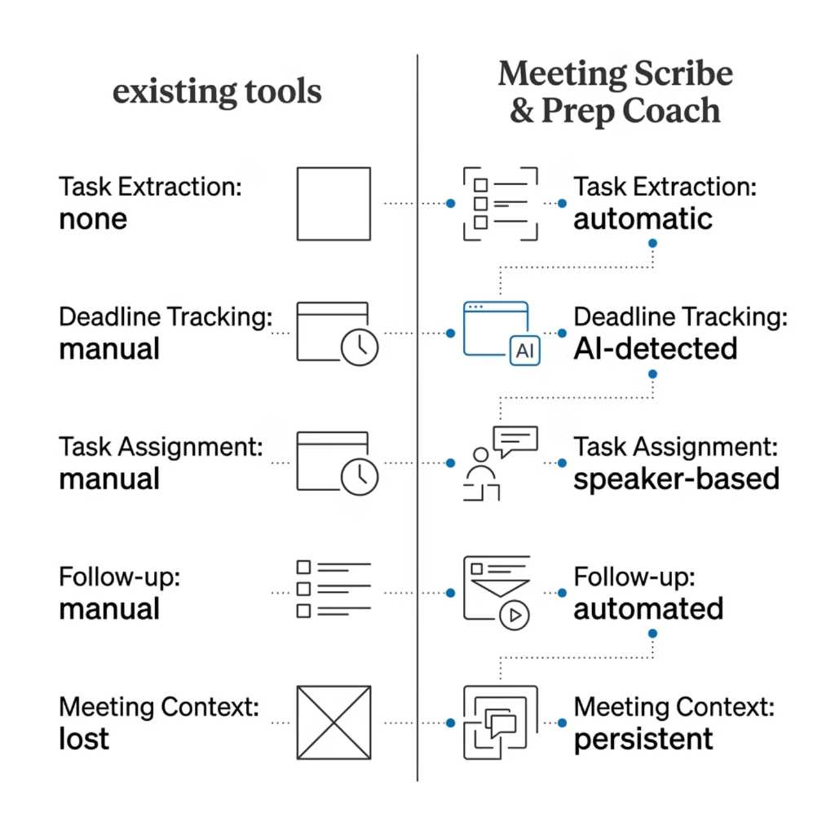


What Exists Today — And Why It Still Fails
The Gap in Current Tools
Today's solutions stop at transcription. They capture words but miss the actionable intent behind them.
No intelligent task extraction from conversations
No automatic deadline identification
No speaker-level responsibility assignment
Manual follow-up still required
Previous meeting context gets lost
Conversations contain actionable insights — current systems simply can't convert them automatically.

Slide 4


Introducing Our Solution
Meeting Scribe & Prep Coach transforms raw meeting transcripts into structured, actionable productivity systems — automatically.
Smart Summaries
AI-generated meeting summaries that capture key decisions and context.
Actionable Task Lists
Automatic extraction of action items assigned to the right speakers.
Deadline-Aware Workflows
Identifies and tracks deadlines mentioned in conversation.
Notion Integration
Tasks sync directly to Notion for persistent, cumulative tracking.

Slide 5
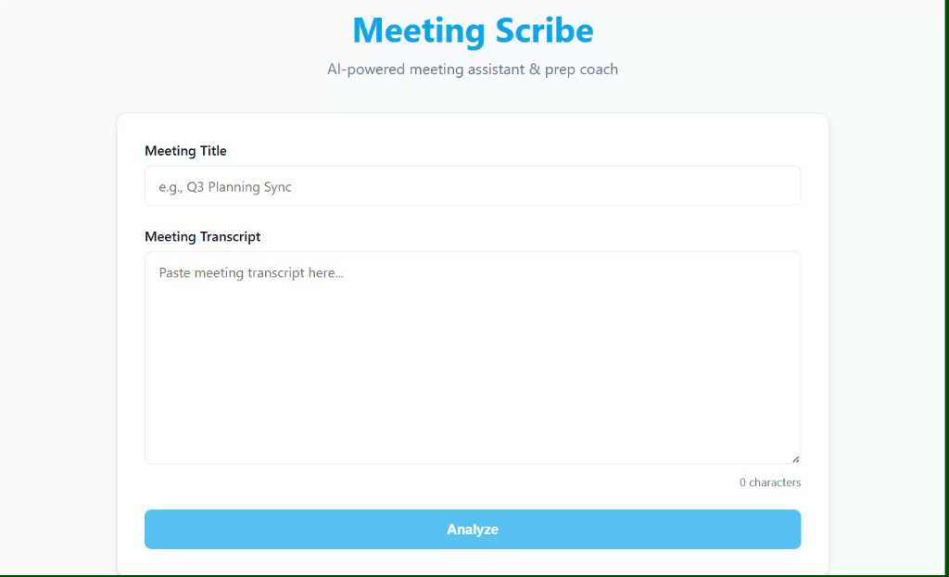

Product Demo & User Journey
Upload Transcript
NLP Extraction
Submit raw meeting audio or text
Summaries, tasks and deadlines
FastAPI Processing
Notion Sync
Handle file intake and routing
Push structured tasks to Notion
From raw transcript to structured workflow in seconds — no manual effort required.
Demo Highlights
What You'll See
Multi-speaker task extraction with speaker detection
Automatic deadline parsing from natural language
Persistent task management across meetings
Cumulative productivity dashboard
Live transcript processing output
Extracted action items with owner assignment
Notion database populated in real time
Frontend dashboard with cumulative tasks

Slide 6
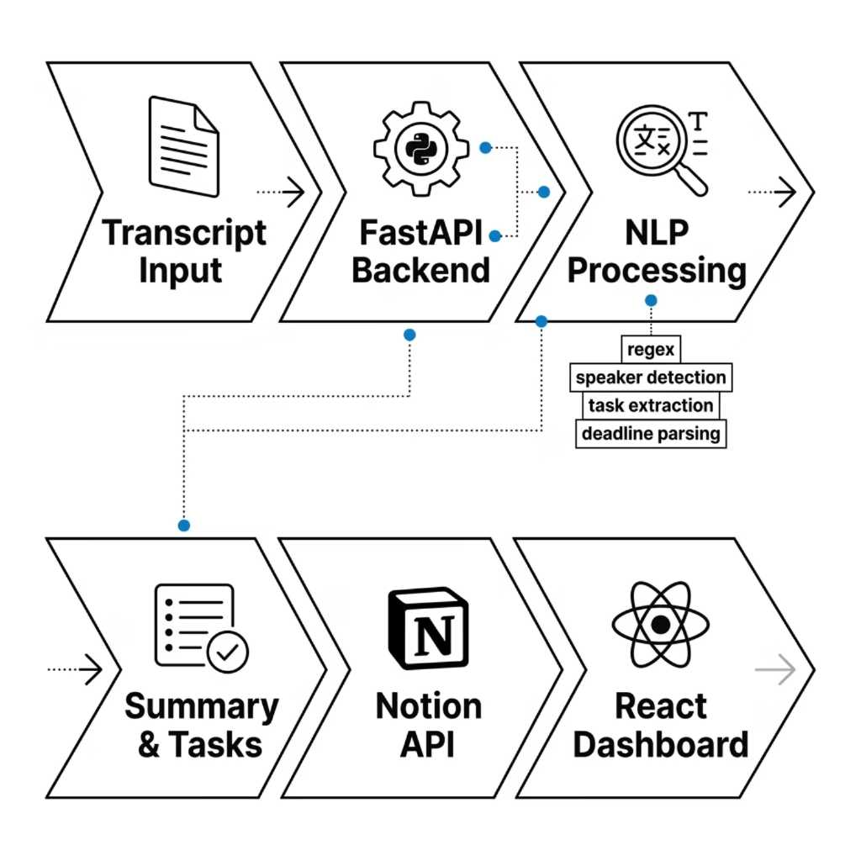

Technology Behind the Product
Tech Stack
Frontend
Backend
React + Vite · Responsive dashboard UI
FastAPI · Python · RESTful architecture
NLP Processing
Integrations
Regex-based extraction · Speaker detection · Deadline parsing
Notion API · Persistent task storage
Architecture is modular and AI-ready — designed for future LLM integration.

Slide 7

Real-World Impact & Applications
Corporate Meetings
Eliminate manual minutes and ensure every decision is tracked.
Agile Sprint Planning
Convert standup discussions directly into sprint tasks.
Startup Standups
Keep fast-moving teams aligned without administrative overhead.
Academic Teams
Coordinate student project teams with structured accountability.
Future Expansion: Whisper speech-to-text · Jira integration · RAG memory system · Calendar sync · AI meeting prep assistant

Slide 8
Why Our Solution Stands Out
Key Differentiators
Competitive Advantage
Speaker-wise task extraction — assigns ownership automatically
Most tools stop at transcription. We convert conversations into structured productivity systems.
Deadline-aware tracking — catches commitments in natural language
Long-Term Vision
An enterprise-grade AI productivity ecosystem for intelligent meetings — where every conversation drives execution.
Persistent Notion workflows — tasks accumulate across meetings
Modular AI-ready architecture — built to scale with LLMs

Slide 9

Explore the Product
Everything you need to evaluate, run, and extend Meeting Scribe & Prep Coach is available below.
GitHub Repository
Full source code, setup instructions, and contribution guidelines.
Demo Video
End-to-end walkthrough of the product in action.
Resources Included
Source Code · PPT · README · AI Disclosure · Screenshots · Working Prototype

Slide 10


Beyond the Hackathon
1
Phase 1 — Live Transcription
Whisper integration for real-time speech-to-text during meetings.
2
Phase 2 — Advanced LLM
Upgraded summarization and intelligent RAG-based memory system.
3
Phase 3 — Integrations
Automatic Jira ticket creation and calendar synchronization.
4
Phase 4 — AI Prep Coach
Proactive meeting preparation assistant powered by conversation history.
Vision: Create AI systems that transform conversations into intelligent, actionable workflows for teams everywhere.

