Slide 1
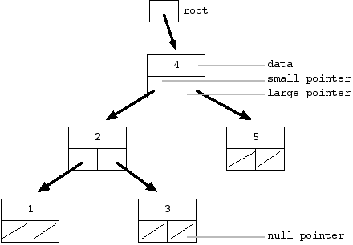
Convert a Binary search tree into a Circular Doubly Linked List
Given are some values. Construct a binary search tree first and the convert that binary search tree into a circular double linked List
Eg: Given values 1,2,3,4,5
Construct a binary search tree first

Slide 2
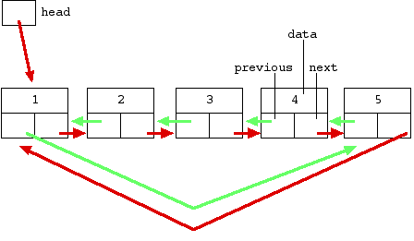
2. Convert it into a circular Double linked list

Slide 3
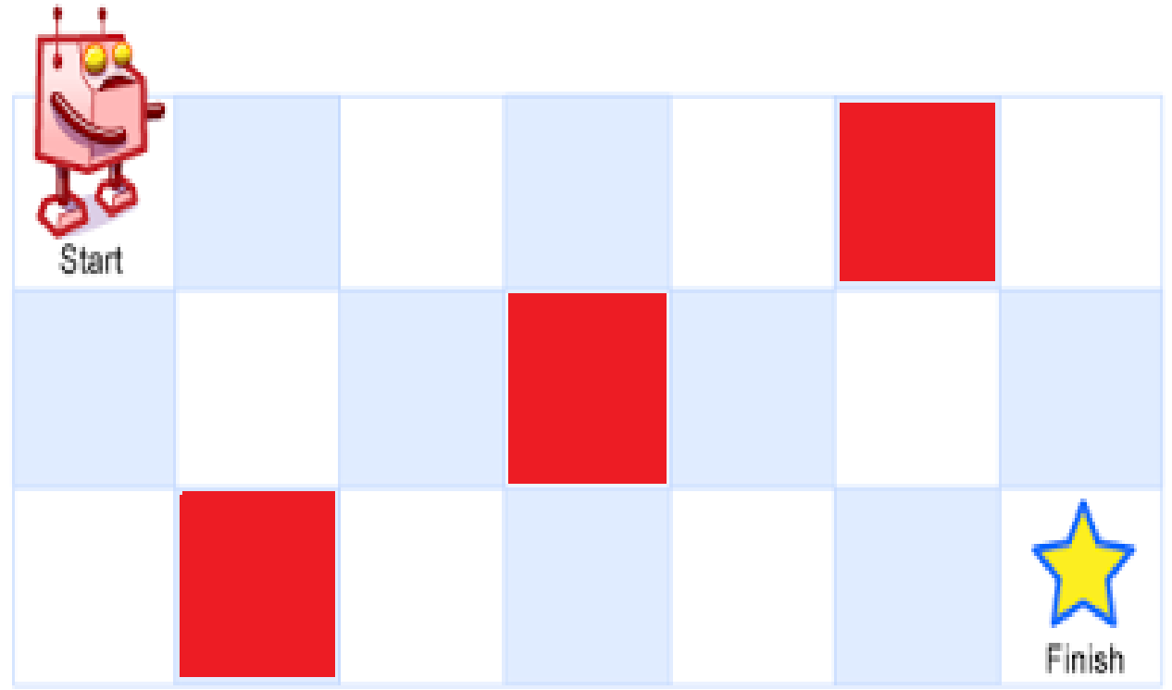
Unique Path (with Off-limits)
A robot is located at the top-left corner of a mxn grid. The robot can only move either down or right at any point in time. The robot is trying to reach the bottom-right corner of the grid. How many possible unique paths are there when there are few grids that are off-limits and robot cannot step in them?

Slide 4
Creating Off – limits
Off – limits are generated randomly and stored as a point in hash map with value False
If first cell, last cell or a cell that’s already marked as a off limit is being generated as off limit again then a new off limit is generated

