Slide 1

Fluent: An AI Augmented Writing Tool for People who Stutter
Notes:
Hello everyone
I am Bhavya Ghai from Stony Brook University
N today I will presenting our joint work with IBM Research i.e. “Active Learning++: Incorporating A ……………………..”
This is a joint work with Vera and Yunfeng from IBM and my adviser Klaus Mueller
Let’s start off with an overview of Active learning

Slide 2
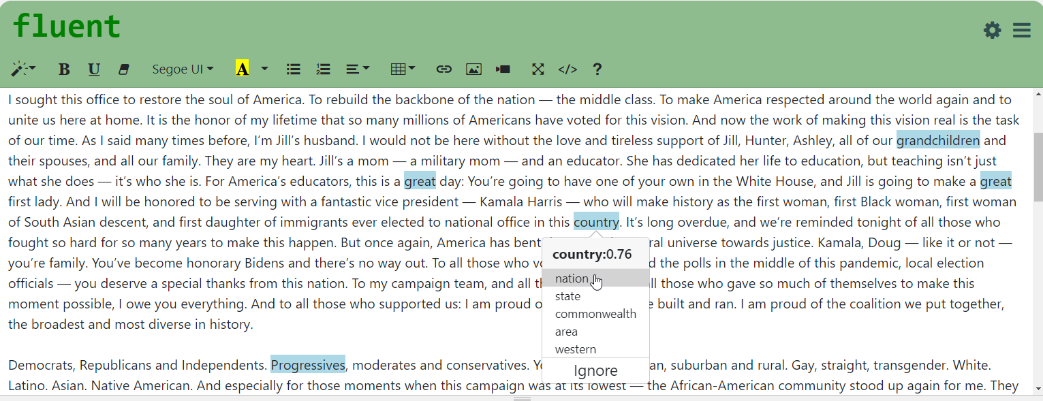
Teaser
Refine Model
Preferences
Notes:
Existing literature to counter algorithmic bias can be classified into 3 different stages :- data, model and prediction

Slide 3
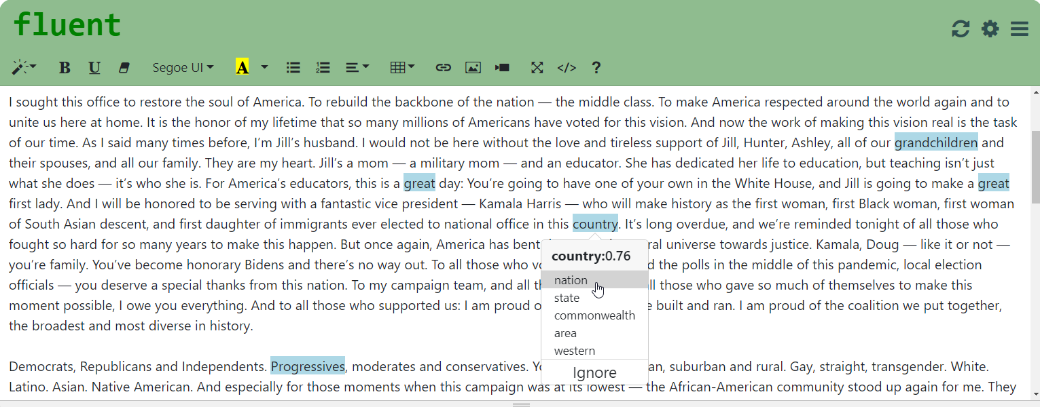
Teaser
Update Highlighting
Refine Model
Preferences
Notes:
Existing literature to counter algorithmic bias can be classified into 3 different stages :- data, model and prediction

Slide 4
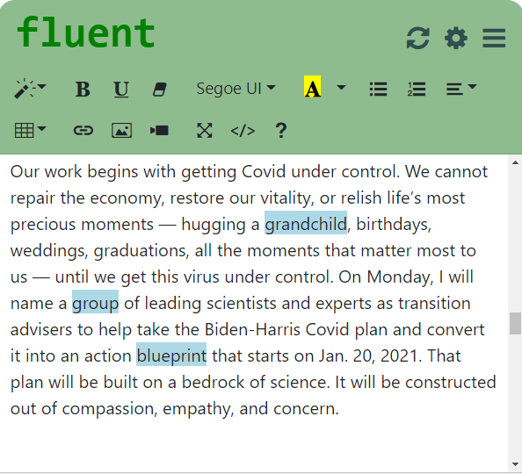

Workflow
Alternatives
Difficult
Words
Seed
Words
Difficult Words +
Alternatives
Active learner
(Classifier)
Explicit + Implicit Feedback
Raw
Text
Tokenizer
Words
Named Entity Recognition
Words
+ Tags

Slide 5
Workflow
Alternatives
Difficult
Words
Seed
Words
Difficult Words +
Alternatives
Active learner
(Classifier)
Explicit + Implicit Feedback
Raw
Text
Tokenizer
Words
Named Entity Recognition
Words
+ Tags

Slide 6
Notes:
Existing literature to counter algorithmic bias can be classified into 3 different stages :- data, model and prediction

Slide 7
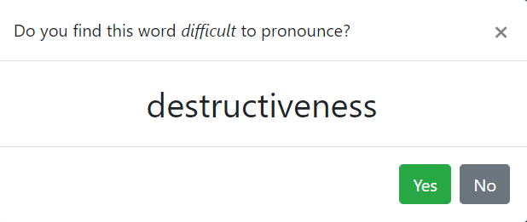
Refining Model
Notes:
Existing literature to counter algorithmic bias can be classified into 3 different stages :- data, model and prediction

Slide 8
