Slide 1


Fluent: An AI Augmented Writing Tool for People who Stutter
Bhavya Ghai, Klaus Mueller
Department of Computer Science
Stony Brook University
Notes:
Hello everyone
I am Bhavya Ghai from Stony Brook University
N today I will presenting our joint work with IBM Research i.e. “Active Learning++: Incorporating A ……………………..”
This is a joint work with Vera and Yunfeng from IBM and my adviser Klaus Mueller
Let’s start off with an overview of Active learning

Slide 2
Stuttering
Stuttering is a speech disorder which impacts more than 70M people worldwide.
Common signs of Stuttering include disfluencies like repetition of a sound, prolonging a sound, pause or blocks, etc.
On the personal front, Stuttering can lead to anxiety, frustration, embarrassment, public stigma and self stigma.
On the professional front, People who Stutter (PWS) might be perceived as less capable and less employable than their peers who do not stutter.
Speech therapy can be helpful in managing or living with Stuttering. However, access to therapy can be limited & might be associated with blaming and shaming
Unfortunately, there is no cure for Stuttering
https://www.asha.org/public/speech/disorders/stuttering/
Notes:
Multiple research studies have documented the profound negative impact of Stuttering on the personal and professional life of people who stutter (PWS).

Slide 3
Avoidance Behaviors
As a person gets older, they become more conscious of their condition and learn to anticipate stuttering moments better (also known as anticipation effect)
When an individual anticipates a stuttering moment, they use different strategies to conceal their condition which are known as Avoidance behaviors.
This may include using fillers (e.g., ‘um’, ‘like’), substituting the feared word with its synonym, talk around the feared word (circumlocution), etc.
Research has shown that all people who stutter use such strategies to some degree. A recent study found that the objective of 69.5% of PWS was to hide their stuttering.
Anticipating stuttering and managing it can cause additional stress and burden.
In this work, we have focused on Word Substitution
Notes:
Existing literature to counter algorithmic bias can be classified into 3 different stages :- data, model and prediction

Slide 4
Our Contributions
We devise a novel method to identify words an individual might struggle pronouncing.
We design and implement a new writing tool ‘Fluent’ which embodies our approach to identify difficult to pronounce words and suggests suitable personalized alternatives.
We evaluate our system by measuring its ability to identify trigger words for 10 simulated users.
Notes:
Existing literature to counter algorithmic bias can be classified into 3 different stages :- data, model and prediction

Slide 5
Identify Difficult to Pronounce Words
Research has shown that people are likely to stutter on some words more than others based on their underlying phonological patterns.
To capture the phonological aspects of different words, we have used Phonetic Embeddings which are based on CMU Pronouncing Dictionary.
Phonetic embeddings provide high dimensional vector representation for a word such that words with similar pronunciation lie close to each other in high-D space.
In the beginning, we ask the user to provide two set of words that they find easy and difficult to pronounce, respectively.
Each word is mapped to its corresponding Phonetic Embedding. Thereafter, we train a binary classifier to differentiate between easy and difficult words.
Notes:
Existing literature to counter algorithmic bias can be classified into 3 different stages :- data, model and prediction

Slide 6
Personalized Support
Each person who stutters might struggle on different set of words, so we need to train a different classification model for each user.
Typical Supervised Machine Learning (ML) models require large amounts of labeled training data to provide good results.
Asking each user to provide 100’s or 1000’s of labeled data points upfront can be too cognitively taxing.
To circumvent this issue, we have used Active learning (AL); AL focuses on training effective ML models using a minimum number of labeled training instances.
At the outset, AL requires few labeled data points. Thereafter, the model keeps evolving iteratively by leveraging user feedback over time.
Notes:
Existing literature to counter algorithmic bias can be classified into 3 different stages :- data, model and prediction

Slide 7
DEMO
Notes:
Existing literature to counter algorithmic bias can be classified into 3 different stages :- data, model and prediction

Slide 8
Evaluation Setup
We modeled 10 different users based on self reported data from stuttering communities on facebook and reddit.
Each simulated user is characterized by a phonological pattern that they struggle pronouncing e.g., words beginning with ‘st’ or ‘fl’.
We used 2467 TED talks transcripts to test our tool for 10 simulated users.
We simulated two scenarios i.e., when a user provides solely Implicit & solely Explicit feedback.
For each feedback scenario, we compute and record metrics like Accuracy, F1 score and Precision after every interaction.
Our objective is to evaluate how well our approach can learn user’s needs
Dataset link: https://www.kaggle.com/rounakbanik/ted-talks?select=transcripts.csv
Notes:
So, each user struggles on a different set of words.
We used 2467 TED talks transcripts which contains ~57k unique words to evaluate our tool. We split ~57k words into train and test dataset in the ration of 75:25.

Slide 9
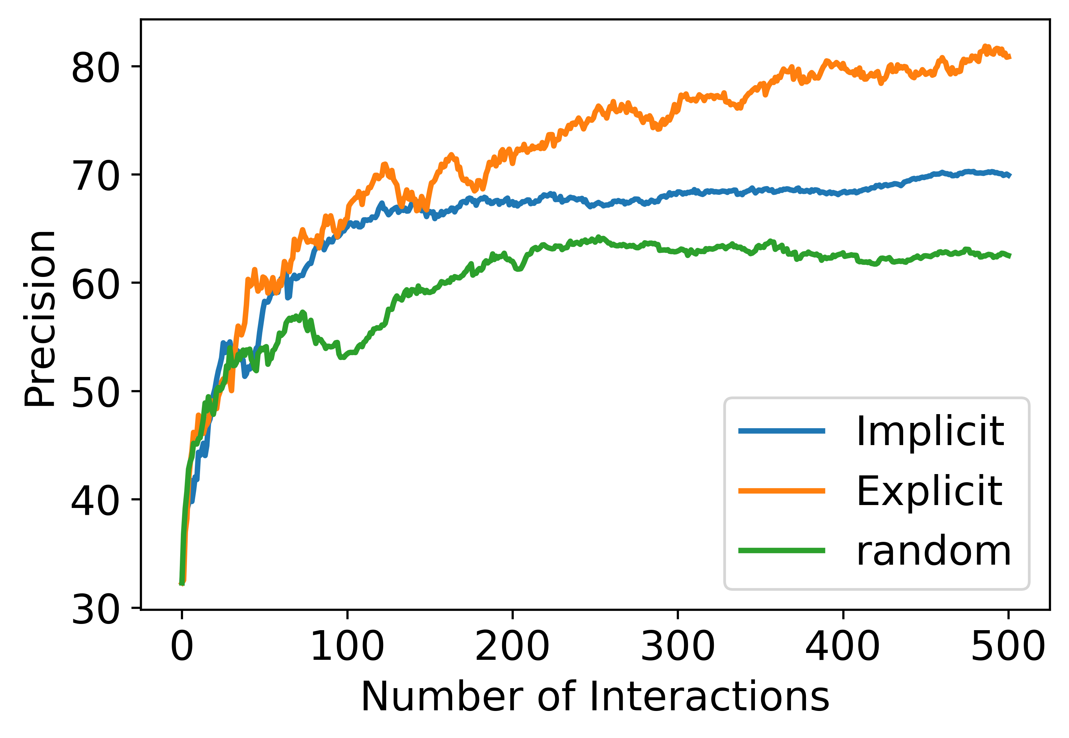
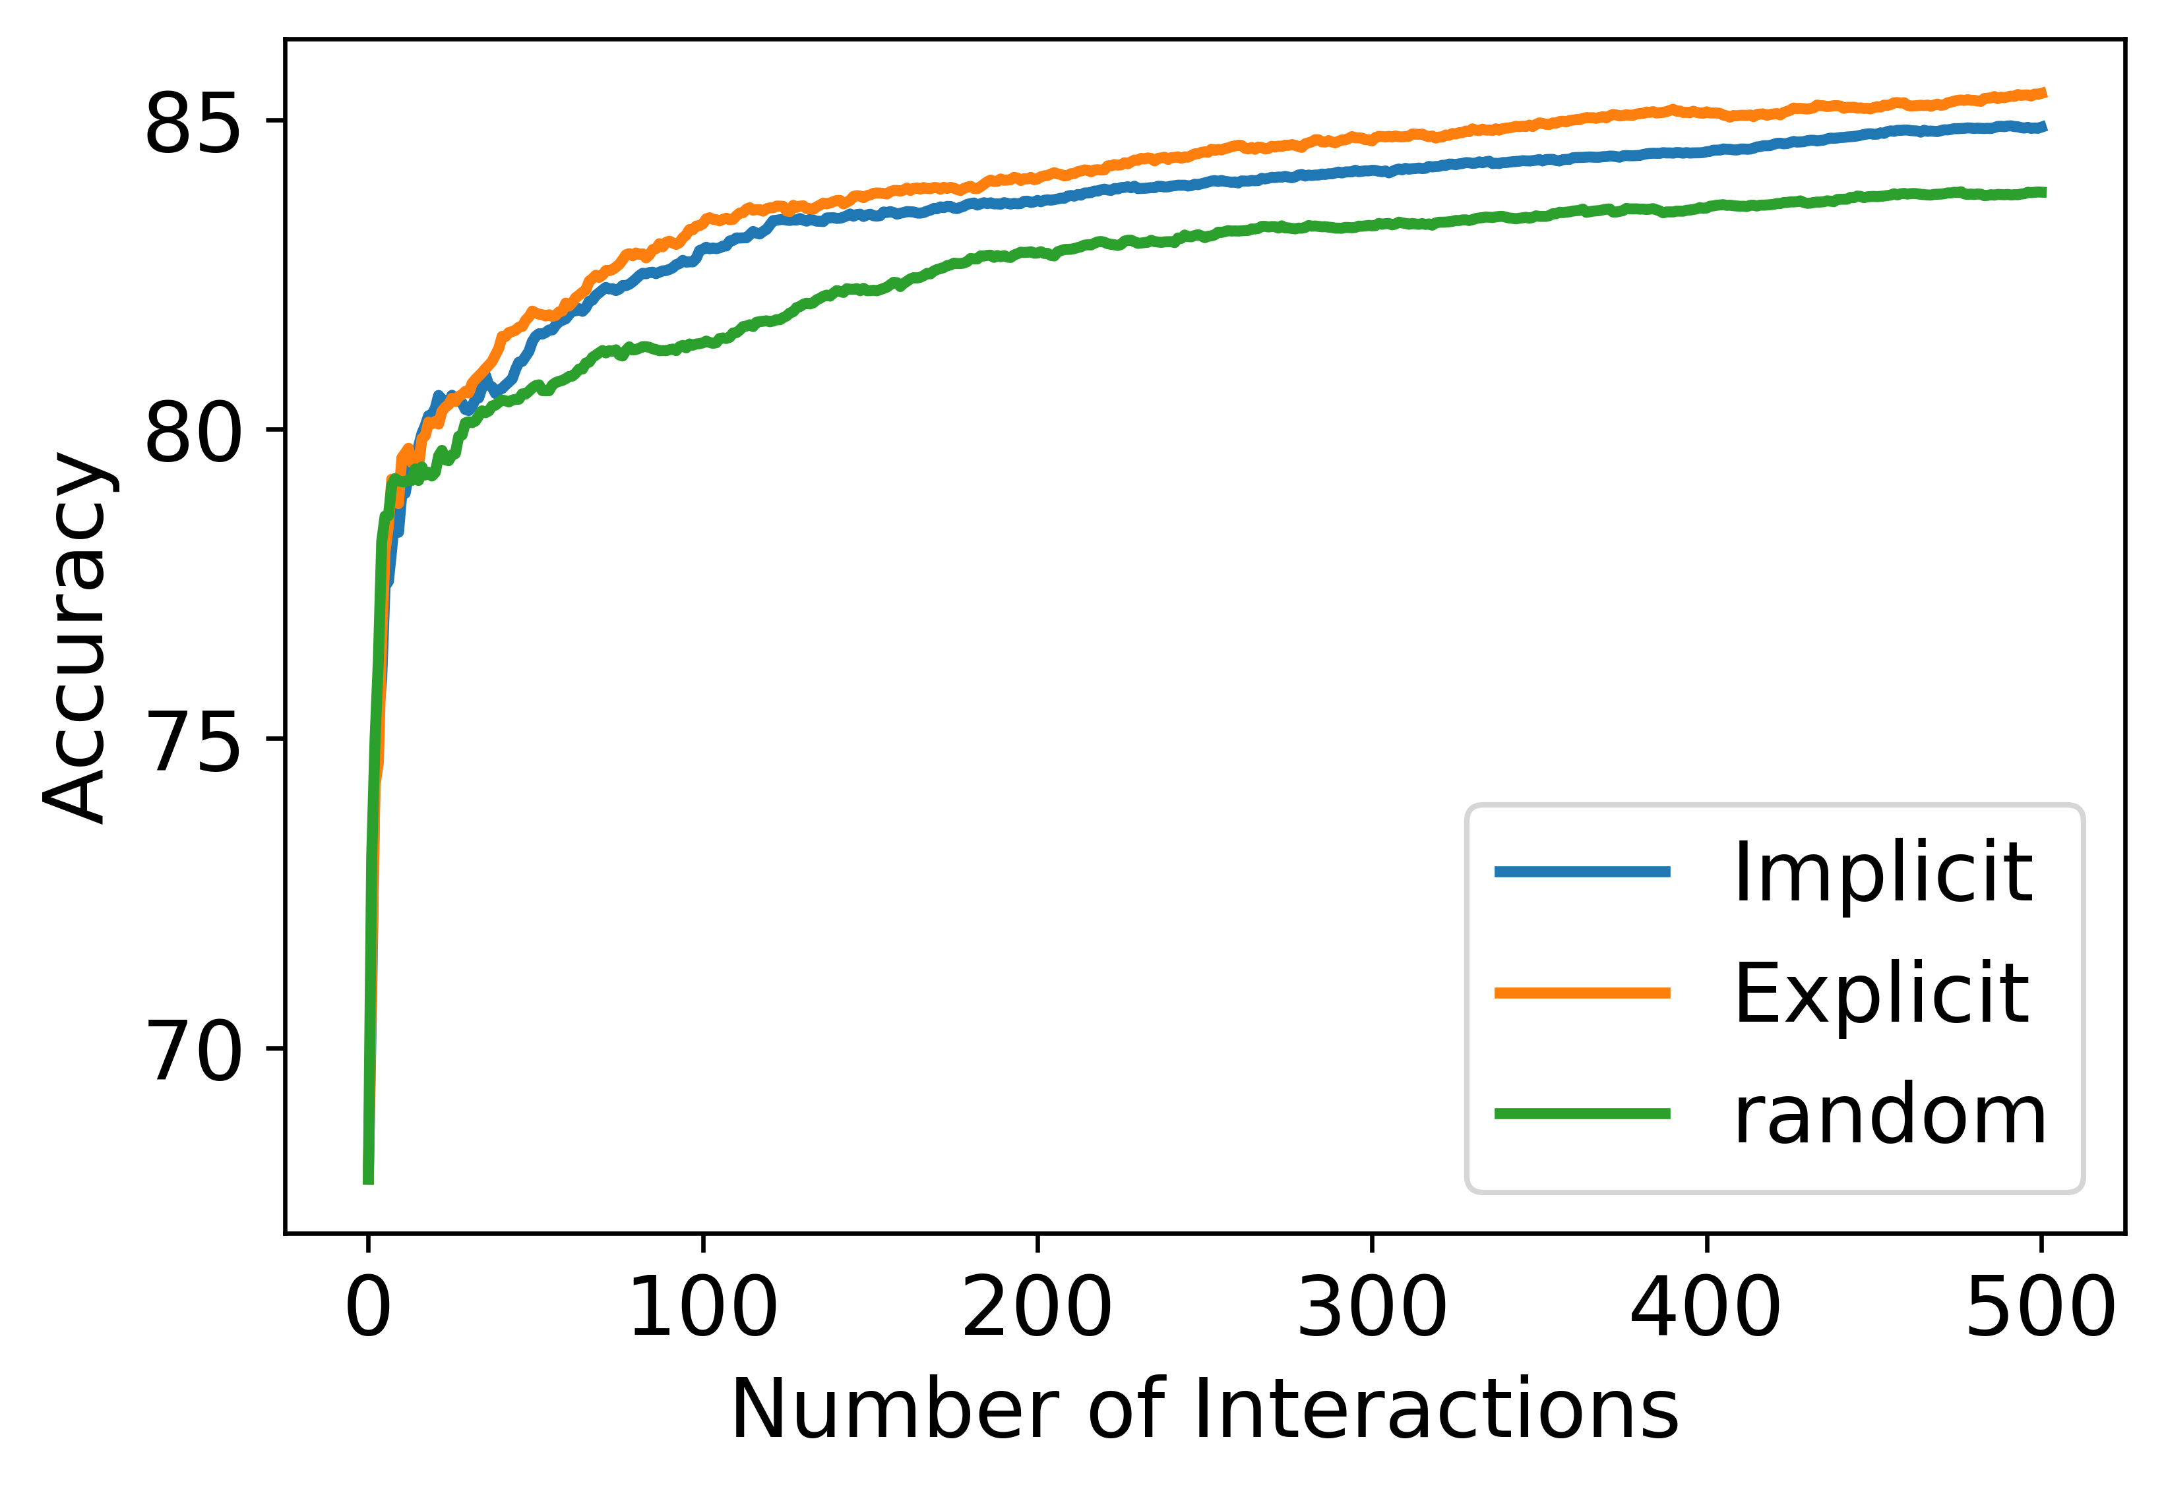
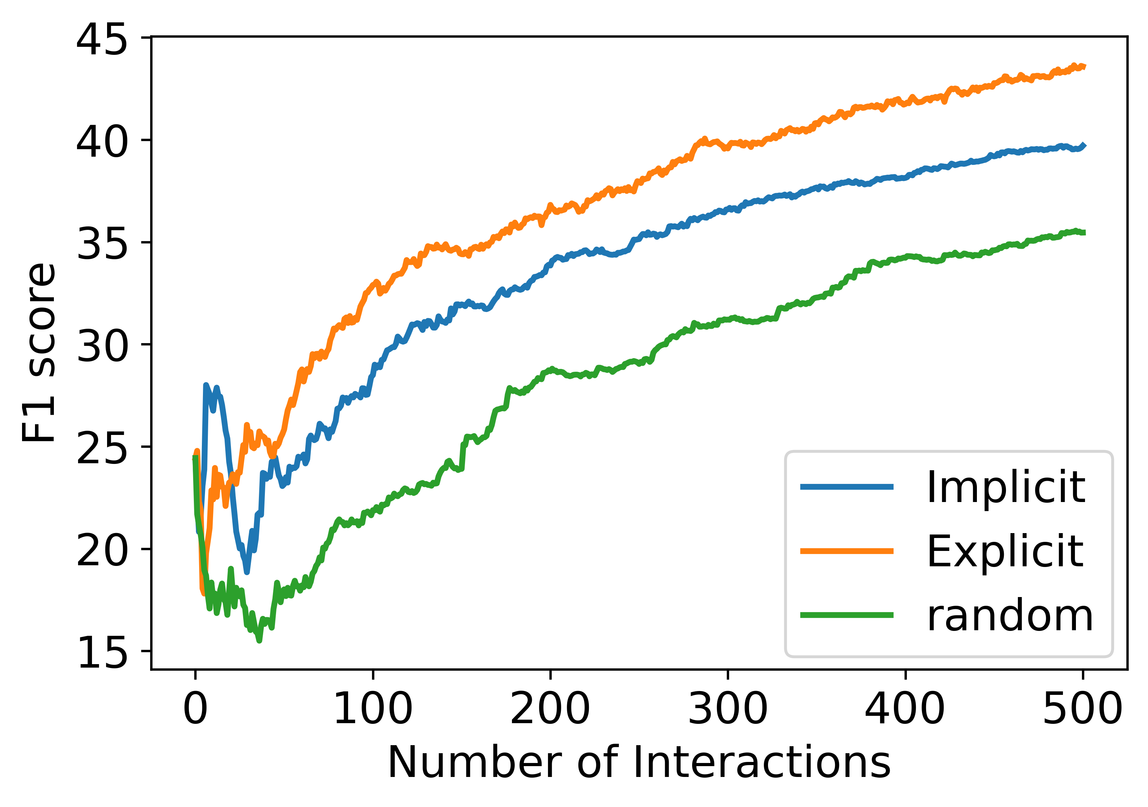
Results
We can observe an overall positive trend for both forms of feedback across different metrics.
In under 20 interactions, our classifier reached a mean accuracy of over 80% for both forms of feedback (random classifier will yield 50%).
It is also interesting to observe that Explicit feedback is more effective than Implicit feedback and random sampling across different metrics.
These results validate the theoretical capability of Fluent to learn user’s needs.
Notes:
The above plots show the mean precision, accuracy and f1 score for 10 simulated users across 500 interactions.
Explicit feedback helps learn faster

Slide 10
Conclusion
We present Fluent, the first AI Augmented Writing Tool for People who Stutter.
Fluent embodies a novel interactive and iterative technique to identify words which an individual might struggle pronouncing and proposes suitable alternatives.
Our evaluation from a theoretical ML perspective show promising results and corroborate this problem as a possible research direction.
Future work might explore the usability, utility & effectiveness of this tool from a human centered perspective.
Future work might also devise design guidelines to inform the development of such tools in the future.
Please checkout github.com/bhavyaghai/Fluent for more details
Notes:
We hope our work might inspire popular tools like MS Word, MS PowerPoint, etc. to add accessibility features for people who stutter.

Slide 11
Thanks for Watching !
Notes:
Existing literature to counter algorithmic bias can be classified into 3 different stages :- data, model and prediction

Slide 12
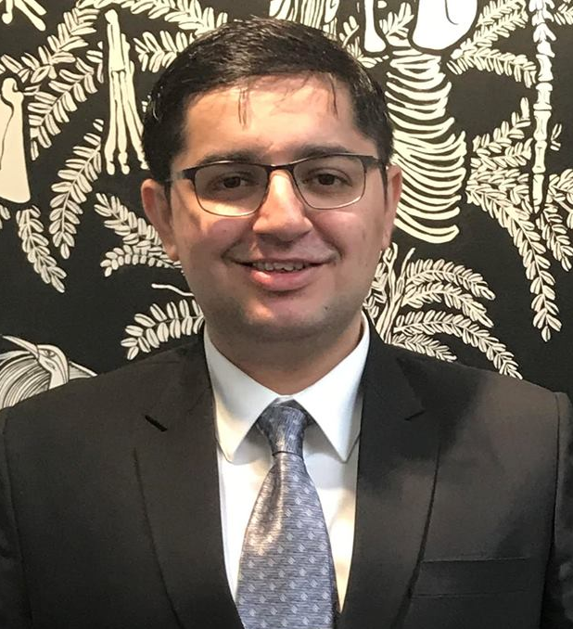

Thanks for your attention!
For any Questions, suggestions, feedback, criticism, please email me at:- bghai@cs.stonybrook.edu
Bhavya Ghai

Slide 13
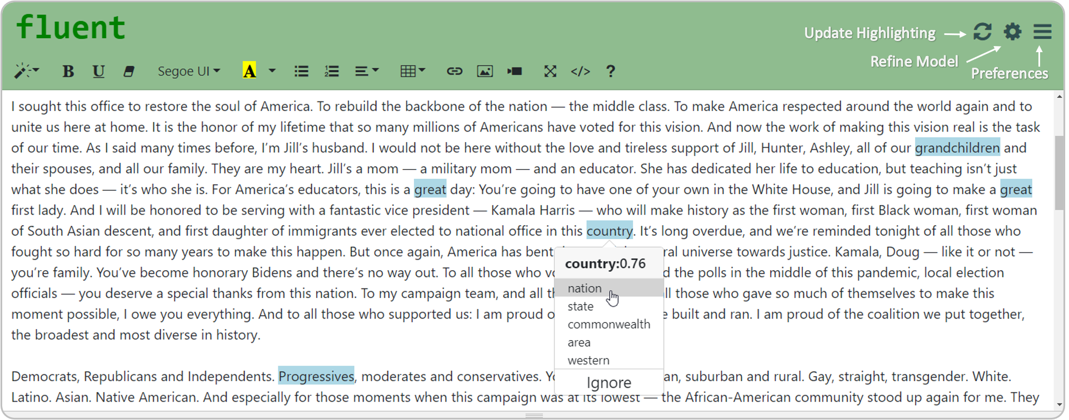
Visual Interface
The Interface is designed to be Intuitive, Accessible and Minimalist
Notes:
Existing literature to counter algorithmic bias can be classified into 3 different stages :- data, model and prediction

Slide 14
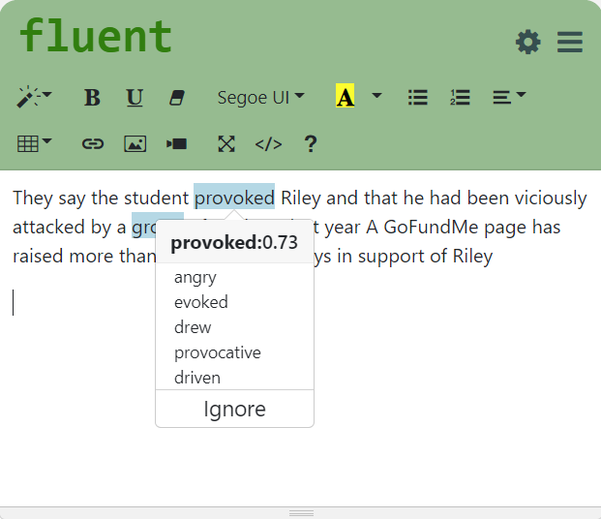
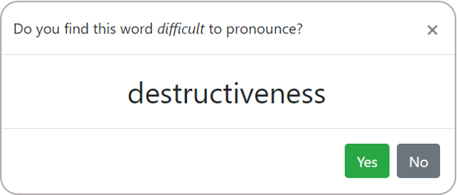
Refining Model
Implicit Feedback
Explicit Feedback
Each Implicit/Explicit interaction provides new labeled training instance
Notes:
Existing literature to counter algorithmic bias can be classified into 3 different stages :- data, model and prediction

Slide 15
Workflow
Alternatives
Difficult
Words
Seed
Words
Difficult Words +
Alternatives
Active learner
(Classifier)
Explicit + Implicit Feedback
Raw
Text
Tokenizer
Words
Named Entity Recognition
Words
+ Tags

Slide 16



Active Learning
AL is a semi-supervised learning technique where the objective is to train a machine learning model using minimum number of labeled training instances
Sampling
Strategy
Query
Label
Unlabeled
Data
Classifier
Oracle
Typically, AL Algorithms learns solely from the labels provided by the Oracle
Notes:
AL achieves this by intelligently selecting/sampling a batch of instances iteratively from a pool of unlabeled instances and getting them labeled by an oracle (human annotator)
This process goes on and the model keeps evolving.
This kind of learning technique plays a key role when labeled data is scarce and obtaining new labels is expensive or difficult.
Use cases include speech recognition, named entity recognition, text classification, etc.

Slide 17
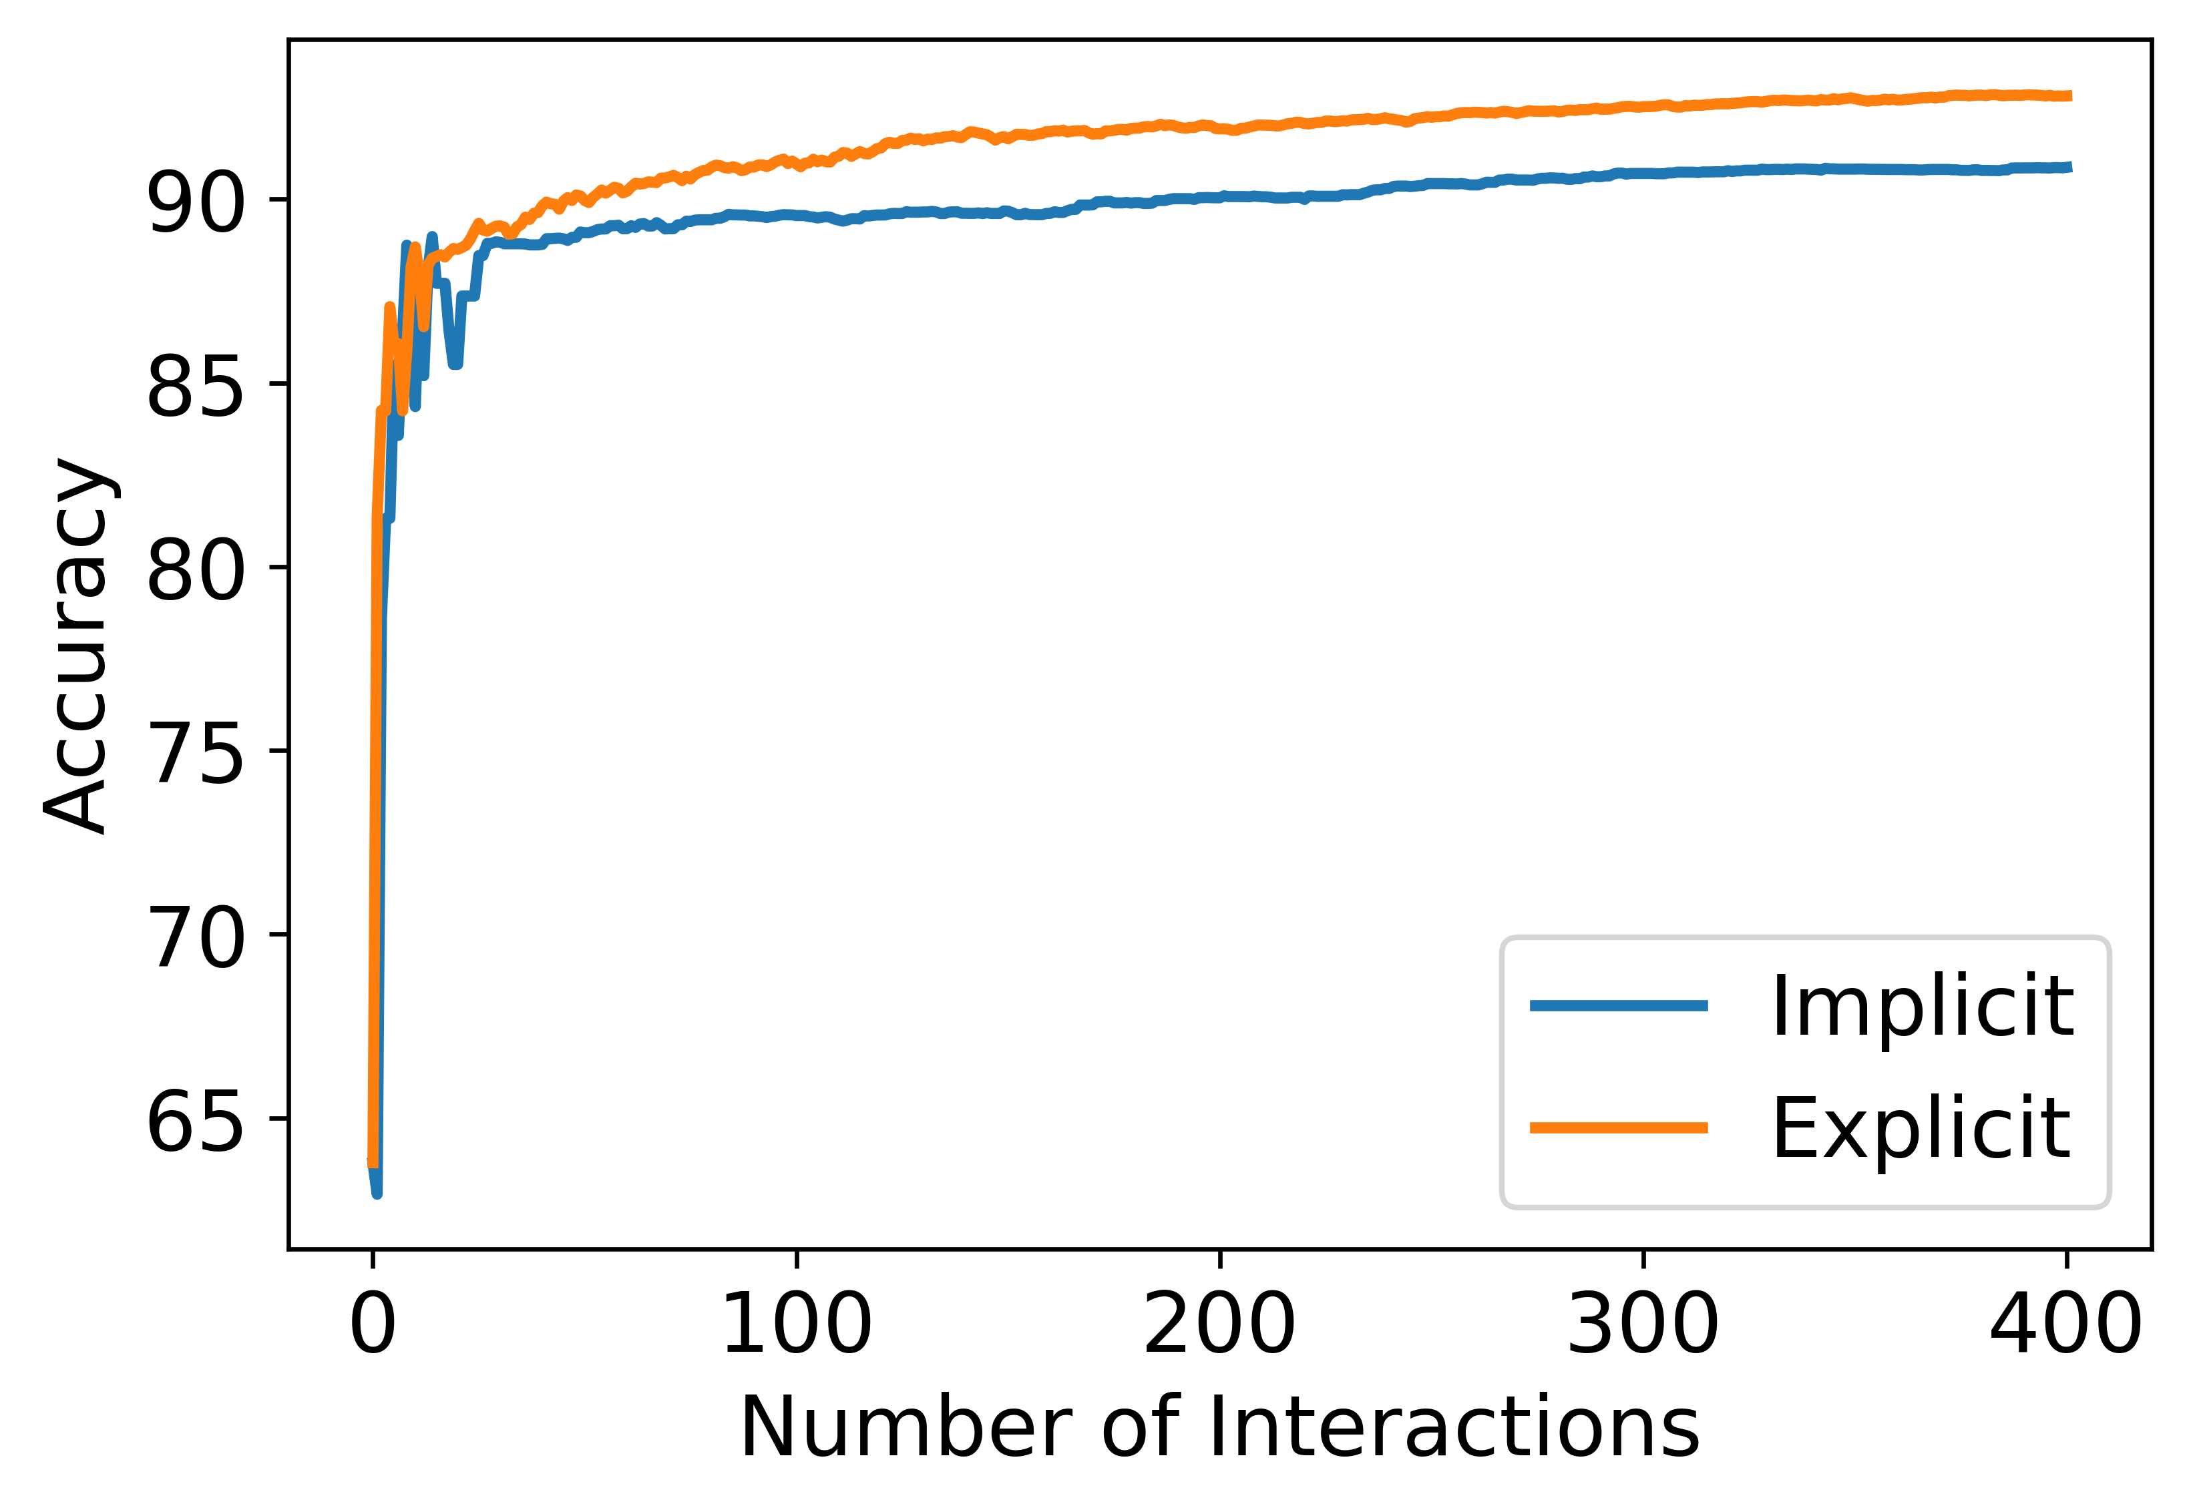
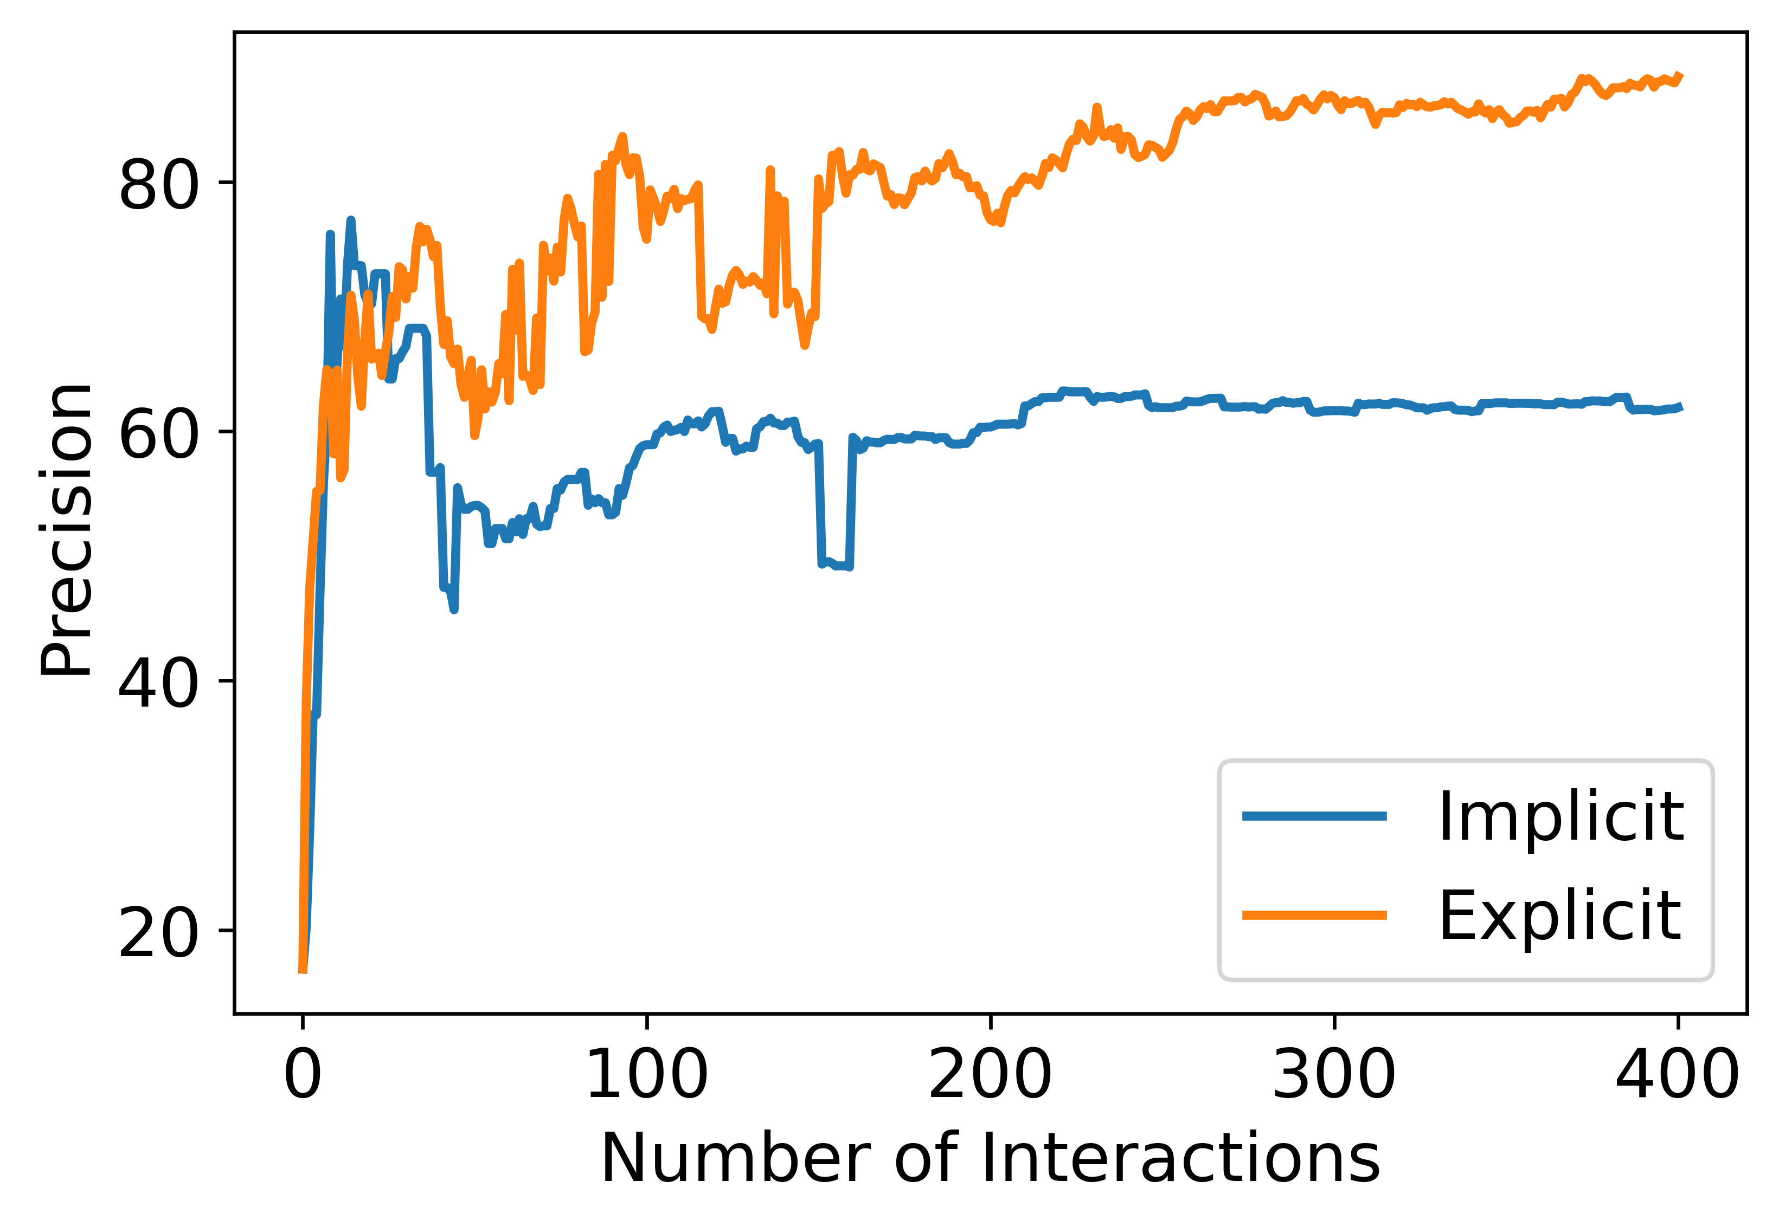
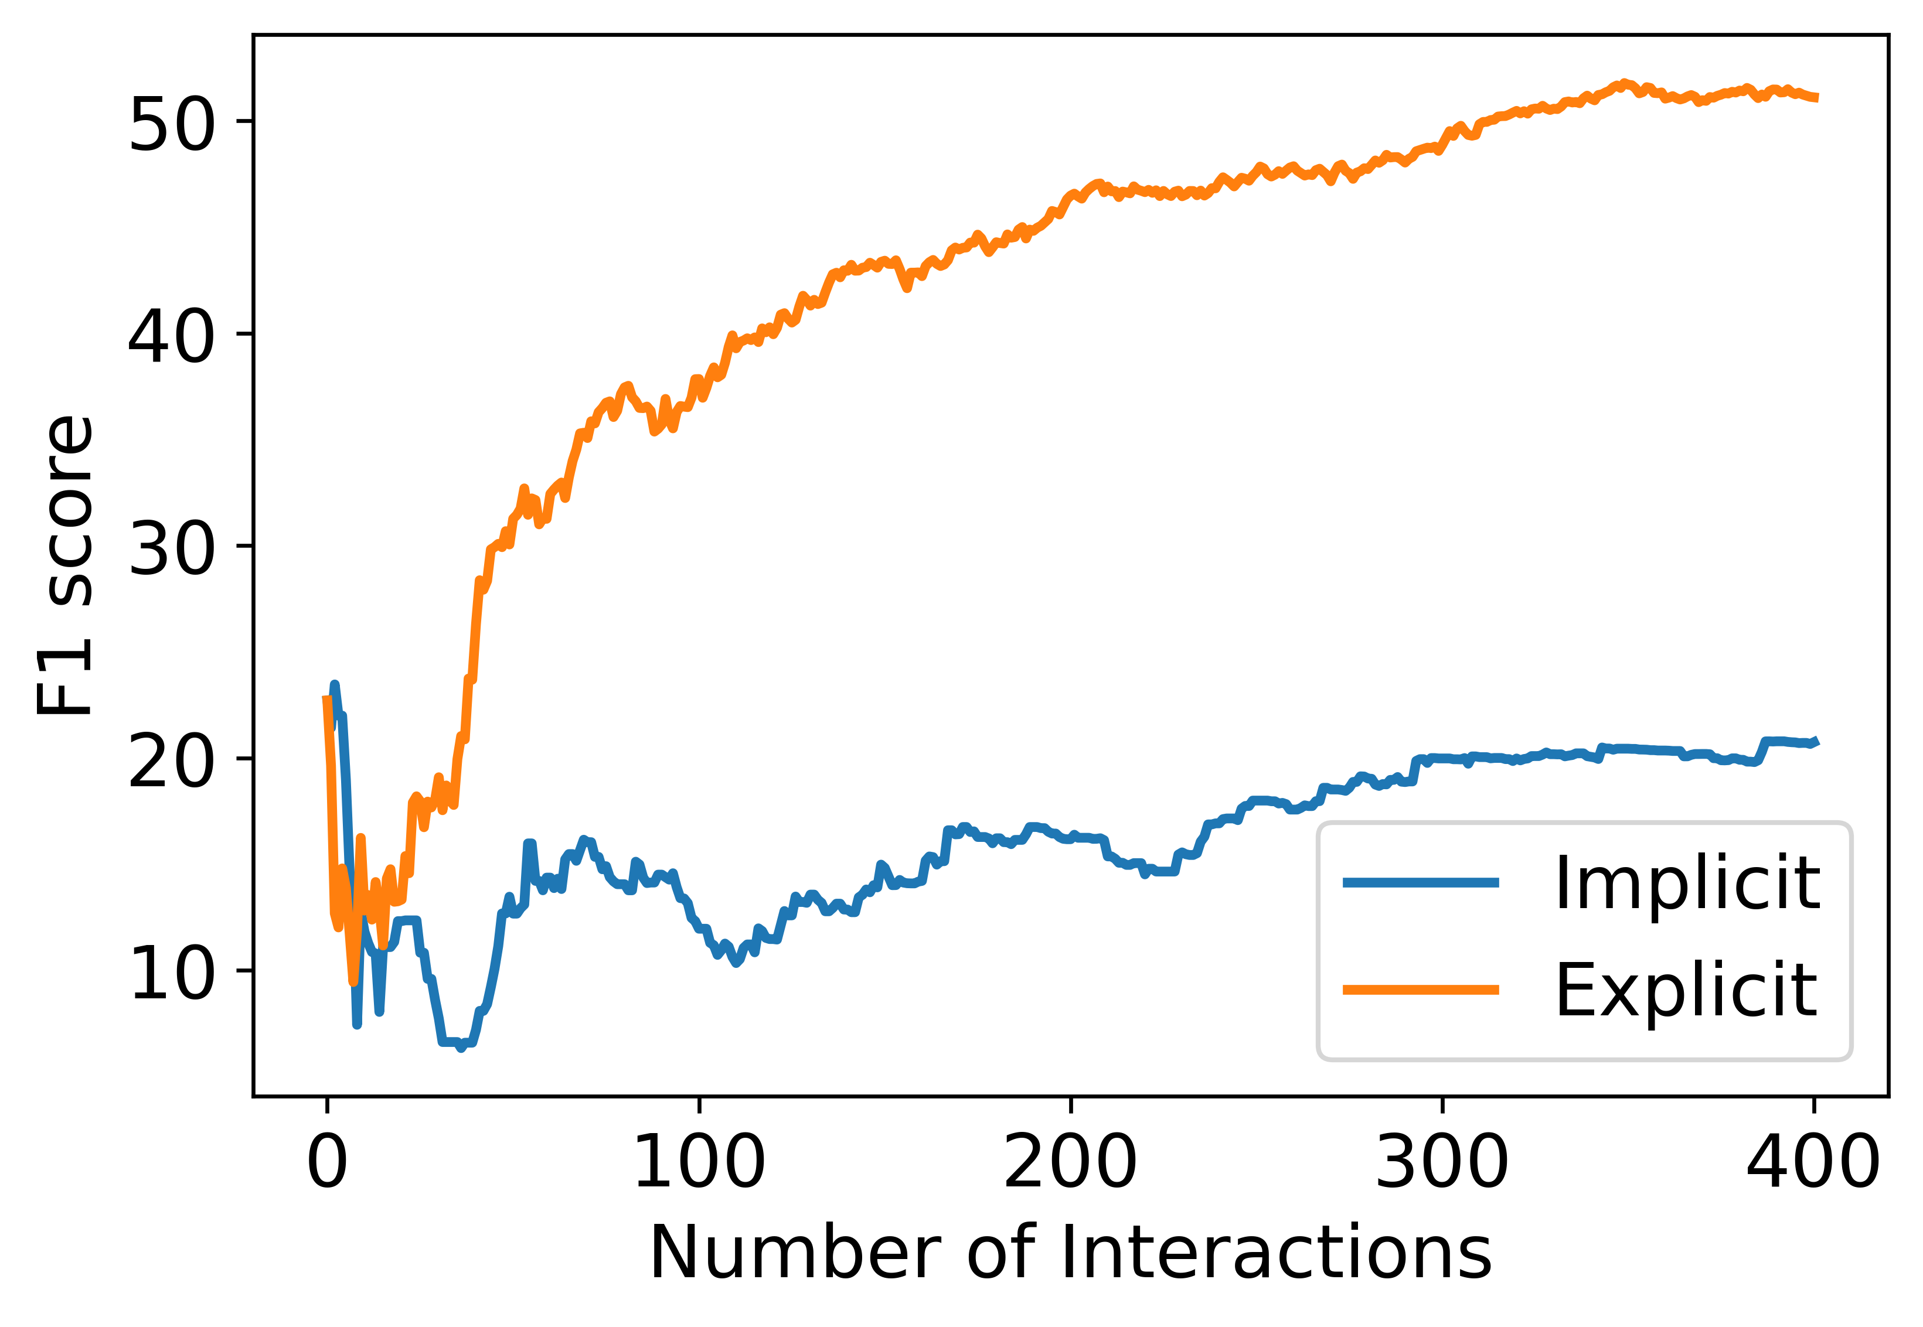
Results
The above plots show the mean accuracy, precision and f1 score across 400 interactions.
We can observe that the accuracy reaches 85% in under 50 interactions for both modes of feedback.
It is also interesting to observe that Explicit feedback is more effective than Implicit feedback across different metrics. It should be noted that each implicit feedback adds two data points compared to a single data point for Explicit feedback.
Our approach is effective. Explicit feedback helps learn faster
Notes:
Existing literature to counter algorithmic bias can be classified into 3 different stages :- data, model and prediction

Slide 18
Limitations
Our tool classifies each word without considering its context. However, some words might be easier to pronounce on their own but might be difficult with specific other words like ‘rural juror’.
Words Representing Names, Places, etc. can’t be substituted. Our tool just highlights such words. The user might go for alternate techniques like circumlocution, etc.
Our approach mightn’t work for someone suffering from acute stammering. Substituting multiple words in a sentence might break the semantic structure of the sentence and require rephrasing.
The user is asked to provide a binary label for a word (difficult or not). However, in the real world, a user might struggle on a word often but not always. To cater to such situations, our tool should elicit a more nuanced (continuous) feedback instead of a discrete binary label.
So far, our tool only supports English language.
We hope this work will encourage other researchers to work on this important and under-explored area
Notes:
Existing literature to counter algorithmic bias can be classified into 3 different stages :- data, model and prediction

Slide 19
AI Augmented Writing Tools
People with Visual Impairments
Autocompletion of sentences - Gmail
Refine tone, grammatical errors (Grammarly)
Gender Bias (Text.io)
Notes:
Existing literature to counter algorithmic bias can be classified into 3 different stages :- data, model and prediction

Slide 20
Thanks for your Attention!

Slide 21
Xiaojun Bi’s Feedback
Name, place, date can’t be replaced – limitation
Best way is not to avoid such words – Justify if this approach is right
Each word has a nuance. Can’t be completely replaced
Maybe, helps user to better pronounce by identifying such words
Evaluation – baseline – manual replacement, Expert interview, simulating
Notes:
Existing literature to counter algorithmic bias can be classified into 3 different stages :- data, model and prediction

Slide 22
Evaluation
User Study
Difficult to find users with speaking difficulties. Non-native speakers might be an option.
Our system is bad at the beginning but evolves with time. Might be tricky to evaluate
Can ask for subjective evaluation
Expert Evaluation
We can demonstrate our tool to experts like Speech Language Pathologists Simulation
Simulation
We can simulate users who find certain words difficult and evaluate our tool on precision and recall. This way we can also see how the performance of the tool increases with time.
Notes:
Existing literature to counter algorithmic bias can be classified into 3 different stages :- data, model and prediction

Slide 23
AI Augmented Writing Platforms
People with Visual Impairments
Autocompletion of sentences
Refine tone, grammatical errors (Grammarly)
Gender Bias (Text.io)
Notes:
Existing literature to counter algorithmic bias can be classified into 3 different stages :- data, model and prediction

Slide 24
Methodology
How much money might a person with the following attributes make in a year?
Arrange the attributes based on their impact towards the given prediction task
Model 1
Attribute | Value
Age | 39
Work class | Private
Years of Education | 13
Marital Status | Never Married
Occupation | Executive & Managerial
Race | White
Gender | Male
Hours per week | 50
Age
Model 2
Work class
Years of Education
Next Instance
to be queried
Marital Status
Labeled
data
Max
Disagreement
Model 3
Occupation
.
.
.
.
.
.
Race
Committee
Of Classifiers
Gender
Less than $50,000
More than $50,000
Hours per week
Model n
Notes:
Existing literature to counter algorithmic bias can be classified into 3 different stages :- data, model and prediction

Slide 25
Motivation - XAL
Explainable Active learning (XAL) is an AL framework where a user is presented with a query, model’s prediction and its local explanation.
Local
Explanation
Sampling
Strategy
Prediction
Query
Unlabeled
Data
Label
Classifier
Oracle
Annotator’s naturally want to “teach” with rationale beyond just labels
Ghai, Bhavya, et al. "Explainable Active Learning (XAL): An Empirical Study of How Local Explanations Impact Annotator Experience." arXiv preprint arXiv:2001.09219 (2020).
Notes:
This work is motivated from our previous work on Explainable active learning or XAL.
we conducted a user study to understand the impact of adding local explanations with every query in the Active learning pipeline.
One of the key takeaways from the this work is that
A common way to justify their label is by indicating the most important features
where an annotator is presented with a query, model’s prediction and its local explanation
Last summer, we were working on a different project where we
To know more about XAL, please refer

Slide 26
Sampling Strategy
To incorporate the additional feedback, we used bagging based Query by Committee (QBC) sampling strategy and modified its disagreement measure
Annotator’s Rationale
Model i
Model 1
w₁
Local Model Explanation
Model 2
w₂
Feature Ranking
Disagreement
Measure
Next Instance
to be queried
Feature Ranking
Labeled
data
Model 3
w₃
.
.
.
.
.
Committee
Of Classifiers
Similarity
w_{n}
Model n
w_{i}
Model with higher similarity to Annotator’s rationale is given higher weight
Notes:
Let’s first see how a typical QBC sampling strategy works.
Given a pool of labeled data, we train a set of models by randomly selecting instances. These models form the committee of classifiers
Thereafter, each model is used to generate predictions for the unlabeled data. The unlabeled instance on which the committee disagrees the most is selected to be queried.
In this current system, each model in the committee has equal say.
However for AL++, we have modified this strategy such the each model is assigned a weight wi. If a model’s rationale is pretty similar to the annotator’s rationale, its assigned a higher weight.
Model agnostic

Slide 27
Active Learning++
AL++ is a novel AL framework which can utilize an annotator’s labels as well as it’s rationale.
We propose a new way to elicit annotator’s rationale and incorporate that into the learning process.
Annotator’s
Rationale
Sampling
Strategy
Query
Label
Unlabeled Data
Classifier
Oracle
Our hypothesis is that the additional feedback should help train the model faster
Notes:
To address this challenges, we present a new AL framework called Active Learning++
Rationale is the additional feedback which provides the reasoning behind the label

Slide 28
Elicit Annotator’s Rationale
For each query, we elicit Annotator’s rationale in the form of ranking of input features based on their contribution towards the prediction task
How much money might a person with the following attributes make in a year?
Arrange the attributes based on their impact towards the given prediction task
Attribute | Value
Age | 39
Work class | Private
Years of Education | 13
Marital Status | Never Married
Occupation | Executive & Managerial
Race | White
Gender | Male
Hours per week | 50
Age
Work class
Education
Marital Status
Occupation
Race
Gender
Less than $50,000
More than $50,000
Hours per week
Notes:
This is line with our XAL study
Where we saw that annotator’s feedback is imprecise.

Slide 29
Sampling Strategy
To incorporate the additional feedback, we used bagging based Query by Committee (QBC) sampling strategy and modified its disagreement measure
Model 1
w₁
Model 2
w₂
Disagreement
Measure
Next Instance
to be queried
Labeled
data
Model 3
w₃
.
.
.
.
.
Committee
Of Classifiers
w_{n}
Model n
Model with higher similarity to Annotator’s rationale is given higher weight
Notes:
Let’s first see how a typical QBC sampling strategy works.
Given a pool of labeled data, we train a set of models by randomly selecting instances. These models form the committee of classifiers
Thereafter, each model is used to generate predictions for the unlabeled data. The unlabeled instance on which the committee disagrees the most is selected to be queried.
In this current system, each model in the committee has equal say.
However for AL++, we have modified this strategy such the each model is assigned a weight wi. If a model’s rationale is pretty similar to the annotator’s rationale, its assigned a higher weight.
Model agnostic

Slide 30
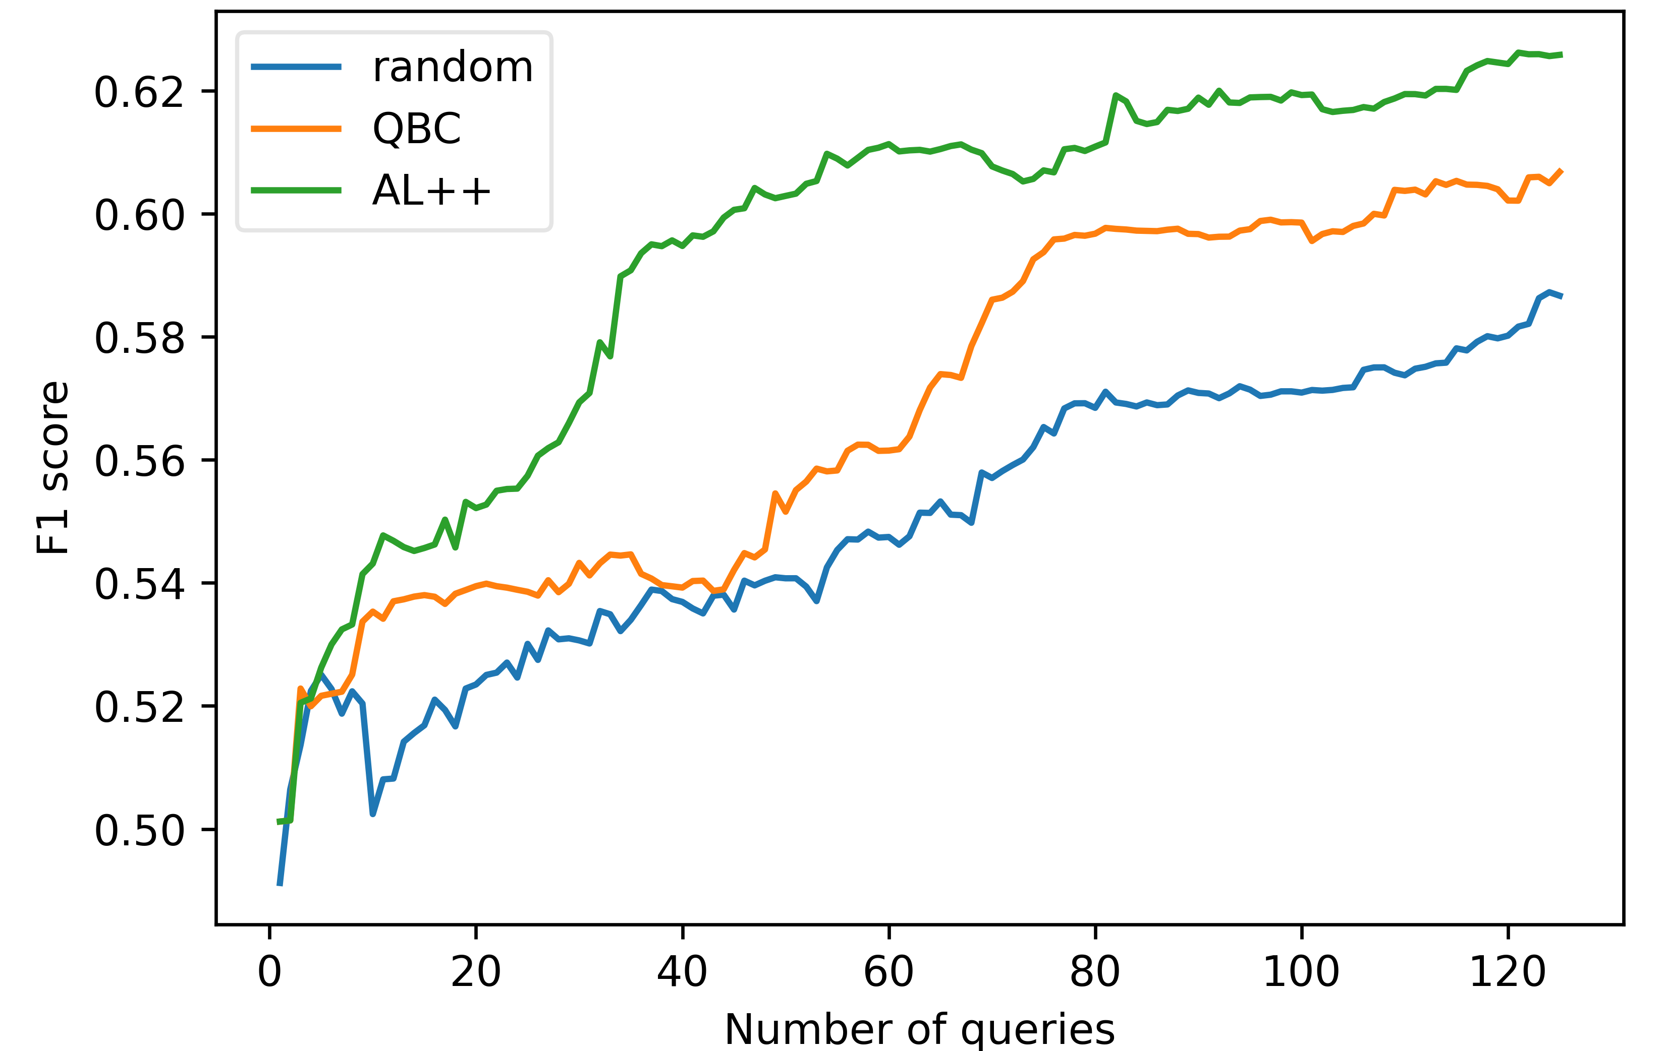
Preliminary Results
We performed 10 simulations with different initial labeled dataset for 125 queries using Adult Income dataset.
We found that the mean F1 score for AL++ is significantly higher than QBC and random sampling (p<0.01).
To reach F1 score of 0.54, AL++ requires 11.8 queries vs 25.9 queries required by QBC on average.
AL++ helps train the ML model faster than vanilla AL
Notes:
AL++ maintains a contant lead over others right from the beginning
This simulation based on Adult Income dataset show that AL++ helps train ………………..

Slide 31

Conclusion & Future Work
We presented a new AL framework, Active learning++, which can utilize annotator’s rationale in the form of feature importance-based ranking.
Next, we plan to conduct a comprehensive analysis using different datasets and even different domains like text classification.
We wish to simulate other scenarios where the annotator provides noisy feedback or ranking for only top-k features.
Lastly, we plan to conduct a user study to see how this framework works in practice and compares with vanilla AL.
Notes:
For k=1, annotator only needs to provide the most important feature for a given query.
For comparing with vanilla AL, we can also account for the cost of providing the additional feedback.
With that, I thank you for your attention. Looking forward to any questions, suggestions, feedback!

