Slide 1


Fluent: An AI Augmented Writing Platform for People with Speaking difficulties
Bhavya Ghai, Klaus Mueller
Department of Computer Science
Stony Brook University
Notes:
Hello everyone
I am Bhavya Ghai from Stony Brook University
N today I will presenting our joint work with IBM Research i.e. “Active Learning++: Incorporating A ……………………..”
This is a joint work with Vera and Yunfeng from IBM and my adviser Klaus Mueller
Let’s start off with an overview of Active learning

Slide 2
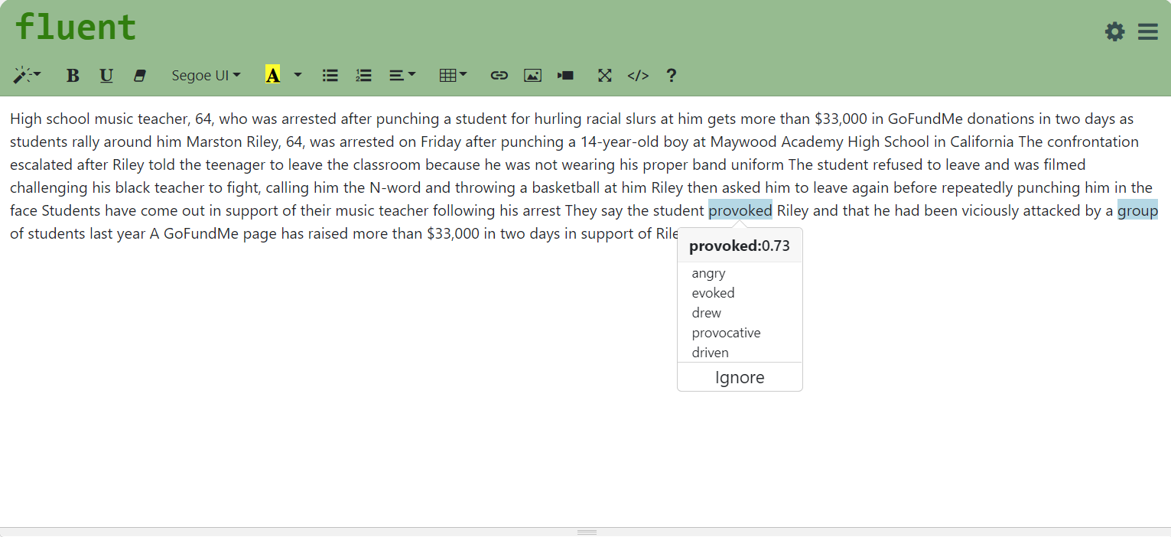
Teaser
Refine Model
Preferences
Notes:
Existing literature to counter algorithmic bias can be classified into 3 different stages :- data, model and prediction

Slide 3
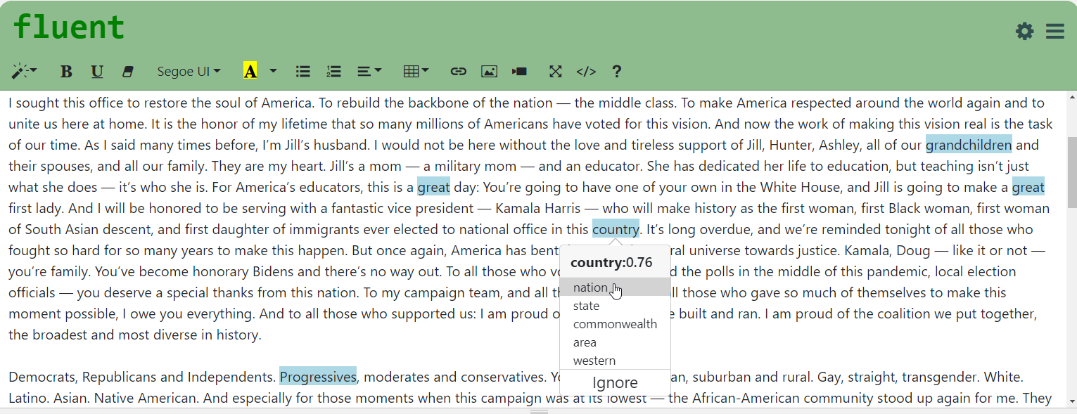
Teaser
Refine Model
Preferences
Notes:
Existing literature to counter algorithmic bias can be classified into 3 different stages :- data, model and prediction

Slide 4
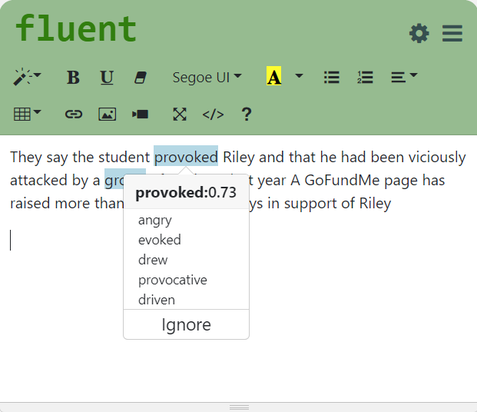
Workflow
Alternatives
Difficult
Words
Seed
Words
Difficult Words +
Alternatives
Active learner
(Classifier)
Explicit + Implicit Feedback
Raw
Text
Tokenizer
Words
Named Entity Recognition
Words
+ Tags

Slide 5
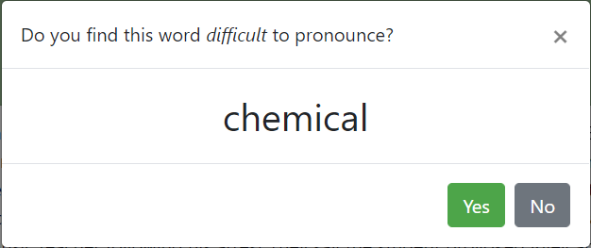
Refining Model
Notes:
Existing literature to counter algorithmic bias can be classified into 3 different stages :- data, model and prediction

Slide 6
