Slide 1


Fluent: An AI Augmented Writing Platform for People who Stutter
Bhavya Ghai, Klaus Mueller
Department of Computer Science
Stony Brook University
Notes:
Hello everyone
I am Bhavya Ghai from Stony Brook University
N today I will presenting our joint work with IBM Research i.e. “Active Learning++: Incorporating A ……………………..”
This is a joint work with Vera and Yunfeng from IBM and my adviser Klaus Mueller
Let’s start off with an overview of Active learning

Slide 2
Stuttering
Stuttering is a speech disorder which impacts more than 70 million people worldwide.
Its symptoms include:
repetition of a sound eg. "Iw-w-w-want a drink“
prolonging a sound eg. "Ssssssssam is nice“
pause or blocks eg. "I want a (pause) cookie“
It impacts people across culture, race, sex, age, ethnicity, etc. It is more prevalent in boys than girls.
Stuttering can have a profound negative impact on the personal and professional life of people who stutter (PWS).
Unfortunately, there is no quick cure for Stuttering
Notes:
Existing literature to counter algorithmic bias can be classified into 3 different stages :- data, model and prediction

Slide 3
AI Augmented Writing Platforms
People with Visual Impairments
Autocompletion of sentences - Gmail
Refine tone, grammatical errors (Grammarly)
Gender Bias (Text.io)
Notes:
Existing literature to counter algorithmic bias can be classified into 3 different stages :- data, model and prediction

Slide 4
Our Contributions
We devise a novel method to identify words an individual might struggle pronouncing.
We design and implement a new writing platform ‘Fluent’ which embodies our approach to identify difficult to pronounce words and suggests suitable alternatives.
We demonstrate the effectiveness, usability and utility of our system using expert interviews and simulation experiment.
Notes:
Existing literature to counter algorithmic bias can be classified into 3 different stages :- data, model and prediction

Slide 5
Phonetic Embeddings
Phonetic embeddings are high dimensional vector representation of each word such that words with similar pronunciation lie close to each other in high-D space.
The phonetic embeddings used in this paper are derived from CMU pronunciation dictionary where each word is mapped to a set of phonemes.
Poetic Sound Similarity Vectors Using Phonetic Features
Notes:
Existing literature to counter algorithmic bias can be classified into 3 different stages :- data, model and prediction

Slide 6



Active Learning
AL is a semi-supervised learning technique where the objective is to train a machine learning model using minimum number of labeled training instances
Sampling
Strategy
Query
Label
Unlabeled
Data
Classifier
Oracle
Typically, AL Algorithms learns solely from the labels provided by the Oracle
Notes:
AL achieves this by intelligently selecting/sampling a batch of instances iteratively from a pool of unlabeled instances and getting them labeled by an oracle (human annotator)
This process goes on and the model keeps evolving.
This kind of learning technique plays a key role when labeled data is scarce and obtaining new labels is expensive or difficult.
Use cases include speech recognition, named entity recognition, text classification, etc.

Slide 7
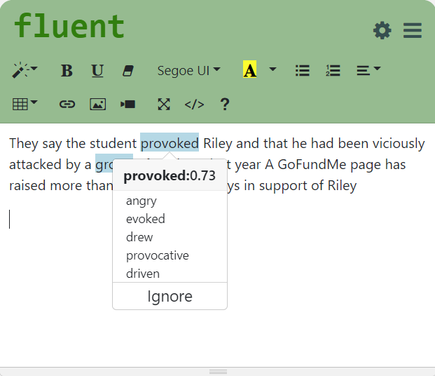
Workflow
Alternatives
Difficult
Words
Seed
Words
Difficult Words +
Alternatives
Active learner
(Classifier)
Explicit + Implicit Feedback
Raw
Text
Tokenizer
Words
Named Entity Recognition
Words
+ Tags

Slide 8
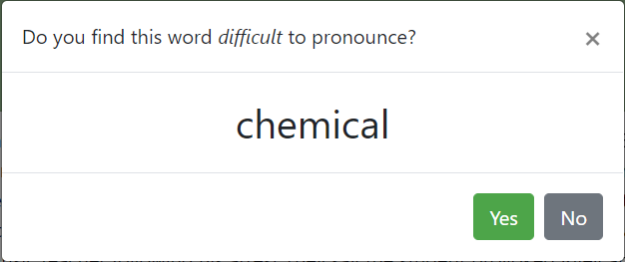
Refining Model
Implicit Feedback
Explicit Feedback
Each Implicit/Explicit interaction provides a new training labeled instance
Notes:
Existing literature to counter algorithmic bias can be classified into 3 different stages :- data, model and prediction

Slide 9
Experiment Setup
We have simulated 10 different users who struggle with different speech patterns like:
words starting with B,P,D,M,N, and F like nostalgia
words beginning with ‘st’ or ‘fl’ like street
words with begin with a consonant followed by a ‘r’ like grey
words which contain ‘sc’ or ‘ch’ sound like chair
We used 2467 TED talks transcripts which contains ~57k unique words to evaluate our tool. We parsed all these transcripts to identify different words each simulated user might struggle with.
We split ~57k words into train and test dataset in the ration of 75:25.
We have considered two scenarios i.e., when a user provides solely Implicit and Explicit feedback. Here, each user provides 5 easy and difficult words in the beginning.
For each feedback, we compute and record metrics like accuracy, F1 score, precision, etc.
Our objective is to evaluate if our approach can adopt to user needs
Dataset link: https://www.kaggle.com/rounakbanik/ted-talks?select=transcripts.csv
Notes:
Existing literature to counter algorithmic bias can be classified into 3 different stages :- data, model and prediction

Slide 10
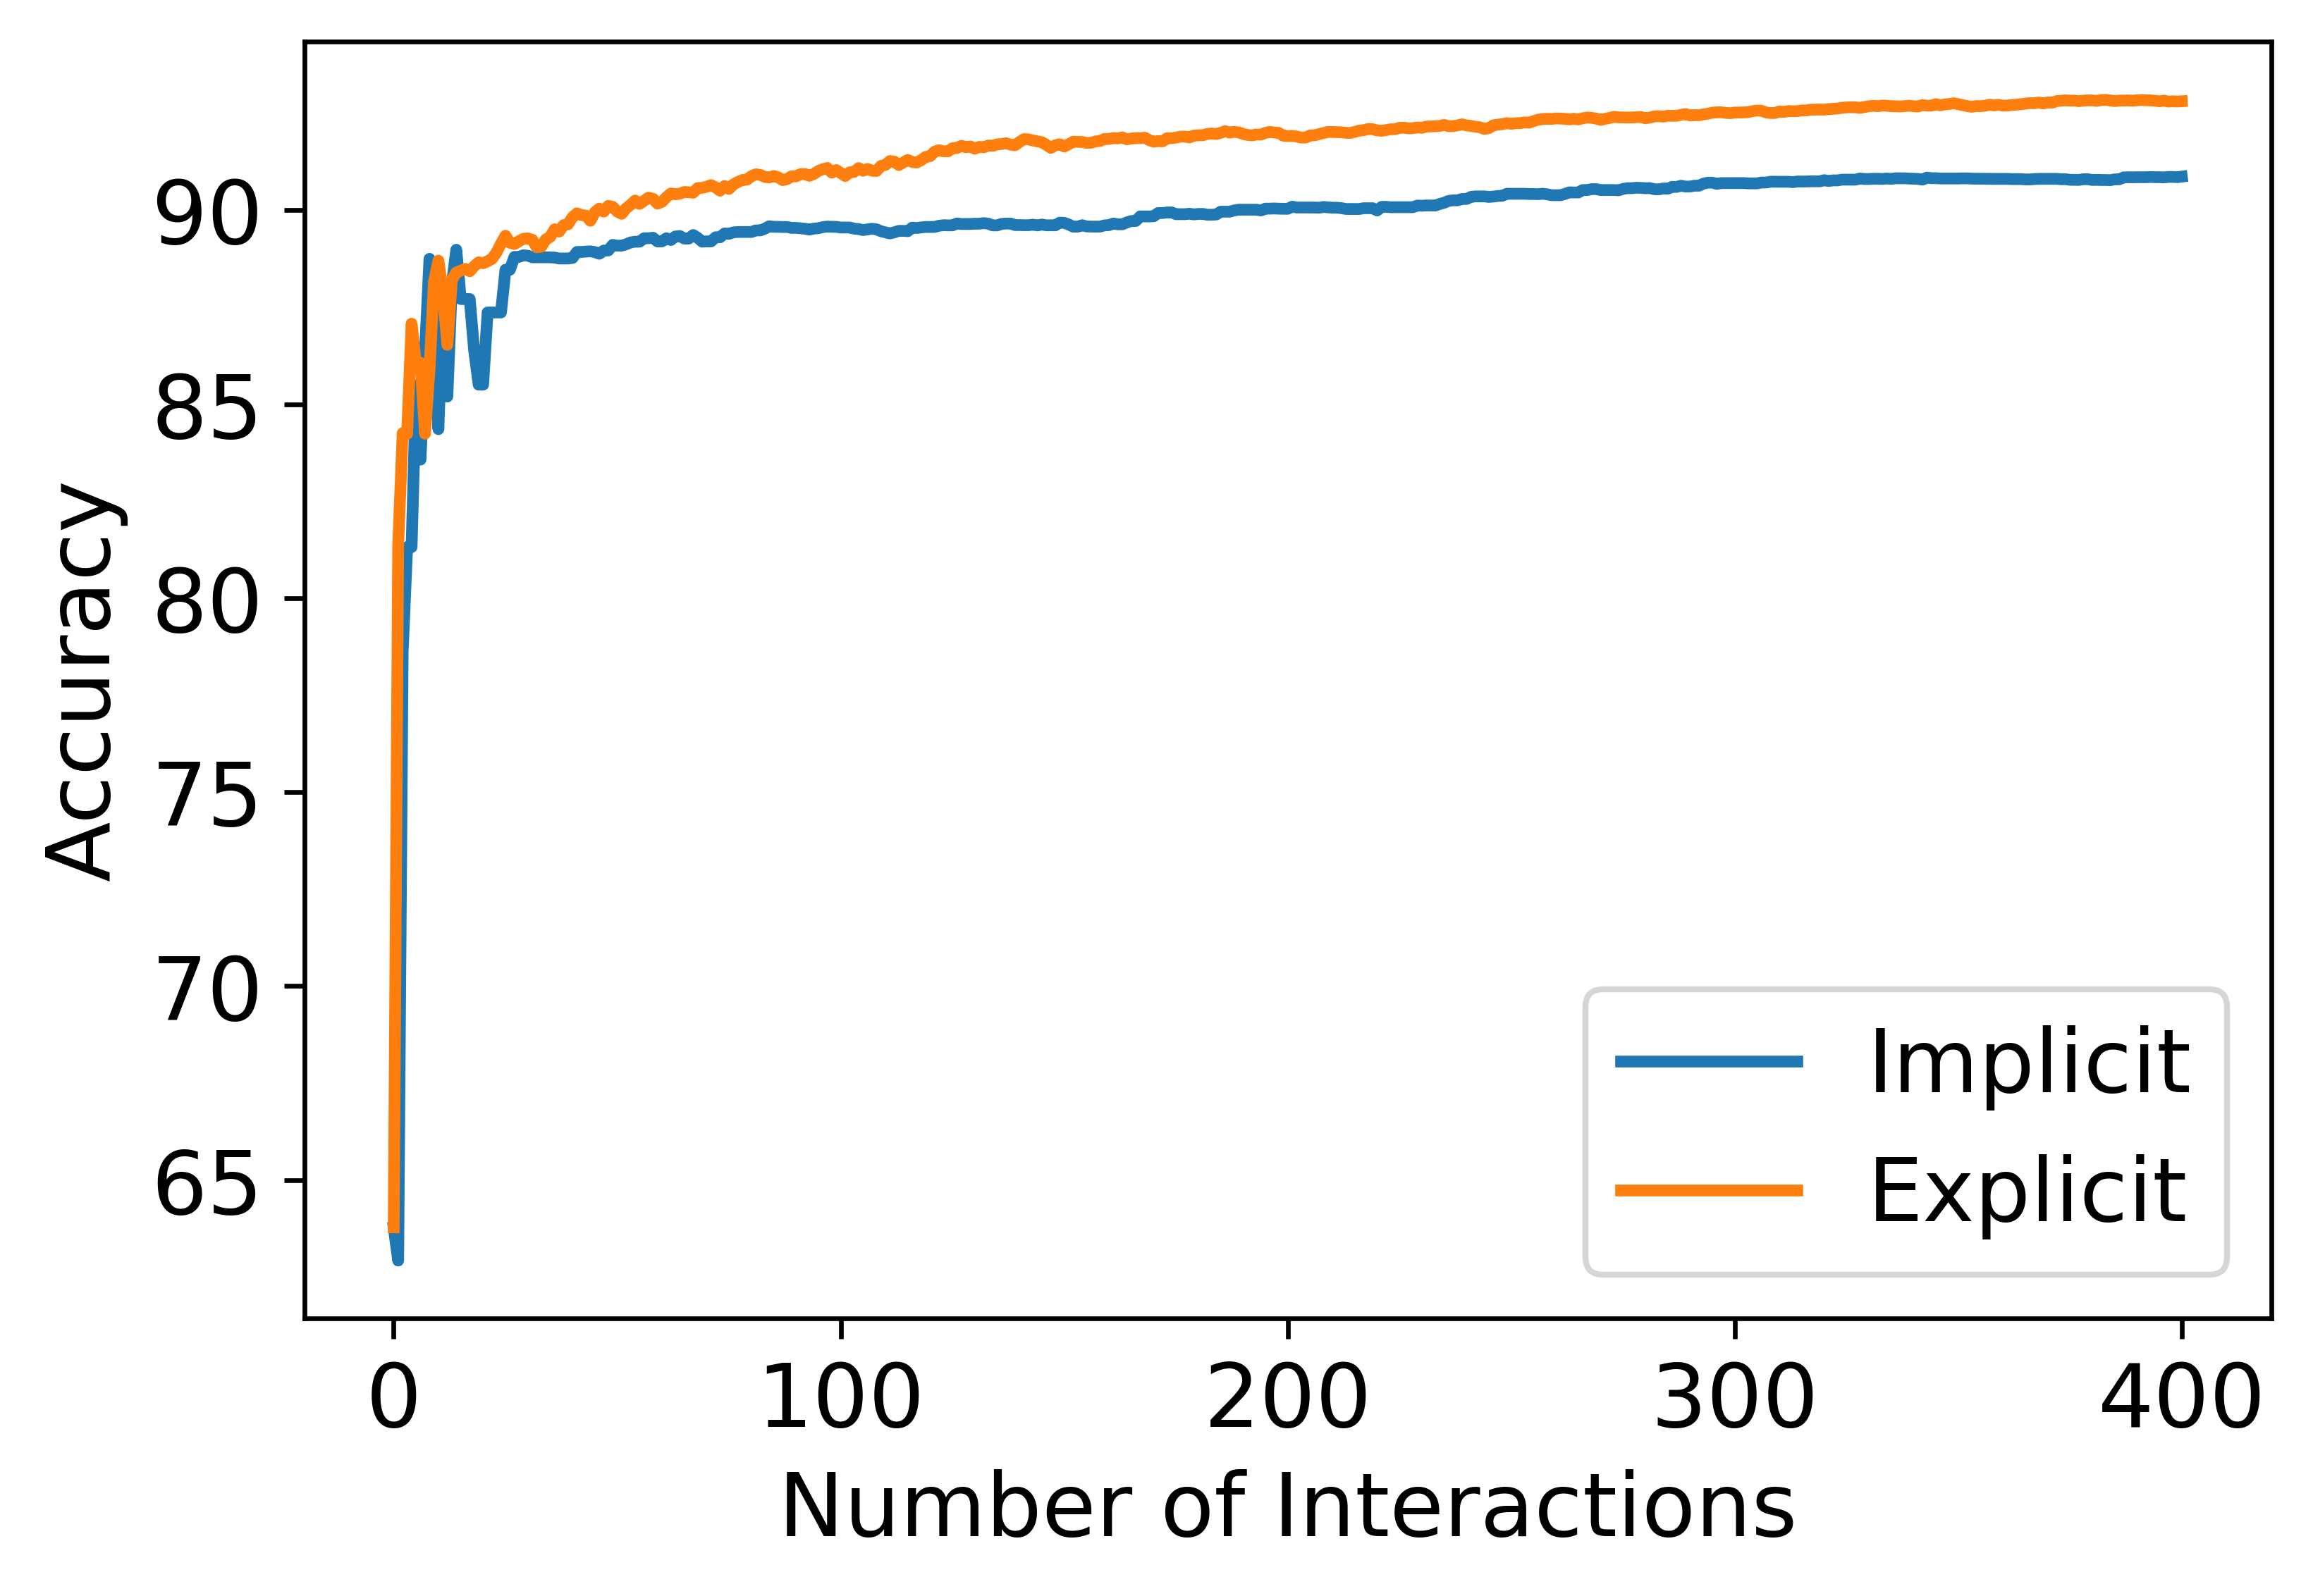
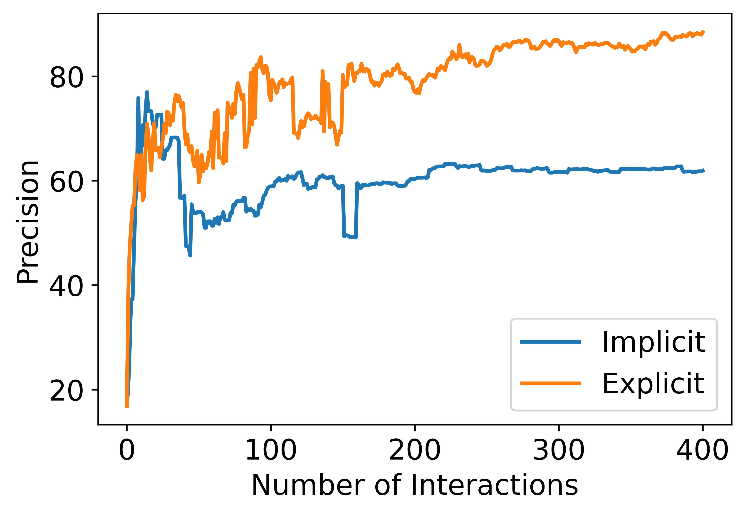
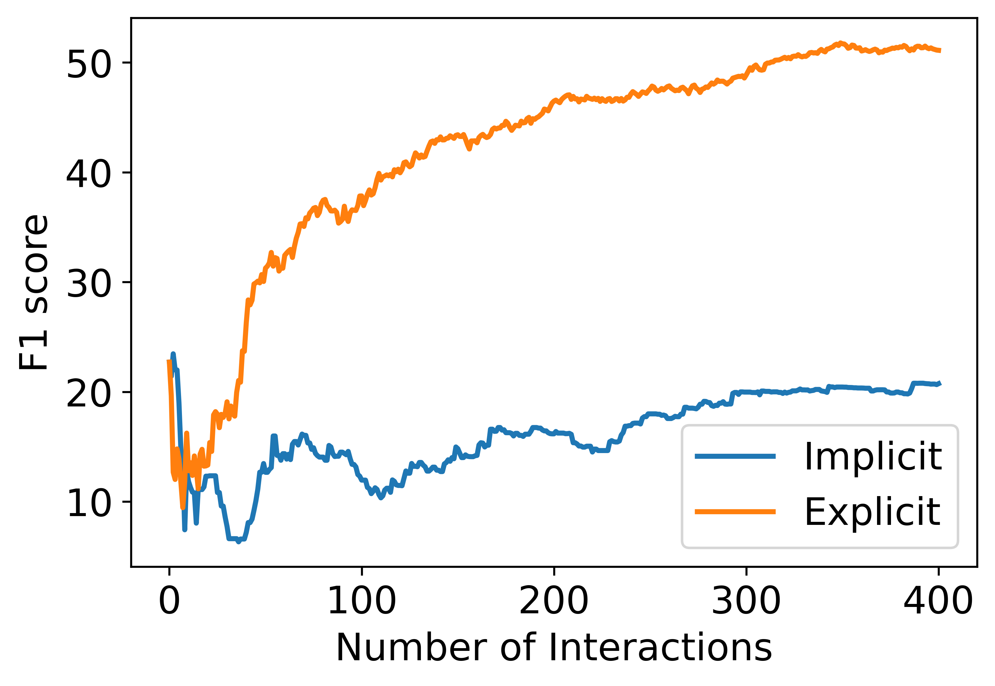
Results
The above plots show the mean accuracy, precision and f1 score across 400 interactions.
We can observe that the accuracy reaches 85% in under 50 interactions for both modes of feedback.
It is also interesting to observe that Explicit feedback is more effective than Implicit feedback across different metrics. It should be noted that each implicit feedback adds two data points compared to a single data point for Explicit feedback.
Our approach is effective. Explicit feedback helps learn faster
Notes:
Existing literature to counter algorithmic bias can be classified into 3 different stages :- data, model and prediction

Slide 11
Limitations
Our tool classifies each word without considering its context. However, some words might be easier to pronounce on their own but might be difficult with specific other words like ‘rural juror’.
Words Representing Names, Places, etc. can’t be substituted. Our tool just highlights such words. The user might go for alternate techniques like circumlocution, etc.
Our approach mightn’t work for someone suffering from acute stammering. Substituting multiple words in a sentence might break the semantic structure of the sentence and require rephrasing.
The user is asked to provide a binary label for a word (difficult or not). However, in the real world, a user might struggle on a word often but not always. To cater to such situations, our tool should elicit a more nuanced (continuous) feedback instead of a discrete binary label.
So far, our tool only supports English language.
We hope this work will encourage other researchers to work on this important and under-explored area
Notes:
Existing literature to counter algorithmic bias can be classified into 3 different stages :- data, model and prediction

Slide 12
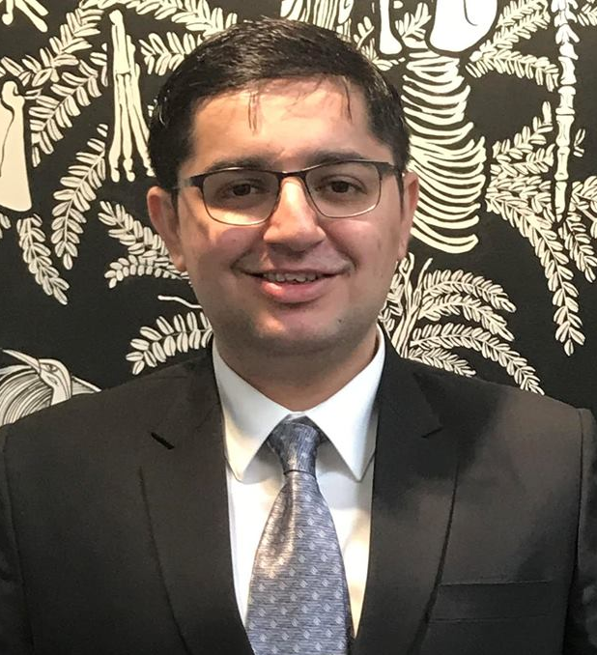

Thanks for your attention!
For any Questions, suggestions, feedback, criticism, please email me at:- bghai@cs.stonybrook.edu
Bhavya Ghai

Slide 13
Thanks for your Attention!

Slide 14
Xiaojun Bi’s Feedback
Name, place, date can’t be replaced – limitation
Best way is not to avoid such words – Justify if this approach is right
Each word has a nuance. Can’t be completely replaced
Maybe, helps user to better pronounce by identifying such words
Evaluation – baseline – manual replacement, Expert interview, simulating
Notes:
Existing literature to counter algorithmic bias can be classified into 3 different stages :- data, model and prediction

Slide 15
Evaluation
User Study
Difficult to find users with speaking difficulties. Non-native speakers might be an option.
Our system is bad at the beginning but evolves with time. Might be tricky to evaluate
Can ask for subjective evaluation
Expert Evaluation
We can demonstrate our tool to experts like Speech Language Pathologists Simulation
Simulation
We can simulate users who find certain words difficult and evaluate our tool on precision and recall. This way we can also see how the performance of the tool increases with time.
Notes:
Existing literature to counter algorithmic bias can be classified into 3 different stages :- data, model and prediction

Slide 16
AI Augmented Writing Platforms
People with Visual Impairments
Autocompletion of sentences
Refine tone, grammatical errors (Grammarly)
Gender Bias (Text.io)
Notes:
Existing literature to counter algorithmic bias can be classified into 3 different stages :- data, model and prediction

Slide 17
Methodology
How much money might a person with the following attributes make in a year?
Arrange the attributes based on their impact towards the given prediction task
Model 1
Attribute | Value
Age | 39
Work class | Private
Years of Education | 13
Marital Status | Never Married
Occupation | Executive & Managerial
Race | White
Gender | Male
Hours per week | 50
Age
Model 2
Work class
Years of Education
Next Instance
to be queried
Marital Status
Labeled
data
Max
Disagreement
Model 3
Occupation
.
.
.
.
.
.
Race
Committee
Of Classifiers
Gender
Less than $50,000
More than $50,000
Hours per week
Model n
Notes:
Existing literature to counter algorithmic bias can be classified into 3 different stages :- data, model and prediction

Slide 18
Motivation - XAL
Explainable Active learning (XAL) is an AL framework where a user is presented with a query, model’s prediction and its local explanation.
Local
Explanation
Sampling
Strategy
Prediction
Query
Unlabeled
Data
Label
Classifier
Oracle
Annotator’s naturally want to “teach” with rationale beyond just labels
Ghai, Bhavya, et al. "Explainable Active Learning (XAL): An Empirical Study of How Local Explanations Impact Annotator Experience." arXiv preprint arXiv:2001.09219 (2020).
Notes:
This work is motivated from our previous work on Explainable active learning or XAL.
we conducted a user study to understand the impact of adding local explanations with every query in the Active learning pipeline.
One of the key takeaways from the this work is that
A common way to justify their label is by indicating the most important features
where an annotator is presented with a query, model’s prediction and its local explanation
Last summer, we were working on a different project where we
To know more about XAL, please refer

Slide 19
Sampling Strategy
To incorporate the additional feedback, we used bagging based Query by Committee (QBC) sampling strategy and modified its disagreement measure
Annotator’s Rationale
Model i
Model 1
w₁
Local Model Explanation
Model 2
w₂
Feature Ranking
Disagreement
Measure
Next Instance
to be queried
Feature Ranking
Labeled
data
Model 3
w₃
.
.
.
.
.
Committee
Of Classifiers
Similarity
w_{n}
Model n
w_{i}
Model with higher similarity to Annotator’s rationale is given higher weight
Notes:
Let’s first see how a typical QBC sampling strategy works.
Given a pool of labeled data, we train a set of models by randomly selecting instances. These models form the committee of classifiers
Thereafter, each model is used to generate predictions for the unlabeled data. The unlabeled instance on which the committee disagrees the most is selected to be queried.
In this current system, each model in the committee has equal say.
However for AL++, we have modified this strategy such the each model is assigned a weight wi. If a model’s rationale is pretty similar to the annotator’s rationale, its assigned a higher weight.
Model agnostic

Slide 20
Active Learning++
AL++ is a novel AL framework which can utilize an annotator’s labels as well as it’s rationale.
We propose a new way to elicit annotator’s rationale and incorporate that into the learning process.
Annotator’s
Rationale
Sampling
Strategy
Query
Label
Unlabeled Data
Classifier
Oracle
Our hypothesis is that the additional feedback should help train the model faster
Notes:
To address this challenges, we present a new AL framework called Active Learning++
Rationale is the additional feedback which provides the reasoning behind the label

Slide 21
Elicit Annotator’s Rationale
For each query, we elicit Annotator’s rationale in the form of ranking of input features based on their contribution towards the prediction task
How much money might a person with the following attributes make in a year?
Arrange the attributes based on their impact towards the given prediction task
Attribute | Value
Age | 39
Work class | Private
Years of Education | 13
Marital Status | Never Married
Occupation | Executive & Managerial
Race | White
Gender | Male
Hours per week | 50
Age
Work class
Education
Marital Status
Occupation
Race
Gender
Less than $50,000
More than $50,000
Hours per week
Notes:
This is line with our XAL study
Where we saw that annotator’s feedback is imprecise.

Slide 22
Sampling Strategy
To incorporate the additional feedback, we used bagging based Query by Committee (QBC) sampling strategy and modified its disagreement measure
Model 1
w₁
Model 2
w₂
Disagreement
Measure
Next Instance
to be queried
Labeled
data
Model 3
w₃
.
.
.
.
.
Committee
Of Classifiers
w_{n}
Model n
Model with higher similarity to Annotator’s rationale is given higher weight
Notes:
Let’s first see how a typical QBC sampling strategy works.
Given a pool of labeled data, we train a set of models by randomly selecting instances. These models form the committee of classifiers
Thereafter, each model is used to generate predictions for the unlabeled data. The unlabeled instance on which the committee disagrees the most is selected to be queried.
In this current system, each model in the committee has equal say.
However for AL++, we have modified this strategy such the each model is assigned a weight wi. If a model’s rationale is pretty similar to the annotator’s rationale, its assigned a higher weight.
Model agnostic

Slide 23
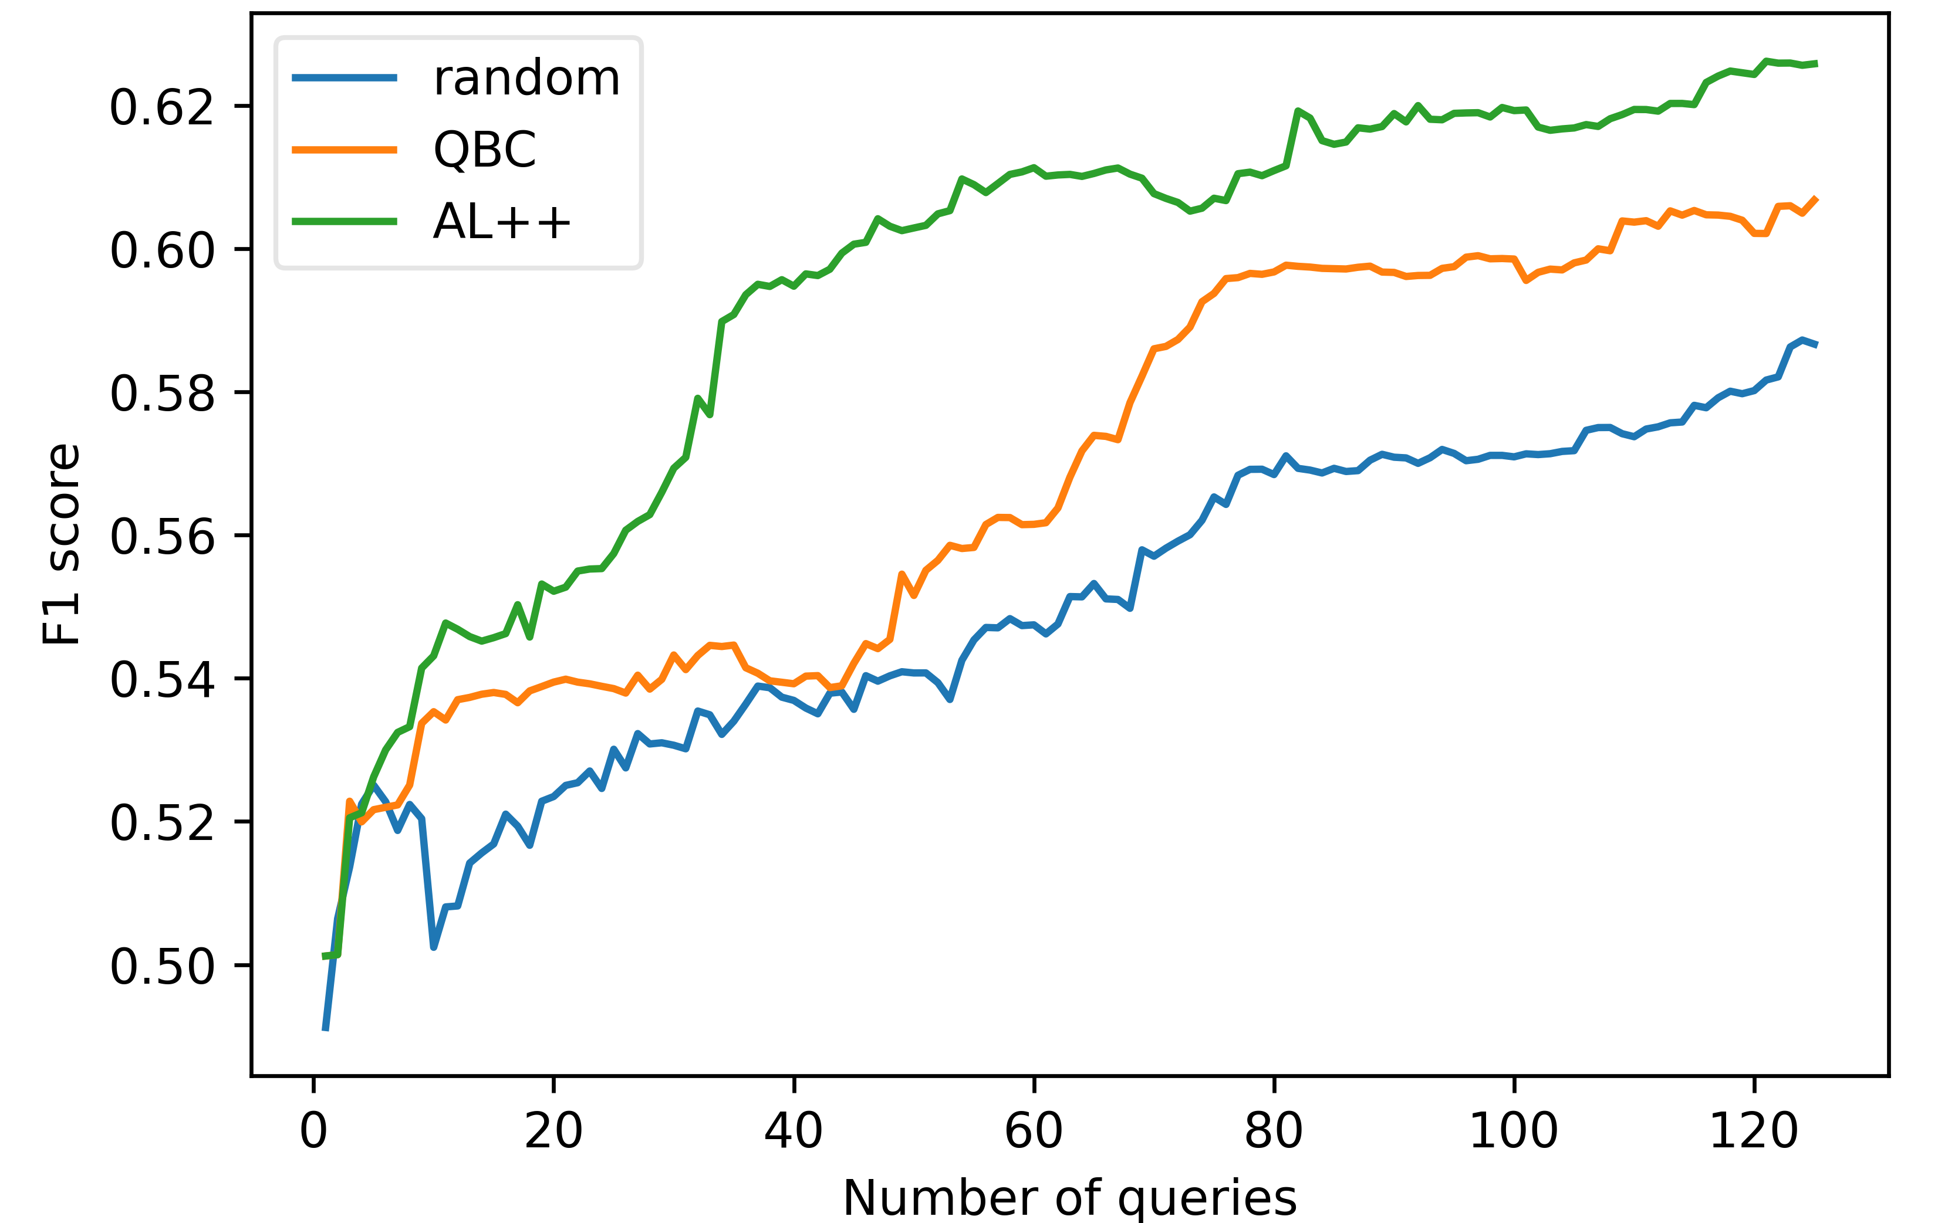
Preliminary Results
We performed 10 simulations with different initial labeled dataset for 125 queries using Adult Income dataset.
We found that the mean F1 score for AL++ is significantly higher than QBC and random sampling (p<0.01).
To reach F1 score of 0.54, AL++ requires 11.8 queries vs 25.9 queries required by QBC on average.
AL++ helps train the ML model faster than vanilla AL
Notes:
AL++ maintains a contant lead over others right from the beginning
This simulation based on Adult Income dataset show that AL++ helps train ………………..

Slide 24

Conclusion & Future Work
We presented a new AL framework, Active learning++, which can utilize annotator’s rationale in the form of feature importance-based ranking.
Next, we plan to conduct a comprehensive analysis using different datasets and even different domains like text classification.
We wish to simulate other scenarios where the annotator provides noisy feedback or ranking for only top-k features.
Lastly, we plan to conduct a user study to see how this framework works in practice and compares with vanilla AL.
Notes:
For k=1, annotator only needs to provide the most important feature for a given query.
For comparing with vanilla AL, we can also account for the cost of providing the additional feedback.
With that, I thank you for your attention. Looking forward to any questions, suggestions, feedback!

