Slide 1
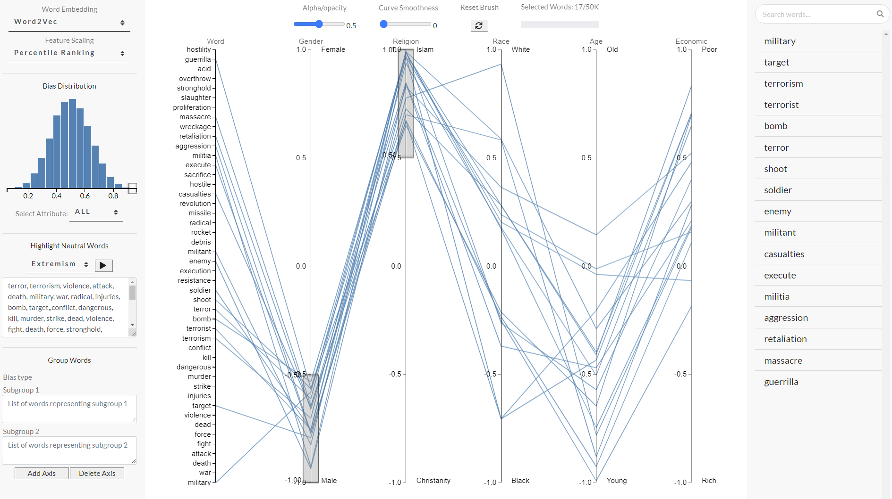
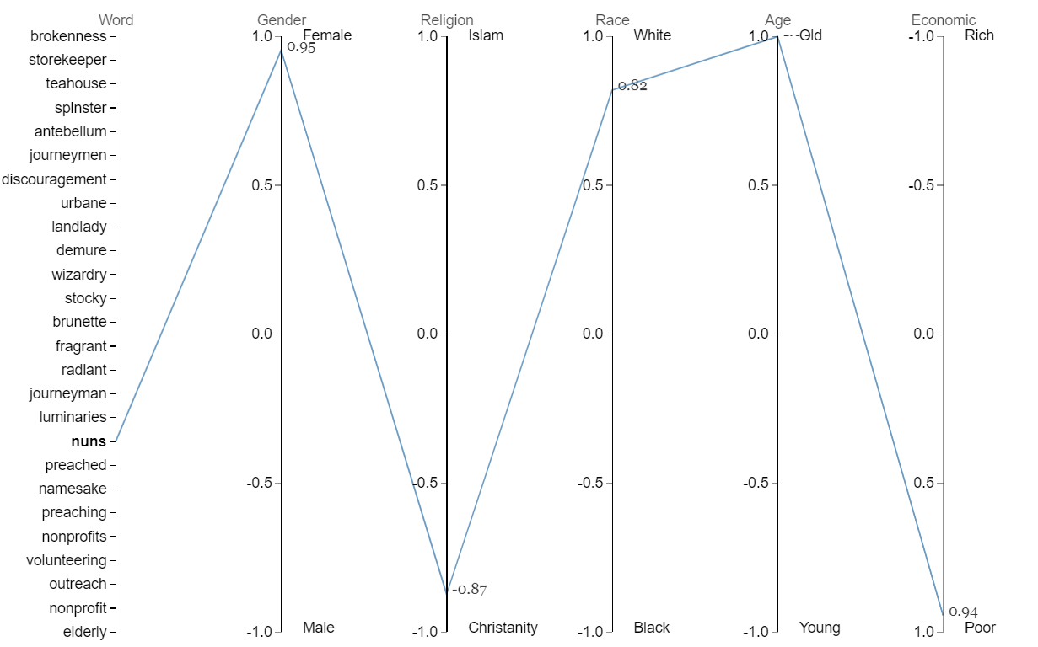

WordBias: An Interactive Visual Tool for Discovering Intersectional Biases Encoded in Word Embeddings
Bhavya Ghai, Md Naimul Hoque, Klaus Mueller
Stony Brook University, USA
Abstract
Visual Interface
Intersectional bias is a bias caused by an overlap of multiple social factors like gender, sexuality, race, disability, religion, etc. Word embedding models can be laden with biases against intersectional groups like African American females. We present WordBias, an interactive visual tool designed to explore biases against intersectional groups encoded in word embeddings. Identifying such biases will serve as the first step in deterring their spread and help develop counter strategies.
WordBias can be used as an Auditing tool by data scientists, Educational tool by students/non-experts and to expedite the bias discovery process by researchers.
Design Choice
We used Parallel Coordinate plot to visualize associations (bias scores) of different words along different groups in the word embedding. Each polyline (blue) encodes a word, and each axis represents a sensitive attribute like gender, race, religion, etc.
In the above figure, the user has brushed over 'Male' and 'Islam' subgroups. Words with strong association to both these subgroups are listed below the search box like military, terrorism, terrorist, soldier, aggression, retaliation, etc.
Results
Intersectional Groups | Associated Words
Poor - Young - Black | disaster, struggle, tackle, chaos, woes, hunger, uprising, desperation, insecurity, rampage, roadblocks
Rich - Old - White | formal, attractive, appealing, desirable, castle, desserts, seaside, golfing, cordial, bungalow, fanciful, warmly, salty
Black - Muslim - Male | gun, assassination, bullets, bribes, thugs, looted, dictators, electrocuted, cowards, agitating, storekeeper, looter, bleeping
Young - Christian - Male | career, dominant, brilliant, lone, terrific, heroes, superb, epic, monster, prowess, heavyweights, excelled, superstars
On Hovering over the word 'nuns', its corresponding polyline gets highlighted. We can observe its association with 'Female', 'Christianity', 'White', 'Old' and 'Poor' subgroups.

