Slide 1
Recognition of Prokaryotic and Eukaryotic promoters using convolutional deep learning neural networks

Slide 2
Implementation Guide
Used the dataset from https://github.com/solovictor/CNNPromoterData.git. and extracted the DNA sequences from the fasta files.
Converted DNA sequence into one hot encoding for the ATGC bases.
Split the dataset into training, validation and testing datasets in the ratio 8:1:1
Created the CNN network with 1. Convolution Layer with 200 channels and a filter of dimension (21,1).
2. MaxPooling layer with kernel size of (31,1) with ReLU Activation function.
3. Fully connected linear layer of size 128 nodes followed by ReLU activation.
4. Linear layer of 2 nodes to classify Promoter/Non Promoter.
Trained the above model for 15 epochs.

Slide 3
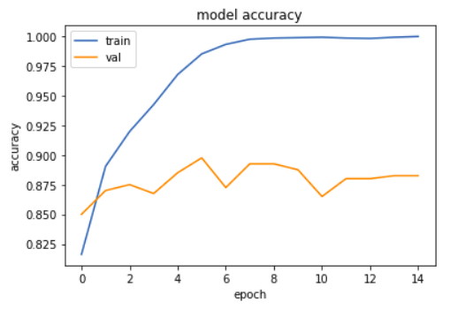
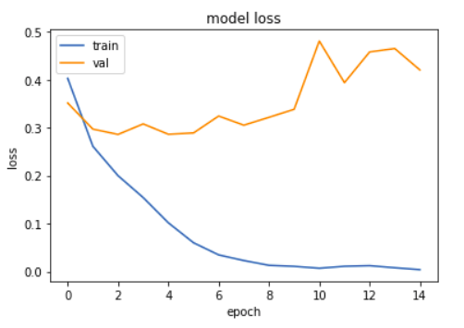
Results
We received a training accuracy of 99.97% and a test accuracy of 93.62% on Ecoli promoter and non-promoter dataset.
Below are the results of the model in graphical format :-

