Slide 1
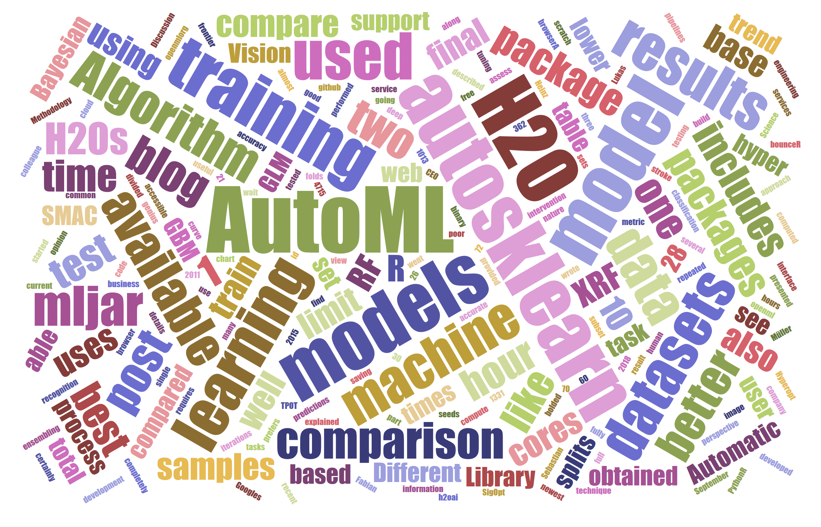
AUTO-ML
PRESENTED BY
Team - 5
Saumil Shah
Nikita Gawde
Harshitha GS
Bhavya Haridas

Slide 2
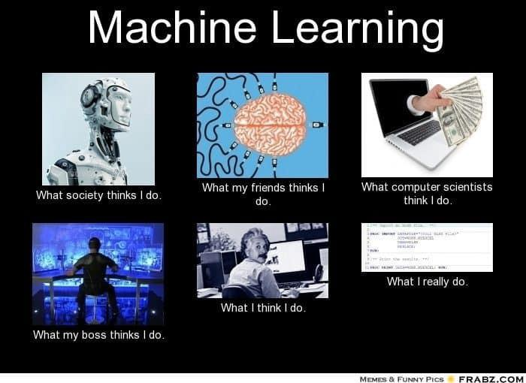
Why automate Machine Learning??
Improve efficiency of ML
Accelerate research on ML
Make ML available to non-ML experts

Slide 3
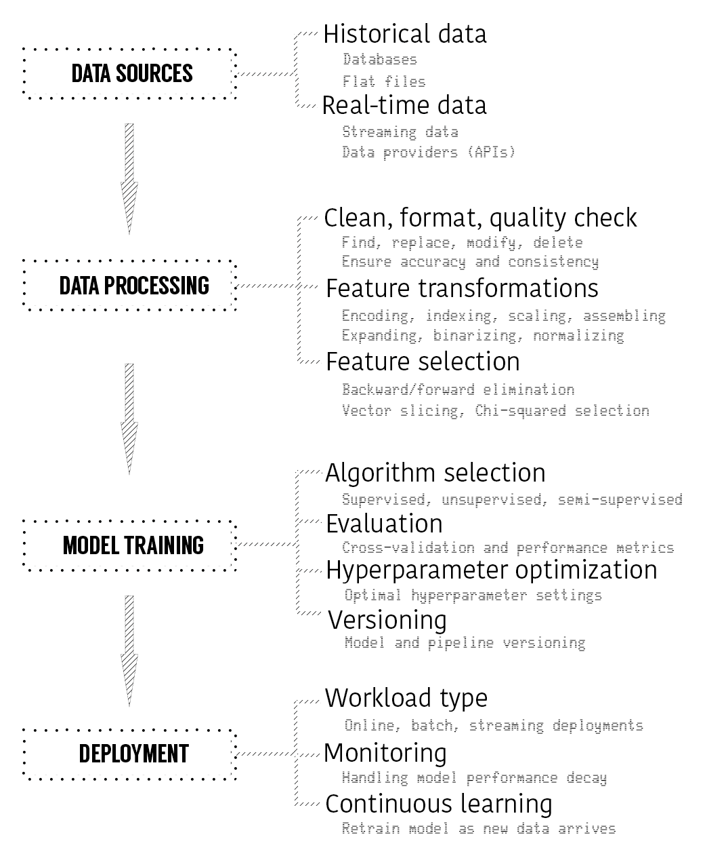
Auto-ML Goals
Automatically constructs ML pipelines for
Data pre-processing
Feature engineering
Feature selection
Model selection
Hyper-parameter optimization
Image source – “Hands-on Machine Leaning” – by Umit Mert Cakmak, Sibanjan Das

Slide 4
Auto-ML Libraries and Methodologies
Google Cloud Auto ML
Neural Architecture Search
Demo using Cloud NLP
Comparison with Auto Keras
Microsoft Azure Machine Learning Services
Introduction to Azure ML Services
Automated ML – models and parameters
Demo
H2O.ai
Introduction
Installation and basic commands in python
Auto SKLearn
Usage of Bayesian optimization, meta-learning and ensemble construction
Installation and demo
TPOT
Introduction and Principle

Slide 5
Google Cloud Auto-ML

Slide 6
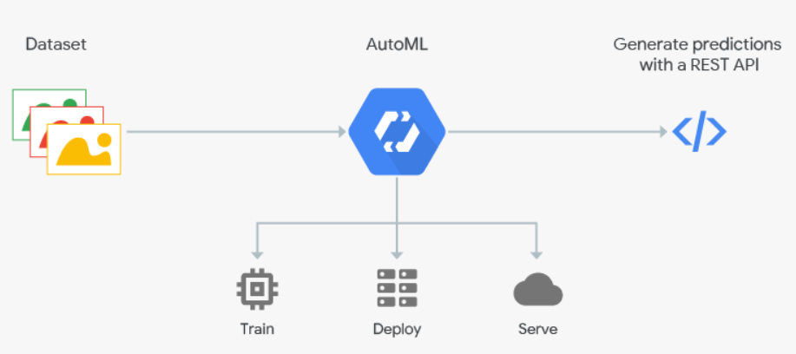
Features
Image source - https://cloud.google.com/automl/
Creates custom machine learning models for
Vision – Image classification
Natural Language – Text classification
Translation – Domain (Language) translation
Based on Neural Architecture Search (NAS)

Slide 7
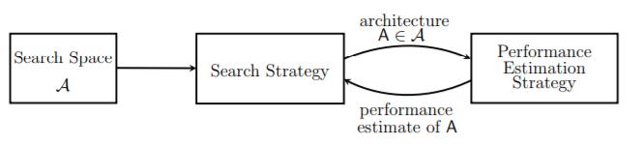
Neural Architecture Search (NAS)
First logical step in automated ML
Parallels to the idea of searching a program from examples
Components -
Search space - describes set of possible neural network architectures to consider
Search strategy - determines how to explore search space
Performance Estimation Strategy - measures the quality of each architecture considered
Image source - https://www.ml4aad.org/wp-content/uploads/2018/12/nas-1.pdf

Slide 8
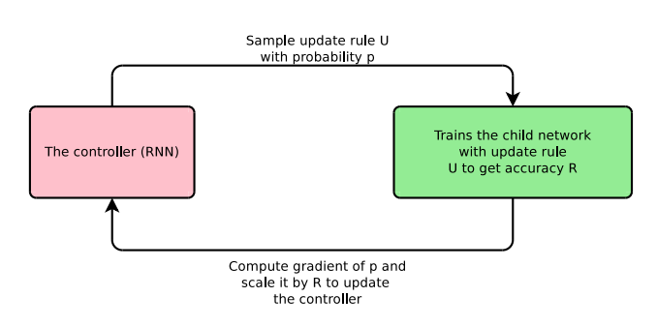
Reinforcement Learning in NAS
Reinforcement Learning to design neural networks
Parent NN (Recurrent Neural Network) will randomly propose a child model architecture with probability p
Which is then trained and evaluated for quality on specific tasks
Feedback used by the parent to improve the next generated child architecture
The process is repeated 1000’s of times every time generating new architectures, testing them and giving feedback to parent.
Computes gradient of p
The parent learns to assign a high probability to areas of architecture space that have the best accuracy

Slide 9
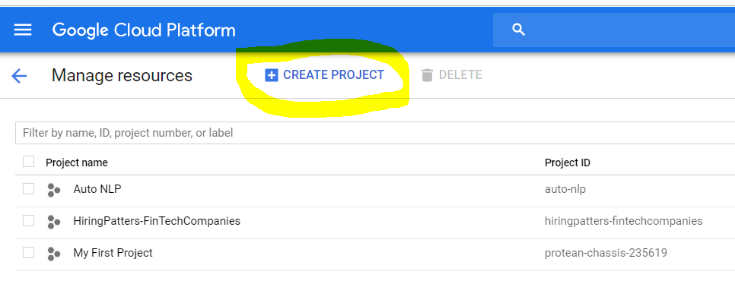
Install Google Cloud SDK
Create/Choose your google cloud project
Install SDK and run gcloud init
Create new dataset
Train and Evaluate

Slide 10
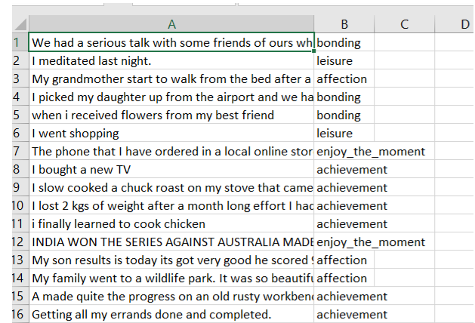
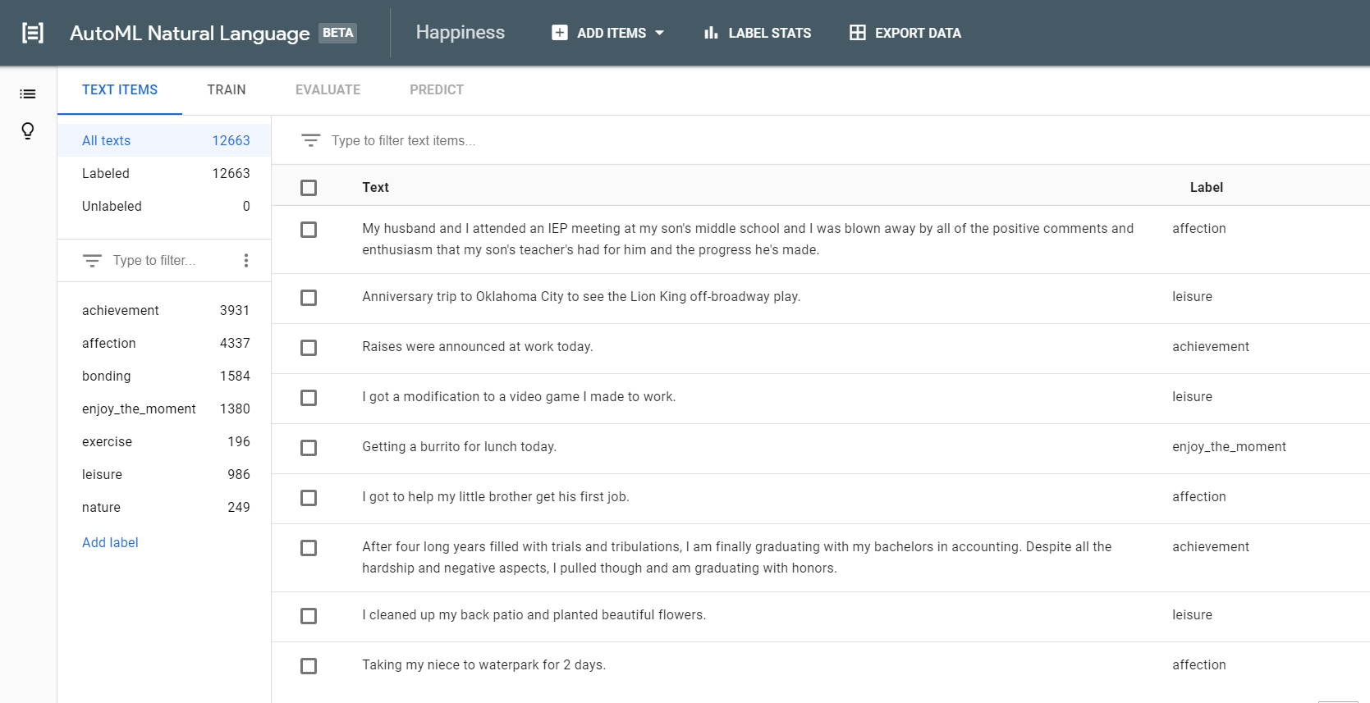
Create Dataset

Slide 11
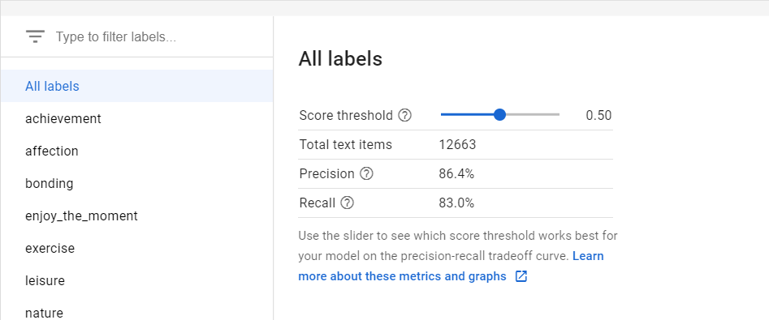
Dashboard
https://cloud.google.com/automl/ui/text/models/list?project=auto-nlp
Score Threshold - customisable level of confidence to classify.
Average Precision - how well model performs across all score thresholds
Precision - Higher the precision, fewer false positives
Recall - Number of examples that were assigned a label. Higher the recall, fewer false positives

Slide 12
E-NAS and Auto-Keras
Computational bottleneck of NAS - train model till convergence; measure its test accuracy; throw away all the trained weights.
Transfer learning - higher accuracy - networks trained on somewhat similar tasks discover similar weights.
Enhanced NAS forces models to share weights than train from scratch - faster convergence.
Auto-keras - open source deep learning alternative for Google Cloud AutoML
Uses E-NAS and Network Morphism

Slide 13
MS Azure ML Services

Slide 14
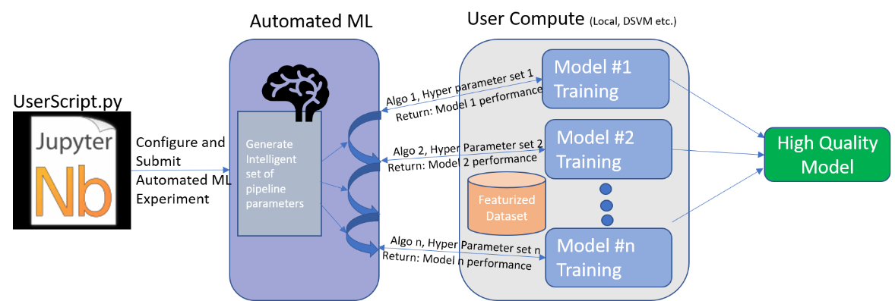
SDK Features
SDKs and cloud services to quickly prep data, train, and deploy machine learning models
Improves productivity with autoscaling compute and pipelines
Can be used on open source Python frameworks - TensorFlow, PyTorch, and scikit-learn
Provides advanced data pipelining -
Unattended runs
Mixed and diverse compute
Reusability
Tracking and versioning
Model Explainability -
Awareness of pipeline
Feature importance
Image source - https://docs.microsoft.com/en-us/azure/machine-learning/service/concept-automated-ml

Slide 15
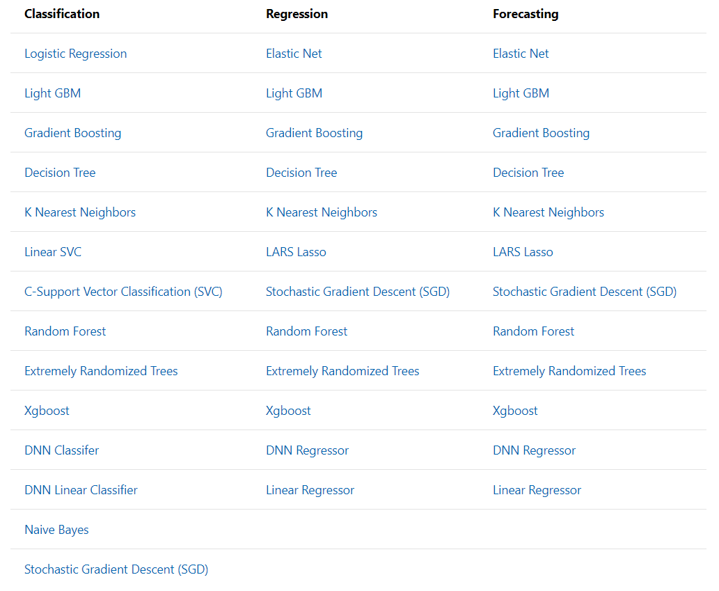
Models tried while training

Slide 16
Azure Machine Learning Data Prep SDK
Explore, cleanse and transform data for machine learning workflows.
SDK includes functionalities like
Automatic file detection
Summary statistics
Intelligent time-saving transformations
Assertion
Benefits of SDK
Cross-platform functionality.
Intelligent transformations powered by AI.
Seamless integration with other Azure Machine Learning services.
AUTO-TRAIN
https://docs.microsoft.com/en-gb/azure/machine-learning/service/tutorial-auto-train-models

Slide 17
H2O.ai

Slide 18
Introduction
Open source machine learning and predictive analytics platform .
Source code is written in Java.
Algorithms implemented on H2O’s distributed Map/Reduce framework using Java Fork/Join framework for multi-threading.
Data parser has built-in intelligence to get the format and datatype of data imported from multiple sources.
Rest API used by H2O’s web interface (Flow UI), R binding (H2O-R), and Python binding (H2O-Python).

Slide 19
Stacked Ensembles
Ensemble machine learning methods used to obtain better predictive performance than could be obtained from any of the constituent learning algorithms.

Slide 20
Stacked Ensembles
H2O’s Stacked Ensemble method is supervised ensemble machine learning algorithm
Stacking, also called Super Learning , is a class of algorithms that involves training a second-level “meta learner” to find the optimal combination of the base learners.
The Super Learner ensemble is distinguished by the use of cross-validation to form “level-one” data, or the data that the meta learning algorithm is trained on.

Slide 21
Stacked Ensembles
Set up the ensemble.
Specify a list of L base algorithms
Specify a meta learning algorithm.
Train the ensemble.
Train each of the L base algorithms on the training set.
Perform k-fold cross-validation on each of these learners and collect the cross-validated predicted values.
The N cross-validated predicted values from each of the L algorithms are combined to form a new N x L matrix. This matrix, along with the original response vector, is called the “level-one” data.
Train the meta learning algorithm on the level-one data. The “ensemble model” consists of the L base learning models and the meta learning model, which can then be used to generate predictions on a test set.
Predict on new data.
Generate ensemble predictions using the predictions from the base learners

Slide 22
Auto-Sklearn

Slide 23
Introduction
Auto-sklearn won both the auto track and the tweakathon phases of the ChaLearn Machine Learning Algorithm Competition.
It leverages recent advances in Bayesian optimization, meta-learning and ensemble construction.It frees a machine learning user from algorithm selection and hyperparameter tuning.
It has the following system requirements:
1.Linux operating system (for example Ubuntu)
2.Python (>=3.5)
3.C++ compiler (with C++11 supports)
4.SWIG (version 3.0 or later)

Slide 24
Installation Process
Ensure that above system requirements are met and then in terminal type the following commands:
curl https://raw.githubusercontent.com/automl/auto-sklearn/master/requirements.txt | xargs -n 1 -L 1 pip install
pip install auto-sklearn
pip install pyrfr
If there’s error during installation of pyrfr package then create a virtual environment.The steps are:
python3 -m pip install --user virtualenv (installing virtual environment for MacOS and Linux)
py -m pip install --user virtualenv (for Windows)
python3 -m virtualenv env ( creating a virtual environment)
py -m virtualenv env (for Windows)
source env/bin/activate ( activating a virtual env)
.\env\Scripts\activate (for Windows)
Then install the pyrfr package and the auto-sklearn package using the pip command.
Deactivate (to stop the virtual environment)

Slide 25
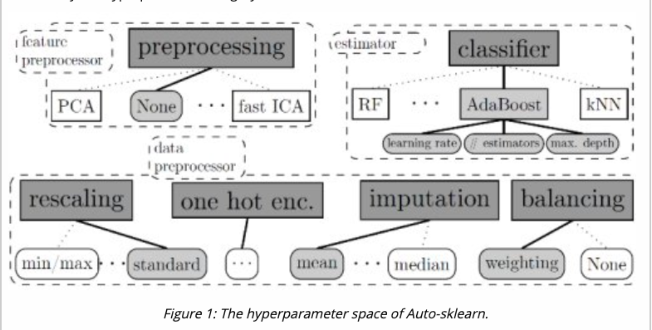

Slide 26
TPOT

Slide 27
Features
Its called The Tree-Based Pipeline Optimization Tool (TPOT)
Was one of the very first AutoML methods and open-source software packages developed for the data science community
Its goal is to automate the building of ML pipelines
It combines a flexible expression tree representation of pipelines TPOT makes use of this
It uses Python-based scikit-learn library as its ML menu
It has a genetic search algorithm to find the best parameters and model ensembles

Slide 28
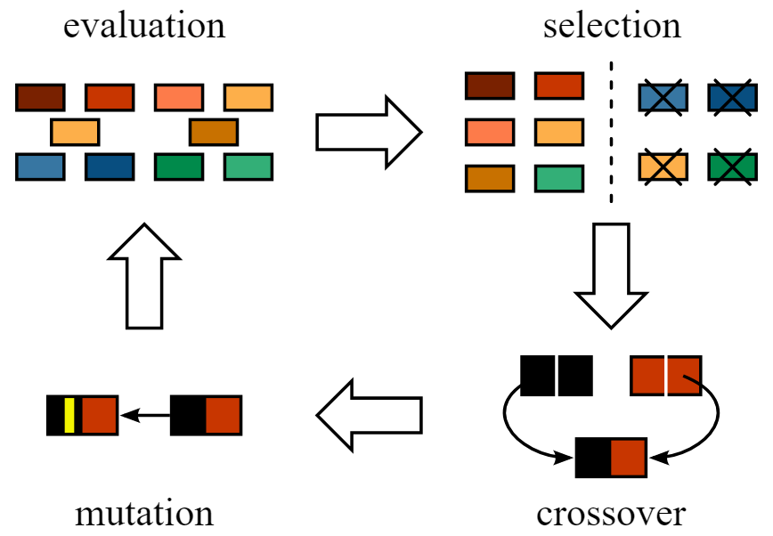
Genetic Algorithm

Slide 29
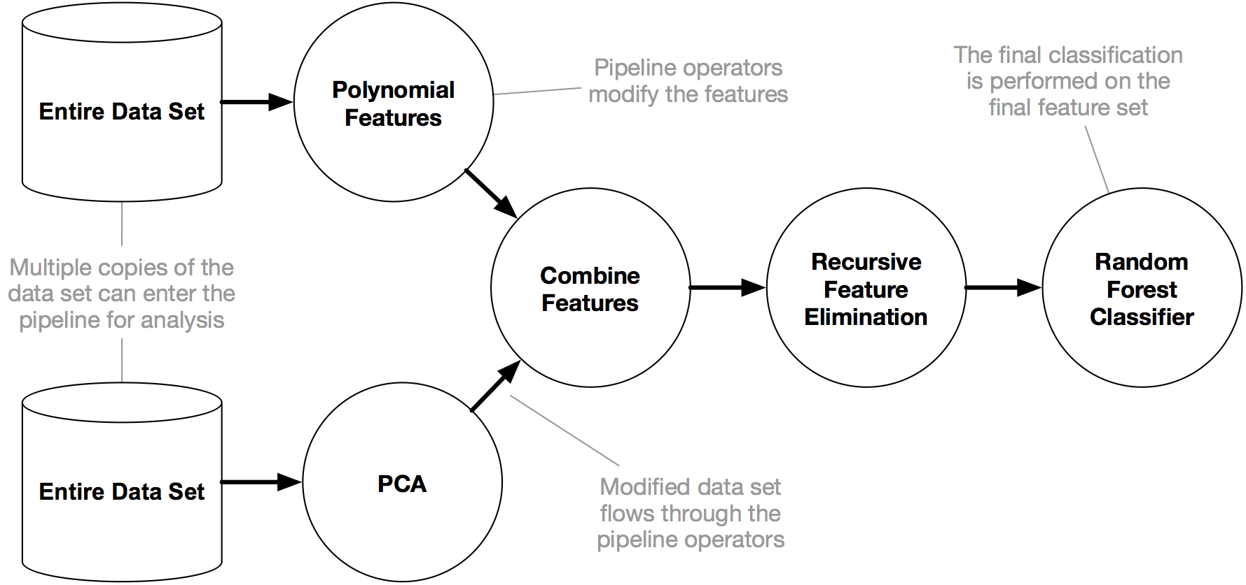
TPOT pipeline

Slide 30
TPOT Installation
To install Xgboost
pip install xgboost
If you plan to use Dask for parallel training, make sure to install dask[delay] and dask_ml.
pip install dask[delayed] dask-ml
Finally to install TPOT
pip install tpot

Slide 31
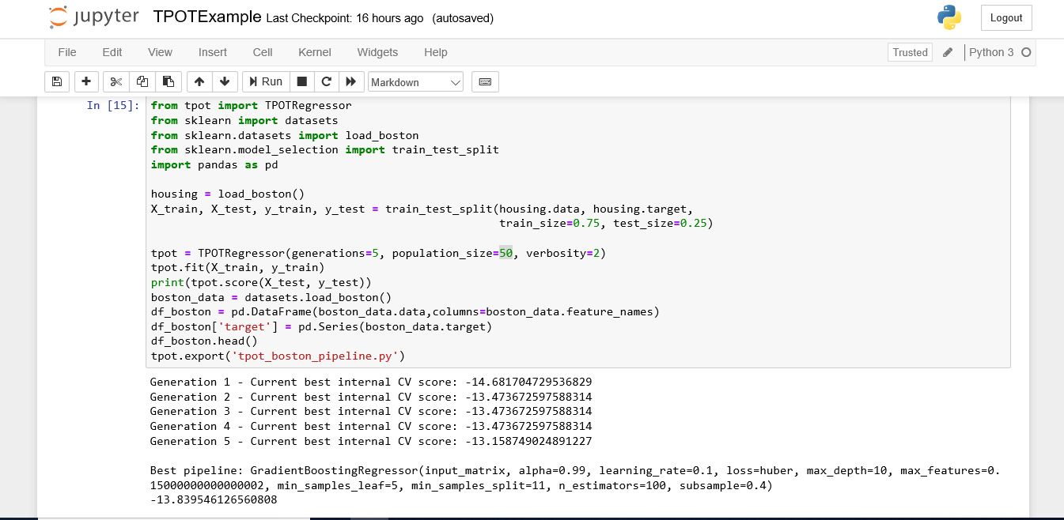
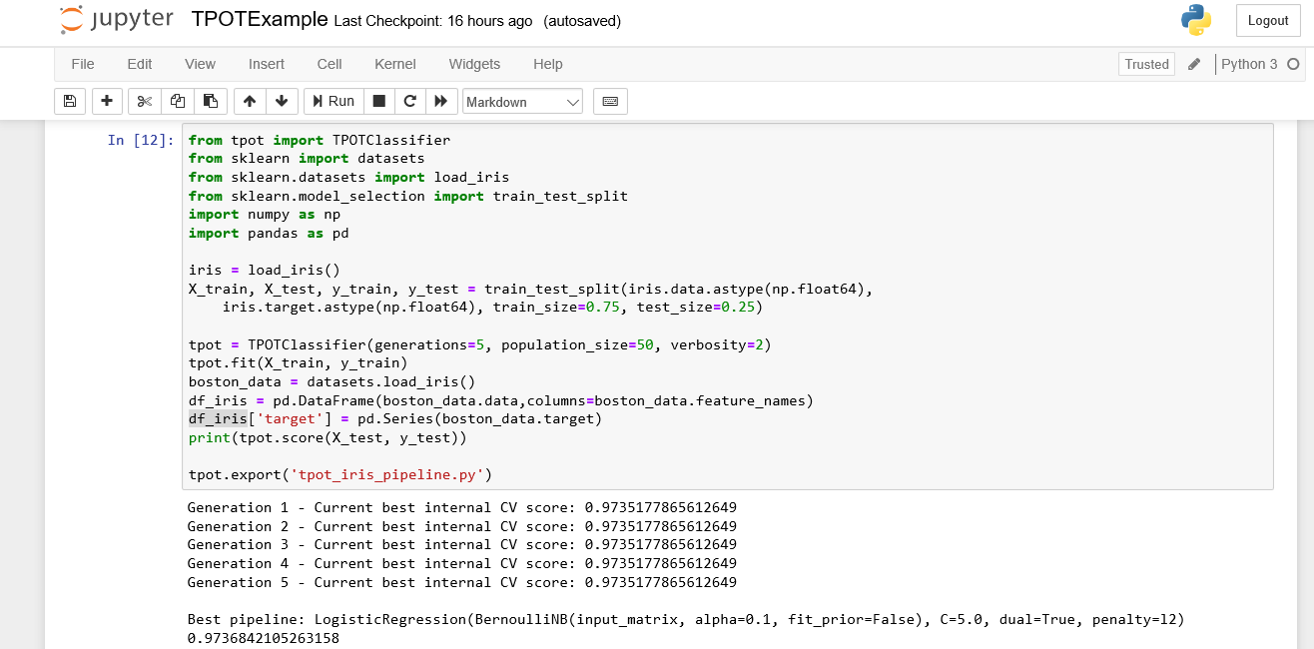
TPOT API

Slide 32
Wrapping Up
An Auto-ML tool like Cloud Auto-ML resolves a lot of challenges. However, an important aspect to be considered
Data Quality -poor data quality or biased data can lead to poor results
Relying on a model without accounting for biases can lead to costly results
Proper data processes and testing still need to be thoroughly applied with a model produced by Auto ML.

Slide 33
Resources
https://automl.info/
https://www.automl.org/automl/
https://xgboost.readthedocs.io/en/latest/tutorials/model.html
https://automl.github.io/auto-sklearn/stable/examples/example_regression.html#sphx-glr-download-examples-example-regression-py
https://learning.oreilly.com/library/view/hands-on-automated-machine/9781788629898/#toc
https://automl.github.io/auto-sklearn/stable/manual.html
https://www.mavenwave.com/cloud-machine-learning/why-googles-cloud-auto-ml-is-most-important-launch-yet/

Slide 34
Thank You!

