Slide 1
2 Wheeler Cluster Display

Slide 2
2 Wheeler Cluster Display
Project Objective & System Overview
Modern vehicles are rapidly shifting from traditional analog meters to fully digital instrument clusters.
Digital displays provide better visibility, real-time updates, and enhanced user interaction.
This project aims to develop a digital instrument cluster using Qt/QML on an embedded platform, capable of displaying real-time vehicle parameters received wirelessly from an ESP32 sensor module through Wi-Fi and Firebase.
Implemented Features
Displays real-time speed and temperature fetched from ESP32 via Wi-Fi and Firebase
Shows current time and date using the OKT507-C RTC
Provides a graphical battery level indicator
Includes Anti-Theft Lock for vehicle security
Detects vehicle tilt/fall and triggers an alarm
Implements a Wi-Fi configuration GUI for hotspot connection
System Architecture (Working Principle)
ESP32 acts as the sensor data acquisition unit
Sensor data is transmitted wirelessly using Wi-Fi
Firebase is used as a cloud intermediary for data transfer
C++ backend on OKT507-C handles data fetching and processing
QML UI layer displays the received data in real time on the screen

Slide 3
2 Wheeler Cluster Display
Hardware Components Used
ESP32 Microcontroller
Used as the microcontroller to sense the data from the sensors
Collects real-time speed and temperature values
Provides built-in Wi-Fi connectivity for data transmission to firebase
OKT507-C Embedded Board
Acts as the processing and display unit
Runs Embedded Linux
Executes the Qt/QML digital instrument cluster application
Display Panel
Visualizes speed, temperature, time/date, battery level, settings features and Anti-Theft.
Power Supply
Provides regulated power to ESP32 and OKT507-C board

Slide 4
2 Wheeler Cluster Display
Tools, Kits & Languages Used
Development Environment
  Ubuntu Linux
  Qt Creator
  Arduino IDE
Embedded Linux
  Custom Linux image on OKT507-C
Hardware Platform
  OKT507-C Single Board Computer
  External ESP32 sensor module
Programming Languages
  C++ – backend logic and data handling
  QML – real-time UI and animations
  Python Script – To bypass firebase data to PC and to OKT

Slide 5
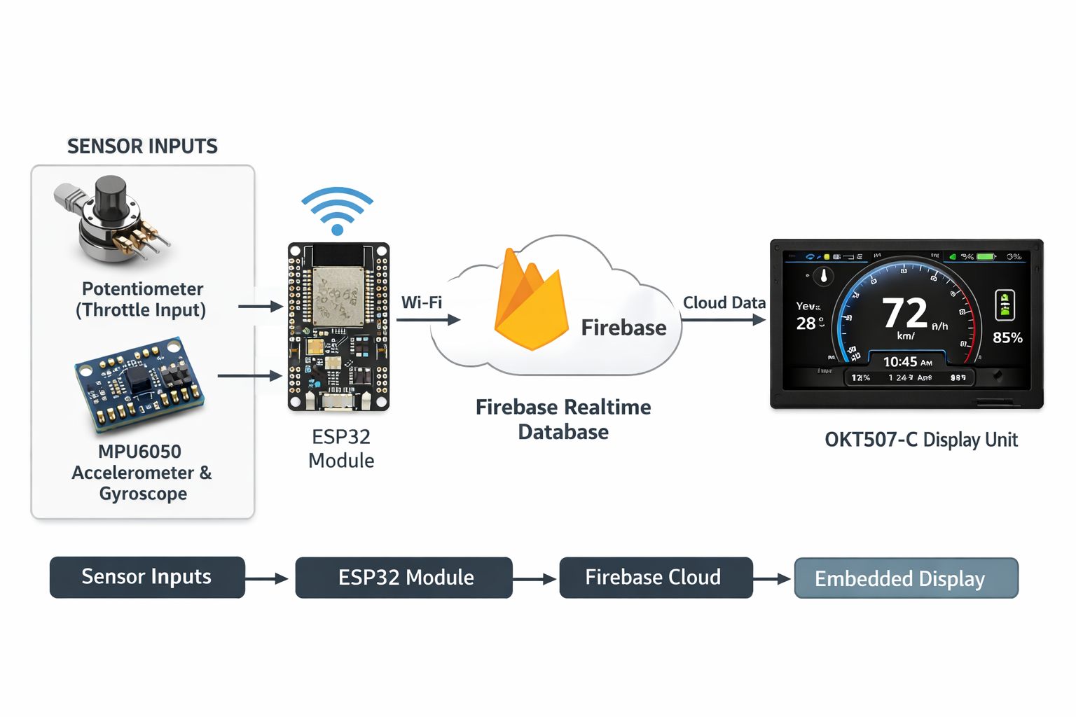
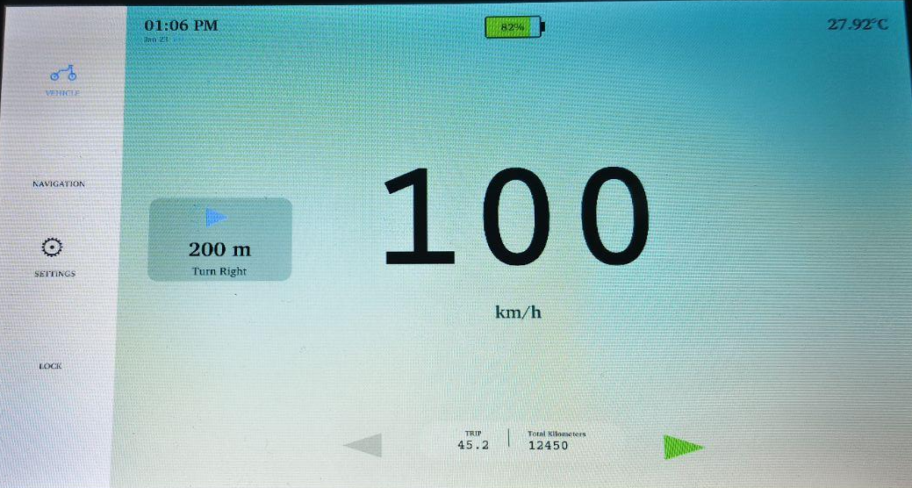
2 Wheeler Cluster Display
WorkFlow

Slide 6

2 Wheeler Cluster Display

Slide 7
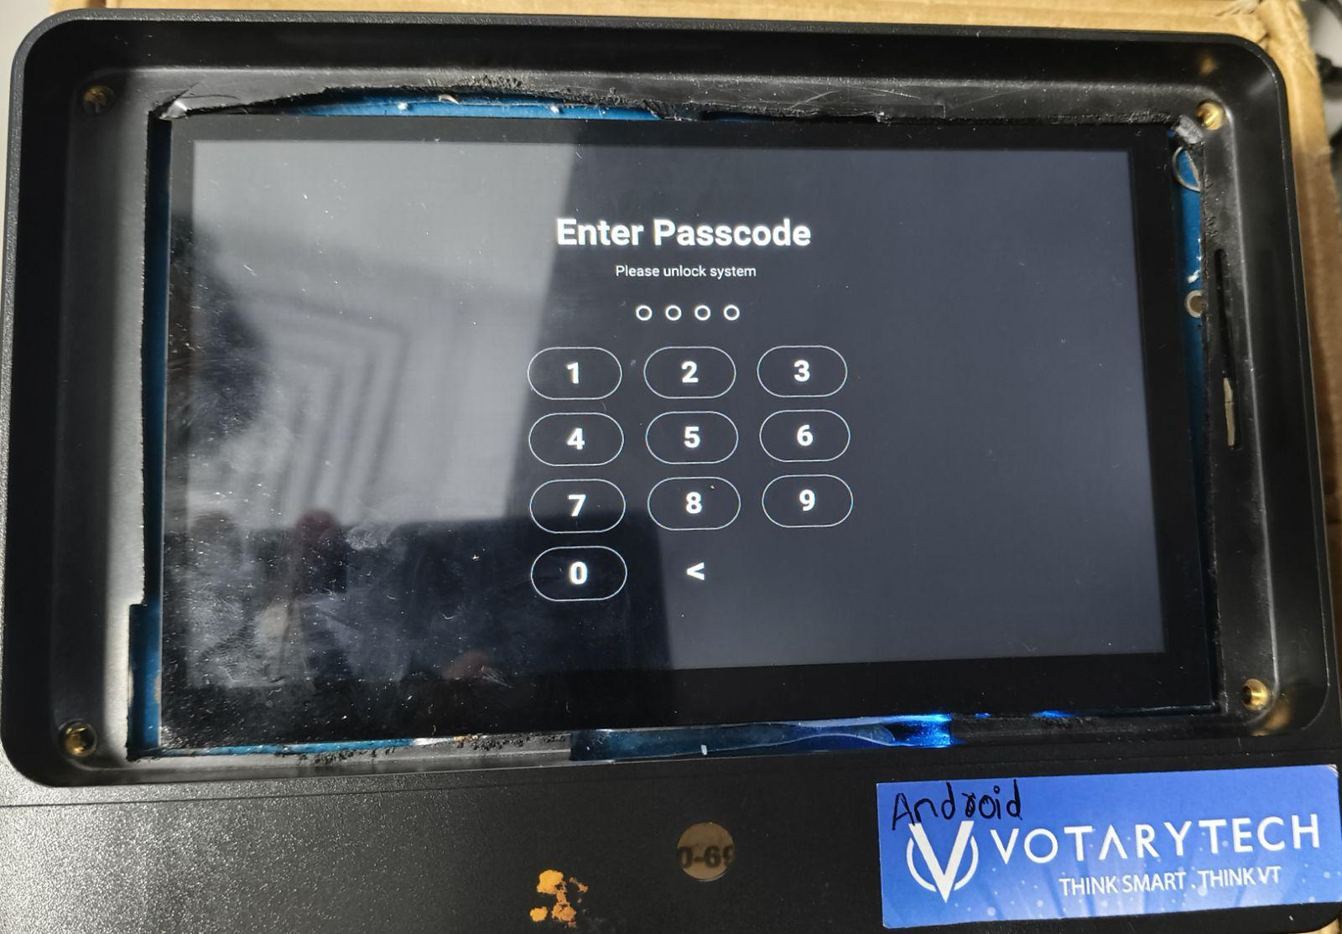
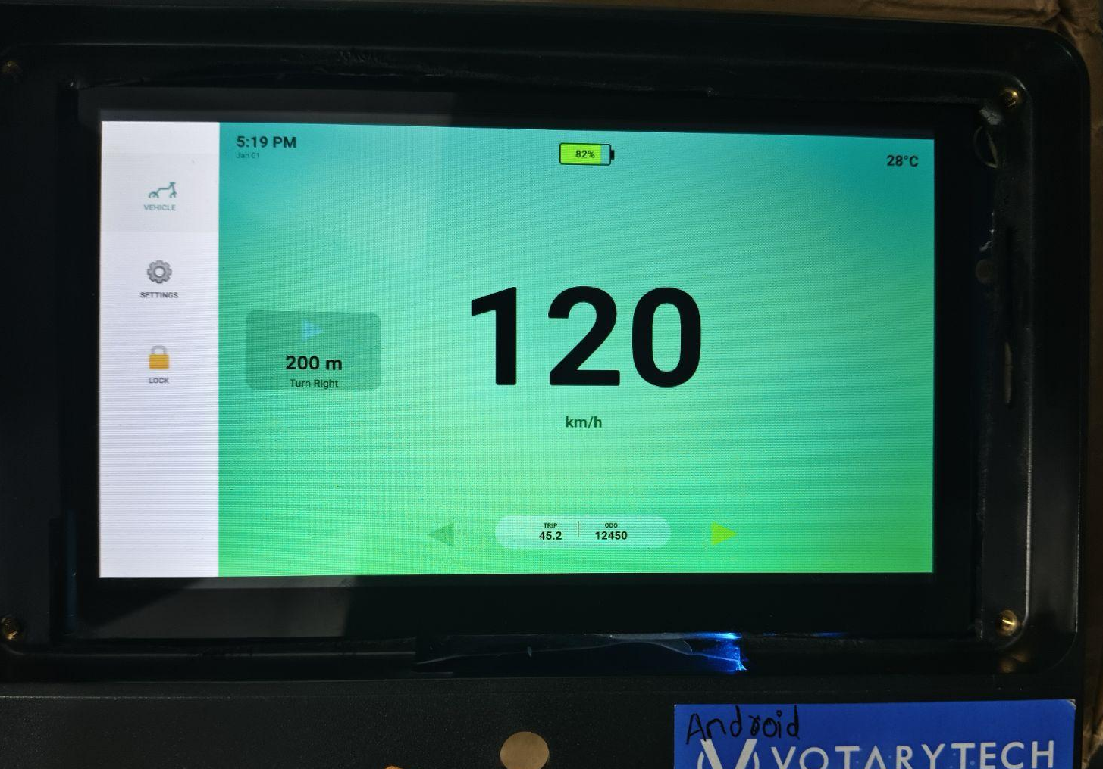
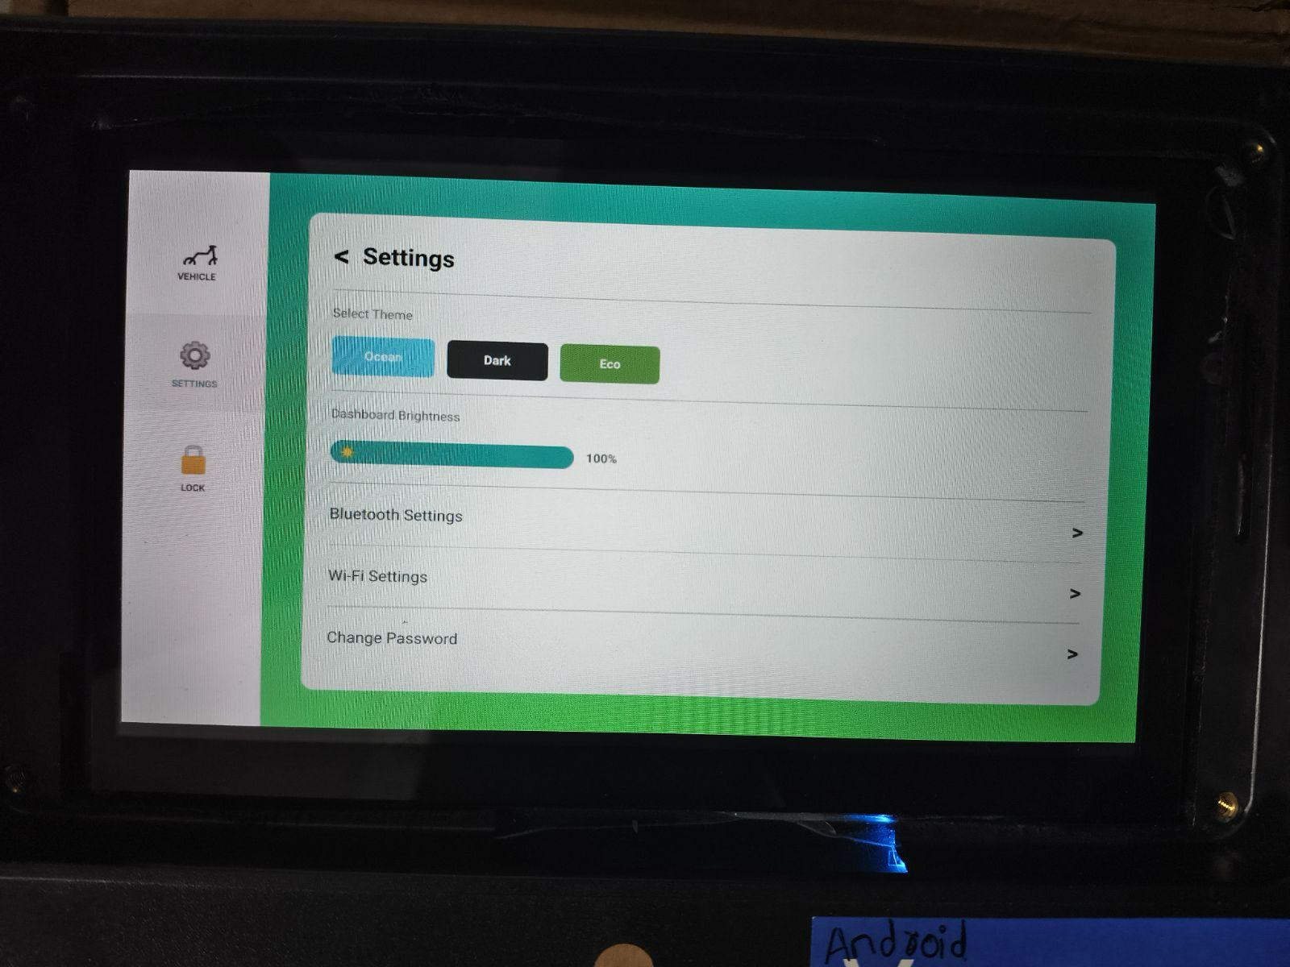
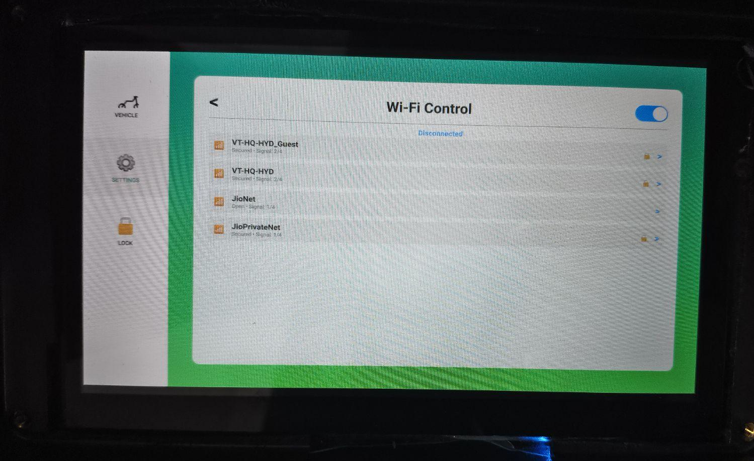
2 Wheeler Cluster Display

Slide 8
2 Wheeler Cluster Display
Automotive Industry Standards vs. OKT507-C Implementation
Aspect | Industry-Standard (2-Wheeler Cluster) | Implemented Solution (OKT507-C)
Primary Controller | Automotive-Grade SoC (e.g., NXP i.MX, Renesas) or MCU (STM32/Infineon) | Industrial-Grade SBC (Forlinx OKT507-C)
Operating System | Real-Time OS (QNX, FreeRTOS) or Android Automotive | Embedded Linux (Standard Distribution)
Data Communication | CAN Bus / LIN Bus (Wired, Deterministic, Low Latency) | Wi-Fi + HTTP Bridge (Wireless, Cloud-Dependent)
Sensor Interface | Hardwired to ECU/BCM (Body Control Module) | Wireless IoT Node (ESP32) via Firebase Cloud
Graphics Engine | Qt Automotive Suite / Kanzi UI / Altia | Qt 5.12 / QML (Community Edition)
Data Gateway | Central Gateway ECU (Secure Onboard Comms) | Python Script Bridge (PC-based Data Forwarding)
Theft Protection | Hardware Immobilizer (Key Transponder / ECU Lock) | Software Anti-Theft (PIN/Pattern Lock Screen)
Safety Features | ABS / TCS / Side-Stand Cutoff (Hardwired Signals) | Tilt/Fall Detection (Accelerometer via ESP32)
Boot Time | Instant (< 2 seconds required by regulation) | Linux Boot Sequence (~15â€“30 seconds)
Power Management | Automotive PMIC (Handles 12V cranks/surges) | Regulated 5V DC Supply (Stable Bench Power)
Connectivity | Bluetooth (Phone Pairing) / LTE (Telematics) | Wi-Fi (Hotspot connection for Data Sync)

Slide 9
2 Wheeler Cluster Display
THANK YOU

